Slide 1
Semiconductors
A semiconductor is a substance which has resistivity in between conductors and insulators.
It has negative temperature co-efficient of resistance which means the resistance of a semiconductor decreases with the increase in temperature and vice-versa.
When a suitable metallic impurity is added to a semiconductor, its current conducting property change appreciably.

Slide 2
Semiconductors
Crystal Lattice Structure
The unique capability of semiconductor atoms is their ability to link together to form a physical structure called a crystal lattice.
The atoms link together with one another sharing their valence electrons.
These links are called covalent bonds.

Slide 3
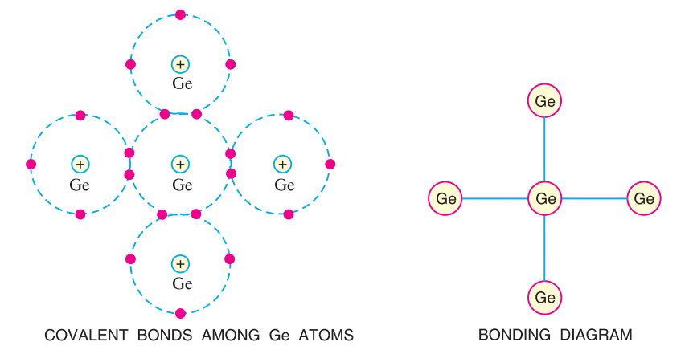
Semiconductors
Covalent bonds

Slide 4
Semiconductors
Intrinsic semiconductor
An intrinsic semiconductor is a pure semiconductor which does not have any doping agent (an impurity added to crystal lattice).
In an intrinsic semiconductors, the number of charge carrier depends upon property of the material not on impurity present.
Has little current conduction capability at room temperature.

Slide 5
Semiconductors
Extrinsic Semiconductors
An extrinsic semiconductor is a semiconductor whose electrical conductivity can be increased by adding the trace amounts of other elements such as impurities in the material.
There are two types of impurities added to Ge and Si Crystal.
Pentavalent material - it is made up of atoms which have five valence electrons.
Trivalent material – it is materials has three valence electrons.

Slide 6
Semiconductors
Doping
To make the semiconductor conduct electricity, other atoms called impurities must be added.
“Impurities” are different elements.
This process is called doping.
Semiconductors can be Conductors
An impurity, or element like arsenic, has 5 valence electrons.
Adding arsenic (doping) will allow four of the arsenic valence electrons to bond with the neighboring silicon atoms.
The one electron left over for each arsenic atom becomes available to conduct current flow.

Slide 7
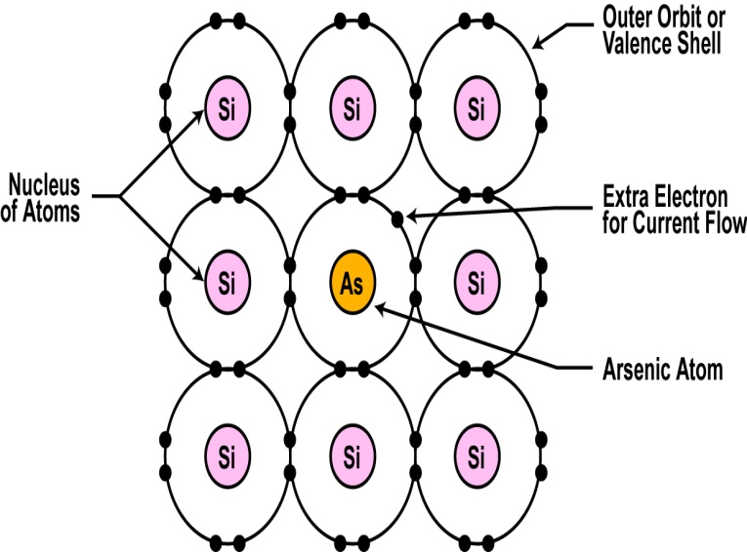
Semiconductors

Slide 8
Semiconductors
Another Way to Dope
You can also dope a semiconductor material with an atom such as boron that has only 3 valence electrons.
The 3 electrons in the outer orbit do form covalent bonds with its neighboring semiconductor atoms as before. But one electron is missing from the bond.
This place where a fourth electron should be is referred to as a hole.
The hole assumes a positive charge so it can attract electrons from some other source.
Holes become a type of current carrier like the electron to support current flow.

Slide 9
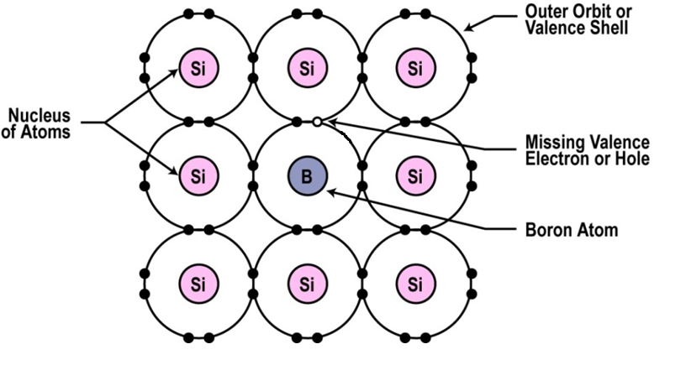
Semiconductors

Slide 10
Semiconductors
Types of Semiconductor Materials
The silicon doped with extra electrons is called an “N type” semiconductor.
“N” is for negative, which is the charge of an electron.
Silicon doped with material missing electrons that produce locations called holes is called “P type” semiconductor.
“P” is for positive, which is the charge of a hole.
N type as well as P type semiconductor is electrically neutral.

Slide 11
Semiconductors
Majority and Minority Carriers
N-type material has a large number of free electrons and a small number of holes in which case free electrons are considered majority carriers and holes are the minority carriers
P-type material has a large number of holes and a small number of electrons in which case holes are considered majority carriers and free electrons are the minority carriers

Slide 12
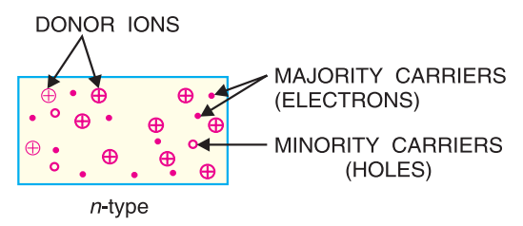
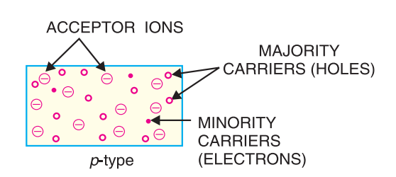
Semiconductors

Slide 13
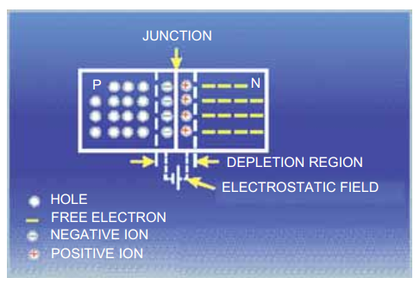
Semiconductors
Pn Junction
The contact surface of the joint of a p-type semiconductor and a n-type semiconductor
The control element for the semiconductor devices
Most semiconductor devices contain one or more pn junctions.

Slide 14
Semiconductors
Depletion Layer
The free electrons of n region begin to diffuse across the junction into the p region where they combine with the holes near the junction.
The p region also loses holes as the electrons and holes combine.
The result is that there are layers of positive charge (pentavalent ions) and negative charge (trivalent ions).
These two layers form depletion layer or depletion region
This layer is free of charge carriers

Slide 15
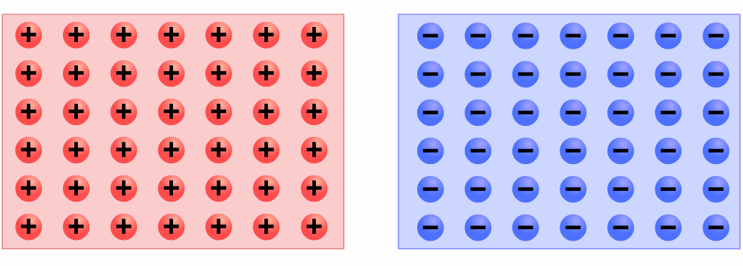
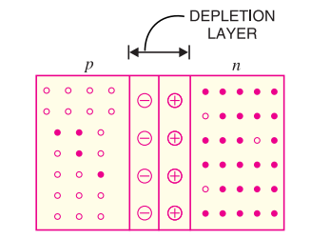
Semiconductors
Depletion Layer

Slide 16
Semiconductors
Barrier Potential
Once depletion layer created, the diffusion of free electrons stops
The depletion region acts as a barrier to the further movement of free elections across the junction
The positive and negative charges set up an electric field across the junction which is a barrier to the free electrons in the n-region
The potential difference across the depletion layer is called barrier potential

Slide 17
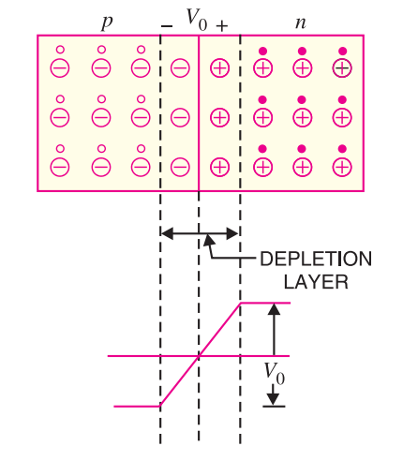
Semiconductors
Barrier Potential
Barrier potential of a pn junction depends upon several factors including:
Semiconductor material
Amount of doping
Temperature
Typical barrier potential is approximately:
Silicon: 0.7 V
Germanium: 0.3 V

Slide 18
Semiconductors
Use of semiconductor in computers
Computer memory is made up of semiconductor materials because it provides reliability
CPU contains number of integrated circuits, which are made up of semiconductor materials.

