Slide 1

CA 6120 Photo-catalysis
Some Fundamental knowledge assumed
Chemistry
Physics
Electronic structure of solids
Electronics
Materials
Reactor designs
Process controls

Slide 2
Possible Coverage
(May include many other aspects)
INTERFACES WITH RESPECT TO SEMICONDUCTOR
PRINCIPLES OF PEC AND ITS RELEVANCE TO PHOTO CATALYSIS
MATERIALS FOR PHOTOCATALYSIS
POSSIBLE PHOTOCATALYTIC REACTIONS
DSSC
PHOTOSYNTHESIS AND RELATED AREAS

Slide 3


CA-6120 Photocatalysis
Principles of photocatalysis – History and Evolution – semiconductors - positions of VB and CB – Determination – Fermi level – Material selection – principles and procedures – Various configurations of photocatalytic materials – Modification of semiconductors – Typical photocatalytic reactions like water decomposition, carbon dioxide and dinitrogen reduction – decontamination and pollutants removal – solar cells –
Photosynthesis and photocatalysis
Perspectives

Slide 4
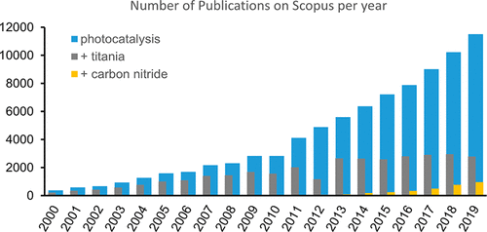
Figure 1. Histogram of number of publications on photocatalysis (blue bars) and on photocatalysis with TiO₂ and C₃N₄ (gray and yellow bars respectively) from 2000 to 2019 (data source: Scopus, March 12th, 2020).

Slide 5
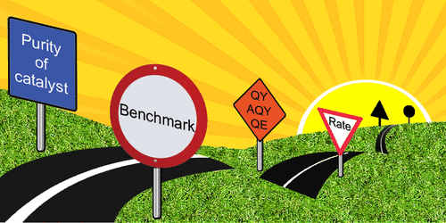

Slide 6
Heterogeneous photocatalysis has become a rapidly expanding galaxy with multiple diverse subjects being explored and developed. It is recognized that each different stream of research inevitably has a certain autonomy due to the different issues addressed and the variability of the specific technical challenges. For this reason, an attempt to standardize all the topics in terms of reported data under a common umbrella of rigid rules is to a certain extent a chimera. Surely, a few general good practices can be shared and must be followed, but it must also be accepted that the different subtopics of photocatalysis should enter into their own class when it comes to reporting data. Despite the notable progress, there is still too much confusion in papers associated with photocatalysis, where terms of comparison are often unclear or mistakenly arbitrary. The inhomogeneity in reporting figures of merit is a classic sensible point, as well as the correct establishment of the true mechanistic nuts and bolts, that can be largely unreliable on account of the deficient assessment of the catalyst’s structural features. It is time to make an effort and propose agreed guidelines in each of the photocatalysis subjects, so that future research will be more efficient and less time and money wasted.

Slide 7
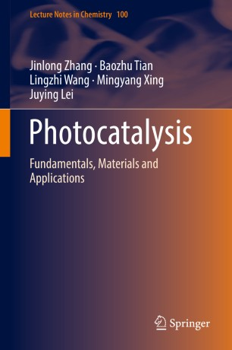


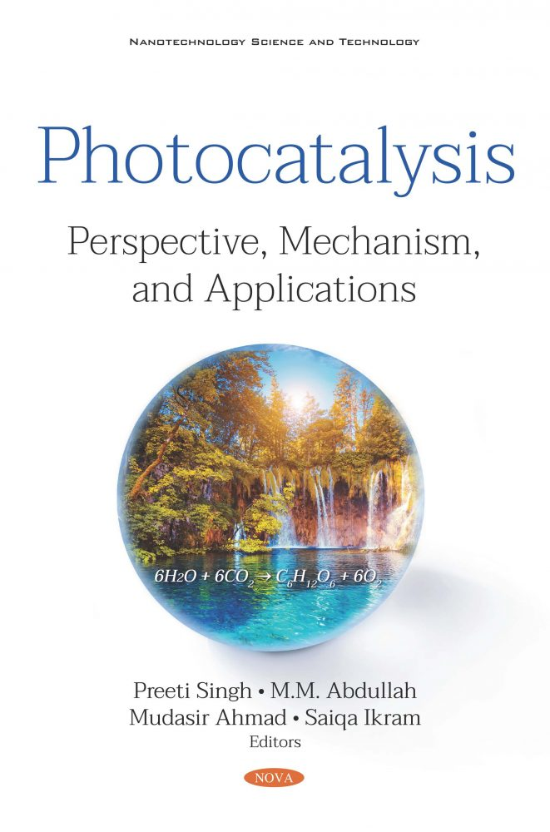
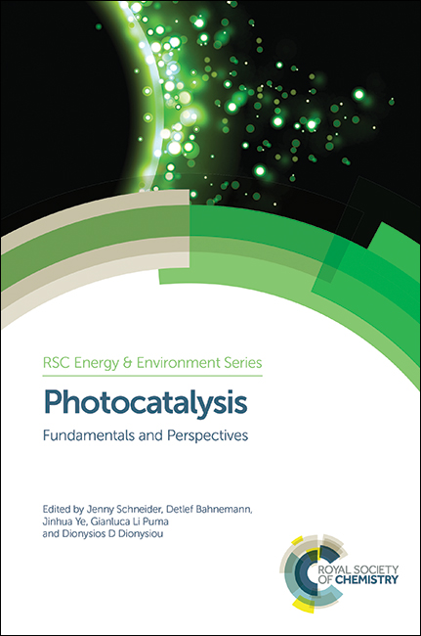



Slide 8


Slide 9

Origin of Photo-catalysis
Claim to Nature article by Fujishima and Honda but the truth is different
Most studied photo-catalyst is TiO₂ why?
1976 Carey et al photo-de-chlorination of polychlorinated biphenyls (PCBs)
1975- 1980 249
2000 to 2010 16757

Slide 10

Definition of photo-catalysis
Photo-catalysis is a term that combines the basic notion of a catalyst as a material that enhances the rate as a reaction approaches equilibrium without being consumed with the notion that the reaction is accelerated by photons, which of course are consumed. Thus, it is a hybrid concept. As with other areas of catalysis, it has its heterogeneous and its homogeneous dimensions with the former dominating the research literature.

Slide 11

The homogeneous opportunities should not be overlooked. A typical example -a dye photo-catalyst having two oxidation states where one state can achieve an electron transfer after excitation by light, where that reaction is not feasible from the ground state. If the resulting oxidation state is thermally or photo-chemically unstable, a catalytic cycle can be completed.
Some non-dye examples of homogeneous photo-catalysts include soluble ions with multiple oxidation states, including at least one readily excitable by light, such as the poly-oxometallates of tungsten or Fenton’s reagent. Although photo-chemists prefer the term “sensitizer”, excited states that transfer energy to a molecule that then reacts can be viewed as photo--catalysts.

Slide 12
Three generations
The first generation (1975–1985) focused primarily on the studies that provided the understanding of the semiconductor /solution interface under illumination from studies of single crystal semiconductor surfaces and the exploration of a wide variety of semiconductors

Slide 13
Second Generation
The second generation, the first important one for photo-catalysis with exponential growth of the literature well underway, spans approximately 1986 through 2000. This phase featured work on polycrystalline thin films, efforts to dope semiconductors to exploit visible light, dye sensitization, and widespread use of suspensions to explore the scope of photo-catalysis. It was in this period that the industry emerged. Dye sensitized photo-catalysts have been extensively evaluated for destruction of dyes in waste streams.
Unfortunately many of these papers use UV sources and do not distinguish dye sensitization from band gap excitation.

Slide 14
In the third generation period since 2000, photo-catalysis research has continued to expand so that in the 2006–2010 period, publications on photo-catalysis exceeded those aimed at energy conversion, 16,757 to 12,811 . This period has seen recognition of two fundamental principles, the special properties of the nanoscale and the power of self-organization, which converge to provide a new conceptual platform on which to construct photo-catalysts. Key examples emerge as nanostructured semiconductors and composites, size dependent quantization or “quantum dots”, and nanowires or nanofibres.

Slide 15
Independently of these developments, there has been continuing research on the design of photo-catalytic reactors to achieve treatment of water and air at high flow rates competitive with such established technology as UV disinfection. This continues to be limited by the separation problems faced if slurries are used. Yet slurries offer the best way to achieve uniform distribution of photons over catalytic particles in a well stirred reactor that reduces the mass transport problem for delivering substrates to the active surface to crossing the diffusion layer. If the separation problem is overcome by design of fixed beds, the problems of uniform exposure of substrate to active sites and uniform illumination of photo-catalyst must be addressed. Also, oxygen or other electron acceptors must be delivered in conjunction with the contaminants to be oxidized. So far, success in design of reactors that outperform slurries has remained a challenge.

Slide 16

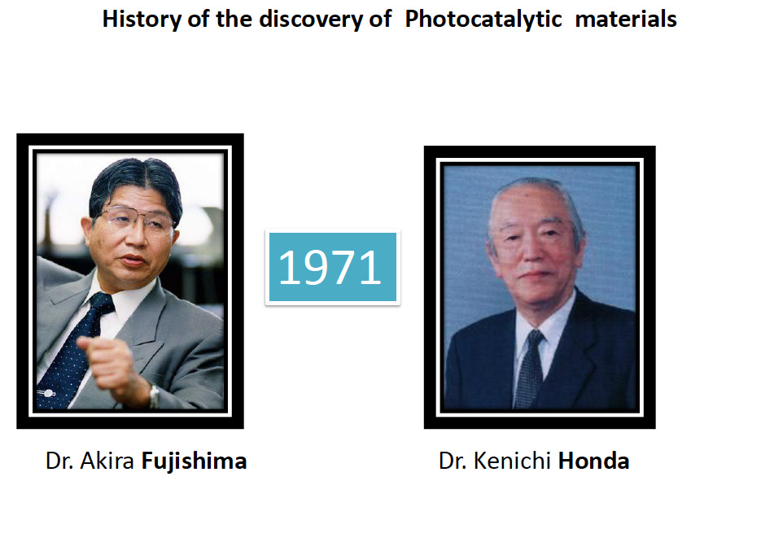
.
Notes:
Play the slide show for this presentation to listen to the audio commentary by Peter Walsh and view slide timings. Or, click the sound icon on a slide for controls that you can use to hear the audio at your own pace.
A little organization will go a long way to enhancing your PowerPoint presentation.
Your title slide should be catching and relevant to your audience – offer something in the title that your audience wants.
Keep some basic principles in mind:
Your slides should complement what you have to say, not say it for you.
Keep slides direct and to the point - less is more!
Choose a background color or design that enhances and complements your presentation rather than competes with it.
Don’t get too fancy - a simple font, elegant color scheme and clear message is more important than lots of information (clutter!) on the slide.
Keep it simple! The purpose of the PowerPoint slide is to keep the mind of your audience focused – fewer words are better.
Note: You understand that Microsoft does not endorse or control the content provided in the following presentation.

Slide 17
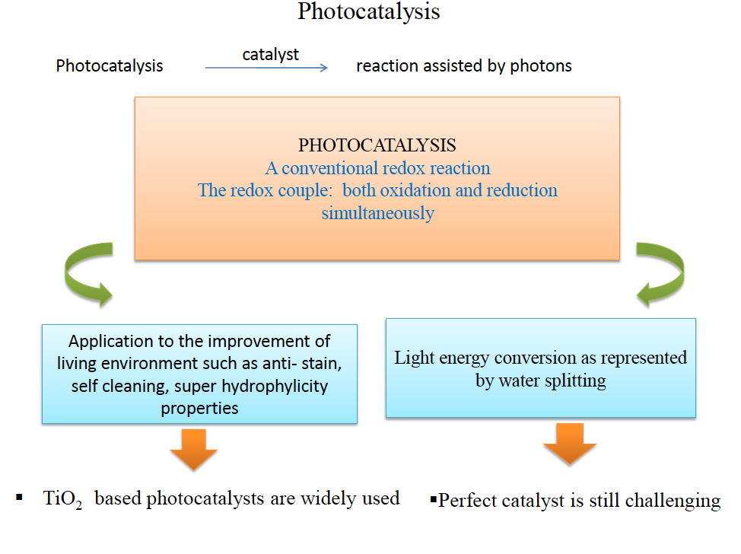

Slide 18
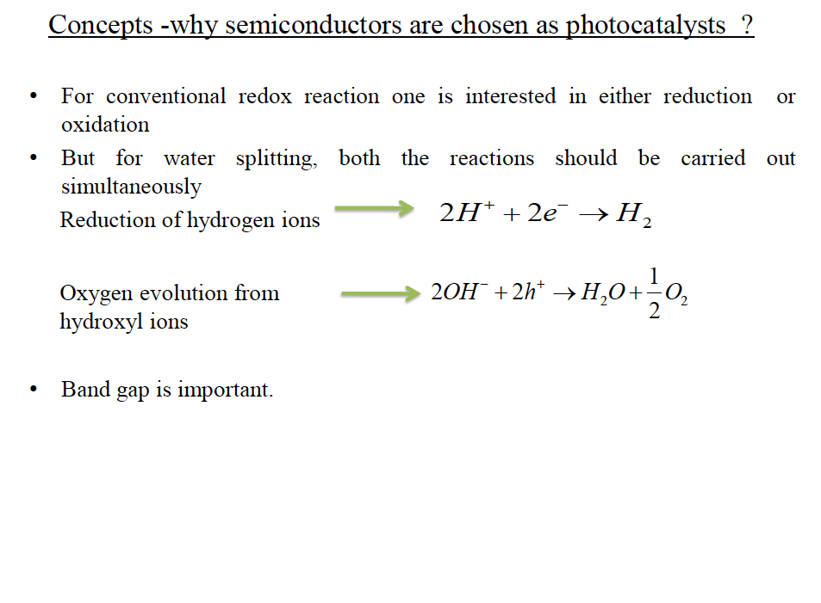

Slide 19
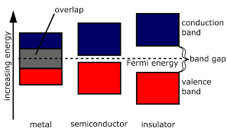

Slide 20
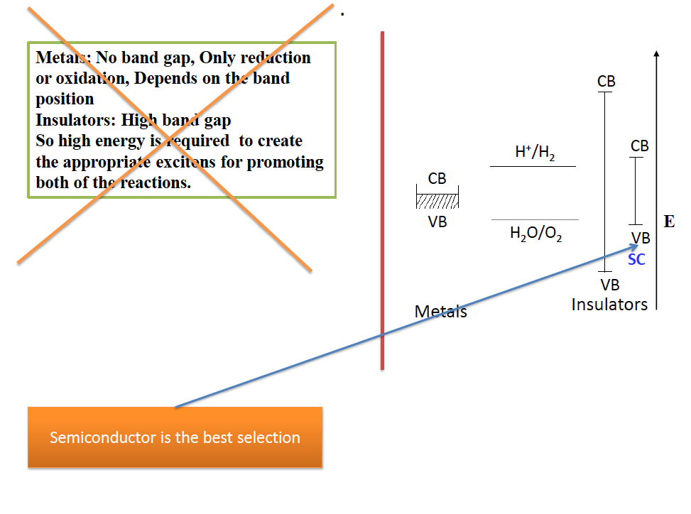

Slide 21
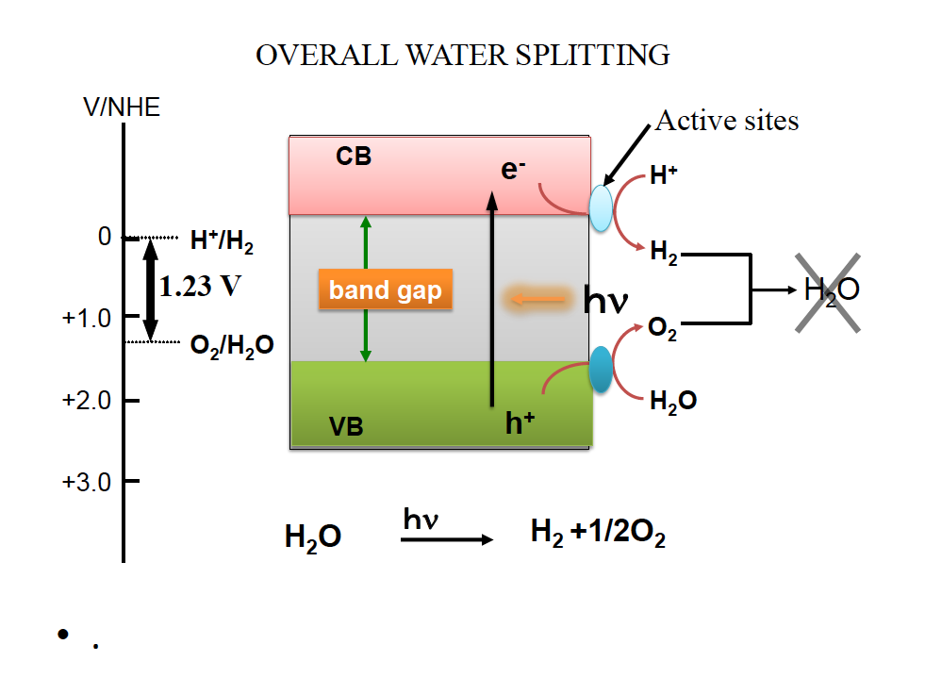

Slide 22
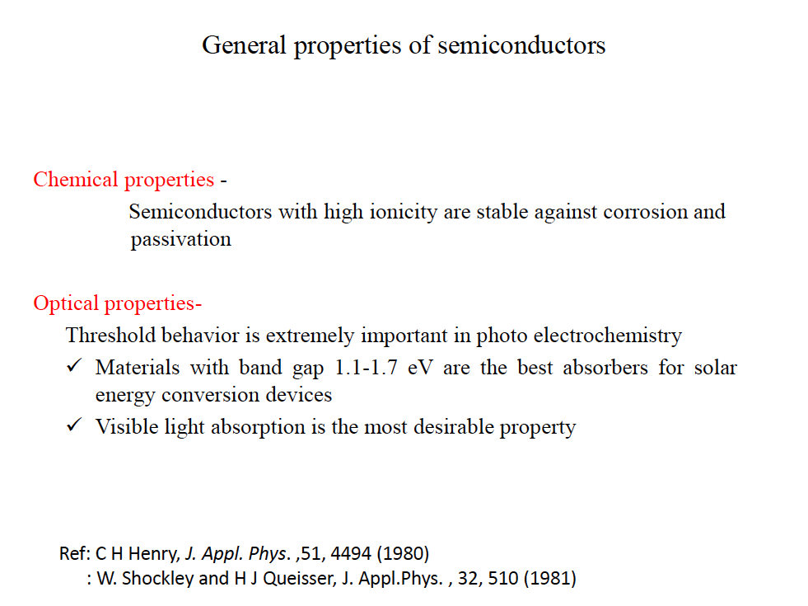

Slide 23
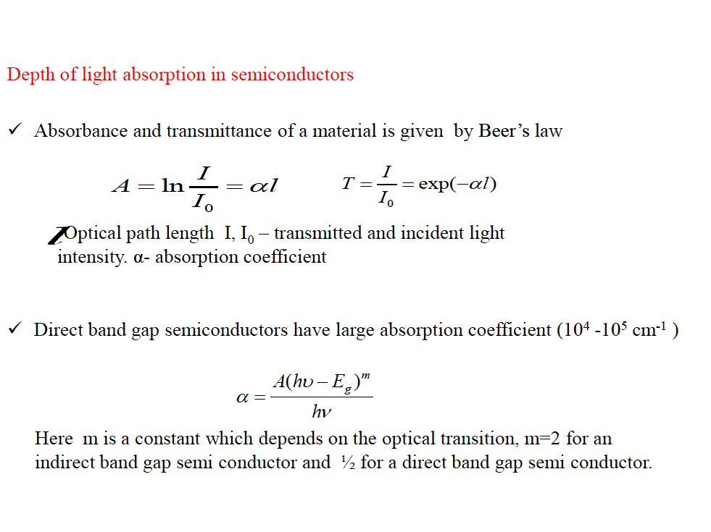

Slide 24
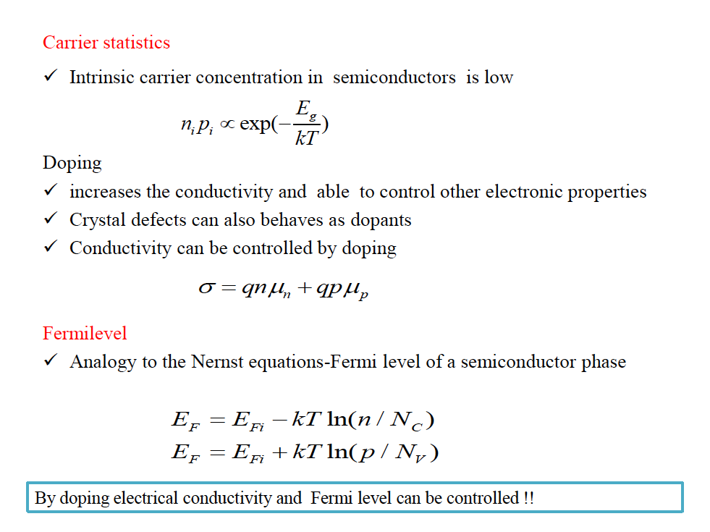

Slide 25
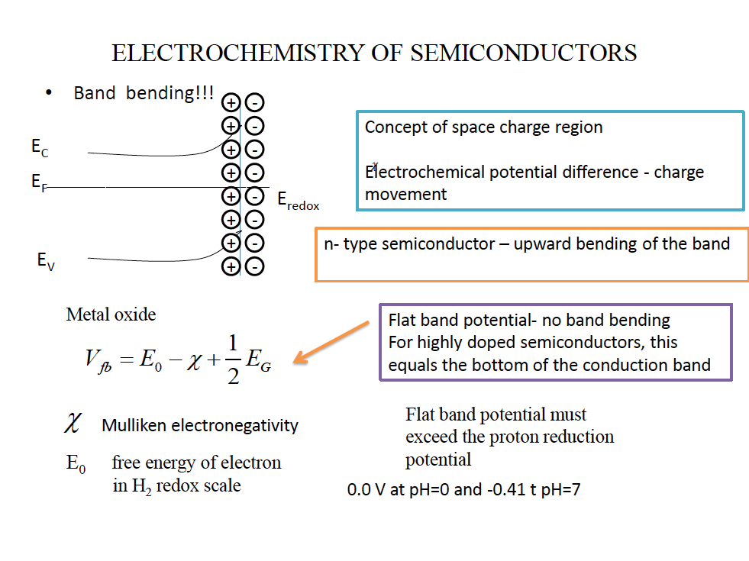

Slide 26
Definition of Photocatalysis
Photo-catalysis is a term that combines the basic notion of a catalyst as a material that enhances the rate as a reaction approaches equilibrium without being consumed with the notion that the reaction is accelerated by photons, which of course are consumed. Thus, it is a hybrid concept. As with other areas of catalysis, it has its heterogeneous and its homogeneous dimensions with the former dominating the research literature

Slide 27
photocatalysis is the acceleration of a photoreaction in the presence of a photocatalyst, the excited state of which "repeatedly interacts with the reaction partners forming reaction intermediates and regenerates itself after each cycle of such interactions

Slide 28
According to the definition of the International Union of Pure and Applied Chemistry (IUPAC): “photocatalysis act as a change in the rate of a chemical reaction or its initiation under the action of ultraviolet, visible, or infrared radiation in the presence of a substance-the photocatalyst-that absorbs light and is involved in the chemical transformation of the reaction partners.

Slide 29
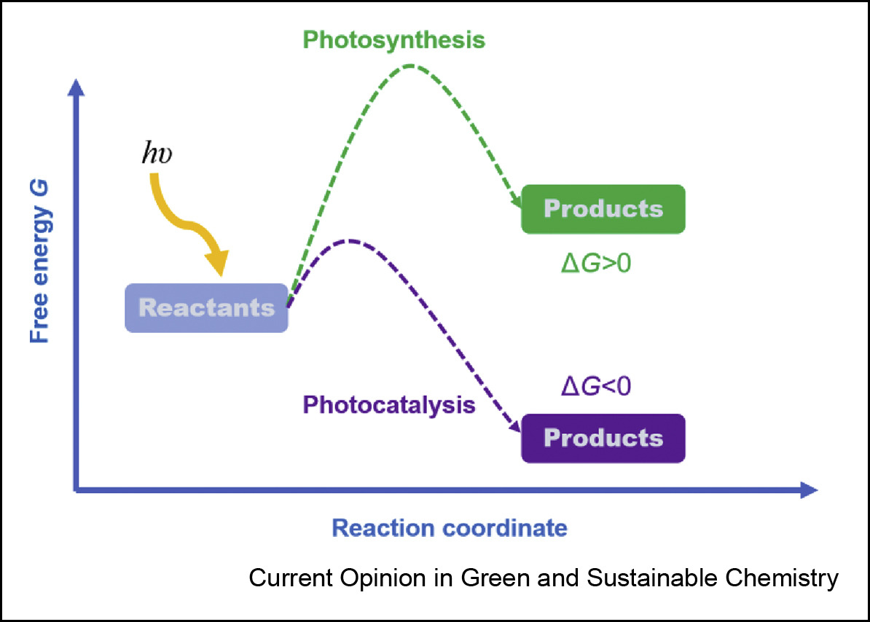

Slide 31
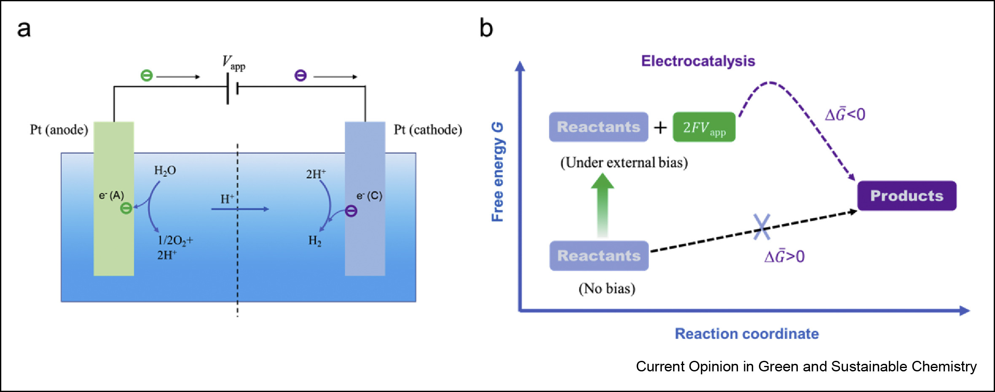
2. (a) Scheme of electrocatalytic water splitting process. (b) Gibbs free energy change when the electrochemical potential is considered.

Slide 32
After introducing the light field, the ΔG˜₀ is altered into downhill by adding the photochemical potential of absorbed photons at the reactant side, and the photocatalytic process occurs. Similar to electrocatalytic water splitting, the photocatalyst does not change the reaction equilibrium. Therefore, by considering photons as the reactants, all light-induced catalytic processes can be generally defined as photocatalysis, regardless of the free energy change of chemical reactions.

Slide 33
The controversies about photocatalysis and photosynthesis always focus on the thermodynamic spontaneity of the chemical reactions involved in the processes. Whereupon the observation and analysis of a whole process is limited. In this brief review, a renewed criterion of photochemical free energy is proposed by introducing the photochemical potential of absorbed photons. The so-called “photocatalytic” and “photosynthetic” processes are both spontaneous reactions in the corresponding physical fields. The classification method according to thermodynamic spontaneity of chemical reactions could be rectified under the new cognition. In this vision, the photocatalysts in photochemical systems act as the “mediator” between the reactants and photons (a special reactant) to accelerate the kinetics process, which is exactly what the catalysts does.

Slide 34
Photosynthesis
Photocatalysis
∆G > 0
Products
Free Energy G
Reactants
∆G < 0
Products
Reaction coordinate
Fig 1.1. A photochemical process with reaction DG > 0 (uphill is attributed to photosynthesis, ilike water photolysis, CO2 reduction, and the natural photosynthesis while the process with reaction DG < 0 (downhill) is actually the photocatalysis, like hydrogen evolution reaction with sacrificial reagents.

Slide 35
Reactants
+
ZFV
(Under external Bias)
∆G < 0
Products
Free Energy G
X
∆G > 0
Reactants
(No Bias)
Reaction Coordinate

Slide 36
Photocatalysis
Reactants
+
Photon field
(Under light field)
∆G < 0
Products
Free Energy G
X
∆G > 0
Reactants
(Dark reaction)
Reaction Coordinate

Slide 38
It has been already known that solar energy can be harnessed and converted into many other forms of energy and also for environmental protection. Thus, photocatalysis opens up a way to transform solar energy into value added chemicals and dispose environmental pollutants. Briefly, in 1921, Baly et al., employed the term photocatalysis to describe a photochemical synthesis process in the living plant. In 1938, Goodeve and Kirchner discovered that titanium dioxide could act as a photosensitizer for bleaching dyes in the presence of oxygen [2]. In 1972, Fujishima and Honda reported the semiconductor electrochemical photolysis phenomenon [3]. A more detailed account of history of this phenomenon can be seen in ref.[4]. Subsequent to this, a spate or research activities have been reported on a variety of topics like water splitting to produce fuel hydrogen, carbon dioxide conversion to value added chemicals, reduction of dinitrogen, degradation of contaminants in water and air and also for organic synthesis

Slide 39
In photocatalysis, the process has to be properly comprehended since photons are consumed in these processes, and hence the term Photocatalysis appears to be a misnomer. In essence, this may be termed as Photon assisted catalysis.
According to the definition of the international Union of Pure and Applied Chemistry (IUPAC) “ Photocatalysis act as a change in the rate of a chemical reaction or its initiation under the action of ultraviolet, visible or infrared radiation in the presence of a substance –the photocatalyst - that absorbs light and involved in the chemical transformation of the reaction partners” [5]. In essence, reactions promoted under this category are driven by light, though it may imply that light acts as the catalyst. The term before catalysis can be regarded as the environmental condition ( so called field) in which the catalytic process takes place.
In addition, some researchers perceived that if photocatalysis is a catalytic process, the existence of catalyst should change the kinetic rate rather than thermodynamic limits of the photochemical process. Based on this contention, these people classified these photochemical reactions into photocatalytic and photosynthetic process according to the thermodynamic spontaneity of the chemical reactions

Slide 40
As shown in Fig.1, a photochemical process with reaction ∆G > 0 (uphill) is attributed to photosynthesis, including the overall water photolysis, CO₂ reduction, and the natural photosynthesis while the process with reaction ∆G < 0 (downhill) is actually the photocatalysis, such as hydrogen evolution reaction with sacrificial reagents. The differences between photosynthetic devices and photocatalytic processes have been discussed by Osterloh [6] and by Rajeshwar et al [7].

Slide 41
Electrocatalytic splitting of water
Electrocatalytic water decomposition is a non-spontaneous reaction
H₂O → H₂ + ½ O₂ ∆G > 0
In the electrolysis cell a bias V_{app} is applied between two electrodes and the electrolyte is considered to be acidic. The ∆ G ₀ of this reaction can be written as the sum of two terms – one is the free energy of the reaction and the second term arises due to the applied potential V.
∆G₀ = ∆G₀ - 2FV_{app}
The electrolysis of water reaction can proceed spontaneously when the applied bias is large enough to make the net free energy change is negative. This situation is pictorially represented in Fig.1.2.

Slide 42
The controversies on photocatalysis and photosynthesis have been focusing on the thermodynamic spontaneity of only he chemical reactions involved in the process. This type of argument only considers the free energy of the reactants while in electrocatalysis or photocatalysis the electric potential or photons are also involved in the reaction. These situations are pictorially shown in Figs.1.2 and 3. In this consideration the electrochemical potential or photon field are considered for considering the free energy change in the electro (photo) catalysis. Thus, the so called photocatalytic and photosynthetic processes are both spontaneous reactions in the corresponding photon field. It has to be recognized that the type of field involved has to be considered along with other reactants. In photocatalysis,, the solid catalyst only acts as mediator between the reactants and the photons to accelerate the kinetics of the process.
In essence, the controversy appears to be genuine and it may still persist. There can be alternate definitions of photocatalysis and may still be presented, however the difference should be based on the parameter control is either thermodynamic or kinetics.

Slide 43
[1] Baly, ECC, Heilbron, IM, and Barker, WF, Journal of the Chemical Society Transactions, 119, 1025-1035 ( 1921).
[2] Goodeve, CF, and Kirchner, JA, Trans Faraday Soc.,34,570-579 (1938)
[3] Fujishima, A and Honda, K., Nature, 238,37-39 (1972).
[4] Viswanathan B and Scibioh MA., Photo-electrochemistry, Principles and practice, Narosa Publishing House, (2014).
[5] Braslavsky, SE. Braun, AM, Cassano, AE, Emeline, AV, Litter, MI, Palmisano, L, Parmon VN, Serpone, N, Pure Appl. Chem.,83, 931-1014 (2011).
[6] Osterloh FE, ACS Energy Lett., 2,445-453 (2017).
[7] Rajeshwar, K., Valli, A., de Brito, JE, Boldrin Zanoni, MV, ACS Energy lett., 6, 2187-2201 (2021).
[8] Jiazhe Wu, Wenyu Zheng and Yubin Chen, Current opinion in Green and sustainable chemistry, 33, 100580 (2022).,

Slide 44
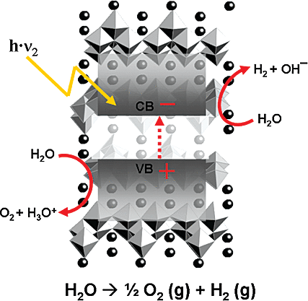

Slide 45
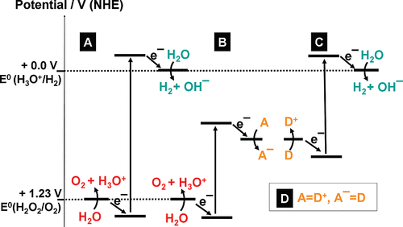
Figure 1. Potential energy diagrams for photochemical water splitting at pH = 0: (A) single semiconductor system; (B) with an electron acceptor; (C) with an electron donor; (D) dual semiconductor system (z scheme) employing a redox shuttle

Slide 46
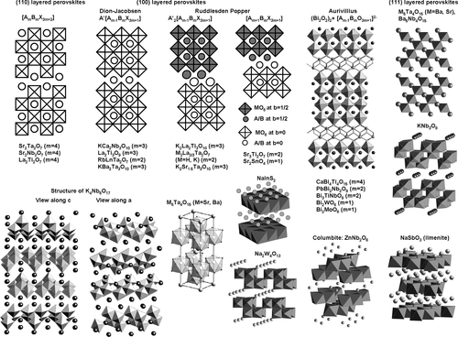
Figure 2. Crystal structures of layered semiconductors. For general structures ABX, A atoms are represented as spheres and BX units are shown as polyhedra.

Slide 47
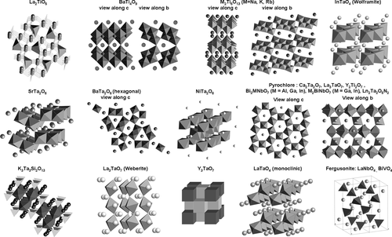
Figure 3. Crystal structures of semiconductors (part I). For general structures ABX, A atoms are represented as spheres and BX units are shown as polyhedra.

Slide 48
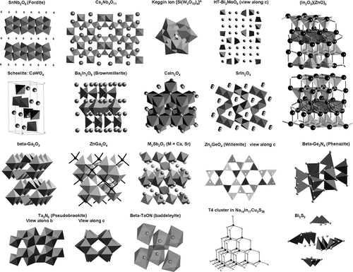
Figure 4. Crystal structures of semiconductors (part II). Continued from Figure 3

Slide 49
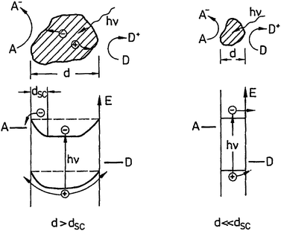
Fig. 10 Space charge layers in large and small particles

Slide 50
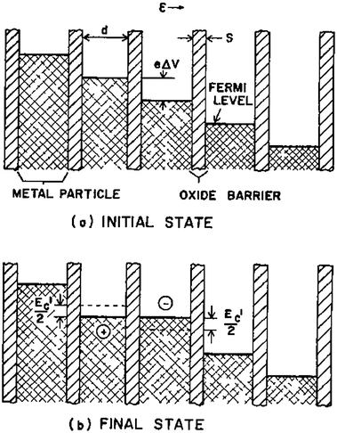
Fig. 12 Electron hopping in nanostructured films. Reproduced from ref. 86 by permission of the publisher (Taylor & Francis Ltd, http://www.tandf.co.uk/journals).

Slide 51
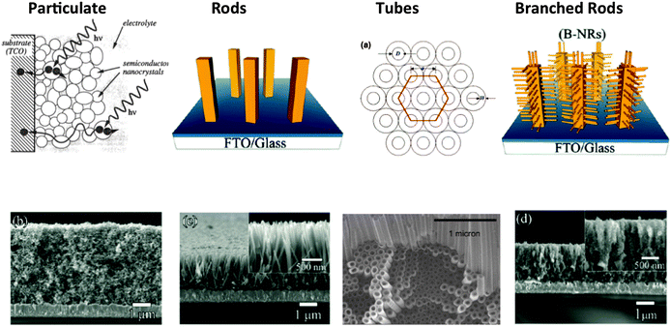
Fig. 14 Types of Nanostructured TiO₂ photoanodes. Adapted with permission from ref. 77, 100 and 106. Copyright 1995, 2008, and 2011 American Chemical Society

Slide 52
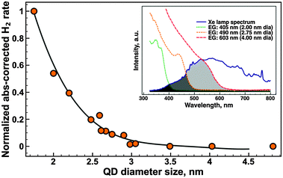
Quantum size effect enhanced water reduction. Reproduced with permission from ref. 62. Copyright 2012, Royal Society of Chemistry.

Slide 53
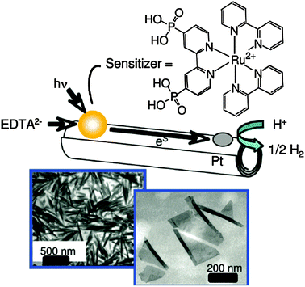
Visible light driven H₂ evolution from Ru bipy-modified nanosheets and scrolls in the presence of EDTA. Reproduced with permission from ref. 136. Copyright 2009, American Chemical Society

Slide 54
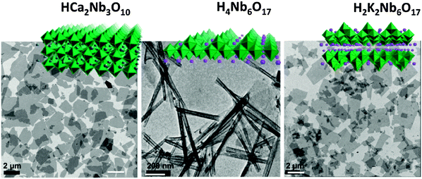
Single crystal niobate nanosheet and nanoscroll photocatalysts

Slide 55
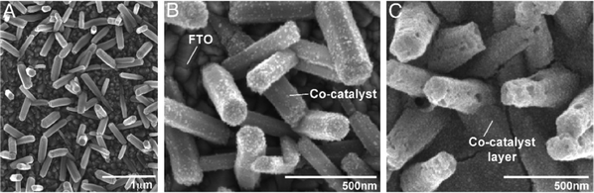
ZnO nanorod array after electrodeposition of CoPi catalyst. Reproduced with permission from ref. 121. Copyright 2009, National Academy of Sciences of the United States of America

Slide 56
Types of Nanostructured TiO₂ photoanodes. Adapted with permission from ref. 77, 100 and 106. Copyright 1995, 2008, and 2011 American Chemical Society.

Slide 57
Figure 1. Histogram of number of publications on photocatalysis (blue bars) and on photocatalysis with TiO₂ and C₃N₄ (gray and yellow bars respectively) from 2000 to 2019 (data source: Scopus, March 12th, 2020).

Slide 58
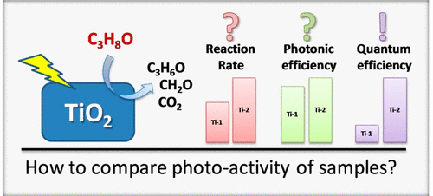
Figure 3. Visual comparison of two TiO₂ catalysts for 2-propanol degradation based on three different activity parameters (reaction rate, photonic efficiency, and quantum efficiency). Depending on the chosen parameter, the two catalysts display unequal levels of activity improvement. Reprinted from ref (18). Copyright 2017, with permission from Elsevier.

Slide 59
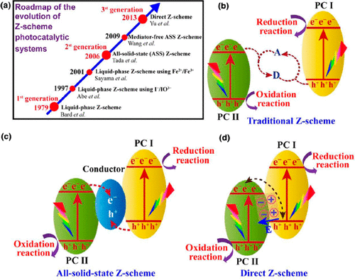
Figure 4. (a) Z-scheme photocatalyst evolution roadmap. (b–d) Schematic illustration of the different types of Z-schemes, respectively: traditional, all-solid-state, and direct. A and D denote the electron acceptor and donor, respectively. E denotes the electric field. Reprinted from ref (24e). Copyright 2018, with permission from Elsevier.

Slide 60
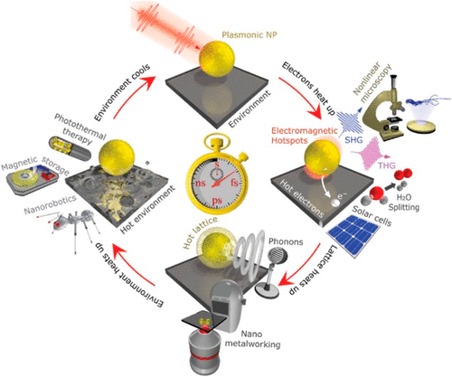
Figure 5. Temperature cycle in plasmonic nanoparticles upon illumination. After illumination (femtosecond time scale), electromagnetic hotspots are generated. These hotspots can enhance nonlinear optical processes for advanced imaging applications. Hot electrons can also be created to be exploited in catalysis. Subsequently, phonons are generated in the picosecond range by lattice heating for nanometal-working techniques. Next, on the nanosecond time scale, environment heating enables applications in photothermal therapy, magnetic storage, and nanorobotics. Finally, the environment cools and the cycle can repeat. Reprinted from ref (45), with permission from Wiley.

Slide 62
Heterogeneous photocatalysis has become a rapidly expanding galaxy with multiple diverse subjects being explored and developed. It is recognized that each different stream of research inevitably has a certain autonomy due to the different issues addressed and the variability of the specific technical challenges. For this reason, an attempt to standardize all the topics in terms of reported data under a common umbrella of rigid rules is to a certain extent a chimera. Surely, a few general good practices can be shared and must be followed, but it must also be accepted that the different subtopics of photocatalysis should enter into their own class when it comes to reporting data. Despite the notable progress, there is still too much confusion in papers associated with photocatalysis, where terms of comparison are often unclear or mistakenly arbitrary. The inhomogeneity in reporting figures of merit is a classic sensible point, as well as the correct establishment of the true mechanistic nuts and bolts, that can be largely unreliable on account of the deficient assessment of the catalyst’s structural features. It is time to make an effort and propose agreed guidelines in each of the photocatalysis subjects, so that future research will be more efficient and less time and money wasted.

Slide 63

The concept of quantum yield (QY) has been introduced long ago, defined for a photochemical reaction as
where the above QY refers to the absorbed photons of wavelength (lambda)
For this reason the concept of apparent quantum yield (AQY) has been introduced, referring to the number of incident photons of a given wavelength per time and volume that reach the inside of the photoreactor
other IUPAC definitions more often used in heterogeneous photocatalysis consider quantum efficiency (QE) and photonic efficiency (PE), the former referring to the rate of photochemical events divided by the absorbed
photon flux and the latter to the ratio of the photoreaction rate measured for a specified time interval to the rate of incident photons

