Slide 1
The active phases in a typical catalyst like hydrodesulphrization
Submitted by: Submitting to:
Vandana Prof. B.Viswanathan

Slide 2
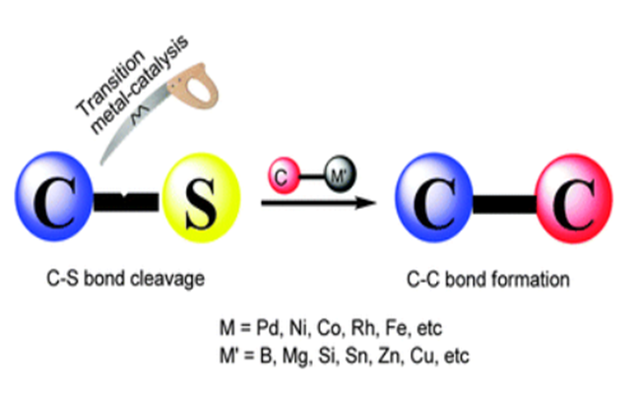
Introduction..
Hydrodesulphurization (HDS) and Hydrodenitrogenation (HDN) is a catalytic process typically used in the Oil & Gas and Refining industries to remove sulfur and nitrogen from natural gas or basic feed.
It’s a hydrogenolysis type of reaction and results in the cleavage of the C-X chemical bond by H2, where C is a carbon atom and X is a sulfur (S), nitrogen (N) or oxygen (O) atom.
The net result of a hydrogenolysis reaction is the formation of C-H and H-X chemical bond.
If we talk about industrial hydrodesulfurization unit, such as in a refinery, the hydrodesulfurization reaction takes place in a fixed-bed reactor at elevated temperature & pressure.

Slide 3
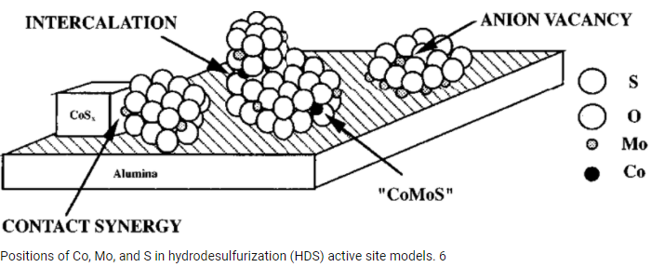

Slide 4
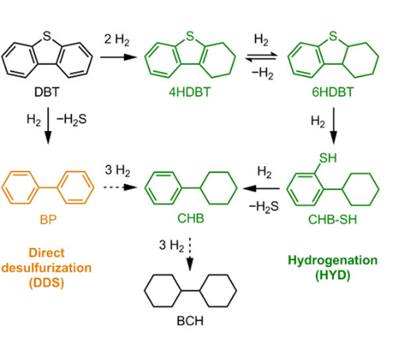
Reaction MECHANISM INVOLVED IN Hydrodesulphurization (HDS)
Dibenzyl thiophene (DBT) treated with the number of H2 moles over Ni-Mo/Al2O3 or Ni-Mo/TiO2 catalyst.
Yellowish product shows complete and only desulphurization using 2 moles of H2 or we can say it is direct desulphurization.
In green product we can get this product (4-hydro dibenzyl thiophene) depending upon the selectivity of catalyst. In which one benzene group is adopting saturation.
On further exposure of no. of moles of H2 we can get kinds of products also, like cyclohexyl benzene (CHB) or Bi-cyclohexyl (BCH).
Target molecule
Right side
Down side
Final product
Fig.(1)

Slide 5
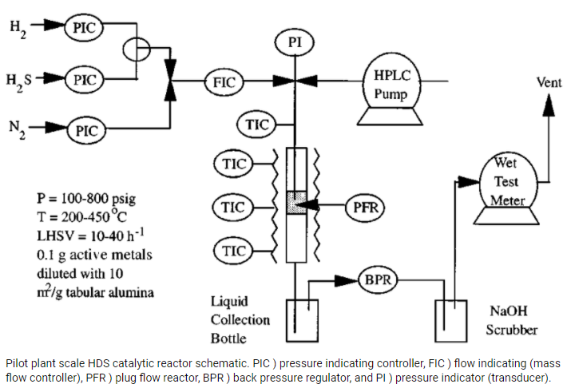

Slide 6
Catalyst SELECTION..
Common combinations of active elements = Co-Mo, Ni-Mo and Ni-W supported on Al2O3 and TiO2.
Catalyst selection is based on the application and desired activity/selectivity.
Ni-Mo/TiO2 = Good for HDS but few drawbacks such as low specific surface area, low mechanical strength, and low thermal stability.
Ni-Mo/Al2O3 = Shows high activity for HDS, HDN and HDA.
Selectivity of heteroatom removal versus hydrogenation can be increased for alumina-supported catalysts by addition of phosphorous.
Choosing proper catalyst particle size and shape, and pore system geometry is important.

Slide 7
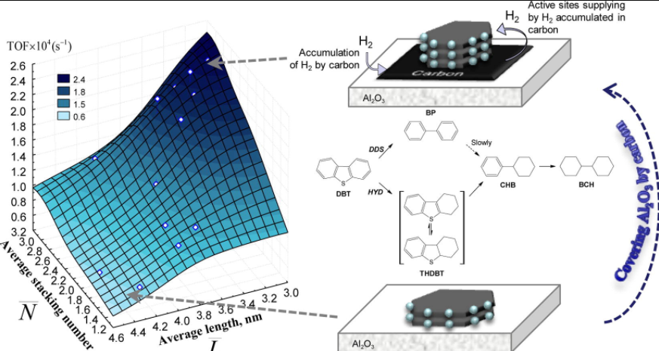
Relationship between active phase morphology and catalytic properties of the carbon–alumina-supported Co(Ni)Mo catalysts in HDS

Slide 8
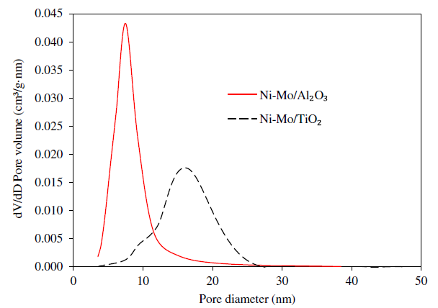
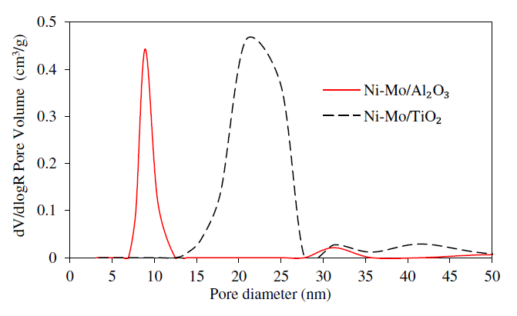
Pore volume distribution of the catalysts..
Fig. 1. Pore volume distribution of the catalysts by BJH(Barrett, Joyner, and Halenda )
Fig. 2. Pore volume distribution of the catalysts (Hg porosimetry)
The Al2O3-supported catalyst contained mesopores in the range of 5–14 nm in contrast.
TiO2-supported catalyst that contained mesopores in the range of 8–25 nm.
Higher activity of the Al2O3-supported catalyst may be caused by its greater surface area and the differences in mesopores size.
Ref: www.elsevier.com/locate/fuproc

Slide 9
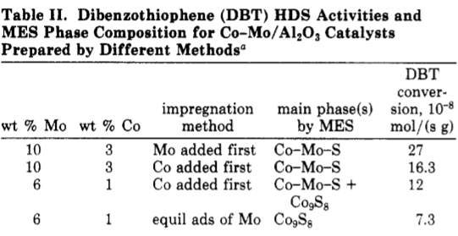
Active phases in HDS
The catalytic performance of hydrotreating catalysts are closely related to the structure and stability of the active phase.
The formation of the active phase structure essentially depends on the extents of metal-support interaction.
The requirements for the extents of metal support interaction decrease in the following order: residue > diesel > gasoline .
Based on the deep insight into the reaction chemistry, the active phase structure can be designed and constructed by optimizing the parameters of catalysts preparation and sulfidation methods to meet specific demands.

Slide 10
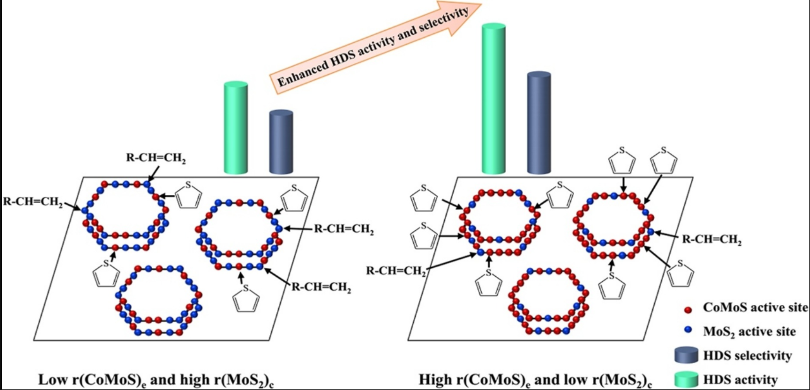
Enhanced Activity and Selectivity of HDS

Slide 11
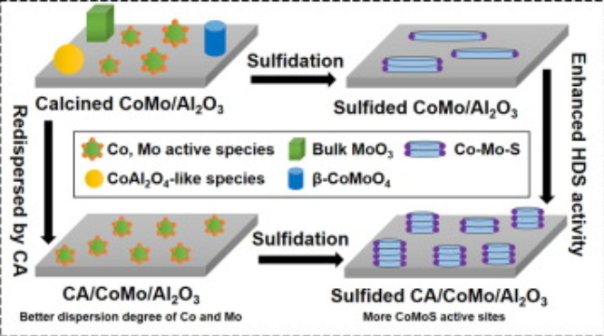
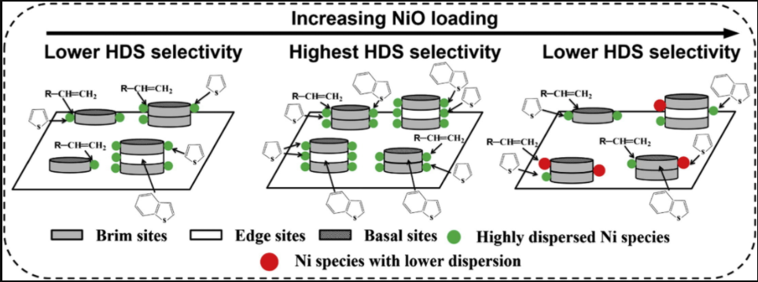
Enhanced Activity and Selectivity of HDS

Slide 12
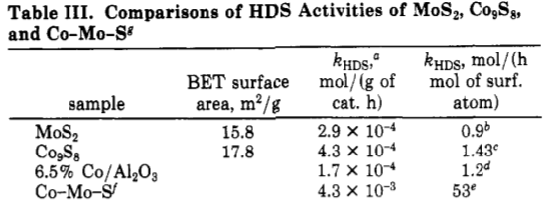
Effect of the stability of the active phase on catalytic performance
It is imperative to prepare stable active phase to ensure the desired lifetime of hydrotreating catalysts for diesel and residue.
The active phase structure undergoes noticeable changes after working at higher temperature and hydrogen pressure for a long period. at higher hydrogen pressure a destacking phenomenon may occur. Such changes in active phase structure may lead to a remarkable decrease in hydrotreating performance and greatly shorten the lifetime of the catalysts.
For example Co (Ni)-Mo (W)-S active phase may gradually aggregate, and then the promoter Co (Ni) may segregate from the active phase.
It is vital to decrease the catalyst deactivation by constructing stable active phase structure for ultra-low sulfur diesel production.

Slide 13
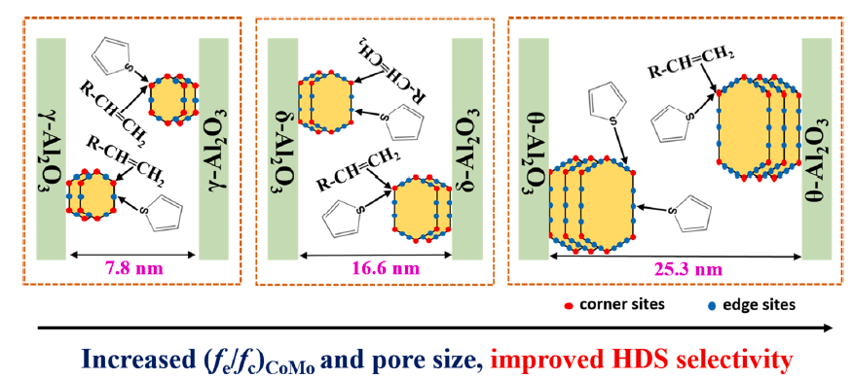
Effect of crystal phase of alumina carrier on the selective HDS performance of their corresponding CoMo supported catalysts.
Effect of the structure of the active phase on catalytic performance
HDS selectivity correlates linearly with the slab length of (Co)MoS2 active phase; the longer average (Co)MoS2 slab length, the better HDS selectivity.
For example, HDS activity and selectivity of CoMo catalysts correlate linearly with the ratio of Co-Mo-S sites/MoS2 sites; moreover, larger Co-Mo-S active phase slabs exhibit higher HDS selectivity.

Slide 14
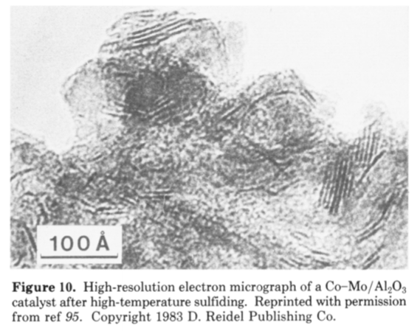
Effect of sulfidation parameters on the structure of the active phase
Sulfidation is the key step to transform oxidic state of the catalyst to sulfided state and form the active phase structure. The parameters of sulfidation, including the state of the reaction medium (gaseous or liquid) and sulfiding agents, pressure, temperature and gas composition have great influence on the formation of active phase structure.
It indicated that in contrast to H₂S/H₂, the sulfidation gas in the absence of H₂ (e.g. H₂S/N₂ or H₂S/He) can greatly promote the sulfidation of supported metal species and weaken the interaction between the active phase and support, but the morphology of the active phase may vary with the types of support and preparation methods.
Thus we can say that Active phase can be designed by adjusting preparing and sulfiding parameters.

Slide 15
Effects of the Active Phase of CoMo/γ-Al2O3 Catalysts Modified Using Cerium and Phosphorus on the HDS Performance for FCC Gasoline
Hydrodesulfurization (HDS) of gasoline is the most widely applied and effective technology at present. Traditionally, HDS catalysts used alumina as a support and Co- or Ni-modified MoS2 crystallites as the active phase.
But traditionally HDS catalysts exhibit high hydrogenation of olefins activity, causing serious loss of the gasoline octane number. In order to overcome this problem and improve the performance of HDS catalysts, it is imperative to develop a catalyst with high HDS/HYDO selectivity to maximize desulfurization and minimize olefin hydrogenation (HYDO).
The morphology of HDS catalyst active phase directly determines the catalytic properties.
The active phase of HDS catalysts has two types: “Co−Mo−S-I” and “Co−Mo−S-II”. The “Co−Mo−S-I” active phase appears as a single layer distribution, and the metal−support interaction (MSI) is stronger. The “Co−Mo−S-II” active phase presents a multilayered stacking state with weaker MSI and a higher sulfidation degree.

Slide 16
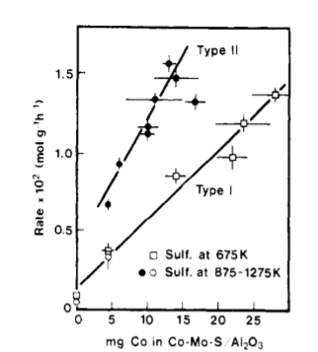
HDS activity as a function of the amount of Co in Co-Mo-S for catalysts sulfided at different temperatures.

Slide 17
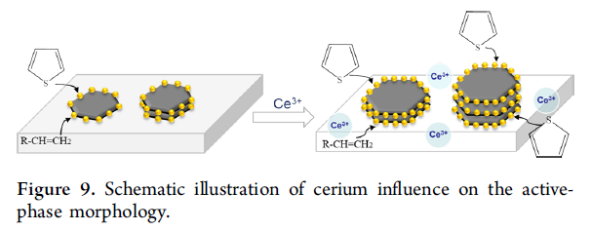
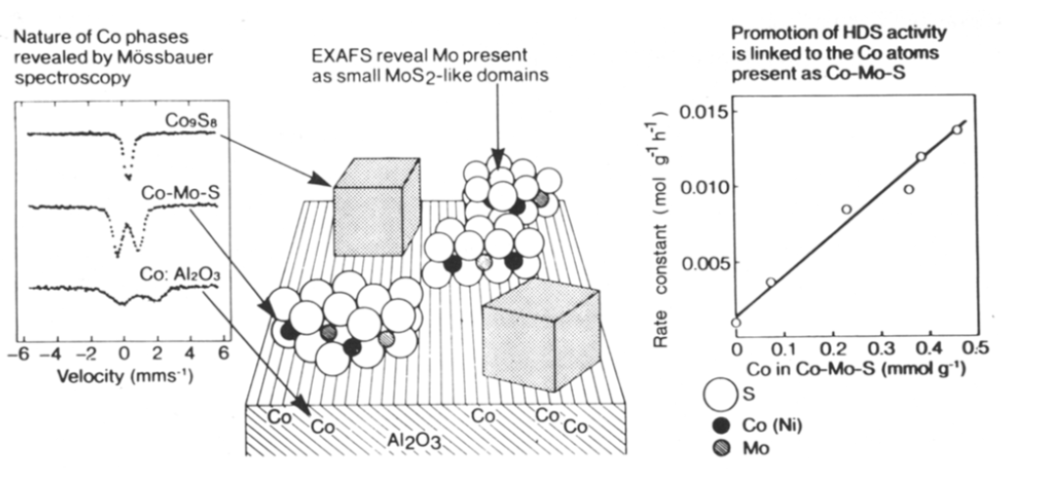
The morphology of the active phase of sulfide catalysts genrally exhibited by HRTEM and XPS methods.
Typical Co-Mo/Al₂O₃ HDS catalyst

Slide 18
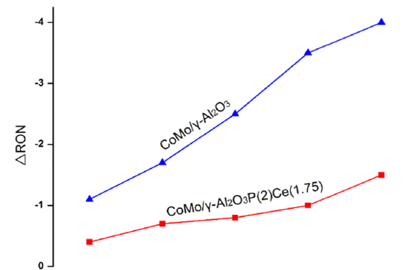
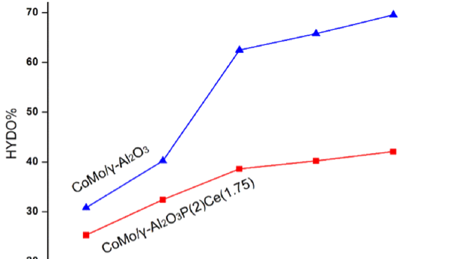
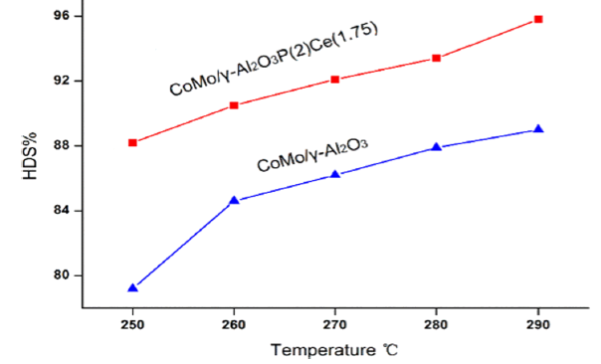
By comparing XPS and HRTEM data, it can be clearly seen that the addition of cerium can optimize the morphology of the active phase. The experimental results support the hypothesis that Ce has the ability to promote HDS activity and inhibit HYDO reaction by modifying the morphology of the active phase. As shown in Figure, the values of TOFHDS for CoMo/γ-Al2O3P(2)Ce(1.75) catalyst is higher than those for the CoMo/γ-Al2O3Ce(1.75) catalyst, suggesting that using Ce and P simultaneously as modifiers can optimize the CoMoS active phase and further promote the HDS activity.
Dependence of HDS, HYDO and ΔRON of FCC gasoline hydrotreatment on temperature over CoMo/γ-Al2O3 and CoMo/γ-Al2O3P(2)Ce(1.75) catalysts.

Slide 19
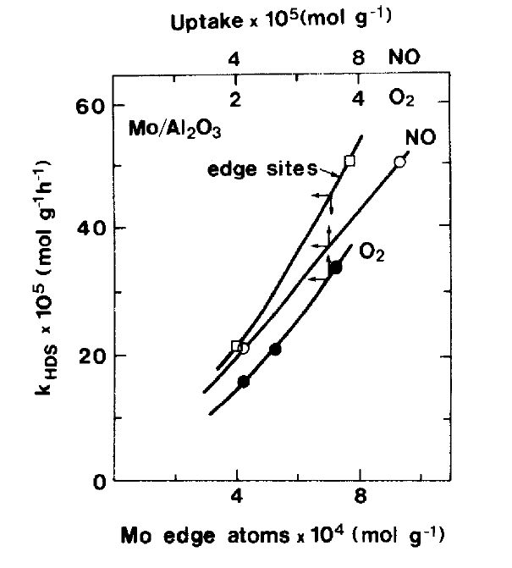
The HDS reaction may not necessarily involve all edge sites. For example, it is likely that the MoS2 edges will contain both different geometric configurations Of the MO atoms (e.g., corner and edge sites) and sulfur vacancies (monovacancies, di-vacanties, vacancy pairs, etc.).
Dependance of the thiophene HDS activity of Mo/A1₂0₃ catalysts on MoS₂ edge sites, O₂ uptake and NO uptake. O₂ uptakes on catalysts sulfided at 873 K; NO uptakes on catalysts sulfided at 673 K; concentration of MoS₂ edge sites has been determined by means of EXAFS on catalysts sulfided at 673 K.

Slide 20
References:
ACTIVE SITES AND SUPPORT EFFECTS IN HYDRODESULFURIZATION CATALYSTS a)
Henrik Topsee and Bjerne S. Clausen Applied Catalysis, 25 (1986) 273-293
Recent Basic Research in Hydrodesulfurization Catalysis Henrlk Topsle,” Bjerne S. Clausen, Nan-Yu Topsae, and Erik Pedersen Ind. Eng. Chem. Fundam. 1988, 25, 25-36
Nie H, Li H, Yang Q, Li D, Effect of structure and stability of active phase on catalytic performance of hydrotreating catalysts, Catalysis Today (2010),
Influence of the alumina crystal phase on the performance of CoMo/Al2O3 catalysts for the selective hydrodesulfurization of fluid catalytic cracking naphtha Fuel 289 (2021) 119843

