Slide 1
Advanced Spectroscopy Techniques for Characterization of Materials
National Centre for Catalysis Research
Indian Institute of Technology, Madras
Chennai 600 036
bviswanathan@gmail.com
8th March 2020

Slide 2
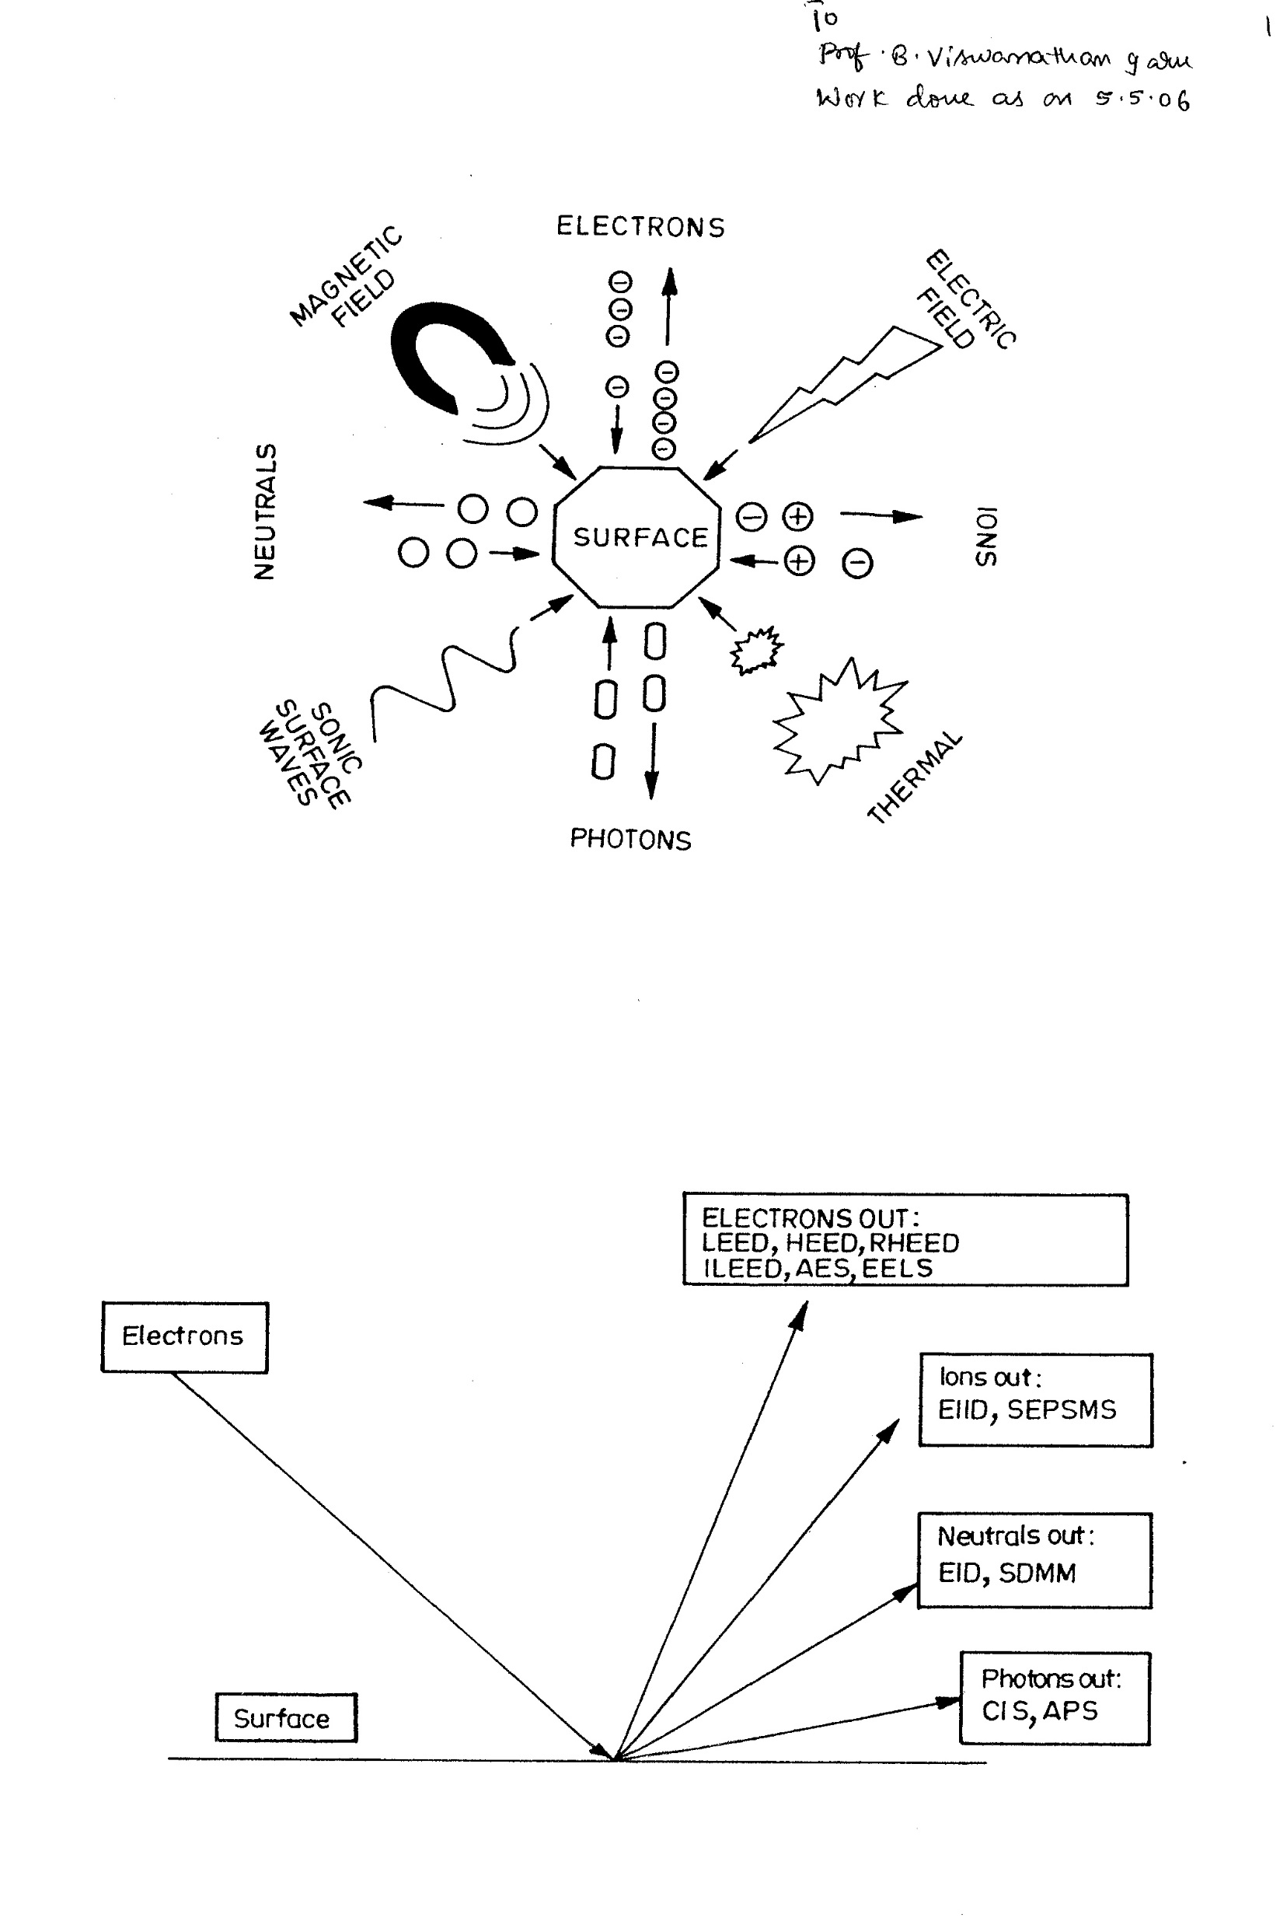
A pictorial representation of generating the possible techniques in terms of input and out put probes

Slide 3

Representation of the techniques based on Electrons in – electron, ion, neutral and photon out LEED: Low Energy Electron Diffraction; HEED: High Energy Electron diffraction; RHHED: Reflected High Energy Electron Diffraction; ILEED: Ineleastic Low Energy Electron Diffraction; AES: Auger Electron Spectroscopy; EELS: Electron Energy Loss Spectroscopy; EIID: Electron Induced Ion Desorption; SEPSMS: Electron Probe Surface Mass Spectrometry; EID: Electron Induced Desorption; SDMM: Surface Desorption Molecular Microscope; CIS: Characteristic Isochromat Spectroscopy; APS: Appearance Potential Spectroscopy.

Slide 4
Photons out IR absorption, Ellipsometry, laser Raman and XPS
Photons in
Neutrals out
Photo-desorption
Electrons out
ESCA,XPS
Ions out
Schematic representation of the techniques that can be generated from Photon- in photon, neutral, electron or ion-out methodology. XPS: X ray Photoelectron Spectrroscopy; ESCA: Electrons Spectroscopy for Chemical Analysis

Slide 5
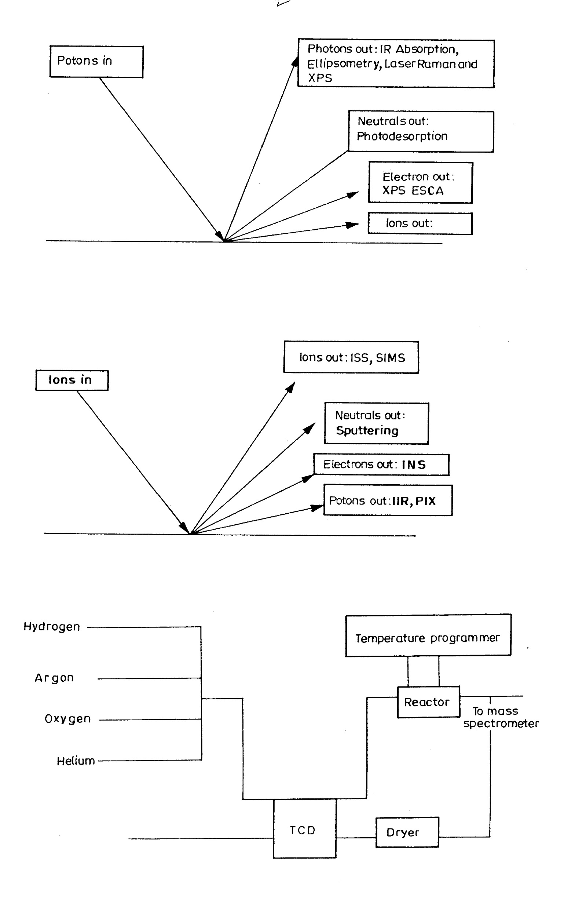
Schematic representation of the techniques that can be generated from Ions-in ion-, neutral-, electron- or photon-out methodology. ISS: Ion Scattering Spectroscopy, SIMS: Secondary Ion Mass Spectrometry, INS: Ion Neutralization Spectroscopy, PIX: Proton Induced X ray emission

Slide 6
Partial listing of the surface Analytic Techniques with the appropriate acronym.
Acronym | Technique
AEAPS | Auger Electron Appearance Potential Spectroscopy
AES | Auger Electron Spectroscopy
AFM | Atomic Force Microscopy
APECS | Auger Photoelectron Coincidence Spectroscopy
APFIM | Atom Probe Field Ion Microscopy
APS | Appearance Potential Spectroscopy
ARPES | Angle Resolved Photoelectron Spectroscopy
ARUPS | Angle Resolved Ultraviolet Photoelectron Spectroscopy
ATR | Attenuated Total Reflection
BEEM | Ballistic Electron Emission Microscopy
BIS | Bremsstrahlung Isochromat Spectroscopy
CFM | Chemical Force Microscopy
CHA | Concentric Hemispherical Analyzer
CMA | Cylindrical Mirror Analyzer
CPD | Contact Potential Difference
CVD | Chemical Vapour Deposition
DAFS | Diffraction Anomalous Fine Structure
DAPS | Disappearance Potential Spectroscopy
DRIFT | Diffuse Reflectance Infra-Red Fourier Transform
EAPFS | Extended Appearance Potential Fine Structure

Slide 7
EDX | Energy Dispersive X-ray Analysis
EELS | Electron Energy Loss Spectroscopy
 | Electron induced luminescence
 | Ellipsometry
EMS | Electron Momentum Spectroscopy
EPMA | Electron Probe Micro-Analysis
ESDMS | Electron Stimulated Desorption Mass Spectrometry
ESCA | Electron Spectroscopy for Chemical Analysis
ESD | Electron Stimulated Desorption
ESDIAD | Electron Stimulated Desorption Ion Angle Distributions
EXAFS | Extended X-ray Absorption Fine Structure
FEM | Field Emission Microscopy
FIM | Field Ion Microscopy
FTIR | Fourier Transform Infra Red
FTRA-IR | Fourier Transform Reflectance-Absorbtion Infra Red
HAS | Helium Atom Scattering
HDA | Hemispherical Deflection Analyser
HEIS | High Energy Ion Scattering
HREELS | High Resolution Electron Energy Loss Spectroscopy
IETS | Inelastic electron tunnelling spectroscopy
KRIPES | k-Resolved Inverse Photoemission Spectroscopy

Slide 8
ILS | Ionisation Loss Spectroscopy
INS | Ion Neutralisation Spectroscopy
IPES | Inverse Photoemission Spectroscopy
IRAS | Infra-Red Absorption Spectroscopy
 | Ion Excited Auger Electron Spectroscopy
ISS | Ion Scattering Spectroscopy
LEED | Low Energy Electron Diffraction
LEEM | Low Energy Electron Microscopy
LEIS | Low Energy Ion Scattering
LFM | Lateral Force Microscopy
MBE | Molecular Beam Epitaxy
MBS | Molecular Beam Scattering
MCXD | Magnetic Circular X-ray Dichroism
MEIS | Medium Energy Ion Scattering
MFM | Magnetic Force Microscopy
MIES | Metastable Impact Electron Spectroscopy
MIR | Multiple Internal Reflection
MOCVD | Metal Organic Chemical Vapour Deposition
MOKE | Magneto-Optic Kerr Effect
NEOM | Near Field Optical Microscopy

Slide 9
MIR | Multiple Internal Reflection
MOCVD | Metal Organic Chemical Vapour Deposition
MOKE | Magneto-Optic Kerr Effect
NEOM | Near Field Optical Microscopy
NIXSW | Normal Incidence X-ray Standing Wave
NEXAFS | Near-Edge X-ray Absorption Fine Structure
NSOM | Near Field Scanning Optical Microscopy
PAES | Positron annihilation Auger Electron Spectroscopy
PECVD | Plasma Enhanced Chemical Vapour Deposition
PEEM | Photo Emission Electron Microscopy
PhD | Photoelectron Diffraction
 | Photon Excited Auger Electron Spectroscopy
PIXE | Proton Induced X-ray Emission
 | Raman Spectroscopy
PSD | Photon Stimulated Desorption
RAIRS | Reflection Absorbtion Infra-Red Spectroscopy
RAS | Reflectance Anisotropy Spectroscopy
RBS | Rutherford Back Scattering
RDS | Reflectance Difference Spectroscopy
REFLEXAFS | Reflection Extended X-ray Absorption Fine Structure
RFA | Retarding Field Analyser
RHEED | Reflection High Energy Electron Diffraction
RIFS | Reflectometric Interference Spectroscopy
SAM | Scanning Auger Microscopy
SEM | Scanning Electron Microscopy
SEMPA | Scanning Electron Microscopy with Polarization Analysis

Slide 10
SERS | Surface Enhanced Raman Scattering
SEXAFS | Surface Extended X-ray Absorption Spectroscopy
SHG | Second Harmonic Generation
SH-MOKE | Second Harmonic Magneto-Optic Kerr Effect
SIMS | Secondary Ion Mass Spectrometry
SKS | Scanning Kinetic Spectroscopy
SMOKE | Surface Magneto-Optic Kerr Effect
SNMS | Sputtered Neutral Mass Spectrometry
SNOM | Scanning Near Field Optical Microscopy
SPIPES | Spin Polarised Inverse Photoemission Spectroscopy
SPEELS | Spin Polarised Electron Energy Loss Spectroscopy
SPLEED | Spin Polarised Low Energy Electron Diffraction
SPM | Scanning Probe Microscopy
SPR | Surface Plasmon Resonance
SPURS | Spin Polarised Ultraviolet Photoelectron Spectroscopy
SPXPS | Spin Polarised X-ray Photoelectron Spectroscopy
STM | Scanning Tunnelling Microscopy
SXAPS | Soft X-ray Appearance Potential Spectroscopy
SXRD | Surface X-ray Diffraction
 | Synchrotron Radiation Photoelectron Spectroscopy
TDS | Thermal Desorption Spectroscopy
TEAS | Thermal Energy Atom Scattering

Slide 11
TIRF | Total Internal Reflectance Fluorescence
TPD | Temperature Programmed Desorption
TPO | Temperature Programmed Oxidation
TPRS | Temperature Programmed Reaction Spectroscopy
TPS | Temperature Programmed sulphidation
TXRF | Total Reflection X-ray Fluorescence
UHV | Ultra High Vacuum
UPS | Ultraviolet Photoemission Spectroscopy
XANES | X-ray Absorption Near-Edge Structure
XAES | X-ray Induced Auger Electron Spectroscopy
XPD | X-ray Photoelectron Diffraction
XPS | X-ray Photoemission Spectroscopy
XRR | X-ray Reflectometry
XSW | X-ray Standing Wave

Slide 12
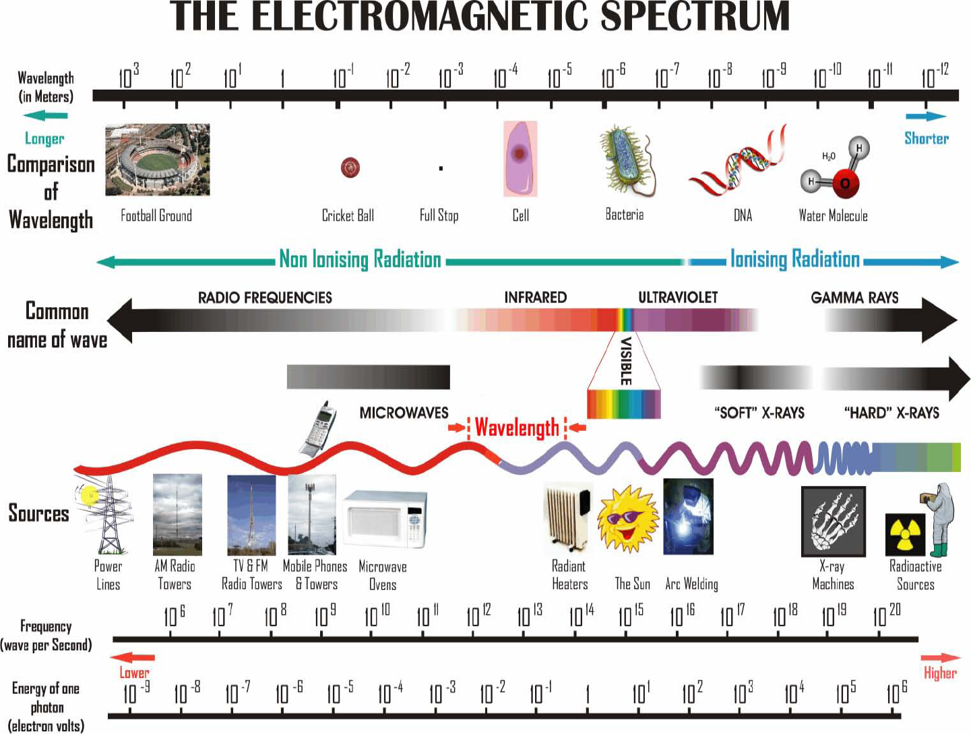

Slide 13
Most often used methods

Slide 14
THEORY

Slide 15
Properties of Light
c = λν c = speed of light in vacuum (2.998 x 10⁸ m/s)
λ = wavelength (m)
v = frequency (Hz)
E = hc/ λ = hcv` h = Planck’s constant (6.626 x 10⁻³⁴ J•s)
v` = wavenumber (m⁻¹)

Slide 16
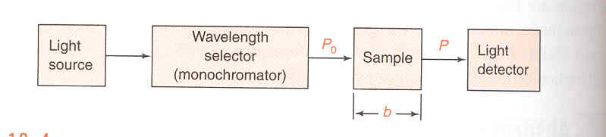
Understanding Beer’s Law₂
Transmittance T = P/P₀
Schematic of Single-Beam Spectrophotometer, P₀ is the irradiance entering sample, P is the irradiance leaving sample, and b is pathlength₂
P = irradiance (energy per unit area of light beam)

Slide 17
Understanding Beer’s Law₃
Absorbance A = log (P/P₀) = -log (T)
Beer’s Law A = εbc
ε = molar absorptivity (M⁻¹ cm⁻¹)
b = pathlength (cm)
c = concentration (M)

Slide 18
LIGHT ABSORPTION SPECTRUM

Slide 19
Absorption Spectrum of Light₄
Wavelength of maximum absorption (nm) | Color Absorbed | Color Observed
380 – 420 | Violet | Green-Yellow
420 - 440 | Violet-Blue | Yellow
440 – 470 | Blue | Orange
470 – 500 | Blue-Green | Red
500 – 520 | Green | Purple
520 – 550 | Yellow-Green | Violet
550 – 580 | Yellow | Violet-Blue
580 – 620 | Orange | Blue
620 – 680 | Red | Blue-Green
680 - 780 | Purple | Green

Slide 20
EXPERIMENTAL PROCEDURE

Slide 21
Detecting Potassium Permanganate
Potassium permanganate (KMn0₄) in solution is purple / violet color meaning maximum absorption should be at 500 – 550 nm
Prepared 5 known concentrations of KMnO₄: 1ppm, 20ppm, 40ppm, 60ppm, 80ppm

Slide 22
Detecting Potassium Permanganate
Calibration Standards measured first on a Perkins-Elmer Lambda 35 over entire UV-Vis region to determine max absorption
KMnO₄ absorbed best at ≈ 520 nm
A Bausch & Lomb Spectronic 21 was used to make all measurements

Slide 23
RESULTS

Slide 25
UV-Vis Absorbance Readings for Potassium Permanganate at 520 nm
 | Average %A (after 3 runs) | Standard Deviation (%A)
1 ppm | 0.015 | 0.004
20 ppm | 0.256 | 0.001
40 ppm | 0.520 | 0.004
60 ppm | 0.753 | 0.002
80 ppm | 1.046 | 0.001
Unknown #4 | 0.462 | 0.001

Slide 26
Calibration Curve for KMnO₄ using UV-Vis Spectroscopy, Absorption vs. Concentration

Slide 27
Determination of Unknown Concentration of KMnO₄
Used cuvette of 1cm length
ε = slope of line = 0.029 ppm⁻¹ cm⁻¹
Unknown #4 concentration found using
c = A/0.029
36 ppm = 0.462 %A / 0.029 ppm⁻¹

Slide 28
Error Analysis
Used 10.00 ± 0.05mL volumetric pipette to make all solutions
Measured density of water with:
ρ = (999.8392 + 16.945176t – 7.9870401*10⁻³t² – 46.170461*10⁻⁶t³ + 105.56302*10⁻⁹t⁴ – 280.54253*10⁻¹²t⁵)/(1 + 16.879850*10⁻³t)₅
ρ_{H2O} = 0.997883 g/mL at 21.5°C
Measured accuracy of scale to be ± 0.0005g

Slide 29
Error in Unknown
Errors determined graphically from calibration curve
A = ± 0.01%
Concentration = ± 1.00 ppm
Final concentration of Unknown #4 was
36 ± 1.00 ppm

Slide 30
CONCLUSION

Slide 31
Conclusion
How accurate are results?
Can be determined by R² value for slope of calibration curve.
For this example R² = 0.999

Slide 32
Conclusion
Use Beer’s law to determine concentration of unknown concentration
Find the molar absorptivity through the slope of calibration curve
Determined ε = 0.029 ppm⁻¹ cm⁻¹
Determined Unknown #4 concentration to be 36 ± 1.00 ppm

Slide 33
UV / visible Spectroscopy
Introduction
Identification of organic species
Quantitation of inorganic species
Colorimetric analysis
Notes:
1
2
3

Slide 34
UV / visible Spectroscopy
The origin of the analytical signal
Excitation of an atom or molecule by ultraviolet or visible radiation.
190 - 900nm
Notes:
2
2
3

Slide 35
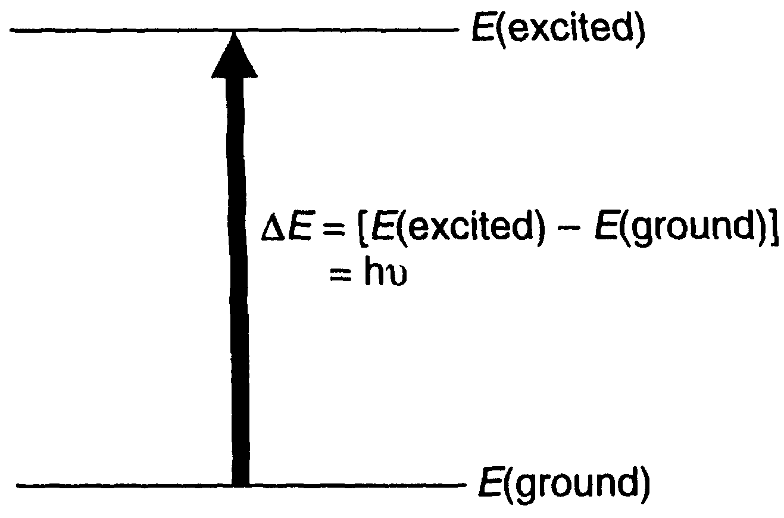
UV / visible Spectroscopy
The radiation which is absorbed has an energy which exactly matches the energy difference between the ground state and the excited state.
These absorptions correspond to electronic transitions.
Notes:
3
2
3

Slide 36
UV / visible Spectroscopy
Abs
Abs
λ / nm
λ / nm
Notes:
5
2
3

Slide 37
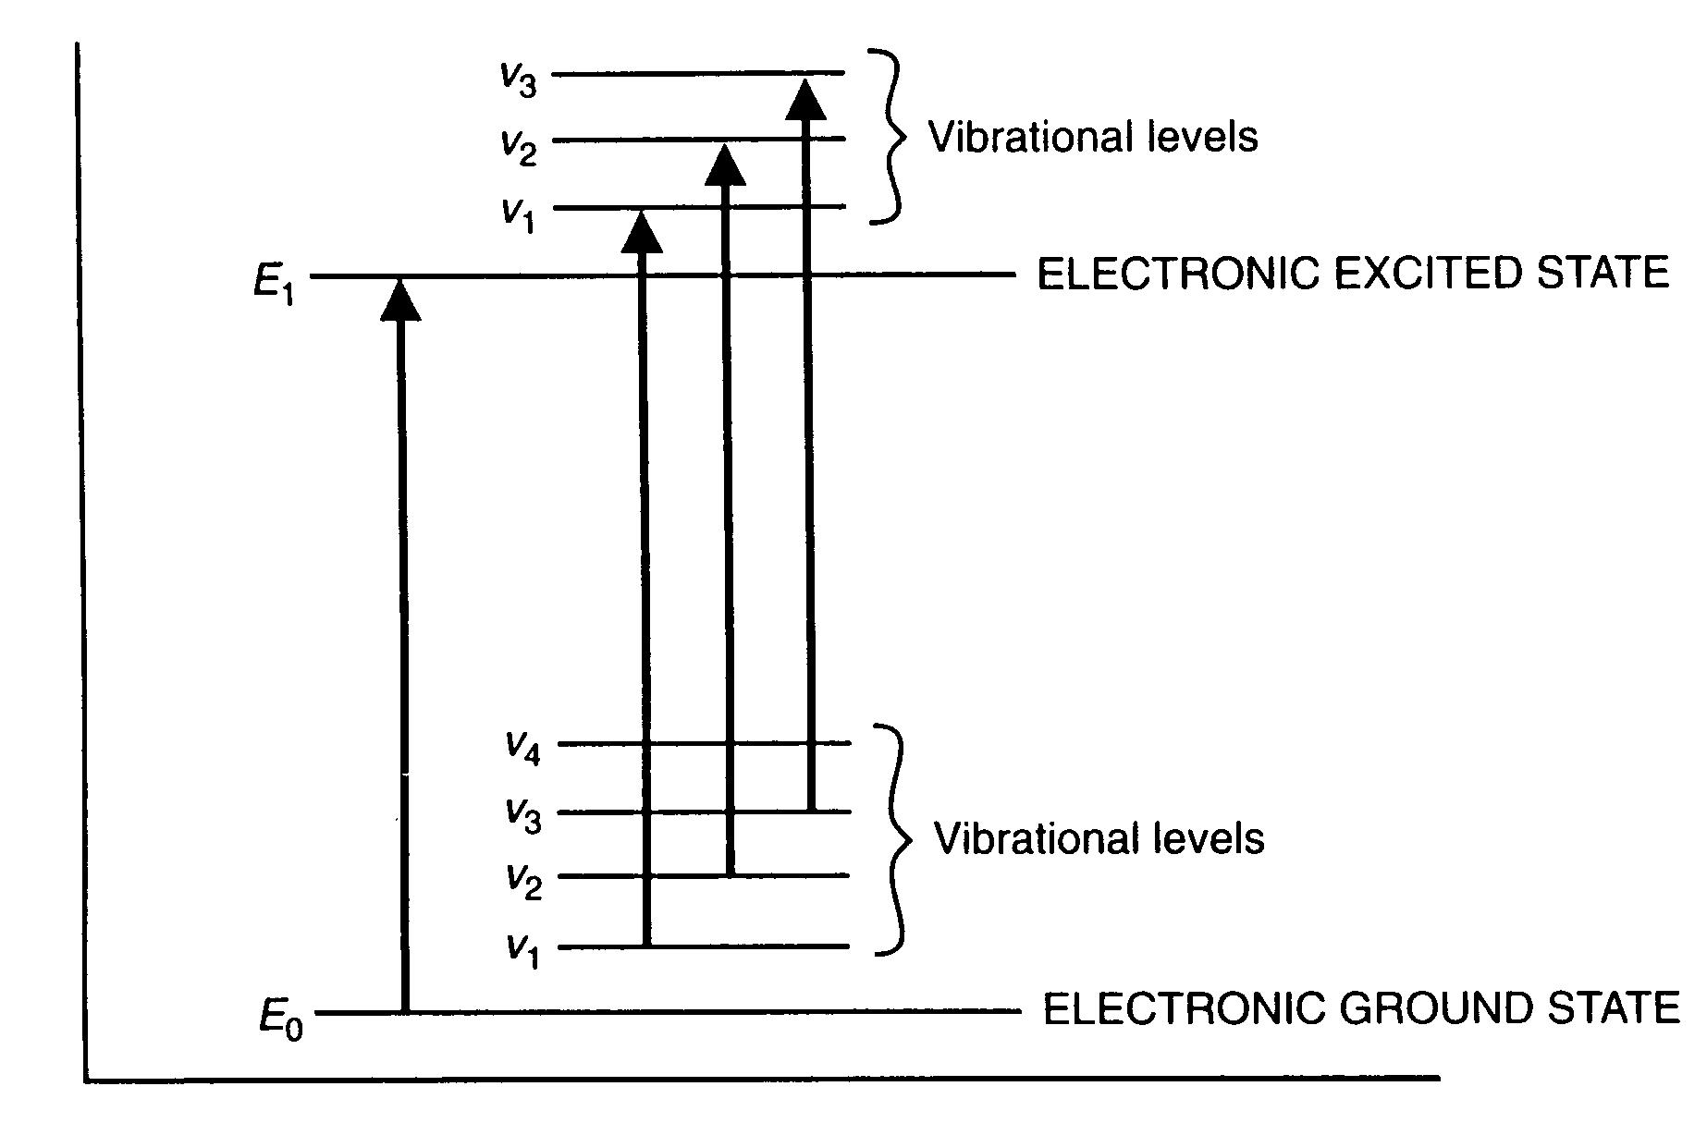
UV / visible Spectroscopy
Notes:
5
2
3

Slide 38
UV / visible Spectroscopy
Electronic transitions involve the promotion of electrons from an occupied orbital to an unoccupied orbital.
Energy differences of 125 - 650 kJ/mole.
Notes:
4
2
3

Slide 39
UV / visible Spectroscopy
Beer-Lambert Law
A = log(I_{O}/I) = ε cl
Notes:
6
2
3

Slide 40
UV / visible Spectroscopy
A = log(I_{O}/I) = εcl
  A = Absorbance (optical density)
  I_{O} = Intensity of light on the sample cell
  I = Intensity of light leaving the sample cell
  c = molar concentration of solute
  l = length of sample cell (cm)
  ε = molar absorptivity (molar extinction coefficient)
Notes:
7
2
3

Slide 41
UV / visible Spectroscopy
The Beer-Lambert Law is rigorously obeyed when a single species is present at relatively low concentrations.
Notes:
8
2
3

Slide 42
UV / visible Spectroscopy
The Beer-Lambert Law is not obeyed:
  High concentrations
  Solute and solvent form complexes
  Thermal equilibria exist between the ground state and the excited state
  Fluorescent compounds are present in solution
Notes:
9
2
3

Slide 43
UV / visible Spectroscopy
The size of the absorbing system and the probability that the transition will take place control the absorptivity (ε).
Values above 10⁴ are termed high intensity absorptions.
Values below 1000 indicate low intensity absorptions which are forbidden transitions.
Notes:
10
2
3

Slide 44
UV / visible Spectroscopy
Organic Spectroscopy
Transitions between
MOLECULAR ORBITALS
Notes:
11
2
3

Slide 45
UV / visible Spectroscopy
Highest occupied molecular orbital
HOMO
Lowest unoccupied molecular orbital
LUMO
Notes:
12
2
3

Slide 46
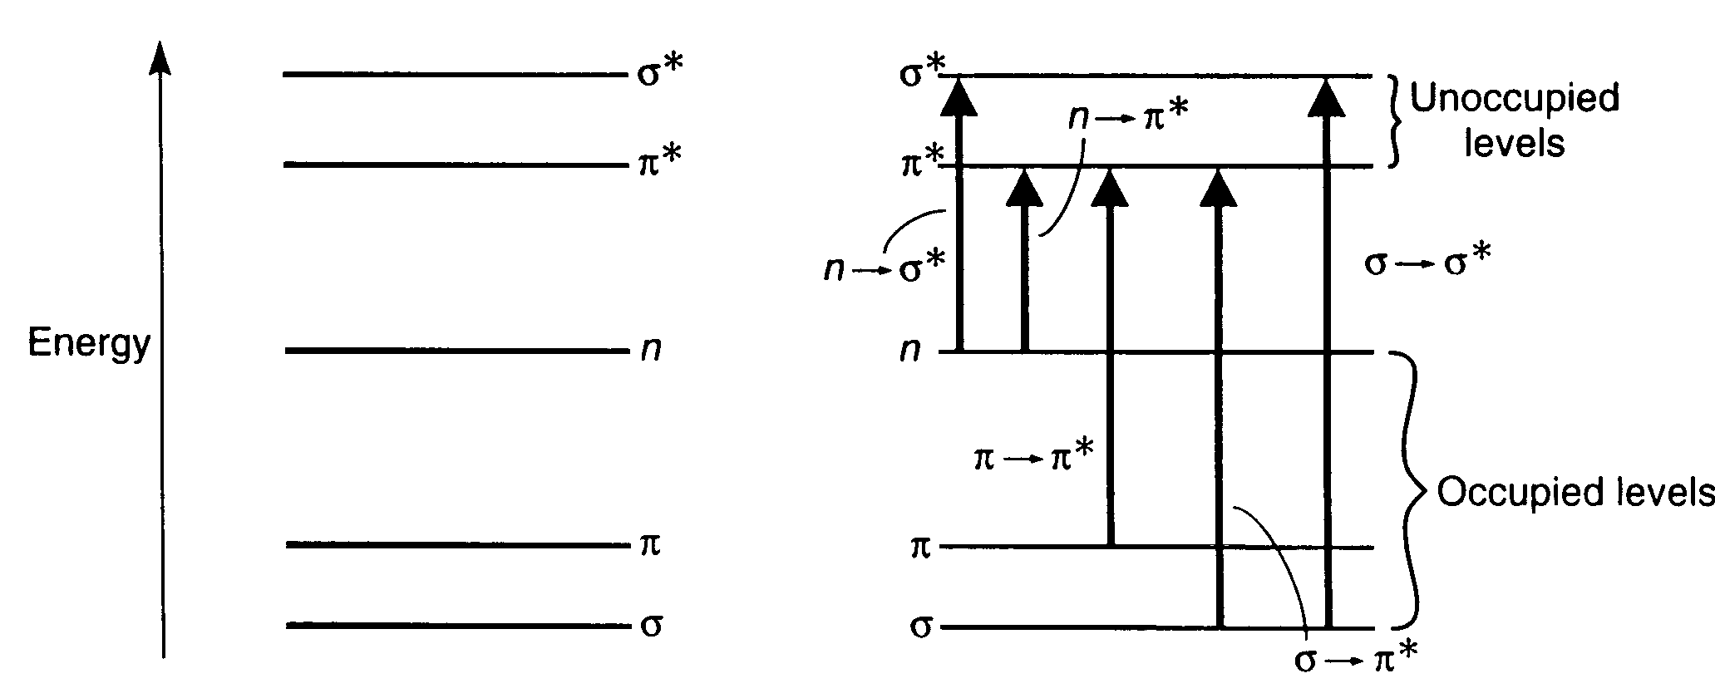
UV / visible Spectroscopy
Notes:
5
2
3

Slide 47
UV / visible Spectroscopy
Not all transitions are observed
There are restrictions called
Selection Rules
This results in
Forbidden Transitions
Notes:
13
2
3

Slide 48
UV / visible Spectroscopy
The characteristic energy of a transition and the wavelength of radiation absorbed are properties of a group of atoms rather than of electrons themselves.
The group of atoms producing such an absorption is called a
CHROMOPHORE
Notes:
14
2
3

Slide 49
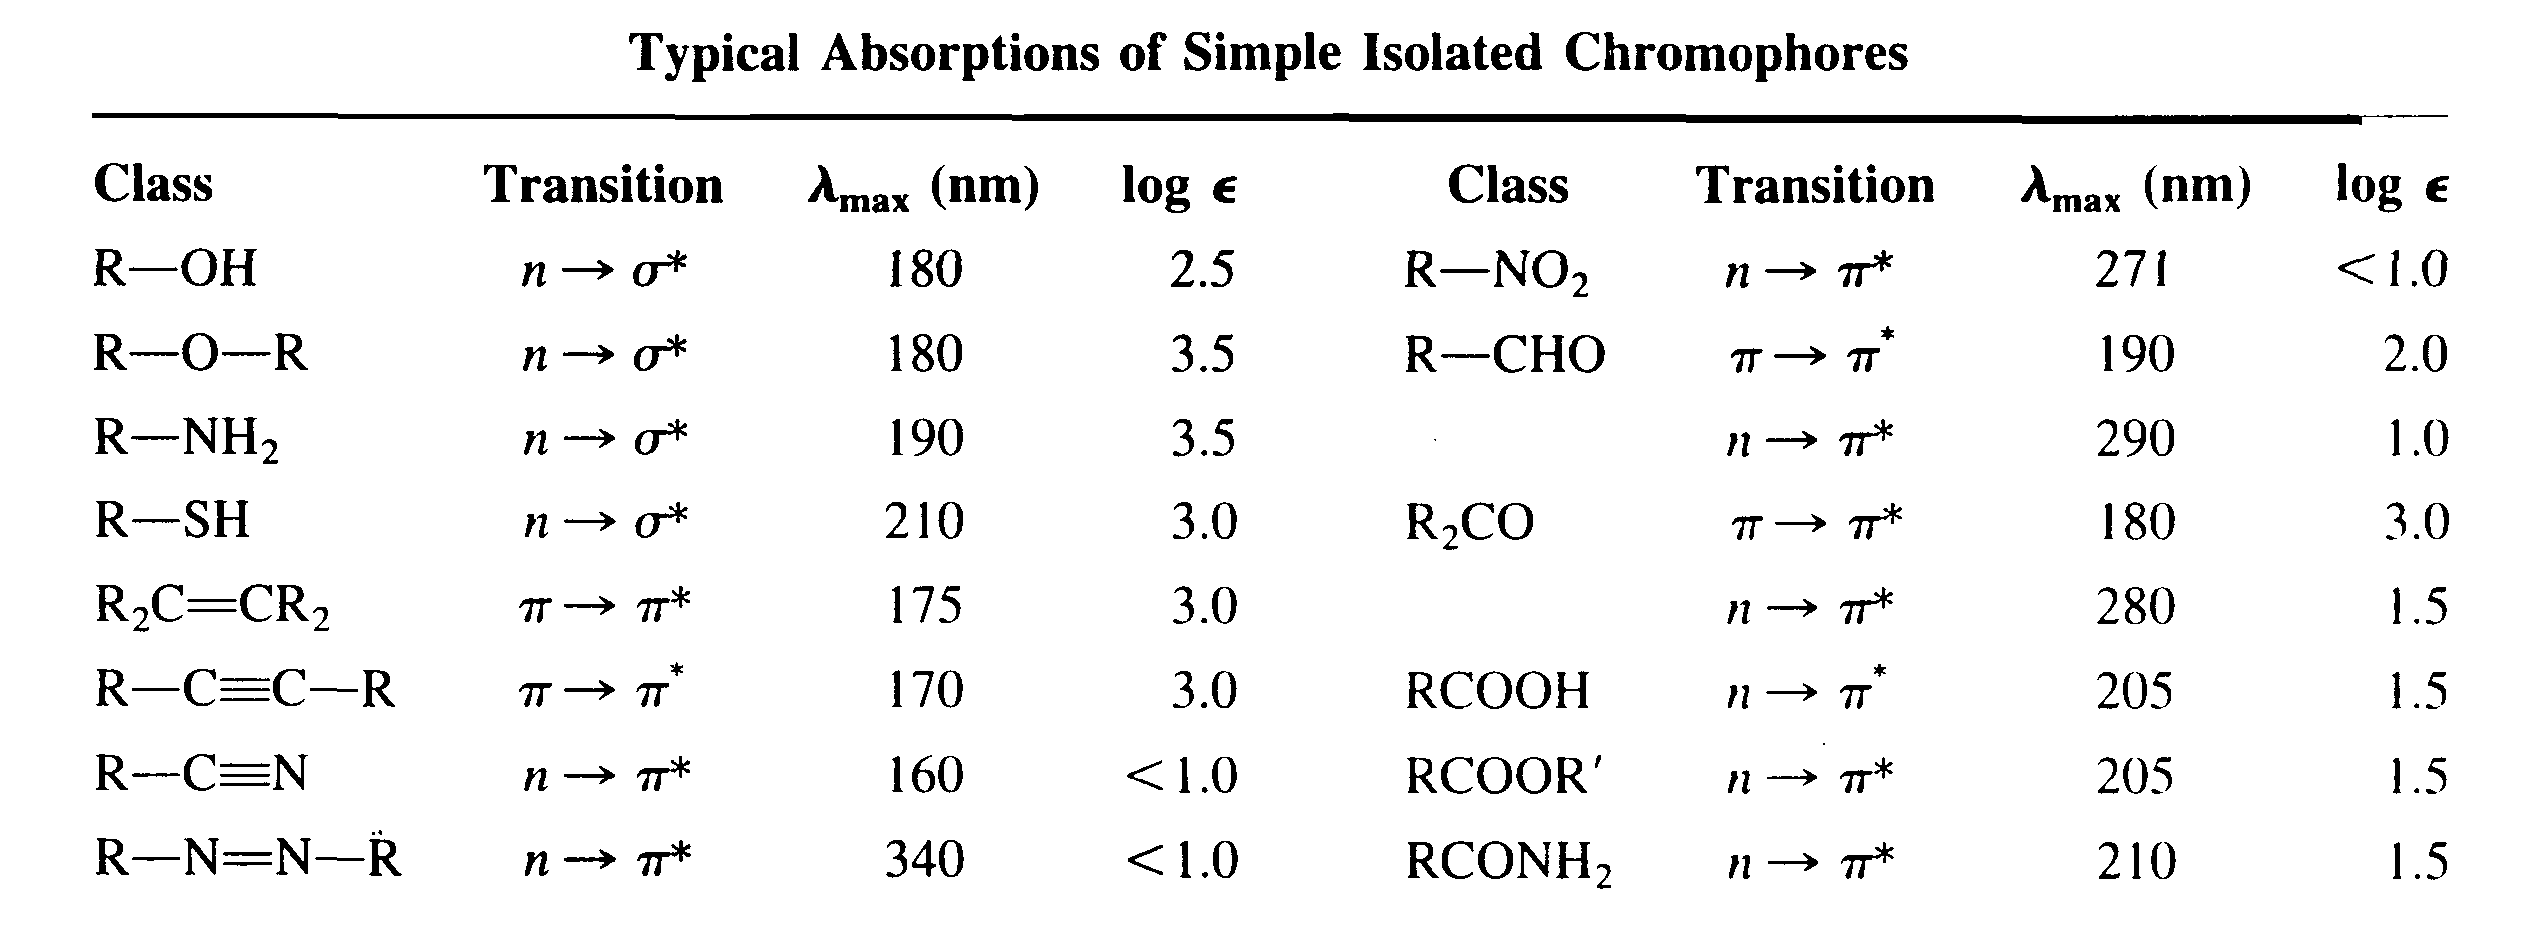
UV / visible Spectroscopy
Notes:
15
2
3

Slide 50
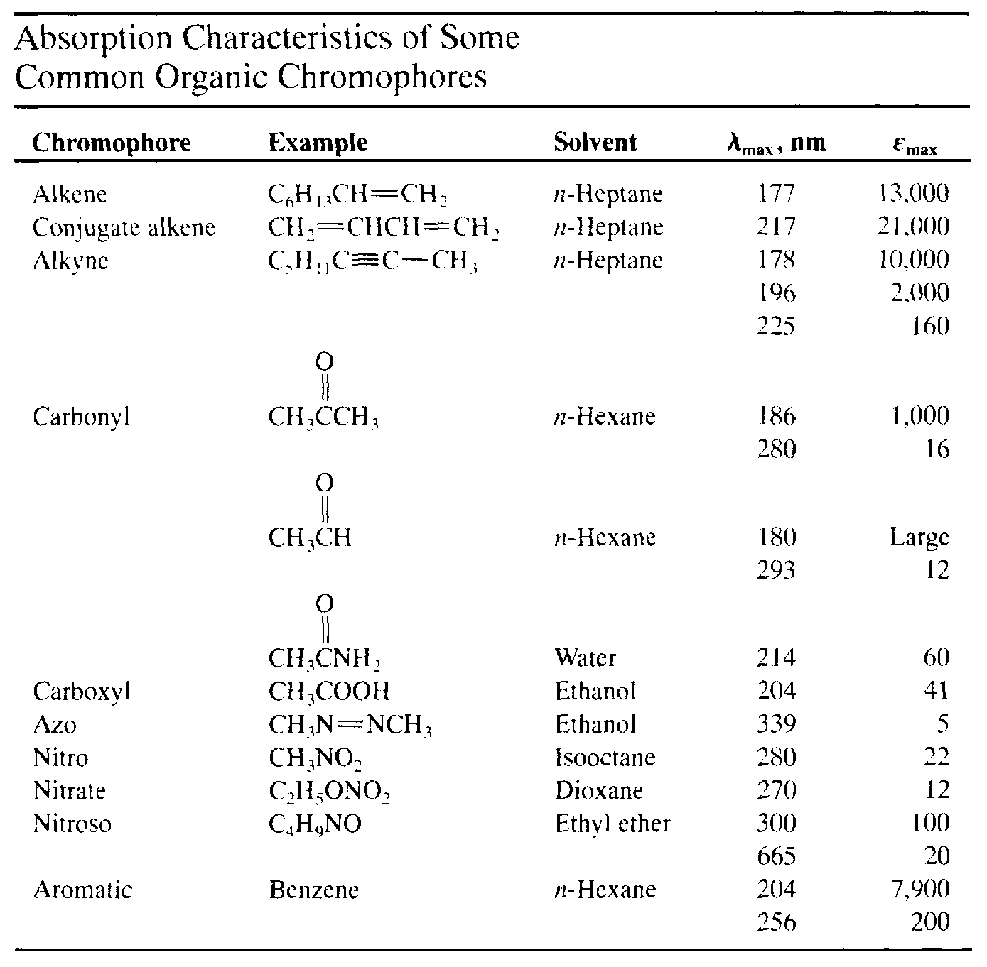
UV / visible Spectroscopy
Notes:
15
2
3

Slide 51
UV / visible Spectroscopy
It is often difficult to extract a great deal of information from a UV spectrum by itself.
Generally you can only pick out conjugated systems.
Notes:
18
2
3

Slide 52
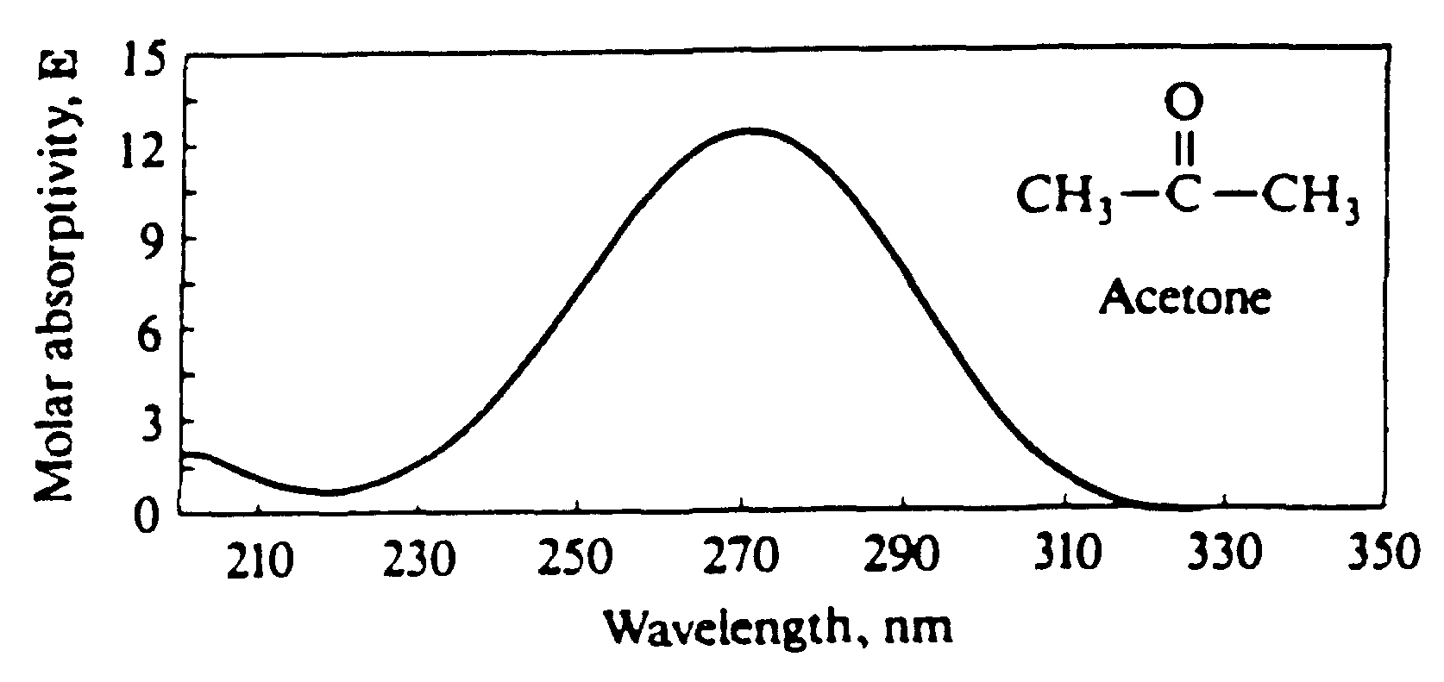
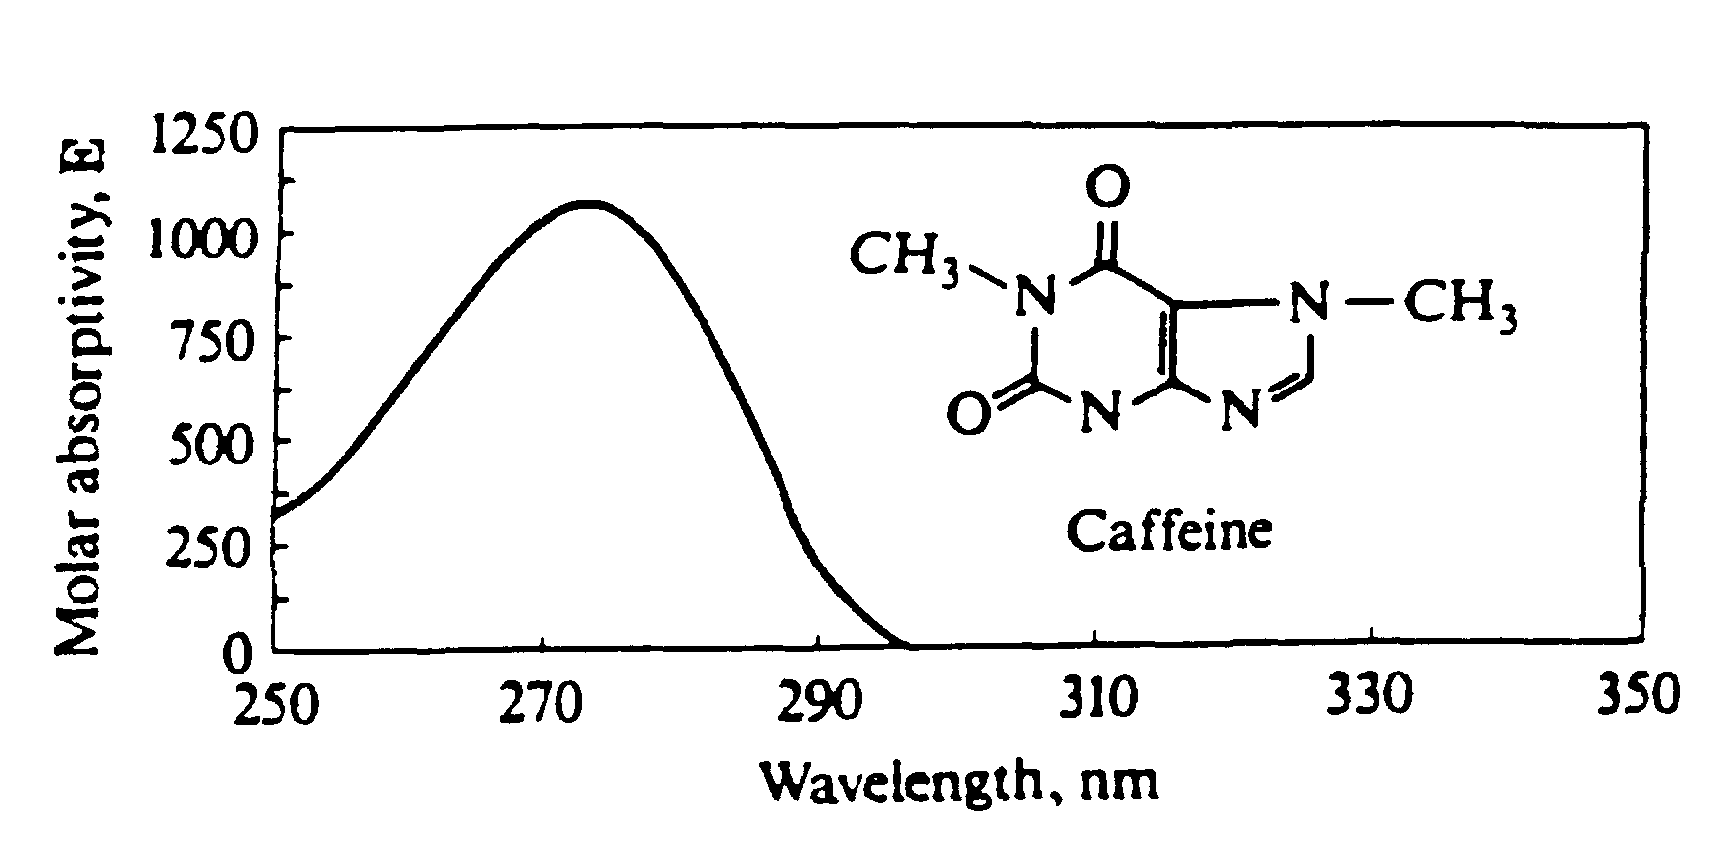
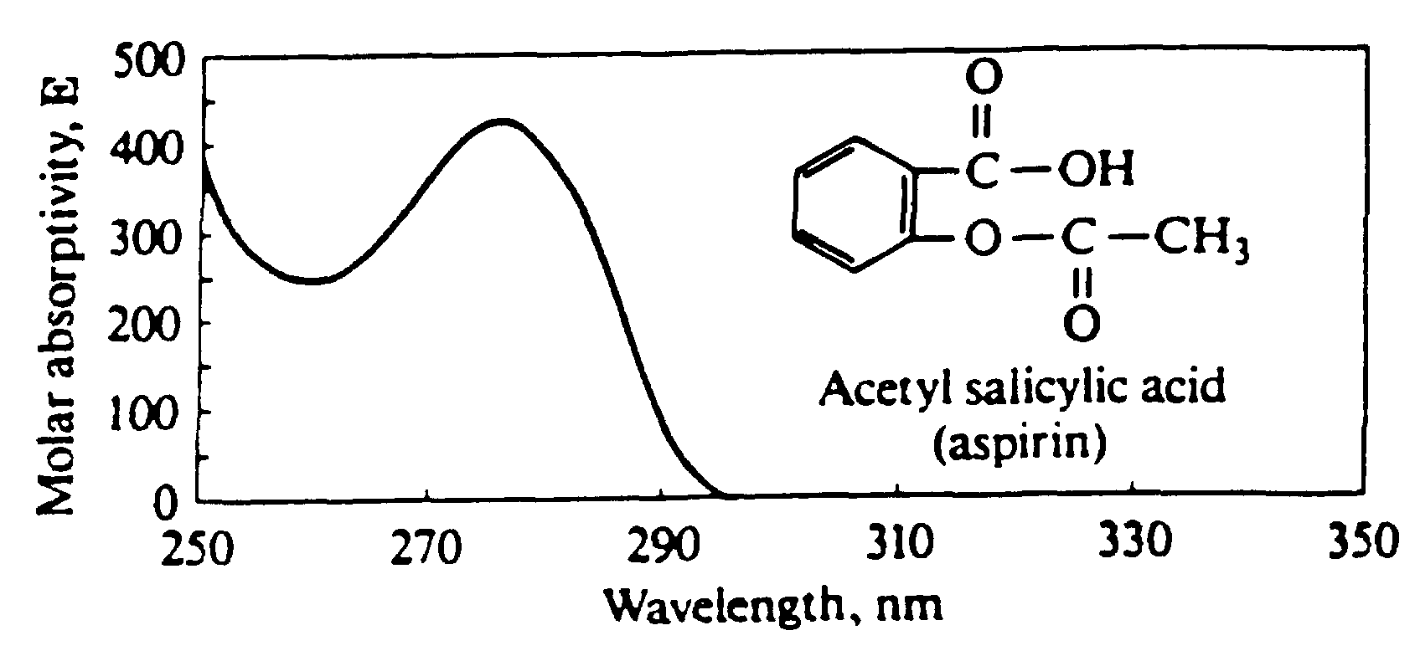
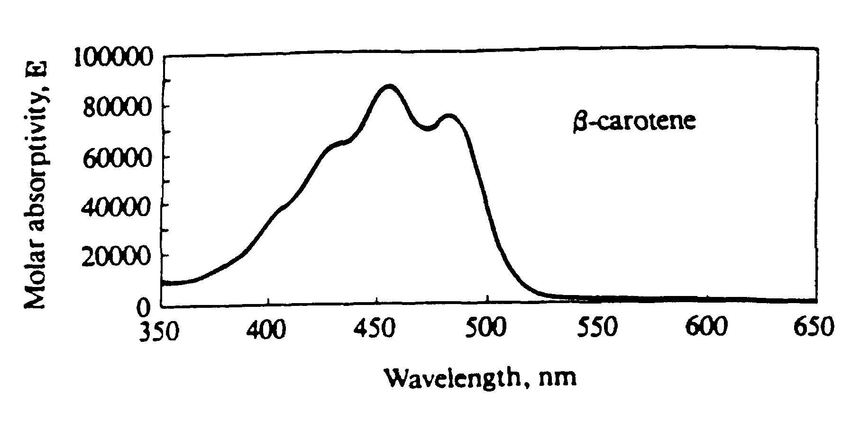
UV / visible Spectroscopy
Notes:
15
2
3

Slide 53
UV / visible Spectroscopy
ALWAYS
use in conjunction with
nmr and infrared spectra.
Notes:
19
2
3

Slide 54
UV / visible Spectroscopy
As structural changes occur in a chromophore it is difficult to predict exact energy and intensity changes.
Use empirical rules.
Woodward-Fieser Rules for dienes
Woodward’s Rules for enones
Notes:
17
2
3

Slide 55
UV / visible Spectroscopy
1. Bathochromic shift (red shift)
  lower energy, longer wavelength
  CONJUGATION.
2. Hypsochromic shift (blue shift)
  higher energy, shorter wavelength.
3. Hyperchromic effect
  increase in intensity
4. Hypochromic effect
  decrease in intensity
Notes:
16
2
3

Slide 56
This exercise is intended to familiarize you with the identification of functional groups in organic compounds using infrared spectra. Before you can use this technique, you need to have an introduction to infrared spectroscopy and to what an IR spectrum is.

Slide 57

Infrared spectroscopy deals with the interaction of infrared light with matter. The energy of an infrared photon can be calculated using the Planck energy relation.
The frequency, ν, and speed of light, c, are related through the relation
E = h ν
Where h = 6.6 X 10⁻³⁴ joules second and nu is the frequency of the photon
where c = 3.0 x 10⁸ meter/second and l = wavelength for the light

Slide 58
These two equations can be used to identify a common spectroscopic unit called
wavenumber, , which is the reciprocal of the wavelength.
E = hν = h c ; E = hν = hcν
= wavenumber = has units of (cm⁻¹)
You can see that both frequency and wavenumber are directly proportional to energy.
Molecules are flexible, moving collections of atoms. The atoms in a molecule are constantly oscillating around average positions. Bond lengths and bond angles are continuously changing due to this vibration. A molecule absorbs infrared radiation when the vibration of the atoms in the molecule produces an oscillating electric field with the same frequency as the frequency of incident IR "light".

Slide 59

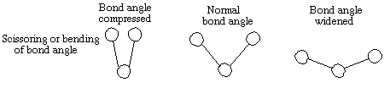
All of the motions can be described in terms of two types of molecular vibrations. One type of vibration, a stretch, produces a change of bond length. A stretch is a rhythmic movement along the line between the atoms so that the interatomic distance is either increasing or decreasing
The second type of vibration, a bend, results in a change in bond angle. These are also sometimes called scissoring, rocking, or "wig wag" motions
Note the high wavenumber (high energy) required to produce these motions. The bending motions are sometimes described as wagging or scissoring motions

Slide 60
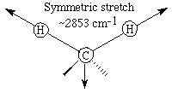

Each of these two main types of vibration can have variations. A stretch can be symmetric or asymmetric. Bending can occur in the plane of the molecule or out of plane; it can be scissoring, like blades of a pair of scissors, or rocking, where two atoms move in the same direction.
Different stretching and bending vibrations can be visualized by considering the CH₂ group in hydrocarbons. The arrows indicate the direction of motion. The stretching motions require more energy than the bending ones.

Slide 61
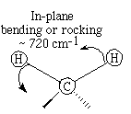
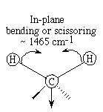
You can see that the lower wavenumber values are consistent with lower energy to cause these vibrations.
A molecule absorbs a unique set of IR light frequencies. Its IR spectrum is often likened to a person's fingerprints. These frequencies match the natural vibrational modes of the molecule. A molecule absorbs only those frequencies of IR light that match vibrations that cause a change in the dipole moment of the molecule. Bonds in symmetric N2 and H2 molecules do not absorb IR because stretching does not change the dipole moment, and bending cannot occur with only 2 atoms in the molecule. Any individual bond in an organic molecule with symmetric structures and identical groups at each end of the bond will not absorb in the IR range. For example, in ethane, the bond between the carbon atoms does not absorb IR because there is a methyl group at each end of the bond. The C-H bonds within the methyl groups do absorb.

Slide 62
In a complicated molecule many fundamental vibrations are possible, but not all are observed. Some motions do not change the dipole moment for the molecule; some are so much alike that they coalesce into one band.
Even though an IR spectrum is characteristic for an entire molecule, there are certain groups of atoms in a molecule that give rise to absorption bands at or near the same wavenumber, ,
(frequency) regardless of the rest of the structure of the molecule. These persistent characteristic bands enable you to identify major structural features of the molecule after a quick inspection of the spectrum and the use of a correlation table. The correlation table is a listing of functional groups and their characteristic absorption frequencies.
The infrared spectrum for a molecule is a graphical display. It shows the frequencies of IR radiation absorbed and the % of the incident light that passes through the molecule without being absorbed. The spectrum has two regions. The fingerprint region is unique for a molecule and the functional group region is similar for molecules with the same functional groups.

Slide 63
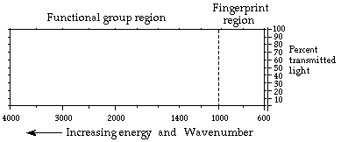

Slide 64
The nonlinear horizontal axis has units of wavenumbers. Each wavenumber value matches a particular frequency of infrared light. The vertical axis shows % transmitted light. At each frequency the % transmitted light is 100% for light that passes through the molecule with no interactions; it has a low value when the IR radiation interacts and excites the vibrations in the molecule.
A portion of the spectrum where % transmittance drops to a low value then rises back to near 100% is called a "band". A band is associated with a particular vibration within the molecule. The width of a band is described as broad or narrow based on how large a range of frequencies it covers. The efficiencies for the different vibrations determine how "intense" or strong the absorption bands are. A band is described as strong, medium, or weak depending on its depth.
In the hexane spectrum below the band for the CH stretch is strong and that for the CH bend is medium. The alkane, hexane (C₆H₁₄) gives an IR spectrum that has relatively few bands because there are only CH bonds that can stretch or bend. There are bands for CH stretches at about 3000 cm⁻¹. The CH₂ bend band appears at approximately 1450 cm⁻¹ and the CH₃ bend at about 1400 cm⁻¹.

Slide 65

The spectrum also shows that shapes of bands can differ.

Slide 66
Procedure
Every molecule will have its own characteristic spectrum. The bands that appear depend on the types of bonds and the structure of the molecule. Study the sample spectra below, noting similarities and differences, and relate these to structure and bonding within the molecules.
The spectrum for the alkene, 1-hexene, C₆H₁₂, has few strong absorption bands. The spectrum has the various CH stretch bands that all hydrocarbons show near 3000 cm⁻¹. There is a weak alkene CH stretch above 3000 cm⁻¹. This comes from the C&emdash;H bonds on carbons 1 and 2, the two carbons that are held together by the double bond. The strong CH stretch bands below 3000 cm⁻¹ come from carbon-hydrogen bonds in the CH₂ and CH₃ groups. There is an out-of-plane CH bend for the alkene in the range 1000-650 cm⁻¹. There is also an alkene CC double bond stretch at about 1650 cm⁻¹ .

Slide 67
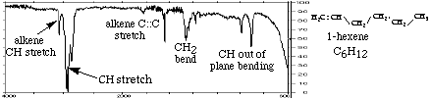

Slide 68
The spectrum for cyclohexene, (C₆H₁₀) also has few strong bands. The main band is a strong CH stretch from the CH₂ groups at about 3000 cm⁻¹. The CH stretch for the alkene CH is, as always, to the left of 3000 cm⁻¹. The CH₂ bend appears at about 1450 cm⁻¹. The other weaker bands in the range 1000-650 cm⁻¹ are for the out of plane CH bending . There is a very weak alkene CC double bond stretch at about 1650 cm⁻¹.

Slide 69
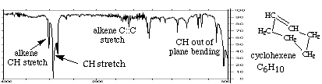

Slide 70
The IR spectrum for benzene, C₆H₆, has only four prominent bands because it is a very symmetric molecule. Every carbon has a single bond to a hydrogen. Each carbon is bonded to two other carbons and the carbon-carbon bonds are alike for all six carbons. The molecule is planar. The aromatic CH stretch appears at 3100-3000 cm⁻¹ There are aromatic CC stretch bands (for the carbon-carbon bonds in the aromatic ring) at about 1500 cm⁻¹. Two bands are caused by bending motions involving carbon-hydrogen bonds. The bands for CH bends appear at approximately 1000 cm⁻¹ for the in-plane bends and at about 675 cm⁻¹ for the out-of-plane bend.

Slide 71
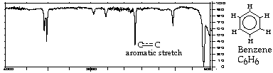

Slide 72
The IR spectrum for the alcohol, ethanol (CH₃CH₂OH), is more complicated. It has a CH stretch, an OH stretch, a CO stretch and various bending vibrations. The important point to learn here is that no matter what alcohol molecule you deal with, the OH stretch will appear as a broad band at approximately 3300-3500 cm⁻¹. Likewise the CH stretch still appears at about 3000 cm⁻¹.

Slide 73
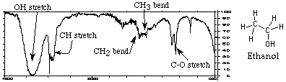

Slide 74

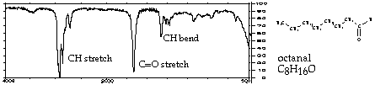
The spectrum for the aldehyde, octanal (CH₃(CH₂)₆CHO), is shown here. The most important features of the spectrum are carbonyl CO stretch near 1700 cm⁻¹ and the CH stretch at about 3000 cm⁻¹. If you see an IR spectrum with an intense strong band near 1700 cm-1 and the compound contains oxygen, the molecule most likely contains a carbonyl group,

Slide 75
The spectrum for the ketone, 2-pentanone, appears below. It also has a characteristic carbonyl band at 1700 cm⁻¹. The CH stretch still appears at about 3000 cm⁻¹, and the CH2 bend shows up at approximately 1400 cm⁻¹. You can see the strong carbonyl CO stretch at approximately 1700 cm⁻¹. You can also see that this spectrum is different from the spectrum for octanal. At this point in your study of IR spectroscopy, you can't tell which compound is an aldehyde and which is a ketone. You can tell that both octanal and a 2-pentanone contain C-H bonds and a carbonyl group.

Slide 76



Slide 77
Carboxylic acids have spectra that are even more involved. They typically have three bands caused by bonds in the COOH functional group. The band near 1700 cm⁻¹ is due to the CO double bond. The broad band centered in the range 2700-3300 cm⁻¹ is caused by the presence of the OH and a band near 1400 cm⁻¹ comes from the CO single bond . The spectrum for the carboxylic acid, diphenylacetic acid, appears below. Although the aromatic CH bands complicate the spectrum, you can still see the broad OH stretch between 2700-3300 cm⁻¹. It overlaps the CH stretch which appears near 3000 cm⁻¹. A strong carbonyl CO stretch band exists near 1700 cm⁻¹. The CO single bond stretch shows up near 1200 cm⁻¹.

Slide 78
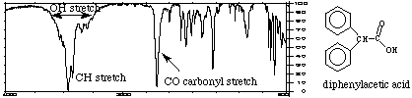

Slide 79
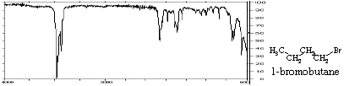
The spectrum for 1-bromobutane, C₄H₉Br, is shown here. This is relatively simple because there are only CH single bonds and the CBr bond. The CH stretch still appears at about 3000 cm-1. The CH₂ bend shows up near 1400 cm⁻¹, and you can see the CBr stretch band at approximately 700 cm⁻¹.

Slide 80
IR spectra can be used to identify molecules by recording the spectrum for an unknown and comparing this to a library or data base of spectra of known compounds. Computerized spectra data bases and digitized spectra are used routinely in this way in research, medicine, criminology, and a number of other fields.
In this exercise you will try to identify the outstanding bands characteristic of certain bonds and functional groups in the spectra you examine. You are certainly not expected to identify all the absorption bands in each IR spectrum at this point in your work.
When you analyze the spectra, it is easier if you follow a series of steps in examining each spectrum.
1. Look first for the carbonyl C::O band. Look for a strong band at 1820-1660 cm-1. This band is usually the most intense absorption band in a spectrum. It will have a medium width. If you see the carbonyl band, look for other bands associated with functional groups that contain the carbonyl by going to step 2. If no C::O band is present, check for alcohols and go to step 3.

Slide 81
2. If a C::O is present you want to determine if it is part of an acid, an ester, or an aldehyde or ketone. At this time you may not be able to distinguish aldehyde from ketone and you will not be asked to do so.
ACID | Look for indications that an O-H is also present. It has a broad absorption near 3300-2500 cm⁻¹. This actually will overlap the C-H stretch. There will also be a C-O single bond band near 1100-1300 cm⁻¹. Look for the carbonyl band near 1725-1700 cm⁻¹.
ESTER | Look for C-O absorption of medium intensity near 1300-1000 cm⁻¹. There will be no O-H band.
ALDEHYDE | Look for aldehyde type C-H absorption bands. These are two weak absorptions to the right of the C-H stretch near 2850 cm⁻¹ and 2750 cm⁻¹ and are caused by the C-H bond that is part of the CHO aldehyde functional group. Look for the carbonyl band around 1740-1720 cm⁻¹.
KETONE | The weak aldehyde CH absorption bands will be absent. Look for the carbonyl CO band around 1725-1705 cm⁻¹.

Slide 82
3. If no carbonyl band appears in the spectrum, look for an alcohol O-H band.
ALCOHOL
Look for the broad OH band near 3600-3300 cm⁻¹ and a C-O absorption band near 1300-1000 cm⁻¹.
4.. If no carbonyl bands and no O-H bands are in the spectrum, check for double bonds, C::C, from an aromatic or an alkene.
ALKENE | Look for weak absorption near 1650 cm⁻¹ for a double bond. There will be a CH stretch band near 3000 cm⁻¹.
AROMATIC | Look for the benzene, C::C, double bonds which appear as medium to strong absorptions in the region 1650-1450 cm⁻¹. The CH stretch band is much weaker than in alkenes.
ALCOHOL | Look for the broad OH band near 3600-3300 cm⁻¹ and a C-O absorption band near 1300-1000 cm⁻¹.

Slide 83
5. If none of the previous groups can be identified, you may have an alkane.
ALKANE
The main absorption will be the C-H stretch near 3000 cm⁻¹. The spectrum will be simple with another band near 1450 cm⁻¹.

Slide 84
6. If the spectrum still cannot be assigned you may have an alkyl bromide.
ALKYL BROMIDE | Look for the C-H stretch and a relatively simple spectrum with an absorption to the right of 667 cm⁻¹.

Slide 85
Each of these two main types of vibration can have variations. A stretch can be symmetric or asymmetric. Bending can occur in the plane of the molecule or out of plane; it can be scissoring, like blades of a pair of scissors, or rocking, where two atoms move in the same direction.
Different stretching and bending vibrations can be visualized by considering the CH₂ group in hydrocarbons. The arrows indicate the direction of motion. The stretching motions require more energy than the bending ones.

Slide 86
This exercise is intended to familiarize you with the identification of functional groups in organic compounds using infrared spectra. Before you can use this technique, you need to have an introduction to infrared spectroscopy and to what an IR spectrum is.

