Slide 1
CO₂ Reduction by Semiconductor TiO₂
Indian Institute of Technology Madras,
Chennai 600036
Project Review
On
06/12/2019
By:-
NARESH KUMAR
CA18M003
NCCR
Guided by:- B. Viswanathan

Slide 2
Contents
Objective
Motivation
Properties of CO₂
Activation of CO₂
Limitations
Photo catalytic Reduction of CO₂
TiO₂ Rut
Current scenario
Conclusion
References

Slide 3
Objective
Find out Minimum conversion at least 10% of CO₂ and H₂O into Valuable Fuels and Chemicals.

Slide 4
Motivation
Global Warming
Alarming consumption of energy sources
Photochemical reduction of CO₂ is attractive because of economically and environmentally friendly

Slide 5
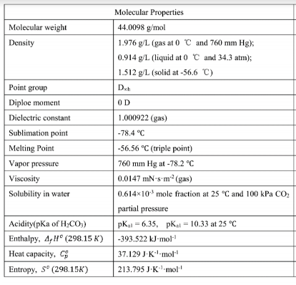
Properties of CO2
Linear and stable molecule
C-O bond length 1.16A⁰
C-O bond strength D=532KJ/mol
D – Dissociation Energy to
break bond

Slide 6
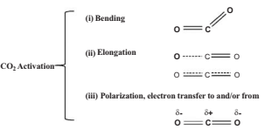
Activation of CO₂
CO₂ + e⁻ CO₂⁻ ; E⁰=-1.9V vs NHE
CO₂ molecule is high oxidation product
∆G⁰ = -394KJ/mol
CO₂ absorb on metal surface by different
ways
Fig.- possible ways of adsorption of CO₂ on semiconductor surfaces
Fig.- CO₂ activation Types

Slide 7
Limitations
Based on Photocatalytic process-
Electron transfer steps
Photon absorption
Charge separation
Surface reaction
Electron-hole recombination
By illuminated Beam-
Scattering
reflecting
Efficiency based-
Quantum efficiency
Turnover rate
Turnover number
Turnover frequency

Slide 8
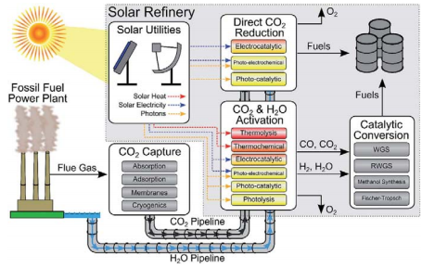
Photocatalytic Reduction of CO₂
CO₂ + H₂O ^{hν} CO, CH₃OH, CH₄
Fundamentals of Photocatalysis
Diffusion of the reactant to the catalyst
Adsorption of reactant
Chemical reaction
Desorption of product
Diffusion of Product
Fig.-Schematic representation of a futuristic solar refinery for the transformation and utilization of CO₂ using sunlight and H₂O

Slide 9
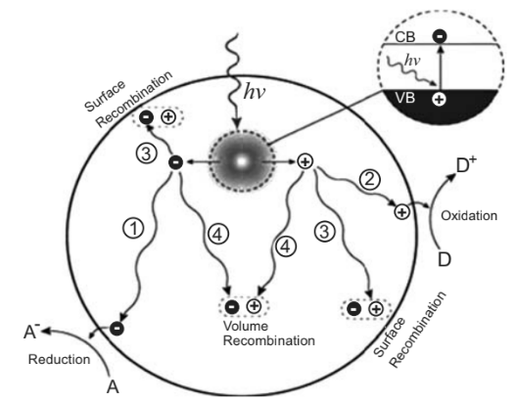
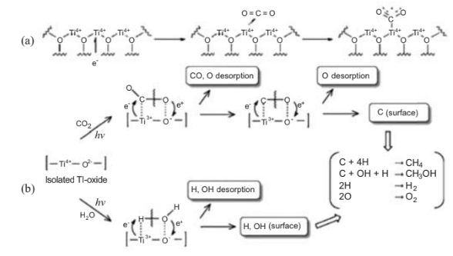
Fig.- photo induced generation of electrons and holes and their reaction cum recombination pathways
Fig.- (a) bending and concurrent the formation of CO₂(-) of CO₂ on TiO₂ surfaces
(b) Photocatalytic reduction of CO₂ on the anchored TiO₂ species

Slide 10
TiO₂ Rut
TiO₂ and its modification have been matter of attraction since the publication of the work by Teichner and Coworkers in 1971 followed by Fwjishima’s breakthrough article in 1972
All possibilities like zeolite, grapheme, carbon nanotubes, qunantum dots incorporated in the TiO₂ matrix for increasing the photoactivity towards the visible light region.
TiO₂ found in nature as the minerals
Rutile
Anatase
Brookite
Anatase form of TiO₂ is mostly used for CO₂ reduction and its conduction band lies at -0.1V(pH7)
Anatase band gap around 3.2eV

Slide 11
Year | Rutile (eV) | Anatase (eV) | Brookite (eV) | TiO2 (B) (eV)
2008 | 3.01-3.37 | 3.20-3.53 | 3.13-3.56
2018 |  |  | 3.45
2014 |  | 3.2 |  | 3.0-3.2
2012 | 3.0 | 3.2 | 3.03,3.05,3.13
2014 | 3.0 | 3.2 |  | 3.29
2013 | 3.03 | 3.2
Table :- Literature on the band gaps of rutile, anatase, and brookite

Slide 12
Current scenario
Maximum yield has been reached up to some micromoles.
Current scenario, 1.1*10⁸ Kg of TiO₂ would be required for production of methanol from CO₂ and H₂O by production rate = 1Kg/sec.
Assuming
catalyst activity = 1μmol_{product}/g_{cat}.h

Slide 13
Photocatalyst | Product (yield, μl /h g_{cat.} | year
TiO₂ Anatase film | CO(240) | 2012
Au (0.25%)/ Pt(0.75%)/TiO₂(nanofiber) | CH₄ (110) CO(54) | 2013
Cu/Pt₂ /TiO₂ nanotube | CH₄ (166) | 2012
Au (1.5%)/ TiO₂ | CH₄ (210) | 2014
Pt(0.21%)/ TiO₂ | CH₄(420) | 2012
Pt (0.94%)/ TiO₂ | CH₄(1400) | 2012
Au/ Pt-TiO₂ nanotube | CH₄ (114), CO(17) | 2013
CdS/TiO₂ nanotubes | CH₃OH(159.5) | 2012
Table-Some Literature data of Photocatalytic reduction of CO₂ with product irrespective of the reaction conditions

Slide 14
Conclusion
CO₂ reduction is a promising route to the sustainable solar energy conversion.
But still the existing level of knowledge does not permit the design of economically viable process for the conversion CO₂ into chemicals and fuels.
The material development and the lack of a standard procedure has been the bottleneck.

Slide 15
References
Hariprasad Narayanan, Balasubramanian Viswanathan, photocatalytic Reduction of CO2 ; Issues and prospects, 2016
Hariprasad Narayanan, M V Harindranathan Nair, Balasubramanian Viswanathan, On the current states of the mechanistic aspects of photocatalytic reduction of CO2; March 2017, Vol.56A,251-269.
Ciamician, G. The Photochemistry of the Future, Science, 1912, 36, 385-394.
Fujishima, A.; Honda, K. Electrochemical Photolysis of Water at a Semiconductor Electrode. Nature, 1972, 238, 37 – 38.
Gravelle, P. C.; Juillet, F.; Meriaudeau, P.; Teichner, S. J. Surface Reactivity of Reduced Titanium Dioxide. Discuss. Faraday Soc., 1971, 52, 140.
Formenti, M.; Juillet, F.; Meriaudeau, P.; Teichner, S. J.; Vergnon, P. Preparation in a Hydrogen-Oxygen Flame of Ultrafine Metal Oxide Particles: Oxidative Properties Toward Hydrocarbons in the Presence of Ultraviolet Radiation. J. Colloid Interface Sci., 1972, 79–89.
Nakamura, S.; Hatakeyama, M.; Wang, Y.; Ogata, K.; Fujii, K. In: Advances in CO2 Capture, Sequestration, and Conversion, ACS Symposium Series, American Chemical Society: Washington, 2015; 123-134
Tu, W.; Zhou, Y; Zou, Z. Photocatalytic conversion of CO2 into Renewable Hydrocarbon Fuels: State-of-the-Art- Accomplishments, Challenges, and Prospects. Adv. Mater., 2014, 26, 4607- 4626.
White, J. L.; Baruch, M. F.; Pander III, J. E.; Hu, Y.; Fortmeyer, I. C.; Park, J. E.; Zhang, T.; Liao, K.; Gu, J.; Yan, Y. Light-Driven Heterogeneous Reduction of Carbon Dioxide: Photocatalysts and Photoelectrodes. Chem. Rev., 2015, 115, 12888–12935.
Mori, K.; Yamashita, H.; Anpo, M. Photocatalytic Reduction of CO2 with H2O on Various Titanium Oxide Photocatalysts. RSC Adv., 2012, 2, 3165-3172
Linseblinger, A. L.; Lu, G.; Yates, J.T. Photocatalysis on TiO2 Surfaces: Principles, Mechanisms, and Selected Results. Chem.Rev. 1995, 95, 735–758.
Wang, W. N.; An, W. J.; Ramalingam, B.; Mukherjee, S.; Niedzwiedzki, D. M.; Gangopadhyay, S.; Biswas, P. Size and Structure Matter: Enhanced CO2 Photoreduction Efficiency by Size-Resolved Ultrafine Pt Nanoparticles on TiO2 Single Crystals. J. Am. Chem. Soc., 2012, 134, 11276–11281.
Zhang, Z.; Wang, Z.; Cao, S. W.; Xue, C. Au/Pt NanoparticleDecorated TiO2 Nanofibers with Plasmon-Enhanced Photocatalytic Activities for Solar-to-Fuel Conversion. J. Phys. Chem. C, 2013, 117, 25939–25947.

Slide 16
Reyes-Coronado, D., Rodr´ıguez-Gattorno, G., Espinosa-Pesqueira, M. E., Cab, C., Coss, R. D., Oskam, G. (2008). Phase-pure TiO2 nanoparticles: anatase, brookite and rutile. Nanotechnology,19(14), 145605.
Alotaibi, A. M., Sathasivam, S., Williamson, B. A., Kafizas, A., Sotelo-Vazquez, C., Taylor, A., . . . Parkin, I. P. (2018). Chemical Vapor Deposition of Photocatalytically Active Pure Brookite TiO2 Thin films. Chemistry of Materials.
Chimupala, Y., Hyett, G., Simpson, R., Mitchell, R., Douthwaite, R., Milne, S. J., Brydson, R. D. (2014). Synthesis and characterization of mixed phase anatase TiO2 and sodium-doped TiO2 (B) thin films by low pressure chemical vapour deposition (LPCVD). RSC Adv.,4(89), 48507-48515
Lin, H., Li, L., Zhao, M., Huang, X., Chen, X., Li, G., Yu, R. (2012). Synthesis of High-Quality Brookite TiO2 Single-Crystalline Nanosheets with Specific Facets Exposed: Tuning Catalysts from Inert to Highly Reactive. Journal of the American Chemical Society,134(20), 8328-8331.
Kim, D., Kim, W., Kim, S., Hong, S. (2014). Brookite TiO2 Thin Film Epitaxially Grown on (110) YSZ Substrate by Atomic Layer Deposition. ACS Applied Materials & Interfaces,6(15), 11817-11822.
Scanlon, D. O., Dunnill, C. W., Buckeridge, J., Shevlin, S. A., Logsdail, A. J., Woodley, S. M.,. . . Sokol, A. A. (2013). Band alignment of rutile and anatase TiO2 . Nature Materials,12(9), 798-801.

Slide 17
Thank You

