Slide 1

PROJECT PRESENTATION for M.Tech in Catalysis Technology
on
Kinetic Study of Fast Pyrolysis of Biomass
Presented by:-
Vikash Kumar Candravanshi (CA18M007)

Slide 2
OUTLINE
1.1. Objective
Why Reaction Kinetics?
How to do this?
2. Theoretical Approach (Using GAUSSIAN)
pyrolysis of β-D-glucopyranose( a recyclable monomer of cellulose molecule)
Calculation methods
Design of Reaction Pathways
Results and Discussion
Themodynamic Properties at Standard Condition
IRC Plot
Kinetic Parameters and Imagenry Frequency of TS
3. Experimental approach
Lumped Kinetic Modelling Of Pyrolysis of Cellulose
Ressults Obtained (Using Matlab)
4. Future Work
5.Reference

Slide 3
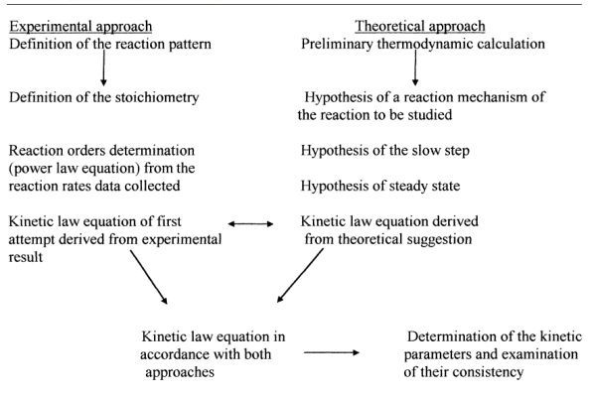
1.OBJECTIVE
Why Reaction Kinetics?
1. | Interpretation of reaction mechanisms and of the molecular behaviour
2. | Interpretation of catalytic phenomena,
3. | Optimisation of catalysts formulations,
4. | Development of new chemical processes and
5. | Reactors modelling and simulation.
How to Do this?

Slide 4
Introduction
In order to understand cellulose pyrolysis mechanism, the pyrolysis of β-D-glucopyranose( a recyclable monomer of cellulose molecule) was investigated.(based on exrimental studies)
Cellulose ( nearly 50% of biomass), so widely used as representative of biomass to investigate the distribution of products and the change in the typical products under different reaction conditions for various feedstocks.
Fast Pyrolysis of Cellulose produce main components of bio-oil are organic compounds such as levoglucosan, glycolicaldehyde, acetol, 5-hydroxy methyl furfural and 3,4-anhydroaltrose.

Slide 5

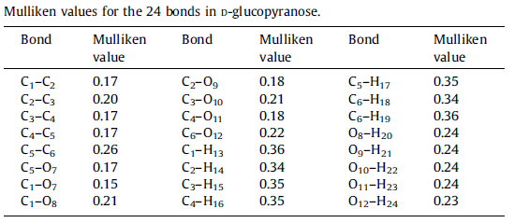

Cellulose model compound (D-glucopyranose)

Slide 6
Calculation methods
Programs:- Gaussian 16 suite.
Theory:- B3LYP (Becke’s three parameter gradient corrected exchange functional with the gradient corrected correlation functional of Lee et al)
Basis set:- 6-31++G(d,p)
The transition states were located by TS method and were confirmed by visual inspection of the imaginary frequency using Gaussview and by IRC calculations.
Standard thermodynamic changes in energy were calculated which is energy differences between the reactants and the products, including the ZPE.

Slide 7
Design of Reaction Pathways
Pathway_1
TS1
Levoglucosen(P1)
TS2
Pathway_2
D-Glucopyranose (R)
3,4-Anhydroaltrose(P2)

Slide 8
Pathway_3 (R to P3) and Pathway_4(P3 to P4)
Continue...
TS3
TS4
IM1
IM2
D-Glucopyranose (R)
TS5
TS7
TS6
FurFural (P4)
Hydroxy Methyl Furfural (P3)
IM3

Slide 9
Results and Discussion
1. Themodynamic Properties at Standard Condition in Hartree:-
Reaction Pathway | SPECIES | Hᶿ(Hartree) | Gᶿ (Hartree) | ∆Hᶿ(KJ/mol) | ∆Gᶿ(KJ/mol)
 | R | -687.018327 | -687.070118 | - | -
Pathway_1 | P1 | -610.592078 | -610.637228 | 15.09 | -24.54
Pathway_2 | P2 | -610.594272 | -610.645669 | 93.33 | 37.62
Pathway_3 | P3 | -457.788669 | -457.831802 | 36.38 | -144.82
Pathway_4 | P4 | -343.284601 | -343.320599 | 60.18 | 12.02
 | H2O | -76.409076 | -76.431159 | - | -
 | HCOH | -114.481144 | -114.506625 | - | -

Slide 10
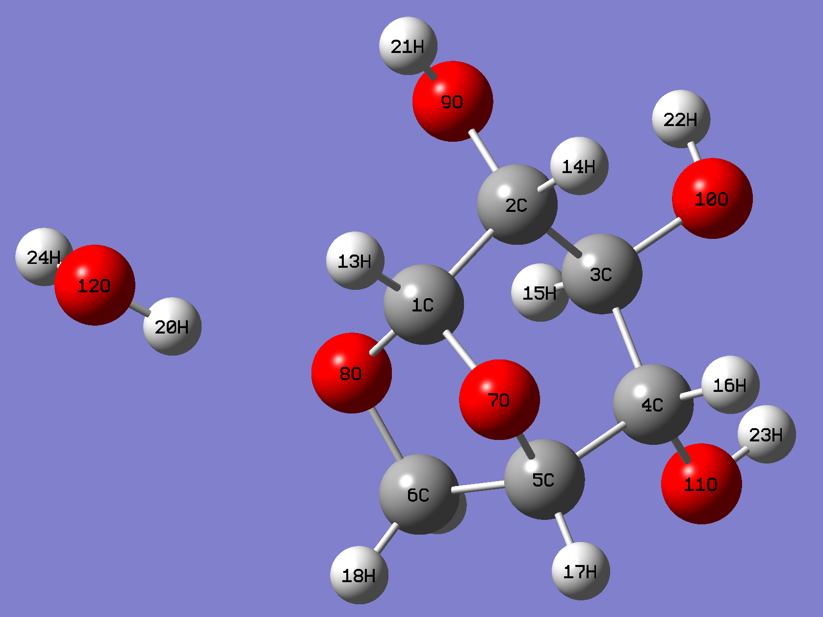
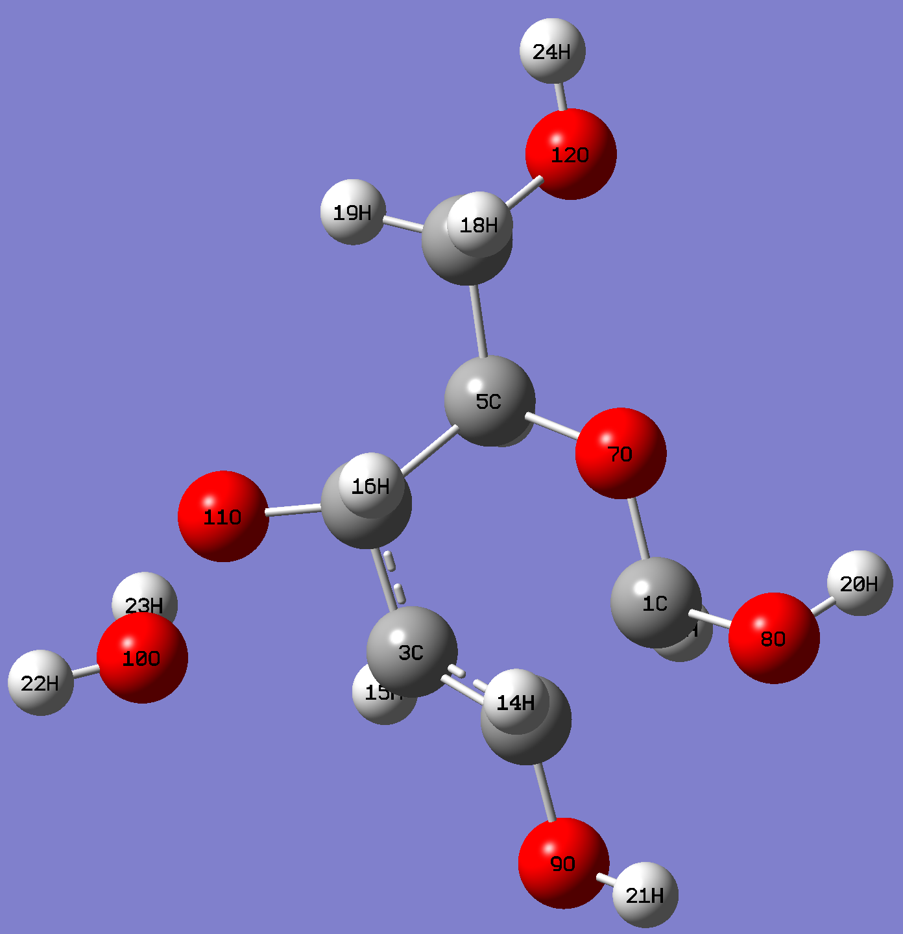
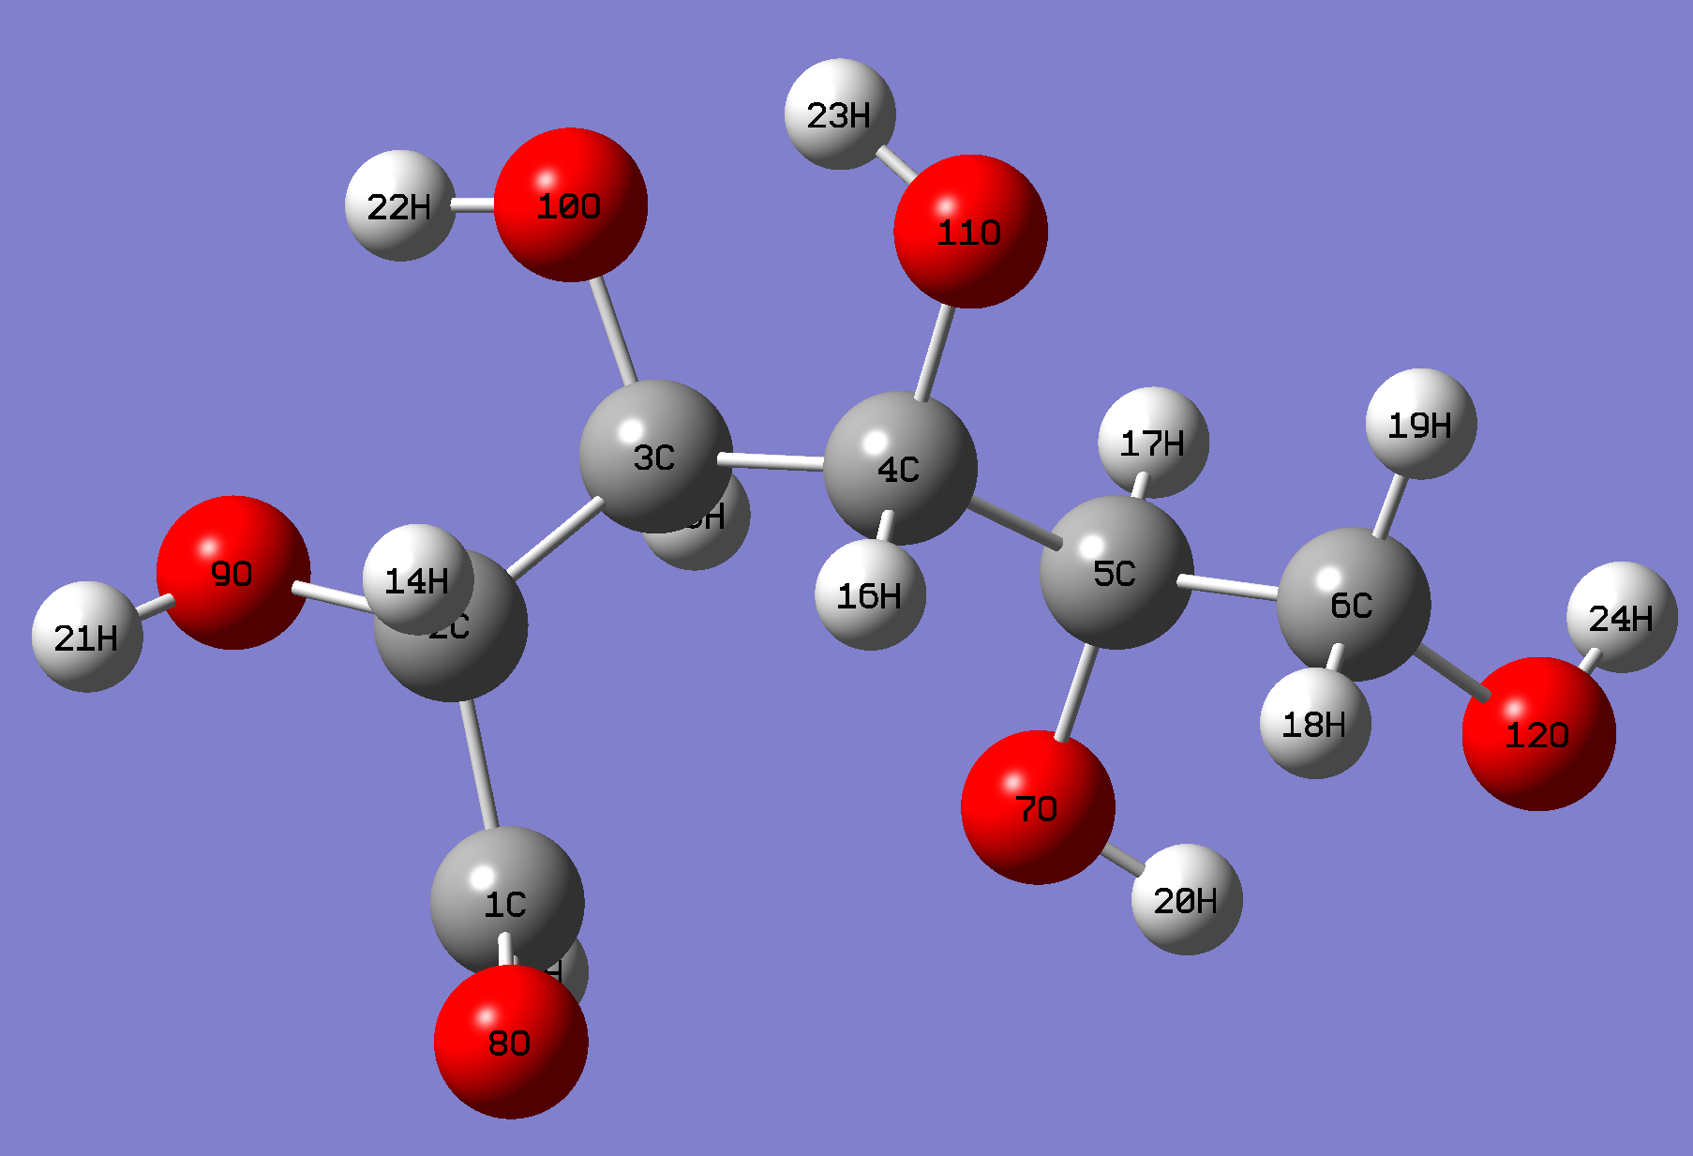
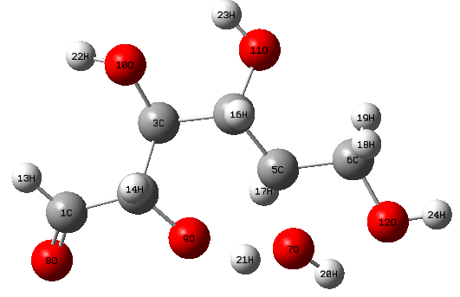
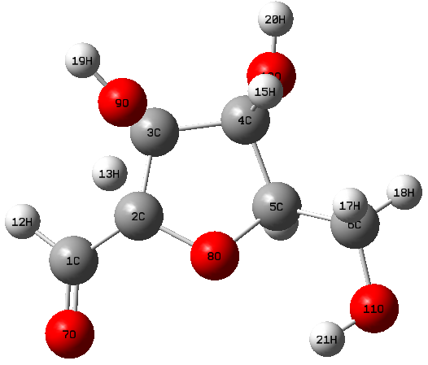
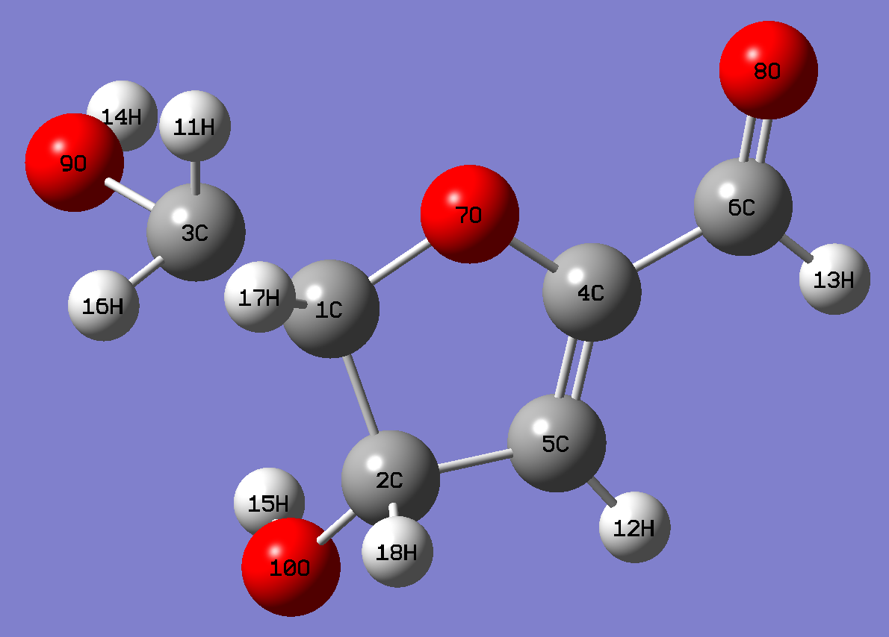
Optimized Transtion states:-
TS1
TS2
TS3
TS4
TS5
TS6

Slide 11
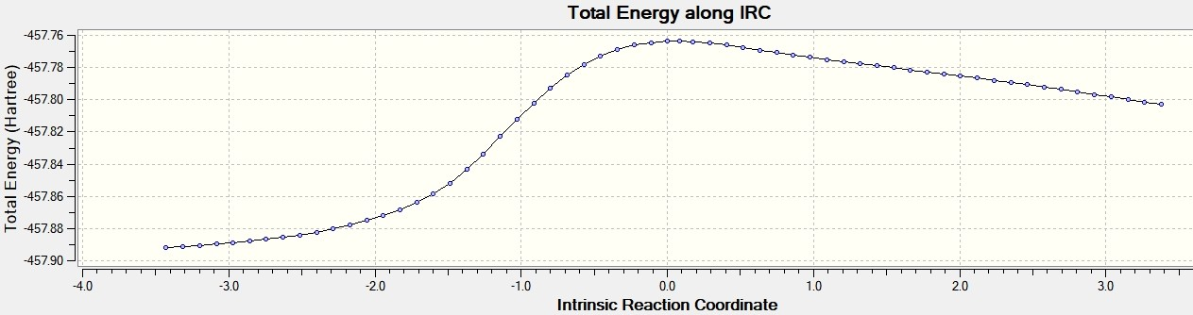
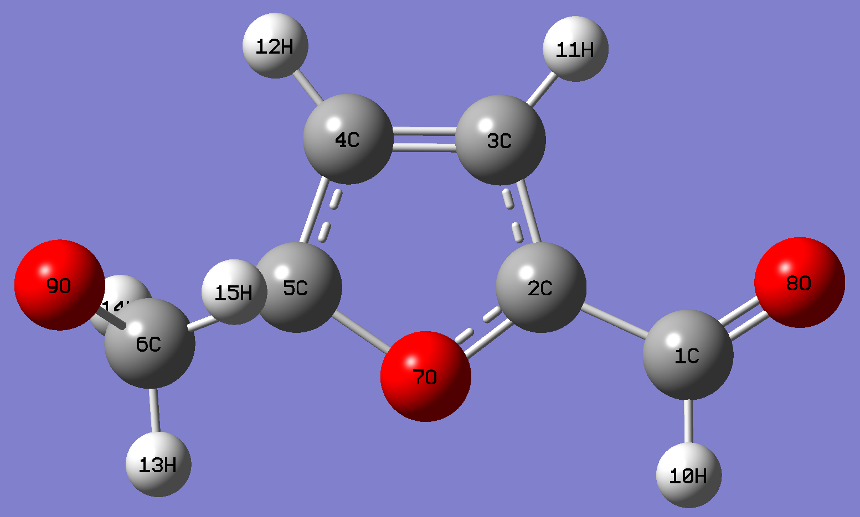
1. IRC Plot :-
Results and Discussion
TS7
Fig.1:- IRC Plot for Pathways-4 using TS7 taking 30 maxpoints
Total Energy along Intrinsic Reaction Coordination for pathways_4

Slide 12
Continue...
Kinetic Parameters and Imagenry Frequency of TS at standard condition:-
Kinetic Parameters | Pathwa y-1 | Pathway-2 | Pathway-3 |  |  |  | Pathway-4
 | TS1 | TS2 | TS3 | TS4 | TS5 | TS6 | TS7
∆Eᶿ≠ | 256.45 | 327.6 | 182.4 | 294 | 233 | 210 | 322
∆Hᶿ≠ | 253.82 | 331.7 | 182.89 | 294.46 | 239 | 210.82 | 324
∆Gᶿ≠ | 259.41 | 317.5 | 183.2 | 295 | 237.8 | 210.51 | 328

Slide 13
Conclusion
Deduced mechanism of reaction pathways in cellulose pyrolysis provides insight into the pyrolysis behavior of cellulose and allows modification of previously proposed related mechanisms.
Thermodynamic data suggest that high amount of heat is required and have very low conversion for pathways 2 and pathway 3 is most favourable pyrolytic pathway and have highest conversion (based on ∆Hᶿand ∆Gᶿ).
IRC plot of Pathway 4 refers that TS7 is 1st order saddle point and it will converge to reactant and product.
Similar Approach is Applied for Kinetic Study of Homogeneous Catalytic Reactions.

Slide 14
Lumped Kinetic Modelling Of Pyrolysis of Cellulose
A Kinetic Model for Pyrolysis of Cellulose (BRADBURY et al)
A simple three reaction, kinetic model could describe the pyrolysis data obtained at low pressure (1.5 Torr) in the temperature range 259-341°C.
It is assumed that an “initiation reaction” leads to formation of an “active cellulose” which subsequently decomposes by two competitive first-order reactions, one yielding volatiles and the other char and a gaseous fraction.

Slide 15
Rate constants of these reactions over the temperature range 259-341°C is given as:-
ki = 1.7e21*exp(-58,000/RT)) min-1
kv = 1.9e16*exp(- 47,300/RT) min-1, and
kc= 7.9e11*exp(- 36,600/RT) min-1
Assumptions:-
It was assumed that reaction during cooling of sample was negligible.
rate of pyrolysis, as followed by weight loss under isothermal conditions
Reproduced results by using Matlab :-
(For actual results Paper is Attached below ppt)

Slide 16
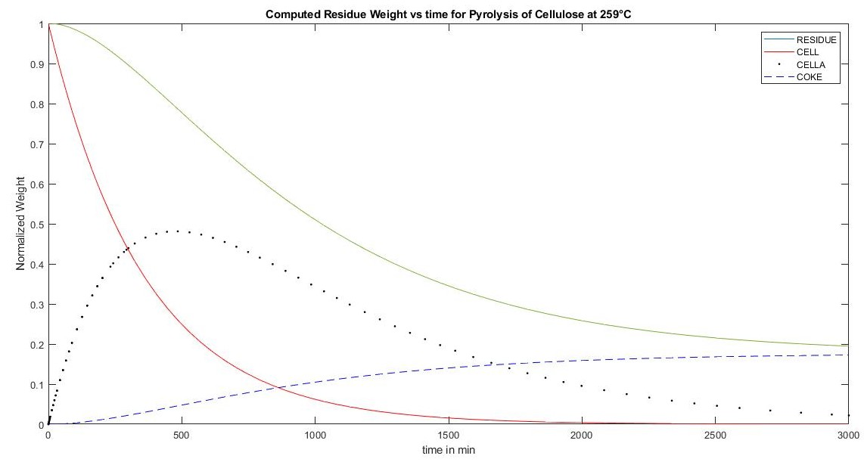
1. Comparison of experimental data to residual weight predicted from reaction mode1 for Tf = 259 °C. WRESIDUE, WCell, WCELLA, and W, are predicted weights.(Figure-6 of Paper)

Slide 17
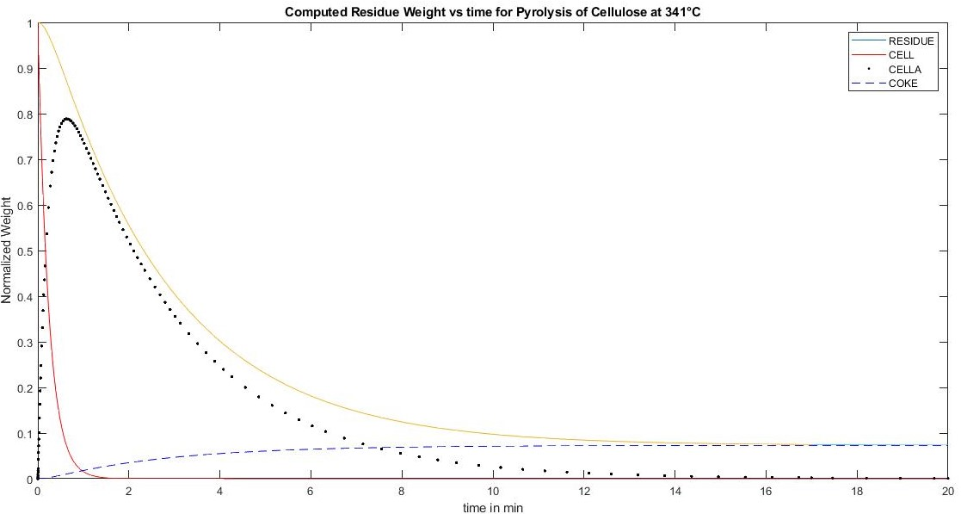
2. Comparison of experimental data to residual weight predicted from reaction mode1 for Tf = 341 °C. WRESIDUE, WCell, WCELLA, and W, are predicted weights. .(Figure-9 of Paper)

Slide 18
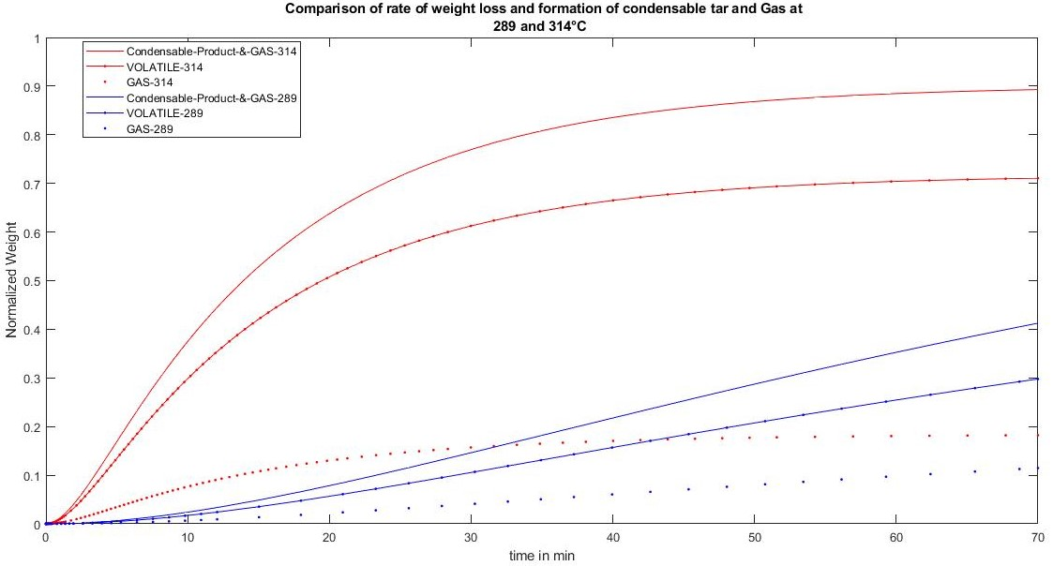
3. Product distribution of Pyrolysis of Cellulose at 289 and 314 °C .(Figure-10 of Paper)
In paper they also plot for the variation in concentration of Levoglucosan with time. I do not able to interpret this Result. Instead of Levoglucosan Yield I have plotted the result for GAS yield.
Volatile yield is Tar yield of the Paper.

Slide 20
Future Work
1. Optimize the Catalyst Used in the experiments based on the Mechanistic kinetic Modelling of available experimental Data.
2. Perform experiments to verify the Lumped kinetic modelling of fast catalytic Pyrolysis of biomass.
3.Add Extractives, Left Metaplastic and Water Evaporated in Reaction kinetics of Biomass which will provide broad picture of Biomass pyrolysis reactions.
4.Interpretation of Role of catalyst on yield of different products from experimental data and kinetic modelling.
5.Effect of catalyst on Selectivity of different products .

Slide 21
Reference:-
S. Wang et al. /DFT study of β-D-Glucopyranose/ Bioresource Technology 104 (2012) 722–728
Bradburry et al/ Journal of Applied Polymer Science, Vol. 23,3271-3280 (1979)
Eliseo Ranzi, Alberto Cuoci, Tiziano Faravelli, Alessio Frassoldati, Gabriele Migliavacca, Sauro Pierucci, and Samuele Sommariva Energy Fuels, 2008, 22 (6), 4292-4300
Eliseo Ranzi et al /Mathematical Modeling of Fast Biomass Pyrolysis and Bio-Oil Formation. Note I: Kinetic Mechanism of Biomass Pyrolysis /ACS Sustainable Chem. Eng. 2017, 5, 2867−2881

Slide 22
Thank You!

