Slide 1
Direct conversion of methane to methanol by iron exchanged MFI Zeolite
May – June,2019

Slide 2
Industrial Routes
Indirect Route
Methane
Steam Reforming
Syn gas
Reactor
Methanol
∆H_{R} = + 206 kJ mol⁻¹
∆H_{R} = - 92 kJ mol⁻¹
Direct Route
O₂
Direct Partial Oxidation Process
Methane
Methanol
∆H_{R} = - 126 kJ mol⁻¹

Slide 3
Selected catalyst for various routes of MeOH synthesis
Direct Partial Oxidation of Methane | Active catalyst | Oxidant | X_{methane} (%) | S_{MeOH} (%) | Yield (µmol g_{cat}⁻¹)
Willox et al | V₂O₅/SiO₂ | N₂O | 0.07 | 56.7
Hutchings et al | H-ZSM-5 | H₂O₂ | 0.3 | 19
Hutchings et al | Fe-ZSM-5(30) | H₂O₂ | 0.7 | 12 | 22
Hutchings et al | 2.5% Fe - ZSM-5(30) with 10umol of Cu²⁺ | H₂O₂ | 0.7 | 85 | 140
Hutchings et al | Fe-Silicalite-1 / Cu-Silicalite-1 | H₂O₂ | 10 | 93 | 168
Van Bokhoven et al | Cu-MOR | O₂ |  |  | 84.3
R. F. Lobo et al | Cu-MOR | H₂O |  | 97%
Hutchings et al | AuPd/TiO₂ | H₂/O₂ |  | 68.2 | 46.1

Slide 4
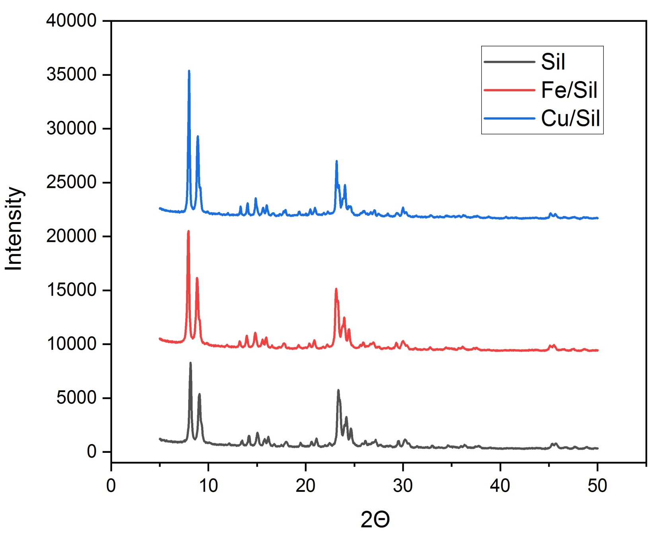
X-ray Diffraction Pattern of metal exchanged Silicalite-1

Slide 5
N₂ adsorption isotherms and textural properties
Sample | S_{BET} (m² /g) | V_{P} (cm³ /g)
Un calcined Fe-Silicalite-1 | 196 | 0.086
Calcined Fe-Silicalite-1 | 286 | 0.111
Pore Size Distribution of calcined Fe-Silicalite-1
dV/dD(a.u)
N₂ adsorption isotherm of (a) Uncalcined Fe-Silicalite-1 (b) Calcined Fe-Silicalite-1
r_{p} (nm)

Slide 6
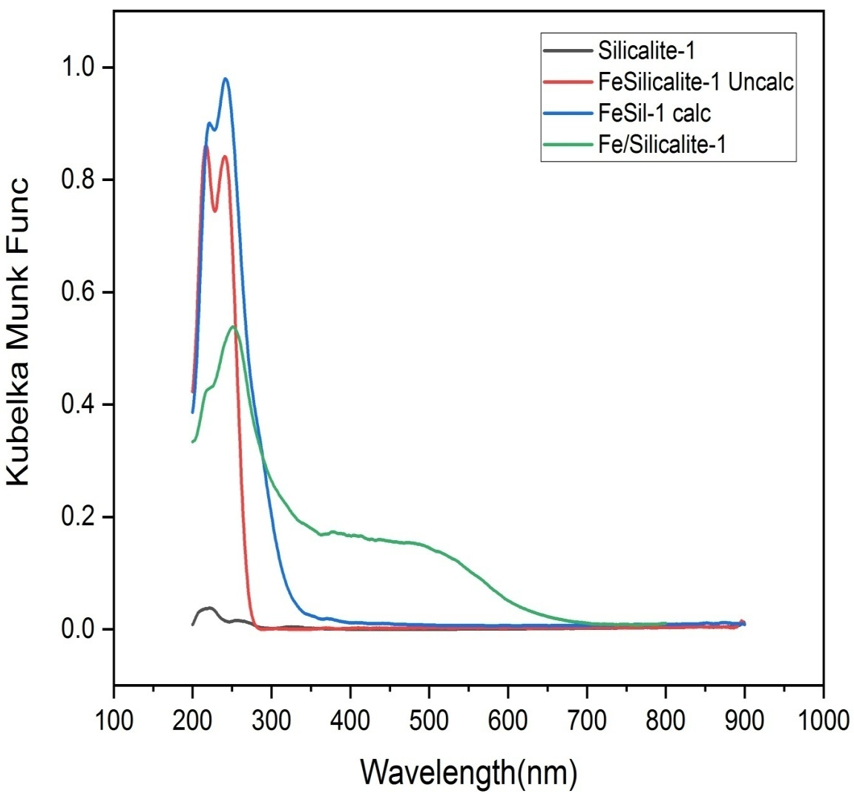
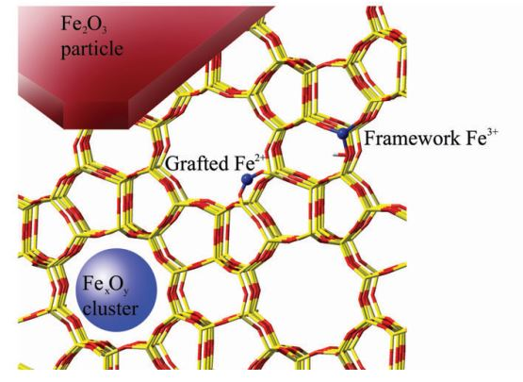
DRS-UV Spectra of Fe-Silicalite-1
A1 - Framework Fe
A2 - Extra-framework Fe
A3 - fine iron oxide clusters
A4 - bulk iron oxide
A₁
A₂
A₃
A₄
Bruckner et al., J. Catal., 227 (2004), pp. 384-397

Slide 7
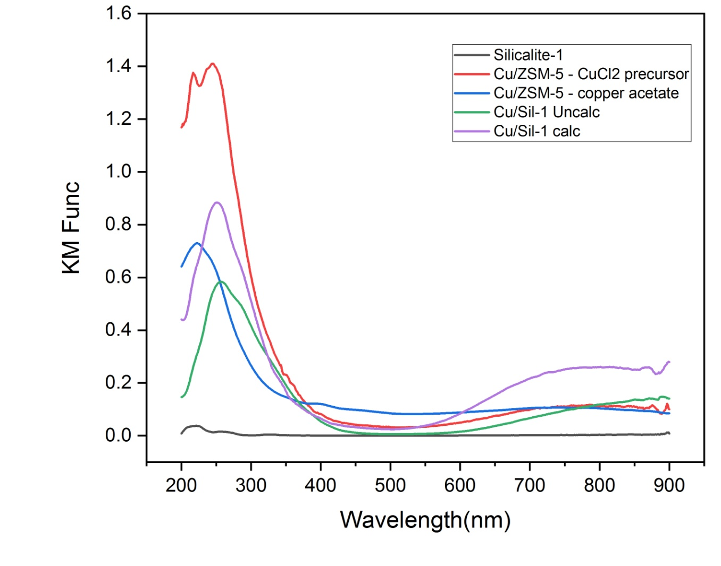
DRS-UV Spectra of Cu/Silicalite-1

Slide 8
Catalytic testing of 0.5wt% Fe-Silicalite-1
S.No | Pressure | Temperature | H₂O₂ (M) | Copper nitrate conc. (umol) | Methanol (umol)
1 | 3bar | 70ºC | 1 | 10 | 8
2 | 30bar | 50ºC | 0.5 | - | 15
3 | 30bar | 50ºC | 0.5 | 10 | 40
4 | 30bar | 50ºC | 0.5 | 15 | 55
Hutchings et al., Angew. Chem., Int. Ed., 2012, 51, 5129–5133

Slide 9
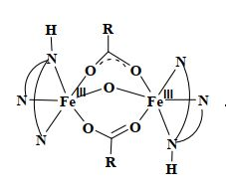
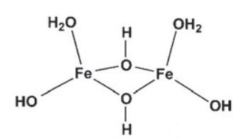
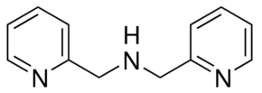
Active site – Iron Zeolite- complex
Ligand 3 – N,N-dimethyl-N-
(pyrid-2-ylmethyl) ethylenediamine
Ligand 1 – Diethylene triamine
Ligand 2 – Di-(2-picolyl) amine
Hutchings et al., Angew. Chem., Int. Ed., 2012, 51, 5129–5133

Slide 10
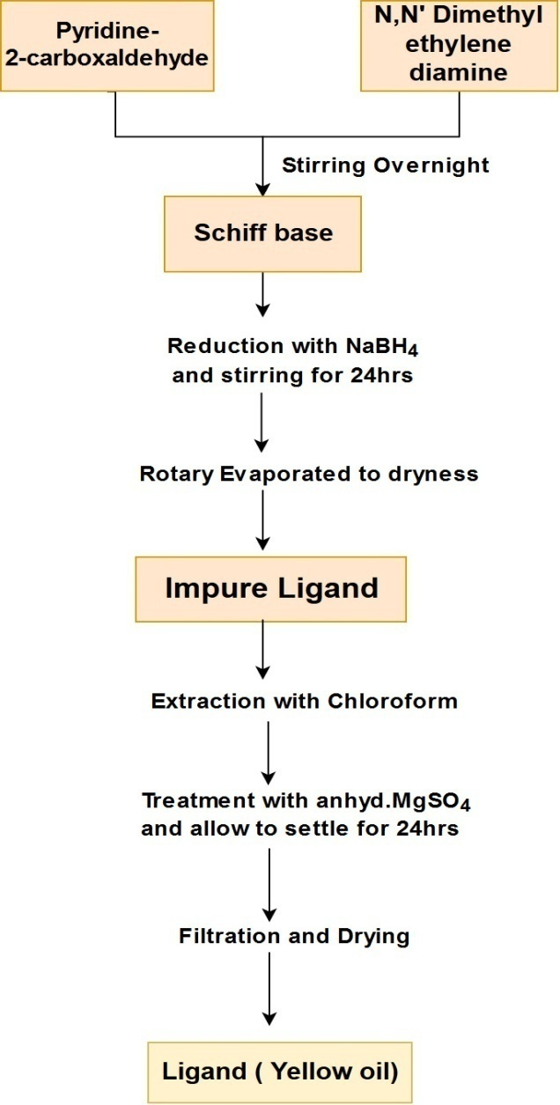
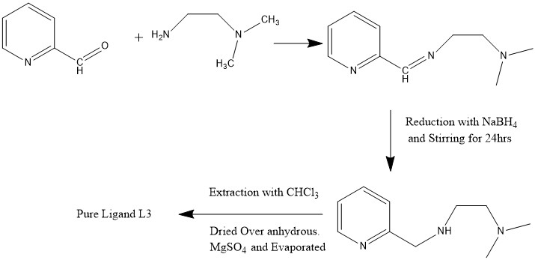
Preparation of Ligand L3
Impure Ligand L3
Dalton Trans., 2016, 45, 11422-11436

Slide 11
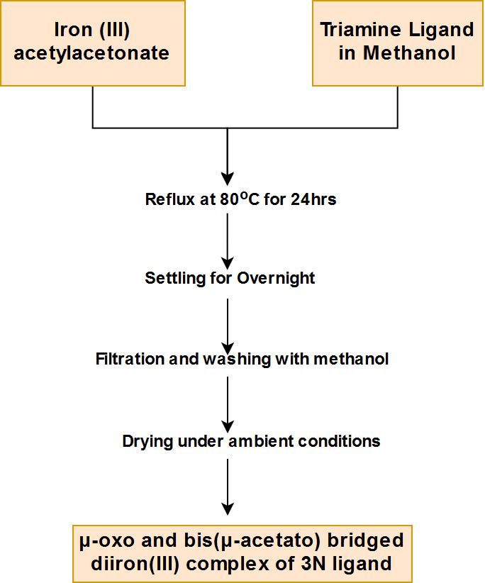
Preparation of diiron(III) complex
Dalton.Transac, 2016, 45, 11422-11436

Slide 12
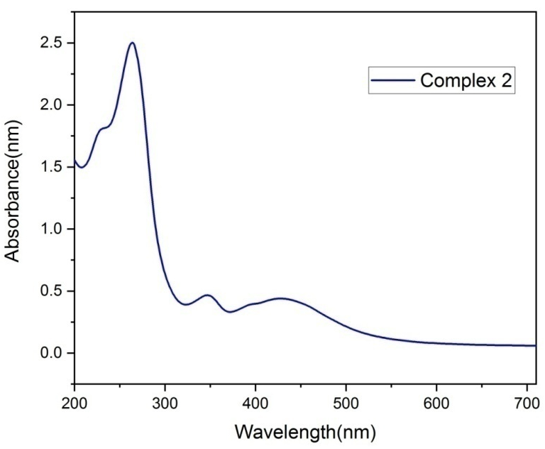
Electronic spectral data of [Fe₂O(OAc)₂(L)₂]²⁺ in acetonitrile
1
1
2
2
3
3
band no | Bridged complex 1 | Bridged complex 2 | Bridged Complex 3 | Assignment
1 | 268 | 263 | 265 | π π* (LLCT)
2 | 350 | 347 | 350 | n π* (LMCT)
3 | 437 | 428 | 432 | d-d transition [⁴ T₂ (⁴ D)]
J. Am. Chem. Soc., Vol. Ill, No. 21, 1989
Notes:
5 X 10⁻⁴ M

Slide 13
Bond vibrational modes of Neat Fe-Complex
Complex | v(NH₂ ) cm⁻¹ | v(COO⁻ ) free cm⁻¹ | v(COO) bridged cm⁻¹ | v(N-H ) cm⁻¹ | v(Fe-O-Fe) bridged cm⁻¹ | v(Fe-N ) cm⁻¹
Fe-L1 | 3140 | 1585 | 1445 | 1356,1048 | 760 | 442
Fe-L2 | - | 1571 | 1432 | 1353,1052 | 769 | 435
Fe-L3 | 3149 | 1560 | 1438 | 1351,1051 | 768 | 438
K Nakamoto - Handbook of Vibrational Spectroscopy, 2006 - Wiley Online Library

