Slide 1
Band alignments and Charge Transfer Possibilities in Hetero-Junctions Presentation In the Series of Scientific Discussions at NCCR Started on 19.10.2018 A Prologue and an Apology

Slide 2
The absolute positions of valence band and conduction bands in semiconductors are necessary for selecting the application of the semiconductor in a chosen photo(other)catalytic processes. This concept is being examined in the case of TiO₂ for most obvious reasons

Slide 3
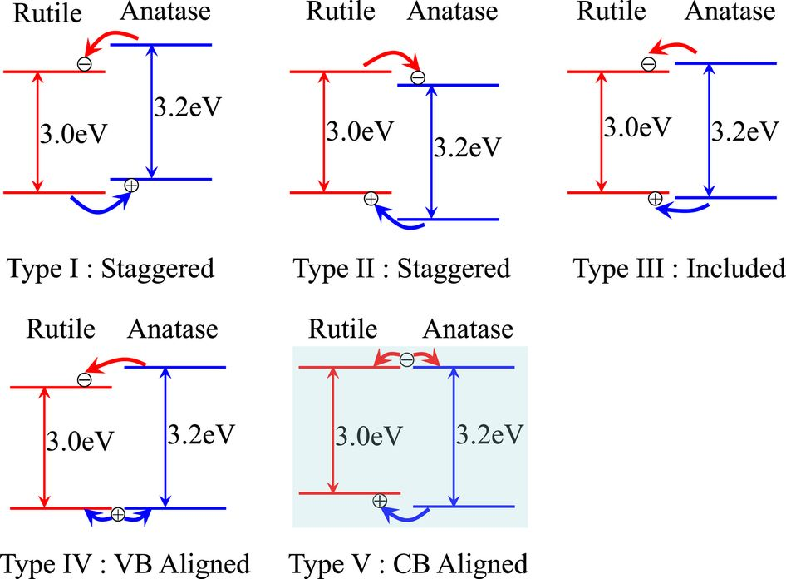

Slide 4
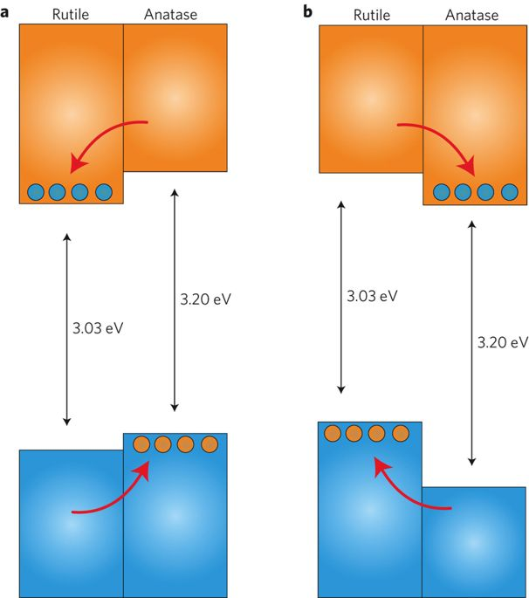

Slide 5
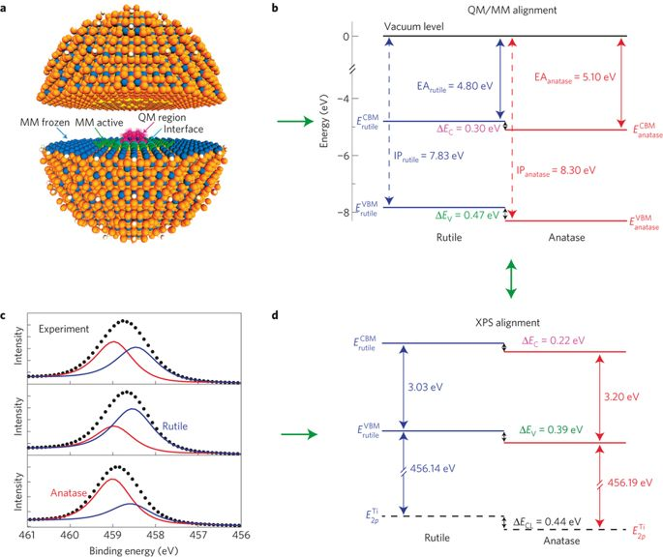

Slide 6
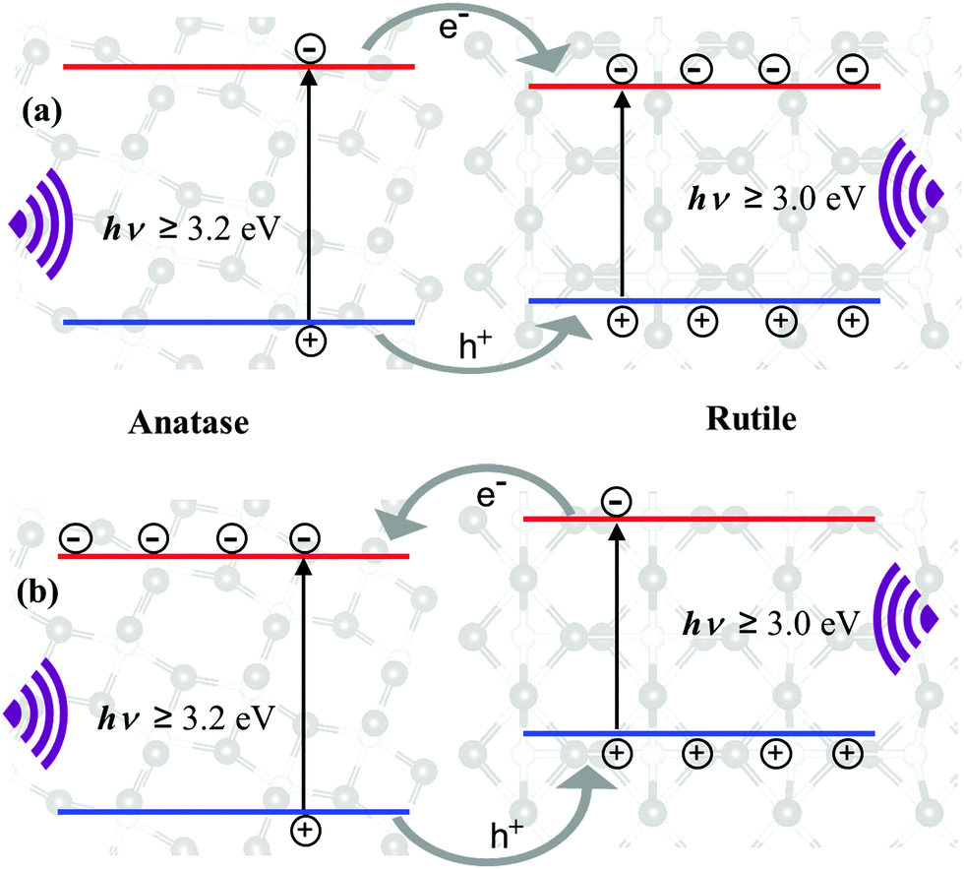

Slide 7
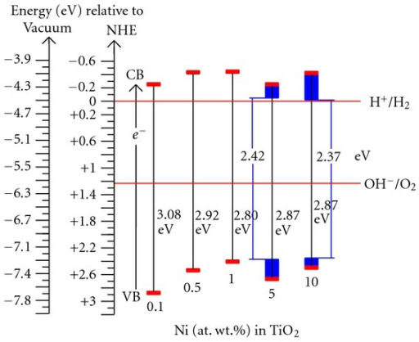

Slide 8
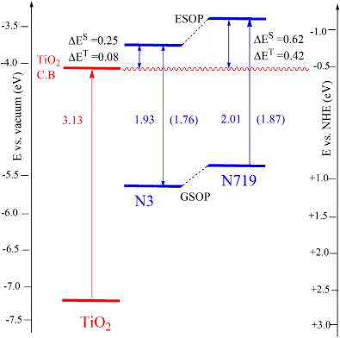

Slide 9
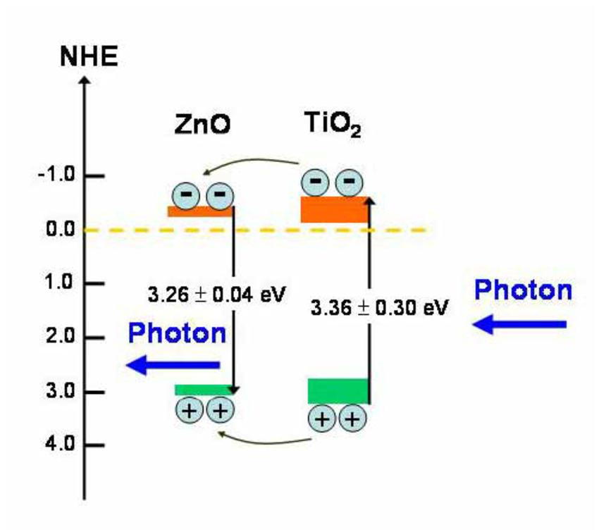

Slide 10
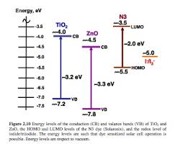

Slide 11
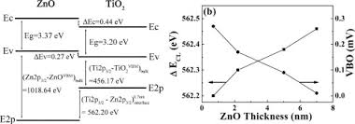
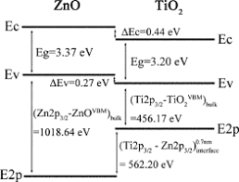

Slide 12
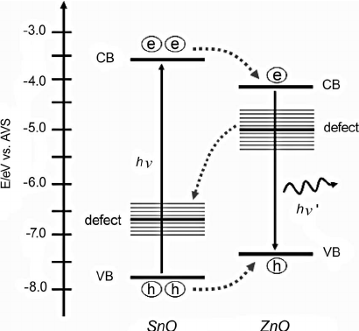

Slide 16
Among the many polymorphs of TiO2, rutile and anatase are the most studied. For the photocatalytic applications of these crystalline structures, the determination of the position of the energy levels is essential. The position of the valence band (VB) and the conduction band (CB) and the size of the optical band gap (Eg) are dependent on the crystalline phase. These parameters influence the number of photons absorbed upon illumination and the respective oxidation and reduction potentials of holes and electrons, generated by light. The presence of defects or dopants as well as the particle size may also play a key role and allow tuning the electronic properties of titania materials.

Slide 17
The relative positions of the energy levels determine the direction of the electronic transfer of a photocatalytic material based on a heterojunction between TiO2 and a meta1 or a semiconductor. Particular interest is also devoted to the materials composed of different titania phases. The most known one is Degussa P25 titania which is a mixture of rutile and anatase. The exact nature of its high photocatalytic activity still remains not completely understood, but the energy diagrams are obviously crucial to explain its properties.

Slide 18
The band alignment between the two phases in Degussa P25 was claimed to enhance charge carrier separation.15 However, there is a controversy in the literature concerning this band alignment. The band gaps of rutile and anatase TiO2 polymorphs are 3.0 and 3.2 eV, respectively. However, their relative position is still under debate. Three possibilities are generally discussed (Fig. 1)

Slide 19
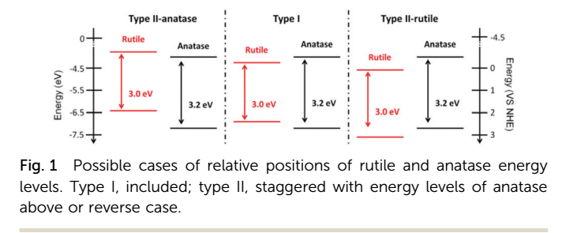
The energy levels of both phases can be included as Eg,rutile Eg,anatase (type I). It can also be a staggered alignment with the CB and the VB of anatase lying above those of rutile (type II-anatase) or with the CB and the VB of rutile lying above those of anatase (type II-rutile). The band positioning of type II-rutile or type I should induce an electronic transfer from anatase to rutile. For type II-anatase, the charge transfer is in the opposite direction

Slide 20
The first paper to advocate a type II-rutile alignment came from Mott–Schottky analysis by Kavan et al. This hypothesis was supported by experimental data and calculations. However, recently it was shown that the Mott–Schottky analysis is strongly influenced by the surface charges. Adsorption of ions at the surface of TiO2 leads to the appearance of a dipole layer which interferes with band alignment analysis provided by this technique

Slide 21
The hypothesis of the type II-anatase band alignment was mainly supported by XPS measurements The offset between the EVB of two phases was measured and then, the ECB offset is deduced from the known E g difference. Scanlon et al. reported a difference of 0.4 eV and Pfeifer et al. of 0.6–0.7 eV. Gao and co-workers claimed a similar band alignment using Kelvin probe force microscopy. This work has the particularity to evidence the band alignment for a real heterojunction, previously it was shown only on separate TiO2 phases.

Slide 22
Recent theoretical experiments support the type II-anatase band alignment but with a higher band offset. Ko et al. using the relativistic DFT calculation suggested that the type of alignment depends on the size of rutile and anatase particles. It means that sizes should be taken into account as well as the presence of surface states, impurities or structural defects. Indeed, between two powders, even within the same phase, these parameters can induce variation of the electronic structure. Therefore, clear and accurate experimental protocols are needed to determine the absolute electronic structure of any TiO2-based powder materials (extendable to any powder materials). To this day, no such protocol is reported in the literature. Two spectroscopic techniques were used, UV-Vis Diffuse Reflectance Spectroscopy (DRS) to study transitions from the VB to the CB and Ultraviolet photoelectron spectroscopy (UPS)

Slide 23
The UPS technique is extensively used to map out the valence (occupied states) of the semiconductors The UPS results obtained on the TiO2(001) monocrystalline surface highlight the formation of new structures with narrower band gaps after reductive or oxidative treatments or after nitrogen implantation. Formation of new electronic states located above the O 2p band after N-doping has been evidenced with this method. As another example, UPS on VOx/TiO2 (001) showed the presence of intermediate states near the Fermi level.
However, the most efficient TiO2 photocatalysts are not single crystals but nanopowders. Morphological and chemical differences may induce differences between the model materials, prepared under a controlled atmosphere and with a true electronic structure of powdered samples.

Slide 24
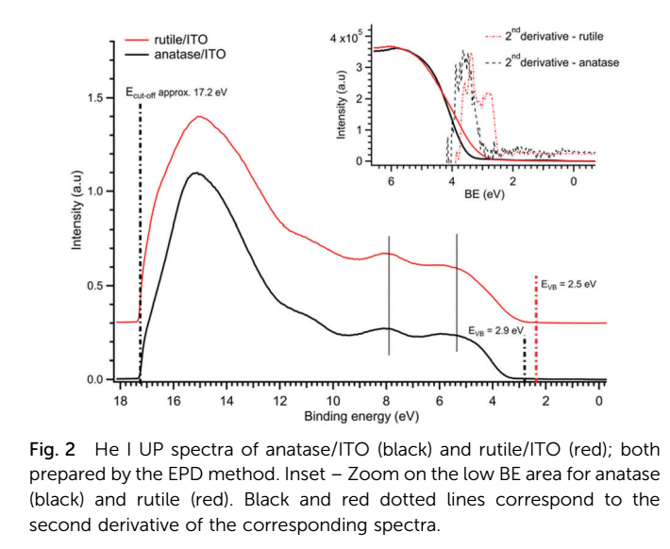

Slide 25
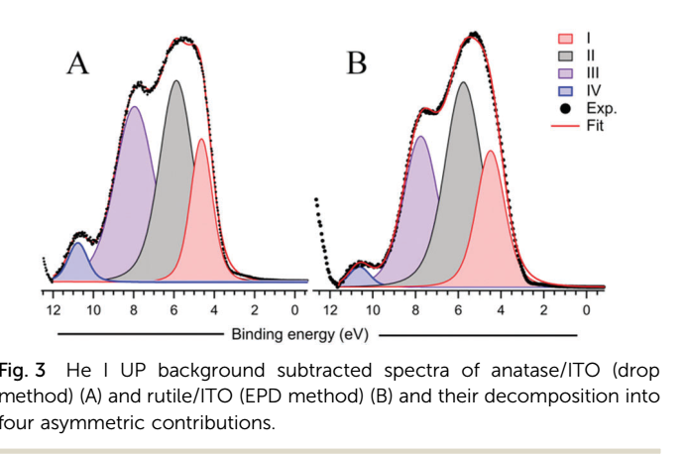

Slide 26
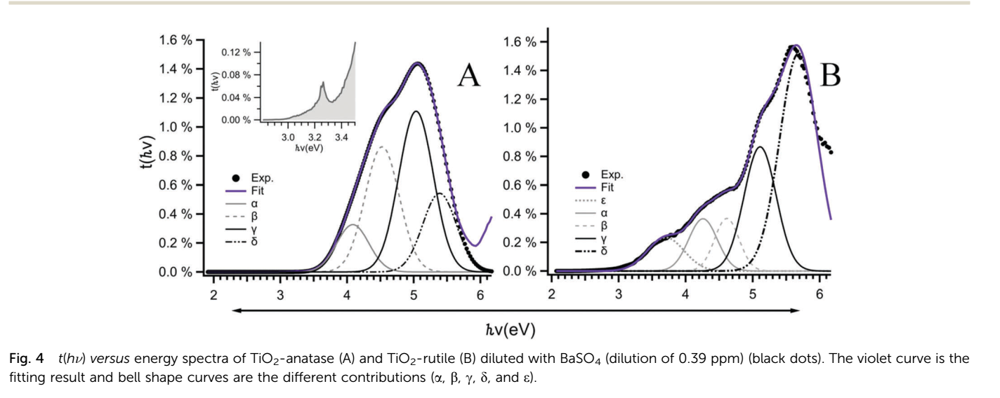

Slide 27
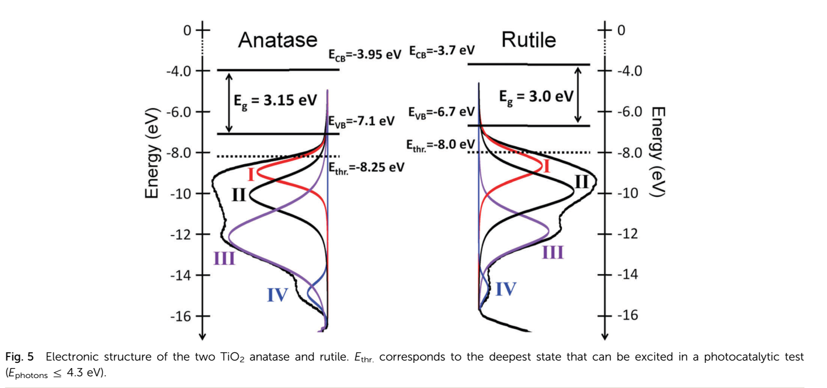

Slide 28
The powders of the two main polymorphs of TiO2, anatase and rutile, were studied by UPS and UV-Vis spectroscopies. Up to now, UPS on the powders has been only qualitatively interpreted. It can provide a quantitative description of the energy levels comprising the valence band. Combination of UV-Vis and UPS allowed positioning of the energetic levels and discussion of the electronic structures of the two solids. In the case of anatase and rutile powders the absolute EVB positions were measured at -7.1 eV and - 6.7 eV, respectively. The resulting electronic structure obtained one at a time for anatase and rutile supports the hypothesis of a type II-anatase energy band alignment. In a mixture of both polymorphs the transfer of the electrons from rutile to anatase particles should be favoured. Considering the photocatalytic experiments, efficient photoelectrons for this process are excited from the top of the VB, attributed to a narrow contribution originating from the non-bonding O 2p orbitals

Slide 29
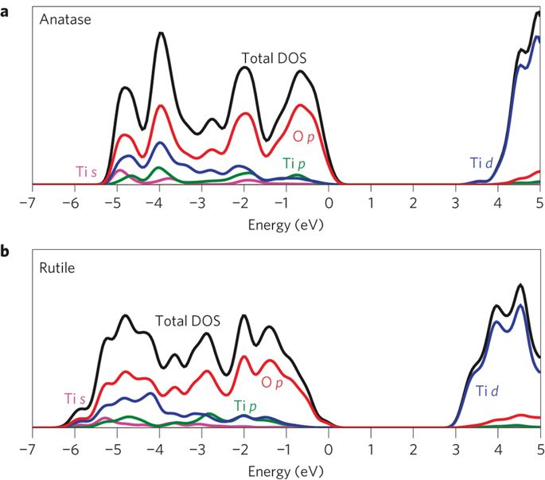

Slide 31
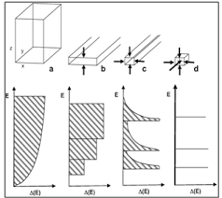

Slide 32
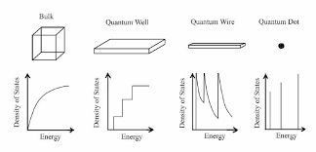

Slide 33
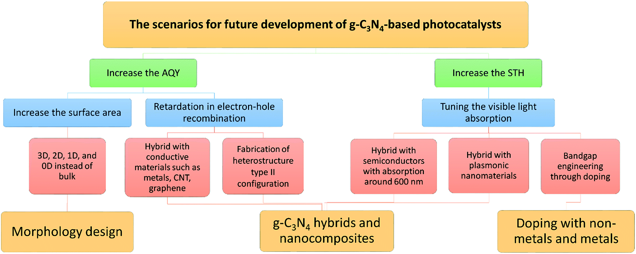

Slide 34
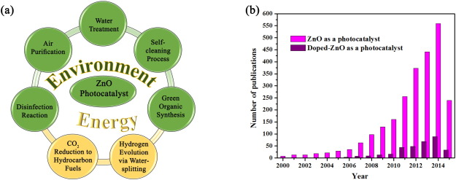

Slide 35
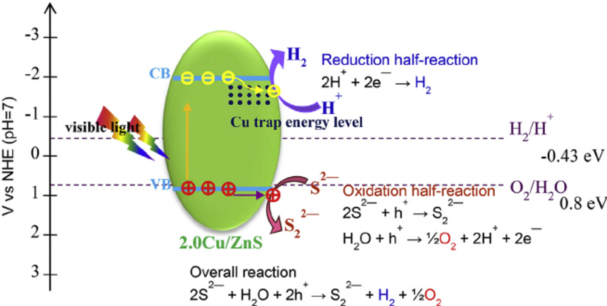

Slide 36
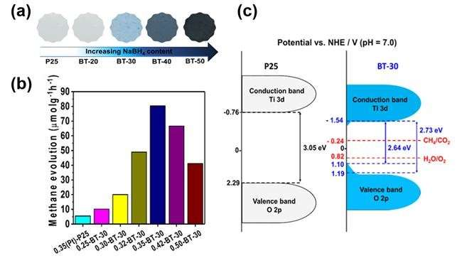

Slide 37
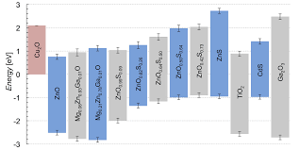

Slide 38
Using photoelectron spectroscopy, the interface formation of anatase and rutile TiO₂ with RuO₂ and tin-doped indium oxide (ITO) is studied. It is consistently found that the valence band maximum of rutile is 0.7 ± 0.1 eV above that of anatase. The alignment is confirmed by electronic structure calculations, which further show that the alignment is related to the splitting of the energy bands formed by the O 2p_{z} lone-pair orbitals. The alignment can explain the different electron concentrations in doped anatase and rutile and the enhanced photocatalytic activity of mixed phase particles.

Slide 39
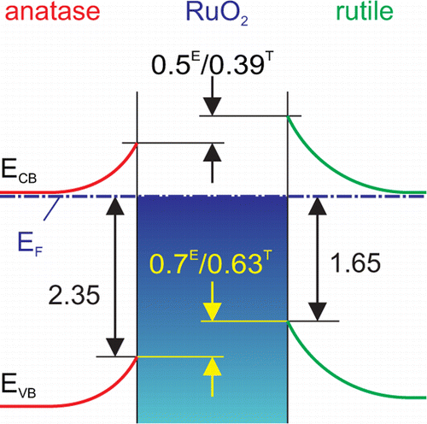

Slide 40
Table I. Theoretical electronic band gaps calculated by GW method reported in literatures. For rutile, “D” in the bracket means direct band gap energy and (I) in the bracket means indirect band gap energy.
Rutile 3.34(I)/3.38(D) 3.59(D) 3.40(D) 3.46(D)
Anatase 3.56 3.83 3.70 3.73 3.79
Brookite 4.45 3.68
Columbite Not given
Baddeleyite Not given
Cotunnite Not given
Pyrite Not given
Fluorite 2.367(2.369)

Slide 58
Using photoelectron spectroscopy, the interface formation of anatase and rutile TiO₂ with RuO₂ and tin-doped indium oxide (ITO) is studied. It is consistently found that the valence band maximum of rutile is 0.7 ± 0.1 eV above that of anatase. The alignment is confirmed by electronic structure calculations, which further show that the alignment is related to the splitting of the energy bands formed by the O 2p_{z} lone-pair orbitals. The alignment can explain the different electron concentrations in doped anatase and rutile and the enhanced photocatalytic activity of mixed phase particles.

Slide 60
Table I. Theoretical electronic band gaps calculated by GW method reported in literatures. For rutile, “D” in the bracket means direct band gap energy and (I) in the bracket means indirect band gap energy.
Rutile 3.34(I)/3.38(D) 3.59(D) 3.40(D) 3.46(D)
Anatase 3.56 3.83 3.70 3.73 3.79
Brookite 4.45 3.68
Columbite Not given
Baddeleyite Not given
Cotunnite Not given
Pyrite Not given
Fluorite 2.367(2.369)

