Slide 1
Synthesis of Nb2O5 nanoparticles through the oxidant peroxide method applied to organic pollutant photodegradation: A mechanistic study Osmando F. Lopes, Elaine C. Paris , Caue Ribeiro Applied Catalysis B: Environmental 144 (2014) 800–808

Slide 2
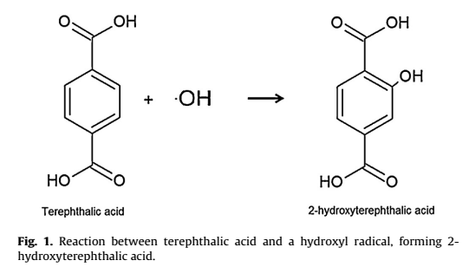

Slide 3
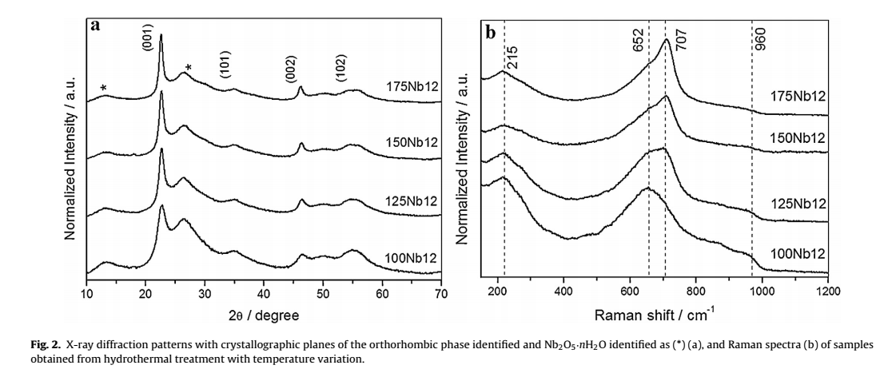

Slide 4
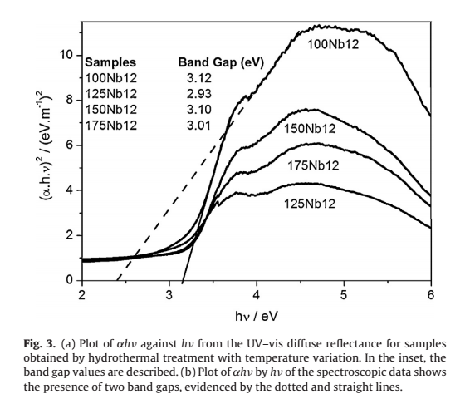

Slide 6
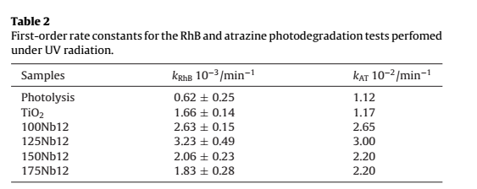

Slide 7
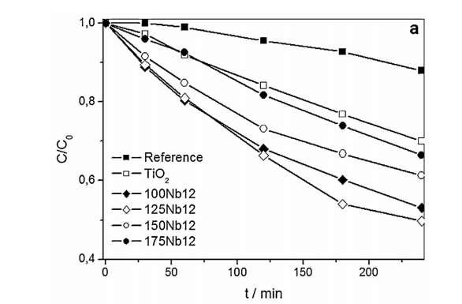

Slide 8
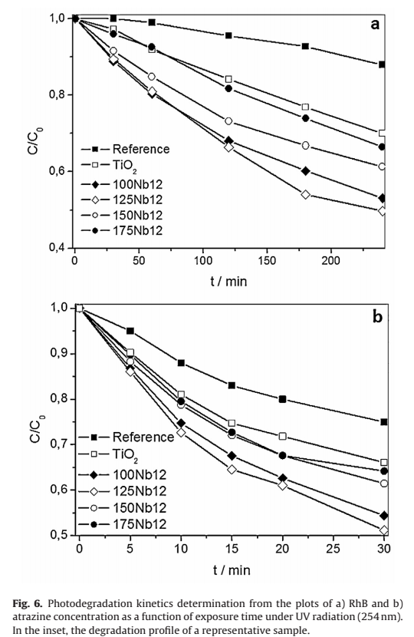

Slide 9
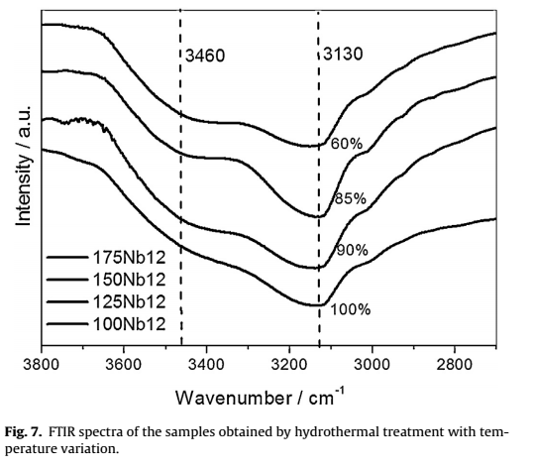

Slide 10
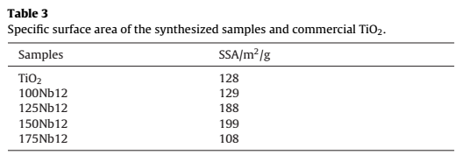

Slide 12
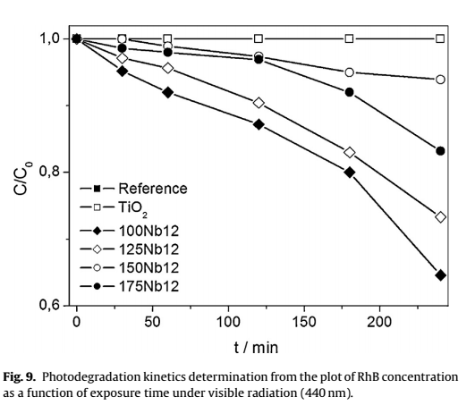

Slide 13
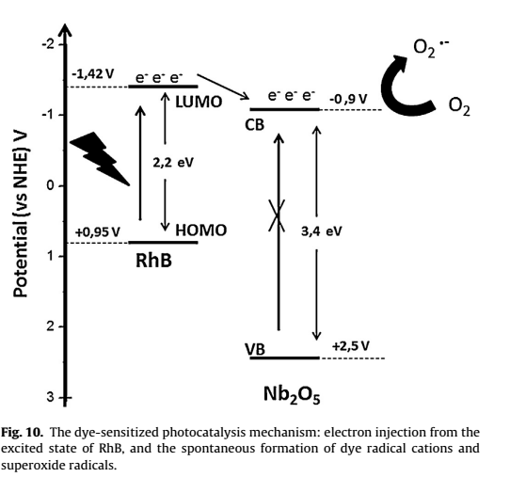

Slide 14
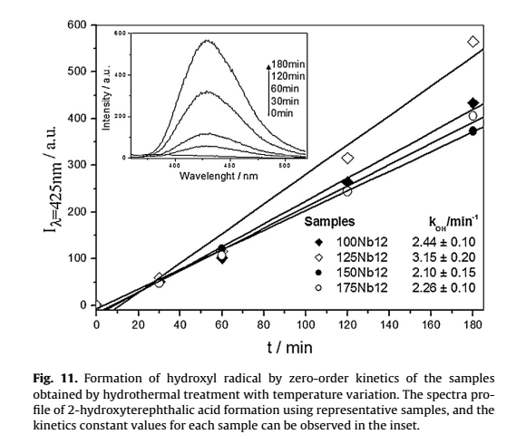

Slide 15
