Slide 1
Pre-Synopsis seminar on
Investigations on carbonaceous materials as electrodes for the next generation electrochemical energy storage device applications.
Manoj M
Division for Research in Advanced Materials Department of Physics
Cochin University of Science and Technology
Supervising guide: Prof S Jayalekshmi

Slide 2
Contents
1
Introduction
2
Characterization tools and techniques
3
Biomass-derived, activated carbon-sulfur composite cathode with a bifunctional interlayer of functionalized carbon nanotubes for lithium-sulfur cells.
4
Sulfur-polyaniline coated mesoporous carbon composite in combination with carbon nanotubes interlayer as a superior cathode assembly for high capacity lithium-sulfur cells.
5
Polyaniline–graphene oxide based ordered nanocomposite electrodes for high-performance supercapacitor applications.
6
Mn₃O₄-mesoporous carbon composite as an improved anode material for rechargeable lithium ion cells.
7
A Li-ion full cell using LiFePO₄ cathode and Mn₃O₄-mesoporous carbon anode
8
Conclusions and future outlook
9
Acknowledgements

Slide 3
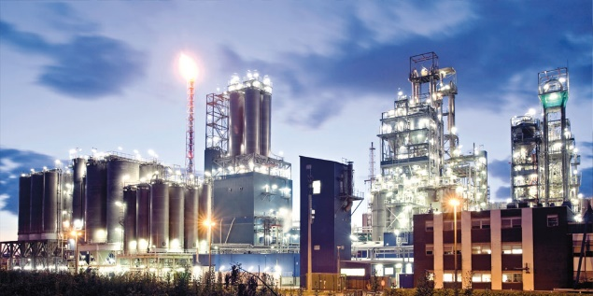
Chapter 1
Chapter 2
Chapter 3
Chapter 4
Chapter 5
Chapter 6
Chapter 7
Industry
Energy Consumption
by Sectors
Transportation
Electricity
Commercial and Residential

Slide 4
Chapter 1
Chapter 2
Chapter 3
Chapter 4
Chapter 5
Chapter 6
Chapter 7
Motivation
Adverse Effects of Non-Renewable Resources
Greenhouse gas emissions
Acid Rain
Land pollution and waste generation
Oil Spills

Slide 5
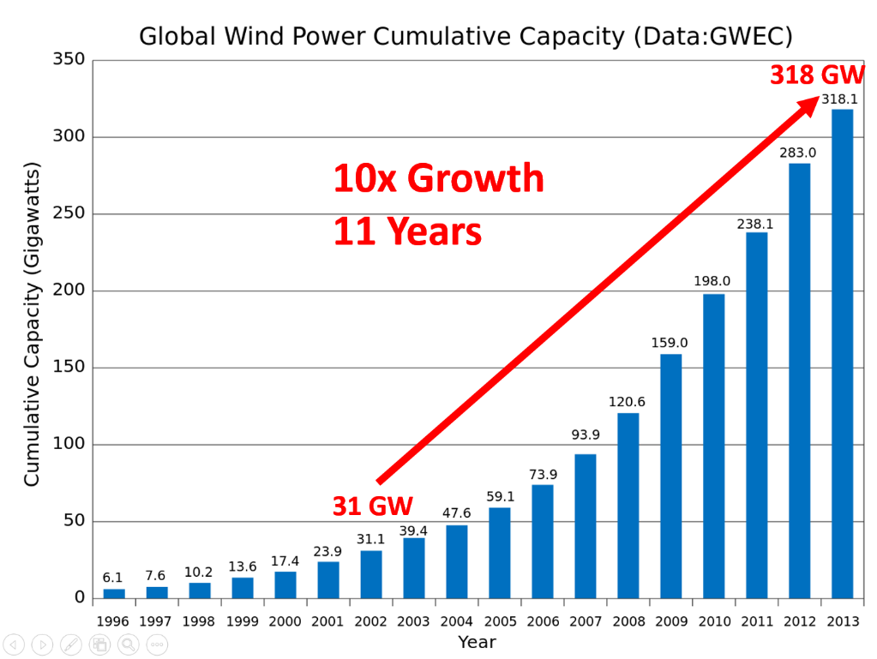
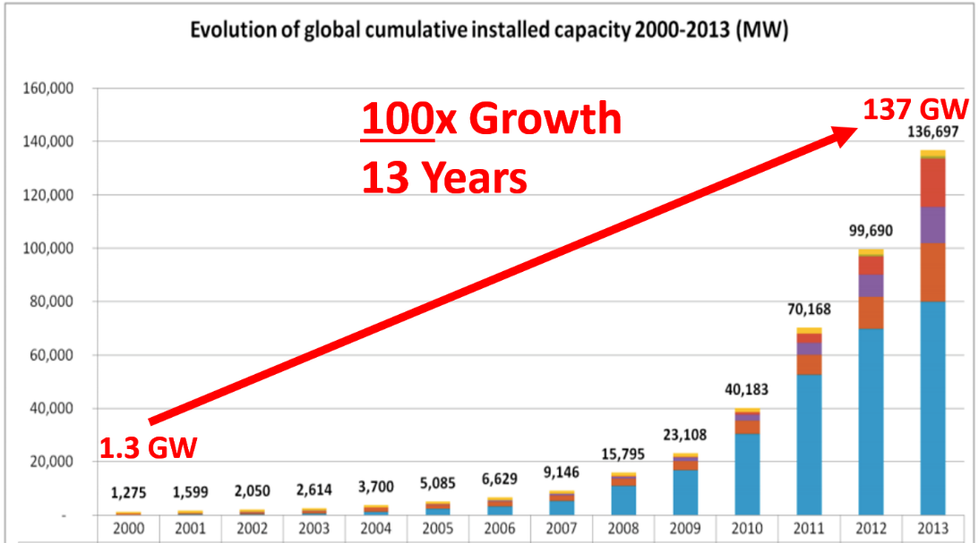
Why Energy Storage?
Chapter 1
Chapter 2
Chapter 3
Chapter 4
Chapter 5
Chapter 6
Chapter 7
Need of cleaner and renewable energy sources
Move Fast
Renewable energy output is intermittent since it is affected by weather conditions.
It makes the development of advanced energy storage systems mandatory.
Store energy when it is available in excess and release back to grid on demand.
Notes:
The amount of wind power around the world has grown by an astounding 10x over the last 11 years
In 2016 world consumed 3x more wind energy than in 2010
The solar market has exploded, surging by an incredible 100x in just 13 years
10x more solar energy in 2016 than in 2010

Slide 6
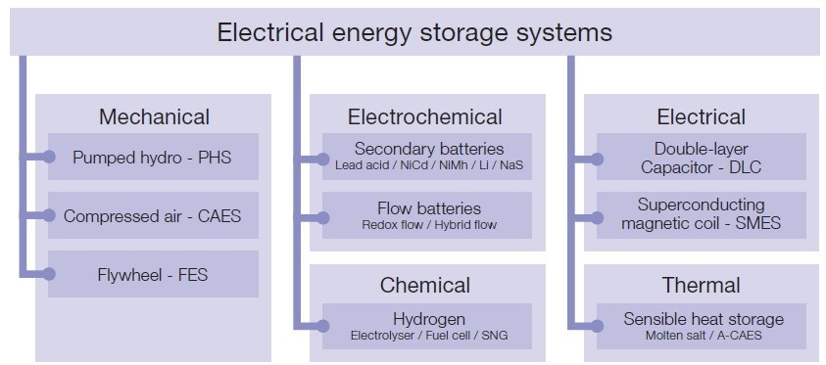
Chapter 1
Chapter 2
Chapter 3
Chapter 4
Chapter 5
Chapter 6
Chapter 7
BATTERY and SUPERCAPACITOR

Slide 7
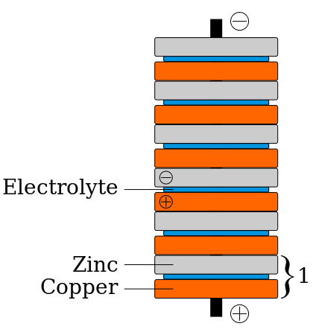
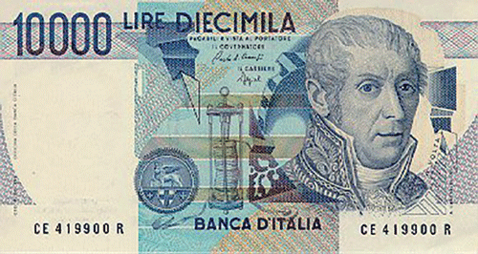
History of batteries
Chapter 1
Chapter 2
Chapter 3
Chapter 4
Chapter 5
Chapter 6
Chapter 7
The invention of Alessendro Volta cell in 1800
Stack of zinc and copper discs separated
by cardboard soaked in salt water (Electrolyte)
Leclanche ́ cell
Lead-acid cell
Nickel-Cadmium Cell
The commercialization of Li-ion battery in 1991 by Sony
The price of Li-ion battery dropped by roughly a factor of 10 between 1991 and 2005
Li-ion battery market is expected to reach 68.97 Billion USD, globally, by 2022
Notes:
The history of batteries run from the invention of Alessendro Volta cell
in 1800 to the commercialization of Li-ion battery in 1992, via the well-known
Leclanche ́ cell, lead-acid battery, nickel-cadmium accumulator and numerous other
systems.
The price of small lithium-ion batteries dropped by roughly a factor of 10 between 1991 and 2005

Slide 8
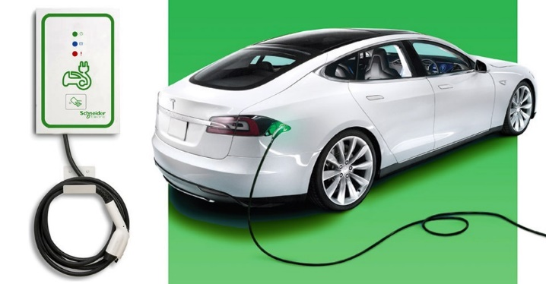
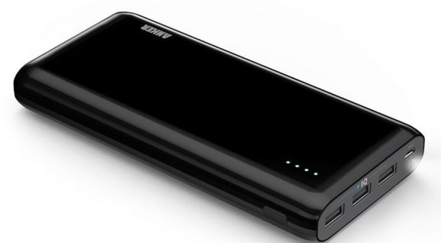
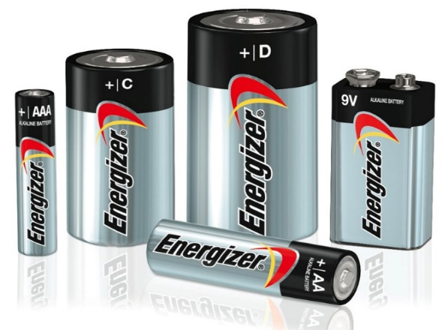
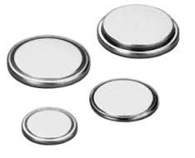
Chapter 1
Chapter 2
Chapter 3
Chapter 4
Chapter 5
Chapter 6
Chapter 7
Applications of Li ion batteries
Portable Electronics
Laptop
Transportation
Can be charged faster
Last longer
High energy density
Powerbank
Trimmer
Batteries comparison
Coin cells
AA
AAA
C
D
9V
Notes:
Dominating portable electronic market owing to its lightweight and compactness
Compared with traditional battery technology, lithium-ion batteries charge faster, last longer and have a higher power density for more battery life in a lighter package.

Slide 9
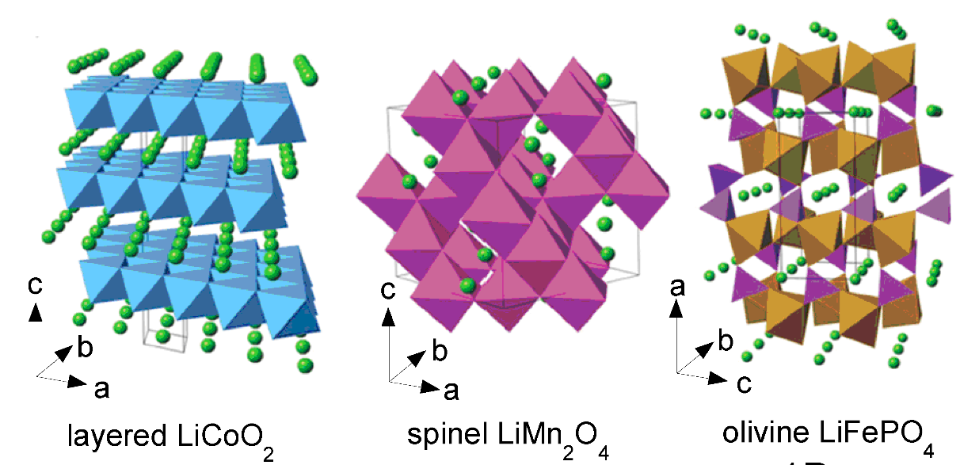
Chapter 1
Chapter 2
Chapter 3
Chapter 4
Chapter 5
Chapter 6
Chapter 7
Main components of batteries
Anode (Negative Electrode)
Cathode (Positive Electrode)
Graphite, Silicon
LiCoO₂, LiMn₂O₄, LiFePO₄
Electrolyte: Example: Lithium hexafluorophosphate
Transport ions from the anode to the cathode or vice-versa
Separator: Example: Polypropylene (Celgard)
Porous membrane which is a good electronic insulator
Keeps positive and negative electrodes apart to prevent electrical short circuits.
Notes:
Keep positive and negative electrodes apart to prevent electrical short circuits and, at the same time allow rapid transport of ionic charge
Commercially available Li-ion cells use polyolefin as a separator. This material has excellent mechanical properties, good chemical stability and is low-cost. A polyolefin is a class of polymer that is produced from olefin by polymerizing olefin ethylene. Ethylene comes from a petrochemical source; polyolefin is made from polyethylene, polypropylene or laminates of both materials. The Li-ion separator must be permeable and the pore size ranges from 30 to 100nm.

Slide 10
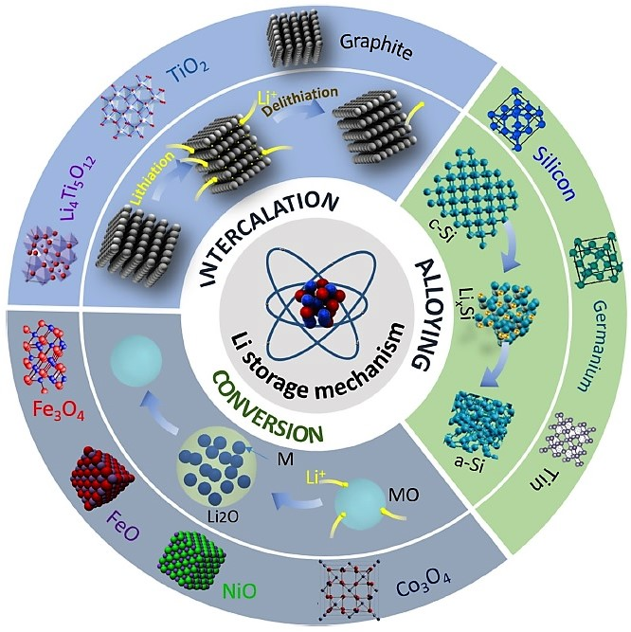
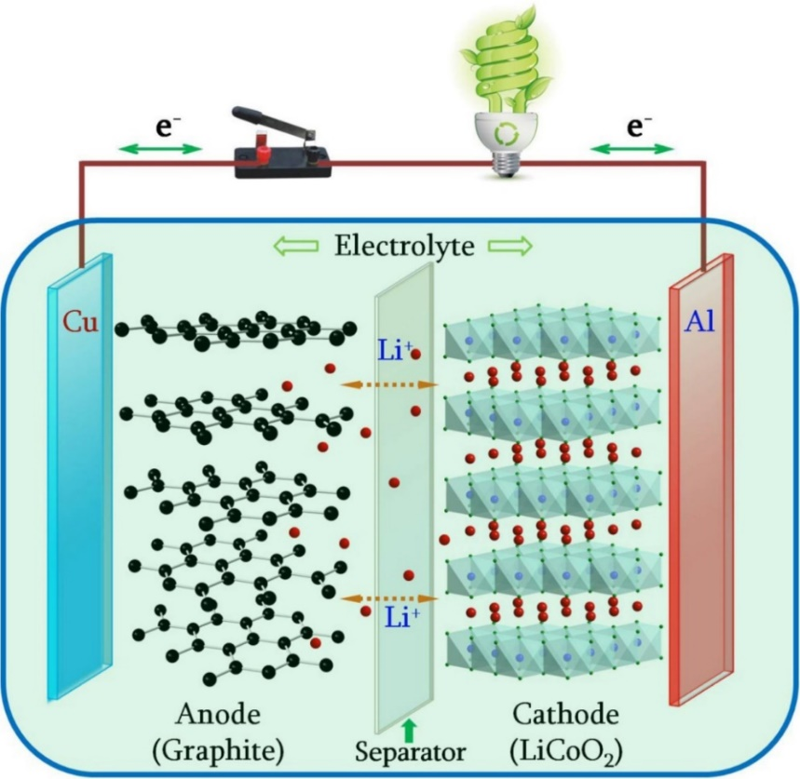
Chapter 1
Chapter 2
Chapter 3
Chapter 4
Chapter 5
Chapter 6
Chapter 7
Working of Li ion batteries
Imagine a never ending rally
Lithium ion is as light as a shuttle cork
Both electrodes allow lithium ions to move in and out of their structures
Intercalation
Notes:
Both electrodes allow lithium ions to move in and out of their structures with a process called insertion (intercalation)

Slide 11
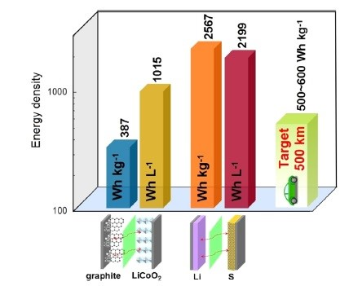
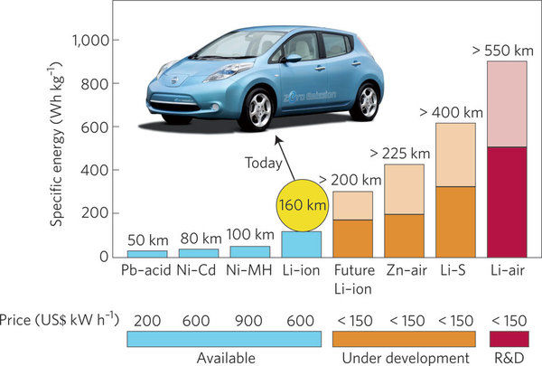
New Energy Storage Systems
Chapter 1
Chapter 2
Chapter 3
Chapter 4
Chapter 5
Chapter 6
Chapter 7
The Li-ion technology, though highly advanced, faces limitations when applied to electric vehicles
Comparison of theoretical gravimetric/volumetric energy densities of Li-ion (Graphite/LiCoO₂) and Li-S batteries
Theoretical energy density 5 times greater than Li-ion
Notes:
Li-ion battery dominated the portable electronics market
The conventional graphite/LiCoO₂ even fully developed still far behind the requirement of electric vehicles.

Slide 12
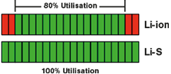
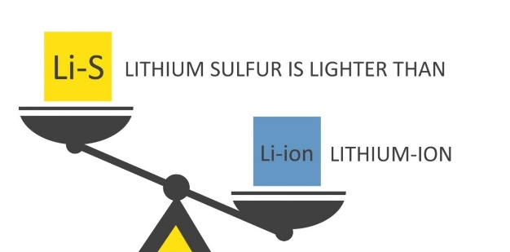
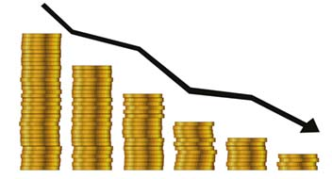
Advantages of Li-S batteries
Chapter 1
Chapter 2
Chapter 3
Chapter 4
Chapter 5
Chapter 6
Chapter 7
Eco-friendly
Full discharge
Lightweight
Maintenance free
Cost Effectiveness
Temperature and Pressure tolerance

Slide 13
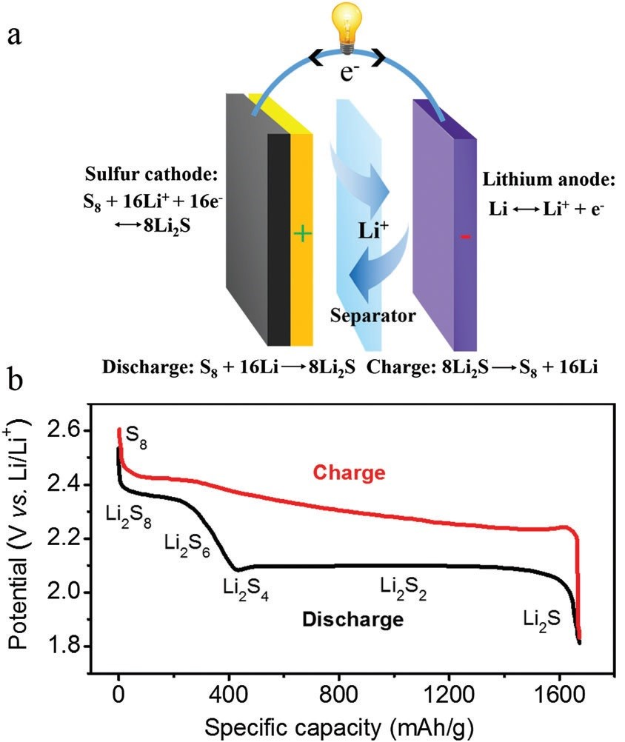
Working of Li-S batteries
Chapter 1
Chapter 2
Chapter 3
Chapter 4
Chapter 5
Chapter 6
Chapter 7
Li
S
Li
Sulfur can host two ions of lithium
Li
Co
Compared to one in Li-ion technology
Lithium interacts directly with sulfur
Discharge
Anode : Li Li⁺ + e⁻
Cathode : S₈ + 16Li⁺ + 16e⁻ 8Li₂S
Charge
Anode : Li⁺ + e⁻ Li⁺
Cathode : 8Li₂S S₈ + 16Li⁺ + 16e⁻

Slide 14
Mechanism
Chapter 1
Chapter 2
Chapter 3
Chapter 4
Chapter 5
Chapter 6
Chapter 7
Charge/Discharge process is more complicated
Sulfur becomes lithiated during discharge process to form polysulfide species
S₈ Li₂S₈ Li₂S₆ Li₂S₄ Li₂S₂ Li₂S
Long-chain lithium polysulfides
Short-chain lithium polysulfides
Contributes 25% of the theoretical capacity of S
Contributes 75% of the theoretical capacity of S
The opposite process occurs during charging , although the intermediate species might be different.

Slide 15
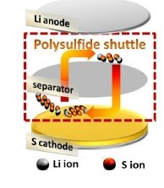
Major challenges
Chapter 1
Chapter 2
Chapter 3
Chapter 4
Chapter 5
Chapter 6
Chapter 7
Low conductivity of sulfur and lithium sulfide
The insulating nature of sulfur and lithium sulfide, both electronically and ionically, results in poor utilization of the active material.
Dissolution of intermediate lithium polysulfide species in the electrolyte
Long-chain lithium polysulfide species (Li₂S₄ to Li₂S₈) dissolve readily in the electrolyte. This leads to continuous loss of the active material,sulfur.
Polysulfide shuttle effect
The higher-order polysulfides migrate towards the anode, react with the lithium metal, get reduced to lower-order polysulfides, migrate back to the cathode, form higher-order polysulfides again, and so on.
How do they have adverse effects?
Internal shorting
Self-discharging
Low Coulombic efficiency

Slide 16
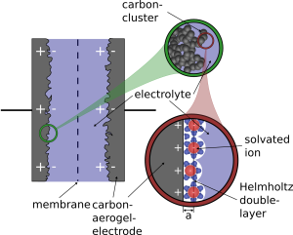
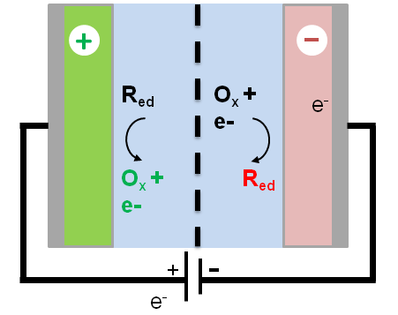
Supercapacitors
Chapter 1
Chapter 2
Chapter 3
Chapter 4
Chapter 5
Chapter 6
Chapter 7
Supercapacitors (SC’s) are energy storage systems having similarities with both batteries and conventional capacitors.
Electrochemical capacitors
Electrochemical double layer capacitors (EDLC)
(non-Faradaic)
Pseudo–capacitors
(Faradaic)
Hybrid capacitors
EDLC+Pseudo–capacitors
EDLC
Pseudo-capacitor

Slide 17
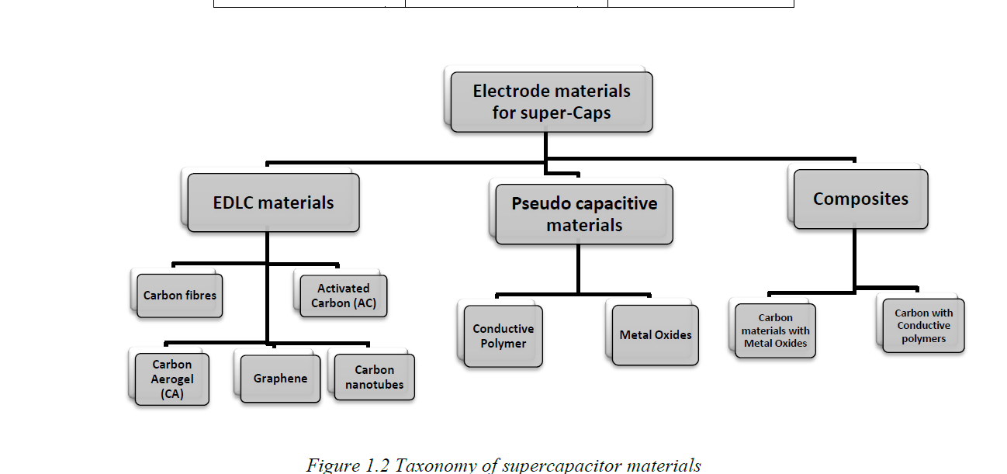
Chapter 1
Chapter 2
Chapter 3
Chapter 4
Chapter 5
Chapter 6
Chapter 7

Slide 18
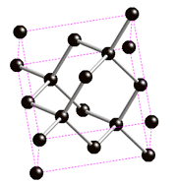
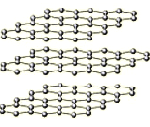
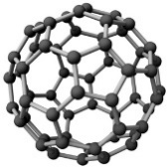
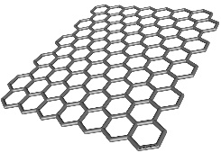
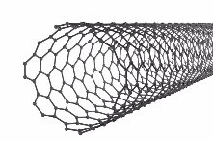
Chapter 1
Chapter 2
Chapter 3
Chapter 4
Chapter 5
Chapter 6
Chapter 7
Carbonaceous materials
Carbon is the basic building block of the cells in the body.
Carbon forms about 18% of the human body constituents
Amorphous carbon
They have transformed the electronics industry and revolutionized the energy scenario
Diamond
Graphite
Tunable electrical and optical properties
Economically viable
Environmentally benign
Carbon
C
Fullerene
Graphene
Graphene Oxide
Mesoporous Carbon
Activated Carbon
Carbon nanotubes
Carbon nanotube
Notes:
Transformed the electronics industry and energy storage devices.

Slide 19
Chapter 2
Chapter 1
Chapter 2
Chapter 3
Chapter 4
Chapter 5
Chapter 6
Chapter 7
Characterization tools and techniques

Slide 20
Characterization Tools
Chapter 1
Chapter 2
Chapter 3
Chapter 4
Chapter 5
Chapter 6
Chapter 7
Structural, morphological and thermal characterizations
XRD (X-ray diffraction)
Micro-Raman Spectroscopy
FTIR (Fourier Transform Infra-red) Spectroscopy
FE-SEM (Scanning Electron Microscopy)
HR-TEM (High Resolution Transmission Electron Microscopy)
EDX (Energy Dispersive X-ray) analysis.
TGA (Thermo Gravimetric Analysis)
Electrochemical Analysis
Cyclic Voltammetry
Galvanometric charge - discharge studies
Impedance spectroscopy

Slide 21
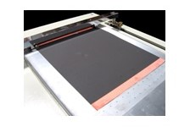
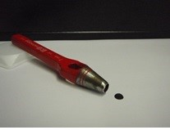
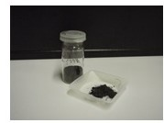
Chapter 1
Chapter 2
Chapter 3
Chapter 4
Chapter 5
Chapter 6
Chapter 7
Cell Manufacturing Process
Manufacturing Process
Material
Active Material (80%)
Slurry Mixing
Conductive Agent (10%)
Binder (10%)
Solvents
Electrode Manufacturing
Coating
Al foil/Cu foil
Drying
Solvents
Cutting
10-16 mm

Slide 22
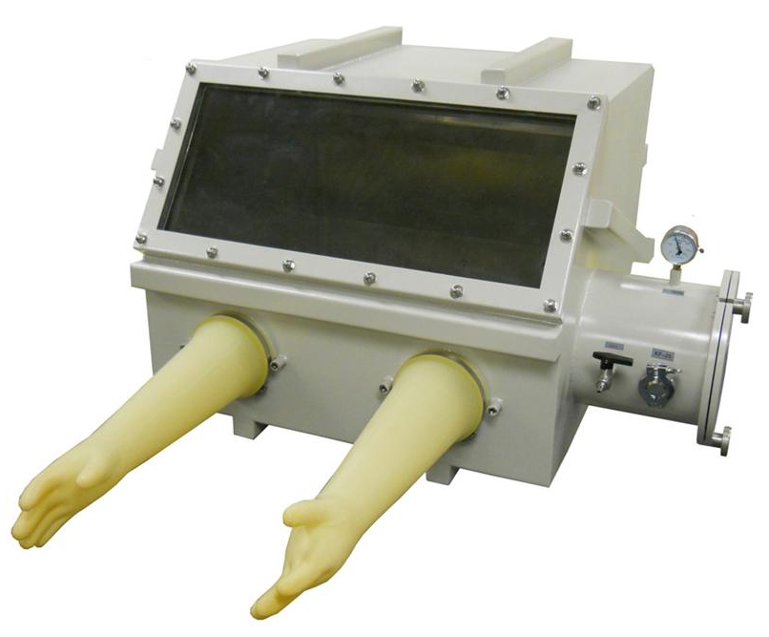
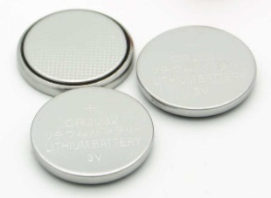
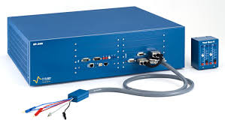
Chapter 1
Chapter 2
Chapter 3
Chapter 4
Chapter 5
Chapter 6
Chapter 7
Cell Manufacturing Process
Manufacturing Process
Material
Cell Assembly
Electrolyte
Stacking
Separator
Sealing
Cell testing
Notes:
Test cells were assembled in a glove box with moisture content less than 5ppm, using Li metal as anode and LiPF6 in organic solvents as the electrolyte.

Slide 23
Terminology used in electrochemical technology
Chapter 1
Chapter 2
Chapter 3
Chapter 4
Chapter 5
Chapter 6
Chapter 7
Specific charge :
The charge obtained in one discharge cycle from unit mass of the active material of the cell. Specific charge capacity is expressed in mA h g⁻¹
Specific capacitance :
The ability of a supercapacitor cell to store electric charge for a unit mass of the active material and is expressed in F g⁻¹
C-rate :
The duration of one full charge or discharge of a cell and expressed in h⁻¹.
Coulombic efficiency :
Ratio of energy output on discharge to the input energy upon charging of a rechargeable cell.

Slide 24
Chapter 3
Chapter 1
Chapter 2
Chapter 3
Chapter 4
Chapter 5
Chapter 6
Chapter 7
Biomass-derived, activated carbon-sulfur composite cathode with a bifunctional interlayer of functionalized carbon nanotubes for lithium-sulfur cells.
Under review in Journal of Colloids and Interface Science

Slide 25
Introduction
Chapter 1
Chapter 2
Chapter 3
Chapter 4
Chapter 5
Chapter 6
Chapter 7
Sulfur.
High theoretical specific capacity of 1675 mA h g⁻¹
Low electrical conductivity.
Activated carbon (AC).
Promising candidate for high performance Li-S cells.
Low-cost and the availability of easy processing techniques (biomass sources such as jackfruit, coconut shell, sugarcane and rice husk).
Adjustable surface properties.
The coconut shell derived carbons dominate the field due to their natural abundance and the desirable electrochemical properties.
The activation processes also play a crucial role in determining the performance of the electro active carbon materials.
Activated carbon sulfur composite (ACS)-Cathode
Acid functionalized CNTs interlayer
Li-S cells with good performance characteristics

Slide 26
Synthesis
Chapter 1
Chapter 2
Chapter 3
Chapter 4
Chapter 5
Chapter 6
Chapter 7
Coconut shell derived steam activated carbon (CSC)
Washed with distilled water and dried overnight at 110 ºC.
Washed with 5 vol % NaOH, distilled water and dried at 110 ℃ for 12 hours.
Washed with HF (1.2 M) and then with distilled water until a neutral pH was obtained and dried at 110 ℃ for 12 hours.

Slide 27
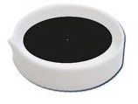
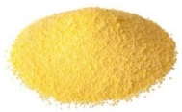
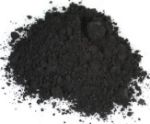
Synthesis of free-standing and flexible film of acid-functionalized carbon nanotubes (CNTF interlayer).
Chapter 1
Chapter 2
Chapter 3
Chapter 4
Chapter 5
Chapter 6
Chapter 7
H₂SO₄ : HNO₃ (6M)
in 3:1 volume ratio
Refluxed at 120 ℃ for 12 hours
Pristine CNTs
Ultra-sonicated for 2 hours
Acid-functionalized CNTs
Ultra-sonicated for 3 hours
0.2 mm
Dried at 60 ℃ in vacuum oven
PVDF in NMP solution
Synthesis of acid washed activated carbon-sulfur (ACS) composite.
Sulfur
+
Dispersed in acetone
Ultra-sonicated (3 hrs) in an ice bath and then stirred (3 hrs)
Solvothermal process at 120 ℃ for 4 hours
ACS composite
Activated carbon
Sulfur : AC
80 : 20
Notes:
The commercially obtained sulfur and the synthesized activated carbon were mixed in a weight ratio of 8:2 in 30 ml of acetone
Explain why IL?

Slide 28
Structural and morphological characterization
Chapter 1
Chapter 2
Chapter 3
Chapter 4
Chapter 5
Chapter 6
Chapter 7
(222)
(313)
(222)
X- Ray diffraction patterns of AC, Sulfur and ACS composite
Micro Raman spectra of pristine and functionalized CNTs
Characteristics Raman peaks of CNTs: D band: 1346 cm⁻¹, G band: 1574 cm⁻¹, and G' band : 2689 cm⁻¹.
After functionalization, the intensity ratio I_{D}/I_{G} is found to increase to 0.82 from 0.62
Notes:
The dominant peak at 23.1 corresponds to the 222 plane of orthorhombic fddd phase of sulfur.
After functionalization, the intensity ratio ID/IG is found to increase to 0.82 from 0.62 which implies that the acid functionalization brings about structural distortions in the CNTs network [53]. The acid treatment also facilitates the good dispersion of the CNTs in NMP solution with reduced agglomeration [54].

Slide 29
Chapter 1
Chapter 2
Chapter 3
Chapter 4
Chapter 5
Chapter 6
Chapter 7
153 cm⁻¹
219 cm⁻¹
473 cm⁻¹
I_{D}/I_{G}: 1.16
I_{D}/I_{G}: 1.11
In ACS composite, slight shift in D and G bands is also observed
Micro Raman spectra of sulfur, AC and ACS composite
Peaks at 153 cm⁻¹, 219 cm⁻¹, and 473 cm⁻¹ correspond to those of orthorhombic sulfur.
Notes:
The 153 cm-1 peak is assigned to E2 symmetry interactions, and the 219 cm-1 and 473 cm-1 peaks are assigned to A1 vibration modes
There are two typical Raman peaks in the spectrum of AC shown in figure 5(b), located at 1340 cm-1 and 1590 cm-1 which are related to the D-band and G-band respectively and the intensity ratio ID/IG of AC is observed to be 1.16. The D band corresponds to the defects in the carbon structure and the G band is linked to the vibration of sp2 carbon atoms [56].
The Raman spectrum of the ACS composite (figure 5(c)) displays the significant peaks of sulfur, while those of AC are not visible because of the presence of the high-intensity sulfur peaks in the composite. The distinct scan of the ACS composite in the range 1000-2000 cm-1 as depicted in figure 5(d) reveals the characteristics peaks of AC.
After the reaction of AC with sulfur the intensity ratio ID/IG is found to decrease to 1.11, and slight changes in the positions of D and G bands are also observed in the spectrum of the composite which can be associated with the interaction of sulfur with carbon during the solvothermal process

Slide 30
Chapter 1
Chapter 2
Chapter 3
Chapter 4
Chapter 5
Chapter 6
Chapter 7
EDX of ACS composite
FESEM images of AC (a-b) and ACS (c-d)
S~80 wt.%
TGA of ACS composite
Notes:
The XRD pattern of AC shows no crystalline peaks which is an indication of its amorphous nature
After functionalization, the intensity ratio ID/IG is found to increase to 0.82 from 0.62 which implies that the acid functionalization brings about structural distortions in the CNTs network [53]. The acid treatment also facilitates the good dispersion of the CNTs in NMP solution with reduced agglomeration [54].

Slide 31
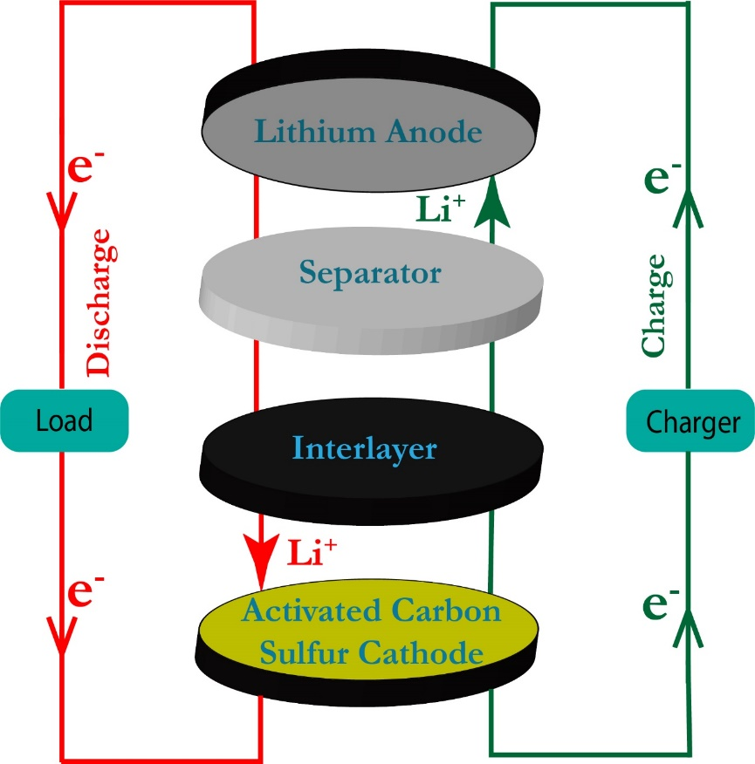
Cell fabrication
Chapter 1
Chapter 2
Chapter 3
Chapter 4
Chapter 5
Chapter 6
Chapter 7
Li-S test cells : Swagelok type.
Cathode : ACS composite,
Anode : Li foil,
Separator : Celgard
Electrolyte : 1M lithium perchlorate in a mixed solvent of 1, 3 dioxolane (DOL) and 1, 2 dimethoxymethane (DME) at a volume ratio of 1:1 including 0.5 M LiNO₃ .
Voltage window : 1.5 V – 3 V
Sulfur loading ~1.3 mg cm⁻².
Notes:
The ACS composite cathode electrodes for Li-S cells were prepared from the slurry containing 80 wt. % ACS composite, 10 wt. % of acetylene black and 10 wt. % of polyvinylidene difluoride (PVDF) in N-methyl pyrrolidinone (NMP) solvent as explained earlier. The homogeneous slurry was then spray coated on an aluminium foil and after drying at 60 °C under vacuum for 12 hours, the cathode electrodes were cut into circular disks of 10 mm in diameter with a sulfur loading of approximately 1.3 mg cm-2. Using stainless steel Swagelok cells, Li-S cells were assembled by stacking ACS composite as the cathode active material, Li foil as the anode and Celgard as the separator in an argon-filled glove box,with 1 M lithium perchlorate in a mixed solvent of 1, 3-dioxolane (DOL) and 1, 2-dimethoxymethane (DME) at a volume ratio of 1:1 including 0.5 M LiNO3 as an electrolyte additive, as the electrolyte[42,43]. The synthesized CNTF interlayer was placed between the separator and the ACS cathode and the amount of electrolyte added to each cell was 70 μl. The cyclic voltammetry (CV) test was carried out at a scan rate of 0.1 mV s-1 in the voltage window of 1.5-3 V and the electrochemical impedance spectroscopy (EIS) studies in the frequency range between 1 MHz and 10 mHz, using Bio-Logic SP300 workstation. The test cells were charge-discharge cycled between 1.5 and 3 V at various C-rates (1C=1650 mA g-1) using the 8 channel battery analyzer (MTI Corporation-USA) at room temperature

Slide 32
Electrochemical studies
Chapter 1
Chapter 2
Chapter 3
Chapter 4
Chapter 5
Chapter 6
Chapter 7
Cyclic voltammograms (a) With out CNT interlayer (b) With CNT interlayer at 0.1mV S⁻¹
Cathodic peak
~2.3 V
: Reduction of sulfur to soluble higher order lithium polysulfides (Li₂S_{n}, 4 ≤ n ≤8)
~2.0 V
: Reduction of the higher order lithium polysulfides to the lower order insoluble Li₂S₂ and ultimately to Li₂S
Anodic peak
~2.50 V
:Conversion of Li₂S₂/Li₂S to polysulfides and sulfur
Notes:
The ACS composite cathode electrodes for Li-S cells were prepared from the slurry containing 80 wt. % ACS composite, 10 wt. % of acetylene black and 10 wt. % of polyvinylidene difluoride (PVDF) in N-methyl pyrrolidinone (NMP) solvent as explained earlier. The homogeneous slurry was then spray coated on an aluminium foil and after drying at 60 °C under vacuum for 12 hours, the cathode electrodes were cut into circular disks of 10 mm in diameter with a sulfur loading of approximately 1.3 mg cm-2. Using stainless steel Swagelok cells, Li-S cells were assembled by stacking ACS composite as the cathode active material, Li foil as the anode and Celgard as the separator in an argon-filled glove box,with 1 M lithium perchlorate in a mixed solvent of 1, 3-dioxolane (DOL) and 1, 2-dimethoxymethane (DME) at a volume ratio of 1:1 including 0.5 M LiNO3 as an electrolyte additive, as the electrolyte[42,43]. The synthesized CNTF interlayer was placed between the separator and the ACS cathode and the amount of electrolyte added to each cell was 70 μl. The cyclic voltammetry (CV) test was carried out at a scan rate of 0.1 mV s-1 in the voltage window of 1.5-3 V and the electrochemical impedance spectroscopy (EIS) studies in the frequency range between 1 MHz and 10 mHz, using Bio-Logic SP300 workstation. The test cells were charge-discharge cycled between 1.5 and 3 V at various C-rates (1C=1650 mA g-1) using the 8 channel battery analyzer (MTI Corporation-USA) at room temperature

Slide 33
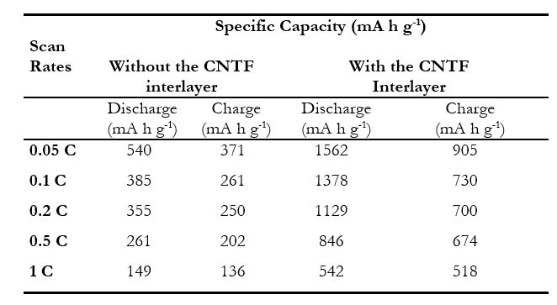
Chapter 1
Chapter 2
Chapter 3
Chapter 4
Chapter 5
Chapter 6
Chapter 7
Initial Charge-Discharge profiles of Li-S cells (a) With out CNTF interlayer (b) With CNTF interlayer
Notes:
The ACS composite cathode electrodes for Li-S cells were prepared from the slurry containing 80 wt. % ACS composite, 10 wt. % of acetylene black and 10 wt. % of polyvinylidene difluoride (PVDF) in N-methyl pyrrolidinone (NMP) solvent as explained earlier. The homogeneous slurry was then spray coated on an aluminium foil and after drying at 60 °C under vacuum for 12 hours, the cathode electrodes were cut into circular disks of 10 mm in diameter with a sulfur loading of approximately 1.3 mg cm-2. Using stainless steel Swagelok cells, Li-S cells were assembled by stacking ACS composite as the cathode active material, Li foil as the anode and Celgard as the separator in an argon-filled glove box,with 1 M lithium perchlorate in a mixed solvent of 1, 3-dioxolane (DOL) and 1, 2-dimethoxymethane (DME) at a volume ratio of 1:1 including 0.5 M LiNO3 as an electrolyte additive, as the electrolyte[42,43]. The synthesized CNTF interlayer was placed between the separator and the ACS cathode and the amount of electrolyte added to each cell was 70 μl. The cyclic voltammetry (CV) test was carried out at a scan rate of 0.1 mV s-1 in the voltage window of 1.5-3 V and the electrochemical impedance spectroscopy (EIS) studies in the frequency range between 1 MHz and 10 mHz, using Bio-Logic SP300 workstation. The test cells were charge-discharge cycled between 1.5 and 3 V at various C-rates (1C=1650 mA g-1) using the 8 channel battery analyzer (MTI Corporation-USA) at room temperature

Slide 34
Chapter 1
Chapter 2
Chapter 3
Chapter 4
Chapter 5
Chapter 6
Chapter 7
Li-S cells with the interlayer
Specific capacity : 384 mA h g⁻¹ at 1 C after 200 cycles.
Capacity retention : 71% at 1 C
Coulombic efficiency : 97% at 1 C
Rate capability of the Li-S cells: Capacity of 976 mA h g⁻¹ was obtained after the C-rate was reverted back to 0.1 C from 1 C.

Slide 35
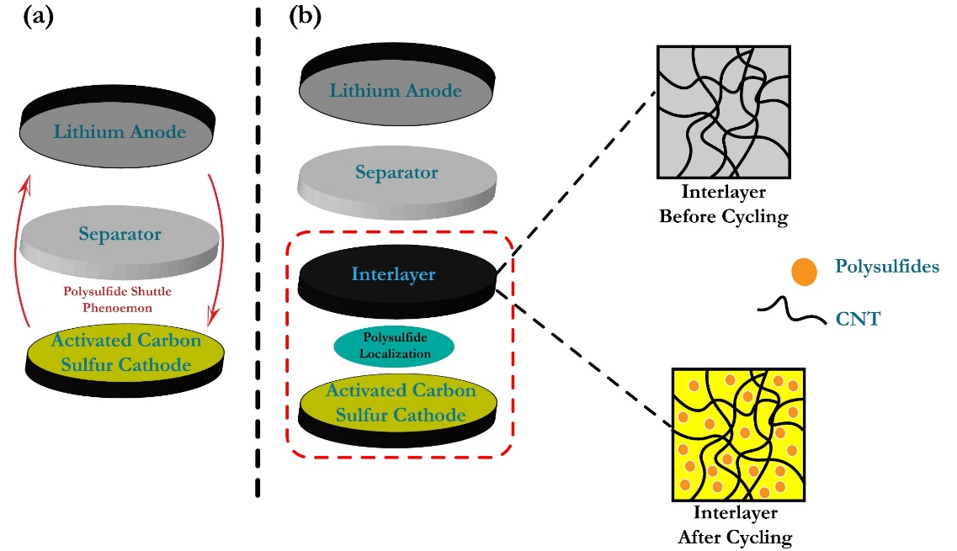
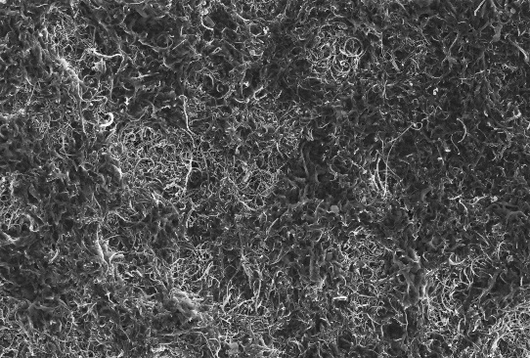
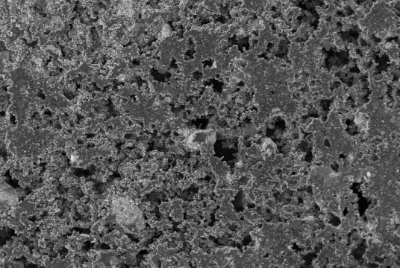
Role of CNTF interlayer
Chapter 1
Chapter 2
Chapter 3
Chapter 4
Chapter 5
Chapter 6
Chapter 7
Before cycling
After cycling
(a) Conventional and (b) modified structure of Li-S cell
Trapped Polysulfides
Importance of the porosity of CNTF interlayer.
Helps in the localization of polysulfides and acts as a pseudo current collector.
Facilitates the penetration of the electrolyte for the electrochemical reaction.
Notes:
Figure 15. FE-SEM images of the CNTF interlayer (a) before cycling (inset: enlarged image), (b) after 200 cycles at 1 C rate (inset: enlarged image).
Figure 16. The EDAX spectrum of the CNTF interlayer after 200 cycles at 1 C rate.
The image of the free standing and flexible CNTF interlayer displays interconnected carbon nanotubes which are randomly aligned with a porous 25 | P a g e
structure. The porous nature of interlayer is beneficial in two different ways. It allows an easy pathway for the electrolyte to permeate through the layer. The porous CNTF layer can trap the migrating polysulfides species and retain them within the cathode region. The FE-SEM image of the CNTF interlayer after 200 charge-discharge cycles is given in figure 15(b) and the inset shows the enlarged form.
The morphology of the interlayer after cycling is quite different from that of the interlayer before cycling. The pores of the interlayer have almost disappeared after cycling as they have been blocked by the precipitate. The agglomeration found in the interlayer after cycling indicates the trapping of the migrating polysulfides from the cathode region. The EDAX elemental distribution pattern shown in figure 16 confirm the nature of the precipitate that blocks the pores of the CNTF interlayer. It is clear that the precipitate contains elemental sulfur which further supports the entry of the polysulfides and their accumulation in the interlayer. The CNTF interlayer thus suppresses the polysulfide shuttle phenomenon and effectively improves the electrochemical activity of the Li-S cells

Slide 36
Chapter 1
Chapter 2
Chapter 3
Chapter 4
Chapter 5
Chapter 6
Chapter 7
Nyquist plot of Li-S cell without and with CNTF interlayer
There is a sharp fall in the value of charge transfer resistance (R_{ct}) of the cell from 1050 Ω to 250 Ω for the Li-S cells with the CNTF interlayer
The significant decrease in the value of R_{ct} is due to the formation of a conductive pathway for charge transfer by the interconnected CNTs network.
Notes:
The EIS measurements were carried out in the frequency range between 1 MHz and 10 mHz at the open-circuit voltage. The observed Nyquist plots of the Li-S cells without and with the CNTF interlayer are shown in figure 14. In the Nyquist plot, the diameter of the semicircular portion in the high-frequency region gives the charge transfer resistance (Rct) of the cell.
The significant decrease in the value of Rct after the insertion of the CNT interlayer is attributed to the formation of a conductive pathway for charge transfer by the highly electrically conducting CNT interlayer [60,61]. The interlayer acts as an upper current collector, reducing the resistance of cathode material and thereby conversely enhancing the utilization of the SPMC composite cathode [44,62,63]. The CNT interlayer can improve the electrochemical environment at the cathode interface by accelerating the electrochemical kinetics taking place at the cathode by allowing rapid electron transfer and efficient accessibility of active material to the electrolyte [29,64]. The increase in the available surface area by the introduction of conductive CNT matrix is the main reason for the improved kinetics taking place at the cathode.

Slide 37
Conclusions
Chapter 1
Chapter 2
Chapter 3
Chapter 4
Chapter 5
Chapter 6
Chapter 7
The coconut shell derived, steam activated carbon, treated with HF acid to achieve maximum purity, termed as AC, is used as the material to make the composite with sulfur to serve as the composite cathode ACS.
The adoption of this type of cathode assembly is a green approach, since the AC sample is obtained from the bio product coconut shell.
The use of the flexible film of acid-functionalized carbon nanotubes (CNTF) as the interlayer is also part of the green approach, because acid functionalization removes the inherent toxic effects of the CNTs
The Li-S cells deliver an initial discharge capacity of 1562 mA h g⁻¹ at 0.05 C rate and retain 71% of the initial capacity at 1 C rate after 200 cycles.
The interlayer effectively hinders the polysulfide shuttle effect and stimulates the performance of the Li-S cells by providing much higher discharge capacity of 542 mA h g⁻¹ at 1 C and excellent cycling stability

Slide 38
Chapter 4
Chapter 1
Chapter 2
Chapter 3
Chapter 4
Chapter 5
Chapter 6
Chapter 7
Sulfur-polyaniline coated mesoporous carbon composite in combination with carbon nanotubes interlayer as a superior cathode assembly for high capacity lithium-sulfur cells.
Manoj M., et.al, Applied Surface Science. (2018) - Accepted

Slide 39
Introduction
Chapter 1
Chapter 2
Chapter 3
Chapter 4
Chapter 5
Chapter 6
Chapter 7
Sulfur.
High theoretical specific capacity of 1675 mA h g⁻¹
Low electrical conductivity
Mesoporous Carbon (MC).
An inexpensive and highly conductive carbon material.
High surface area and pore volume facilitates the effective confining of sulfur particles within its pores
Polyaniline (PANI)
High electrical conductivity.
Ease of synthesis
Highly stable and eco-friendly.
Sulfur-Polyaniline coated Mesoporous Carbon (SPMC)
Sulfur-polyaniline coated mesoporous carbon composite (SPMC)-Cathode
Li-S cells of excellent performance
CNT interlayer
Notes:
The electrically conducting polymer PANI is extensively used to improve the electrochemical properties of various energy storage devices including rechargeable cells, supercapacitors and fuel cells owing to its ease of synthesis, environmental stability and relatively high electrical conductivity

Slide 40
Chapter 1
Chapter 2
Chapter 3
Chapter 4
Chapter 5
Chapter 6
Chapter 7
Synthesis of Sulfur-PANI coated Mesoporous Carbon (SPMC) composite.
(Ammonium peroxydisulfate)
APS Solution
Sulfur
Filtration and washing
Ultrasonicationand stirring
6 hours stirring
Ice bath
3 hours
Aniline monomer + Mesoporous Carbon in HCl solution
PANI Coated
Mesoporous Carbon (PMC)
Sulfur : PMC
80 : 20
Sulfur with PANI Coated
Mesoporous Carbon (SPMC)
Solvothermal process at 120 ℃ for 4 hours

Slide 41
Chapter 1
Chapter 2
Chapter 3
Chapter 4
Chapter 5
Chapter 6
Chapter 7
Structural and morphological characterization
(002)
(002)
XRD pattern of MC shows a sharp peak at 26° corresponding to (002) diffraction from graphitic carbon.
XRD peaks of sulfur (15° to 60° ) represent its orthorhombic structure.
In SPMC composite, the diffraction peaks of sulfur are obvious while those of MC are not apparent due to the high degree of crystallization of sulfur.
Notes:
For PANI, characteristic diffraction peaks are observed at 12°, 20° and 25°.
the dominant peak at 23.1° is attributed to the (222) crystal plane of sulfur.

Slide 42
Chapter 1
Chapter 2
Chapter 3
Chapter 4
Chapter 5
Chapter 6
Chapter 7
FESEM images of (a) PANI (b) Mesoporous carbon and TEM images of PMC composite (c-d)
(e)FESEM image of PMC and (f), (g) and (h) elemental mapping of PMC
TEM images of PMC composite clearly show the PANI coating on the surface of MC
Notes:
Elemental mapping of the PMC composite is carried out to confirm the distribution of carbon and is shown in figure 3(f). The presence of elements such as oxygen and sulfur (figure 3(g-h)) observed in the elemental mapping of the PMC composite arises from the oxidant, ammonium persulfate used in the polymerization of aniline and further confirms the existence of PANI on the surface of MC .

Slide 43
Chapter 1
Chapter 2
Chapter 3
Chapter 4
Chapter 5
Chapter 6
Chapter 7
EDX of SPMC
TEM images (a-c) and (d) SAED pattern of SPMC (e) FESEM image of SPMC
Lattice fringes with an interlayer spacing of 0.38 nm correspond to the (222) plane.
Sulfur ~ 80%
TGA curves
Notes:
The crystalline nature of sulfur particles is visible in the HR-TEM image. The lattice fringes observed with an interlayer spacing of 0.38nm
correspond to the (222) plane of sulfur.

Slide 44
Cell fabrication
Chapter 1
Chapter 2
Chapter 3
Chapter 4
Chapter 5
Chapter 6
Chapter 7
Li-S test cells : Swagelok type.
Cathode : SPMC composite
Anode : Li foil,
Separator : Celgard
Electrolyte : 1M lithium perchlorate in a mixed solvent of 1, 3 dioxolane (DOL) and 1, 2 dimethoxymethane (DME) at a volume ratio of 1:1 including 0.5 M LiNO₃ .
Voltage window : 1.5 V - 3V
Sulfur loading ~ 1.3 mg cm⁻²
Notes:
The ACS composite cathode electrodes for Li-S cells were prepared from the slurry containing 80 wt. % ACS composite, 10 wt. % of acetylene black and 10 wt. % of polyvinylidene difluoride (PVDF) in N-methyl pyrrolidinone (NMP) solvent as explained earlier. The homogeneous slurry was then spray coated on an aluminium foil and after drying at 60 °C under vacuum for 12 hours, the cathode electrodes were cut into circular disks of 10 mm in diameter with a sulfur loading of approximately 1.3 mg cm-2. Using stainless steel Swagelok cells, Li-S cells were assembled by stacking ACS composite as the cathode active material, Li foil as the anode and Celgard as the separator in an argon-filled glove box,with 1 M lithium perchlorate in a mixed solvent of 1, 3-dioxolane (DOL) and 1, 2-dimethoxymethane (DME) at a volume ratio of 1:1 including 0.5 M LiNO3 as an electrolyte additive, as the electrolyte[42,43]. The synthesized CNTF interlayer was placed between the separator and the ACS cathode and the amount of electrolyte added to each cell was 70 μl. The cyclic voltammetry (CV) test was carried out at a scan rate of 0.1 mV s-1 in the voltage window of 1.5-3 V and the electrochemical impedance spectroscopy (EIS) studies in the frequency range between 1 MHz and 10 mHz, using Bio-Logic SP300 workstation. The test cells were charge-discharge cycled between 1.5 and 3 V at various C-rates (1C=1650 mA g-1) using the 8 channel battery analyzer (MTI Corporation-USA) at room temperature

Slide 45
Electrochemical studies
Chapter 1
Chapter 2
Chapter 3
Chapter 4
Chapter 5
Chapter 6
Chapter 7
Cyclic voltammograms of the Li-S cell (a) without and (b) with CNT interlayer
Increase in redox currents observed in the Li-S cells with CNT interlayer, which indicates better utilization of the sulfur cathode material.
The slight over potential observed in the initial cathodic and anodic peaks in the cells with interlayer disappears after the first cycle, perhaps due to the rearrangement of the active material to electrochemically favorable positions

Slide 46
Chapter 1
Chapter 2
Chapter 3
Chapter 4
Chapter 5
Chapter 6
Chapter 7
Initial Discharge-charge profiles of the Li-S cell (a) without and (b) with CNT interlayer
The cells without the CNT interlayer show rapid capacity fading (one-forth of the initial values on cycling at 0.2 C and 0.5 C rates) after 50 cycles.
Li-S cell without interlayer: 315 mA h g⁻¹ at 0.5 C
Li-S cell with interlayer: 1093 mA h g⁻¹ at 0.5 C and 968 mA h g⁻¹ at 1 C
Notes:
The cells without the CNT interlayer show an initial lithiation capacity of 1095 mA h g-1 at 0.1 C with rapid capacity fading. At higher C-rates of 0.2 C and 0.5 C, the initial discharge capacities observed are 555 mA h g-1 and 315 mA h g-1 respectively which gives an indication of the weakening of the electrochemical activity in the cells. The inset of figure 7(a) shows the cycling stability curves of the Li-S cells without the CNT interlayer at the rates of 0.2 C and 0.5 C. The discharge capacities of the Li-S cells without employing the CNT interlayer are found to deteriorate sharply to below one-forth of the initial values on cycling at both the C rates, after 50 cycles.
The cells with the CNT interlayer show much better electrochemical performance during the charge-discharge process with higher charge-discharge capacities

Slide 47
Chapter 1
Chapter 2
Chapter 3
Chapter 4
Chapter 5
Chapter 6
Chapter 7
Li-S cells with the interlayer
Specific capacity : 360 mA h g⁻¹ at 2 C after 200 cycles.
Capacity retention : 67% at 2 C and 72.3% at 1 C
Coulombic efficiency : 98% at 2 C
Rate capability of the Li-S cells: Capacity of 890 mA h g⁻¹ obtained after the C-rate was reverted back to 0.5 C from 2 C.
Notes:
This retention of discharge capacity even after undergoing cycling at higher C-rates indicates good compatibility between the CNT interlayer and the SPMC cathode, which facilitates the smooth transport of lithium ions also, suppressing the shuttling of polysulfides across the electrodes.

Slide 48
Role of CNT interlayer
Chapter 1
Chapter 2
Chapter 3
Chapter 4
Chapter 5
Chapter 6
Chapter 7
Functions of the CNT interlayer
It facilitates the localization of the polysulfides within the cathode region
Acts as a pseudo-upper current collector and enhances the performance of the Li-S cells
Notes:
Figure 9. Rate capability of the Li-S cells with the CNT interlayer from 0.5 C to 2 C.
From these observations, it is quite clear that the insertion of the CNT interlayer between the separator and the sulfur composite cathode significantly improves the electrochemical performance of the Li-S cells. The CNT interlayer helps in better utilization of the sulfur composite cathode material by improving the conductivity of the interface and thereby accelerating the electrochemical kinetics taking place. This is in addition to the effects of the polyaniline coated mesoporous carbon (PMC) in improving the electrical contact and thereby enhancing the utilization of sulfur. The presence of the PMC helps in blocking the dissolution of the polysulfides in the electrolyte and the CNT interlayer facilitates the localization of the polysulfides within the cathode region and the combined effects substantially hinder the polysulfide shuttle phenomenon.

Slide 49
Chapter 1
Chapter 2
Chapter 3
Chapter 4
Chapter 5
Chapter 6
Chapter 7
Before cycling
After cycling
Trapped Polysulfides
Nyquist plots of Li-S cell
FESEM images of the CNT interlayer after 200 cycles
In Nyquist plots, the semicircular loop at high to medium frequency region is related to the charge transfer resistance.
The Li-S cell with the CNT interlayer shows a drastic decrease in R_{ct} from 1073 Ω to 150 Ω.
Notes:
The CNT interlayer helps to reduce the charge transfer resistance by providing a conductive path

Slide 50
Conclusions
Chapter 1
Chapter 2
Chapter 3
Chapter 4
Chapter 5
Chapter 6
Chapter 7
The SPMC composite cathode with the CNT interlayer significantly improves the performance of the assembled Li-S cells
The presence of the conducting PMC network facilitates good electrical contact for the sulfur particles
The polyaniline coating over sulfur particles also limits the enormous volume expansion of sulfur during lithium intake.
The network of the carbon nanotubes of the interlayer acts as a “store-room” of the polysulfides by holding back the migrating polysulfides.
The conducting network of the interlayer helps in lowering the charge transfer resistance and subsequently ensuring better utilization of the sulfur composite cathode material during the cycling process.
The Li-S cells with the CNT interlayer offer high discharge capacity of 968 mA h g⁻¹ at 1 C and 700 mA h g⁻¹ after 200 cycles corresponding to an extremely low capacity decay of 0.14% per cycle

Slide 51
Chapter 5
Chapter 1
Chapter 2
Chapter 3
Chapter 4
Chapter 5
Chapter 6
Chapter 7
Polyaniline–Graphene Oxide based ordered nanocomposite
electrodes for high-performance supercapacitor applications.
Manoj M., et.al, Journal of Material Science: Materials in Electronics (2017) 28: 14323

Slide 52
Introduction
Chapter 1
Chapter 2
Chapter 3
Chapter 4
Chapter 5
Chapter 6
Chapter 7
The suitability of polyaniline (PANI)–graphene oxide (GO) nano-composite for developing high power supercapacitors is investigated.
Interfacial double layer capacitance
Carbon based electrode materials
Pseudo-capacitance
Conducting polymers and transition metal oxides based electrodes
Polyaniline (PANI)
Ease of synthesis, environmental stability and tunable electrical properties
PANI has lower surface area.
Poor cycling stability due to the low mechanical strength.
Conducting polymer composites with carbon-based materials can be used to serve as electrode materials in super capacitors to eliminate the above-mentioned limitations.
Graphene oxide (GO) is chosen as the material to make composites with PANI because of its ease of synthesis and good mechanical properties

Slide 53
Chapter 1
Chapter 2
Chapter 3
Chapter 4
Chapter 5
Chapter 6
Chapter 7
Synthesis of PANI-GO composite.
Graphite powder
APS Solution
Modified Hummer’s method
Filtration and washing
6 hours stirring
Ice bath
Graphene oxide (GO)
PANI-GO composite
Aniline monomer + GO in HCl solution

Slide 54
Chapter 1
Chapter 2
Chapter 3
Chapter 4
Chapter 5
Chapter 6
Chapter 7
Structural and morphological characterization
(002)
X-Ray diffraction
FESEM of (a) GO, (b) PANI and (c-d) GO-PANI composite
In the PANI–GO composite formation, GO acts as a supporting material and provides sites for the nucleation and growth processes of PANI rods on the surfaces of GO sheets
Notes:
The synthesized GO shows diffraction peaks at 11.4° and 42.6° corresponding to the (002) and (100) planes.
The XRD peaks observed for PANI indicate the semi-crystalline nature of the polymer
The same nature of the peaks observed for the PANI–GO composite confirms that the semi-crystalline nature of PANI is maintained after the insitu polymerization
The FE-SEM image of PANI–GO composite exhibits a layered structure of GO with PANI rods on the surfaces of the GO sheets.

Slide 55
Chapter 1
Chapter 2
Chapter 3
Chapter 4
Chapter 5
Chapter 6
Chapter 7
Structural and morphological characterization
FTIR spectral analysis
For GO, the peaks at 1025, 1220 and 1720 cm⁻¹ are assigned to C–O (alkoxy groups) stretching, C–O (epoxy groups) stretching and C=O stretching modes respectively.
For PANI, the characteristic peaks at 1480 and 1560 cm⁻¹ correspond to the benzenoid and quinoid ring vibrations respectively.
Notes:
The peaks at 1292, 1111 and 793 cm⁻¹ can be associated with the C–N stretching of the secondary aromatic amine, C–H in-plane bending and C–H out of plane bending vibrations, respectively.

Slide 56
Electrochemical studies
Chapter 1
Chapter 2
Chapter 3
Chapter 4
Chapter 5
Chapter 6
Chapter 7
Three electrode configuration
Mass loading ~ 2 mg
Voltage window
Aqueous electrolyte ~ 1 V
Organic electrolyte ~ 3 V
Standard calomel electrode
Platinum
wire
Working electrode (PANI-GO)
Electrolyte
( 1 M LiClO₄)
GO- EDLC (Rectangular shape)
PANI-GO composite EDLC + Pseudo capacitor
CV curves at 10 mV s⁻¹

Slide 57
Chapter 1
Chapter 2
Chapter 3
Chapter 4
Chapter 5
Chapter 6
Chapter 7
CV curves of PANI-GO composite
GCD curves of GO
$C=\frac{I ∆t}{m ∆V}$
$I$– Discharge current
$∆t$- Discharge time
$m$- Mass of the active material
$∆V$ – Voltage window
GO : 177 F g⁻¹ at 0.2 A g⁻¹
PANI-GO : 810 F g⁻¹ at 0.2 A g⁻¹
GCD curves of PANI-GO composite

Slide 58
Chapter 1
Chapter 2
Chapter 3
Chapter 4
Chapter 5
Chapter 6
Chapter 7
Two electrode configuration
Coin-type super capacitor test cell
Specific capacitance
3 A g⁻¹ : 230 F g⁻¹
4 A g⁻¹ : 175 F g⁻¹
5 A g⁻¹ : 132 F g⁻¹
GCD curves at 5 Ag⁻¹

Slide 59
Chapter 1
Chapter 2
Chapter 3
Chapter 4
Chapter 5
Chapter 6
Chapter 7
Nyquist plots in the frequency range of 20 kHz–10 mHz
Cycling stability
After 1000 cycles:
Specific capacitance :112 F g⁻¹ at 5 A g⁻¹
84.8% of the initial capacitance
GO
R_{s} : 1.508 Ω
R_{ct} :240 Ω
PANI-GO:
R_{s} :0.7441 Ω
R_{ct} :13.5 Ω
Notes:
This is the Nyquist plot of the device which determines the series and charge transfer resistance. These are the resisitance values observed for GO and PANI-GO composite. For PANI-GO composite the significant decrease in Rct value was observed due to the increased SA of the composite.
The series resistance and charge transfer resistance of the GO electrode are found to be 1.508 and 240 Ω and those of the PANI–GO composite electrode are 0.7441 and 13.5 Ω. The significant decrease in the value of the charge transfer resistance is due to the increased surface area of the composite which offers added area of contact between the electrode and the electrolyte and thus reduces the resistance at the interface.

Slide 60
Conclusions
Chapter 1
Chapter 2
Chapter 3
Chapter 4
Chapter 5
Chapter 6
Chapter 7
Specific capacitance around 810 F g⁻¹ at a current density of 0.2 A g⁻¹ was obtained for the PANI–GO composite electrode in three electrode configuration.
The in-situ oxidative polymerization of aniline in the presence of GO facilities the ordered growth of PANI with rod like structure, with the GO sheets acting as the templates for the growth.
Charge storage mechanism involves both EDLC and pseudo capacitance.
The capacitance around 132 F g⁻¹ at a current density of 5 A g⁻¹ obtained for PANI–GO composite based super capacitor test cells.
The cells are found to have remarkable cycling stability with a retention of 84.8% of the initial capacitance after 1000 cycles.
This simple and cost effective synthesis technique helps in the designing of high-power super capacitors.

Slide 61
Chapter 6
Chapter 1
Chapter 2
Chapter 3
Chapter 4
Chapter 5
Chapter 6
Chapter 7
Mn₃O₄-mesoporous carbon composite as a promising anode material for rechargeable lithium ion cells.

Slide 62
Introduction
Chapter 1
Chapter 2
Chapter 3
Chapter 4
Chapter 5
Chapter 6
Chapter 7
Graphite: The most commonly used anode material for LIBs.
Layered structure: Li ions can intercalate and de-intercalate easily.
Abundant, relatively low-cost and long cycle life.
Low theoretical capacity (375 mA h g⁻¹)
( Insufficient to meet large scale applications)
Transition metal oxides (TMOs): Possible replacements for graphite.
Conversion-type reaction with Li
Mn₃O₄.
High theoretical capacity (936 mA h g⁻¹)
Earth abundance and environmentally benign nature
Limitations
Poor electrical conductivity
Volume expansion during cycling
Mesoporous carbon: Excellent substrate to host anode materials
Short diffusion path of lithium ions
Easy electrolyte penetration through mesopores.
High surface area and good electrical conductivity.

Slide 63
Chapter 1
Chapter 2
Chapter 3
Chapter 4
Chapter 5
Chapter 6
Chapter 7
Synthesis of Mn₃O₄- MC composite.
Hexadecyltrime- thylammonium bromide
(CTAB) in water
Hydrazine Hydrate
Filtration and washing
Stirring
Solvothermal process at 180 ℃ for 12 hours
Mn₃O₄ rods
Manganese acetate tetra hydrate (MATH)
dissolved in water
Drying
Ultra sonication
Acetone
Mesoporous carbon
Mn₃O₄-MC composite
Mn₃O₄: MC
1 : 1

Slide 64
Chapter 1
Chapter 2
Chapter 3
Chapter 4
Chapter 5
Chapter 6
Chapter 7
Structural and morphological characterization
The diffraction peaks at 2$θ$ angles are indexed which suggests the presence of highly pure Mn₃O₄ with tetragonal spinel structure.
The XRD pattern of MC shows a sharp peak at 26° corresponding to (002) diffraction from graphitic carbon.
The XRD pattern of the composite has peaks corresponding to both Mn₃O₄ and MC phases, which confirms that in the final composite, the structures of Mn₃O₄ and MC are retained without any changes.
Notes:
As seen in this figure, an intense vibrational mode located a 655 cm-1 which is the characteristics of the spinel structures assigned to the A1g mode, which corresponds to the Mn–O breathing vibration of Mn2+ ions in tetrahedral coordination [19]. It is also observed that two low-intensity bands at 316 and 370 cm-1 witch in well agreement with the literature reports on Mn3O4 Raman features
The strong peak at 647 cm-1 (Mn-O breathing vibration of Mn2+ ions) and a minor peak at 358 cm-1 can be ascribed to crystallined Mn3O4. 21, 23, 24 All of the experimental facts clearly indicate the formation of Mn3O4@C nanocomposites.

Slide 65
Chapter 1
Chapter 2
Chapter 3
Chapter 4
Chapter 5
Chapter 6
Chapter 7
Structural and morphological characterization
Pure Mn₃O₄: Peak at 640 cm⁻¹ corresponds to the Mn–O breathing vibration of Mn²⁺ ions in tetrahedral coordination .
Two characteristic Raman peaks of MC:
D – band: 1350 cm⁻¹ attributed to amorphous carbon or deformation vibrations of the hexagonal ring.
G - band 1580 cm⁻¹ assigned to the stacking of the graphite hexagon network plane.
G band
D band
640 cm⁻¹
Mn₃O₄-MC composite has a higher I_{D}/I_{G} than bare MC
In Mn₃O₄-MC, the increase of I_{D}/I_{G} is presumably due to two reasons: (i) Mn₃O₄ may occupy some portion of crystalline graphite, and (ii) graphite surface may be partially destroyed during the composite formation.
Notes:
As seen in this figure, an intense vibrational mode located a 655 cm-1 which is the characteristics of the spinel structures assigned to the A1g mode, which corresponds to the Mn–O breathing vibration of Mn2+ ions in tetrahedral coordination [19]. It is also observed that two low-intensity bands at 316 and 370 cm-1 witch in well agreement with the literature reports on Mn3O4 Raman features
The strong peak at 647 cm-1 (Mn-O breathing vibration of Mn2+ ions) and a minor peak at 358 cm-1 can be ascribed to crystallined Mn3O4. 21, 23, 24 All of the experimental facts clearly indicate the formation of Mn3O4@C nanocomposites.

Slide 66
Chapter 1
Chapter 2
Chapter 3
Chapter 4
Chapter 5
Chapter 6
Chapter 7
(a)
(b)
200 nm
100 nm
(c)
(d)
200 nm
200 nm
FESEM images of (a-b) Bare Mn₃O₄ (c) MC and (d) Mn₃O₄-MC composite
EDX analysis
FESEM images of composite establish the dispersion of Mn₃O₄ nanorods within the MC upon physical mixing.
EDX mapping displays a uniform distribution of elements such as Carbon, Manganese and Oxygen in the composite.
Notes:
The element mapping analysis confirmed the coexistence and homogeneous dispersion of elements Mn, C and O in the as-obtained Mn3O4@C nanocomposites.

Slide 67
Cell fabrication
Chapter 1
Chapter 2
Chapter 3
Chapter 4
Chapter 5
Chapter 6
Chapter 7
Li-ion test cells : Swagelok type.
Anode : Mn₃O₄-MC composite on Cu foil
Cathode : Li foil
Separator : Celgard
Electrolyte : 1M LiPF₆ in mixed ethylene carbonate and diethyl carbonate (1:1)
Voltage window : 0.01 - 3V
Mass loading ~ 1.5 mg
Cathodic peak
1.03 V and 0.6 V : Solid electrolyte interface (SEI) layer formation – electrolyte decomposition on the electrode surface and some irreversible reactions.
[during the initial discharge ].
0.02 V: Decomposition of MnO to metallic Mn.
Anodic peak
1.3 V: Oxidation of Mn to MnO.
CV curve of Mn₃O₄-MC composite at 0.1 mV s⁻¹

Slide 68
Chapter 1
Chapter 2
Chapter 3
Chapter 4
Chapter 5
Chapter 6
Chapter 7
Bare Mn₃O₄ :
First discharge capacity : 1301 mA h g⁻¹
First charge capacity : 650 mA h g⁻¹
Mn₃O₄-MC composite
First discharge capacity : 1601 mA h g⁻¹
First charge capacity : 894 mA h g⁻¹.
Coulombic efficiency- 55.8 %
Second discharge capacity : 920 mA h g⁻¹
Second charge capacity : 882 mA h g⁻¹
Coulombic efficiency- 95 %
GCD curves of Mn₃O₄ and Mn₃O₄-MC composite at 100 mA g⁻¹
Loss in capacity is due to the SEI layer formation and the irreversible reaction of the samples.
Discharge profile in the first cycle differs from the subsequent cycles and is in congruence with the results from CV studies.
Notes:
The first discharge curve is different from other cycles, which may relate to the irreversible reaction from Mn (III) to Mn (II) and the formation of amorphous Li2O matrics.11, 37

Slide 69
Chapter 1
Chapter 2
Chapter 3
Chapter 4
Chapter 5
Chapter 6
Chapter 7
During conversion reaction Mn₃O₄ gets disintegrated to fragments while it is transformed into MnO and subsequently to metallic Mn
*
In subsequent cycling, charge storage has been proposed to involve only Mn and MnO
The higher capacity in the first cycle is not only contributed by the conversion of Mn₃O₄ to Mn, but with the formation of SEI as well, which is not included in the theoretical capacity of Mn₃O₄.

Slide 70
Chapter 1
Chapter 2
Chapter 3
Chapter 4
Chapter 5
Chapter 6
Chapter 7
After 100cycles
730 mA h g⁻¹
CE: 92%
Rate capability of Mn₃O₄ and Mn₃O₄-MC composite
Cycling stability of Mn₃O₄-MC composite
Current density (mA g⁻¹) | Specific capacity (mA h g⁻¹)
 | Mn₃O₄ - MC |  | Bare Mn₃O₄
 | Discharge | Charge | Discharge | Charge
100 | 1601 | 894 | 1390 | 640
200 | 780 | 723 | 533 | 504
500 | 627 | 610 | 334 | 306
1000 | 488 | 469 | 204 | 189
2000 | 378 | 356 | 126 | 118
100 | 810 | 725 | 380 | 340
Notes:
The average reversible discharge capacities of Mn3O4@C nanocomposites are 584 mA h g-1 (0.2 A g-1), 500 mA h g-1 (0.5 A g-1), 430 mA h g-1 (1 A g-1), 320 mA h g-1 (2 A g-1), 170 mA h g-1 (5 A g-1) at different current densities. What is more, the discharge capacity of Mn3O4@C nanocomposites can return to 588 mA h g-1 when changing the current density to 0.2 A g-1, indicating the high electrochemical reversibility of the process.

Slide 71
Conclusions
Chapter 1
Chapter 2
Chapter 3
Chapter 4
Chapter 5
Chapter 6
Chapter 7
The Mn₃O₄-MC composite can be explored as a high-capacity, low-cost and eco-friendly anode material for Li-ion battery applications.
FESEM studies and Raman analysis confirm the formation of Mn₃O₄-MC composite by the incorporation of Mn₃O₄ on the surfaces of MC.
After the first discharge/charge cycle, coulombic efficiency is increased to 95%.
Discharge and charge capacities of 920 mA h g⁻¹ and 882 mA h g⁻¹ at 100 mA g-¹, respectively, are obtained by reversible electrochemical reaction.

Slide 72
Chapter 7
Chapter 1
Chapter 2
Chapter 3
Chapter 4
Chapter 5
Chapter 6
Chapter 7
A Li-ion full cell using LiFePO₄ cathode and
Mn₃O₄-mesoporous carbon anode

Slide 73
Introduction
Chapter 1
Chapter 2
Chapter 3
Chapter 4
Chapter 5
Chapter 6
Chapter 7
LiCoO₂ - first cathode material when Li-ion batteries were commercialized in 1990.
Cathode materials such as, LiNiO₂, LiMn₂O₄, and LiFePO₄ have also been developed
LiCoO₂ is costly and toxic, and its resources are no longer abundant
LiFePO₄:
Olivine structure
Low cost and non toxicity
High thermal stability
High specific capacity of 170 mA h g⁻¹.
For realization of a full cell configuration, LiFePO₄ (cathode)-Mn₃O₄-MC (anode)- full cells are assembled with a cathode limiting capacity
This electrode configuration can be a highly attractive model for applications requiring high power, low cost, and reliability.
Notes:
This electrode configuration could be a highly attractive candidate for applications requiring high power, low cost, and reliability.

Slide 74
Synthesis
Chapter 1
Chapter 2
Chapter 3
Chapter 4
Chapter 5
Chapter 6
Chapter 7
Lithium Nitrate
LiFePO₄
Iron Oxalate dihydrate
Ammonium dihydrogen phosphate
300 nm
(121)
LiFePO₄
(111)
(131)
HNO₃ + Citric Acid
(1 M) at 50 ºC
(011)
(020)
(031)
(211)
Dried at 80 ºC and fired at 700 ºC in argon atmosphere
(120)
(221)
(140)
(112)
LiFePO₄
All of the reflections can be attributed to the orthorhombic phase LiFePO₄.
Notes:
that lacks any impurity phase. The profiles of the reflection peaks are quite narrow and symmetric, indicating the high crystallinity of the LiFePO4 sample

Slide 75
Chapter 1
Chapter 2
Chapter 3
Chapter 4
Chapter 5
Chapter 6
Chapter 7
Electrochemical characterization of LiFePO₄
CV curve of LiFePO₄ half cell at 0.1 mVs⁻¹
GCD curves of LiFePO₄ at 0.2 C
It shows two peaks:
Anodic peak at 3.6 V due to oxidation of Fe²⁺ to Fe³⁺.
Cathodic peak at 3 V due to reduction of Fe³⁺ to Fe²⁺.
Initial discharge capacity: 55 mA h g⁻¹ at 0.2 C

Slide 76
Chapter 1
Chapter 2
Chapter 3
Chapter 4
Chapter 5
Chapter 6
Chapter 7
Full cell configuration
Pre-lithiation of anode
Mn₃O₄-MC composite coated on Cu foil partially pre-lithiated by placing it in direct contact with a Li foil wetted with electrolyte (12 hours)
Lithium ions from Li metal are released into the electrolyte. In order to obtain charge neutrality, lithium ions of the electrolyte are intercalated/inserted into the active material.
To suppress the irreversible capacity loss
Li-ion full cell : Swagelok type.
Cathode : LiFePO₄ (1.4 mg)
Anode : Pre-lithiated Mn₃O₄-MC composite (1.5 mg)
Separator : Celgard
Electrolyte : 1M LiPF₆ in mixed ethylene carbonate and diethyl carbonate (1:1).
Voltage window : 2.5 V to 4.2 V
Notes:
Lithium ions from Li metal are released into the electrolyte. In order to obtain charge neutrality, lithium ions of the electrolyte are intercalated/inserted into the active material of the

Slide 77
Chapter 1
Chapter 2
Chapter 3
Chapter 4
Chapter 5
Chapter 6
Chapter 7
Electrochemical characterization of Full cell
CV curve of Mn₃O₄-MC-LiFePO₄ full cell at 0.1 mV s⁻¹
GCD curves of Mn₃O₄-MC-LiFePO₄ at 0.2 C
Initial discharge capacity: 33 mA h g⁻¹ at 0.2 C
Cycling stability of full cell for 50 cycles at 0.2 C

Slide 78
Chapter 1
Chapter 2
Chapter 3
Chapter 4
Chapter 5
Chapter 6
Chapter 7
Conclusions
The electrochemical properties of Mn₃O₄-MC as anode and LiFePO₄ as cathode for LIBs were investigated in a half cell configuration.
The Mn₃O₄-MC electrode was prelithiated by placing it in direct contact with a Li foil wetted with electrolyte.
Prelithiated Mn₃O₄-MC was combined with LiFePO₄ cathode for a complete Li-ion cell with a cathode limiting capacity.
The LiFePO₄-Mn₃O₄-MC full cell delivers reversible capacity without capacity fading for 50 cycles, at 0.2 C.
The LiFePO₄-Mn₃O₄-MC full cell configuration can be developed as a reliable lithum cell, potentially offering low cost, high rate capability, and excellent safety features.

Slide 79
General Conclusions
The coconut shell derived, steam activated carbon, treated with HF acid (AC) is used as the material to make the composite with sulfur for high performance Li-S cells.
The concept of having free-standing and flexible film of acid-functionalized carbon nanotubes (CNTF) interlayer simplifies the battery processing techniques.
Incorporated CNT interlayer localizes the polysulfides in the cathode region and provides high specific capacity and serves as pseudo-secondary current collector.
ACS based Li-S cells deliver an initial discharge capacity of 1562 mA h g⁻¹ at 0.05 C rate and retain 71% of the initial capacity at 1 C rate after 200 cycles.
The interlayer effectively hinders the polysulfide shuttle effect and stimulates the performance of the Li-S cells by providing much higher discharge capacity of 542 mA h g⁻¹ at 1 C and excellent cycling stability

Slide 80
In SPMC based Li-S cells, the presence of the conducting PMC network facilitates good electrical contact for the sulfur particles and also limits the adverse effects of the possible enormous volume expansion of sulfur during lithium intake.
In these Li-S cells , the network of the carbon nanotubes interlayer also acts as a “store-room” of the polysulfides by holding back the migrating polysulfides.
SPMC based Li-S cells with CNT interlayer delivers an initial discharge capacity of 968 mA h g⁻¹ at 1 C and 700 mA h g⁻¹ after 200 cycles corresponding to an extremely low capacity decay of 0.14% per cycle.
SPMC based Li-S cells show high discharge capacity at higher C rates than ACS based Li-S cells.
High performance PANI-GO based super capacitors are assembled.
PANI-GO composite electrode shows 810 F g⁻¹ at 0.2 A g⁻¹ in three electrode configuration.
Charge storage mechanism involves both EDLC and pseudo capacitance.

Slide 81
PANI–GO composite based super capacitor shows high capacitance of 132 F g⁻¹ at a current density of 5 A g⁻¹ and remarkable cycling stability with a retention of 84.8% of the initial capacity after 1000 cycles.
Mn₃O₄-MC composite can be explored as a high-capacity, low-cost and eco-friendly anode material for Li-ion battery applications.
Mn₃O₄-MC composite based Li-ion cells show high coulombic efficiency (95%) with second discharge/charge capacity of 920 mA h g⁻¹/882 mA h g⁻¹.
Li-ion full cells using LiFePO₄ cathode and Mn₃O₄-MC anode are assembled.
The LiFePO₄-Mn₃O₄-MC based full cell delivers reversible capacity without capacity fading for 50 cycles at 0.2 C.
The LiFePO₄-Mn₃O₄-MC full cell configuration can be developed as a reliable lithium cell potentially offering low cost, high rate capability, and good safety features.

Slide 82
Future Plans
Optimization of various parameters for the development of next generation Li-S full cells with suitable anode materials.
Realization of LiFePO₄ -Mn₃O₄-MC based Li-ion full cells meeting commercial standards.

Slide 83
Journal Publications
Manoj, M., Anilkumar, K.M., Jinisha, B, S Jayalekshmi, Polyaniline–Graphene Oxide based ordered nanocomposite electrodes for high-performance supercapacitor applications, J Mater Sci: Mater Electron (2017) 28: 14323
Manoj M, Jasna M, Anilkumar K M Jinisha B, Abhilash A, Pradeep VS, S. Jayalekshmi, Sulfur-with polyaniline coated mesoporous carbon composite in combination with carbon nanotubes interlayer as a superior cathode assembly for high capacity lithium-sulfur cells, Applied Surface Science (2018).
K.M. Anilkumar, B. Jinisha, M. Manoj, V.S. Pradeep, S. Jayalekshmi, Layered sulfur/PEDOT:PSS nano composite electrodes for lithium sulfur cell applications, Applied Surface Science 442 (2018) 556–564.
K.M. Anilkumar, B. Jinisha, M. Manoj, S. Jayalekshmi, Poly(ethylene oxide) (PEO) – Poly(vinyl pyrrolidone) (PVP) blend polymer based solid electrolyte membranes for developing solid state magnesium ion cells,, European Polymer Journal 89 (2017) 249–262.
Jinisha B, Anilkumar KM, Manoj M, Pradeep V.S, Jayalekshmi S, Development of a novel type of solid polymer electrolyte for solid state lithium battery applications based on lithium enriched poly (ethylene oxide) (PEO)/poly (vinyl pyrrolidone) (PVP) blend polymer, Electrochimica Acta 235 (2017) 210–222.

Slide 84
Jinisha, B., Anilkumar, K.M., M.Manoj, S Jayalekshmi. Poly (ethylene oxide) (PEO)-based, sodium ion-conducting‚ solid polymer electrolyte films, dispersed with Al2O3 filler, for applications in sodium ion cells, Ionics (2018) 24.
Joseph John, M. Manoj, K. M. Anilkumar, V. S. Pradeep, S. Jayalekshmi, Lithium-enriched polypyrrole as a prospective cathode material for Li-ion cells, Ionics (2018).
C. Muhamed Ashraf, K. M. Anilkumar, B. Jinisha, M. Manoj, V. S. Pradeep and S. Jayalekshmi Acid Washed, Steam Activated, Coconut Shell Derived Carbon for High Power Supercapacitor Applications, Journal of The Electrochemical Society, 165 (5) A900-A909 (2018).
Anand B. Puthirath, Sudeshna Patra, Shubhadeep Pal, Manoj M., Aravind Puthirath Balan, Jayalekshmi S. and Narayanan Tharangattu N. Transparent flexible lithium ion conducting solid polymer electrolyte. J. Mater. Chem. A, 2017, 5,11152.
Anilkumar KM, Manoj M, Jinisha B, Pradeep VS, S. Jayalekshmi, Mn3O4/reduced graphene oxide nanocomposite electrodes with tailored morphology for high power supercapacitor applications, Electrochimica Acta 236 (2017) 424–433

Slide 85
Conference Publications
On the structural and electrical properties of Polyaniline-graphene nanocomposite films, M Manoj, S Jayalekshmi, 2nd International Conference on Advanced Functional Materials (ICAFM 2014), Trivandrum, India.
Polyaniline zinc oxide composite electrode materials for supercapacitor applications, Manoj M, Anilkumar K M, Jinisha B, S Jayalekshmi, 28th Kerala Science Congress, Jinisha B, Anil Kumar K M, S Jayalekshmi Calicut University Campus, Thenhippalam.
Polyaniline graphene oxide composite electrode materials for supercapacitor applications, Manoj M, Anilkumar K M, Jinisha B, S Jayalekshmi National conference on Carbon Materials (NCCM 2015) Conducted by NPL , New Delhi ,India.
Polyaniline coated CNT-Sulfur composite as cathode material for lithium-sulfur batteries, Manoj M, V.S. Pradeep, Anilkumar K M, Jinisha B, S. Jayalekshmi, International Conference on Advances in Functional Materials,ICAFM-2017, January, 6-8, 2017, Anna University, Chennai, India.
Anilkumar K M, Jinisha B, Manoj M, S Jayalekshmi, “Will Mg-ion cells serve as substitute for Li-ion cells ?” Proceedings of IC CAST, 2015, BHU-Varanasi, August 7-9.

Slide 86
Acknowledgments
Prof. S Jayalekshmi , Supervising Guide.
Prof.M Junaid Bushiri, HOD, and all former HODs, Department of Physics, CUSAT.
Former and Present Teachers of DOP , CUSAT
Prof. M.K. Jayaraj, Doctoral committee member
Anil Kumar K M, Assistant Professor, MSM College Kayamkulam
Dr. Pradeep V S, Empa, Swiss Federal Laboratories for Materials Science and Technology, Switzerland.
Ms Jasna M, Research Scholar, DOP, CUSAT
All Non-Teaching staffs , DOP , CUSAT
UGC-BSR for Research fellowship.
OED Lab and Other lab friends
STIC, Kochi
Members of Dream Lab

Slide 87
Thank You

Slide 89
BET Surface Area Analysis
(b)
(a)
Figure 3. (a) Nitrogen adsorption isotherms of acid washed activated carbon (b) Pore size distribution curve of acid washed activated carbon.
Back

Slide 90
Theoretical capacity calculation by Faraday’s law:
Q_{theoretical} = (nF) / (3600*Mw) A h g⁻¹
Where,
n is the number of charge carrier,
F is the Faraday constant and
Mw is the molecular weight of the active material.
For example: LiFePO₄ → FePO₄ + 1Li⁺ + 1e⁻
In this case we have:
Molecular weight of LiFePO₄ is 157.7×10⁻³ kg mol⁻¹ = 157.7 g mol⁻¹
n=1Li⁺=1
F=96 485.3329 sA mol⁻¹
So finally we obtain: Q=170 mA h g⁻¹

Slide 91
C-rate calculation
Suppose if current density 60 mA g⁻¹
1 g
60 mA
1 mg
60 µA
If mass is 1.5 mg
60 µA * 1.5 = 0.09 mA
If 0.09 mA is given to the sample with mass 1.5 mg, then the current density is 60 mA g⁻¹

