Slide 1

Synthesis, Characterisation and Photocatalytic Properties of Ordered Mesoporous Titania
Work Discussion
Sanjeev GuptA
department of chemistry
iit madras
30/04/2018

Slide 2
Introduction
Mesoporous TiO₂ with high specific surface areas, regular and tunable pore sizes and high pore
volumes as well as stable and interconnected framework seems to be promising material.
However, it is difficult to synthesize mesoporous TiO₂, in particular, ordered structure
as the titania precursor used for the synthesis is easily hydrated, it is hard to maintain
chemical composition and not easy to control the pore structure.
Recently, TiO₂(B) phase has triggered a great interest since it’s a unique phase out of 11 phases
which contains crystalline voids.
Here, we have reported first time ordered mesoporous titania having unique phase composition
of TiO₂(B) and anatase phase prepared by using Pluronic F-127 and F-108 as a surfactant
template.
Notes:
ial

Slide 3
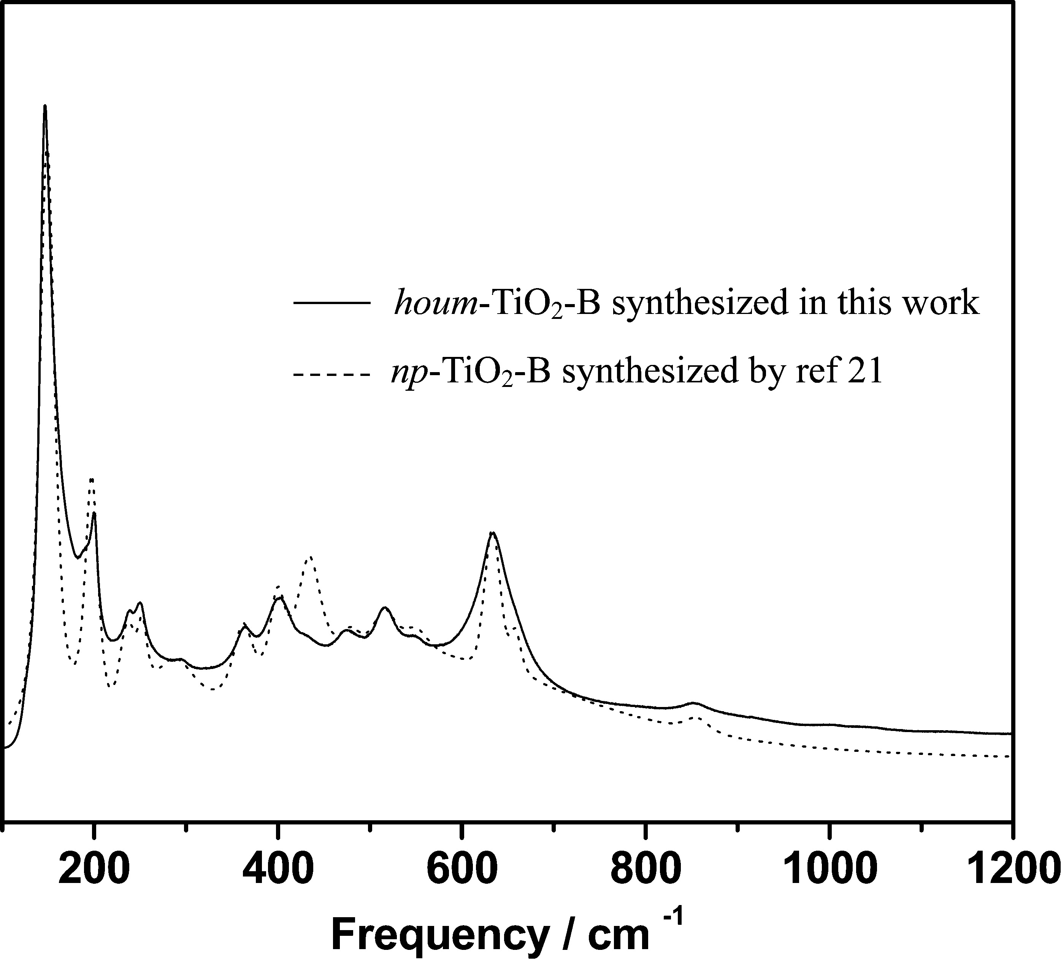
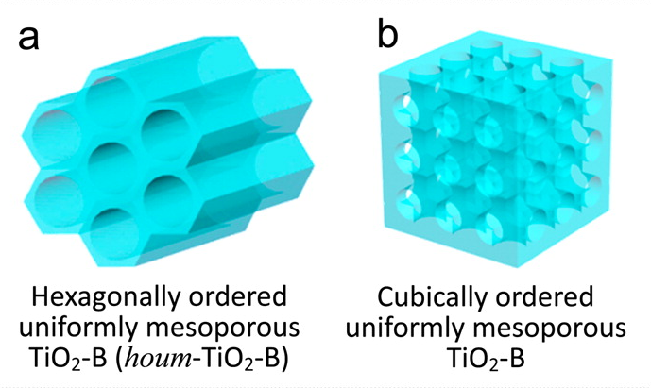
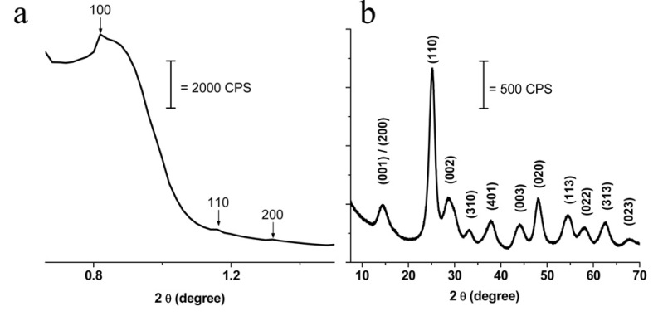
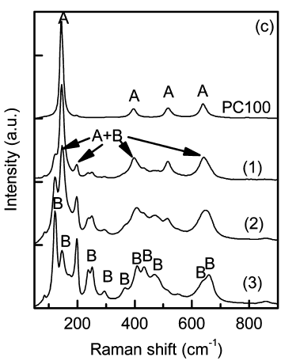
Recent Literature
Hossain et al., Chem. Mater., 2015, 27, 6550-6557.
42.6 wt % (A), 57.4 wt % (B)
12 wt % (A), 88 wt % (B)
5 wt % (A), 95 wt % (B)
Thomas et al., J. Phys. Chem. C, 2009, 113, 13703–13706.

Slide 4
Objective
Preparation of well-ordered mesoporous titania having a unique phase
composition of TiO₂(B) and anatase phase.
Photocatalytic hydrogen evolution on prepared material and competitive
studies with commercial available titania (P-25) catalysts.

Slide 5
Synthesis, Characterisation and Photocatalytic activity of Ordered Mesoporous TiO₂ using
Surfactant Template (F-127)

Slide 6
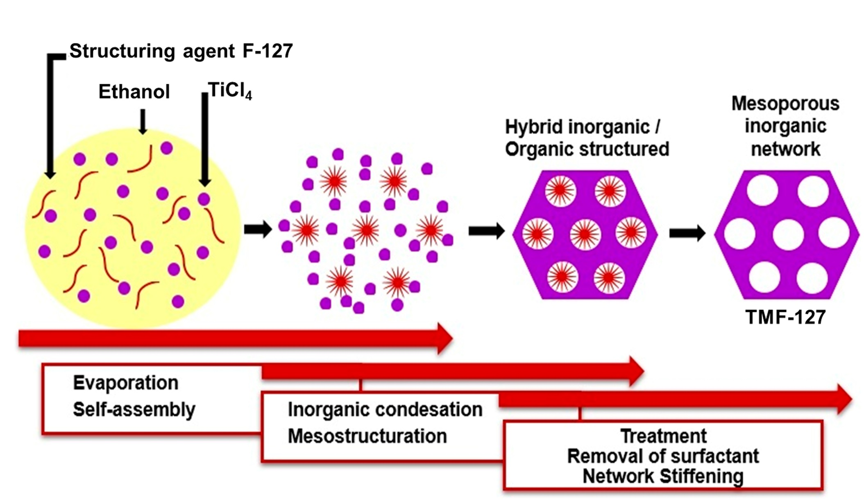
Mechanism

Slide 7
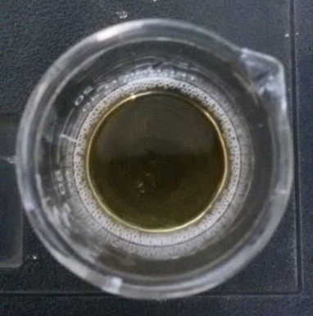
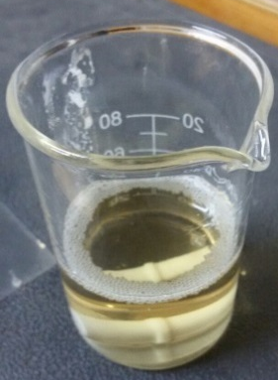
Synthesis Procedure
F-127 + Ethanol
F-127:
HO[CH₂CH₂O]₁₀₀ -[CH₂ CH(CH₃) O-]₆₅ –[CH₂CH₂O]₁₀₀-H
Stirred for 2 h
Addition of TiCl₄ (drop-by-drop)
Stirred vigorously
for 30 min.
Formation of Transparent sol
Transfer sol in open dish
for a week at 40°C.
Gel formation
Calcined at 350°C
for 4 h; 0.5°C/min
Mesoporous TiO₂
(TMF-127)

Slide 8
XRD pattern
Kubelka – Munk plot
SXRD patterns shows mesoporous structure is achieved whereas WXRD pattern shows
mesoporous structure is well crystallized , intense reflection corresponds to anatase and
TiO₂(B) phase.
The onset band gap calculated by kubelka-Munk plot is 3.2 eV.

Slide 9
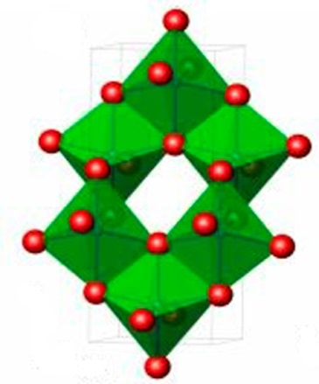
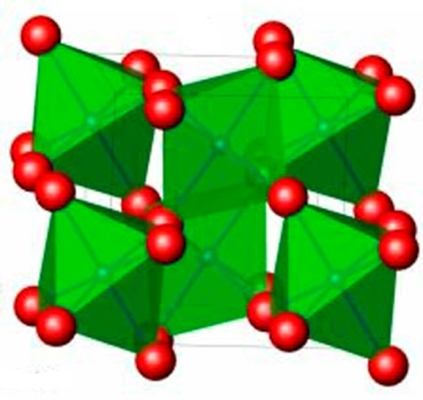
Rietveld refined XRD pattern
Anatase
TiO₂(B)
Table.1 Structural parameter of TMF-127

Slide 10
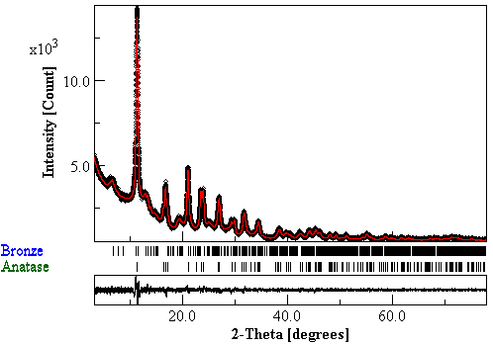
Rietveld refined Synchrotron XRD pattern
TMF-127
Goodness of fit (S) = 1.42
R_{wp} (%) = 3.67
R_{exp} (%) = 2.58
Bronze - 63.1 ± 0.5 wt.%
Anatase - 36.9 wt.%
Table.2 Structural parameter of TMF-127

Slide 11
Nitrogen sorption
Typical type IV isotherm with H1-type
hysteresis loop characteristic in a region
(P/P₀= 0.4 to 0.7) region.
Second hysteresis also observed at high relative pressure due to secondary pores. Isotherm is not levelling off at saturation vapour pressure at high relative pressure suggests slit like pore
geometry.
Table.2
Structural, electronic ,textural and photocatlytic hydrogen evolution
Catalyst | ªt (nm) | ^{b}P_{s} (nm) | ^{c}E_{g} (eV) | ^{d}S_{BET} (m² g⁻¹) | ^{e}D_{p} (nm) |  |  | ^{f}V_{p} (cm³ g⁻¹) | ^{g}h_{w} (nm) | ^{h}r_{H2} (mmolg⁻¹ h⁻¹)
 |  |  |  |  | BJH |  | TEM
TMF-127 | 5(M), 8(A) | 8.2 | 3.2 | 175 | 5 | 4.9 |  | 0.23 | 6.4 | 0.07
ªCrystallite size; ^{b}Particle size; ^{c}Band gap; ^{d}Surface area; ^{e}Pore diameter; ^{f}Pore volume; ^{g}Wall thickness;
^{h}rate of hydrogen evolution

Slide 12
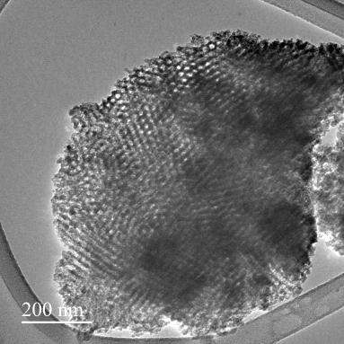
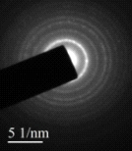
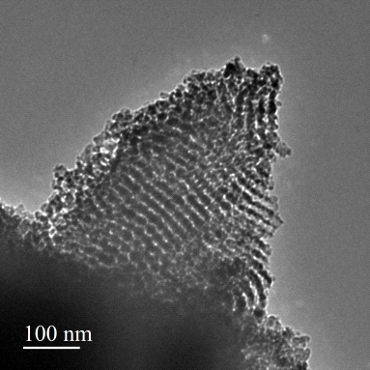
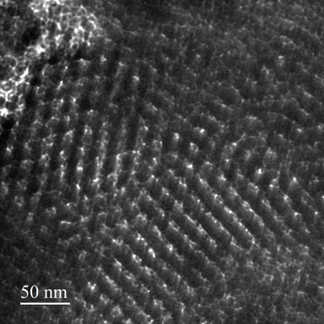
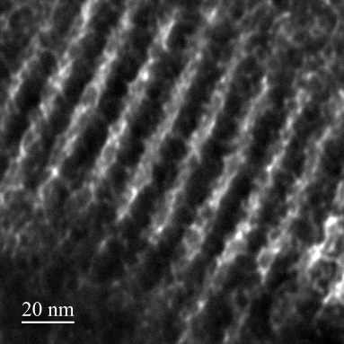
Raman
TEM
(a)
(b)
(c)
(d)
4.9 nm
(e)
(f)
Peaks at 145.6, 398.9, 514.5 and 638.9 cm⁻¹ are corresponds to anatase phase where as peaks
at 201.1, 247.86, 364, 476.7 cm⁻¹ corresponds to TiO₂ (B) phase.
TEM image viewed along [110] direction shows long range ordered pore channels and
selected area electron diffraction (inset) shows well crystallized mesoporous framework.

Slide 13
EPR spectra

Slide 14
VSM
TMF- 127 shows ferromagnetic order at low field but dominated by diamagnetic order
at high magnetic field.

Slide 15
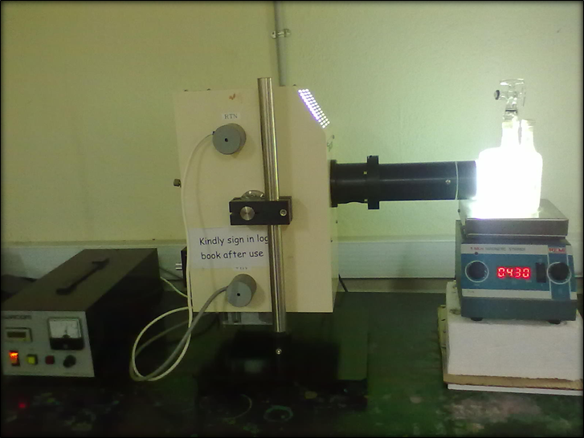
Photocatalytic hydrogen evolution
Experimental set up
The illumination constitutes 37.3 % of ultra violet radiation (23.8% for λ=335 nm and 14.5% for λ=365 nm ) and the remaining in the visible region.
Reaction Condition: Catalyst wt.- 65 mg, Water- 225 mL, Methanol- 75 mL, Light Source – 77 W Hg lamp,
Reactor Volume- 315 mL.

Slide 16
PHOTOCATALYTIC HYDROGEN PRODUCTION
LITERATURE vs. PRESENT WORK
TiO₂ Photocatalyst | Synthesis Method | Pt (wt.%) | MeOH (%) | Light source | H₂ evolution Rate (mmol g⁻¹ h⁻¹) | Ref.
OMT-WT | EISA | NIL | 25 | Solar Simulator | 0.03 | 1
TiO₂ -10 | Nano-casting | NIL | 18.2 | 300 W Xe lamp | 0.13 | 2
TMF-127 | EISA | NIL | 25 | 77 W Hg lamp | 0.09 | Our Work
Zhou et al., J. Am. Chem. Soc., 2014, 136, 9280.
J. Mahoney et al., Molecules, 2015, 20, 21881.

Slide 17
Synthesis, Characterisation and Photocatalytic activity of Ordered Mesoporous TiO₂ using
Surfactant Template (F-108)

Slide 18
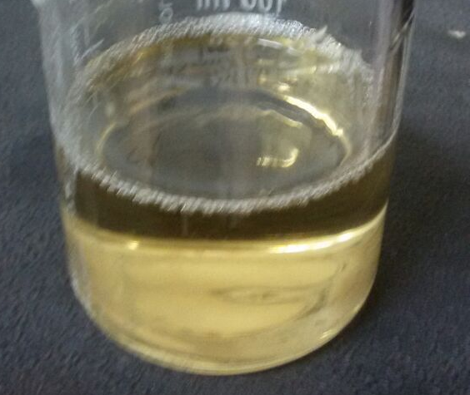
Synthesis Procedure
4 g F-108 + 40 mL ethanol
F-108-
HO[CH₂CH₂O]₁₃₃-[CH₂ CH(CH₃) O-]₅₀–[CH₂CH₂O]₁₃₃-H
Stirred for 2 h
Add drop by drop 16 mL of TiCl₄
Stirred vigorously
for 2 h.
Formation of Transparent sol
transfer sol in open dish
for a week at 40°C
Gel
calcined at 360°C
for 4 h; 0.5°C/min
Mesoporous TiO₂ (TMF-108)

Slide 19
Mechanism

Slide 20
XRD Pattern
Kubelka Munk plot

Slide 21
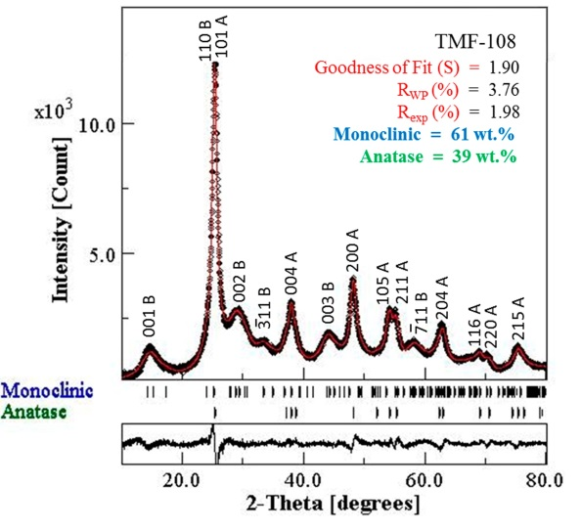
Rietveld refined XRD pattern
Table.1 Structural parameter of TMF-108

Slide 22
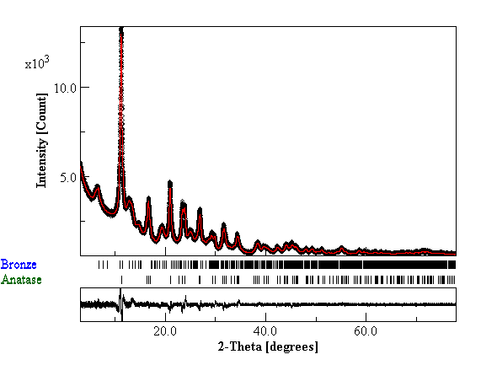
Rietveld refined Synchrotron XRD pattern
TMF-108
Goodness of fit (S) = 1.77
R_{wp} (%) = 4.54
R_{exp} (%) = 2.55
Bronze – 56.6 ± 0.2 wt.%
Anatase - 43.4 wt.%

Slide 23
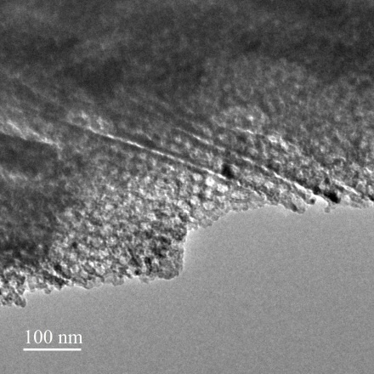
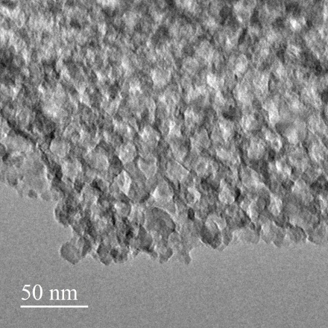
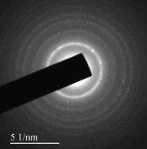
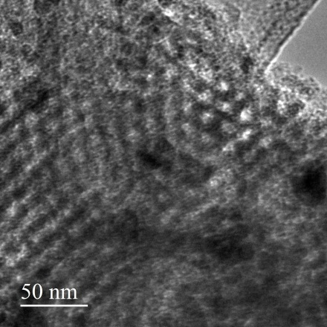
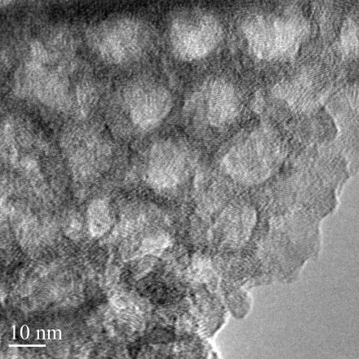
Raman specta
TEM
(a)
(c)
3.6 nm
(b)
(d)
8.7 nm
Peaks at 146.8, 407.1, 514.5 and 636.9 cm⁻¹ are corresponds to anatase phase where as
peaks at 198.5, 237.6, 351.6, 490.3cm⁻¹ corresponds to TiO₂ (B) phase.
TEM image viewed along [110] direction show long range ordered pore channels and [100]
direction shows well 2D hexagonal arrangement electron diffraction (inset) shows well
crystallized mesoporous framework.

Slide 24
Nitrogen sorption
Typical type IV isotherm with H₁ hysteresis
loop characteristic. Isotherm is not levelling
off at saturation vapour pressure at high
relative pressure it suggests slit like pore
geometry.
Table.2 Structural, electronic ,textural and photocatlytic hydrogen evolution
Catalyst | ªE_{g} (eV) | ^{b}S_{BET} (m² g⁻¹) | ^{c}D (nm) |  | ^{d}V_{p} (nm) | ^{e}h_{w} (nm) | ^{e}r_{H2} (mmol g⁻¹h⁻¹)
 |  |  | BJH | TEM
TMF-108 | 3.1 | 124 | 4.7 | (3.6, 8.7) | 0.17 | 7 | 0.47
ªBand gap; ^{b}Surface area; ^{c}Pore diameter; ^{d}Pore Volume, ^{e}Wall thickness; (h_{w} = a₀ - D_{BJH}), ^{e}Rate of H₂ evolution

Slide 25
Photoluminescence spectra
Photoluminescence spectra shows low recombination of excitons for TMF-108 compared to
compared to P-25 WT signal occurred at 365 nm is due to band edge excitons other signals in
the range of 450-520 nm excitonic Pl signal which mainly occur due to surface oxygen
vacancy and other surface defects.

Slide 26
EPR spectra

Slide 27
VSM
RTFM observed at weak magnetic field which is dominant by dimagnetic order at
high field due to low concentration of defect.
Magnitude of FM order increased further at 70 K dominating by diamagnetic order.

Slide 28
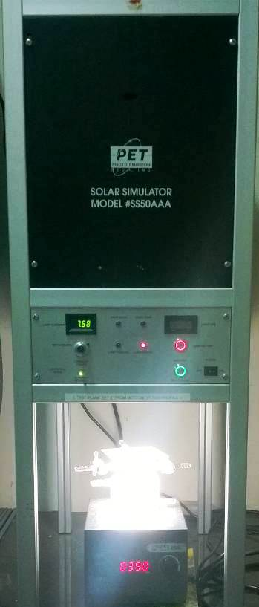
Photocatalytic Hydrogen evolution
Reaction Condition: Catalyst wt.- 30 mg, Water- 75 mL, Methanol- 25 mL, Light Source – Solar Simulator 150 W,
Reactor Volume- 315 mL.

Slide 29
PHOTOCATALYTIC HYDROGEN PRODUCTION
LITERATURE vs. PRESENT WORK
Photocatalyst | Synthesis Method | MeOH (%) | Light source | r_{H2} (mmol g⁻¹ h⁻¹) | Ref.
OM-WT | EISA | 25 | Solar simulator | 0.03 | [1]
TiO₂-10 | Nano-casting | 18.2 | 300 W Xe Lamp (UV only) | 0.13 | [2]
P-25 | Commercial | 25 | Solar Simulator | 0.44 | Our Work
TMF-127 | EISA | 25 | 77 W Hg lamp | 0.07 | Our work
TMF-127 | EISA | 25 | Solar Simulator | 0.34 | Our Work
TMF-108 | EISA | 25 | Solar Simulator | 0.47 | This Work
WT - white titania; OM – Ordered mesoporous; TMF- Ordered mesoporous titania.
Zhou et al., J. Am. Chem. Soc., 2014, 136, 9280
L. Mahoney et al., Molecules, 2015, 20, 21881.

Slide 30
Conclusions
Ordered mesoporous titania material (TMF-108) having high specific surface area, well
crystallize framework is successfully synthesized via EISA method using F108 as a
surfactant.
Its been reported first time that TMF-108 has mixed phase composition of anatase and
TiO₂(B) it is synthesized using soft template (F-108) which is depicted by XRD pattern
and Raman spectra.
Phototcatalytic hydrogen evolution shows (~1.07 times) enhanced in activity analogous to
commercial Degussa P-25.

Slide 31
Synthesis of disordered worm- like mesoporous titania

Slide 32

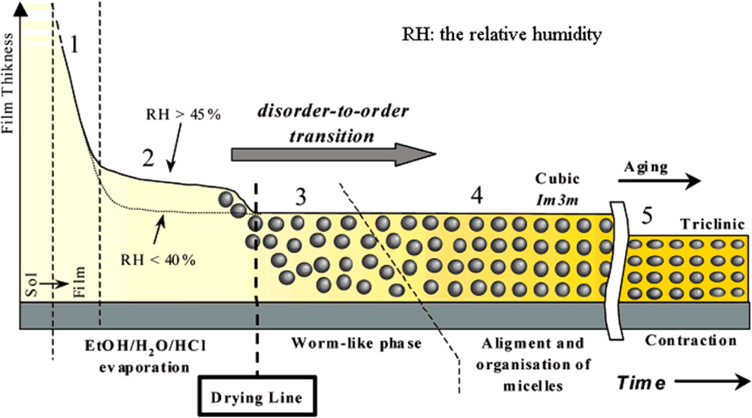
Schematic representing the various stages for the synthesis of ordered mesoporous TiO2 films via an EISA process. Reprinted from ref 32 with permission by American Chemical Society, Copyright 2003.
Published in: Wei Li; Zhangxiong Wu; Jinxiu Wang; Ahmed A. Elzatahry; Dongyuan Zhao; Chem. Mater. 2014, 26, 287-298.
DOI: 10.1021/cm4014859
Copyright © 2013 American Chemical Society

Slide 33
Synthesis
2 g F-127 + 40 mL ethanol
Stirred for 30 min
Add drop by drop 5 mL of TiCl₄
Stirred vigorously
for 2 h.
Transparent sol
transfer sol in open dish
for a week at 40°C
Gel
calcined at 350°C
for 4 h; 0.5°C/min
Mesoporous TiO₂ TMF-127(14)

Slide 34
XRD pattern
Kubelka-Munk plot

Slide 35
N₂ sorption isotherm
XRD
4.2 nm
Table.2 Structural, electronic ,textural and photocatlytic hydrogen evolution
Catalyst | t (nm) | E_{g} (eV) | a₀ (nm) | S_{BET} (m² g⁻¹) | D_{p} (nm) | V_{p} (cm³ g⁻¹) | ªW_{p} (nm) | r_{H2} (mmolg⁻¹ h⁻¹)
MTO-127 | .. | 3.2 | 11.5 | 128 | 4.2 | 0.16 | 7.3 | 0.34

Slide 36
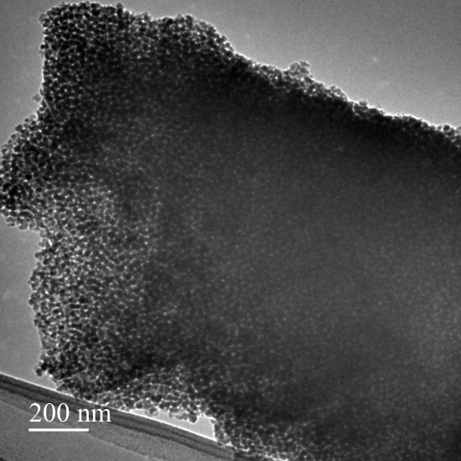
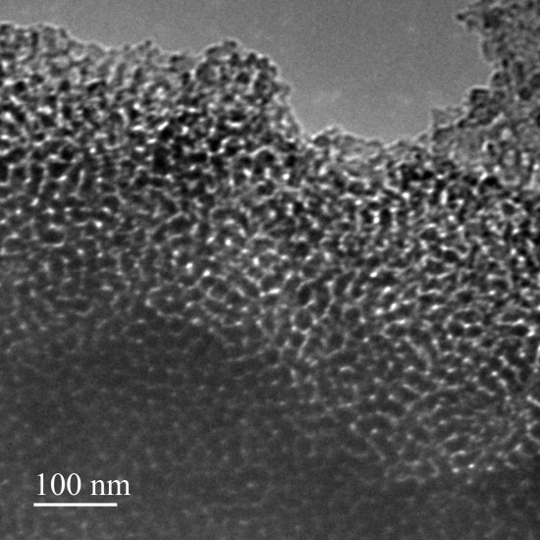
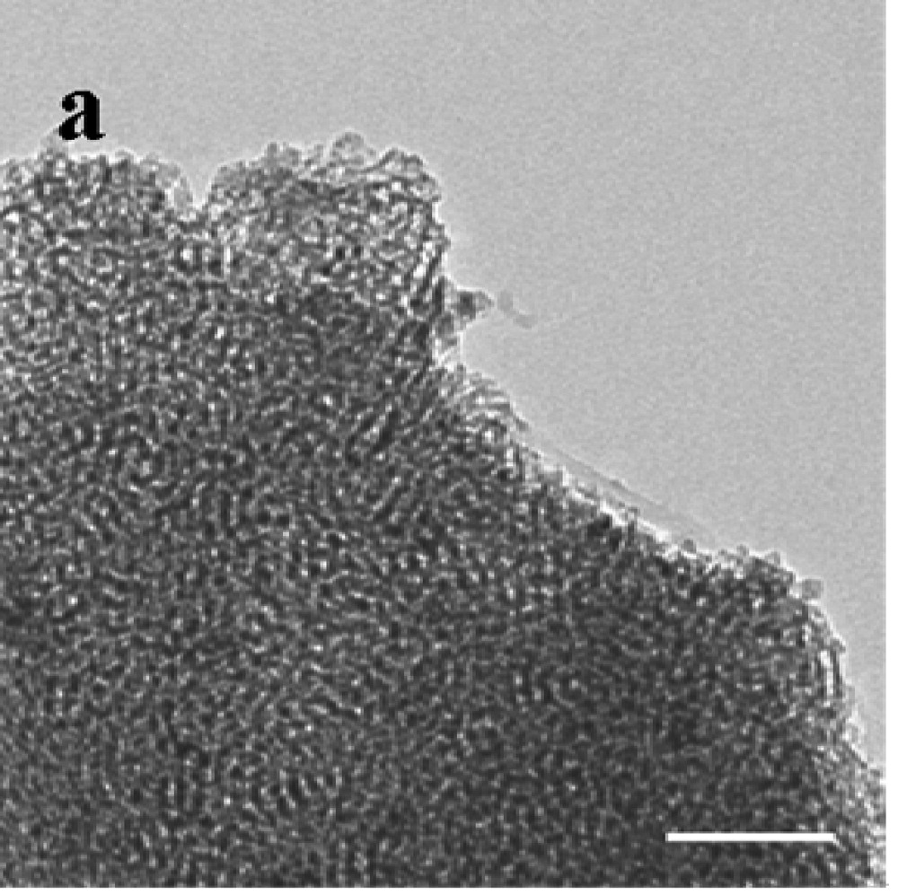
TEM
Literature
Chen et al, J. Phys. Chem. C 2007, 111, 11849-11853.

Slide 37
Synthesis, characterization and photo-catalytic activity of Ytterbium-incorporated ordered mesoporous titania using soft template (F-127)

Slide 38
Bulk TiO₂ is extensively used photocatalyst due to its biological and chemical inertness,
non-toxic, low cost and easy availability for a wide range of applications in areas like
Gas sensing, Photocatalysis, Solar energy conversion, etc.
However, the application is limited by low surface area (~ 50 m²/g) and electron-hole
recombination.
Ordered mesoporous TiO₂ with high specific surface areas, regular and tunable large
pore sizes and high pore volumes as well as stable and interconnected framework seems
to be promising.
However, it is difficult to synthesize ordered mesoporous TiO₂, in particular, ordered structure as the titania precursor used for the synthesis is easily hydrated and it is hard to maintain chemical composition and not easy to control the pore structure.
Effect of doping of trivalent ion to an ordered mesoporous structure further enhanced its structural, electronic and optical properties to some extent. The effect has been less extensively investigated.
Here we have successfully synthesized Yb³⁺ doped ordered mesoporous TiO₂ having specific high surface area using soft template (F127 and F108).
Introduction

Slide 39
Synthesis
4 g F-127 + 40 mL ethanol
Stirred for 1 h
Add 0.898 g YbNO₃.5H₂O
Stirred 15 min.
Add 14 mL of TiCl₄ (1M in methylene chloride)
Stirred for 1 h
transfer sol in open dish
Put in oven for 2 days at 40°C
than 2 days at 100°C
Mol ratio Ti: Yb
1:0.14
Calcined at 350°C
for 4 h; 0.5°C/min
Yb-TMF-127

Slide 40
XRD pattern

Slide 41
DRUV-vis spectra and Kubelka Munk plot

Slide 42
N₂ sorption isotherm
Raman
Table2. Structural, electronic ,textural and photocatlytic hydrogen evolution
Catalyst | E_{g} (eV) | a₀ (nm) | S_{BET} (m² g⁻¹) | D_{p} (nm) | V_{p} (cm³ g⁻¹) | ªW_{p} (nm) | r_{H2} (mmolg⁻¹ h⁻¹)
Yb-TMF-127 | 3.25 | 10 | 224 | 4.3, 6.9 | 0.32 | 5.2, 6.4 | 0.62

Slide 43
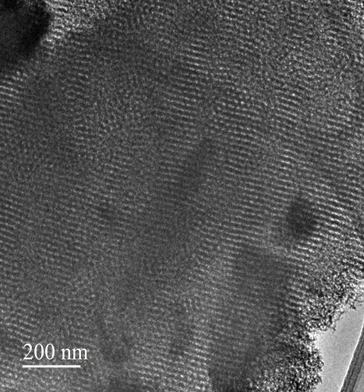
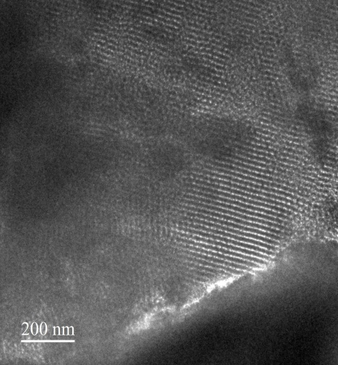
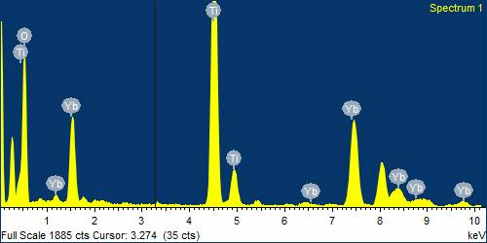
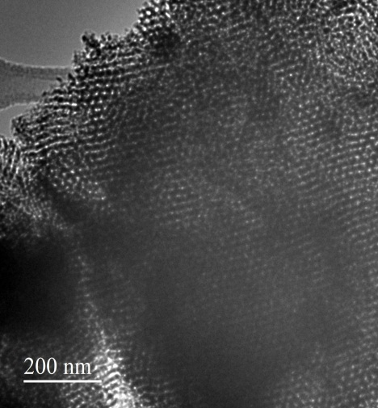
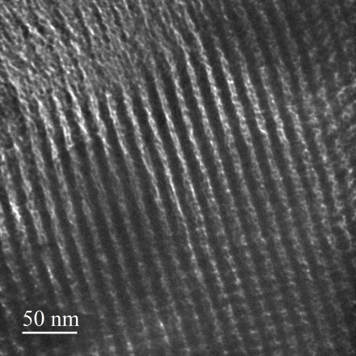
TEM
EDX
(a)
(c)
4.5 nm
(b)
(d)
6.9 nm

Slide 44
EPR

Slide 45
Synthesis, characterization and photocatalytic activity of Ytterbium-incorporated ordered mesoporous titania using soft template (F-108)

Slide 46
Synthesis
4 g F-108 + 45 mL ethanol
Stirred for 1h 30 min.
Add 0.898 g YbNO₃.5H₂O
Stirred 20 min.
Add 14 mL of TiCl₄
Stirred for 1 h
transfer sol in open dish
Put in oven for 2 days at 40°C
than 2 days at 100°C
Calcined at 350°C
for 4 h; 0.5°C/min
Yb doped m-TiO₂ (Yb-TMF-108)

Slide 47
XRD pattern

Slide 48
DRUV-vis spectra and Kubelka Munk plot

Slide 49
N₂ sorption isotherm
Raman spectra
4.8 nm
Table1.
Structural, electronic ,textural and photocatlytic hydrogen evolution
Catalyst | t (nm) | E_{g} (eV) | a₀ (nm) | S_{BET} (m² g⁻¹) | D_{p} (nm) | V_{p} (cm³ g⁻¹) | ªW_{p} (nm) | r_{H2} (mmolg⁻¹ h⁻¹)
Yb-MTO-108 | .. | 3.2 | 9.7 | 195 | 4.8 | 0.27 | 4.9 | 0.53

Slide 50
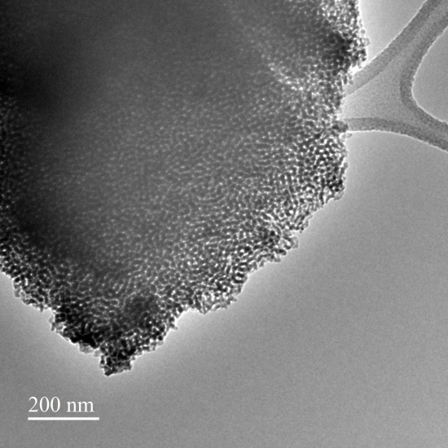
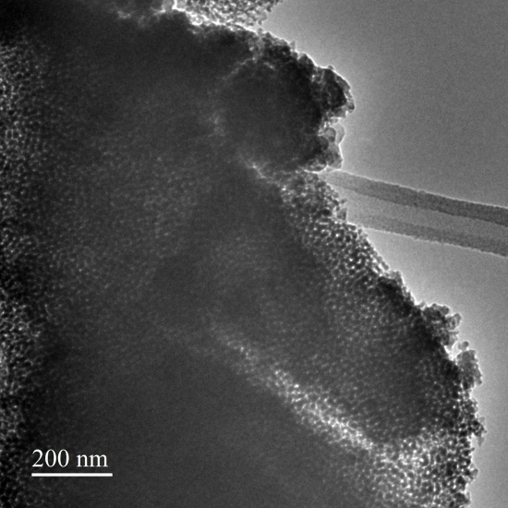
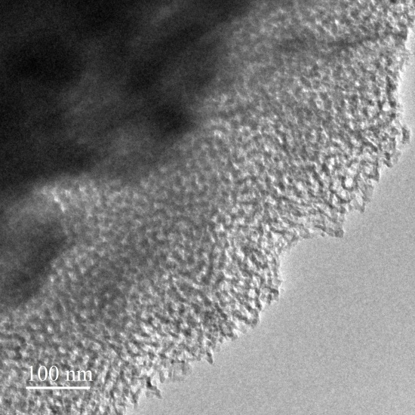
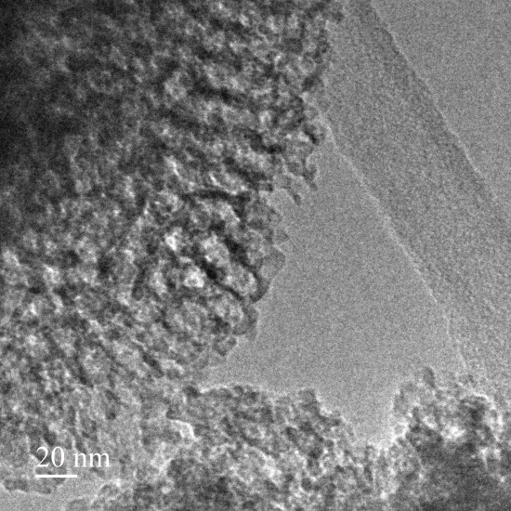
TEM
(a)
(c)
(b)
(d)

Slide 51
Photocatalytic Hydrogen evolution
Reaction Condition: Catalyst wt.- 30 mg, Water- 75 mL, Methanol- 25 mL, Light Source – Solar Simulator 150 W,
Reactor Volume- 315 mL.

Slide 52
PHOTOCATALYTIC HYDROGEN PRODUCTION
LITERATURE vs. PRESENT WORK
TiO₂ Photocatalyst | Synthesis Method | Pt (wt.%) | MeOH (%) | Light source | r_{H2} (mmol g⁻¹ h⁻¹) | Ref.
OMT-WT | EISA | NIL | NIL | Solar Simulator (300 W) | 0.003 | 1
TiO₂ -10 | EISA | NIL | 18.2 | 300 W Xe lamp | 0.13 | 2
TMF-127 | EISA | NIL | 25 | 77 W Hg Lamp | 0.07 | Our Work
 |  |  |  | Solar Simulator (150 W) | 0.34
Yb-TMF-127 | EISA | NIL | 25 |  | 0.62
TMF-127 (14) | EISA | NIL | 25
 |  |  |  |  | 0.34
TMF-108 | EISA | NIL | 25 |  | 0.47
Yb-TMF-108 | EISA | NIL | 25
 |  |  |  |  | 0.54
Hombikat | Commercial | NIL | 25
 |  |  |  |  | 0.57
P-25 |  | NIL | 25
 |  |  |  |  | 0.44
Zhou et al., J. Am. Chem. Soc., 2014, 136, 9280.
J. Mahoney et al., Molecules, 2015, 20, 21881.

Slide 53
Conclusions
Ordered mesoporous titania is successfully synthesized using F-127, F-108 surfactant.
Successfully synthesized high specific surface area materials are well suited for full
capture solar energy and make a large no. of active sites for photochemical reactions.
Yb³⁺ stablized ordered mesoporous titania (Yb-MTO-127) yields (~1.4 times) higher
photocatalytic hydrogen evolution compared to commercial available degussa P-25 and
(~1.12 times) compared to Hombikat UV 100.
Yb³⁺ stablized ordered mesoporous titania (Yb-MTO-108) yields (~1.2 times) higher
photocatalytic hydrogen evolution compared to commercial available degussa P-25.

