Slide 1
The Field of Catalysis – Today
1st January 2018
National Centre for Catalysis Research
Indian Institute of Technology Madras

Slide 2
Typical Unresolved issues in Catalysis so far:
Key unresolved issues include the epoxidation of ethene with silver as a catalyst. Different conflicting models exist on how the precise composition of the silver surface influences this reaction. This factor determines the selectivity of the catalyst and therefore also the optimization of the process.
Another example is the hydrogenation of ethene on a metal surface. Again: what is the exact structure of the surface during the reaction? Is it the naked metal surface, or is the surface filled with organic intermediates?
We also lack basic insight into the synthesis of zeolites for catalysts. What role does molecular recognition play in building intermediates at a molecular level, when producing a zeolite? Or is the building of the structure a collective process, in which molecules are reorganized in a gel, without molecular recognition on a piecemeal basis.
In Fischer Tropsch catalysis, several groups have reported on particle size effects for cobalt. Other groups have denied these effects, stating “cobalt is cobalt is cobalt.” We are seeing the emergence of theory to understand the (non-)existence of this particle size effect .
Future perspective in catalysis a Dutch study Dutch National school combination

Slide 3
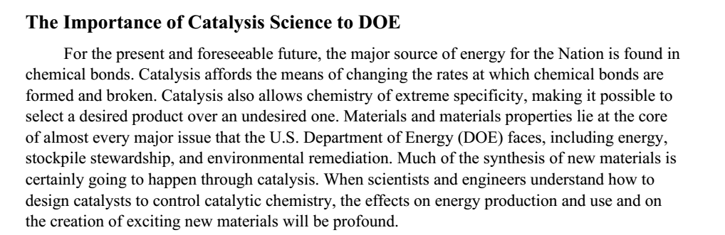

Slide 4
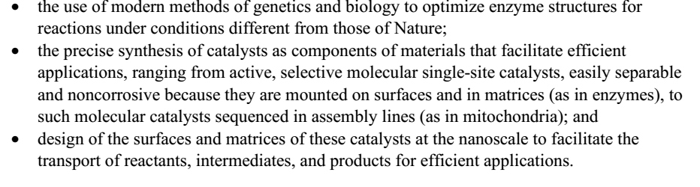

Slide 5
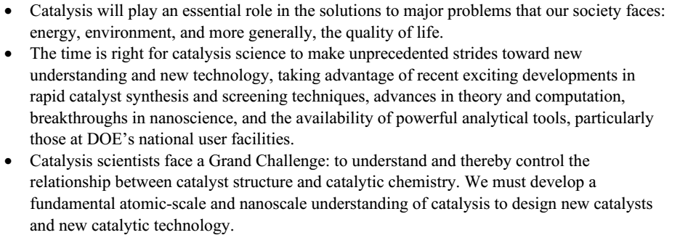
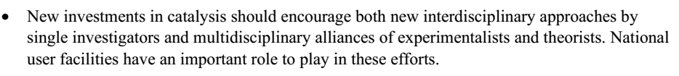

Slide 6
Role of Catalysis in a National Economy
24% of GDP from Products made using catalysts (Food, Fuels, Clothes, Polymers, Drug, Agro-chemicals)
> 90 % of petro refining & petrochemicals processes use catalysts
90 % of processes & 60 % of products in the chemical industry
> 95% of pollution control technologies
Catalysis in the production/use of alternate fuels (NG,DME, H₂, Fuel Cells, biofuels…)

Slide 7
Why R&D in catalysis is important
For discovery/use of alternate sources of energy/fuels/raw material for chemical industry
For Pollution control
For preparation of new materials
(organic & inorganic-eg: Carbon Nanotubes)

Slide 8
Three Scales of Knowledge Application

Slide 9
Some Developments in Industrial catalysis-1
1900- 1920s
Industrial Process Catalyst
1900s: CO + 3H₂ ⇒ CH₄ + H₂O Ni
Vegetable Oil + H₂ ⇒ butter/margarine Ni
1910s: Coal Liquefaction Ni
N₂ + 3H₂ ⇒ 2NH₃ Fe/K
NH₃ ⇒NO ⇒NO₂ ⇒HNO₃ Pt
1920s: CO + 2H₂ ⇒ CH₃OH (HP) (ZnCr)oxide
Fischer-Tropsch synthesis Co,Fe
SO₂ ⇒ SO₃ ⇒H₂SO₄ V₂O₅

Slide 10
Industrial catalysis-2
1930s and 1940s
1930s:Cat Cracking(fixed,Houdry) Mont.Clay
C₂H₄ ⇒C₂H₄O Ag
C₆H₆ ⇒ Maleic anhydride V₂O₅
1940s:Cat Cracking(fluid) amorph. SiAl
alkylation (gasoline) HF/acid- clay
Platforming(gasoline) Pt/Al₂O₃
C₆H₆ ⇒C₆H₁₂ Ni

Slide 11
Industrial catalysis-3
1950s
C₂H₄ ⇒Polyethylene(Z-N) Ti
C₂H₄ ⇒Polyethylene(Phillips) Cr-SiO₂
Polyprop &Polybutadiene(Z-N) Ti
Steam reforming Ni-K- Al₂O₃
HDS, HDT of naphtha (Co-Mo)/Al₂O₃
C₁₀H₈ ⇒ Phthalic anhydride (V,Mo)oxide
C₆H₆ ⇒ C₆H₁₂ (Ni)
C₆H₁₁OH ⇒C₆H₁₀O (Cu)
C₇H₈+ H₂ ⇒C₆H₆ +CH₄ (Ni-SiAl)

Slide 12
Industrial catalysis-4
1960s
Butene ⇒Maleic anhydride (V,P) oxides
C₃H₆ ⇒ acrylonitrile(ammox) (BiMo)oxides
Bimetallic reforming PtRe/Al₂O₃
Metathesis(2C₃ ⇒C₂+C₄) (W,Mo,Re)oxides
Catalytic cracking Zeolites
C₂H₄ ⇒vinyl acetate Pd/Cu
C₂H₄ ⇒ vinyl chloride CuCl₂
O-Xylene ⇒Phthalic anhydride V₂O₅/TiO₂
Hydrocracking Ni-W/Al₂O₃
CO+H₂O ⇒H₂+CO₂ (HTS) Fe₂O₃/Cr₂O₃/MgO
--do-- (LTS) CuO-ZnO- Al₂O₃

Slide 13
Industrial catalysis-5
1970s
Xylene Isom( for p-xylene) H-ZSM-5
Methanol (low press) Cu-Zn/Al₂O₃
Toluene to benzene and xylenes H-ZSM-5
Catalytic dewaxing H-ZSM-5
Autoexhaust catalyst Pt-Pd-Rh on oxide
Hydroisomerisation Pt-zeolite
SCR of NO(NH₃) V/ Ti
MTBE acidic ion exchange resin
C₇H₈+C₉H₁₂ ⇒C₆H₆ +C₈H₁₀ Pt-Mordenite

Slide 14
Industrial catalysis-6
1980s
Ethyl benzene H-ZSM-5
Methanol to gasoline H-ZSM-5
Vinyl acetate Pd
Improved Coal liq NiCo sulfides
Syngas to diesel Co
HDW of kerosene/diesel.GO/VGO Pt/Zeolite
MTBE cat dist ion exchange resin
Oxdn of methacrolein Mo-V-P
N-C6 to benzene Pt-zeolite

Slide 15
Industrial catalysis-7
1990^{s}
DMC from acetone Cu chloride
NH₃ synthesis Ru/C
Phenol to HQ and catechol TS-1
Isom of butene-1(MTBE) H-Ferrierite
Ammoximation of cyclohexanone TS-1
Isom of oxime to caprolactam TS-1
Ultra deep HDS Co-Mo-Al
Olefin polym Supp. metallocene cats
Ethane to acetic acid Multi component oxide
Fuel cell catalysts Rh, Pt, ceria-zirconia
Cr-free HT WGS catalysts Fe,Cu- based

Slide 16
Industrial catalysis-8
2000+
Solid catalysts for biodiesel
- solid acids, Hydroisom catalysts
Catalysts for carbon nanotubes
- Fe (Ni)-Mo-SiO₂
_{For Developed} Catalysts MAINLY IMPROVEMENT IN PERFORMANCE by New Synthesis Methods & use of PROMOTERS

Slide 17
Green Chemistry is Catalysis
Pollution control (air and waste streams; stationary and mobile)
Clean oxidation/halogenation processes using O₂,H₂O₂ (C₂H₄O, C₃H₆O)
Avoiding toxic chemicals in industry
(HF,COCl₂ etc)
Fuel cells (H₂ generation)
Latest Trends

Slide 18
Catalysis in Nanotechnology
Methods of Catalyst preparation are most suited for the preparation of nanomaterials
Nano dimensions of catalysts
Common prep methods
Common Characterization tools
Catalysis in the preparation of carbon nanotubes
Latest Trends

Slide 19
Catalysis in the Chemical Industry
Hydrogen Industry(coal,NH₃,methanol, FT, hydrogenations/HDT,fuel cell)
Natural gas processing (SR,ATR,WGS,POX)
Petroleum refining (FCC, HDW,HDT,HCr,REF)
Petrochemicals (monomers,bulk chemicals)
Fine Chem. (pharma, agrochem, fragrance, textile,coating,surfactants,laundry etc)
Environmental Catalysis (autoexhaust, deNOx, DOC)
Latest Trends

Slide 20
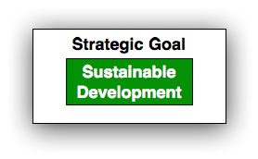
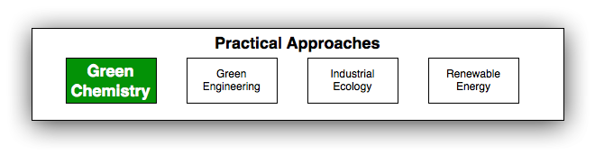
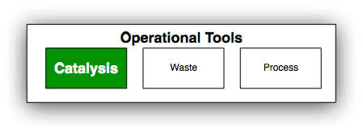
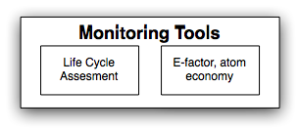
Big picture: Sustainable Development

Slide 21
Green Chemistry Is About...
^{Waste}
^{Materials}
^{Hazard}
Reducing
^{Risk}
Energy
Cost

Slide 22

The drivers of green chemistry
Economic benefit
Lower
capital investment
Lower
operating costs
Societal pressure
Government legislation
Improved
public image
Less
hazardous materials
Safer
and smaller plants
Green chemistry
High fines for waste
Pollution control
Producer
responsibility

Slide 23
Green Catalytic Processes
Alternative feedstocks, reagents, solvents, products
Enhanced process control
New catalysts
Greater integration of catalysis and reactor engineering:
membrane reactors, microreactors, monolith technology, phenomena integration
Increased use of natural gas and biomass as feedstock
Photodecomposition of water into hydrogen and oxygen
Catalysts for depolymerizing polymers for recycle of the monomers
Improvements in fuel cell electrodes and their operation

Slide 24
Cleaner and greener Environment: Catalysis
New directions for research driven by market, social & environmental needs:
Catalysis for energy-friendly technologies and processes (primary methods)
New advanced cleanup catalytic technologies (secondary methods)
Catalytic processes and technologies for reducing the environmental impact of chemical and agro-industrial solid or liquid waste and improving the quality and reuse of water (secondary methods)
Catalytic processes for a sustainable chemistry (green chemistry and engineering approach)
Replacement of environmentally hazardous catalysts in existing processes

Slide 25
How to Decrease the Greenhouse Effect?
New catalysts for high output fuel cells
Electricity production via electrocatalytic oxidation of hydrocarbons
Chemical energy of hydrocarbon is converted to electricity
Catalysts and processes for solar energy conversion and hydrogen
production
CO₂ or other greenhouse gases are not emitted into the atmosphere,
First solar energy is converted into the chemical energy of synthesis gas (CO + H₂) via the endothermic reaction of methane reforming
Storage of the synthesis gas
The stored energy can be released via the reverse exothermal methanation reaction
CO + 3H₂ → CH₄ + H2O
Efficiency from 43 to 70 %
Catalysts are needed for these reactions!!!

Slide 26
Examples of Green Catalysis

Slide 27
Examples of Green Catalysis

Slide 28
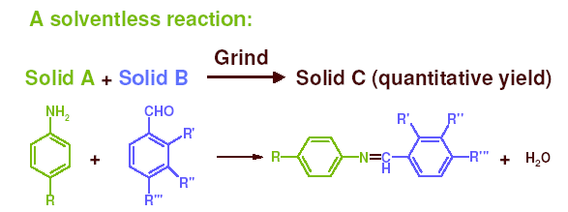
“The use of auxiliary substances (e.g. solvents, separation agents, etc.) should be minimized”
Examples of Green Catalysis

Slide 29
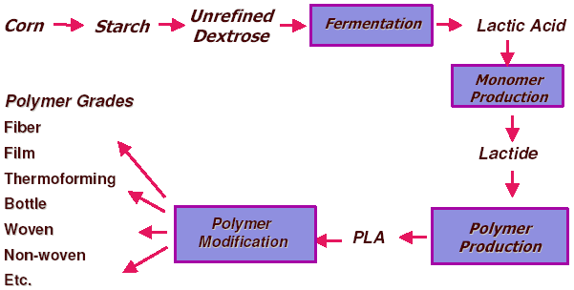
Poly lactic acid (PLA) for plastics production
Examples of Green Catalysis

Slide 30
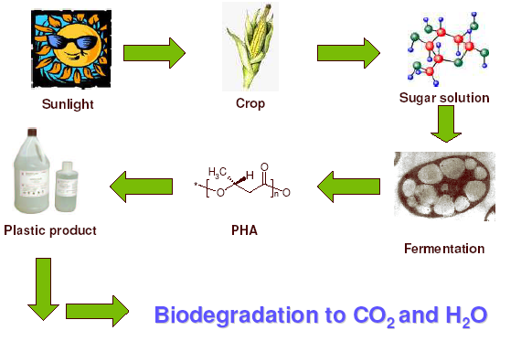
Polyhydroxyalkanoates (PHA’s)
Examples of Green Catalysis

Slide 31
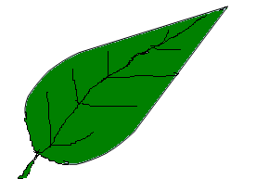
Photocatalysis
CO₂ + H₂O
CO₂
Chlorophyll
Photocatalyst
Organic
Compound
H₂O
Starch + O₂
Organic compound
+ H₂O + O₂

Slide 32
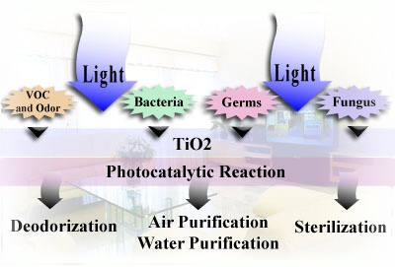
Photocatalytic Applications

Slide 33
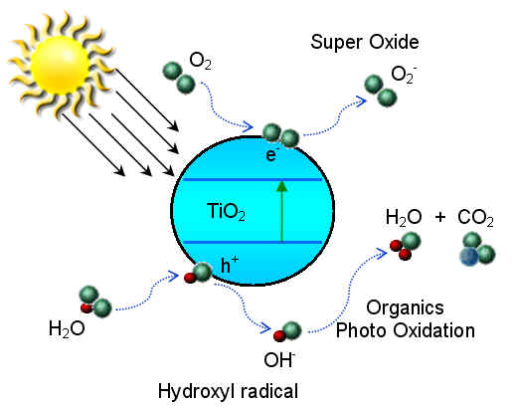
TiO₂ - Photocatalysis
3.12 eV (380 nm)

Slide 34
Some Potential Problems
Short residence times require fast reactions
Fast reactions require very active catalysts that are stable (The two most often do not go together)
Catalyst deactivation and frequent reactor repacking or reactivation
Fouling and clogging of channels
Leaks between channels
Malfunctioning of distributors
Reliability for long time on-stream
Structural issues
So far there are only two major commercial uses of micro-channel systems (monoliths) –
Automotive catalytic convectors (major success)
Selective catalytic reduction (NH₃ – SCR) of power plant NO_{x}
Notes:
S18 The following question then arises. With all their perceived advantages, and the technologies available to manufacture micro reactors in silicon, in glass and in steel, or other metals, why aren’t they more widely used?
The answer is that they require very fast reactions and active stable catalyst (usually these two do not go together).
Most importantly micro reactors are, due to small dimensions, more prone to fouling and clogging, leaks between channels, and their reliability and life on stream is an unknown.
All of these are potentially solvable problems on a case by case basis. However, the perceived risk factor is too large for them to replace existing installations.
Most likely acceptance of micro-devices will occur in the consumer products, distributed power systems, highly energetic fast reactions, in-situ production of hazardous chemicals. Other applications will be slower.

Slide 35
Applications of the Process Utilizing Biomass Streams
Process
Hydrogen
Energy
Crops
Extraction
Hydrogen
APR
PEM
Fuel Cell
Biomass
Waste
Extraction
SOFC
ICE
Genset
Aqueous
Biomass
Stream
Fuel Gas
APR
Microturbine
Genset

Slide 36
Biomass Sources For Biofuels
LignoCellulose (Cellulose, Hemicellulose, Lignin)
Starch
Sugars
Lipid Glycerides (Vegetable Oils & Animal Fats)

Slide 37
Pathways to Renewable
Transportation Fuels
Biomass
Methanol,
Ethanol,
FT( diesel,etc)
Gasifier
Syngas
Veg Oils
Algae Oils
Biodiesel
Pyrolysis
Bio Oils
Refine to Liquid
Fuels
Ferment to
ethanol,
butanol
Gasoline
additives
Hydrolysis
Aqueous phase
Reforming
Hydrogen

Slide 38
Bioethanol Overview - Global
Current bioethanol production in US is 12 billion gallons.
Most cars on the road in US today can run on blends of up to 10% ethanol.
US DOE has estimated that there is a potential to produce over 80 Billion gallons of bio-ethanol from cellulose and hemi-cellulose present in corn biomass in the 9 major US corn producing states.
This equates to over 250 Million tons of bio-ethanol and >$160 Billion revenue.
Iogen’s Demo plant producing cellulosic ethanol from wheat straw in Canada since 2004.
DuPont-Danisco JV has started demonstration of cellulosic ethanol from corncobs since Jan., 2010 in USA.
Brazil currently blends 25% ethanol in gasoline and bioethanol is produced directly from sugarcane.
Brazilian flex cars are capable of running on just hydrated ethanol (E100), or just on a blend of gasoline with 20 to 25% anhydrous ethanol, or on any arbitrary combination of both fuels
China uses 10% bioethanol in gasoline .

Slide 39
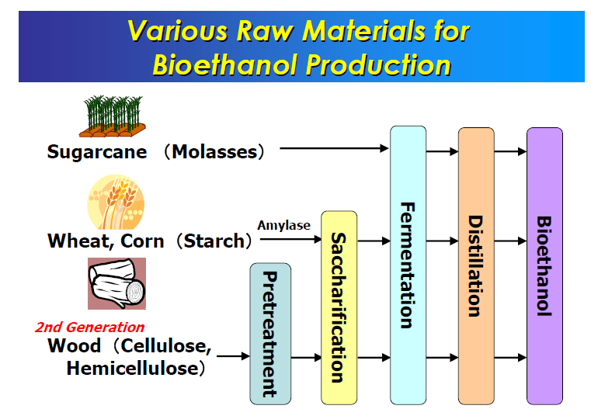

Slide 40
Natural gas to Transportation Fuels : Options
Natural Gas ⇒ Syngas
I. Syngas ⇒Methanol (DME) ⇒ Gasoline
II. Syngas ⇒ Fischer-Tropsch Syndiesel
Syndiesel Can use existing infrastructure
III. Syngas ⇒ H₂ ⇒ Fuel Cell – driven cars: Stationary vs On-board supply options for Hydrogen
Natural Gas ⇒Electricity;MCFC and SOFC can generate electricity by direct internal reforming of NG at 650C;Ni/ Zr(La)Al₂O₄, loaded on anode

Slide 41
Catalysts for conversion of NG to Transportation Fuels
I.Syngas Preparation
Hydrodesulphurisation(Co/Ni-Mo-alumina)
Syngas generation(H₂/ CO); POX, steam, autothermal, “dry” reforming; Ni(SR),Ru(POX) – based catalysts; Pt metals for POX for FT.
2.Fischer Tropsch Synthesis:
Co – Wax and mid dist; Fe - gasoline; Cu & K added.
Supported Co preferred due to its lower WGS activity & consequent lower loss of C as CO₂.
3.Product Work up:
Wax Conversion to diesel and gasoline.
Mild Hydro-cracking/Isom catalysts
(Pt metal- acidic oxide support )

Slide 42
Petroleum - vs- Syngas :: Diesel
Property Petro- Syn-
Boiling Range,ºC 150-300 150-300
Density at 15 C,kg/m³ 820-845 780
S, ppm vol 10 - 50 <1
Aromatics,% vol 30 <0.1
Cetane No >51 >70
CFPP, ºC -15 -20
Cloud point,ºC -8(winter) -15
Due to lower S, N and aromatics, GTL diesel generates less SOx and particulate matter.

Slide 43
Power and fuels from Coal / PetCoke Gasification Texaco EECP Project
FEED:1235 TPD OF PetCoke
PC ⇒ SG ⇒ (75%)Power Plant
⇒ 25%FT fuel(tail gas ⇒Power)
55 MW Electricity; Steam.
20 tpd diesel; 4 tpd naptha
82 tpd Wax(⇒60 tpd diesel); 89 tpd S;
H₂: CO = 0.67;Once-thru slurry(Fe) FT reactor; RR = 15 % at a refinery site.

Slide 44
Coal To Syngas To Fuel Cells
Catalysis in Coal / PetCoke gasification
SR: C + H₂O ⇒CO + H₂ (+117 kJ/mol)
Combust:2C+ O₂ ⇒ 2CO (ΔH = -243 kJ/mol)
WGS :CO + H₂O ⇒ H₂ + CO₂ ( -42 kJ/mol)
Methan: CO+3 H₂ ⇒ CH₄ + H₂O(- 205 kJ/mol)
Methanation can supply the heat for steam gasification and lower oxygen plant cost. K & Fe oxides lower temp of gasification
H₂/CO ~0.6 in coal gasification;Good WGS is needed;
MCFC and SOFC can use H₂,CO, & CH₄ as
fuel to generate electricity.
Low rank coals, Lignites gasify easier.

Slide 45
Hydrogen Production Costs
(The Economist / IEA)
SOURCE USD / GJ
Coal / gas/ oil/ biodiesel 1-5
NG + CO₂ sequestration 8-10
Coal + CO₂ sequestration 10-13
Biomass(SynGas route) 12-18
Nuclear (Electrolysis) 15-20
Wind (Electrolysis) 15-30
Solar (Electrolysis) 25-50

Slide 47
Catalysts for H₂O and CO₂ Photothermal Splitting
Using Sunlight
1. H₂O ⇒ H₂ + 0.5 O₂
2. CO₂ ⇒ CO +0.5 O₂
FT Synthsis: CO + H₂ ⇒(CH₂)_{n} ⇒petrol/Diesel
Sandia’s Sunlight To Petrol Project: Cobalt ferrite loses O atom at 1400º C; When cooled to 1100º C in presence of CO₂ or H₂O, it picks up O, catalyzing reactions 1 and 2; Solar absorber provides the energy.
Challenge: Find a solid which loses / absorbs O from H₂O / CO₂ reversibly at a lower temp.

Slide 48
Splitting H₂O

Slide 49
Future Fuels: Catalysis Challenges
Meeting Specifications of Future Fuels
Remove S,N, aromatics, Particulate Matter
Power Generation
- Lower CO₂ Production in Catalytic Gasification
- Lower CO₂ and H₂/CO ratio in Syngas generation
FT Synthesis: Lower CH₄ and CO₂ ;Inhibit metal sintering; Increase attrition strength; Reactor design
Biomass:1.Cellulose to Ethanol ( enzymes)
2. Biomass gasification catalysts.
Decentralized Production/ Use of H₂ and Biofuels will avoid costs due to their storage and distribution.
“Holy Grail “ Challenges
Direct Conversion of CH₄ to methanol and C₅⁺.
Catalytic Water and CO₂ splitting using solar energy

Slide 50
Future Challenges in Heterogeneous Catalysis: Understanding Catalysts under Dynamic Reaction Conditions
Dr. Kai F. Kalz, Dr.‐Ing. Ralph Kraehnert, Dr. Muslim Dvoyashkin, Prof. Dr.‐Ing. Roland Dittmeyer, Prof. Dr. Roger Gläser, Prof. Dr.‐Ing. Ulrike Krewer, Prof. Dr. Karsten Reuter and Prof. Dr. Jan‐Dierk Grunwaldt ChemCatChem. 2017 Jan 9; 9(1): 17–29.
In the future, (electro‐)chemical catalysts will have to be more tolerant towards a varying supply of energy and raw materials. This is mainly due to the fluctuating nature of renewable energies. For example, power‐to‐chemical processes require a shift from steady‐state operation towards operation under dynamic reaction conditions. This brings along a number of demands for the design of both catalysts and reactors, because it is well‐known that the structure of catalysts is very dynamic. However, in‐depth studies of catalysts and catalytic reactors under such transient conditions have only started recently. This requires studies and advances in the fields of 1) operando spectroscopy including time‐resolved methods, 2) theory with predictive quality, 3) kinetic modelling, 4) design of catalysts by appropriate preparation concepts, and 5) novel/modular reactor designs. An intensive exchange between these scientific disciplines will enable a substantial gain of fundamental knowledge which is urgently required. This concept article highlights recent developments, challenges, and future directions for understanding catalysts under dynamic reaction conditions.

Slide 51
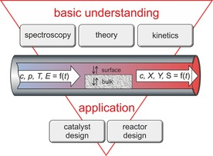
For understanding catalysts under dynamic reaction conditions different scientific disciplines such as (operando) spectroscopy, theory and kinetic modelling have to work hand in hand in order to provide a basic understanding of the relevant processes at the catalyst surface and the bulk. In a second step, this knowledge can then be implemented into the design of novel materials and reactor concepts. Fluctuations of the incoming variables concentration (c), pressure (p), temperature (T) and eventually electric potential (E) influence the local state of the catalyst and thereby lead to variations of the product stream composition in the form of concentration (c), conversion (X), yield (Y) and selectivity (S) of a specific product.

Slide 52
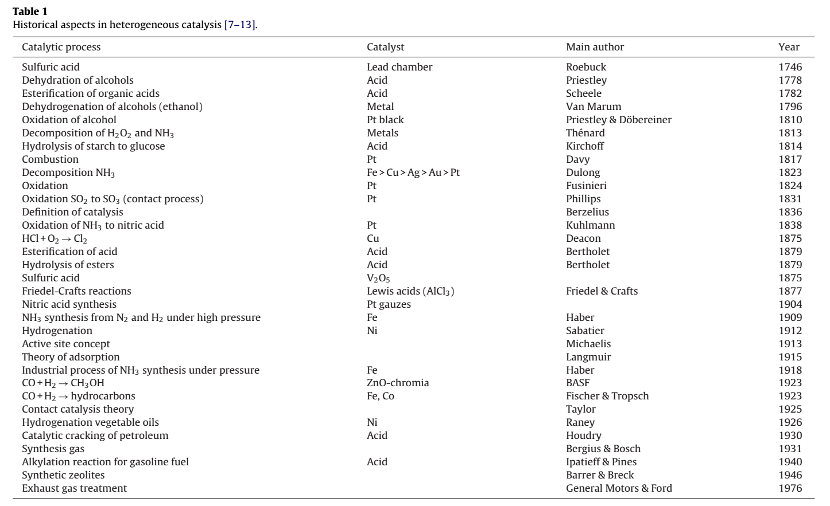

Slide 53
  New and Future Developments in Catalysis
  Chapter 1 - Metal Catalysts for the Conversion of Biomass to Chemicals, Pierre Gallezot
  Chapter 2 - Current Catalytic Processes for Biomass Conversion, Hirokazu Kobayashi, Atsushi Fukuoka
  Chapter 3 - Emerging Catalysis for 5-HMF Formation from Cellulosic Carbohydrates, Z. Conrad Zhang
  Chapter 4 - Trends and Challenges in Catalytic Biomass Conversion, Christian Mårup Osmundsen, Kresten Egeblad, Esben Taarning
  Chapter 5 - Catalytic Processes of Lignocellulosic Feedstock Conversion for Production of Furfural, Levulinic Acid, and Formic Acid-Based Fuel Components, B. Kamm, M. Gerhardt, G. Dautzenberg
  Chapter 6 - Synthetic Biology for Biomass Conversion, Christopher E. French, Damian K. Barnard, Eugene Fletcher, Steven D. Kane, Sahreena Saleem Lakhundi, Chao-Kuo Liu, Alistair Elfick
  Chapter 7 - Hybrid Plant Systems for Breeding and Gene Confinement in Bioenergy Crops, Albert P. Kausch, Adam Deresienski, Joel Hague, Michael Tilelli, Stephen L. Dellaporta, Kimberly Nelson, Yi Li
  Chapter 8 - An Introduction to Pyrolysis and Catalytic Pyrolysis: Versatile Techniques for Biomass Conversion
  Li Li, Jack S. Rowbotham, H. Christopher Greenwell, Philip W. Dyer
  9. Chapter 9 - Using Microwave Radiation and SrO as a Catalyst for the Complete Conversion of Oils, Cooked Oils, and Microalgae to Biodiesel, Miri Koberg, Aharon Gedanken
  10.Chapter 10 - Environmental Benefits of Integrated Algal Biorefineries for Large-Scale Biomass Conversion
  Bobban Subhadra
  11. Chapter 11 - Heterogeneous Catalysts for Biomass Conversion, Lei Jin, Chung-hao Kuo, Steven L. Suib
  12. Chapter 12 - Processing Issues in Biofuels Production , Richard S. Parnas, Michael Pomykala, Iman Noshadi
  13. Chapter 13 - Economic Analysis of Bioenergy: An Integrated Multidisciplinary Approach
  Fred V. Carstensen, Marcello Graziano, Natalia Vorotytseva, William E. Waite, Kathryn E. Parr
  14. Chapter 14 - Biofuels of the Present and the Future, Arnold L. Demain, Marco A. Báez-Vásquez
  15.Chapter 15 - Catalysts for Biomass Conversion

Slide 54
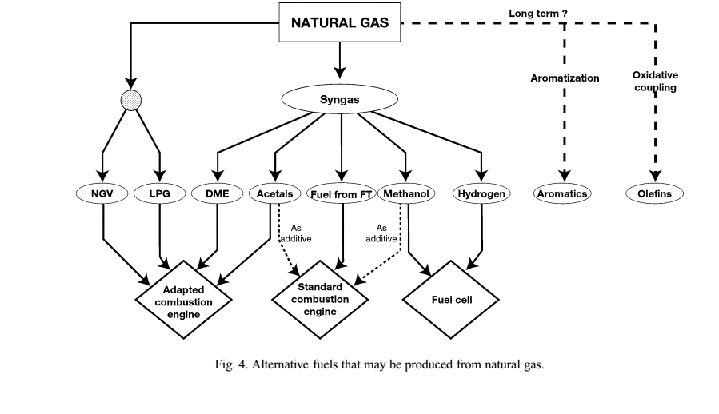
  New and Future Developments in Catalysis
  Introduction
  Chapter 1 - Metal Catalysts for the Conversion of Biomass to Chemicals, Pierre Gallezot
  Chapter 2 - Current Catalytic Processes for Biomass Conversion, Hirokazu Kobayashi, Atsushi Fukuoka
  Chapter 3 - Emerging Catalysis for 5-HMF Formation from Cellulosic Carbohydrates , Z. Conrad Zhang
  Chapter 4 - Trends and Challenges in Catalytic Biomass Conversion, Christian Mårup Osmundsen, Kresten Egeblad, Esben Taarning
  Chapter 5 - Catalytic Processes of Lignocellulosic Feedstock Conversion for Production of Furfural, Levulinic Acid, and Formic Acid-Based Fuel Components, B. Kamm, M. Gerhardt, G. Dautzenberg
  Chapter 6 - Synthetic Biology for Biomass Conversion, Christopher E. French, Damian K. Barnard, Eugene Fletcher, Steven D. Kane, Sahreena Saleem Lakhundi, Chao-Kuo Liu, Alistair Elfick
  Chapter 7 - Hybrid Plant Systems for Breeding and Gene Confinement in Bioenergy Crops, Albert P. Kausch, Adam Deresienski, Joel Hague, Michael Tilelli, Stephen L. Dellaporta, Kimberly Nelson, Yi Li
  Chapter 8 - An Introduction to Pyrolysis and Catalytic Pyrolysis: Versatile Techniques for Biomass Conversion, Li Li, Jack S. Rowbotham, H. Christopher Greenwell, Philip W. Dyer
  Chapter 9 - Using Microwave Radiation and SrO as a Catalyst for the Complete Conversion of Oils, Cooked Oils, and Microalgae to Biodiesel, , Pages 209-227, Miri Koberg, Aharon Gedanken
  Chapter 10 - Environmental Benefits of Integrated Algal Biorefineries for Large-Scale Biomass Conversion,, Bobban Subhadra
  Chapter 11 - Heterogeneous Catalysts for Biomass Conversion, Lei Jin, Chung-hao Kuo, Steven L. Suib
  Chapter 12 - Processing Issues in Biofuels Production, Richard S. Parnas, Michael Pomykala, Iman Noshadi
  Chapter 13 - Economic Analysis of Bioenergy: An Integrated Multidisciplinary Approach, , Fred V. Carstensen, Marcello Graziano, Natalia Vorotytseva, William E. Waite, Kathryn E. Parr
  Chapter 14 - Biofuels of the Present and the Future, Arnold L. Demain, Marco A. Báez-Vásquez
  Chapter 15 - Catalysts for Biomass Conversion

Slide 55
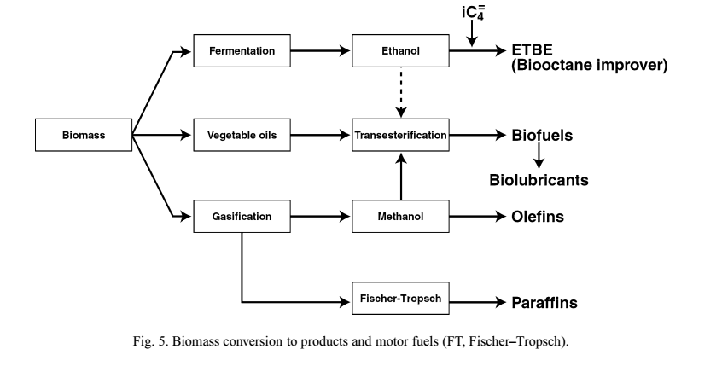

Slide 56
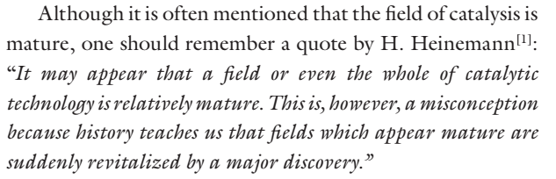

Slide 57
The chilean embargo on nitrates ( an ingredient for explosives in the early 1900s) to Germany boosted Haber and Bosch studies on the fixation of nitrogen in air to produce ammonia (1910-1916).
The need for more efficient automobile fuel that incited E.Houdry to research and develop the oil cracking process (ca1935).
Catalytic reforming and hydrocarbon alkylation developed by UOP in the later 30s and early 40s not only providing higher octane index fuels but also enabling, because of their availability, the British RAF pilots to win the Battle of Britain in the summer of 1940.
Environmental regulations that triggered the development of various catalytic hydrotreating processes, the three way exhaust catalyst, the MTBE and TAME synthesis process and various technologies to reduce NO_{x} Emission.

Slide 58
Todays major pullers are:
Market driven strategy aiming at simpler and less capital intensive processes and the access to abundant, renewable and cheaper feeds;
Societal concern for preservation and remediation of the environment;
Evolving legislations by public/governmental bodies: often fluctuating with time because of the various bodies and lobbies are involved, but eventually always having strict deadlines;
Weak signals from world-wide scientific progress(academic and industrial) because of industry’s awareness of developments made by competitors and fortunately also the identification of creative projects, advances and discoveries in academia.

Slide 59
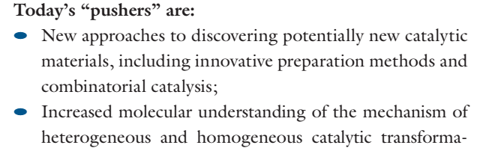
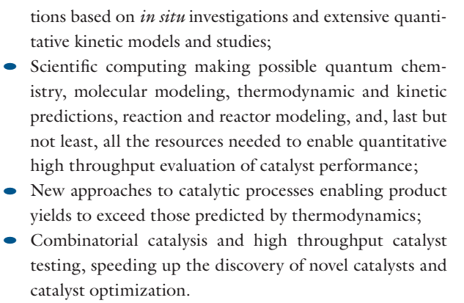

Slide 60
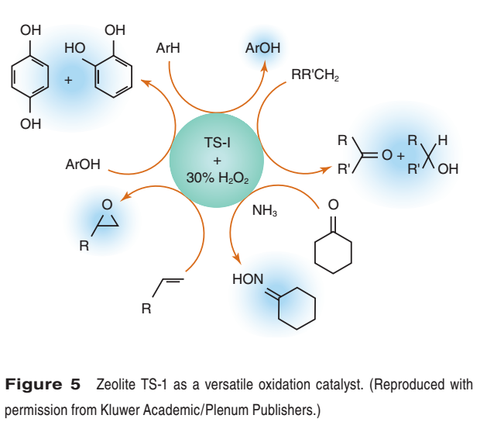

Slide 61
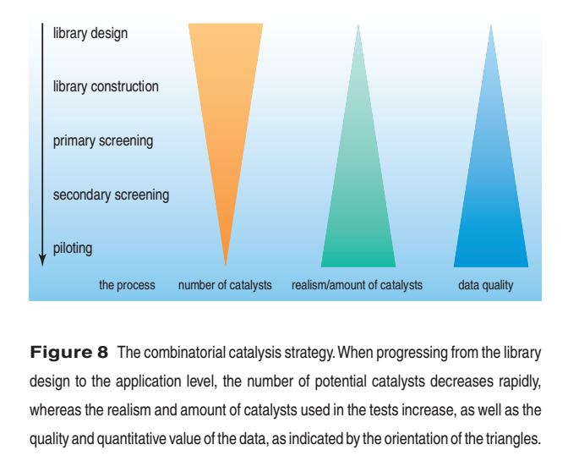

Slide 62
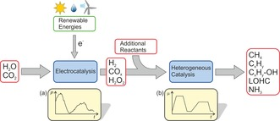
Schematic future scenario for power‐to‐chemicals processes demonstrating the importance of the development of more tolerant catalysts and processes a) time‐dependent power production by wind energy in 48 h (source: Fraunhofer ISE, KW 9, 2015), b) smoothed profile of hydrogen by intermediate storage

Slide 63
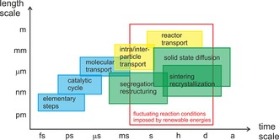
Typical time and length scales relevant for dynamic processes in catalysis. Blue: molecular processes at the active site; green: processes involving solid state catalysts, yellow: transport processes of reactants and products. The time frame important for dynamic operation addressed in the present concept article (indicated with a red box) includes microscopic and macroscopic length scales.

Slide 64
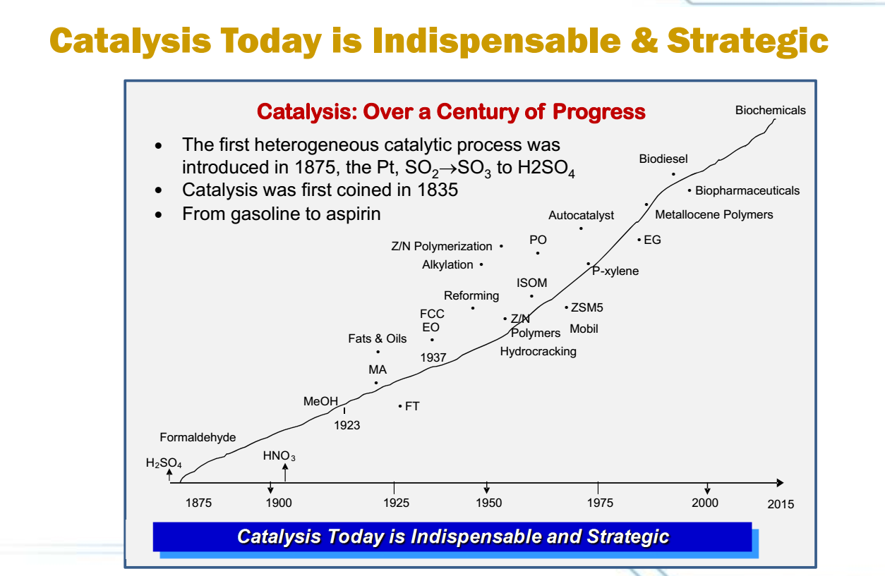

Slide 65
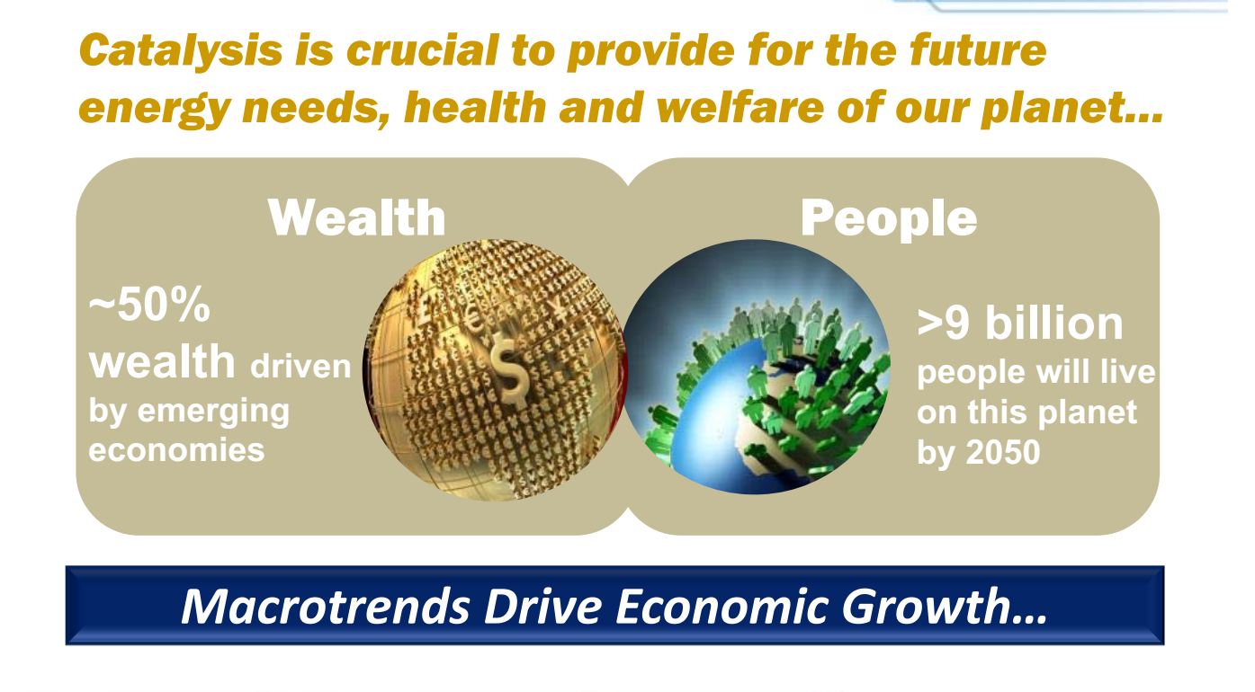

Slide 66
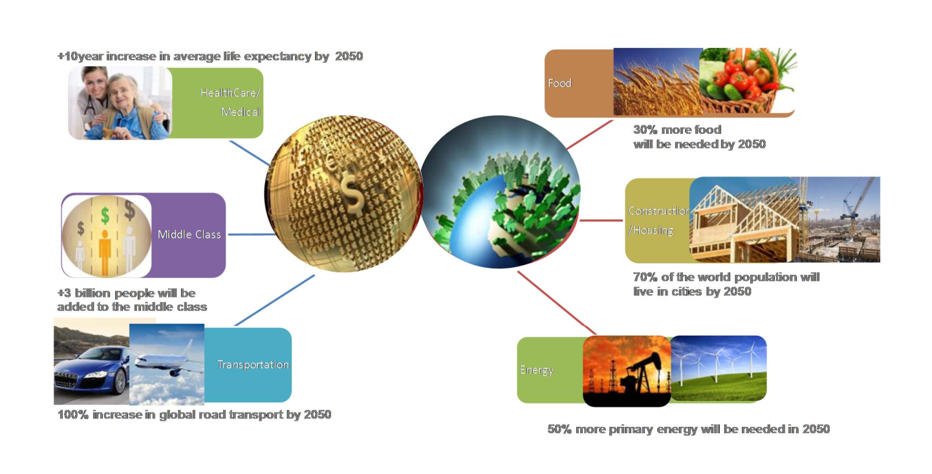

Slide 67
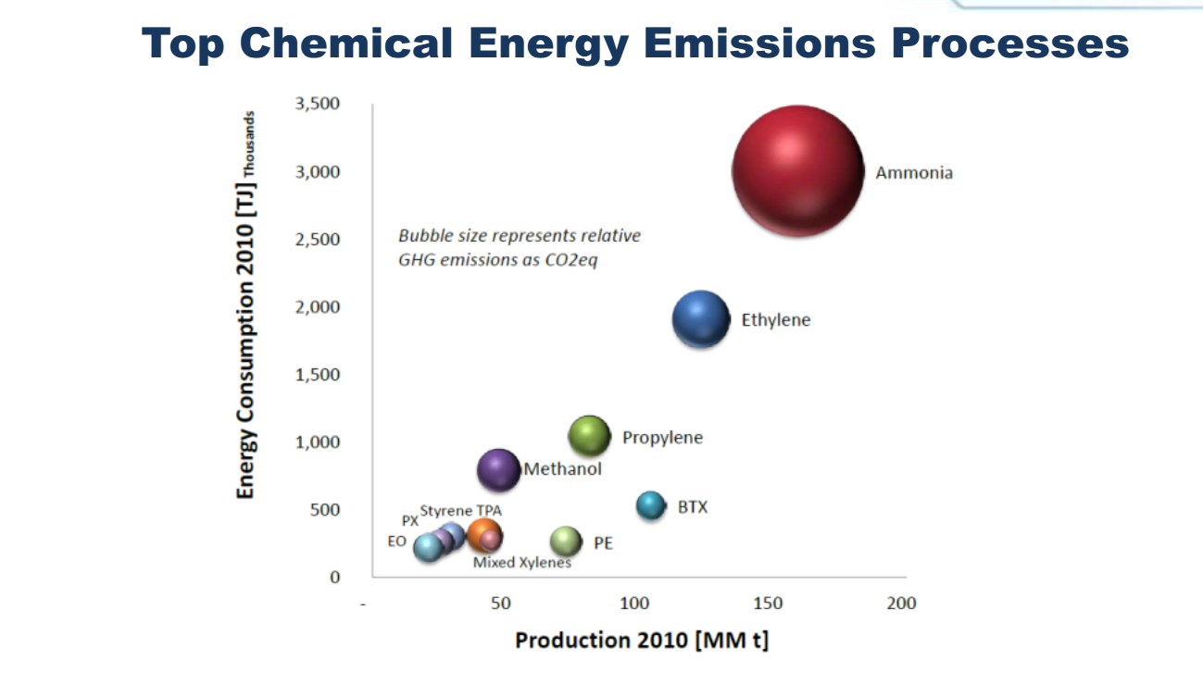

Slide 68
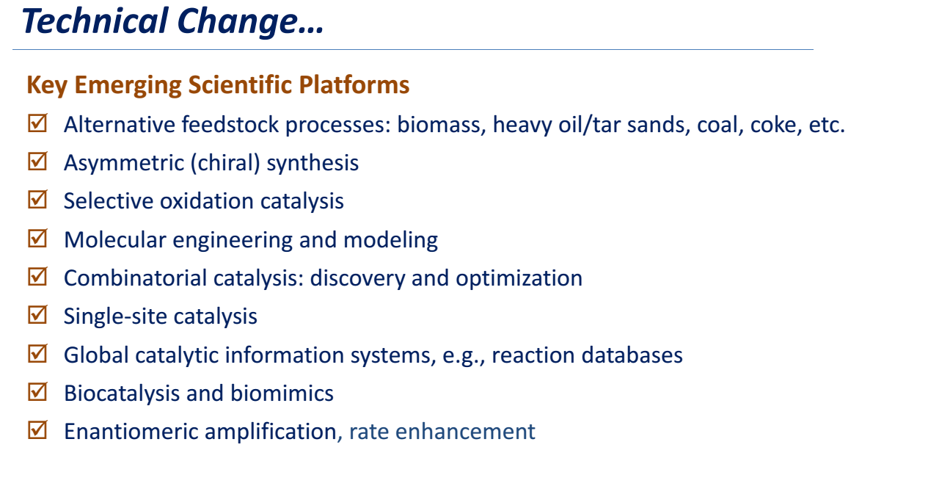

Slide 69
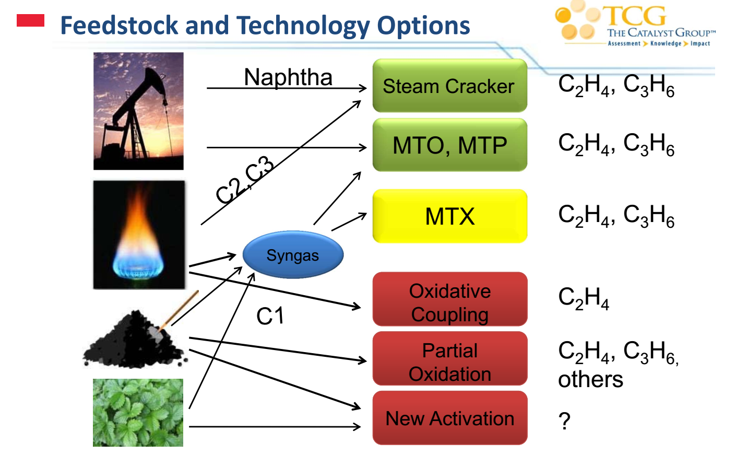

Slide 70
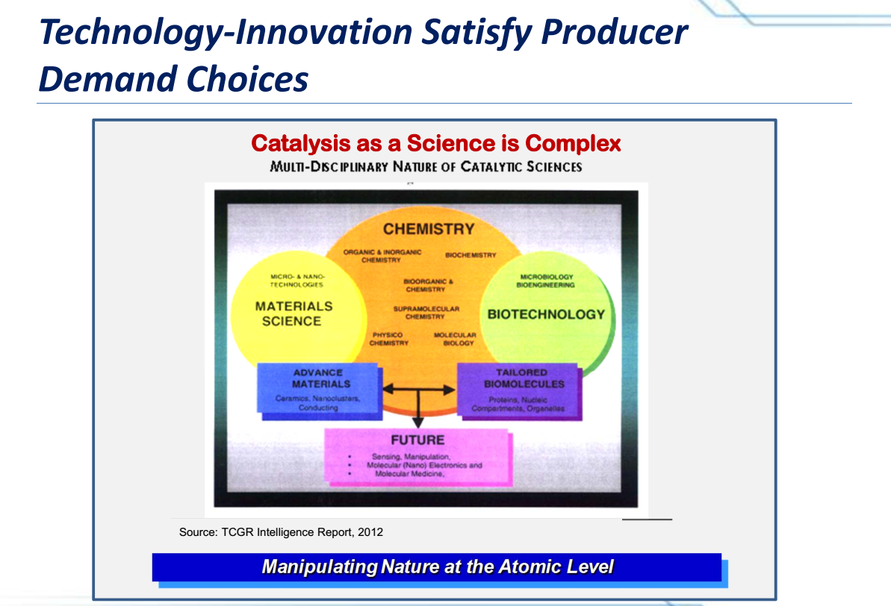

Slide 71
2001 -2005 AD
1. Zeolites as catalysts for fine chemicals and pharmaceuticals synthesis
2. Use of solid acid catalysts in fine chemicals synthesis
3. Biocatalytic removal of S,N, and metals from petroleum feedstocks
4.Extensive use of metallocenes and other single site catalysts for polymer synthesis
5.Alkene to alkane feedstock transition
6.Catalytic combustion to decrease VOCs and No_{x} emissions

Slide 72
2005-2010 AD
1.Nanotechnology in catalyst manufacture
2. Chemical and biochemical (bifunctional, Cascade) catalysts
3. Engineered enzymes in chemicals/fuel production
4.chiral polymeric materials
5. Heterogeneous catalysts for assymmetric synthesis of fine chemicals

Slide 73
2010-2020 AD
1. Fuel cell powered vehicles
2. High temperature inorganic-organic polymers
3. membranes and other multi-functional catalysts
4. Broader use of electro- and photo-catalysis
5. Advent of biopolymers
6. Bio-gradable materials and bio-silk

Slide 74
2020 -2040 AD
1. Photolytic water splitting and Hydrogen economy
2. Catalytic antibodies – biomimetics and synthetic enzymes in fine chemical and pharmaceutical synthesis
3. Engineering microbes/bacteria for fine chemical synthesis
4. Production of chemicals in living plants

Slide 75
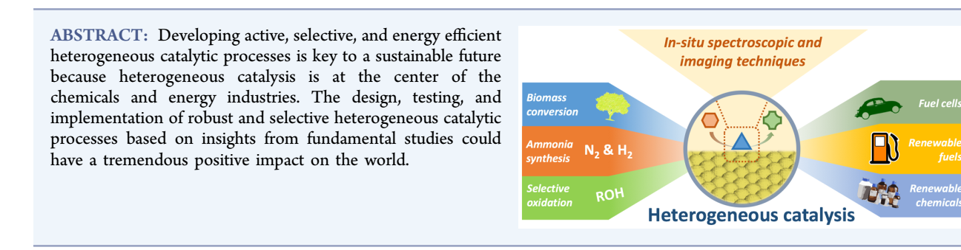

Slide 76
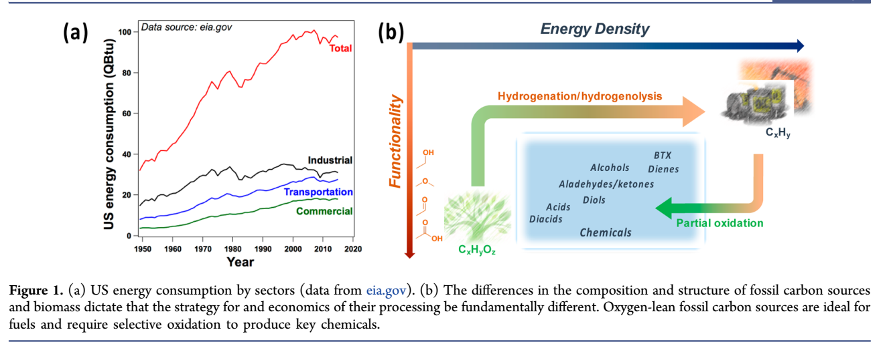

Slide 77
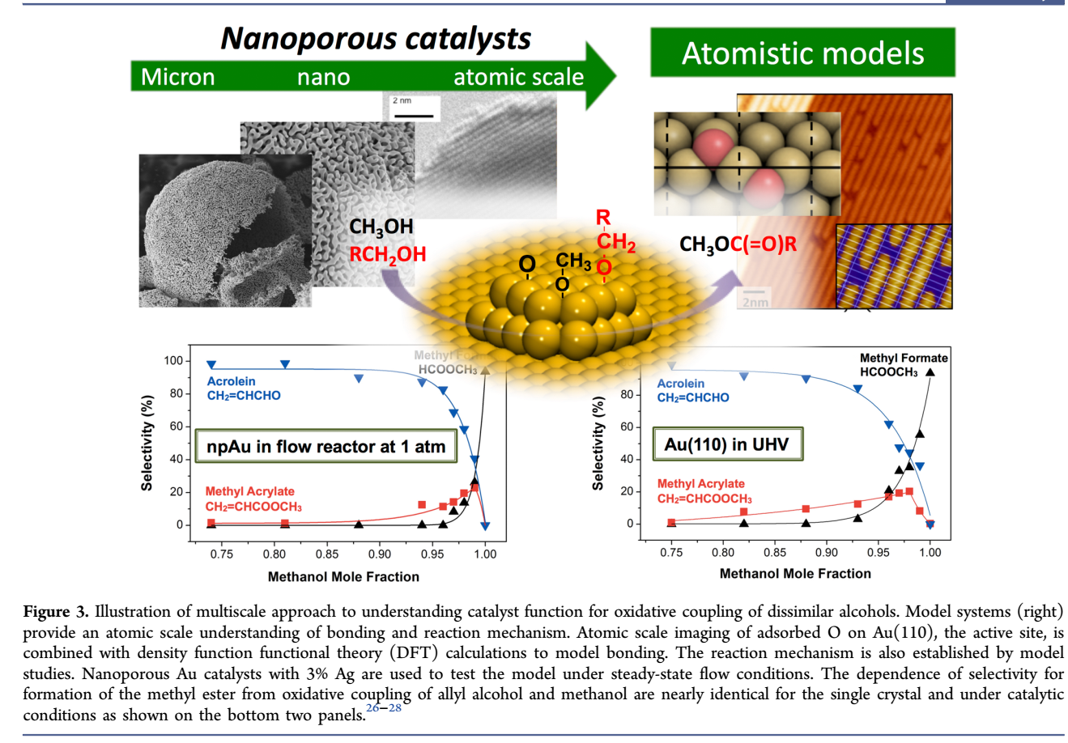

Slide 78
Metal Oxides in Heterogeneous Catalysis is an overview of the past, present and future of heterogeneous catalysis using metal oxides catalysts. The book presents the historical, theoretical, and practical aspects of metal oxide-based heterogeneous catalysis. Metal Oxides in Heterogeneous Catalysis deals with fundamental information on heterogeneous catalysis, including reaction mechanisms and kinetics approaches. There is also a focus on the classification of metal oxides used as catalysts, preparation methods and touches on zeolites, mesoporous materials and Metal-organic frameworks (MOFs) in catalysis. It will touch on acid or base-type reactions, selective (partial) and total oxidation reactions, and enzymatic type reactions The book also touches heavily on the biomass applications of metal oxide catalysts and environmentally related/depollution reactions such as COVs elimination, DeNOx, and DeSOx. Finally, the book also deals with future trends and prospects in metal oxide-based heterogeneous catalysis. In Metal Oxides in Heterogeneous Catalysis, by Jacques C Vedrine

Slide 79
Role of Catalysis in a National Economy
24% of GDP from Products made using catalysts (Food, Fuels, Clothes, Polymers, Drug, Agro-chemicals)
> 90 % of petro refining & petrochemicals processes use catalysts
90 % of processes & 60 % of products in the chemical industry
> 95% of pollution control technologies
Catalysis in the production/use of alternate fuels (NG,DME, H₂, Fuel Cells, biofuels…)

Slide 80
Green Catalytic Processes
Alternative feedstocks, reagents, solvents, products
Enhanced process control
New catalysts
Greater integration of catalysis and reactor engineering:
membrane reactors, microreactors, monolith technology, phenomena integration
Increased use of natural gas and biomass as feedstock
Photodecomposition of water into hydrogen and oxygen
Catalysts for depolymerizing polymers for recycle of the monomers
Improvements in fuel cell electrodes and their operation

Slide 81
Cleaner and greener Environment: Catalysis
New directions for research driven by market, social & environmental needs:
Catalysis for energy-friendly technologies and processes (primary methods)
New advanced cleanup catalytic technologies (secondary methods)
Catalytic processes and technologies for reducing the environmental impact of chemical and agro-industrial solid or liquid waste and improving the quality and reuse of water (secondary methods)
Catalytic processes for a sustainable chemistry (green chemistry and engineering approach)
Replacement of environmentally hazardous catalysts in existing processes

Slide 82
How to Decrease the Greenhouse Effect?
New catalysts for high output fuel cells
Electricity production via electrocatalytic oxidation of hydrocarbons
Chemical energy of hydrocarbon is converted to electricity
Catalysts and processes for solar energy conversion and hydrogen
production
CO₂ or other greenhouse gases are not emitted into the atmosphere,
First solar energy is converted into the chemical energy of synthesis gas (CO + H₂) via the endothermic reaction of methane reforming
Storage of the synthesis gas
The stored energy can be released via the reverse exothermal methanation reaction
CO + 3H₂ → CH₄ + H2O
Efficiency from 43 to 70 %
Catalysts are needed for these reactions!!!

Slide 83
Future Fuels: Catalysis Challenges
Meeting Specifications of Future Fuels
Remove S,N, aromatics, Particulate Matter
Power Generation
- Lower CO₂ Production in Catalytic Gasification
- Lower CO₂ and H₂/CO ratio in Syngas generation
FT Synthesis: Lower CH₄ and CO₂ ;Inhibit metal sintering; Increase attrition strength; Reactor design
Biomass:1.Cellulose to Ethanol ( enzymes)
2. Biomass gasification catalysts.
Decentralized Production/ Use of H₂ and Biofuels will avoid costs due to their storage and distribution.
“Holy Grail “ Challenges
Direct Conversion of CH₄ to methanol and C₅⁺.
Catalytic Water and CO₂ splitting using solar energy

Slide 84
Theory and Computation for Catalysis
Scientific Challenges and Research Approaches
Defining molecular models of reactants and catalysts .
Accurate prediction of potential energy surfaces .
Characterizing potential energy surfaces—understanding the structures of working catalysts
Accurate prediction of entropies and free energies.
Accurate prediction of reaction rate constants .
Coupling the dynamics of electrons and nuclei.
Spanning temporal and spatial scales—multiscale methods . High-performance computing—harnessing the power of peta-scale
and exa-scale computational resources for computational catalysis .
Design and controlled synthesis of catalytic structures—a new challenge for theory and computation

Slide 85
The story goes on ……….century after century
Thank you all

