Slide 1
X-ray Absorption Spectroscopy (XAS) : XANES and EXAFS
RAMLAL
CA17M009

Slide 2
Outline
1) Introduction - X-ray-Matter interactions
2) Principles
3) Absorption edges
4) XANES Theory
Experimental Method
Data Analysis
Examples
5) EXAFS Theory
Data Analysis
Examples
6) Conclusions
Notes:
Core holes are created by the ionization of a core electron in XPS and by excitation in XAS.

Slide 3
X-ray-Matter interactions
Photoelectric absorption -one photon is absorbed and the atom is ionized or excited
Scattering -one photon is deflected from the original trajectory by collision with an electron
• coherent (Thomson scattering) -the photon wavelength is unmodified by the scattering process (scattering from bound electrons)
• incoherent (Compton scattering) -the photon wavelength is modified
For an aggregate of atoms:
• elastic scattering: the photon energy is conserved
• inelastic scattering the photon energy is not conserved

Slide 4
Photoelectric absorption
An X-ray is absorbed by an atom when the energy of the X-ray is transferred to a core-level electron (K, L, or M shell) which is ejected from the atom.
The atom is left in an excited state with an empty electronic level (a core hole). Any excess energy from the X-ray is given to the ejected photoelectron.
De-excitation processes -X-ray fluorescence and Auger emission occur at discrete energies characteristic of the absorbing atom, and can be used to identify the absorbing atom .

Slide 5
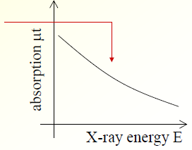
2) Principles
Transmission of X-rays is given by I(x) = I₀ e^{-µt}
- t law t is thickness
- μ is linear absorption coefficient
Absorption coefficient is defined μt=ln(I0/IT)
spectroscopy: measure μt as a function of energy E
-t is constant
-μ decreases with E (X-ray more penetrating)
μ depends strongly on:
- X-ray energy E
- atomic number Z,
- density ρ
- atomic mass A

Slide 6
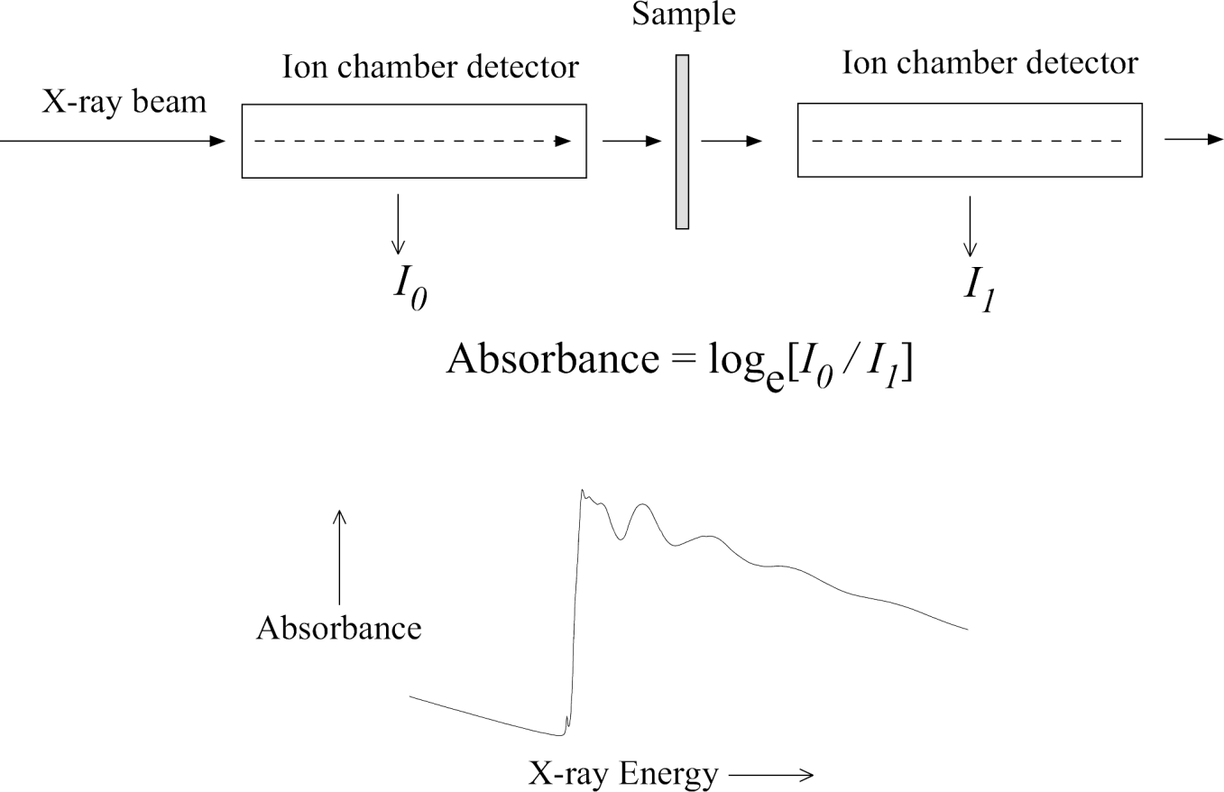
The number of x-ray photons that are transmitted through a sample (I_{t}) is equal to the number of x-ray photons shone on the sample (I₀) multiplied by a decreasing exponential that depends on the type of atoms in the sample, the absorption coefficient µ , and the thickness of the sample t.
When the incident x-ray energy matches the binding energy of an electron of an atom within the sample, the number of x-rays absorbed by the sample increases dramatically, causing a drop in the transmitted x-ray intensity. This results in an absorption edge.
Each element on the periodic table has a set of unique absorption edges corresponding to different binding energies of its electrons, giving XAS element selectivity.

Slide 7
when a Is level electron is excited, the lowest-lying empty -states will be occupied and the process is called K-edge absorption.
X-rays are ionizing electromagnetic radiation that have sufficient energy to excite a core electron of an atom to an empty state below the ionization threshold called an excitonic state, or to the continuum which is above the ionization threshold.

Slide 8
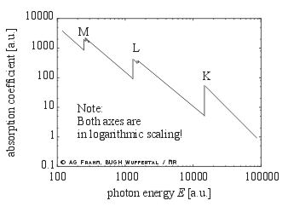
X-ray absorption edges
Absorption edges occur for each shell of core electrons
when E ~ binding energy of core electron
• X-ray absorption edges are labelled after core electrons
K: 1s_{1/2} L1: 2s_{1/2} L2: 2p_{1/2} L3: 2p_{3/2}( nl_{j} notation)
- note that emitted X-rays
have slightly different labels
Kα, Kβ
energy of absorption edge E0
is unique for each element
-element-specific technique

Slide 9
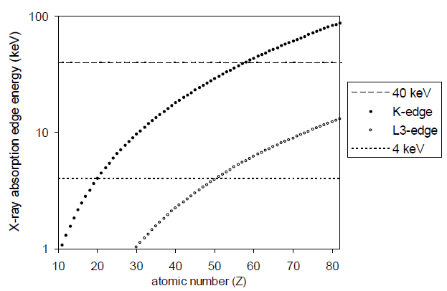
Absorption edge energies
difficult for light elements, e.g. Z<22 (Ti)
heavy elements use L₃ edge, e.g. Z>57 (La)

Slide 10
Introduction
X-ray Absorption Fine-Structure (XAFS) is the modulation of the x-ray absorption coefficient at energies near and above an x-ray absorption edge.
XAFS is also referred to as X-ray Absorption Spectroscopy (XAS) and is broken into 2 regimes:
XANES- X-ray Absorption Near-Edge Spectroscopy Or NEXAFS- Near-Edge X-ray Absorption Fine Structure
EXAFS- Extended X-ray Absorption Fine-Structure
which contain information about an element’s local coordination and chemical state.

Slide 12
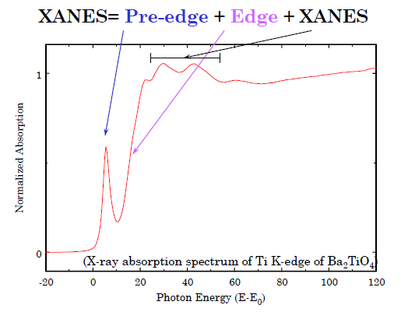

Slide 13
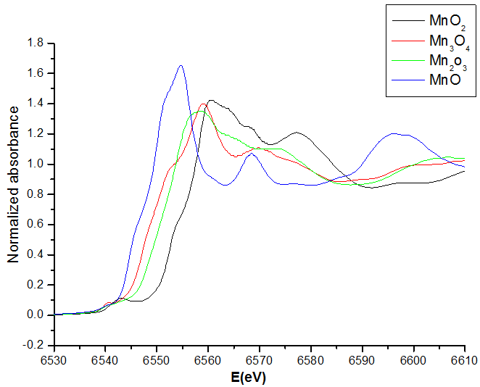
Effect of oxidation state on XANES
higher oxidation state →higher energy of XANES
- higher (+) charge on the excited atom →electron states more tightly bound
XANES is very good for measuring oxidation state
-typically +1 oxidation state →+3 eV energy

Slide 14
XANES: Data analysis

Slide 15
Factors that Affect Metal K-edge Shape and Energy The rising-edge and the edge maxima shift to higher energy as the oxidation state increases.

Slide 26
Identifying Fe and S compounds using the Fingerprint method

Slide 27
EXAFS: Theory

Slide 31
Origin of the fine structure (oscillations)
The interference between the outgoing and the scattering part of the photoelectron at the absorbing atom changes the probability for an absorption of X-rays i.e. alters the absorption coefficient μ(E) that is no longer smooth as in isolated atoms, but oscillates.
The phase relationship between outgoing and incoming waves depends on photoelectron wavelength (and so on the energy of X-rays) and interatomic distance R.
The amplitude is determined by the number and type of neighbours since they determine how strongly the photoelectron will be scattered.

Slide 32
Data Reduction : Converting Raw Data to μ(E)

Slide 33
Data Reduction: Pre-Edge Subtraction, Normalization

Slide 34
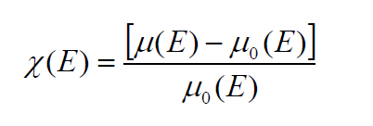
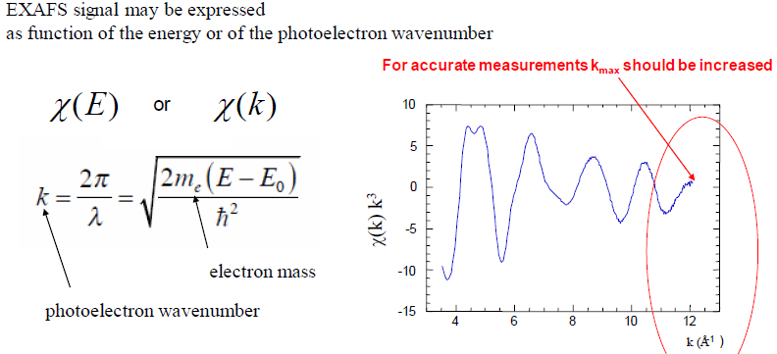
EXAFS signal fitting

Slide 35
μ₀(E) is Smooth function representing the bare atomic background.
EXAFS originates from an interference effect, and depends on the wave-nature of the photoelectron.
χ(k) is often shown weighted by K² or k³ to amplify the oscillations at high-k
A Fourier Transform of the EXAFS signal provides a photoelectron scattering profile as a function of the radial distance from the absorber.

Slide 36
Conclusion
The edge-region of an XAS spectrum provides a powerful spectroscopic tool for geometric and electronic structure elucidation.
2. Information related to:
Oxidation State
Spin State
Site-symmetry
Ligand Field
Local Structure
3. A lot is still not known about the rising-edge and near-edge region. Theoretical advances will unlock this region and help us better understand our data in the future.

