Slide 1
Oganic-Inorganic Perovskites
New generation of photoactive materials
absorber in solar cells and significant progress towards improved efficiency, fabrication and scale up process.
organic inorganic perovskite materials in photovoltaics as well as photoelectrochemical applications

Slide 2
power-conversion efficiency (PCE) of 22% for perovskite solar cells, similar to that of commercial crystalline silicon solar cells. (2009).
crystal structure, photophysical (optical-thermal properties) and surface morphology.
First basic unit of organometal trihalide perovskites (OTP) have been explored by H.L. Wells (1893), who already synthesized alkali-metal lead and tin halides
chemical formula CsPbX3 (X = Cl, Br or I) were analyzed after 64 years by the Danish scientist Christian Møller (1958).
After two decade, Dieter Weber (1978) replaced Cesium with methylammonium cations (CH3NH3+) and generated the first three-dimensional organic–inorganic hybrid perovskites.
In the 1990s, David B. Mitzi and his co-workers focused on perovskite crystal structure methylammonium lead halide, CH3NH3PbX3

Slide 3
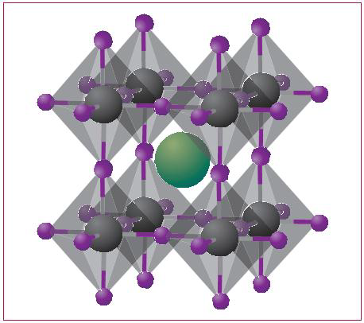
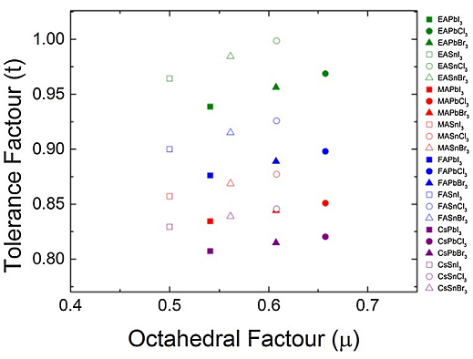
tolerance factor (t) and octahedral factor (μ)
{t = (RA+ RX )/(√2(RB+ RX)
μ
= RB/RX
0.81<t<1.11 and 0.44<μ<0.90
cubic perovskite structure
symmetric tetragonal or orthorhombic structures.

Slide 4
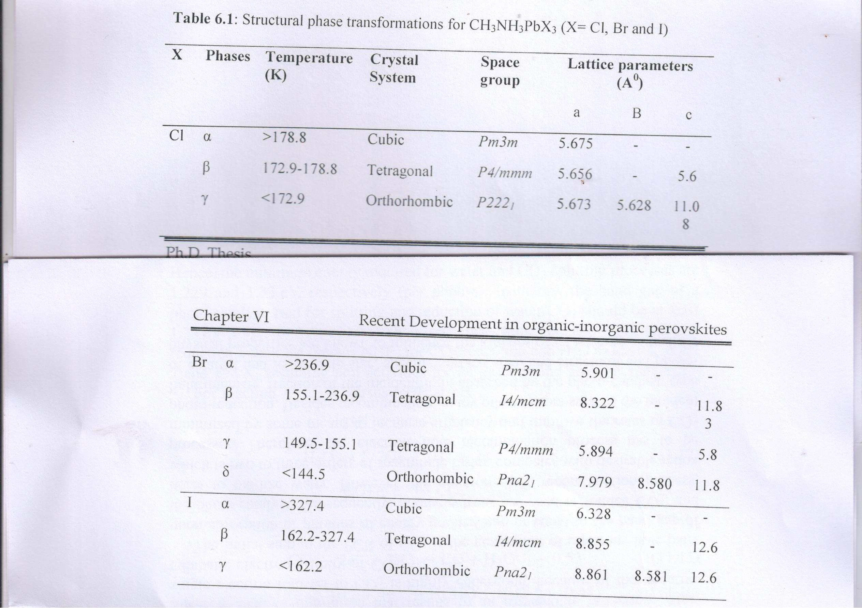

Slide 5
Developments in organometal trihalide perovskites (OTP)
Since 2006 photovoltaic's with a DSSC based on CH3NH3PbBr3 by Miyasaka and colleagues from Toin University reported an efficiency of 2.2%. In 2009, replaced 'Br' by 'I' and ceased efficiency was 3.8%, while stability was poor. In 2011, Nam-Gyu Park and co-workers from Sungkyunkwan University (SKKU) were able to achieve stability with PCE upto 6.5%. Subsequently, Park, Grätzel and other colleagues focused on demerits of electrolytes, introduced solid state hole transporting medium (HTM). A spiro MeOTAD (2,2‘,7,7‘-tetrakis(N,N-di-p-methoxyphenylamine)-9,9‘-spirobifluorene) HTM was effectively used in solid state dye cell in which HTM solute was used within nanoporous TiO2. The HTM improves the stability with increase stability in PCE 9.7%. In mid 2012, Henry Snaith and co-workers from Oxford University simultaneously exploited spiro-MeOTAD and used mixed halide in perovskite structure for better stability.

Slide 6
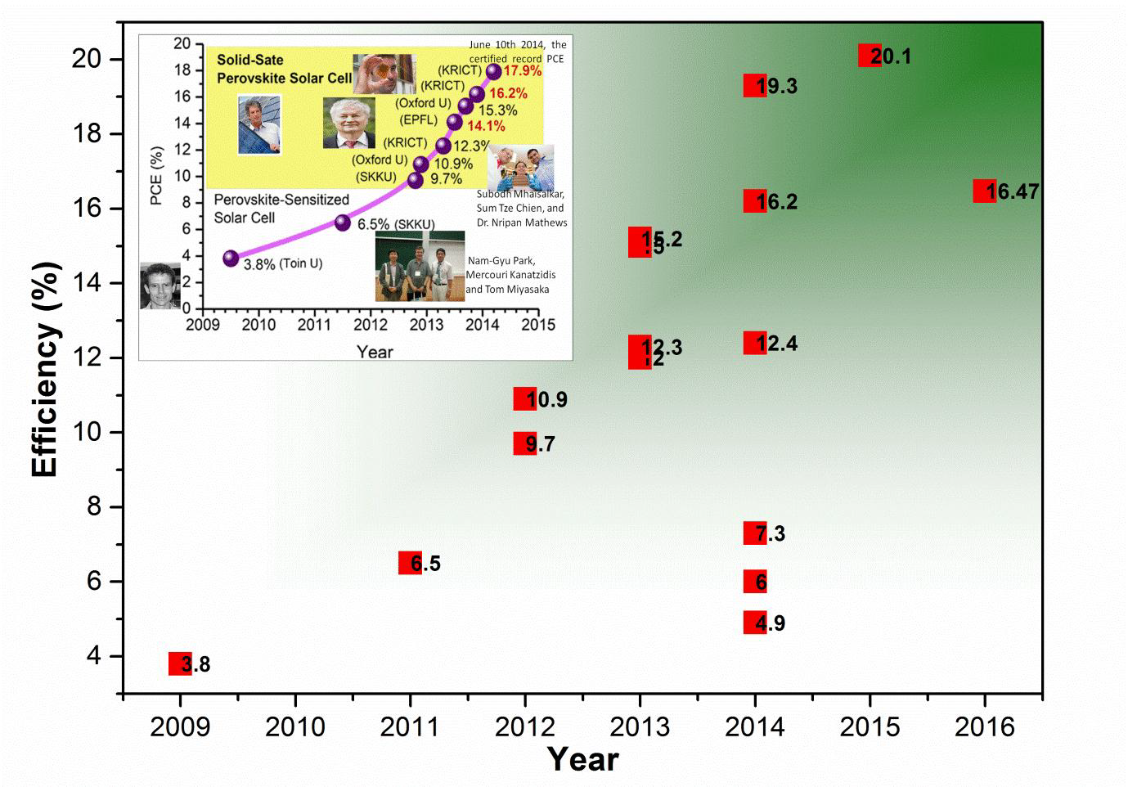

Slide 7
'OTP is a class of materials that has quickly become the rising star of the solar cell world and would enable production of hydrogen fuel using sunlight ' as said by Sam Lemonick

Slide 8
Extremely optical absorption small effective mass of electron and hole dominant point defects – shallow levels grain boundaries

Slide 9
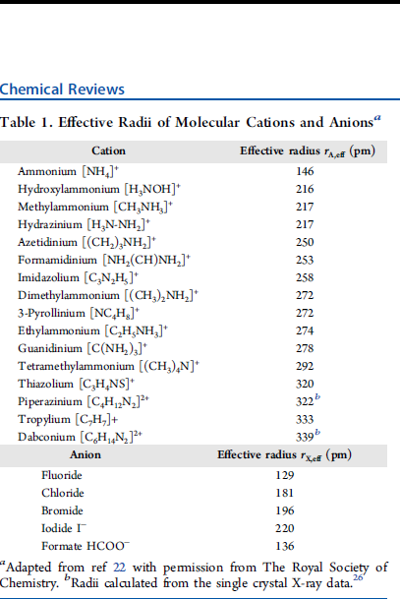

Slide 10
Metal −organic framework (MOF) structure of [C(NH2)3]-Mn(HCOO)3.43In order to show the relationship with the halide perovskites, the oxygen atoms are drawn as red spheres in this figure; C, N, H, and Mn are black, sky blue, light pink, and cyan spheres respectively

Slide 11
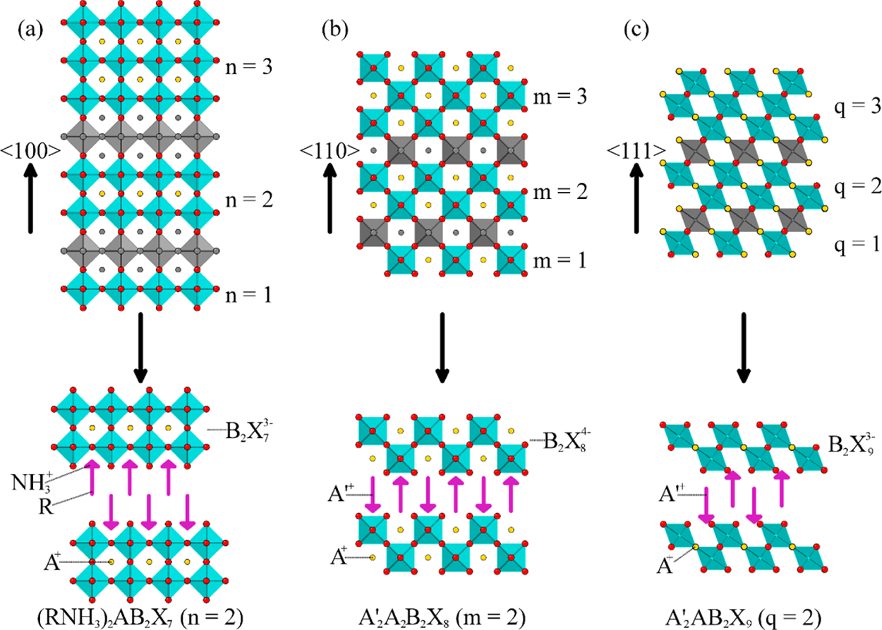
Schematic representation of the derivation of the lower dimensional organic−inorganic perovskites (lower sections) from different cuts of the 3-D perovskite structure (top sections). (a) The family of ⟨100⟩-oriented layered perovskites with a general formula of (RNH3)2An−1BnX3n+1 are obtained by taking n layers from along the ⟨100⟩ direction of the parent structure. (b) Cuts along the ⟨110⟩ direction of the 3-D perovskite structure provide the ⟨110⟩-oriented family, A′2AmBmX3m+2, which includes 1-D chain (m = 1) and 2-D layered (m > 1) members. (c) The ⟨111⟩-oriented family, A′2Aq‑1BqX3q+3, is formed by excising along the ⟨111⟩ direction of the 3-D parent, and features 0-D isolated cluster (q = 1) and 2-D layered (q > 1) members. In each of these layered structures, the perovskite framework is separated by a layer of typically larger organic cations.
2+
2
3
+2
3
metal ions are also impacted by Jahn
Teller and related
3
Cs
Au
Br
,
and KCuF
.
Given the substantial size,
°
°
T
and organic cations are often referred to as
organometal
+
Thiazolium [C
H
NS]
320
“
”
“
”
6
14
2
prototypical examples including [C(NH
)
]M(HCOO)
,
Chloride
181
n
n
n
> 1) members. In each of these layered structures, the perovskite framework is separated by a layer of typically larger organic cations.
Combined skeletal (top) and polyhedral (bottom, shaded) representation of the crystal structure of (C
H
N
)PbI
, which features
]
[PbI
sheets that are separated by a monolayer of aromatic biimidazolium (C
H
N
)
dications.
In the right half of the
gure, the structure of a
inorganic
c
6
fl
−
−
β
°
(6
) ions that are isoelectronic to Bi
and Bi
in BaBiO
.Ina
and
in purely ionic interactions between
A
X
,two
Chemical Reviews
Chemical Reviews
Chemical Reviews
Review
Review
Review
6
addition to the regular dynamic rotational disordering of the

organic cations and the anionic inorganic framework have
C, N, H, and Mn are black, sky blue, light pink, and cyan spheres,
50
respectively.
removal of the B-component from the inorganic framework
the interlayer lattice parameter.
Raman spectra of
ABX
The choice of the organic cation(s) and the reaction
which can impact the structural chemistry. For example, in the
,
44
45
50
a
organic
inorganic perovskites based on metal halides and
3+
1+
)
BX
or (NH
RNH
)-
−
ff
38
34
,
36
,
4
compounds. For example, the band gap of the compounds
fi
= 12, 14, 16
transition temperatures, for (C
H
NH
)
PbI
(
inorganic perovskites, the
ferroelectricity.
For organic
ective Radii of Molecular Cations and Anions
Table 1. E
51
BX
6
NH
)
Sn
I
compounds, for which the parent 3-D
stereochemically active lone pair (or
-orbital hybridization)
3
3
3
49
51
48
52
bilayers.
in alternating long and short B-X bonds and the prospects of
TellerionssuchasCu
The advantageous feature of the hybrid perov-
feature highly distorted CuX
extended family of lower-dimensional perovskites, which then
semiconductor.
In simple terms, this can be rationalized by
(C
H
N
)BI
(B = Pb, Sn),
for example, the inorganic
6
6
8
4
4
4560
4561
4562
DOI:
10.1021/acs.chemrev.5b00715
DOI:
10.1021/acs.chemrev.5b00715
DOI:
10.1021/acs.chemrev.5b00715
Chem.Rev.
−
Chem.Rev.
−
Chem.Rev.
−
2016, 116, 4558
4596
2016, 116, 4558
4596
2016, 116, 4558
4596
directional hydrogen bonding of the organic cation can also
r
ff
E
(pm)
Cation
ective radius
couple through intervening halogens to the steriochemically
A,eff
+
2
Ammonium [NH
]
146
s
active
electron pair, giving rise to a coordinated structural
4
+
NOH]
Hydroxylammonium [H
216
distortion, as has been discussed for the low temperature phase
+
36
]
Methylammonium [CH
NH
217
NH
of CH
SnBr
.
On the other hand, a number of transition
3
3
3
3
3
−
+
Hydrazinium [H
N-NH
]
217
3
2
+
Azetidinium [(CH
)
NH
]
250
distortions: for example, AMnO
(A = Pr, Nd, Dy, Tb, Ho, Er,
3
2
2
+
39
40
41
,
42
Formamidinium [NH
(CH)NH
]
253
Y),
2
2
3
2
2
6
+
H
Imidazolium [C
N
]
258
charge, and chemistry constraints, there are only a limited
3
2
5
“
”
“
”
“
”
+
Dimethylammonium [(CH
)
NH
]
272
number of
A
,
B
, and
X
chemical combinations that can
3
cant impact on the physical properties of the
3
4
−
2+
)
2
⟩
q
1
111
X
3
R
+
°
+
Note that the dimensionality discussed
33
34
E
may sterically interfere with
= 182
was prepared as a light
100
°
= 174
3
4
X,eff
2
octahedra,
32
⟩
octahedra with the I
−

3
.
→
organic framework (MOF) structure of [C(NH
−
52
+1
m
⟩
direction of the 3-D perovskite structure
MOFs
+1
q
tting this number of
A
−
perovskites.
⟩
+1
In
subgroup of the perovskite derivative family, likely in part
because the coordination of the interlayer RNH
plane distortion of
(I)Au(III)I
two di
phase. In all of these phases, charge ordering between Tl
Tl
long Au
nation.
the 3-D perovskite structure (top sections). (a) The family of
possibilities.
⟨
most readily accommodated in these structures. The inter-
actions between organic cations and the inorganic substructure
in general, and the hydrogen bonding schemes in particular, are
important in the perovskite-derivative structures. The majority
of known hybrid perovskites feature primary mono- or
diammonium cations. An interesting example involves long
chain alkyl
lateral restrictions imposed by the metal halide layers, these can
provide a useful model sys
single inorganic [PbI
wherein the Au disprortionates into +1 and +3 states; that is,
the compound can more speci
perovskites further follows from the theoretical prediction
superconductivity in CsTlX
recent experimental work,
brown powder that adopts a double cubic perovskite
structure, whereas orange crystals of CsTlCl
decrease under pressure, no evidence of a phase transition to a
Tl
around Au(I) and Au(III) can perhaps more accurately be
described as square planar for Au
Tl
generally gives rise to a shift of the metal atom away from the
crystallographic center of the metal halide octahedra, resulting
Chemistry.
all the way down to isolated, zero-dimensional (0-D) BX
here refers to the connectivity of the corner-sharing BX
isolated and can readily shift in relative position. This structural
fl
fertile
“
interact with the anionic inorganic substructure, but without the
rest of the organic molecule interfering with the inorganic
components
BX
thought of as intergrowth compounds with a general formula of
(RNH
are remarkably
for the semiconducting
obtaining a superconducting phase, has been observed so far. In
comparison to these inorganic systems, there are only a few
known organic
ing lower-dimensional or 3-D defect crystal structures (see
section 3
the perovskite framework.
a
allows for a remarkable structural tunability, i.e., from the
parent 3-D structure, based upon corner-shared BX
octahedral clusters.
octahedra in the crystal structure, as conceptually excised
from the 3-D parent compound (
structure is cut into slices, the size restrictions, as outlined by
the tolerance factor for the 3-D structures, are gradually lifted.
For example, in two-dimensional (2-D) layered derivatives of
the perovskite structure, there are no known restrictions for the
interlayer
restrictions are not applicable altogether, as MX
structures with varying physical properties.
dimensional perovskites, there are still other important
parameters to consider for the successful design and synthesis
of a targeted perovskite-derived structure.
The presence of ammonium cations leads to various hydrogen
bonding schemes with the anionic substructure, which are
important for determining the orientation and conformation of
the interlayer organic cations (see ref
Depending on the choice of metal, the inorganic framework
can be more or less rigid, which also in
bonding schemes. For example, perovskites containing Jahn
Figure 4.
obtained by taking
provide the
family, A
the fact that the dimensionality of the inorganic framework is
reduced by removing the metal
components with a very di
and, consequently, leading to a larger band gap. In the following
subsections, we will review some of the recent reports on lower-
dimensional perovskite derivatives that feature di
from the 3-D structure, including the well-known
⟨
3.1.
The
along
the 3-D-parent ABX
Figure 5.
(272
Figure 6.
bonding/coordination preferences for the metal ions involved,
related inorganic Cs
perovskite derivatives feature mono- or diammonium cations,
yielding the general formulas of (RNH
A
110
100
Adapted from ref
exibility and tunability of the dimensionality provide a rich and
s
3+
2+
+
While the size restrictions may be relaxed for the lower
In addition to size and charge, there are also the details of the
”
0
3-Pyrollinium [NC
Ethylammonium [C
Guanidinium [C(NH
Tetramethylammonium [(CH
Piperazinium [C
Tropylium [C
Dabconium [C
,Ge
, where here
must contain terminal functional groups that can ionically
octahedral coordination, leading to structural distortions of
⟨
(i.e., delocalized charge) state, which would be required for
⟩
⟩
was con
⟨
2
100
-, and
-oriented perovskites currently represent the richest
C) the melting transition of
100
ff
⟨
3
31
“
Formate HCOO
Fluoride
Bromide
Iodide I
100
erent polymorphs, a tetragonal
playground
′
···
2
Structures of the organic cation bilayers in (C
Schematic representation of the derivation of the lower dimensional organic
,Sn
).
A
A
In another example, the lone pair
⟩
−
I contacts nominally completing octahedral coordi-
“
b
n
-Oriented Perovskites
-oriented perovskites are obtained by the ordered
⟩
6
⟨
A
‑
Anion
“
−
Radii calculated from the single crystal X-ray data.
1
.
110
R
30
B
2+
”
in the ABX
fi
−
“
⟨
B
q
”
B
,
rmed to exist. Although resistivity was found to
7
,Pb
31
X
at, with a Pb
3
−
n
cation length and, in the 0-D derivatives, size
H
⟩
”
groups (
H
3
-oriented family, A
4
7
inorganic mixed-valent perovskites, all featur-
q
H
n
4
]+
+3
α
and
“
Interest in the mixed-valent metal halide
⟩
n
4
2+
22
12
4
layers from along the
N
”
H
+1
9
, is formed by excising along the
-oriented families as well as more exotic
2
]
=2
H
N
,
,Sb
−
2
2
10
”
8
, formed from the two end members: i.e.,
]
)
for the preparation of interesting crystal
−
]
+
2
5
with permission from The Royal Society of
2+
3
]
NH
3
2
“
]
represents an organic functional group.
sheet is shown, viewed along the
2+
Au(I)Au(III)I
X
.
3+
Figure 5
and 2-D-layered (RNH
3
3
”
3
, and Bi
]
. Most of the known layered (2-D)
22
2
structure. Alternatively, they can be
+
3
3
I
,
)
, which features Tl
4
N]
ff
CsTlF
Pb angle of
−
2
erent set of electronegativities
37
“
tem for the study of lipid
fi
B
). Subject to the constraint of
cally be expressed as Cs
3+
′
m
”
In the perovskite structure, a
Figure 4
A
, which results in an increase
m
3
halide perovskite CsAuI
3+
ff
B
6
and linear for Au
ective radius
⟨
m
I
X
s
4/
the primary bonding
fl
2
10
m
uences the hydrogen
m
⟩
“
C.
). As the perovskite
s
direction of the parent structure. (b) Cuts along the
The organic cation
2
, which includes 1-D chain (
and a cubic
51
129
196
220
136
”
5+
10
were obtained in
electrons on B =
+
Reprinted with permission from ref
3
,
2
Au-
of
(6
s
2
) and Tl
3+
3
Fm
3
m
Fm
3
m
+
and
, with
yield a 3-D organic
−
inorganic perovskite.
Note that the perovskites based on metal halide frameworks
“
”
perovskites
a terminology that is misleading, since there are
no metal
−
carbon bonds or direct linkages between metals and
organic ligands. These structures can more accurately be
referred to as
organic-inorganic
or
hybrid
However, organic
inorganic perovskites with direct bonding
between a metal and an organic ligand do exist,
43
−
45
with
2
3
3
where M = Mn, Fe, Co, Ni, Cu, and Zn.
43
In this example
(
Figure 3
) the guanidinium cation occupies the
“
+
”
site in the
3
perovskite framework and the formato anion takes the
role of the X
−
anion (this time an organic anion). Examples of
analogous structures with the guanidinium cation replaced with
other organic amines are also known.
This family of
compounds provides a direct link between the traditional
−
metal
−
organic frameworks or
“
”
: a widely expanding
class of compounds with potential application in catalysis, gas
storage, puri
cation, and separation.
46
,
47
3. LOWER-DIMENSIONAL ORGANIC
−
INORGANIC
PEROVSKITES
While the ABX
3
structure described above has fairly rigid
structural constraints, one can explore within a broader
272
274
278
292
322
b
333
339
b
r
(pm)
26
Figure 3.
Metal
−
2
)
3
]-
Mn(HCOO)
43
In order to show the relationship with the halide
perovskites, the oxygen atoms are drawn as red spheres in this
fi
gure;
6
6
octahedra are
3
3
for details).
−
octahedra that enable greater
fl
exibility for the interaction
with interlayer organic cations.
For the diverse family of 2-D perovskite frameworks,
although there is no de
fi
nitive restriction for the length of
the interlayer organic cations, there is a restriction for the
width, which must
fi
t into an area de
fi
ned by the terminal
halides from four adjacent corner-sharing octahedra. This is
important both from the perspective of hydrogen bonding and
electron counting schemes. The charge balance requirement
dictates the presence of a certain concentration of cations, and
organic molecules that are too large (in terms of their width)
may cause steric hindrance with adjacent organic molecules,
which in turn would render impossible
fi
cations into the targeted perovskite framework. However, if
they are too narrow

i.e., much smaller than the area provided
by the inorganic substructure
the structure can accommodate
by allowing organic molecules to tilt. In summary, both the
templating in
fl
uence on each other, allowing a certain degree of
control over the
fi
nal structures and properties.
As mentioned above, lower-dimensional derivatives of the
perovskite structure can be obtained by making slices along
di
ff
erent crystallographic directions in the parent compounds.
stoichiometry are among the most in
fl
uential parameters on
the orientation of the resultant inorganic frameworks. It is
important to note that the dimensional reduction discussed
here has signi
fi
typically increases as the dimensionality of the structure is
lowered. This is best illustrated by the example of (C
4
H
9
NH
3
)
2
-
(CH
3
3
n
−
1
n
3
n
perovskite (
n
∞
)CH
NH
SnI
is a dopable small band gap
semiconductor (even yielding semimetallic character), whereas
the
n
= 1 compound (C
4
H
9
NH
3
)
2
SnI
4
is a large band gap
inorganic perovskites (lower sections) from di
ff
erent cuts of
⟨
100
⟩
-oriented layered perovskites with a general formula of (RNH
3
)
2
A
1
B
X
3
are
⟨
110
m
= 1) and 2-D layered (
> 1) members. (c) The
⟨
111
-oriented
⟨
111
⟩
direction of the 3-D parent, and features 0-D isolated cluster (
= 1) and 2-D layered (
q
“
”
ff
erent cuts
⟨
100
-,
3
)
BX
4
. The
3
+
cations is
skites is that, unlike free lipid bilayers, since the organic cations
are anchored to the inorganic perovskite lattice, the phase
transitions are solid-to-solid, which allows investigations of
these transitions through a variety of spectroscopic techniques.
Depending on the length of the organic chain and the nature of
the B-metal cation, the temperature and the order of the phase
transitions observed in hybrid perovskites can be di
ff
erent.
49
ammonium functional group, the hybrid perovskites containing
long chain organic cations undergo
“
melting transitions
”
as a
function of temperature, which are characterized by an
increased conformational disorder of the methylene units of
the alkyl groups.
This large increase in gauche conformational
disorder results in the nonuniform distribution of the
orientation of the chains, and consequently, in the increase of
51
(C
n
H
2
n
+1
NH
3
)
2
PbI
4
(
n
= 12, 16 and 18) above the melting
transition are noted to be similar to that of
n
-alkanes in the
molten state. These spectra support the idea that, above the
melting transition, the alkyl chains of the bilayers are liquid-like
in two dimensions between adjacent inorganic layers.
Molecular dynamics (MD) simulations were used to success-
fully reproduce the experimental data, except for the detailed
n
2
n
3
2
4
n
and 18).
Snapshots of the simulated structures above and
below the melting transition for (C
18
H
37
NH
)
2
PbI
4
are
provided in
Figure 5
.
Recently, several examples of perovskites containing non-
primary ammonium cations have also been prepared. In
18
H
37
NH
3
)
2
PbI
4
, obtained using molecular dynamics simulations, below (142
C) and above
51
. Copyright 2010 American Chemical Society.
6
8
4
4
6
8
4
2+
fi
-axis (i.e., top down), with the organic cations removed for clarity. The inorganic layers
, and contain regular PbI
6
−
Pb
−
I angles of 87.70
−
94.83
°
, and the out-of-

Slide 12
Structures of the organic cation bilayers in (C18H37NH3)2PbI4, obtained using molecular dynamics simulations, below (142 °C) and above (272 °C) the melting transition of Tm = 182 °C.51 Reprinted with permission from ref 51

Slide 13
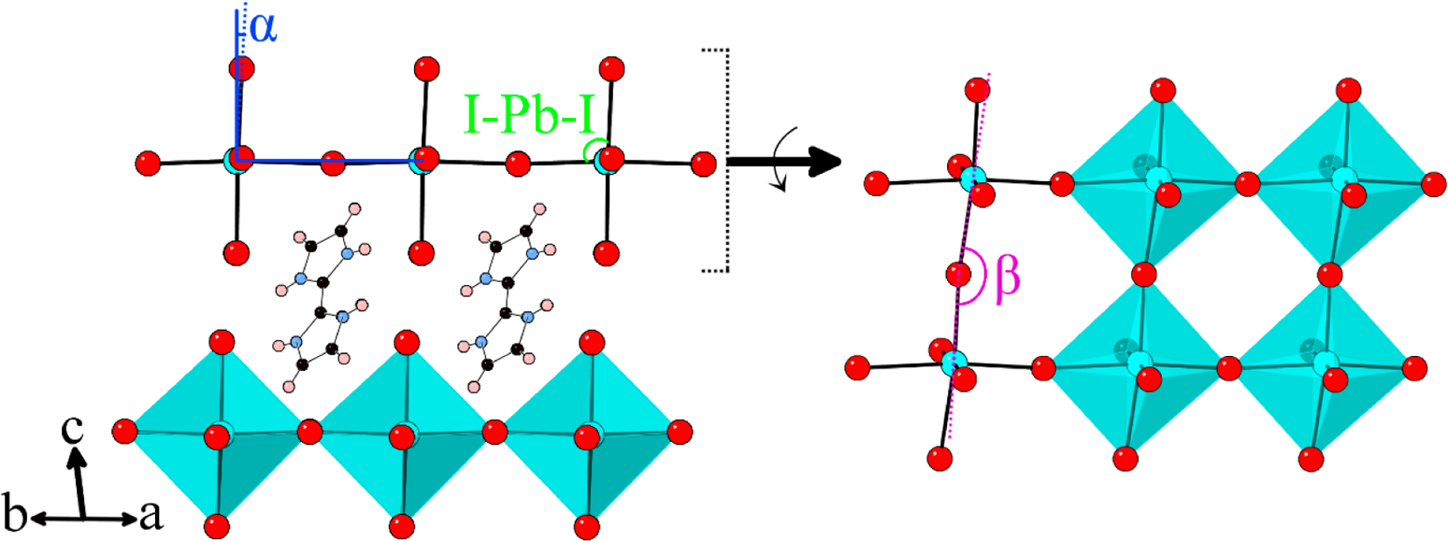

Slide 15
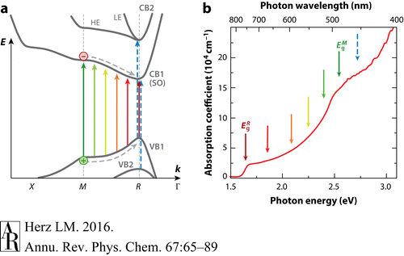
(a) Electronic band structure of MAPbI3 , adopted from density-functional theory calculations presented in References 40 and 45. Colored upward-pointing arrows represent allowed photoinduced electronic transitions. The lowest CB (CB1) is the spin-orbit SO band, whereas the higher-lying CB2 comprises HE and LE states, according to References 40 and 45. The dashed blue arrows indicate the partly dipole-allowed transitions VB2 → CB1 and VB1 → CB2 at the R point. (b) Absorption spectrum showing that a continuum of electronic transitions between the R and M valleys leads to strong absorption across the visible range (46). Relaxation toward the R valley gives rise to a photoluminescence peak near 1.6 eV arising from CBM1 → VBM1 transitions at the R point. Abbreviations: CB, conduction band; CBM, conduction band minimum; HE, heavy electron; LE, light electron; SO, split-off; VB, valence band; VBM, valence band maximum.

Slide 16
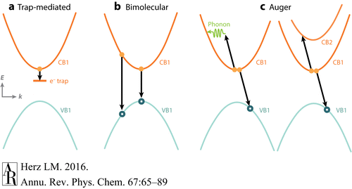
Schematic diagram indicating recombination mechanisms active in organic-inorganic metal halide perovskites. (a) Trap-assisted recombination is a monomolecular process involving the capture of either an electron (as shown) or a hole in a specific trap state (e.g., defect). (b) Bimolecular recombination may occur between electrons and holes, from either the relaxed state (CBM → VBM) or states higher in the band. (c) Auger recombination is a higher-order process involving at least three particles. The energy of an electron (or hole) is here transferred to another electron (or hole) to allow nonradiative recombination with a hole (or electron). As indicated, all processes have to satisfy energy and momentum conservation. Abbreviations: CB, conduction band; CBM, conduction band minimum; VB, valence band; VBM, valence band maximum.

Slide 18
SUMMARY POINTS
1.Hybrid organic-inorganic metal halide perovskites exhibit interesting structure-property relationships deriving from their propensity to undergo structural transformations with relative ease.
2.The exciton binding energy Eb appears to be a function of temperature as a result of the strong temperature dependence of the dielectric function. At room temperature, Eb is in the range of a few milli-electron volts to at most a few tens of milli-electron volts, in accordance with the presence of a free-charge-carrier population.
3.Charge-carrier relaxation dynamics within the first few picoseconds after excitation are marked by thermalization, cooling, and many-body effects. It remains to be explored whether extended hot charge-carrier phases can be utilized in photovoltaic devices that exceed the Shockley-Queisser limit.
4.Trap-assisted (monomolecular) charge-carrier recombination is mostly nonradiative and highly specific to material processing, yielding associated lifetimes from nano- to microseconds. Traps in hybrid lead halide perovskites appear to be mostly shallow (approximately tens of milli-electron volts), arising, for example, from elemental metal, halide, or organic vacancies, and may be present in higher density near interfaces and grain boundaries.
5.Bimolecular charge-carrier recombination is predominantly radiative and exhibits rate constants that defy the Langevin limit by many orders of magnitude.
6.Nonradiative Auger recombination is significant for charge-carrier densities corresponding to the threshold for amplified spontaneous emission. Rate constants show a strong specificity to crystal structure, opening the possibility for the design of materials with low Auger rates from first-principles calculations.

Slide 19
In summary, organic-inorganic metal halide perovskites have proven to be a fascinating material system to investigate. Few materials show such inherent flexibility in terms of compositional and structural modification, yet allow for excellent optoelectronic properties, including high charge-carrier mobilities, strong optical absorption, and low trap-assisted recombination rates. Whether perovskite photovoltaic cells will become competitors to current silicon technology, the lessons learned from investigating their photophysics will serve as highly valuable guidelines on how to design effective light-harvesting and light-emitting materials.

Slide 20
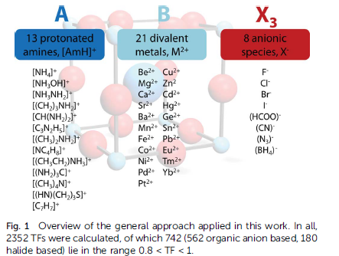
Reproduced from Chem.Soc., 2025,6,3430

Slide 21
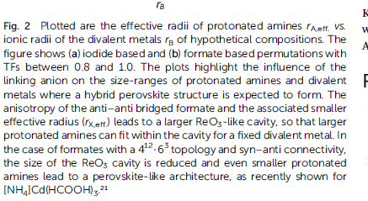
Reproduced from Chem.Soc., 2025,6,3430

Slide 22
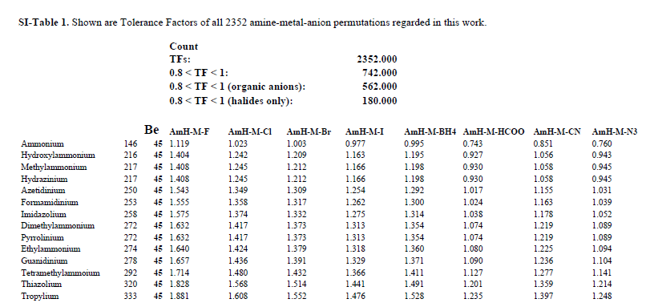
Reproduced from Chem.Soc., 2025,6,3430;supplement

Slide 23
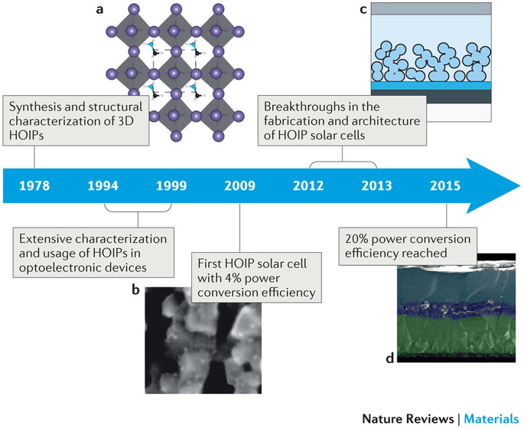

Slide 24
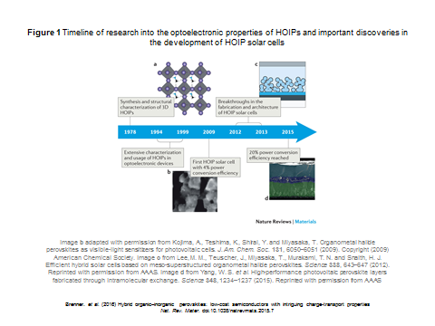

Slide 26
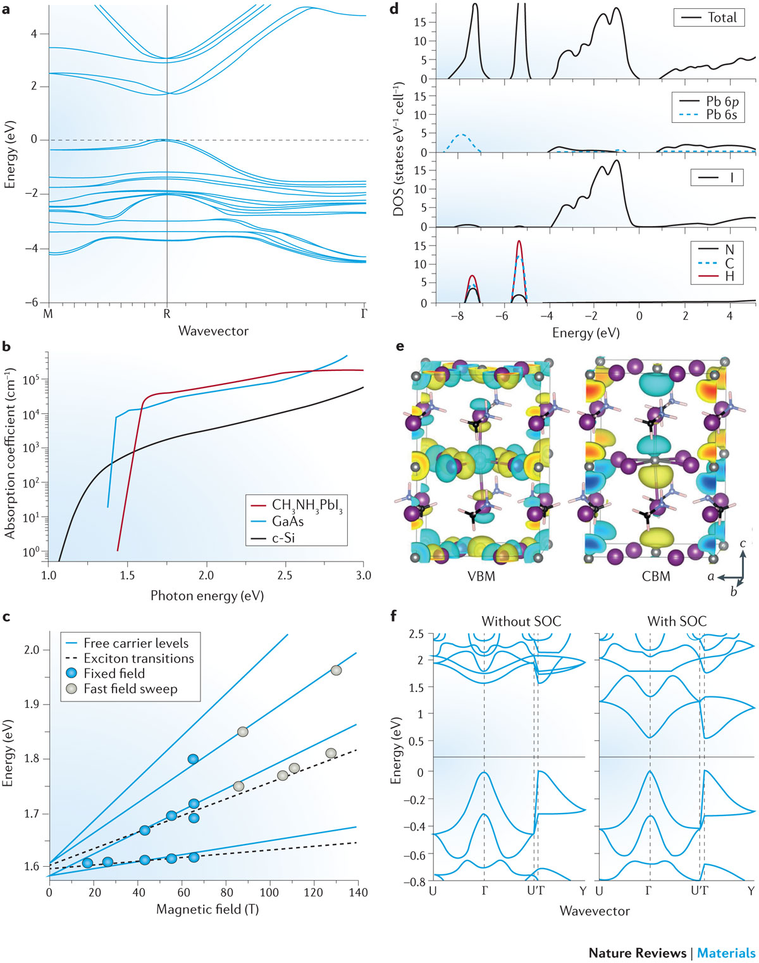
Figure 2 Electronic structure and closely related physical properties of HOIPs
Panel b adapted with permission from REF. 49, American Chemical Society. Panel c from REF. 63, Nature Publishing Group. Panel d adapted with permission from REF. 31, Royal Society of Chemistry. Panel e adapted with permission from REF. 74, American Chemical Society. Panel f adapted with permission from REF. 76, American Chemical Society
Brenner. et al. (2016) Hybrid organic–inorganic perovskites: low-cost semiconductors with intriguing charge-transport properties
Nat. Rev. Mater. doi:10.1038/natrevmats.2015.7

Slide 27
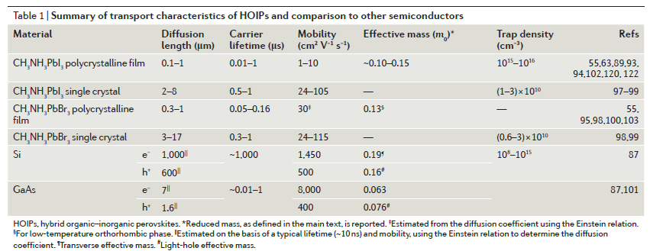

Slide 28
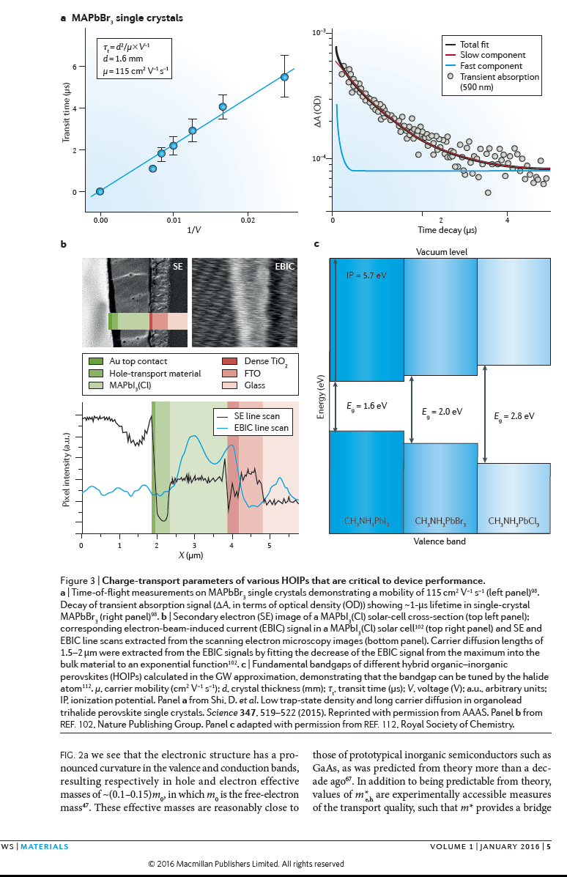

Slide 29
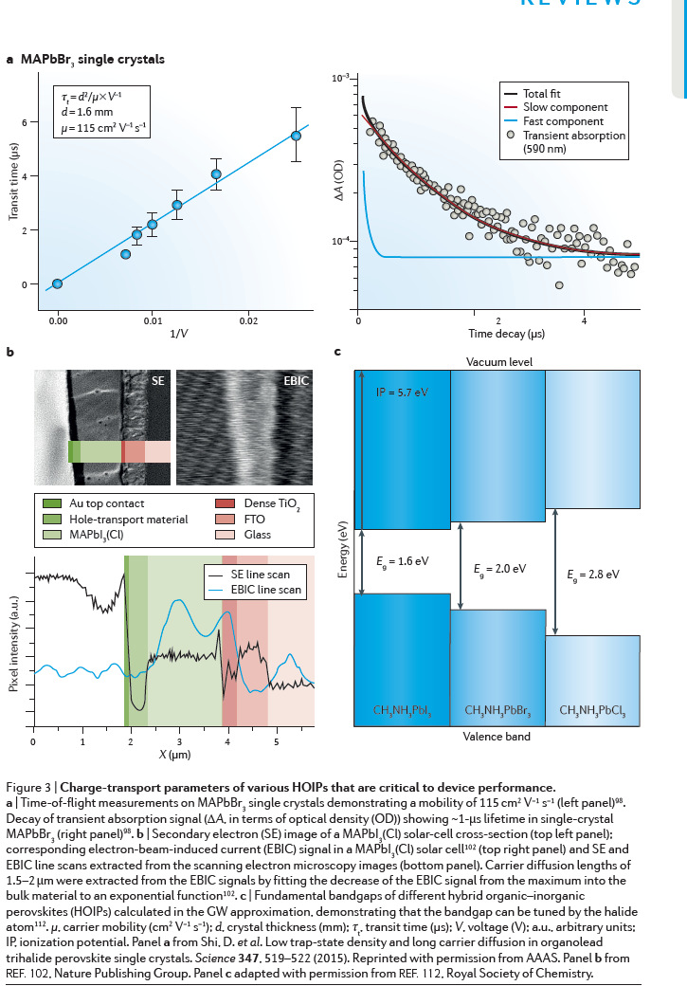

Slide 30
