Slide 1
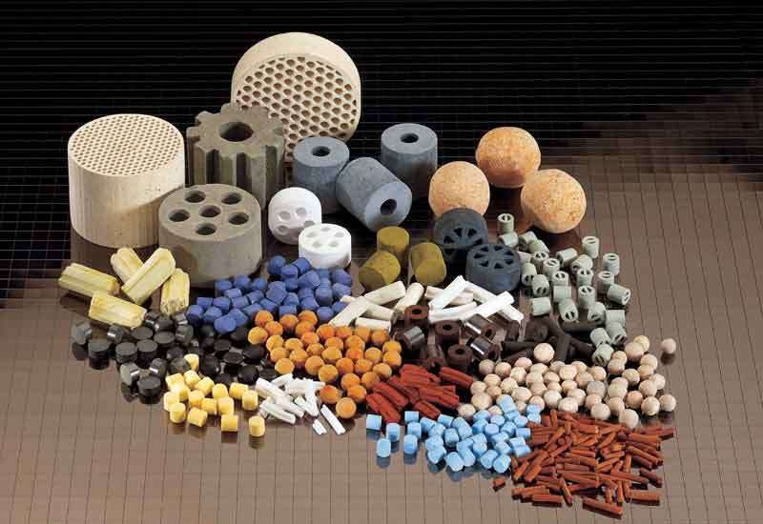
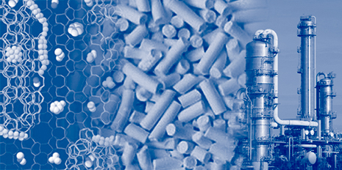
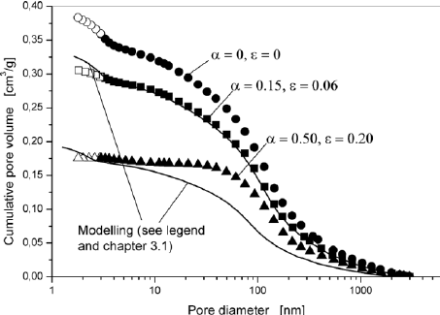
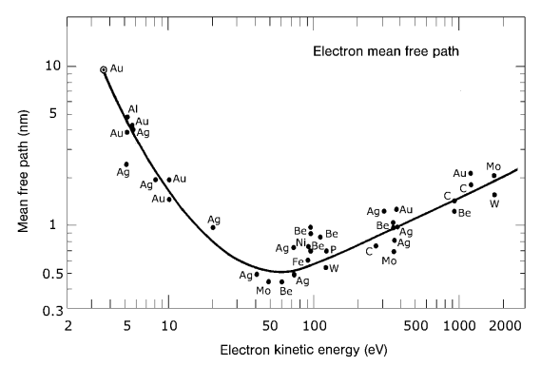
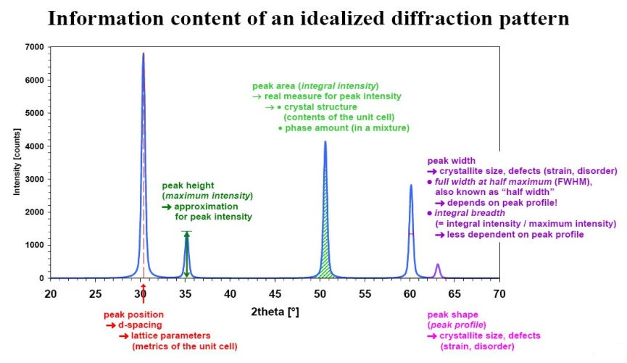
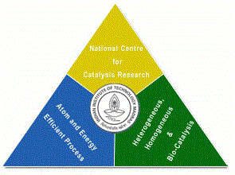
Catalyst Characterization and Interpretation
Presentation 19
National Centre for Catalysis Research
Indian Institute of Technology Madras

Slide 2
Online Lecture Series 4
Catalyst Characterization and Interpretation
Online Lecture Series 1 Carbon Dioxide Conversion into Chemicals and Fuels
Online Lecture Series 2 Photo and Photo-electrochemical Water Splitting
Online Lecture Series 3 Fundamentals of Electrochemistry
Online Lecture Series 4 Catalyst Characterization and Interpretations
All these lectures will be available in YouTube
One can view them whenever they want
Course Details

Slide 3
A Site at NCCR for Catalysis
http://catalysis.eprints.iitm.ac.in/

Slide 4
Module 1
1.1. Introduction to Catalytic Phenomena
1.1.1. Emergence of Catalyst Technology: A Brief History
1.1.2. Importance of Catalysis and Catalyst Technology
1.1.3. Fundamental Catalytic Phenomena and Principles
Exercises/Assignments/Reading Materials
1.2. Catalyst Characterization and Selection
1.2.1. Principles and Objectives of Catalyst Characterization
1.2.2. Determining Physical Properties of Catalysts
1.2.3. Determining Chemical Properties of Catalysts
Exercises/Assignments/Reading Materials

Slide 5
Module 2
2.1. Morphology and Physical Properties
2.1.1. Gas Adsorption at Low Temperatures
2.1.2. Mercury Porosimetry
2.1.3. Incipient wetness method
2.1.4. Microscopy
2.1.5.1. Electron Microscopy
2.1.5.2. Field Emission Microscopy and Ion Microscopy
Exercises/Assignments/Reading Materials

Slide 6
Module 3
3.1. Surface Properties
3.1.1. Volumetric, Gravimetric Adsorption Methods
3.1.2. Adsorption Calorimetry
Exercises/Assignments/Reading Materials
3.2. Spectroscopy in Catalysis
3.2.1. UV- Vis spectroscopy
3.2.2. IR spectroscopy
3.2.3. Raman Spectroscopy
3.2.4. Temperature-Programmed Techniques
3.2.4.1. Temperature-Programmed Reduction
3.2.4.2. Temperature-Programmed Sulfidation
3.2.4.3. Temperature-Programmed Reaction Spectroscopy
3.2.4.4. Temperature-Programmed Desorption
3.2.4.5. Temperature-Programmed Reaction
Spectroscopy in UHV
Exercises and Assignments/Reading Materials
Cont’d

Slide 7
Module 3
3.3. Photoemission and Auger Spectroscopy
3.3.1. X-Ray Photoelectron Spectroscopy (XPS)
3.3.2. Ultraviolet Photoelectron Spectroscopy (UPS)
3.3.3. Auger Electron Spectroscopy
Exercises and Assignments
3.4. The Ion Spectroscopies
3.4.1. Secondary Ion Mass Spectrometry (SIMS)
Exercises and Assignments
3.5. Diffraction and Extended X-Ray Absorption Fine Structure (EXAFS)
3.5.1. X-Ray Diffraction
3.5.2. Low-Energy Electron Diffraction (LEED)
3.5.3. X-Ray Absorption Fine Structure (XAFS)
Exercises and Assignments

Slide 8
Module 4
Module 4
4.1. Bulk Properties
4.1.1. Particle Size Distribution and Mechanical Properties
4.1.2. Particles Size Analysis
4.1.3. Application to Phase Identification
4.1.4 Application to Phase Characterization:
4.1.5. X-Ray Diffraction of Catalysts in a Reactive Atmosphere
4.1.6. Small-Angle X-Ray Scattering (SAXS)
Eexercises/Assignments/Reading Materials

Slide 11
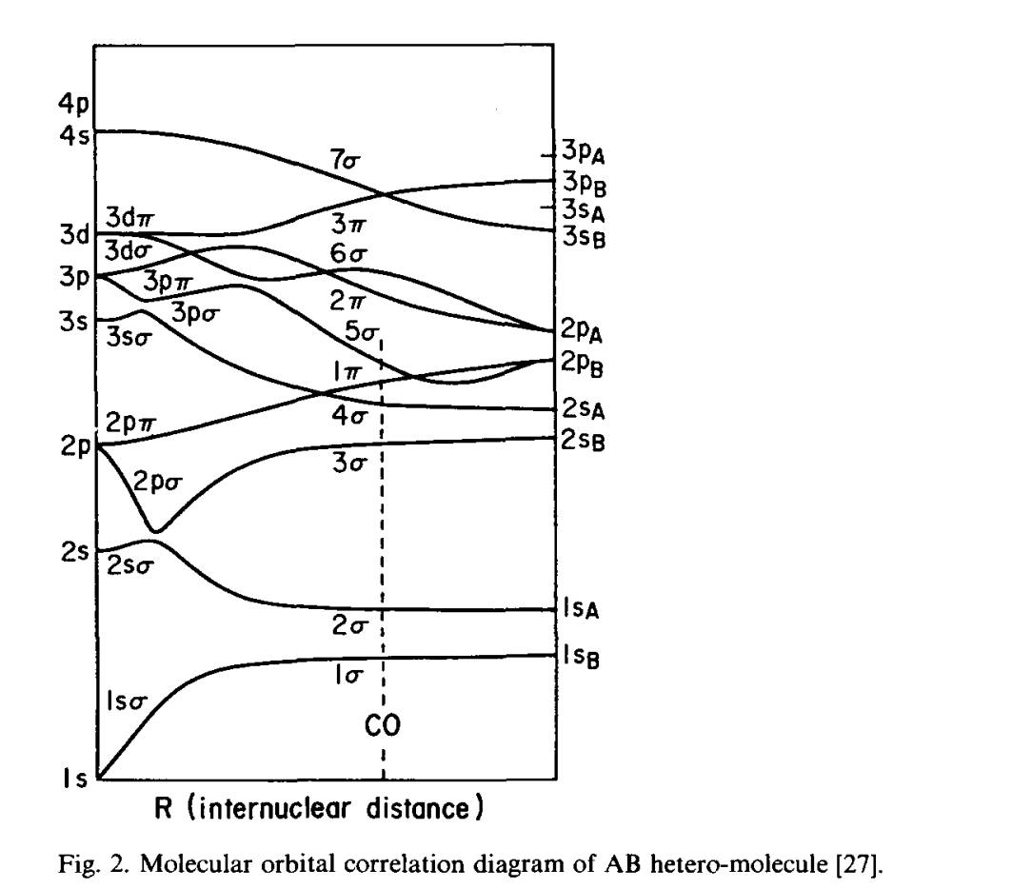

Slide 12
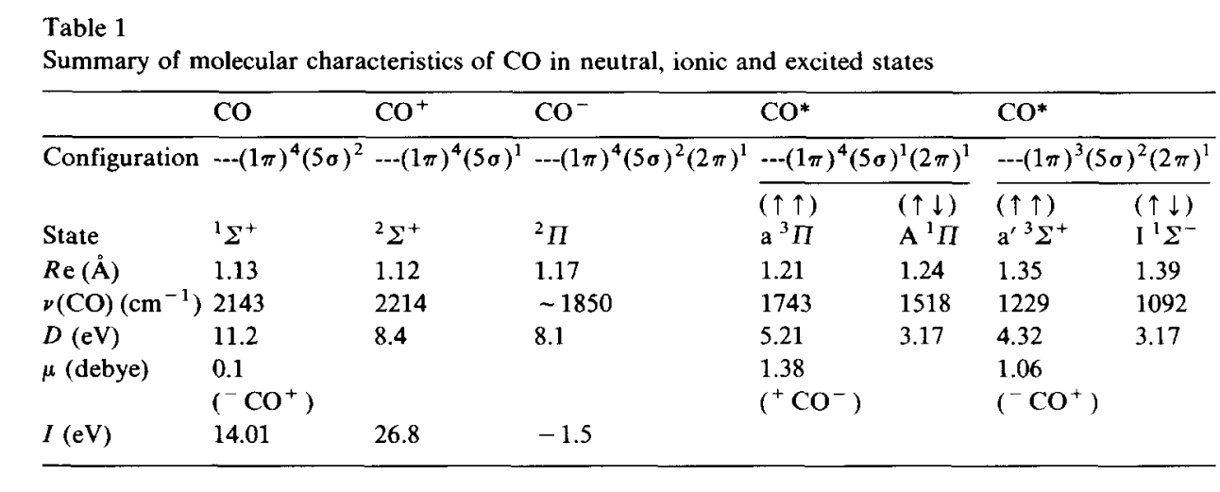

Slide 13
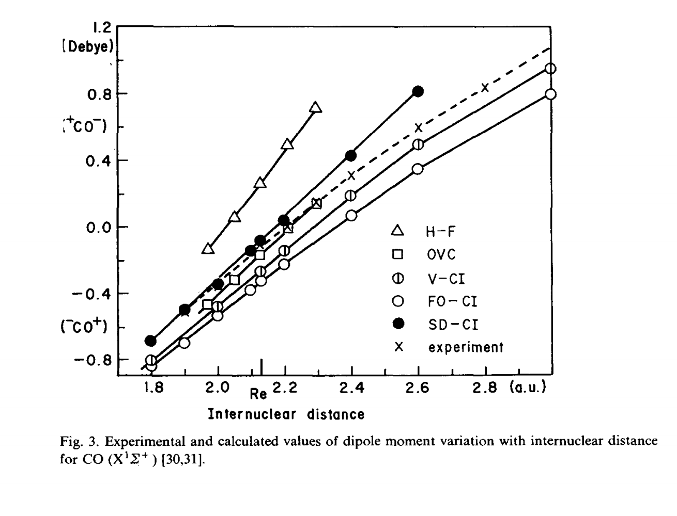

Slide 14
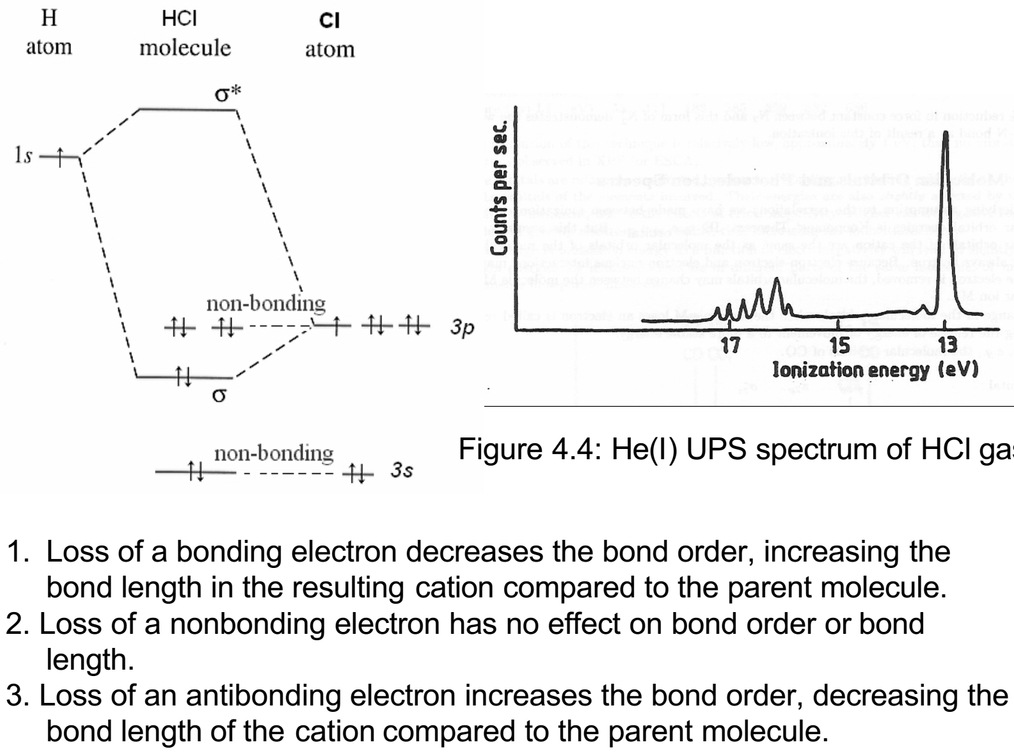

Slide 15
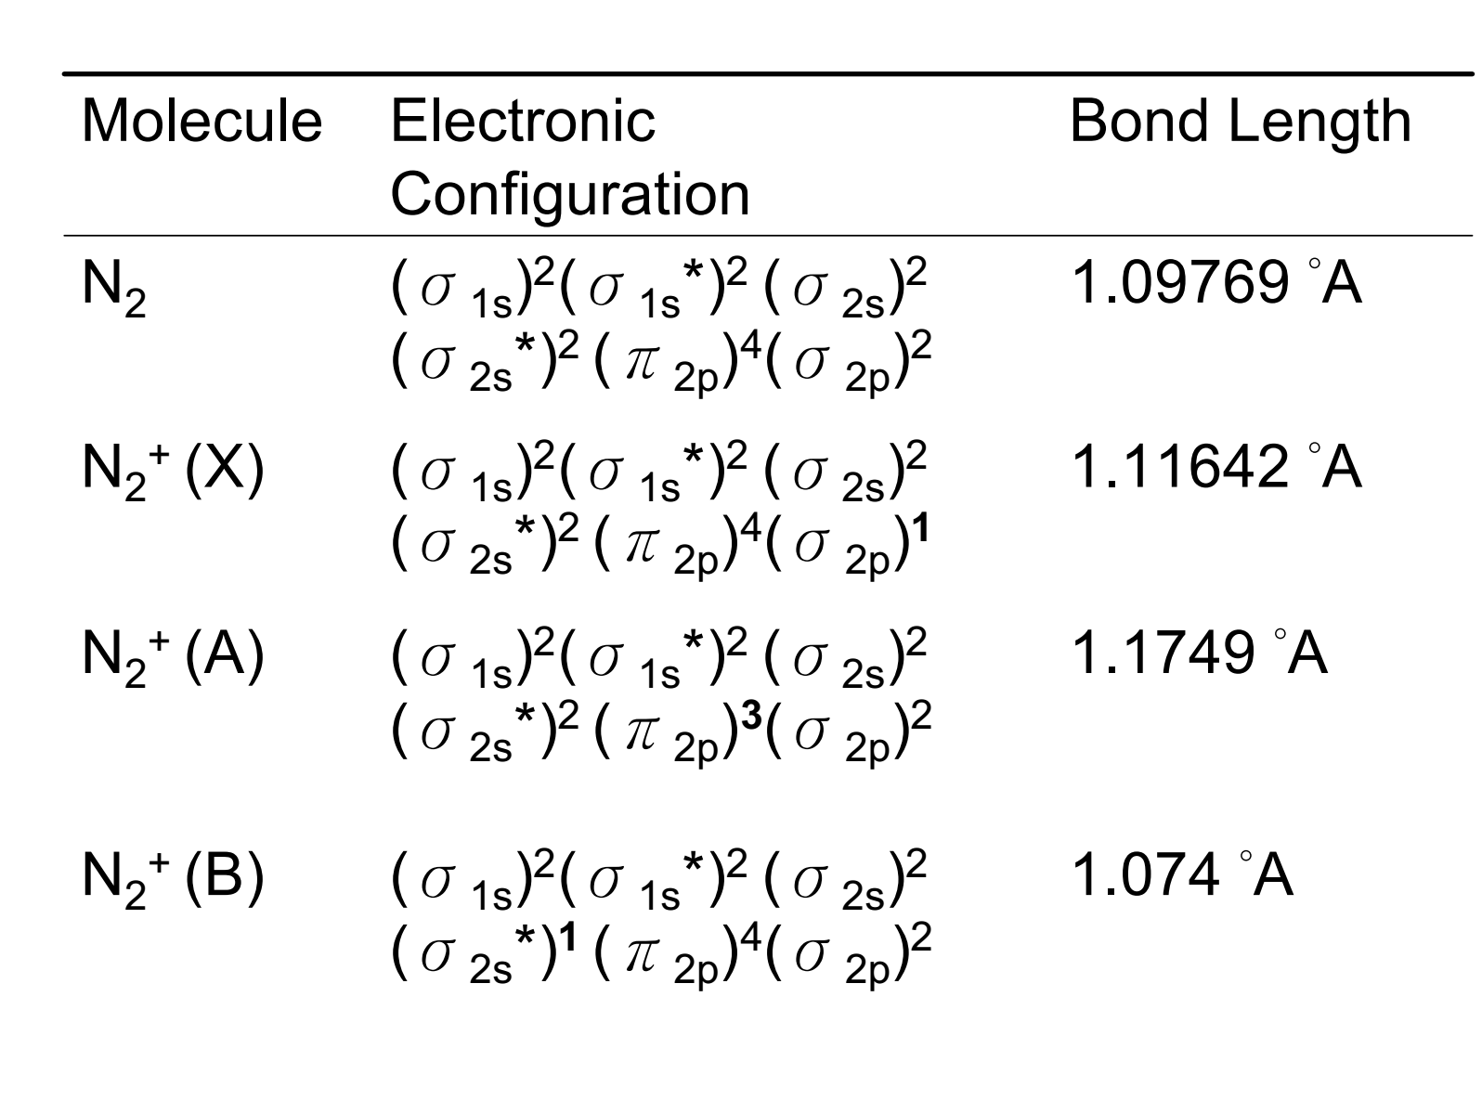

Slide 16
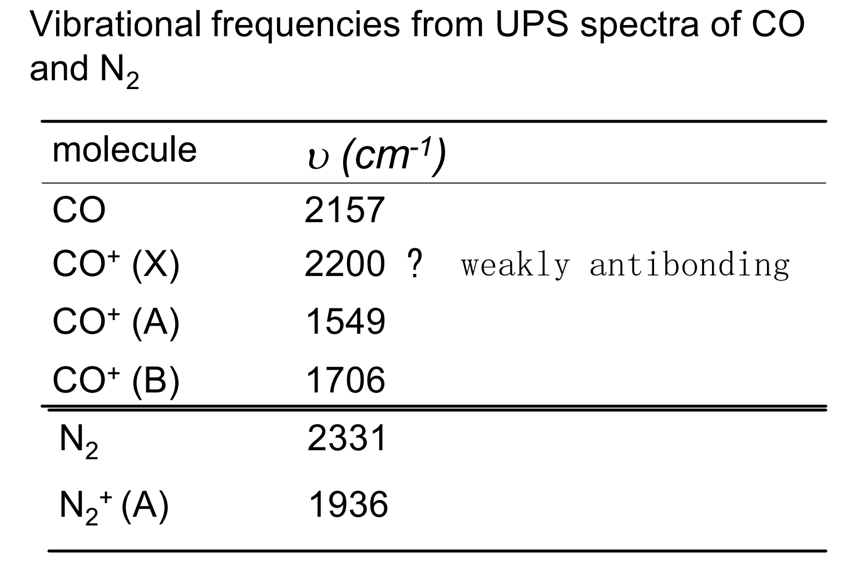

Slide 17
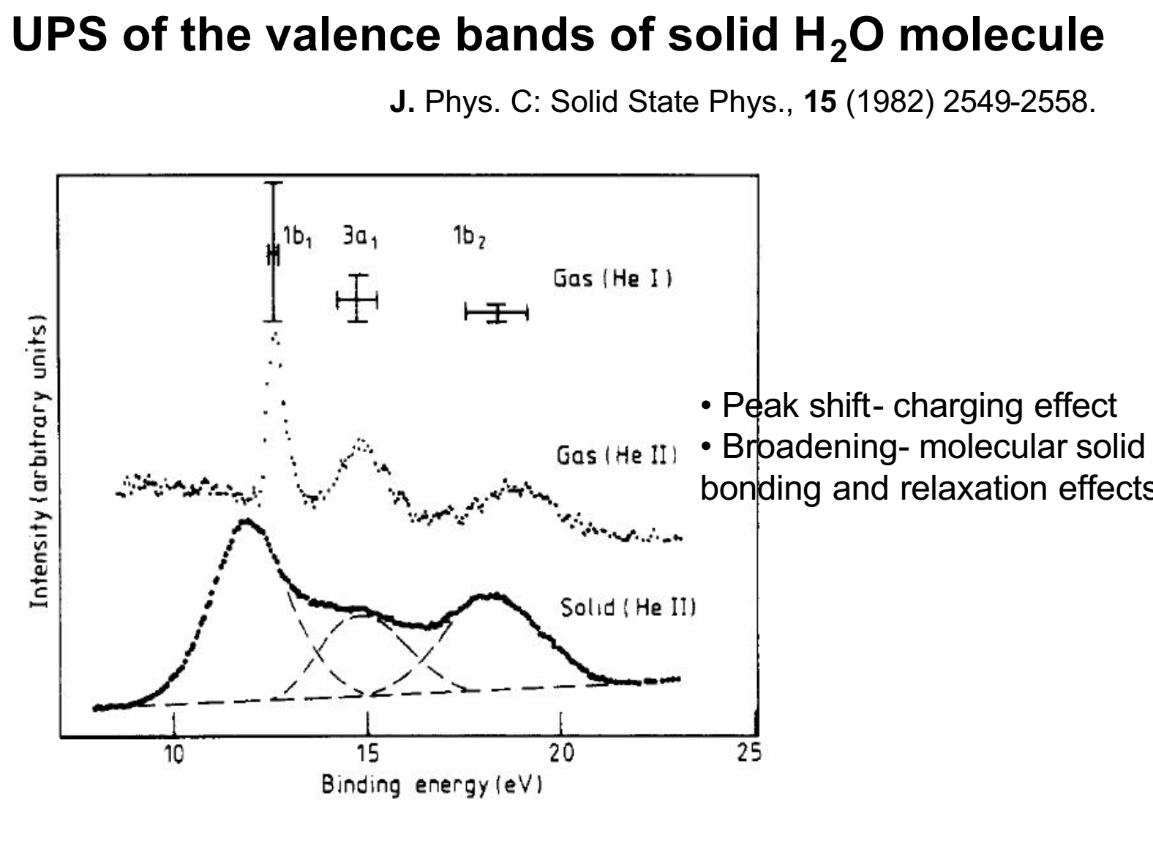

Slide 18
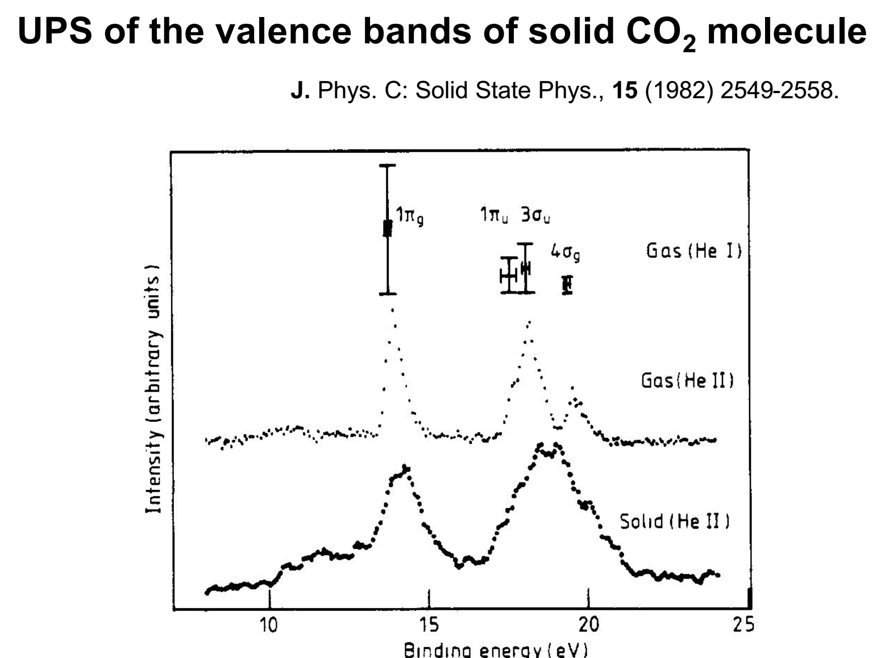

Slide 19
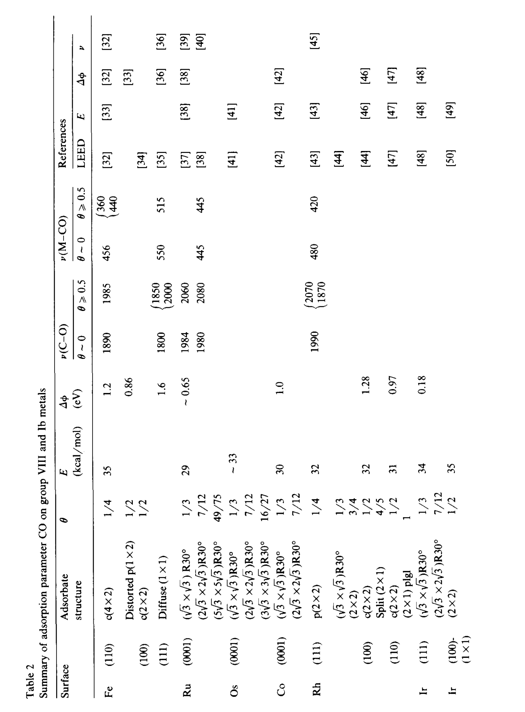

Slide 20
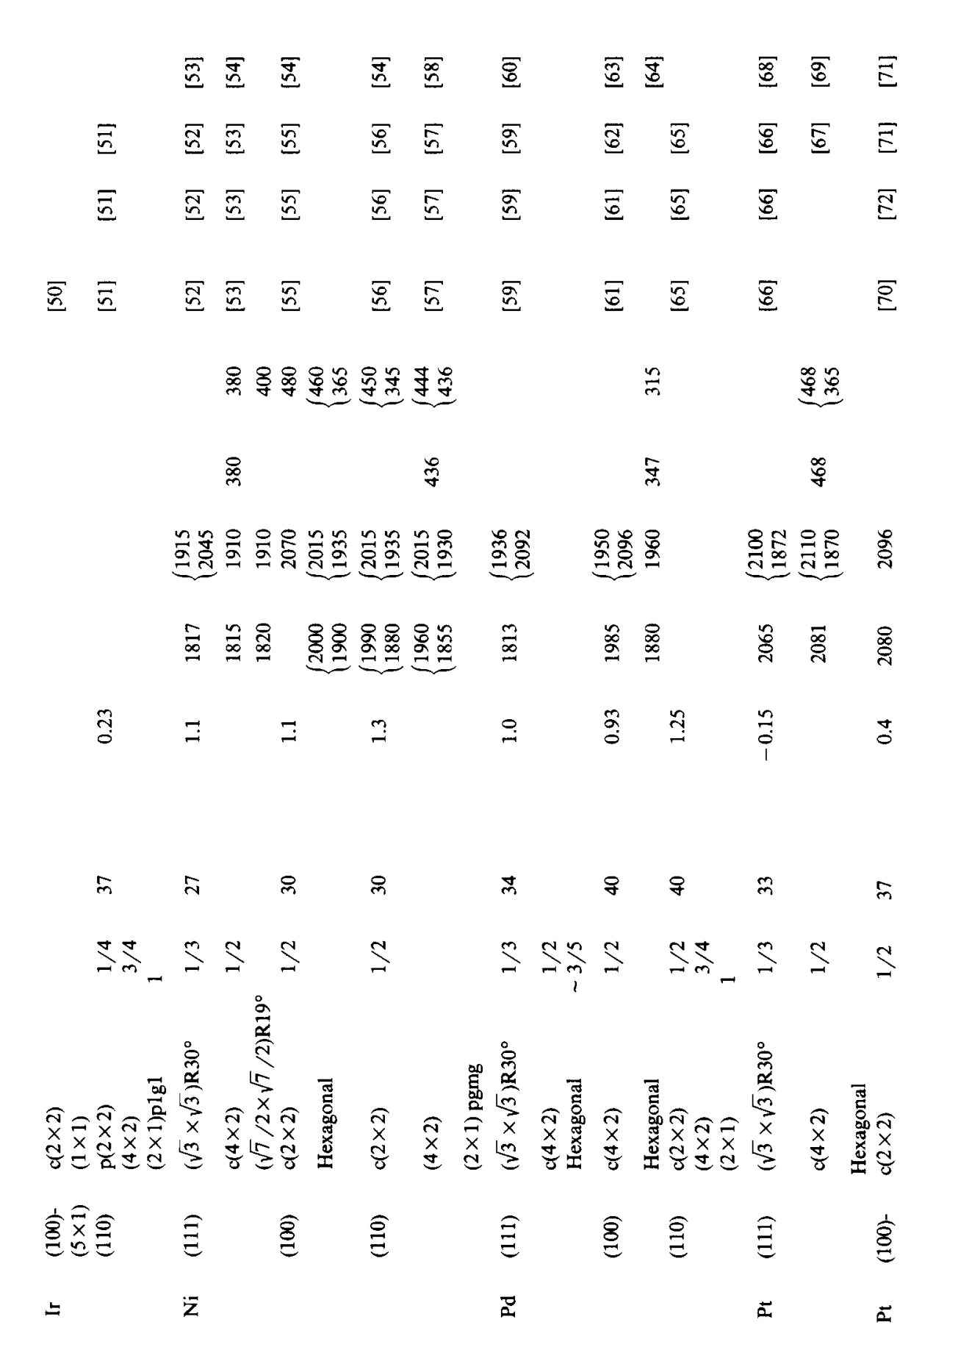

Slide 21
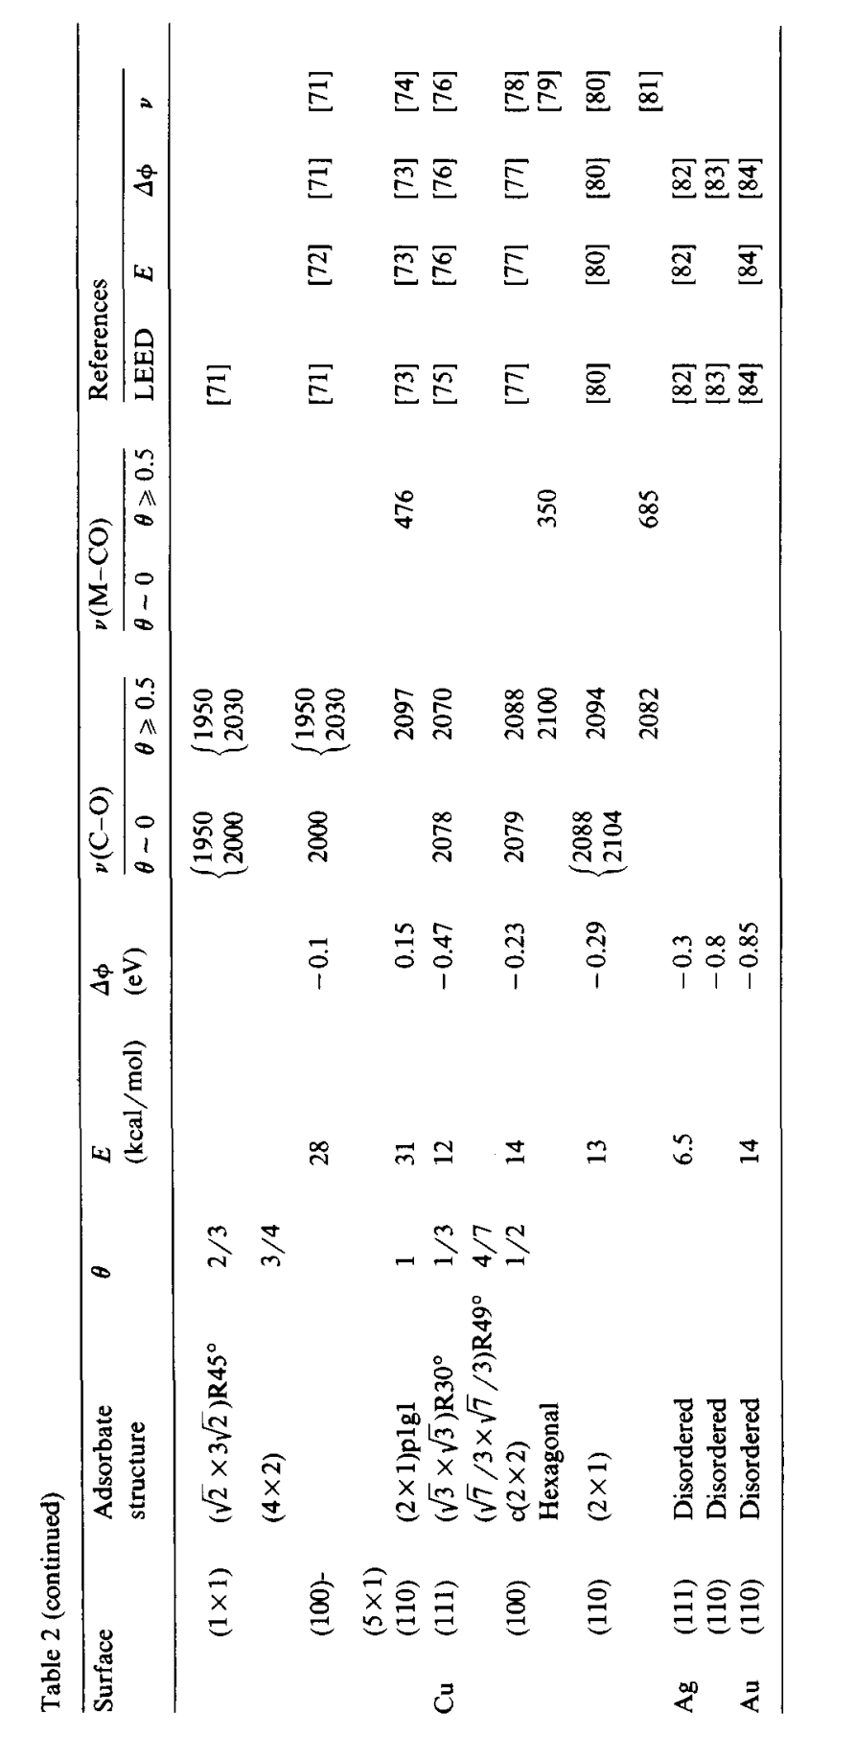

Slide 22
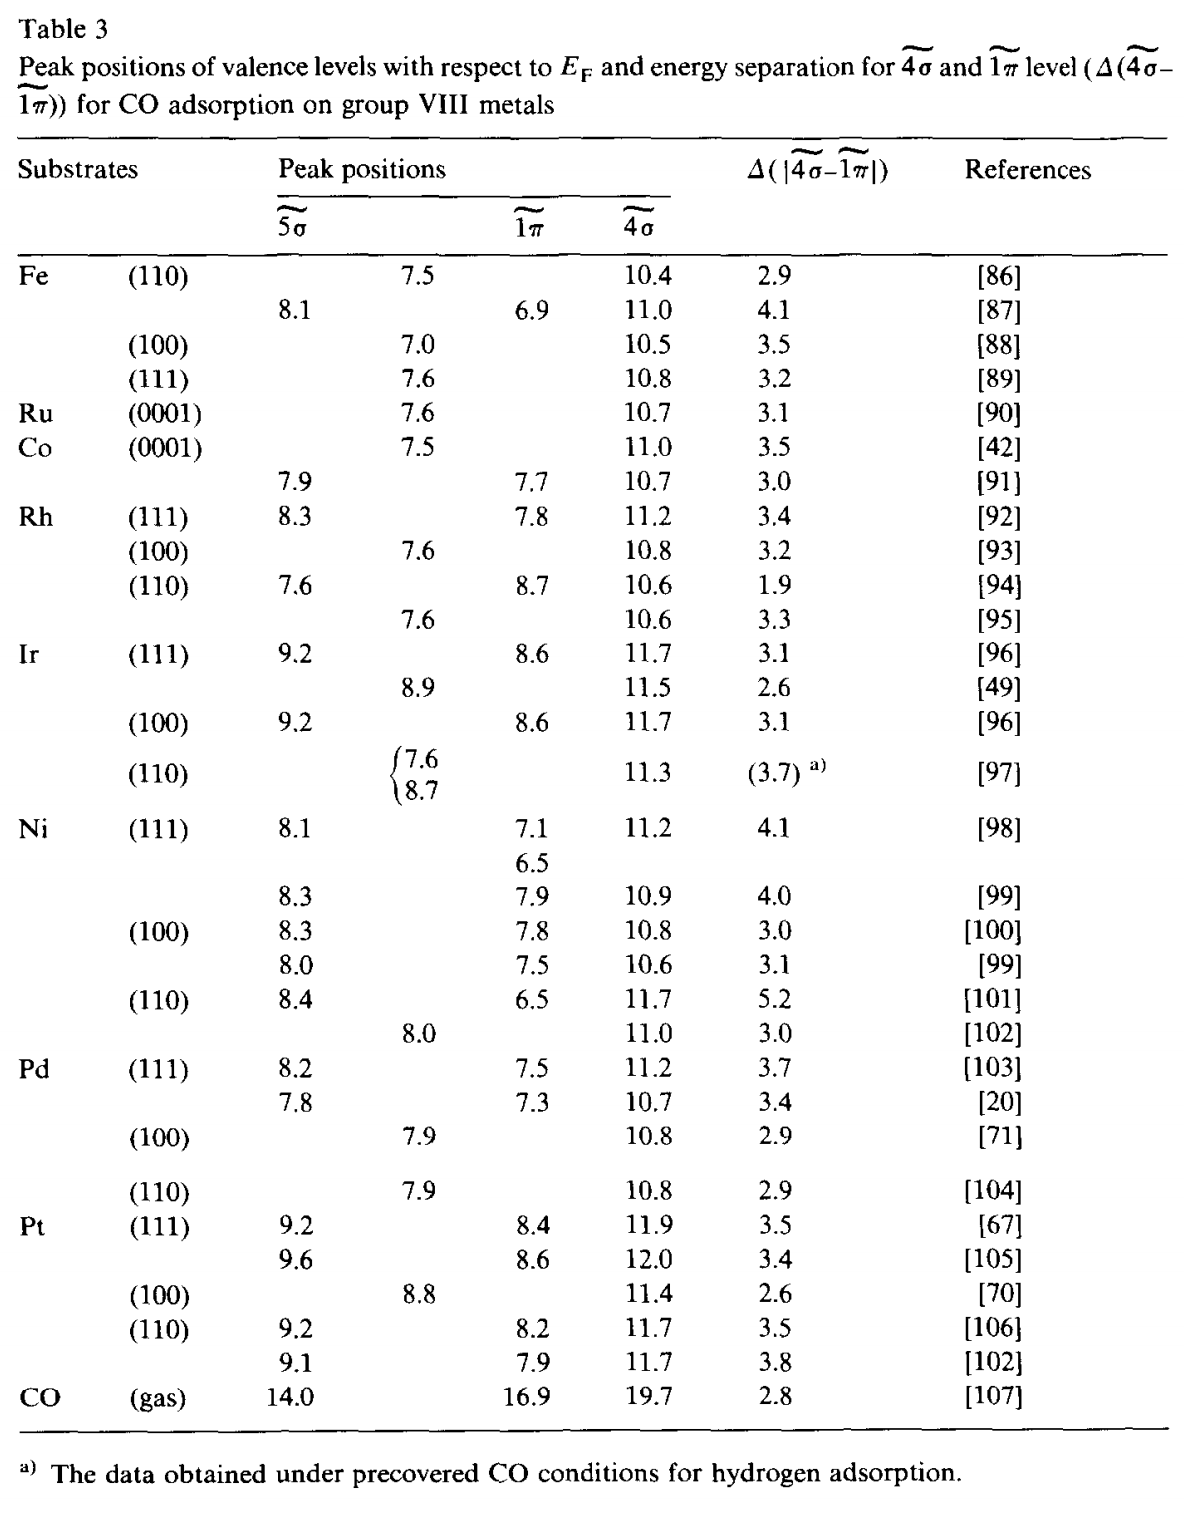

Slide 25
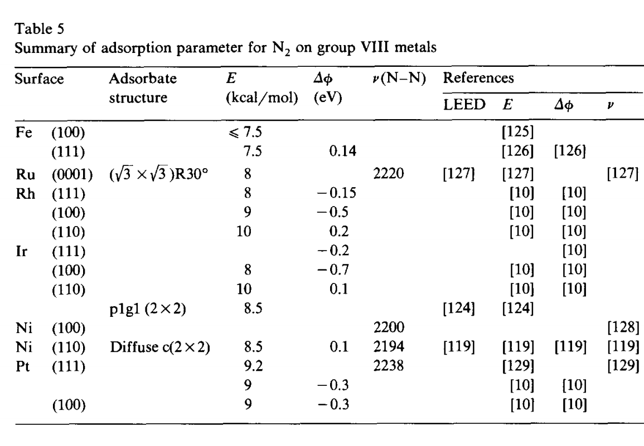

Slide 26
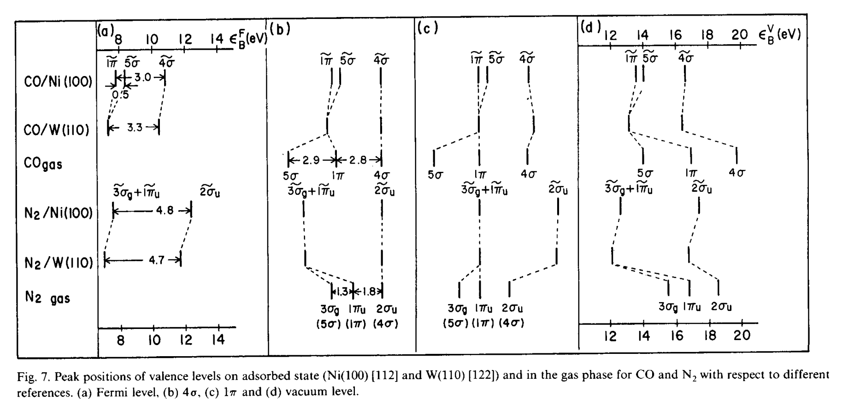

Slide 27
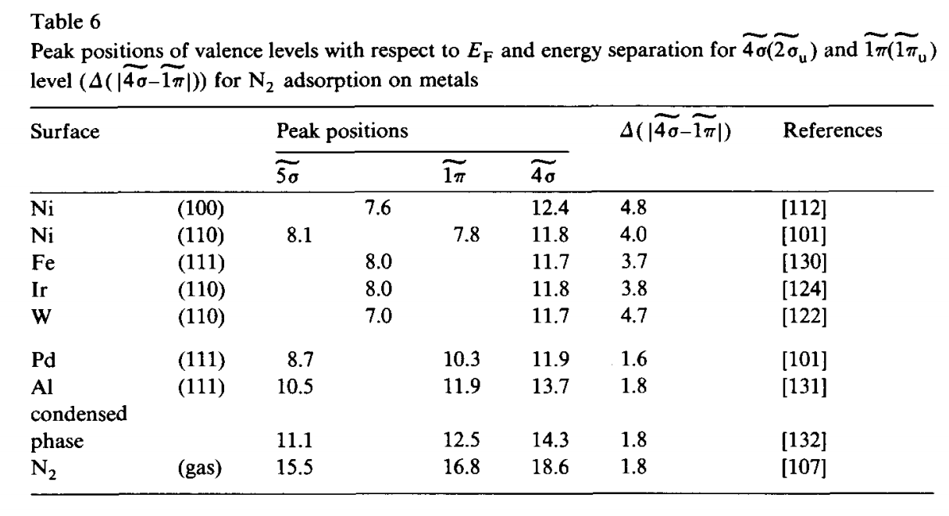

Slide 28
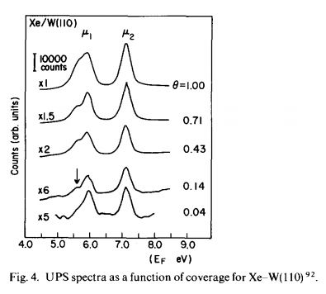

Slide 29
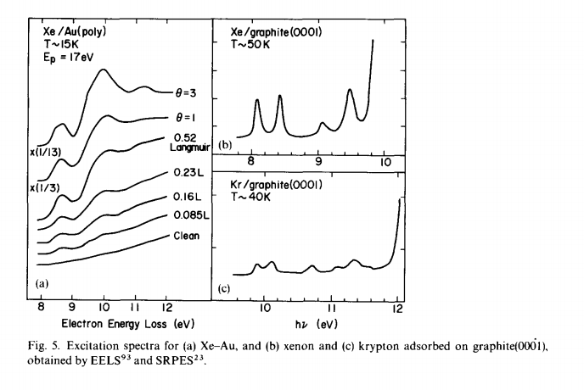

Slide 30
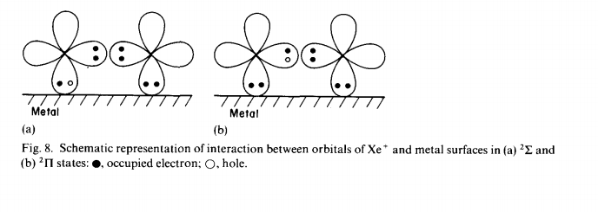

Slide 31
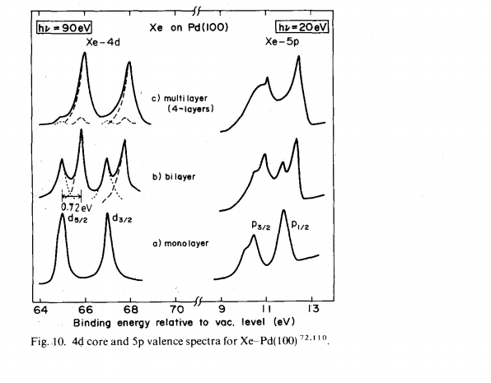

Slide 32
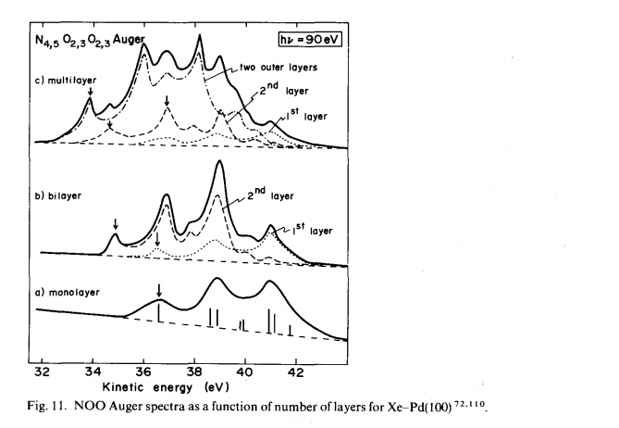

Slide 33
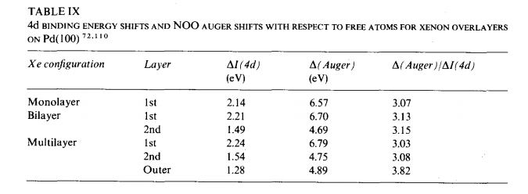

Slide 35
Ultraviolet Photoelectron Spectroscopy (UPS)
UV light ( hν = 5 to 100 eV) to excite photoelectron. From an analysis of the kinetic energy and angular distribution of the photoelectrons, information on the electronic structure (band structure) of the material under investigation can be extracted with surface sensitivity.
Can determine density of States D(Ei) (occupied)

Slide 36
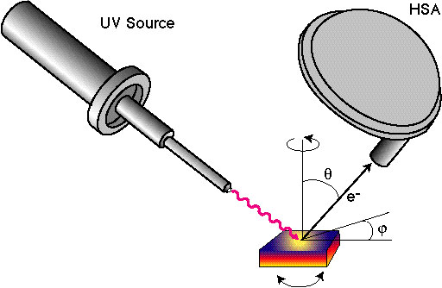
Angular Resolved UPS (ARUPS)
The light incidence angle and polarization and, the plane of incidence (with respect to the surface, crystal lattice) determine the A for the excitation process.
UPS spectra also have strong angular dependence for the excited electron, which can give information about band structure in the k space.

Slide 37
Three-step model
Less accurate but simpler and more instructive
Full quantum-mechanical
Accurate but difficult

Slide 38
Photoemission (UPS) theory
At certain direction (determined by θ and φ) the wave vector of emitted electrons (free electrons into the vacuum) with kinetic energy E_{kin} is:
K_{ex} = (2mE_{kin}/h)^{1/2}
How to determine its origin in the solid?

Slide 39
The first step
The optical excitation of an electron in the first step is simply described by “golden rule”
The transition happened between two states with nearly unchanged k. The perturbation can be described by dipole approximation:
Only electrons with can go out of surface to be detected.
Question: why two states with nearly unchanged k? Hint: compare k of electron in the solid and k of UV photon.

Slide 40
The second step
Only electrons with can go out of surface to be detected, for the selected energy E by the analyzer the intensity is:
Where mfi is the matrix element for the transistion between two states and f(Ei) is density of states.
These electrons, however, in the second step will undergoes various scattering processes including inelastic ones, which make them lose energy and also gives secondary electrons. The mean free path length can be used to describe the transport probability:
λ for UV light is very small between 5 to 20 Å
Surface sensitivity

Slide 41
The third step
The conservation of wave vector parallel:
For the wave vector perpendicular to surface:
There are also energy conservation:
While
We can get information about k||, however, it is still hard to get !!

Slide 42
To determine
Basically if you know E(k) and k||, then you should be able to determine from the energy conservation. But it is really not easy, simple way is to assume a “free electron parabola’ for the final states:
m* is the effective mass of the electron and with inner potential V₀, there is:
However, the unoccupied bands for the final states in most cases are not free-electron-like.
For a simple case we show normal (k || = 0) photoemission of fcc Cu(001) photoemission.

Slide 43
To determine
The energy coincidence method that compares spectra from two different crystal faces
25^{O}
The tip is to find the same peak structure due to the same k points at different surfaces, one is done at normal, the other (must) done at certain angle to have the same spectrum, then from the k|| from the second case of the other can be determined.

Slide 44
The rules to find surface states
So far we talked about UPS to find band structure information, they are the properties of the 3d solid. Concerning the surface states, Four criteria are listed below:
No vertical vector dependence for surface states, the same Ei(k||) must be observed for different photon energies.
For normal emission, k|| = 0, there is no dispersion (change of the peak binding energy position) in contrast to bulk one.
The surface emission band fall into the band gap.
The absorption of gasses (contamination) have strong effects on photoemission from the surface states. However, sometimes photoemission from bulk bands also sensitive to the surrounding change, and the image-potential states are less sensitive to the contamination than the crystal derived surface states.

Slide 45
UPS study of Cu(111)
No change with change of hν ( )
Strong change with change of emission angle (k||)
Exists at the bulk band gap in the k space.

Slide 46
Other applications of UPS
UPS although not so element sensitive as XPS, but it can still give some element information such as absorbates on the surface. Moreover, it can give the chemical states in many cases.
ΔE =hν- Φ
By determining the low kinetic energy cut-off and the high kinetic energy cut-off (Fermi level for metal) for UPS spectrum with certain photon energy, the work function of the material can be obtained from Φ=hν-ΔE.

Slide 47
Why XPS not good for study of bands?
XPS indeed can excite valence bands to get information about such as density of states, however, it is not suitable for the study of valence bands, especially for the study of energy dispersion (k dependence).
XPS photon have too large energy which leads the electrons from valence bands with very high E_{kin}, eg, too big wave vector k.
XPS photon energy is too high, the transition probability for valence bands is very small compared with UV light. ( WHY? )
Generally it is hard to analyze spectra with high kinetic energy with high resolution (ΔE).

Slide 48
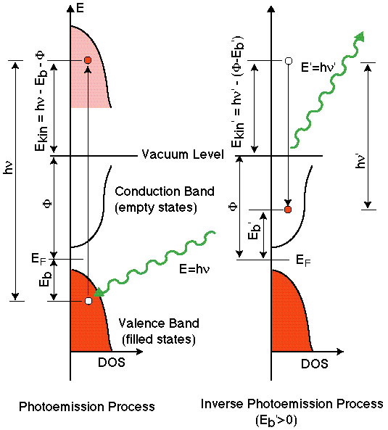
Inverse photoemission (IPES)
UPS give information about occupied states
IPES gives information about unoccupied states.
e-
hν
hν
e-

Slide 49
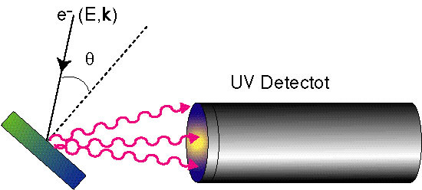
Inverse photoemission (IPES)
IPES
IPES is important to study the unoccupied states of the solids. The surface states exists with binding energy higher than E_{f}, such as image potential states, can only be studied by IPES. IPES have very small cross section than photoemission.

Slide 50
Band diagram for semiconductor
Ei = ½(Ec+Ev) –1/2kTln(N^{c}_{eff}/N^{v}_{eff})
Intrinsic type
Ef = Ei
N type
Ef = Ei + kTln(ND/ni)
P type
Ef = Ei – kTln(NA/ni)
(ni=(np)^{1/2} =(N^{c}_{eff}N^{v}_{eff})^{1/2}e^{-2Eg/kT})

Slide 51
Space-Charge layers at Semiconductors Interfaces
Both are depletion layers
n type
p type
Donors: occupied 0 empty +
Acceptors: occupied - empty 0

Slide 52
Bending at n-type surface
Decreased reversed increased

Slide 53
Solid-Solid Interface
Fermi surface of two contacted metal will be aligned to the same level. This keeps true also for all the solid solid contact, when they have carriers.
Contact potential is the difference of the different work functions of the two metals.

Slide 54
Metal semiconductor interface
Fermi surface aligned.
Due to the fewer carrier the influenced layers (band bending) are much thicker than metal.

Slide 55
Semiconductor interface
aligned
Pinnig of Fermi surface

Slide 56
Pinning of the Fermi Surface
At semiconductor surface, surface states are responsible for the band bending, which increases with density of surface states Qss when the density is low. With Qss increasing, the surface sates will be energetically close to Fermi surface. Thus, the further increasing of Qss, the Ef will be pinned with only infinitesmall increasing of band bending. This happens also at Metal-Semiconductor interface.

Slide 57
Phonons for diatomic linear chain
1 optic and 1 acoustic
For 3d case, there are always 3 acoustic waves and 3(l-1) optic waves for phonons. (l is atom number in a cell)
Optic waves are related to the oscillation of different atoms in the cell and it will change the distribution of p. Thus it changes ε(ω) and therefore they are called optic modes.
Lo vs. TO

Slide 58
Surface Phonons for diatomic linear chain
With complex wave vector
Surface phonons
Optic
Acoustic

Slide 59
Surface Phonon and Plasmon
Surface plasmon
Surface phonon
Phonon is to describe the vibration of the atoms in the solid, while the plasmon to describe the free charge oscillation and it is related to the free charge density.

Slide 60
The techniques to detect surface phonons and plasmons
(High Resolution) Electron energy Loss spectroscopy:
(HR)EELS
Other techniques: XPS, Atomic scattering, Infrared Spectroscopy

Slide 61
Gas | Emission Line | Energy (eV) | Wavelength (nm) | Relative Intensity (%)
H | Lyman α | 10.20 | 121.57 | 100
 | Lyman β | 12.09 | 102.57 | 10
He | 1 α | 21.22 | 58.43 | 100
 | 1 β | 23.09 | 53.70 | approx 1.5
 | 1 γ | 23.74 | 52.22 | 0.5
 | 2 α | 40.81 | 30.38 | 100
 | 2 β | 48.37 | 25.63 | <10
 | 2 γ | 51.02 | 24.30 | negligible
Ne | 1 α | 16.67 | 74.37 | 15
 | 1 α | 16.85 | 73.62 | 100
 | 1 β | 19.69 | 62.97 | < 1
 | 1 β | 19.78 | 62.68 | < 1
 | 2 α | 26.81 | 46.24 | 100
 | 2 α | 26.91 | 46.07 | 100
 | 2 β | 27.69 | 44.79 | 20
 | 2 β | 27.76 | 44.66 | 20
 | 2 β | 27.78 | 44.63 | 20
 | 2 β | 27.86 | 44.51 | 20
 | 2 γ | 30.45 | 40.71 | 20
 | 2 γ | 30.55 | 40.58 | 20
Ar | 1 | 11.62 | 106.70 | 100
 | 1 | 11.83 | 104.80 | 50
 | 2 | 13.30 | 93.22 | 30
 | 2 | 13.48 | 91.84 | 15

Slide 62
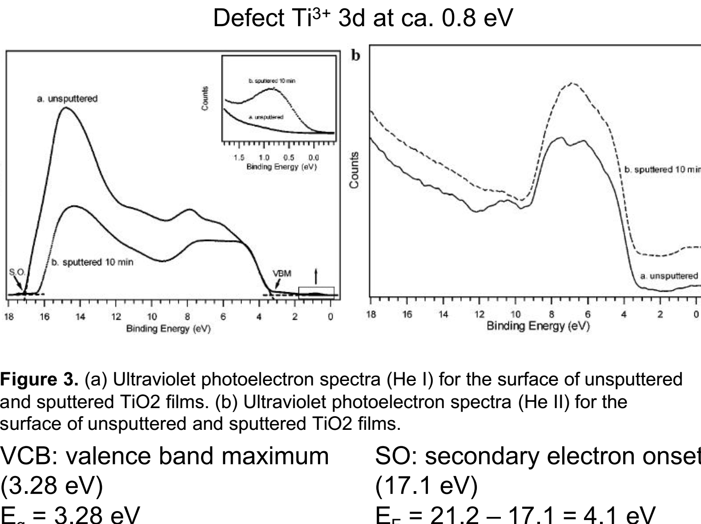

Slide 63
