Slide 2
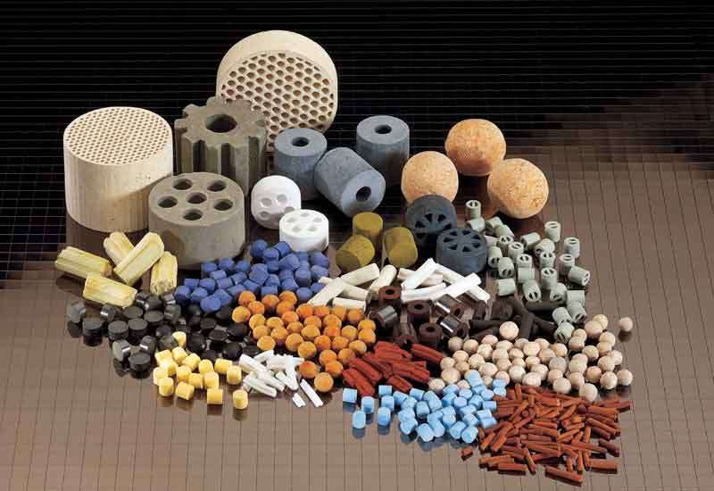
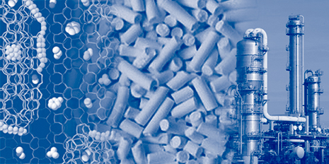
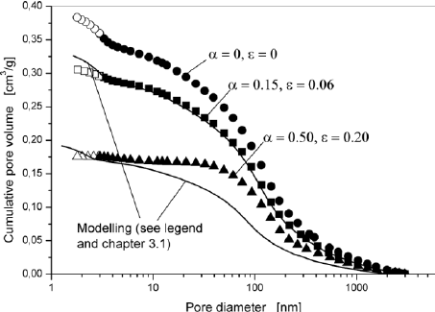
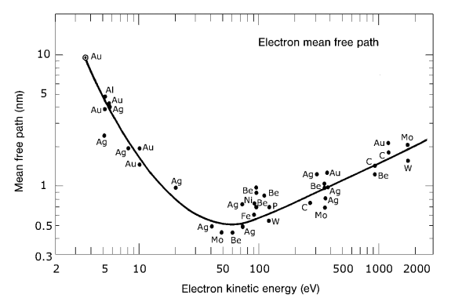
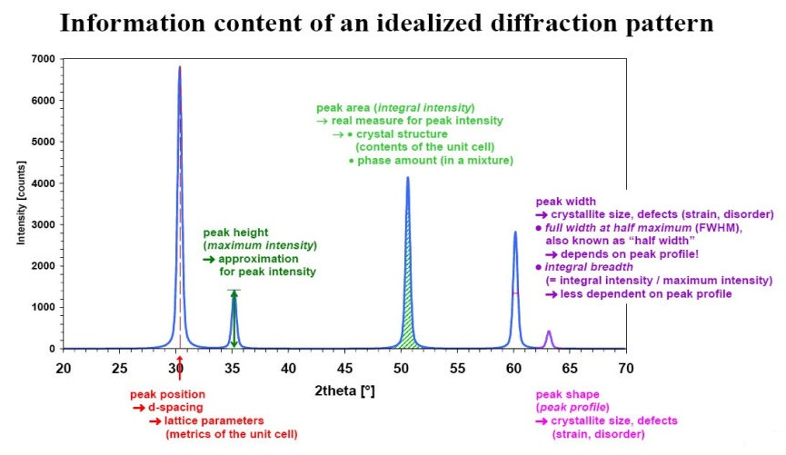
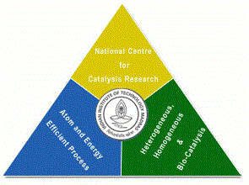
Catalyst Characterization and Interpretation
Presentation 10
National Centre for Catalysis Research
Indian Institute of Technology Madras

Slide 3
Online Lecture Series 4
Catalyst Characterization and Interpretation
Online Lecture Series 1 Carbon Dioxide Conversion into Chemicals and Fuels
Online Lecture Series 2 Photo and Photo-electrochemical Water Splitting
Online Lecture Series 3 Fundamentals of Electrochemistry
Online Lecture Series 4 Catalyst Characterization and Interpretations
All these lectures will be available in YouTube
One can view them whenever they want
Course Details

Slide 4
A Site at NCCR for Catalysis
http://catalysis.eprints.iitm.ac.in/

Slide 5
Module 1
1.1. Introduction to Catalytic Phenomena
1.1.1. Emergence of Catalyst Technology: A Brief History
1.1.2. Importance of Catalysis and Catalyst Technology
1.1.3. Fundamental Catalytic Phenomena and Principles
Exercises/Assignments/Reading Materials
1.2. Catalyst Characterization and Selection
1.2.1. Principles and Objectives of Catalyst Characterization
1.2.2. Determining Physical Properties of Catalysts
1.2.3. Determining Chemical Properties of Catalysts
Exercises/Assignments/Reading Materials

Slide 6
Module 2
2.1. Morphology and Physical Properties
2.1.1. Gas Adsorption at Low Temperatures
2.1.2. Mercury Porosimetry
2.1.3. Incipient wetness method
2.1.4. Microscopy
2.1.5.1. Electron Microscopy
2.1.5.2. Field Emission Microscopy and Ion Microscopy
Exercises/Assignments/Reading Materials

Slide 7
Module 3
3.1. Surface Properties
3.1.1. Volumetric, Gravimetric Adsorption Methods
3.1.2. Adsorption Calorimetry
Exercises/Assignments/Reading Materials
3.2. Spectroscopy in Catalysis
3.2.1. UV- Vis spectroscopy
3.2.2. IR spectroscopy
3.2.3. Raman Spectroscopy
3.2.4. Temperature-Programmed Techniques
3.2.4.1. Temperature-Programmed Reduction
3.2.4.2. Temperature-Programmed Sulfidation
3.2.4.3. Temperature-Programmed Reaction Spectroscopy
3.2.4.4. Temperature-Programmed Desorption
3.2.4.5. Temperature-Programmed Reaction
Spectroscopy in UHV
Exercises and Assignments/Reading Materials
Cont’d

Slide 8
Module 3
3.3. Photoemission and Auger Spectroscopy
3.3.1. X-Ray Photoelectron Spectroscopy (XPS)
3.3.2. Ultraviolet Photoelectron Spectroscopy (UPS)
3.3.3. Auger Electron Spectroscopy
Exercises and Assignments
3.4. The Ion Spectroscopies
3.4.1. Secondary Ion Mass Spectrometry (SIMS)
Exercises and Assignments
3.5. Diffraction and Extended X-Ray Absorption Fine Structure (EXAFS)
3.5.1. X-Ray Diffraction
3.5.2. Low-Energy Electron Diffraction (LEED)
3.5.3. X-Ray Absorption Fine Structure (XAFS)
Exercises and Assignments

Slide 9
Module 4
Module 4
4.1. Bulk Properties
4.1.1. Particle Size Distribution and Mechanical Properties
4.1.2. Particles Size Analysis
4.1.3. Application to Phase Identification
4.1.4 Application to Phase Characterization:
4.1.5. X-Ray Diffraction of Catalysts in a Reactive Atmosphere
4.1.6. Small-Angle X-Ray Scattering (SAXS)
Eexercises/Assignments/Reading Materials

Slide 10
Principles and Objectives of Catalyst Characterization

Slide 11
Objectives of Catalyst Characterization There are various objectives in Catalyst characterization depending on the Scientist and also the purpose for which she or he uses the catalyst. Some of the objectives can be stated as follows – (Not complete list). 1. Phase composition of the feed catalyst 2. Surface functionalities and active sites 3. Identification of Intermediates of catalytic reactions 4. Catalyst degradation and regeneration procedures and the list is endless depends on what questions the scientist wishes to seek answers

Slide 13
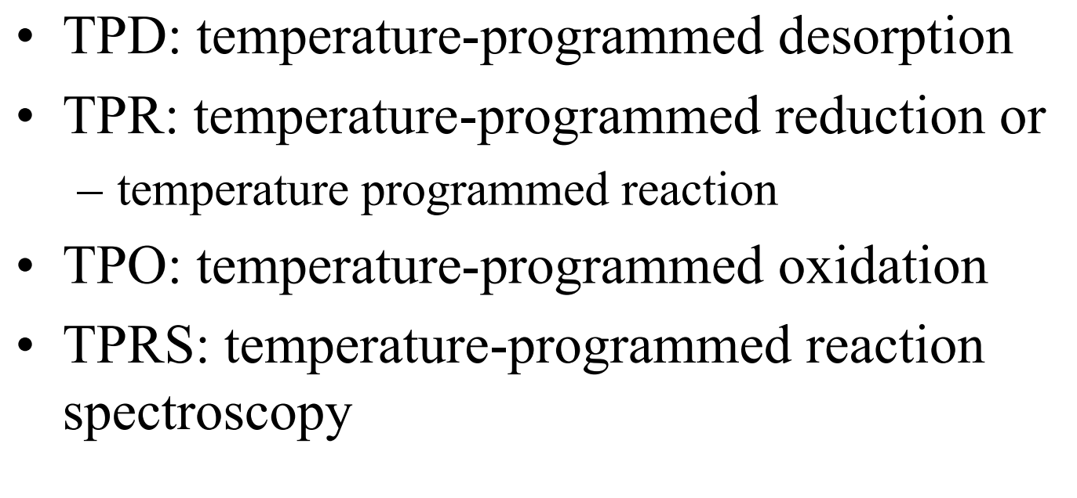

Slide 14
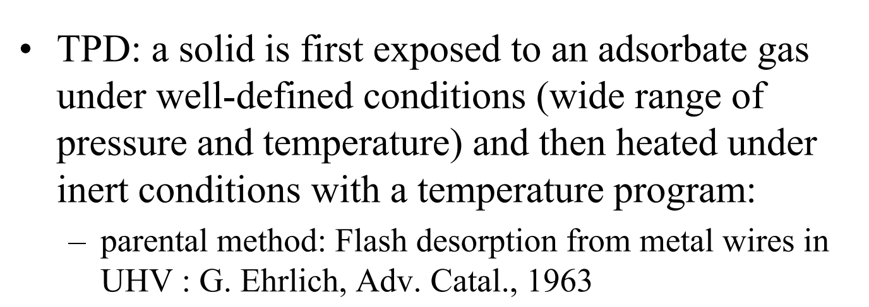

Slide 15
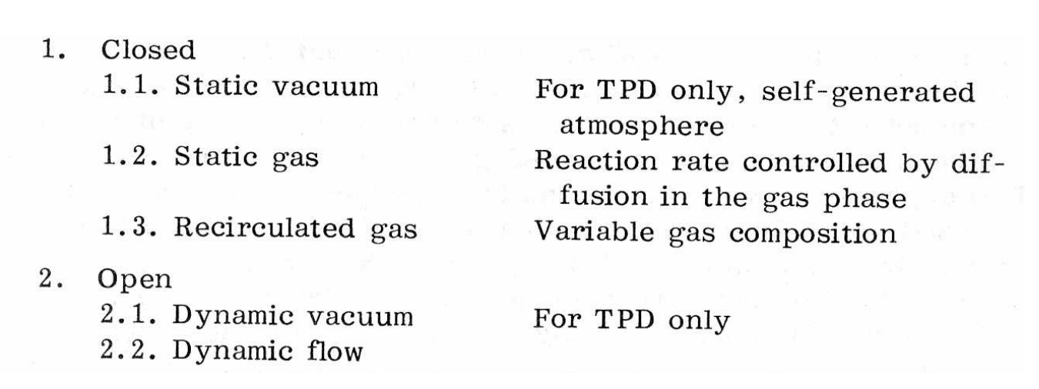

Slide 16
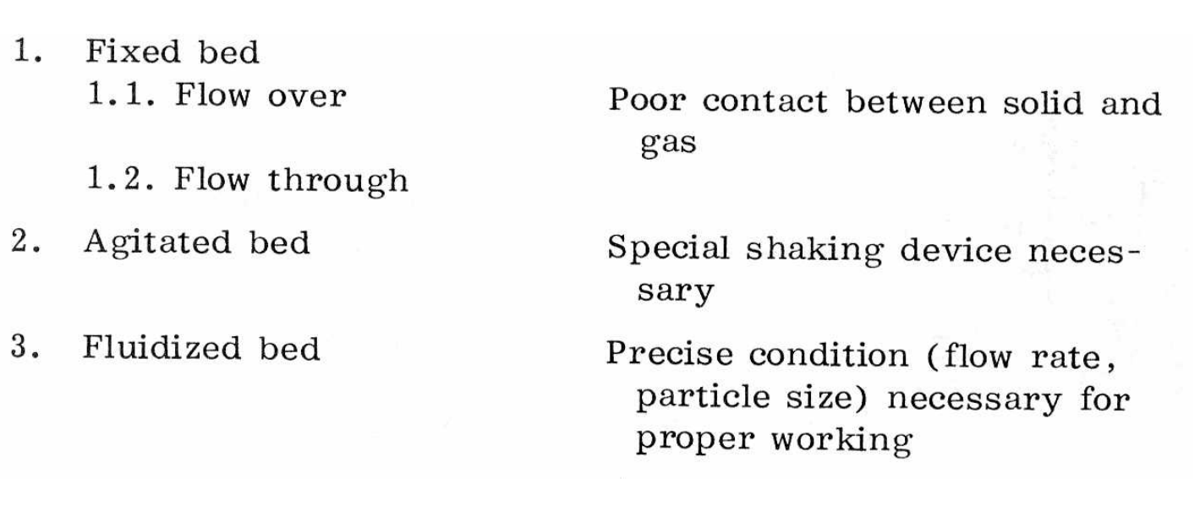

Slide 19
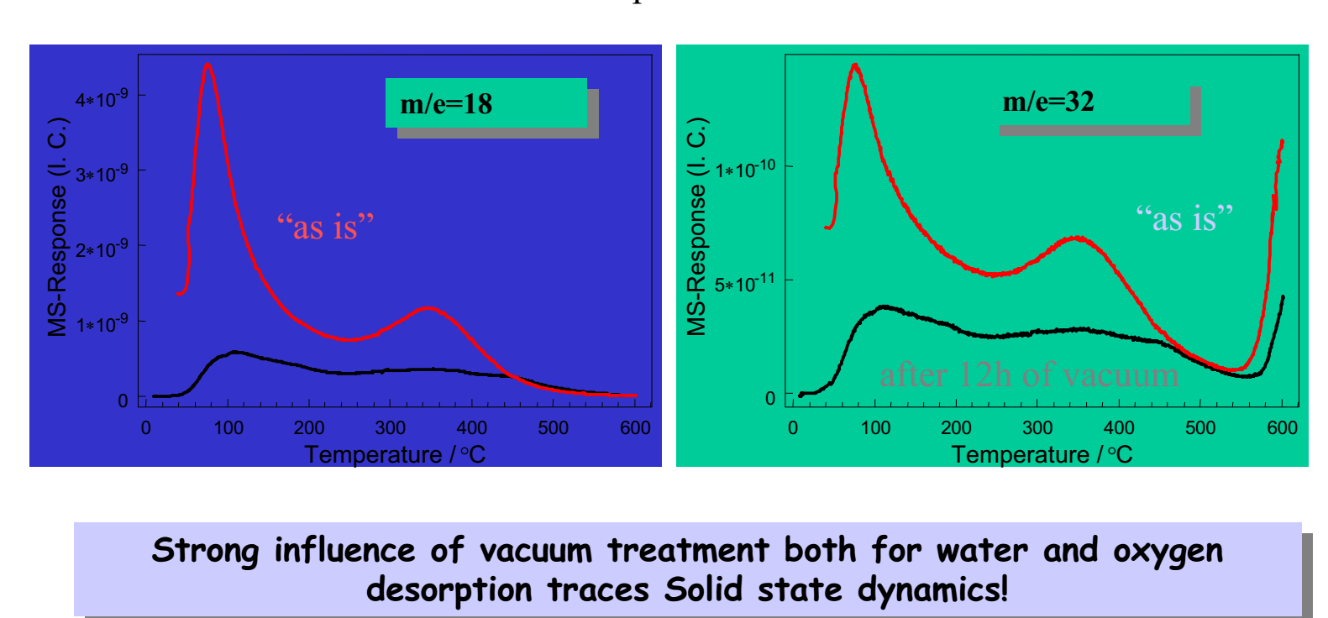

Slide 20
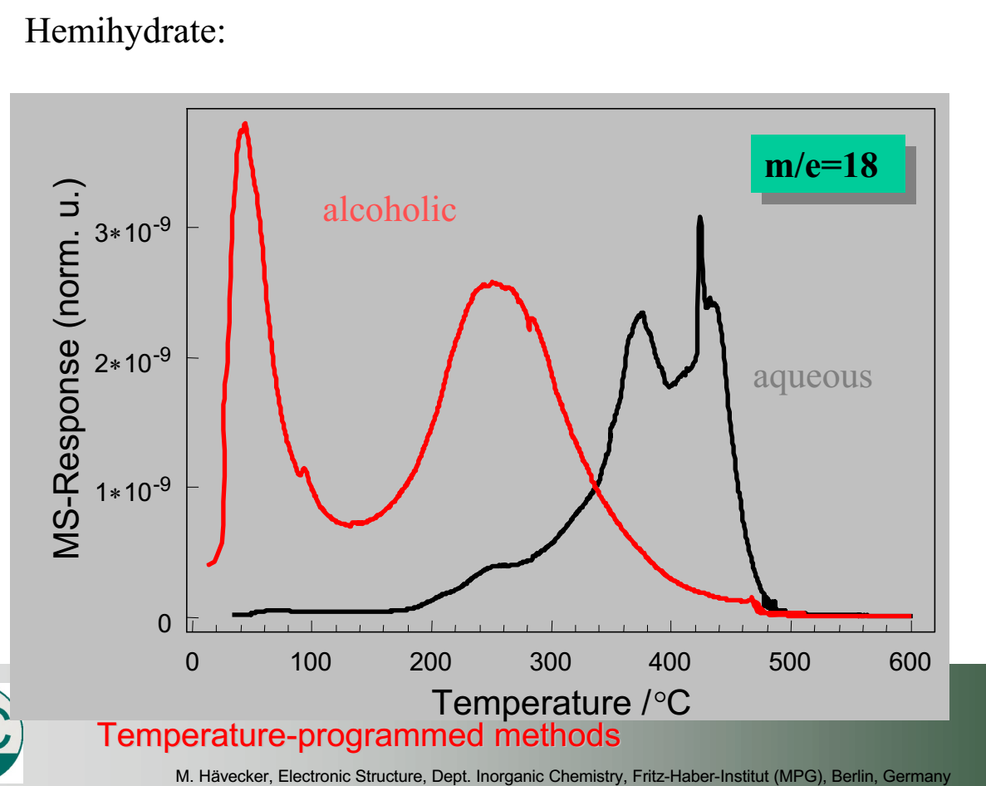

Slide 29
