Slide 2
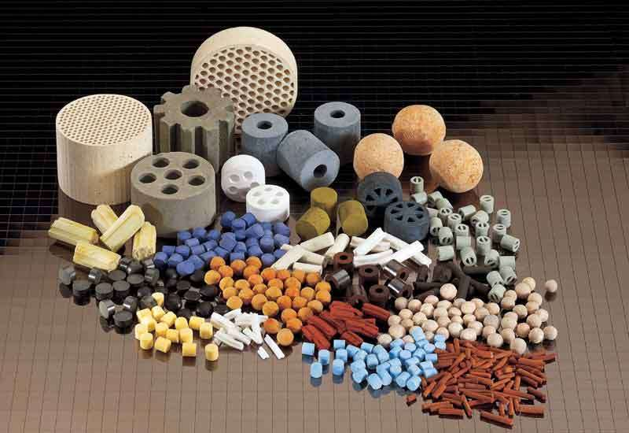
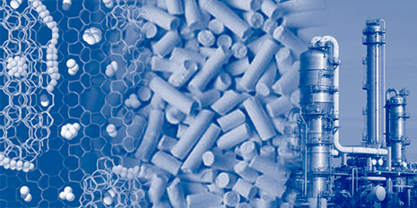
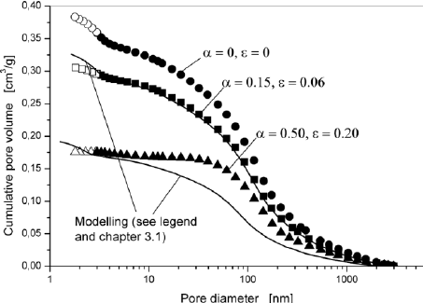
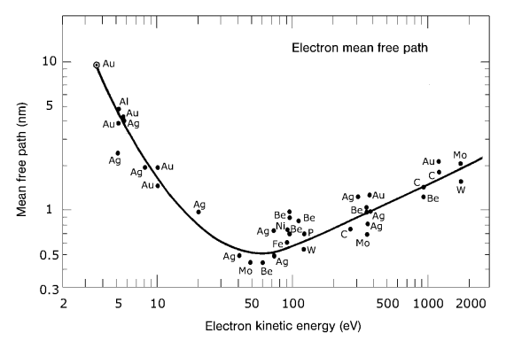
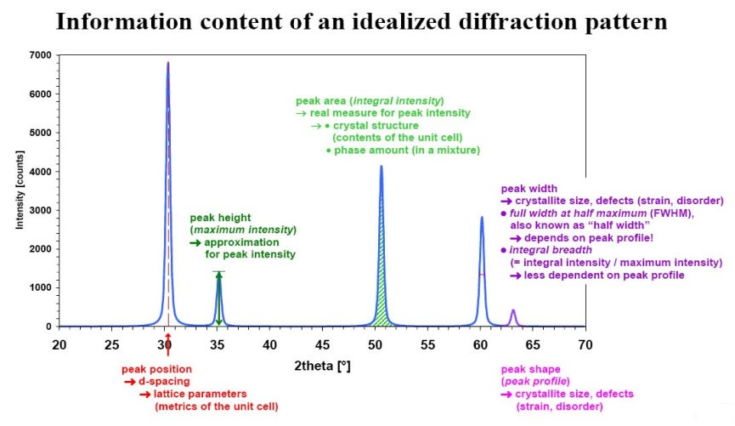
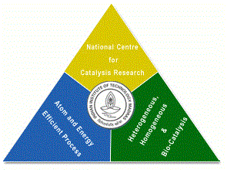
Catalyst Characterization and Interpretation
Presentation 8
National Centre for Catalysis Research
Indian Institute of Technology Madras

Slide 3
Online Lecture Series 4
Catalyst Characterization and Interpretation
Online Lecture Series 1 Carbon Dioxide Conversion into Chemicals and Fuels
Online Lecture Series 2 Photo and Photo-electrochemical Water Splitting
Online Lecture Series 3 Fundamentals of Electrochemistry
Online Lecture Series 4 Catalyst Characterization and Interpretations
All these lectures will be available in YouTube
One can view them whenever they want
Course Details

Slide 4
A Site at NCCR for Catalysis
http://catalysis.eprints.iitm.ac.in/

Slide 5
Module 1
1.1. Introduction to Catalytic Phenomena
1.1.1. Emergence of Catalyst Technology: A Brief History
1.1.2. Importance of Catalysis and Catalyst Technology
1.1.3. Fundamental Catalytic Phenomena and Principles
Exercises/Assignments/Reading Materials
1.2. Catalyst Characterization and Selection
1.2.1. Principles and Objectives of Catalyst Characterization
1.2.2. Determining Physical Properties of Catalysts
1.2.3. Determining Chemical Properties of Catalysts
Exercises/Assignments/Reading Materials

Slide 6
Module 2
2.1. Morphology and Physical Properties
2.1.1. Gas Adsorption at Low Temperatures
2.1.2. Mercury Porosimetry
2.1.3. Incipient wetness method
2.1.4. Microscopy
2.1.5.1. Electron Microscopy
2.1.5.2. Field Emission Microscopy and Ion Microscopy
Exercises/Assignments/Reading Materials

Slide 7
Module 3
3.1. Surface Properties
3.1.1. Volumetric, Gravimetric Adsorption Methods
3.1.2. Adsorption Calorimetry
Exercises/Assignments/Reading Materials
3.2. Spectroscopy in Catalysis
3.2.1. UV- Vis spectroscopy
3.2.2. IR spectroscopy
3.2.3. Raman Spectroscopy
3.2.4. Temperature-Programmed Techniques
3.2.4.1. Temperature-Programmed Reduction
3.2.4.2. Temperature-Programmed Sulfidation
3.2.4.3. Temperature-Programmed Reaction Spectroscopy
3.2.4.4. Temperature-Programmed Desorption
3.2.4.5. Temperature-Programmed Reaction
Spectroscopy in UHV
Exercises and Assignments/Reading Materials
Cont’d

Slide 8
Module 3
3.3. Photoemission and Auger Spectroscopy
3.3.1. X-Ray Photoelectron Spectroscopy (XPS)
3.3.2. Ultraviolet Photoelectron Spectroscopy (UPS)
3.3.3. Auger Electron Spectroscopy
Exercises and Assignments
3.4. The Ion Spectroscopies
3.4.1. Secondary Ion Mass Spectrometry (SIMS)
Exercises and Assignments
3.5. Diffraction and Extended X-Ray Absorption Fine Structure (EXAFS)
3.5.1. X-Ray Diffraction
3.5.2. Low-Energy Electron Diffraction (LEED)
3.5.3. X-Ray Absorption Fine Structure (XAFS)
Exercises and Assignments

Slide 9
Module 4
Module 4
4.1. Bulk Properties
4.1.1. Particle Size Distribution and Mechanical Properties
4.1.2. Particles Size Analysis
4.1.3. Application to Phase Identification
4.1.4 Application to Phase Characterization:
4.1.5. X-Ray Diffraction of Catalysts in a Reactive Atmosphere
4.1.6. Small-Angle X-Ray Scattering (SAXS)
Eexercises/Assignments/Reading Materials

Slide 10
Fundamentals Catalytic Phenomenon and Principles

Slide 11
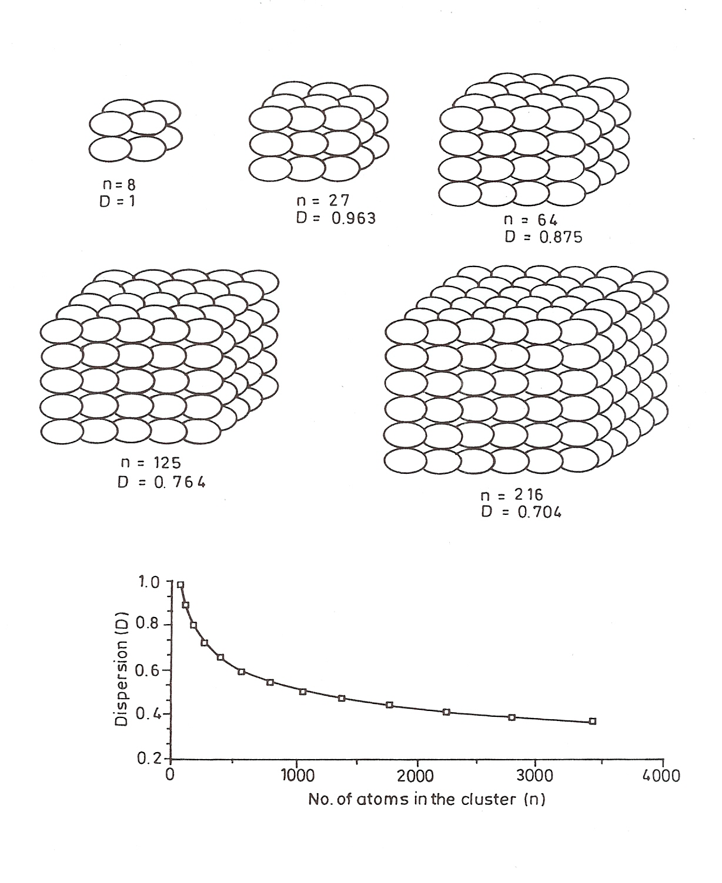
Clusters of atoms with single cubic packing having 8, 27, 64, 125 and 216 atoms. [In an eight-atom cluster, all of the atoms are on the surface. However, the dispersion D, defined as the number of surface atoms divided by the total number of atoms in the cluster, declines rapidly with increasing cluster size]

Slide 12
Adsorption on Semiconductors and Insulators

Slide 13
Metals Semiconductors Insulators One way of classification of Materials; there can be alternate ways of classifying Materials. Electronic exchange (charge transfer and magnitude) (or species exchange transfer)

Slide 14
Electronic Structure of Materials Consider Li atom Li₂…….Li_{n} Electronic Structure Li Atom 2s orbital Li₂ molecule 1σ² Molecular Orbital

Slide 15
Semi conductors n and p type acceptor levels donor levels

Slide 16
Conduction band
CB
Donor levels
Acceptor levels
Valence band
VB

Slide 17
Adsorption on Semiconductors Cumulative and Depletive Chemisorption Hydrogen and oxygen as model systems Hydrogen adsorption on p type depletive and n-type cumulative oxygen adsorption on p-type cumulative and n type depletive

Slide 18
Insulators - Species is Transfer

Slide 19
Semi conductor Catalysis and Photo-catalysis consequences and Current trends 1. Photo-electrochemical decomposition of water 2. Reduction of carbon dioxide 3. Photo-degradation of pollutants 4. Other Synthetic Applications

Slide 20
Due to some other assignments we have to close early today we shall meet next time

