Slide 2
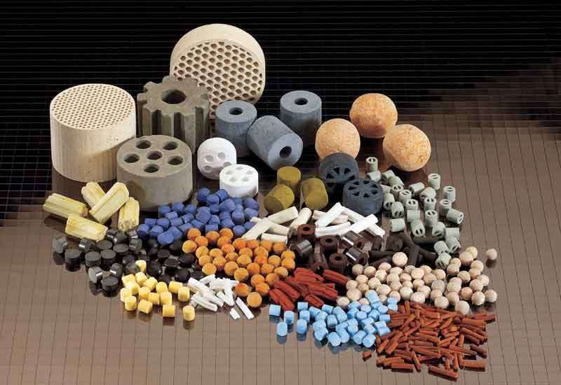
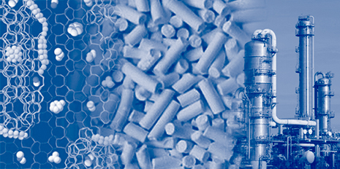
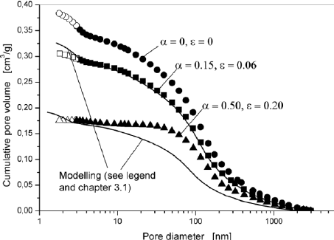
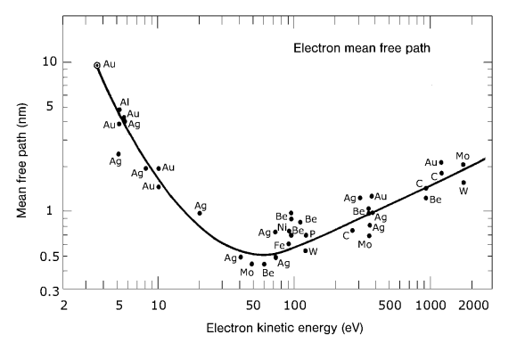
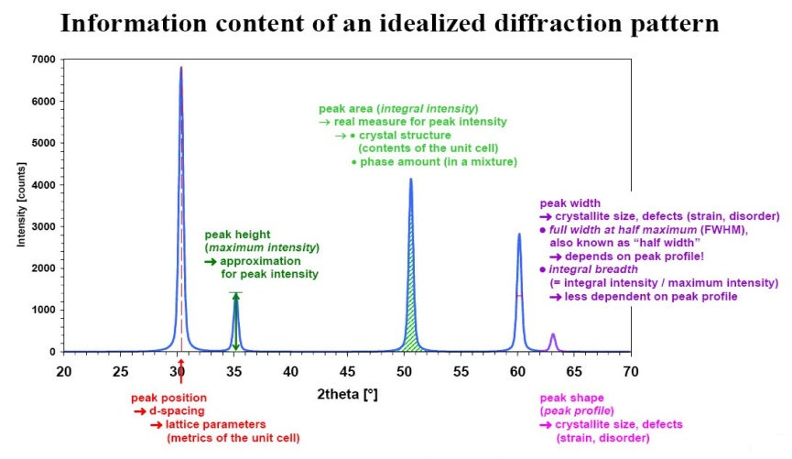
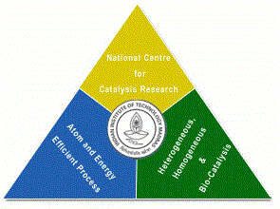
Catalyst Characterization and Interpretation
Presentation 9
National Centre for Catalysis Research
Indian Institute of Technology Madras

Slide 3
Online Lecture Series 4
Catalyst Characterization and Interpretation
Online Lecture Series 1 Carbon Dioxide Conversion into Chemicals and Fuels
Online Lecture Series 2 Photo and Photo-electrochemical Water Splitting
Online Lecture Series 3 Fundamentals of Electrochemistry
Online Lecture Series 4 Catalyst Characterization and Interpretations
All these lectures will be available in YouTube
One can view them whenever they want
Course Details

Slide 4
A Site at NCCR for Catalysis
http://catalysis.eprints.iitm.ac.in/

Slide 5
Module 1
1.1. Introduction to Catalytic Phenomena
1.1.1. Emergence of Catalyst Technology: A Brief History
1.1.2. Importance of Catalysis and Catalyst Technology
1.1.3. Fundamental Catalytic Phenomena and Principles
Exercises/Assignments/Reading Materials
1.2. Catalyst Characterization and Selection
1.2.1. Principles and Objectives of Catalyst Characterization
1.2.2. Determining Physical Properties of Catalysts
1.2.3. Determining Chemical Properties of Catalysts
Exercises/Assignments/Reading Materials

Slide 6
Module 2
2.1. Morphology and Physical Properties
2.1.1. Gas Adsorption at Low Temperatures
2.1.2. Mercury Porosimetry
2.1.3. Incipient wetness method
2.1.4. Microscopy
2.1.5.1. Electron Microscopy
2.1.5.2. Field Emission Microscopy and Ion Microscopy
Exercises/Assignments/Reading Materials

Slide 7
Module 3
3.1. Surface Properties
3.1.1. Volumetric, Gravimetric Adsorption Methods
3.1.2. Adsorption Calorimetry
Exercises/Assignments/Reading Materials
3.2. Spectroscopy in Catalysis
3.2.1. UV- Vis spectroscopy
3.2.2. IR spectroscopy
3.2.3. Raman Spectroscopy
3.2.4. Temperature-Programmed Techniques
3.2.4.1. Temperature-Programmed Reduction
3.2.4.2. Temperature-Programmed Sulfidation
3.2.4.3. Temperature-Programmed Reaction Spectroscopy
3.2.4.4. Temperature-Programmed Desorption
3.2.4.5. Temperature-Programmed Reaction
Spectroscopy in UHV
Exercises and Assignments/Reading Materials
Cont’d

Slide 8
Module 3
3.3. Photoemission and Auger Spectroscopy
3.3.1. X-Ray Photoelectron Spectroscopy (XPS)
3.3.2. Ultraviolet Photoelectron Spectroscopy (UPS)
3.3.3. Auger Electron Spectroscopy
Exercises and Assignments
3.4. The Ion Spectroscopies
3.4.1. Secondary Ion Mass Spectrometry (SIMS)
Exercises and Assignments
3.5. Diffraction and Extended X-Ray Absorption Fine Structure (EXAFS)
3.5.1. X-Ray Diffraction
3.5.2. Low-Energy Electron Diffraction (LEED)
3.5.3. X-Ray Absorption Fine Structure (XAFS)
Exercises and Assignments

Slide 9
Module 4
Module 4
4.1. Bulk Properties
4.1.1. Particle Size Distribution and Mechanical Properties
4.1.2. Particles Size Analysis
4.1.3. Application to Phase Identification
4.1.4 Application to Phase Characterization:
4.1.5. X-Ray Diffraction of Catalysts in a Reactive Atmosphere
4.1.6. Small-Angle X-Ray Scattering (SAXS)
Eexercises/Assignments/Reading Materials

Slide 10
Principles and Objectives of Catalyst Characterization

Slide 11
Surface Area and Porosity Determinations by Physisorption - Measurements and Theory
James B. Condon
Elsevier 2006

Slide 12
Exercise 1 Nitrogen adsorption measurements are conducted on 2.5 g of a solid catalyst at 77K. In plotting x/V(1-x) versus x ( where x = p/p_{o}) over the range of x from 0.05 to 0.30 (why this range, aslope of 1.5 X 10⁻³ cm⁻³ and an intercept of 0.3 X 10⁻³ cm⁻³ are determined).Calculate the BET surface area.

Slide 13
Exercise 2 The following sets of nitrogen adsorption data were obtained at 77 K using a commercial rapid adsorption analyzer for the same 0.233 g sample of H-ZSM-5 with an Si:Al ratio of 12. Calculate the monolayer volume and BET surface area.
Relative pressure (p/p₀) | Volume of Nitorge adsorbed (cm³(STP)/g) Run 1 | Volume of Nitorge adsorbed (cm³(STP)/g) Run 2
0.0500 | 88.953 | 88.839
0.1125 | 92.210 | 92.102
0.1750 | 94.765 | 94.628
0.2375 | 96.124 | 96.077
0.3001 | 97.270 | 97.227

Slide 14
The following sets f Nitrogen adsorption data were obtained at 77 K using 0.2385 g of H mordenite with Si:Al ratio of 5. Calculate the monolayer volume and BET surface area for each run.
Relative pressure (p/p₀) | Volume of Nitorge adsorbed (cm³(STP)/g) Run 1 | Volume of Nitorge adsorbed (cm³(STP)/g) Run 2
0.0500 | 114.431 | 114.368
0.1125 | 116.336 | 116.251
0.1750 | 117.425 | 117.316
0.2375 | 118.198 | 118.060
0.3001 | 118.805 | 118.645

Slide 15
Problem 4 The Nitrogen adsorption data on H-ZSM 5 with Si:Al 12-70 Calculate the monolayer volume and surface area for each sample. Explain why significant variations in surface area for the same zeolite structure
Relative pressure (p/p₀) | Volume of Nitorge adsorbed (cm³(STP)/g) Si:Al=12 | Volume of Nitorge adsorbed (cm³(STP)/g) Si:Al=30 | Volume of Nitorge adsorbed (cm³(STP)/g) Si:Al=70
0.0500 | 88.953 | 104.941 | 107.236
0.1125 | 92.210 | 110.752 | 113.518
0.1750 | 94.765 | 113.994 | 117.974
0.2375 | 96.124 | 116.206 | 121.181
0.3001 | 97.270 | 118.345 | 123.309

Slide 16
The following nitrogen adsorption desorption data were obtained at 77 K for a commercial Raney Nickel catalyst. Using the data Plot the full isotherm and identify important points on the plot and the information that can be obtained also determine monolayer volume and BET surface area. Determine the pore size distribution and average meso-pore radius.
Adsorption |  | Desorption
X = p/p_{o} | Cm³(STP)g⁻¹ | X = p/p_{o} | Cm³(STP)g⁻¹
0.107 | 16.98 | 0.989 | 84.27
0.141 | 18.13 | 0.910 | 79.66
0.167 | 19.75 | 0.825 | 78.25
0.223 | 21.78 | 0.750 | 77.01
0.244 | 22.77 | 0.717 | 75.98
0.268 | 23.89 | 0.677 | 72.62
0.322 | 26.04 | 0.660 | 70.81
0.404 | 29.87 | 0.637 | 66.01
0.470 | 33.80 | 0.625 | 64.36
0.555 | 40.47 | 0.588 | 55.67
0.637 | 50.28 | 0.573 | 51.40
0.667 | 55.86 | 0.542 | 44.30
0.694 | 61.49 | 0.490 | 37.01
0.724 | 65.67 | 0.458 | 33.83
0.756 | 70.65 | 0.417 | 30.90
0.781 | 74.76
0.825 | 78.07
0.863 | 79.38
0.939 | 79.84
0.971 | 81.43
0.990 | 84.14
0.999 | 87.35
1.00 | 96.35

Slide 17
Surface Analysis

Slide 18
The analysis of surface starts with defining what a surface is? Generally, it is considered that the top 4 – 5 layers or top 10 Ǻ depth is considered to be the surface since coordinative unsaturation and variations in configurations can be seen only in these layers. It is usual to list out the available techniques in tabular form.
However, since this will not give the whole and picture, a method based on input/output probes has been adopted..
There are generally four particle beams, namely electrons, ions, neutrals and photons and there are four other fields, namely thermal, electrical, magnetic and surface sonic waves that can be used as input probes.
When one employs any one of these eight probes, they give rise to emission or transmission or scattering of the four particle beams (except the magnetic field) namely electrons, ions, neutrals and photons. These particles carry information of the surface to a suitable detector.
The detector assembly can be tuned to count(1) the number of particles emitted (intensity), or (2) it can be tuned to identify the chemical nature of the species emitted in the case of ions and neutrals or(3) can be made to analyse the energy or(4) angular distribution of the particles emitted. Any or all of these four types of information on the emitted particles are used to develop better understanding of the surface under study

Slide 19
The combination of the 8 different types of input probes with four different output probes on which four different types of information can be gathered give rise to the multitude of techniques. A pictorial representation of this model of generating all the techniques is given in Figure below

Slide 20
It can be demonstrated that most of the surface analytical techniques can be rationalized in terms of input and output probes. Consider the case of electrons-in (electrons used as input probe) which can give rise to all the four particle beams. It is generally believed that it is always simple and easily feasible if the same particle is considered as the output probe

Slide 21
Figure Representation of the techniques based on Electrons in – electron, ion, neutral and photon out LEED: Low Energy Electron Diffraction; HEED: High Energy Electron diffraction; RHHED: Reflected High Energy Electron Diffraction; ILEED: Ineleastic Low Energy Electron Diffraction; AES: Auger Electron Spectroscopy; EELS: Electron Energy Loss Spectroscopy; EIID: Electron Induced Ion Desorption; SEPSMS: Electron Probe Surface Mass Spectrometry; EID: Electron Induced Desorption; SDMM: Surface Desorption Molecular Microscope; CIS: Characteristic Isochromat Spectroscopy; APS: Appearance Potential Spectroscopy.

Slide 22
Figure. Schematic representation of the techniques that can be generated from Photon- in photon, neutral, electron or ion-out methodology. XPS: X ray Photoelectron Spectroscopy; ESCA: Electrons Spectroscopy for Chemical Analysis

Slide 23
Figure Schematic representation of the techniques that can be generated from Ions-in ion-, neutral-, electron- or photon-out methodology. ISS: Ion Scattering Spectroscopy, SIMS: Secondary Ion Mass Spectrometry, INS: Ion Neutralization Spectroscopy, PIX: Proton Induced X ray emission.

Slide 24
It is desirable to deal in detail with the various applications of the surface and bulk analytical techniques and show in which situation, which technique will provide the appropriate information required. However, such an exercise will be out of reach for any single volume. Hence in this volume only a few selected techniques are taken up for consideration. Even in these cases the examples chosen do not cover the entire spectrum of possibilities

Slide 25
Table: Typical information that can be obtained employing surface analytical techniques and the possible limitations of these techniques
Surface Analytical technique | Typical applications | Signal detected | Elements detected | Detection limits | Depth resolution | Imaging/ Mapping possibility | Lateral resolution (Probe size)
Auger spectroscopy | Elemental analysis, depth profiling | Atomic scale roughness | Li-U | - | 206nm | yes | 100 nm
Rutherford Back scattering (RBS) | Quantitative think film composition | Backscattered He atoms | Li-U | 1-10 at% (for Z<20)0.01-1 at % for X 20-70 | 2-20 nm | yes | 2 mm
Secondary Ion Mass Spectrometry | Dopant and impurity depth profiling, microanalysis | Secondary ions | H-U | ppb/ppm | <5 nm | yes | <5 micron imaging <30 micron depth profiling
X-ray Photoelectron Spectroscopy | Surface analysis both inorganic and organic | Photoelectrons | Li-U | 0.01-1 at% | 1-10 nm | yes | 10μm -2μ
X ray Fluorescence | Thin film thickness composition | X-rays | Na-U | 10 ppm | - | no | 100μm
Low Energy Electron Diffraction | Surface structure adsorbate structure | Elastic back scattering of low energy electrons | Only geometry | submonolayer | - | yes | Atomic dimensions
High Resolution Electron Energy Loss Spectroscopy | Structure and bonding of surface atoms and adsorbates | Vibrational excitation of surface atoms adsorbates by inelastic low energy electrons | All adsorbate molecuels | Sub monolayer | - | - | Observation of direct adsorbate-adsorbent bond
Infra red absorption spectroscopy | Structure and bonding of adsorbates | Vibrational excitation of surface bonds | Adsorbates internal bonds | Sub monolayer | - | - | -
Ion Scattering Spectroscopy | Atomic structure composition | Elastic reflection of inert gas ions | Any element mass dependent | - | possible | possible | Atomic dimensions

Slide 26
Partial listing of the surface Analytic Techniques with the appropriate acronym.

Slide 27
Acronym | Technique
AEAPS | Auger Electron Appearance Potential Spectroscopy
AES | Auger Electron Spectroscopy
AFM | Atomic Force Microscopy
APECS | Auger Photoelectron Coincidence Spectroscopy
APFIM | Atom Probe Field Ion Microscopy
APS | Appearance Potential Spectroscopy
ARPES | Angle Resolved Photoelectron Spectroscopy
ARUPS | Angle Resolved Ultraviolet Photoelectron Spectroscopy
ATR | Attenuated Total Reflection
BEEM | Ballistic Electron Emission Microscopy
BIS | Bremsstrahlung Isochromat Spectroscopy
CFM | Chemical Force Microscopy
CHA | Concentric Hemispherical Analyzer
CMA | Cylindrical Mirror Analyzer
CPD | Contact Potential Difference
CVD | Chemical Vapour Deposition
DAFS | Diffraction Anomalous Fine Structure
DAPS | Disappearance Potential Spectroscopy
DRIFT | Diffuse Reflectance Infra-Red Fourier Transform
EAPFS | Extended Appearance Potential Fine Structure
EDX | Energy Dispersive X-ray Analysis
EELS | Electron Energy Loss Spectroscopy
 | Electron induced luminescence
 | Ellipsometry
EMS | Electron Momentum Spectroscopy
EPMA | Electron Probe Micro-Analysis
ESDMS | Electron Stimulated Desorption Mass Spectrometry
ESCA | Electron Spectroscopy for Chemical Analysis
ESD | Electron Stimulated Desorption
ESDIAD | Electron Stimulated Desorption Ion Angle Distributions
EXAFS | Extended X-ray Absorption Fine Structure

Slide 28
FEM | Field Emission Microscopy
FIM | Field Ion Microscopy
FTIR | Fourier Transform Infra Red
FTRA-IR | Fourier Transform Reflectance-Absorbtion Infra Red
HAS | Helium Atom Scattering
HDA | Hemispherical Deflection Analyser
HEIS | High Energy Ion Scattering
HREELS | High Resolution Electron Energy Loss Spectroscopy
IETS | Inelastic electron tunnelling spectroscopy
KRIPES | k-Resolved Inverse Photoemission Spectroscopy
ILS | Ionisation Loss Spectroscopy
INS | Ion Neutralisation Spectroscopy
IPES | Inverse Photoemission Spectroscopy
IRAS | Infra-Red Absorption Spectroscopy

Slide 29
ISS | Ion Scattering Spectroscopy
LEED | Low Energy Electron Diffraction
LEEM | Low Energy Electron Microscopy
LEIS | Low Energy Ion Scattering
LFM | Lateral Force Microscopy
MBE | Molecular Beam Epitaxy
MBS | Molecular Beam Scattering
MCXD | Magnetic Circular X-ray Dichroism
MEIS | Medium Energy Ion Scattering
MFM | Magnetic Force Microscopy
MIES | Metastable Impact Electron Spectroscopy
MIR | Multiple Internal Reflection
MOCVD | Metal Organic Chemical Vapour Deposition
MOKE | Magneto-Optic Kerr Effect
NEOM | Near Field Optical Microscopy
NIXSW | Normal Incidence X-ray Standing Wave
NEXAFS | Near-Edge X-ray Absorption Fine Structure
NSOM | Near Field Scanning Optical Microscopy

Slide 30
PAES | Positron annihilation Auger Electron Spectroscopy
PECVD | Plasma Enhanced Chemical Vapour Deposition
PEEM | Photo Emission Electron Microscopy
PhD | Photoelectron Diffraction
 | Photon Excited Auger Electron Spectroscopy
PIXE | Proton Induced X-ray Emission
 | Raman Spectroscopy
PSD | Photon Stimulated Desorption
RAIRS | Reflection Absorbtion Infra-Red Spectroscopy
RAS | Reflectance Anisotropy Spectroscopy
RBS | Rutherford Back Scattering
RDS | Reflectance Difference Spectroscopy
REFLEXAFS | Reflection Extended X-ray Absorption Fine Structure
RFA | Retarding Field Analyser
RHEED | Reflection High Energy Electron Diffraction
RIFS | Reflectometric Interference Spectroscopy
SAM | Scanning Auger Microscopy

Slide 31
SEM | Scanning Electron Microscopy
SEMPA | Scanning Electron Microscopy with Polarization Analysis
SERS | Surface Enhanced Raman Scattering
SEXAFS | Surface Extended X-ray Absorption Spectroscopy
SHG | Second Harmonic Generation
SH-MOKE | Second Harmonic Magneto-Optic Kerr Effect
SIMS | Secondary Ion Mass Spectrometry
SKS | Scanning Kinetic Spectroscopy
SMOKE | Surface Magneto-Optic Kerr Effect
SNMS | Sputtered Neutral Mass Spectrometry
SNOM | Scanning Near Field Optical Microscopy
SPIPES | Spin Polarised Inverse Photoemission Spectroscopy
SPEELS | Spin Polarised Electron Energy Loss Spectroscopy
SPLEED | Spin Polarised Low Energy Electron Diffraction
SPM | Scanning Probe Microscopy
SPR | Surface Plasmon Resonance

Slide 32
SPURS | Spin Polarised Ultraviolet Photoelectron Spectroscopy
SPXPS | Spin Polarised X-ray Photoelectron Spectroscopy
STM | Scanning Tunnelling Microscopy
SXAPS | Soft X-ray Appearance Potential Spectroscopy
SXRD | Surface X-ray Diffraction
 | Synchrotron Radiation Photoelectron Spectroscopy
TDS | Thermal Desorption Spectroscopy
TEAS | Thermal Energy Atom Scattering
TIRF | Total Internal Reflectance Fluorescence
TPD | Temperature Programmed Desorption
TPO | Temperature Programmed Oxidation
TPRS | Temperature Programmed Reaction Spectroscopy
TPS | Temperature Programmed sulphidation
TXRF | Total Reflection X-ray Fluorescence
UHV | Ultra High Vacuum
UPS | Ultraviolet Photoemission Spectroscopy
XANES | X-ray Absorption Near-Edge Structure
XAES | X-ray Induced Auger Electron Spectroscopy
XPD | X-ray Photoelectron Diffraction
XPS | X-ray Photoemission Spectroscopy
XRR | X-ray Reflectometry
XSW | X-ray Standing Wave

