Slide 1
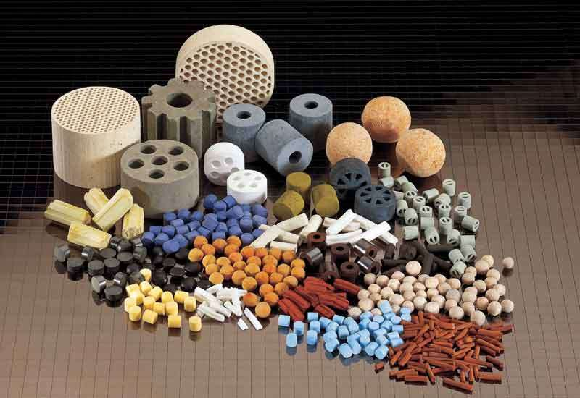
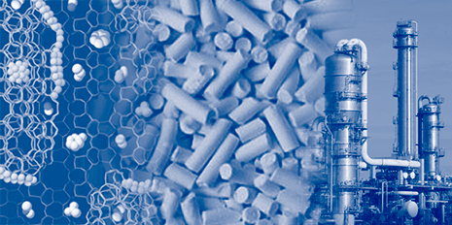
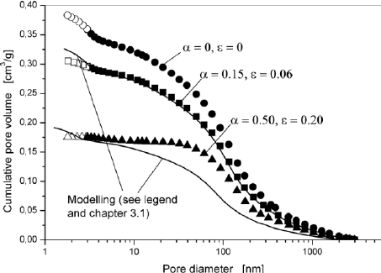
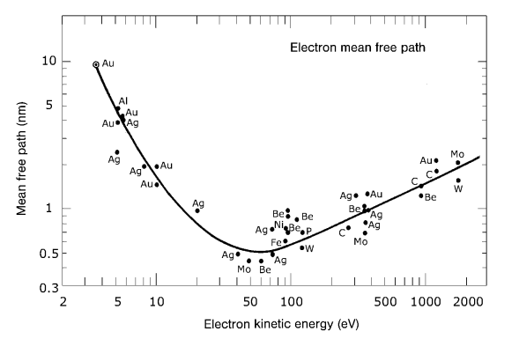
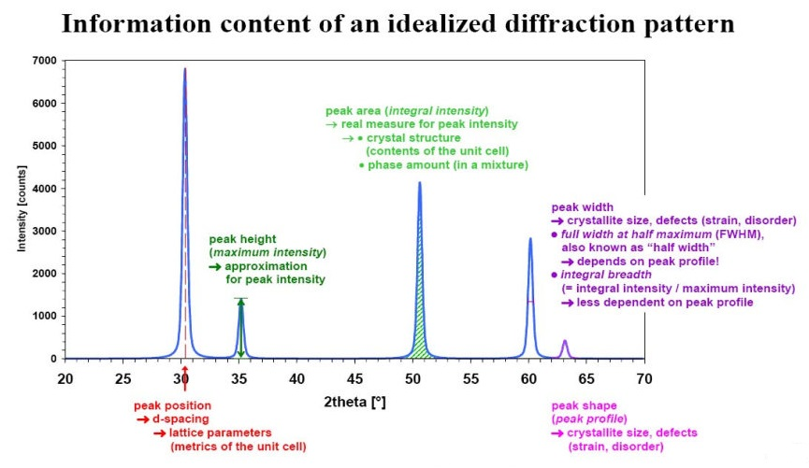
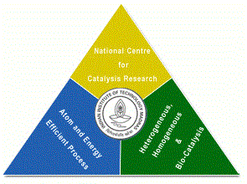

Catalyst Characterization and Interpretation
Presentation 4
National Centre for Catalysis Research
Indian Institute of Technology Madras

Slide 2


Online Lecture Series 4
Catalyst Characterization and Interpretation
Online Lecture Series 1 Carbon Dioxide Conversion into Chemicals and Fuels
Online Lecture Series 2 Photo and Photo-electrochemical Water Splitting
Online Lecture Series 3 Fundamentals of Electrochemistry
Online Lecture Series 4 Catalyst Characterization and Interpretations
All these lectures will be available in YouTube
One can view them whenever they want
Course Details

Slide 3
A Site at NCCR for Catalysis
http://catalysis.eprints.iitm.ac.in/

Slide 4
Module 1
1.1. Introduction to Catalytic Phenomena
1.1.1. Emergence of Catalyst Technology: A Brief History
1.1.2. Importance of Catalysis and Catalyst Technology
1.1.3. Fundamental Catalytic Phenomena and Principles
Exercises/Assignments/Reading Materials
1.2. Catalyst Characterization and Selection
1.2.1. Principles and Objectives of Catalyst Characterization
1.2.2. Determining Physical Properties of Catalysts
1.2.3. Determining Chemical Properties of Catalysts
Exercises/Assignments/Reading Materials

Slide 5
Module 2
2.1. Morphology and Physical Properties
2.1.1. Gas Adsorption at Low Temperatures
2.1.2. Mercury Porosimetry
2.1.3. Incipient wetness method
2.1.4. Microscopy
2.1.5.1. Electron Microscopy
2.1.5.2. Field Emission Microscopy and Ion Microscopy
Exercises/Assignments/Reading Materials

Slide 6
Module 3
3.1. Surface Properties
3.1.1. Volumetric, Gravimetric Adsorption Methods
3.1.2. Adsorption Calorimetry
Exercises/Assignments/Reading Materials
3.2. Spectroscopy in Catalysis
3.2.1. UV- Vis spectroscopy
3.2.2. IR spectroscopy
3.2.3. Raman Spectroscopy
3.2.4. Temperature-Programmed Techniques
3.2.4.1. Temperature-Programmed Reduction
3.2.4.2. Temperature-Programmed Sulfidation
3.2.4.3. Temperature-Programmed Reaction Spectroscopy
3.2.4.4. Temperature-Programmed Desorption
3.2.4.5. Temperature-Programmed Reaction
Spectroscopy in UHV
Exercises and Assignments/Reading Materials
Cont’d

Slide 7
Module 3
3.3. Photoemission and Auger Spectroscopy
3.3.1. X-Ray Photoelectron Spectroscopy (XPS)
3.3.2. Ultraviolet Photoelectron Spectroscopy (UPS)
3.3.3. Auger Electron Spectroscopy
Exercises and Assignments
3.4. The Ion Spectroscopies
3.4.1. Secondary Ion Mass Spectrometry (SIMS)
Exercises and Assignments
3.5. Diffraction and Extended X-Ray Absorption Fine Structure (EXAFS)
3.5.1. X-Ray Diffraction
3.5.2. Low-Energy Electron Diffraction (LEED)
3.5.3. X-Ray Absorption Fine Structure (XAFS)
Exercises and Assignments

Slide 8
Module 4
Module 4
4.1. Bulk Properties
4.1.1. Particle Size Distribution and Mechanical Properties
4.1.2. Particles Size Analysis
4.1.3. Application to Phase Identification
4.1.4 Application to Phase Characterization:
4.1.5. X-Ray Diffraction of Catalysts in a Reactive Atmosphere
4.1.6. Small-Angle X-Ray Scattering (SAXS)
Eexercises/Assignments/Reading Materials

Slide 9
Online Lecture Series 4
Catalyst Characterization and Interpretation
Introduction
Presentation 4
30th August 2017
4 pm IST

Slide 10
Importance of Catalysis and Catalyst Technology

Slide 11
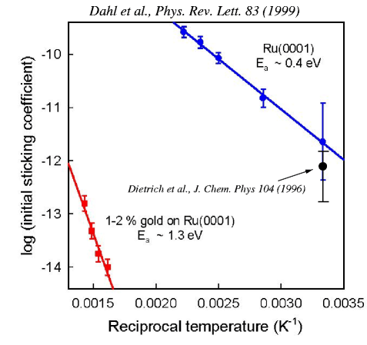
Steps Do Everything
Au decorates steps:
Hwang, Schroder, Gunther, Behm,
Phys. Rev. Lett. 67, 3279 (1991)
Dahl, Logadottir, Egeberg, Larsen, Chorkendorff, Törnqvist, Nørskov, Ph

Slide 12
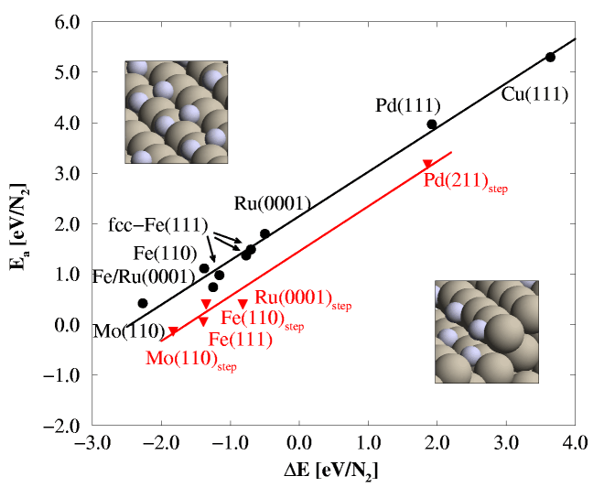
The Brønsted-Evans-Polanyi relation
Logatottir, Rod, Nørskov, Hammer, Dahl, Jacobsen, J. Catal. 197, 229 (2001)

Slide 13
400 C, 50 bar, H₂:N₂=3:1, 5% NH₃
Calculated Ammonia Synthesis Rates
Logatottir, Rod, Nørskov, Hammer, Dahl, Jacobsen, J. Catal. 197, 229 (2001)

Slide 14
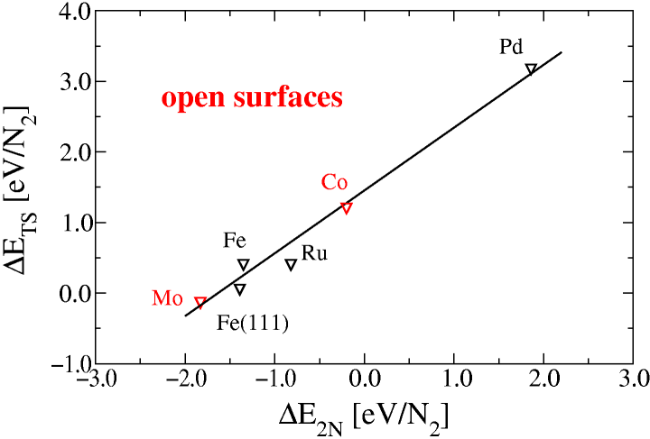
Interpolation in the Periodic Table
Jacobsen, Dahl, Clausen, Bahn, Logadottir, Nørskov, JACS 123 (2001) 8404.

Slide 15
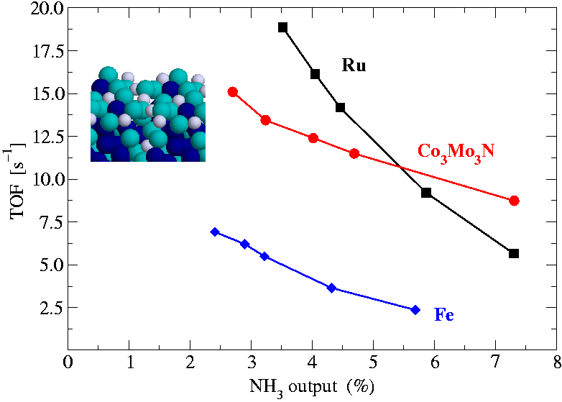
400 C, 50 bar, H₂:N₂=3:1
Measured Ammonia Synthesis Rates
Jacobsen, Dahl, Clausen, Bahn, Logadottir, Nørskov, JACS 123 (2001) 8404.

Slide 16
Data Driven Methods
High Throughput Screening
  Direct testing of many catalysts, fast, efficiently
Data Mining
  Correlating catalytic aactivity/selectivity/ durability to descriptors that can be tabulated

Slide 17
Using DFT Calculations in the Search of Prospective Catalysts
The Object of the Game…
Find sets of descriptors {D_{ik}} of solid materials M_{i} , and a mathematical model F such that A_{ij} being the Turn Over Frequency of Mi as catalyst for the reaction _{j} at operationg conditions C_{j} one has:
Identify ranges of D_{ik} that maximize F
Screen Databases of Materials Properties before screening real materials
Better if one descriptor is sufficient, but do not take it for granted
Much better if F has a sound physical basis
Adsorbate/substrate bond strengths should provide good descriptors according to the Sabatier principle
H. Toulhoat and P. Raybaud Workshop Catalysis from First Principles Vienna 02/02

Slide 18
Using DFT Calculations in the Search of Prospective Catalysts
E MC @ Fm-3m carbides is rather consistent with simple chemisorption models
Onset of dissociative chemisorption as MC bond strength increases
H. Toulhoat and P. Raybaud Workshop Catalysis from First Principles Vienna 02/02

Slide 19
Using DFT Calculations in the Search of Prospective Catalysts
The experimental alloying effects is correctly predicted
H. Toulhoat and P. Raybaud Workshop Catalysis from First Principles Vienna 02/02

Slide 20
Getting Data/Descriptors
Structure (in situ)
Spectroscopy (in situ)
Surface thermochemistry
Calculations
There is a large need for systematic data - and for good descriptors

Slide 21
Structure-activity Correlation
Hydrodesulphurization of Thiophene
1.5
HDS activity
(x10²/mol/g/h)
10
0.5
0
0
1
2
3
Number of Co edge atoms
(x10²⁰/g catalyst)
Topsøe, Clausen, Massoth Hydrotreating Catalysis, Science and Technology
(Anderson and Boudart (Eds.), Springer (1996).

Slide 22
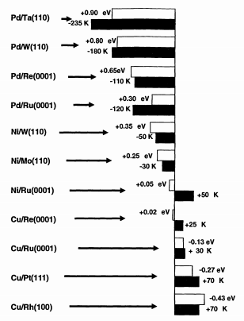
Descriptors from Spectroscopy
CO TPD shift
Core level shift
Goodman and Rodriguez, Science 279 (1992) 87

Slide 23
Single Crystal icrocalorimerty
Cu/MgO
Ag/MgO
Pb/MgO
Larsen, Starr, Campbell, Chem.Thermodyn. 33, 333 (2001)
Brown, Kose, King, Chem. Rev. 98, 797 (1998).

Slide 24
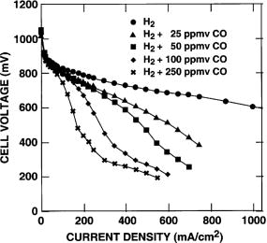
CO tolerance of Pt alloy anodes for PEM fuel cells
Pt
M
S. Gottesfeld et al.,
J. Electrochem. Soc. 148 (2001) A11.
Christoffersen, Liu, Ruban, Skriver, Nørskov, J.Catal. 199, 123 (2001)

Slide 25
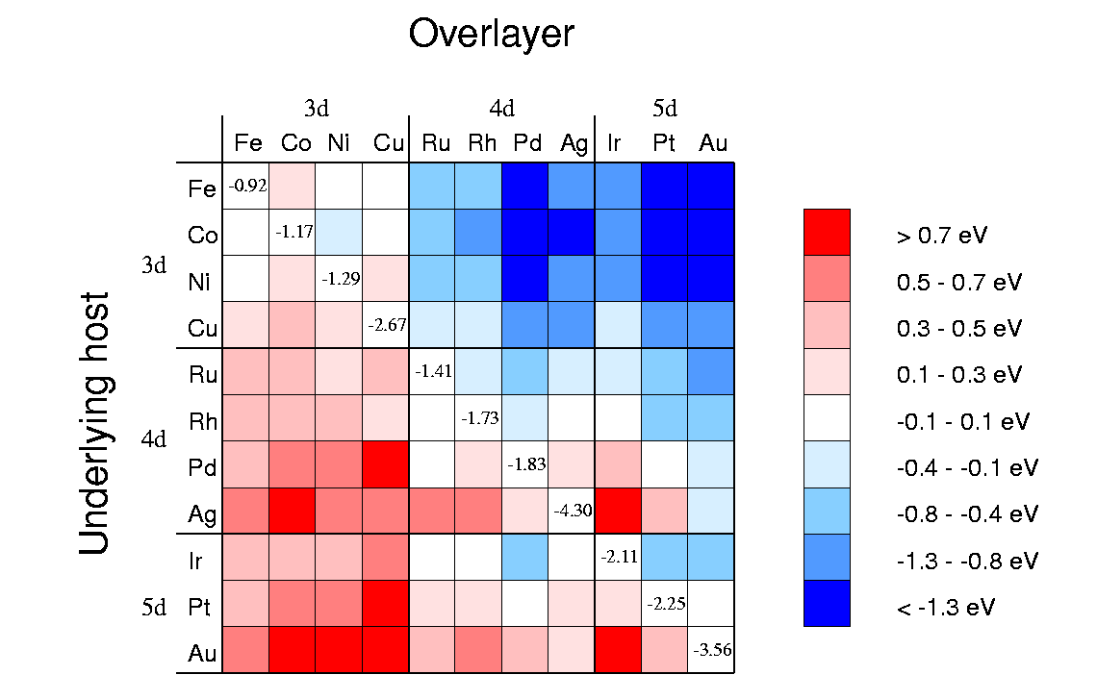
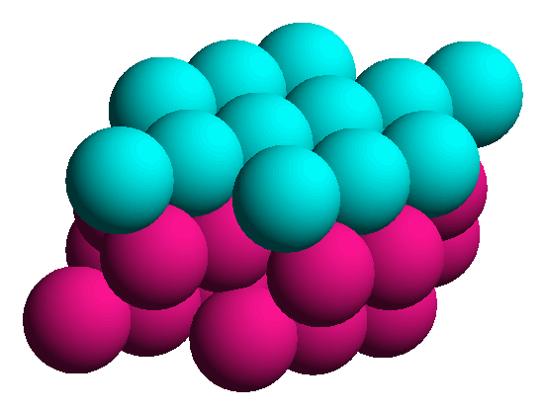
How can the d-band center be changed?
Calculated d band shifts:
Over layer
Host
Ruban, Hammer, Stoltze, Skriver, Nørskov, J.Mol.Catal. A 115, 421 (1997)

Slide 26
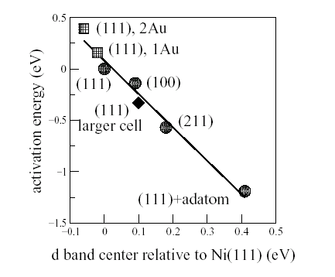
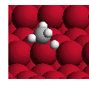
Methane activation
Transition state for CH₄ dissociation on Ni(211)
b
Bengaard, Rostrup-Nielsen, Nørskov

Slide 27
Methane activation on Ni/Ru
Egeberg, Chorkendorff, Catal. Lett. 77, 207 (2001)

Slide 28
Lessons from Biology
Catalysis at ambient temperature and pressure
Extreme selectivity
Direct coupling of energy into the important reaction coordinate (non-thermal catalysis)

Slide 29
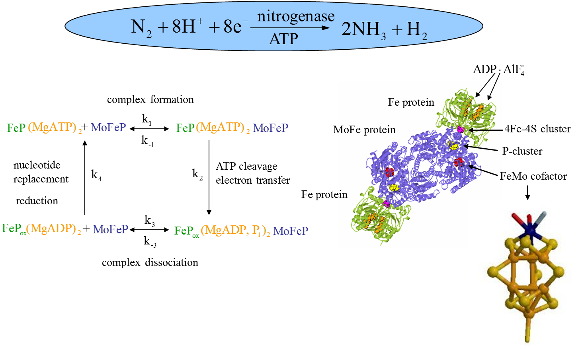
Nitrogenase
Burgess, Lowe, Chem. Rev. 96, 2983 (1996)
Schindelin, Kisker, Schlessman, Howard, Rees, Nature 387, 370 (1997)

Slide 30
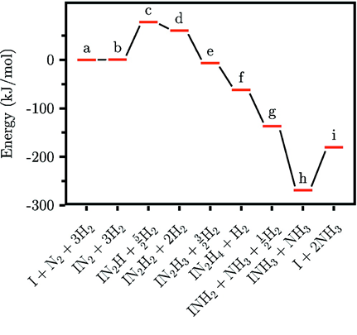
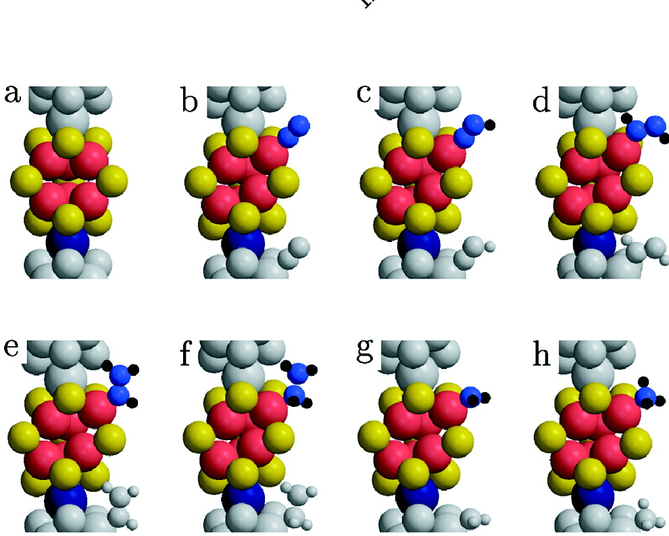
N₂ Hydrogenation on FeMo Cofactor
Rod, Nørskov JACS 122, 12751 (2000)

Slide 31
Status
Well developed basic understanding – theory-experiment
Beginning to be able to use it directly in catalyst design
Some activity-descriptor correlations
Host of new in situ methods for catalyst characterization
New very powerful screening methods
We have a starting point which is radically different from the situation 5 or 10 years ago!

Slide 32
Moving Forward
More basic understanding –theory-experiment
Integration of the conceptual framework for heterogeneous, homogeneous and enzyme catalysis
More systematic data (descriptors)
Better synthesis methods
Better coupling of catalyst design and process engineering
INTEGRATION

Slide 33
Promoting Development
An integrated approach:
Experiments, models
Synthesis
testing
characterization
Theory

Slide 34
Atom-Economy, Environmental Issues, Enantiomeric Purity

Slide 35
Molecular and Supramolecular Chemistry in Catalysis
1.Surface-Tailored Molecular Precursors for Nanostructured Catalysts.
2. Self-Assembly and Recognition Mechanisms in Supramolecular Chemistry as Tools to Prepare New Catalysts.

Slide 36
Molecular insight in Homogeneous and
Heterogeneous Catalysts
Mechanistic Comprehension of Catalytic Processes.

Slide 37
Catalytic Reaction Engineering.
Kinetics of Molecularly Defined Heterogeneous Catalysts
Scale up Issues of Industrially Relevant Processes

Slide 38
CHEMICAL INDUSTRY & CATALYSIS

Slide 39
CHEMICAL INDUSTRY & CATALYSIS
GLOBAL SCENERIO
Chemical/Hydrocarbon industy: $ 1.5 Trillion global enterprise
Catalysis: The key to economic & environmental viability of the industry
More than 7000 products manufactured per year using catalysts
Catalyst market: $ 10 Bill. Industry
Major segments Growth rates (%)
Refining & Petrochemicals 2
Hydroprocessing 5-7
Polymerization 7-10
Chemicals 5
Environmental 10

Slide 40
CATALYSIS IN CHEMICAL INDUSTRY: APPLICATIONS
Catalysis
Petroleum
refining
Petro-
chemicals
Fertilizer&
Inorganic
chemicals
Pharma-
ceutical
Fine &
Agro
chemicals
Environ-
mental
protection

Slide 41
CATALYSIS: THE KEY TO INNOVATIONS IN CHEMICAL TECHNOLOGY
Catalysis
New
processes
New
products
Feed stock
Cost of
production
Environment
Energy

Slide 42
INCREASE IN SELECTIVITY: ECONOMIC IMPACT
Product | Selectivity improvement (%) | Global feedstock savings per year (Mill US$)
Ethylene oxide | 9 | 365
Terephthalic acid | 2 | 35
Acrylonitrile | 18 | 390
Adipic acid & Caprolactum | 7 | 215
Propylene oxide | 3 | 300
Vinyl acetate | 12 | 70
 | TOTAL | 1375

Slide 43
DEVELOPMENT & COMMERCIALIZATION OF CATALYSTS: KEY ELEMENTS
Research & Development
Innovation/Intellectual Property Rights
Pilot scale efforts, scale up & process economics
Product & Process technology development
Process engineering / Instrumentation/Construction
Process licensing
Manufacture
Marketing
Technical services

Slide 44
CHEMICAL INDUSTRY- CHALLENGES
Constraints in feedstock with respect to availability, quality & cost
Eco friendly processes & products: stringent emission levels
Need for conserving energy
Waste minimization/effective treatment
Catalysts with higher efficacy: activity/selectivity/ life
Process improvements: milder conditions/fewer steps
Ever-increasing demand for niche /specialty products at affordable prices
New catalysts /processes: Reduction in discovery & process development cycle time

Slide 45
Feedstock-Alternative routes
Ethylene
Propylene

Slide 47
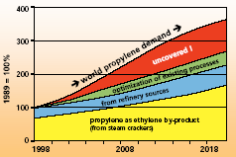
Propylene : Demand- Supply gap

Slide 48
Aletrnative routes for propylene Catalytic Dehydrogenation of Propane
Process | Catalyst | Temp ° C | Pressure (psig) | Conv. (%) | Selectivity (%) | Life (Yrs) | Reactor type
Oleflex* UOP | Pt/ Al₂O₃ | 600- 650 | 30 | 20-30 | 9090 | CCR | Stacked radial flow adiabatic
Catofin* Houdry | Cr₂O₃/ Al₂O₃ | 600- 650 | 30-100 | 25-30 | 95 | 1.5- 3 15 min. Regen. | Fixed bed, adiabatic, cascade mode
STAR* Phillips | Pt/ Al₂O₃ | 560- 620 | 30-100 | 28-40 | 89-95 | 1-2 | Fixed bed isothermal
FBD-4 | Cr₂O₃/ Al₂O₃ | - | - | - | - |  | Fluid bed
Linde- BASF | Cr₂O₃/ Al₂O₃ | - | - | - | - |  | Fixed bed Isothermal

Slide 49
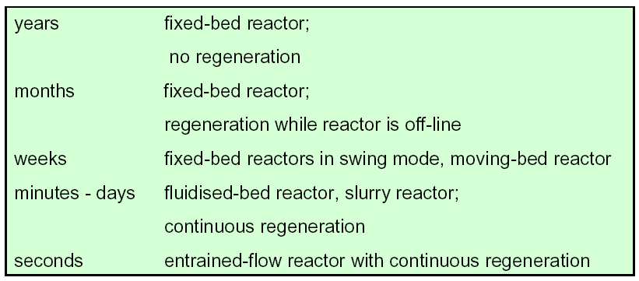
Catalyst Life-Reactor type

Slide 50
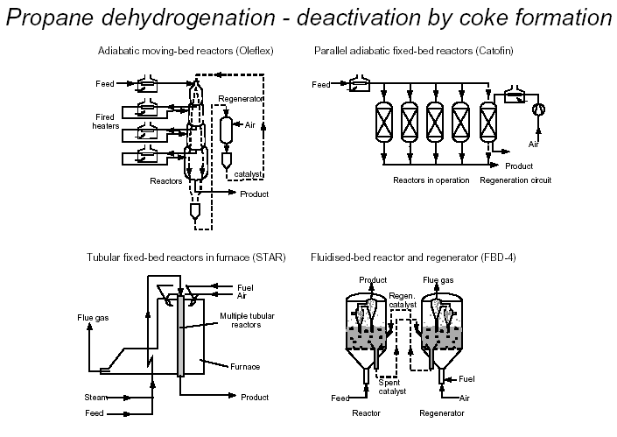

Slide 51
Alternative routes for Propylene
Olefin Metathesislefin Metathesis
C2H4 + C4H8  2 C3H6
Can be a stand alone unit or integrated with cracker/FCC unit
Low investment, less energy intensive, attractive returns
High propylene/ethylene yield ratios, varying from 0.5 to 1.1
Use of low cost C4 stream
Process technologies
META-4 ® (Axens – IFP Group Technologies)
OCT ® Olefins Conversion Technology (ABB Lummus)
UOP’s process
Depends on relative costs of ethylene & propylene

Slide 52
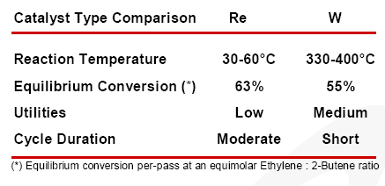
Metathesis- Catalysts & Process conditions

Slide 53
Alternative routes to Propylene
Olefin Inter conversion Processes
Catalytic cracking of C4- C5 streams or the light naphtha streams in a fixed or fluidized bed reactor
Compatible with crackers and FCC units
Unlike metathesis, do not consume ethylene.
Process technologies
Olefin Cracking Process (UOP-ATOFINA)
Propylur (Lurgi)
PCC process (Exxon –Mobil)
SUPERFLEX ® (Lyondell/Kellogg)
Mobil’s Olefin Inter conversion Process (MOI)

Slide 54
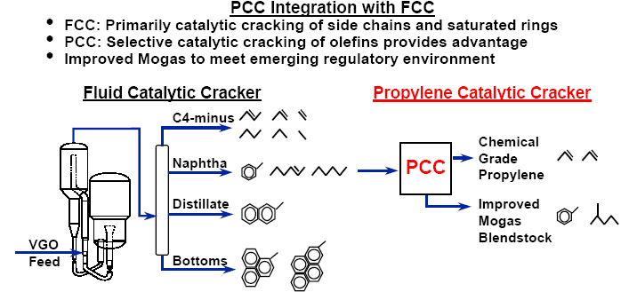

Slide 55
Tuning the Selectivity

Slide 56
PARA-DISUBSTITUTED AROMATICS:USEFULNESS
H3C
CH3
Raw Material for polyester fiber, platiciser etc
para-xylene
H3C
C2H5
Starting material for poly (para-methyl) styrene
para-ethyl toluene
H5C2
C2H5
Desorbent for separation of para-xylene from C8 raffinate
para-diethyl benzene
CH3
Raw material for para-cresol, fragrances, herbicides pharmaceuticals etc
H3C
C
CH3
para-cymene
H3C
CH3
Raw material for variety of polymers, antioxidants, stabilizers, hydroquinones
C
C
H3C
CH3
para-diisopropyl benzene
H5C2
OH
Raw material for variety of polymers, antioxidants
para-ethyl phenol

Slide 57
R1
+ R2OH
R1
R1
R2
R1
R2
R2
R1
R2
Fig.2 Selective alkylation reactions over pore size regulated zeolite

Slide 58
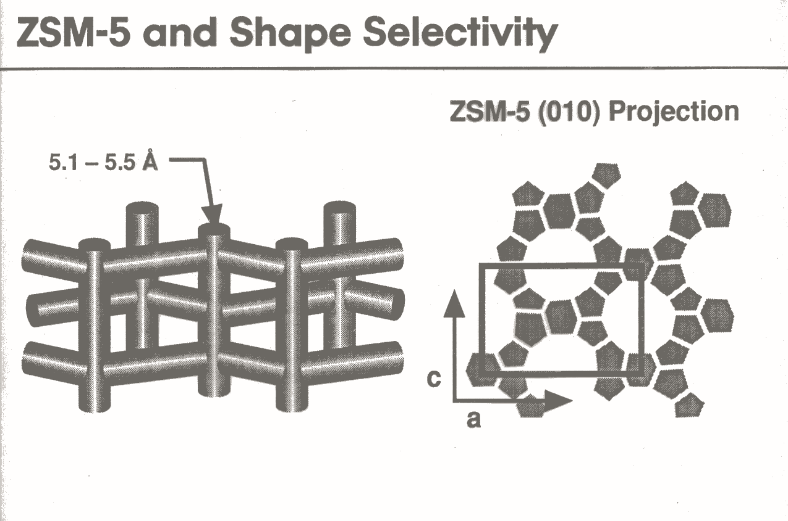

Slide 59
Catalyst/Process for PDEB Production
Issue of Other Aromatics in Feed
H3C
H3C
CH3
H5C2
CH3
H3C
CH3
H3C
CH3
H3C
CH3

Slide 60
Catalyst/Process for PDEB Production
H3C
Pore Size Engineered MFI Zeolite
H3C
CH3
H5C2
CH3
H3C
CH3
CH3
H3C
Bz, Tol. : Create hindrance, get alkylated, reduce yield of PDEB
p-X, PDEB : Create more hindrance, but does not participate in reaction
m-X, o-X, TMBs: Act only as diluent
H3C
CH3
The PDEB selectivity is not affected any way
Bhat, Das & Halgeri: Appl. Catal, A: Gen., 1994, 115, 257-267

Slide 61
Asymmetric Hydrogenation

Slide 62
Asymmetric Hydrogenation

Slide 63
Asymmetric hydrogenation of α-Phenyl acrylic acid to Hydratropic acid in 15 % ee
The Nobel Prize in Chemistry for 2001 was awarded to Prof . KB. Sharpless for Asymmetric catalytic oxidation Prof.R. Noyori & Prof. WS. Knowles for Asymmetric catalytic hydrogenation

Slide 64
Design of Catalysts
Fluid Catalytic Cracking
Hydrotreating

Slide 65
The Oil Industry
Oil provides the largest share (39%) of world energy
source than any other forms
Despite dwindling reserves, global oil consumption is
growing:(MBPD)
  73.15 (1997)
  80.74 (2002)
  112.8 (2020)
Modern oil refineries produce a wide range of fuels &
feed stocks through different processes

Slide 66
Oil Refining Industry: Key Issues
Tough environmental regulations
Increasing cleanliness of fuels
Increasing yields from crudes of inferior
quality
Globalization, thin profit margins
Public scrutiny of environment,
Global warming

Slide 67
Processes in Oil Refining
Physical | Thermal | Catalytic
Distillation | Visbreaking | Hydrotreating
Solvent extraction | Delayed coking | Catalytic Reforming
Solvent dewaxing | Flexicocking | Catalytic Cracking
Propane deasphalting |  | Catalytic dewaxing
Blending |  | Hydrocracking
 |  | Isomerization
 |  | Alkylation
 |  | Etherification
 |  | Polymerization

Slide 68
Fluid Catalytic Cracking (FCC)
Heart of any modern refinery
One of the marvels of petroleum refining technology
Very high levels of sophistication in technology &
process efficiency
Significant value addition and up gradation of
petroleum fractions.
Accounts for 30-40% of refining capacity
Major contributor to the gasoline pool
  FCC (35%)
  Catalytic reforming(30%)
  Alkylation (20%)
  Isomerization (15%)

Slide 69
FCC Process : Advantages
Very high flexibility different & difficult feeds
Yields a variety of valuable products:
  Light olefins, Alky feed, Oxygenates
  Gasoline, LCO, CSO
Volume gain (6 – 12 %), economically attractive
Operates at lower pressure/lower operating cost
Highly energy efficient
Alive to environmental issues
Inexpensive catalyst

Slide 70
FCC Today
More than 400 units
13 MBPD capacity
Catalyst consumption 1500 TPD
Largest FCC unit-RIL JN-9 MTA
FCC Future

Slide 71
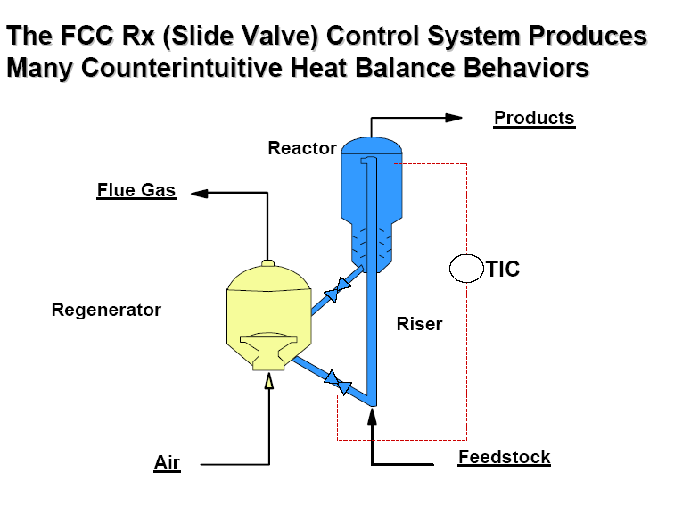

Slide 72
FCC : Operating conditions
Reactor temperature (°C) 500-550
Regenerator temperature (°C) 720-800
Catalyst/Oil (wt ratio) 5-16
Reactor space velocity (lb/hr/lb) 1.1-13.4
Catalyst requirement (lb/bbl feed) 0.15-0.25
Average contact time (Sec) 2-3
Reactor-regenerator-cycle time (min) 10
Catalyst circulation rate (MT/Sec) 1Max.
Reactor pressure psig 15-20

Slide 74
Amorphous silica-alumina Vs Zeolite: Advantages
high activity : at least 10⁴ times more active
high density of acid sites
Favourable distribution site strengths
Pore geometry
- longer life
- hydrothermal stability
- high gasoline/olefins yields
- low coke/ gas make
- better attrition resistance, metal passivation
2 Bill.$ savings per annum when introduced first in US

Slide 75
FCC Catalysts
Application Vs Composition
Gasoline
REHY-10 13 % RE₂O₃, 15-25% zeolite content with moderately active SiO₂& clay matrix
Octane boosting
HSY/REHY with lower RE with active matrix of Al₂O₃ or SiO₂-Al₂O₃ plus clay and ZSM-5 additive
Light olefins- PETRO-FCC
HSY/REHY with lower RE with active matrix of Al₂O₃ or SiO₂-Al₂O₃ plus clay and ZSM-5 additive for olefins maximisation
Resid cracking
HSY/REHY with higher RE, 35-40% zeolite content, with large pore active matrix of Al₂O₃ or SiO₂-Al₂O₃ plus modified clay plus metal passivators /traps, So_{x}, NO_{x} CO combustion additives

Slide 76
FCC Catalysts: Challenges & Design
Acidity: type, site density, strength distribution
Feed characteristics
Complex feed, many reactants, active sites
distribution
Pore modulation./accessibility
Product slate/Yield pattern
Gasoline/Octane/Olefins
Coke combustion
Metal passivation
Mechanical properties/attrition
Morphology/free flow

Slide 77
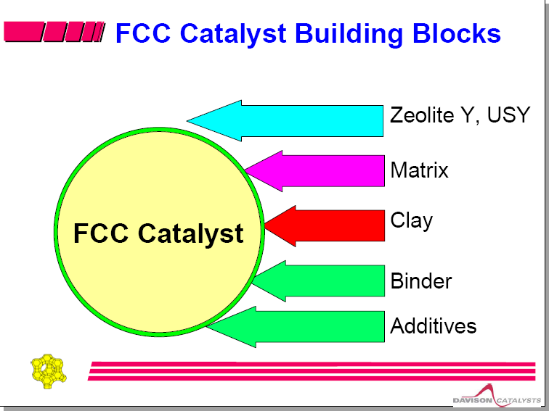

Slide 78
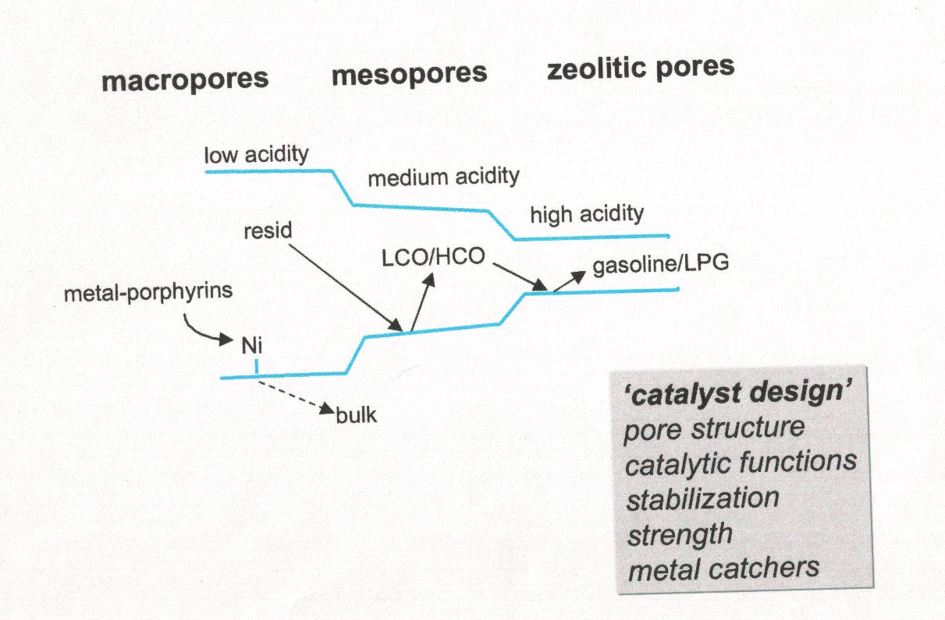

Slide 79
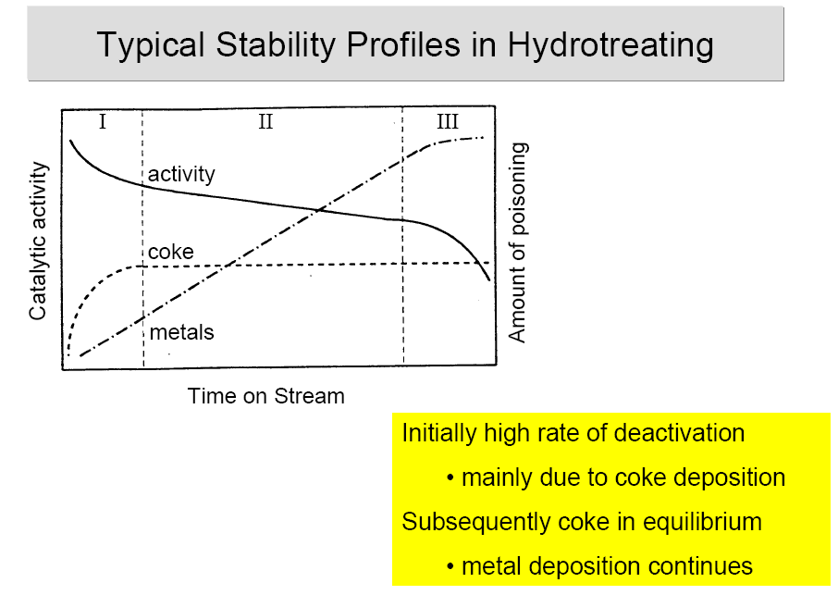

Slide 80
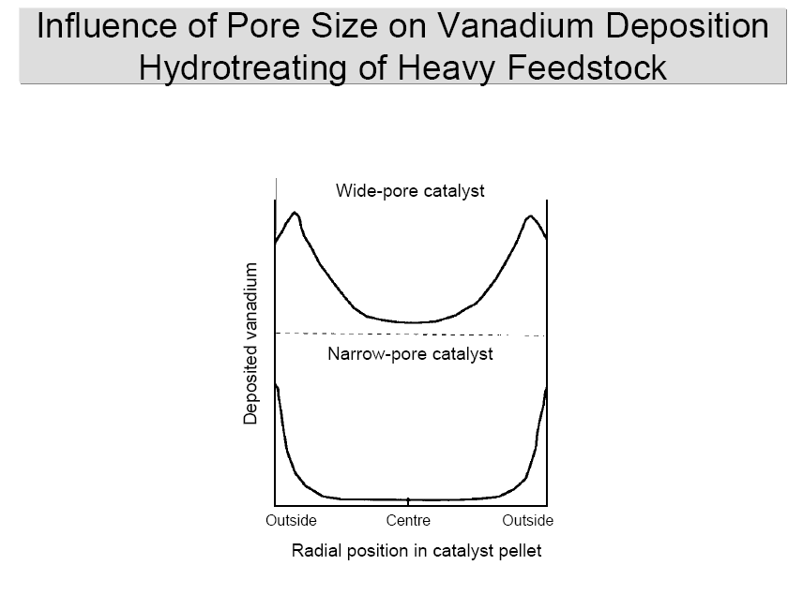

Slide 81
C₁Chemistry

Slide 82
C₁Chemistry
Drivers
Abundance of gas ( C₁) 180 TCM, to last 70 years
Global shift towards gas based economy
Minimize flaring, pollution & energy loss
Stranded gas monetization- Viable alternaive
Technological options
Syn gas to olefins / fuels /n-paraffins via Fischer Tropsch Synthesis
Syngas to fuels/n-paraffins via GTL
Syngas to DME/ Methanol
Methanol to C₂/C₃ Olefins ( MTO)
Methanol to Propylene (MTP)
Methane to methanol

Slide 83
Utilization of Natural Gas Global scenario
Consumption
Chemical feedstocks : 200 Mill.MT
Fuels and chemicals : 3,500 Mill.MT
Proven reserves : 217,000 Mill.MT
Reserves to last for 60-70 more years
Stranded gas reserves need special
attention

Slide 84
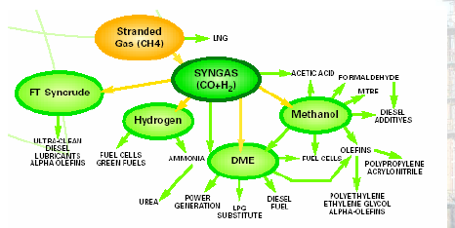

Slide 85
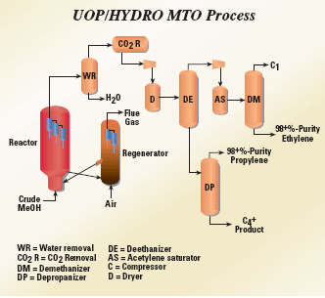

Slide 86
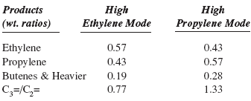
UOP-HYDRO MTO PROCESS

Slide 87
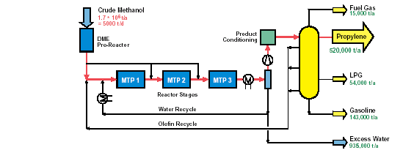
Methanol To Propylene- Lurgi Process

Slide 88
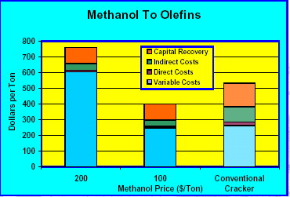

Slide 89
ALKANE ACTIVATION

Slide 90
ALKANE ACTIVATION: CHALLENGES
Inert molecules. Difficult to activate/convert
Lower per pass conversion for acceptable selectivity levels
Extensive recycle streams/equipments/investments
Corrosive catalysts/special & costly MOC
Reaction heat transfer/reactor design
INITIATIVES BY CSIR
New Millennium Indian Technology Leadership Initiatives (NMITLI)
NONO MATERIALS
FUNCTIONALIZATION OF ALKANES

Slide 91
DEVELOPMENTS IN ALKANE ACTIVATION
METHANE PROPANE
Oxidative coupling Acrylonitrile
Formaldehyde Propylene*
Methanol
ETHANE BUTANE
Oxidative dehydrogenation Maleic anhydide*
Acetic acid*
Vinyl chloride
Ethylene glycol
* COMMERCIALLY SUCESSFUL PROCESS
OTHERS AT LABORATORY/PILOT SCALE

Slide 92
ACID CATALYSED REACTIONS
Conventional catalysts
AlCl₃,HF,H₂SO₄,H₃PO₄
Potential hazards in storage, handling & disposal
Generation of waste products/disposal isssues
Non-regenerable
Corrosion, Special MOC, higher investment costs
Solid acid catalysts
Ion-exchange resins
Clays
Amorphous silica-alumina
Crystalline aluminosilicates (Zeolites)

Slide 93
SOLID ACID BASED CATALYTIC PROCESSES
Alkylate production
- ALKYLENE by UOP
- Thin layerd catalyst by ABB Lummus
- Several processes under development
Aromatics alkylation
- Cumene
- Ethyl benzene
- Linear Alkyl Benzene

Slide 94
Clean Fuels

Slide 95
Clean Fuels

Slide 96
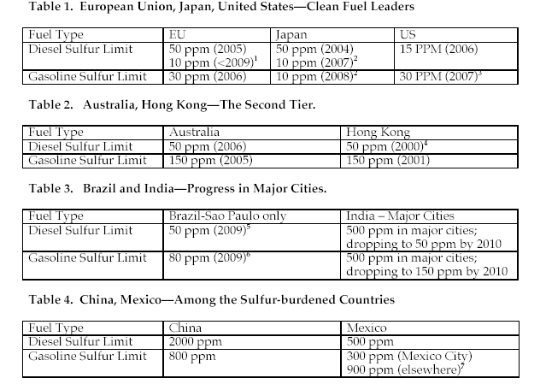

Slide 97
Catalysis for Environment
Process technologies for clean fuels
- Hydrogen requirement
- Loss of RON
- Heavy investments
Synsat Technology- co-current & counter current operation in a single reactor
OATS- Olefinic alkylation of thiophenic sulfur- for gasoline with <10ppm S. Heavier alkylated S compunds removed separately
Z-SORB- Adsorptive removal of sulfur
Oxidative removal of sulfur
Bio-desulfurization

Slide 98
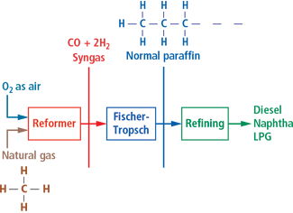
GTL-Block flow diagram

Slide 99
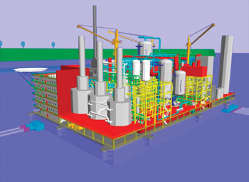
Vision of GTL barge production facility to produce ultra clean fuel- Utilization of stranded gas field
Finished products at the wellhead. The GTL barge provides a processing platform at or near the stranded gas reserve, which allows for finished products to be produced at the source.
GTL barge is a repeatable and modular concept – much like a floating, production, storage and offloading (FPSO) vessel

Slide 100
Reactions under Supercritical Conditions

Slide 101
Hydrogenation with Super Critical CO₂
Hydrogen is infinitely miscible with scCO₂ and therefore, eliminates the mass transport problems commonly associated with traditional solvent-based processing (Batch or Buss loop).
A wide range of substrates can be hydrogenated including alkenes, aldehydes, nitro compounds, ketones and oximes.
Reaction rates with heterogeneous catalysts are especially enhanced with increased selectivity and a high diffusivity/low viscosity environment which maximises mass transport
Supercritical fluid systems combine the mass transport properties of gases with the mass density of liquids. This results in increased reaction kinetics and, hence, high throughputs from a relatively
small reactor system.
Through the appropriate choice of reaction pressure, temperature, catalyst type, residence time and stoichiometry it is possible to achieve far higher degrees of selectivity than has been observed under
traditional reaction conditions.

Slide 102
Figure 1.
Synthesis of Ethyl Cyclohexene under SC CO2 conditions
Thomas Swan& Co,UK-Swan-SCF®

Slide 103
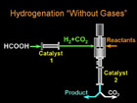
1.Chemical & Engg. News, 82 (43),p12, 2004
2. Continuous hydrogenation of organic compounds in supercritical fluids, MG. Hitzler &M.Poliakoff, Chem. Commun.1997,1667

Slide 104
DEVELOPMENT OF CATALYSTS:
MODERN APPROACHES

Slide 105
DEVELOPMENT OF CATALYSTS: MODERN APPROACHES
COMBINATORIAL CATALYSIS
Systematic preparation, processing and testing of a number of formulations
Rapid library synthesis
Evaluation by high throughput techniques
Micro fabrication
Robotics
Automation & Instrumentation
Computational chemistry
Information management
Better understanding of catalytic functions
Trends & patterns of structure-activity correlations
Faster discovery of new formulations

Slide 106
HIGH THROUGHPUT EVALUATION OF CATALYSTS
EVALUATION OF ACTIVITY, SELECTIVITY & LIFE FOR A
NUMBER OF CATALYST FORMULATIONS
NORMAL SCREENING OF ONE FORMULATION:
ACTIVITY & SELECTIVITY : ONE DAY
STABILITY/LIFE : 30 DAYS TO 90 DAYS
ONE FORMULATION/ONE REACTOR AT A TIME
SCREENING OF PROMISING FORMULATIONS THROUGH
HIGH THROUGHPUT EVALUATION TECHNIQUE
SIMULTANEOUS EVALUATION OF SEVERAL CATALYSTS
8 OR 80 REACTORS BEING USED SIMULTANEOUSLY
FAST ANALYTICAL TECHNIQUES FOR ANALYSIS OF FEED
& PRODUCTS BY IR THERMOGRAPHY/ QMS/TOF-MS

Slide 107
Sustainable Chemistry
SUSTAINABILITY
Meeting the needs of the present generation without compromising the ability of the future generations to meet their own demands
SUSTAINABLE DEVELOPMENT
To ensure the viability of our world in the long run and create a harmonious balance between economic development preservation of eco-systems &improve quality of life
SUSTAINABLE CHEMISTRY
The chemistry that is eco-friendly, minimises waste generation and energy use and preferentially uses renewable raw materials such as agricultural products instead of fossil resources
INDUSTRIAL BIO TECHNOLOGY- White Bio-technology
Means of achieving sustainable development
Green Bio-technology- Agriculture oriented- GM
Red Bio-technology - Medical oriented

Slide 108
Sustainable Chemistry
INDUSTRIAL BIOTECHNOLOGY
Application of modern bio-technology for industrial production of
chemicals & bio-energy using living cells and their enzymes, leading
to inherently clean processes with minimum waste generation &
energy use
SUSTAINABLE CHEMICALS
Inherently safe,pose no risk to human health & environment, low
acute toxicity, low persistency,no bio-accumulation
SUSTAINABLE PRODUCTION & PROCESSING
Best Available Techniques (BAT) & Best Environmental Practice
(BEP) to be adopted.
Responsible care as per Integrated Pollution Prevention & Control
(IPPC) guide lines to be followed with respect to:
Emission to air,water & land
Generation of waste Prevention of accidents
Use of raw materials Risk management auditing systems
Energy efficiency
Noise

Slide 109
Sustainable Chemistry
SUSTAINABLE PRODUCTS
Effects on long term use
Properties suitable for reuse & recycling
Low resource demand in its production & use
Life cycle assessment
Sustainable chemistry as an innovative
new branch of science
is the challenge to
Scientists & Technologists

Slide 110
CHEMICAL INDUSTRY: 2020 GOALS
Reduce catalyst discovery & process development cycle time from 5-10 to 3-5 yrs
Speed up development & commercial availability of tools for computer aided catalysis modeling
Decrease total process costs by 50%
Reduce development cycle time for new high performance products by 50%
Reduce wastes associated with catalyst use and manufacture by 50-75%
Develop low cost manufacturing techniques for catalysts
Reduce the cost of pilot plant scale-up by 30%
Reduce the cost of production of catalyst by 50%
Reduce the process down time due to catalyst failure/regeneration by 50%
Reduce the volume and cost of catalyst used in existing processses by 35%
BETTERCHEAPERFASTER SAFERCLEANER
TOWARDS SUSTAINABLE DEVELOPMENT

