Slide 1
Electrochemistry On-line Course from National Centre for catalysis Research Indian Institute of Technology, Madras Presentation - 5 17th June 2017

Slide 4
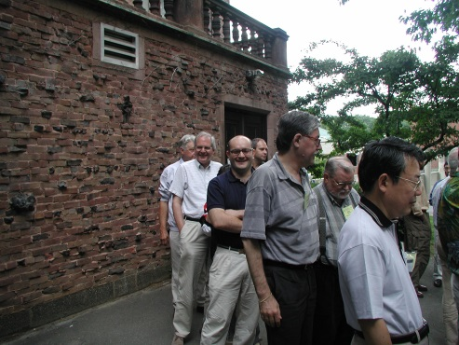

Slide 25
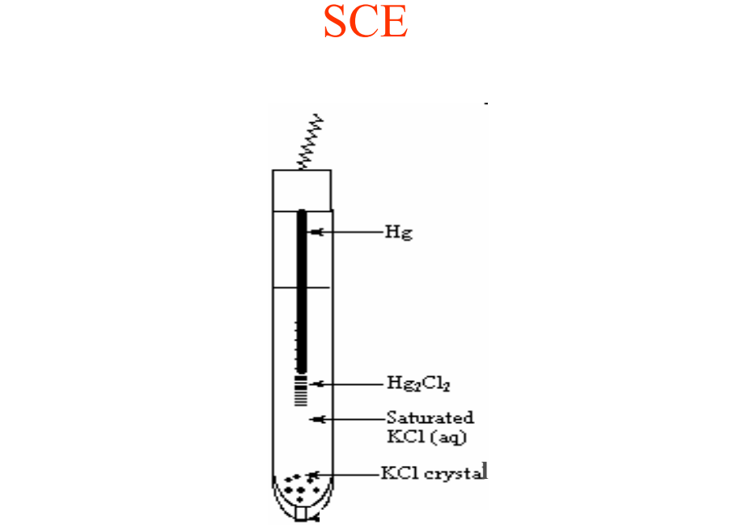

Slide 33
