Slide 1
Course on Carbon dioxide to Chemicals and Fuels
PRESENTATION - SEVEN
3 rd MARCH 2014
On Line Course of NCCR
(Total Number of Projections for this Lecture is )

Slide 2
The concept of tri Reforming
A novel tri-reforming process - involves a synergetic combination of CO2 reforming, steam reforming, and partial oxidation of methane in a single gasification reactor for effective production of useful synthesis gas for use in F-T Process.
The novel tri-reforming concept represents alternate way of thinking for both conversion and utilization of CO2 and CH4 without separation that can be applied to industrial flue gas as well.
The Novel tri-reforming catalytic system can not only produce biomass synthesis gas (CO + H2) with H2/CO ratios (1.5–2.0), but also could eliminate carbon formation which is usually a serious problem in the CO2 reforming of methane and biomass gasification.
This area has assumed importance in the last 10-15 years.

Slide 3
Advantages of Tri Reforming
Therefore, the proposed tri-reforming can solve two important problems that are encountered in individual processing.
The incorporation of low partial pressures of O2 in the partial oxidation reaction generates heat in-situ that can be used to increase energy efficiency and O2 also reduces or eliminates the carbon formation on the reforming catalyst. The selection of catalyst support is critical.

Slide 4
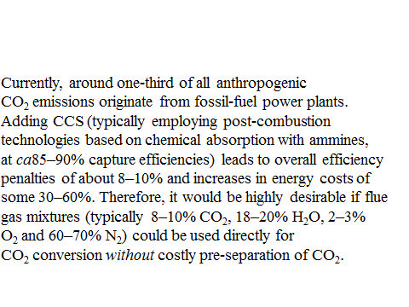
.
Z.Jiang et al, Phil.Trans.Roy.Soc., A368,3343 (2010)

Slide 5
Song and colleagues have pioneered a novel process centred on the unique advantages of directly utilizing flue gas, rather than pre-separated and purified CO₂ from flue gases, for the production of hydrogen-rich syngas from methane reforming of CO₂ (so-called ‘dry reforming’). The overall process, named ‘tri-reforming’, couples the processes of CH₄/CO₂ reforming, steam reforming of CH₄, and partial oxidation and complete oxidation of CH₄. The reactions involved are itemized in the table above together with the corresponding enthalpies of reaction (298 K).
.
Z.Jiang et al, Phil.Trans.Roy.Soc., A368,3343 (2010)

Slide 6
Coupling CO₂ and H₂O can give syngas with the desired H₂/CO ratios for methanol and dimethyl ether synthesis and higher-carbon Fischer–Tropsch synthesis of fuels.
CH₄→ C + 2H₂O
2CO→ C + CO₂
It also helps to avoid the formation of particulate (solid) carbon deposits arising from reactions such as Experimental studies have shown that the introduction of the CO₂ tri-reforming reaction may also enhance the durability and lifetime of metal nanoparticle catalysts owing to the addition of oxygen (and consequent oxidation of carbon deposits).
Z.Jiang et al, Phil.Trans.Roy.Soc., A368,3343 (2010)

Slide 7
It is possible to achieve up to 95 per cent methane conversion by this process at equilibrium temperatures in the range 1073–1123 K. To achieve effective conversion (of both CO₂ and CH₄), the flue gas is combined with natural gas and used as chemical feedstocks for the production of syngas (CO+H₂) with desired H₂/CO ratios. In addition, the process makes use of ‘waste heat’ in the power plant and heat generated in situ from partial oxidation of methane (POM) with the O₂ present in the flue gas (above table). In effect, the two endothermic reactions noted in the table above are thermally sustained by the waste heat content of the exhaust gases, and the partial combustion of the primary methane fuel
.
Z.Jiang et al, Phil.Trans.Roy.Soc., A368,3343 (2010)

Slide 8
The main advantages of Tri reforming 1.Prevention of carbon deposit 2.appropriate CO/H₂ ratio 3.more autothemic reaction enthalpy than dry reforming . Z.Jiang et al, Phil.Trans.Roy.Soc., A368,3343 (2010)

Slide 9
Main reactions for syngas production by tri reforming of natural gas
Reaction | Stoichiometry | ∆H⁰₂₉₈ (kJ/mol) enthalpy
CO₂ reforming of methane (DRM) | CH₄ +CO₂↔2CO +2H₂ | +247.3 (endo)
Steam reforming of methane (SRM) | CH₄ + H₂O↔CO + 3H₂ | +206.3 (endo)
Partial oxidation of methane (POM) | CH₄ + 1/2O₂↔CO + 2H₂ | -35.6 (exo)
Catalytic combustion of methane(CCM) | CH₄+ 2O₂↔CO₂+2H₂O | -880 (exo)

Slide 10
Table 1 Reaction steps of methane tri-reforming process
Reaction steps
a. CH4(g)+ CO2(g) → 2CO(g)+ 2H2(g)
b. CH4(g) + H2O(g) → CO(g) + 3H2(g)
c. CH4(g) + _O2(g) → CO(g) + 2H2(g)
d. CH4(g) + 2O2(g) → CO2(g) + 2H2O(g)
e. CH4(g) → C(s) + 2H2(g)+. 2CO(g) + C(s) → CO2(g)
g. CO2(g) + H2(g) → CO(g) + H2O(g)
h. C(s) + H2O(g) → CO(g) + H2(g)
m. C(s) + O2(g) → CO2(g)
n. 5CH4(g) + 7/2O2(g) → 9H2(g) + 4CO(g) + CO2(g)+ H2O(g)
2. Observed reaction steps
I. CH4(g) + 5/8O2(g) → CO(g) + 7/4H2(g) + _H2O(g)
II. CH4(g) → C(s) + 2H2(g) (Methane cracking)
III. 2CO(g) →2 C(s) + CO2(g) (Boudouard reaction)
IV. CO2(g) + H2(g) → CO(g)+ H2O(g) (Reverse water gas)

Slide 11
Steam reforming
−H⁰₂₉₈(kJ/mol)
1. CH4 + H2O CO + H2 −206
2. CnHm + nH2O nCO + (n + m/2) H2 −1175 (for nC7H16)
3. CO + H2O CO2 + H2 (WGS) +41
CO2 (dry) reforming
4. CH4 + CO2 2CO + 2H2 −247
Autothermal reforming (ATR)
5. CH4 + 1. O2 CO + 2H2O +520
6. CH4 + H2O CO + 3H2 −206
7. CO + H2O CO2 + H2 +41
Catalytic partial oxidation (CPO)
8. CH4 + 1/2O2 CO + 2H2 +38
Total oxidation
9. CH4 + 2O2→ CO2 + 2H2O +802
Boudouard reaction
10. 2CO C + CO2 +172
The main chemical products from natural gas are summarized

Slide 12
REFORMING –STEAM-DRY-BI-TRI
STEAM REFORMING
C_{n}H_{m} + nH₂O → nCO + (n+0.5m)H₂ ∆Hº₂₉₈ =206kJ/mol
Dry Reforming
CH₄ + CO₂→ 2CO + 2H₂ ∆Hº₂₉₈ =247kJ/mol
Water Gas Shift (WGS)
CO + H₂O → CO₂ + H₂ ∆H⁰₂₉₈ = -41 kJ/mol
Boudouard Reaction
2CO→ C + CO₂ ∆H⁰₂₉₈ = -173 kJ/mol
Methane Decomposition
CH₄ → C + 2H₂ ∆H⁰₂₉₈ = 75 kJ/mol

Slide 13
TRI REFORMING A NEW PROCESS FOR REDUCING CARON DI OXIDE EMISSIONS
CO₂ separated, recovered and purified by absorption, adsorption or membrane separation. Refer database
But require energy input in power plants nearly 20%
May be possible to reduce this
Tri reforming (Penn State University)is a three step process avoids separation step, can be cost efficient for synthesis gas production

Slide 14
CO₂ Emissions from different sectors in USA( in Million metric Tons of carbon)
Emissions Source | 1980 | 1985 | 1990 | 1995 | 1997
Residential sector | 248 | 246 | 253 | 270 | 286
Commercial sector | 178 | 190 | 207 | 218 | 237
Industrial Sector | 485 | 425 | 454 | 465 | 483
Transportation Sector | 378 | 384 | 432 | 459 | 473
End use total | 1289 | 1245 | 1346 | 1412 | 1479
Electric Utilities | 418 | 439 | 477 | 495 | 523

Slide 15
Top 10 countries
Canada
China
Germany
India
Italy
Japan
Russia
South Korea
UK
USA
Alphabetical order

Slide 16
Typical Flue Gas Composition
Flue gas 8-10% CO₂18-20% H₂O,2-3% O₂, 67-72% N₂ from natural gas fired power plants
12-14% CO₂, 8-10% H₂O,3-5% O₂,72-77% N₂, coal based boilers

Slide 17
TRI REFORMING PROCESS
CH₄ + CO₂→ 2CO + 2H₂ 247.3 kJ/mol
CH₄ + H₂O →CO + H₂ 206.3 kJ/mol
CH₄ + 1/2O₂ → CO + 2H₂ -35.6kJ/mol
CH₄ + 2O₂→CO₂ + 2H₂O -880kJ/mol
Coupling CO₂ reforming with steam reforming will give synthesis gas fit for FT H₂/CO =2
Dry reforming is endothermic
Carbon formation a major problem

Slide 18
OTHER REACTIONS
CH₄ → C + 2H₂ 74.9 kJ/mol
2CO→C + CO₂ -172kJ/mol
C + CO₂→2CO 172kJ/mol
C + H₂O → CO + H₂ 131 kJ/mol
C+O₂ → CO₂ -393kJ/mol
Steam reforming
Syngas desired H₂/CO mitigate carbon formation heat is also generated
NG or flue gas waste heat

Slide 19
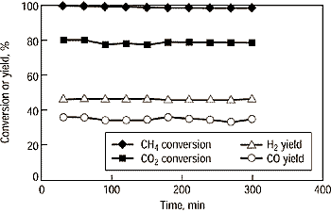
Electric power plant Coal, NG fired
IGCC
Glue gas CO₂,O₂,H₂O, N₂
NG input
Process waste heat exchange
O₂CO2-H₂O reforming of CH₄
Syngas CO+H₂+unreacted gas
Fuels
chemicals
Electricity
Proposed CO₂ based tri generation concept
IGCC Integrated gasification combined cycle

Slide 20
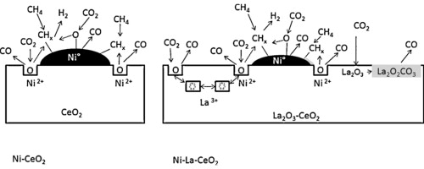
PICTORIAL REPRESENTATION OF ROLE OF SUPPORT AND PROMOTER

Slide 21
The energy sector, which is the largest source of CO2 emissions, is responsible for approximately 25% of global CO2 emissions. Great efforts have been conducted in the past
to use carbon dioxide as a chemical raw material with a very low or even negative cost rather than as a waste, e.g. CO2 reductions under photoirradiation, or under electrolytic conditions, or production of synthesis gas by reforming natural gas. However, many of these reactions produce rather simple molecules such as carbon monoxide and formic acid. CO2 has the advantages of being nontoxic, abundant, and economical, attractive as an environmentally
friendly chemical reagent, especially useful as a phosgene substitute. The largest obstacle for establishing industrial processes based on CO2 as a raw material is its low energy level. In other
words, a large energy input is required to transform CO2. There are several methodologies to transform CO2 into useful chemicals, such as the use of high-energy starting materials such as hydrogen, unsaturated compounds, small-membered ring compounds, and organometallics; the choice of oxidized low-energy synthetic targets such as organic carbonates or the supply of physical energy such as light or electricity. Selecting appropriate reactions can lead
to a negative Gibbs free energy of the reaction .
Ioana et al., Catalysis Today 189,212(2012)

Slide 22
Carbon di oxide to fuels have been studied largely as a complementary technology to carbon sequestration (CSS) and storage. CSS requires the minimization of hydrogen consumption to produce fuels.
From this perspective, the preferable option is to produce alcohols (preferably ≥C2) by use of solar energy to produce the protons and electrons necessary for CO2 reduction. The chemical transformation of CO2 includes a reverse water–gas shift reaction and hydrogenation to produce hydrocarbons, alcohols, dimethyl ether and formic acid, a reaction with hydrocarbons to syngas (such as dry reforming of methane), and photo- and electro-catalytic and thermochemical conversions.
CO2 can be used as a building block in organic syntheses to obtain valuable chemicals and materials has been discussed in many reports and review articles. The main applications of CO2 as chemical raw materials are syntheses of polycarbonates and polyurethanes.
Ioana et al., Catalysis Today 189,212(2012)

Slide 23
Organic carbonates are roughly categorized into cyclic and linear carbonates, which both compounds have three oxygens in each molecule, and are suitable from a thermodynamic point of view as synthetic targets starting from CO2. Four industrially important organic carbonates are ethylene carbonate (EC), propylene carbonate (PC), dimethyl carbonate (DMC), and diphenyl carbonate (DPC). EC, DMC and DPC are useful intermediates for manufacturing
polycarbonates through a non-phosgene process . In addition, EC, PC and DMC are employed as electrolytes in lithium ion batteries and are widely used as aprotic polar solvents. Furthermore,
the excellent properties of DMC as a fuel additive have attracted much attention. DMC can be synthesised from methanol and CO2, over homogeneous catalysts or heterogeneous such as
solid acid catalysts of zirconia modified by Ce and acid additives such as phosphoric acid, or as a support for heteropolyacids, or via cyclic carbonates (CO2 with epoxides), the cycloaddition of oxiranes and oxetanes and CO2 over e.g. CeO2–ZrO2 or homogeneous metal complexes catalysts, or coplymerisation of CO2 and oxiranes on metal complexes, the synthesis of urea (CO2 + NH3) and urethane derivatives, e.g. CO2 + secondary or primary amines giving
carbamic acid which reacts with organic halides or alcohols giving carbamates (urethanes) or are dehydrated to isocyanate without using phosgene, the synthesis of carboxylic acids, e.g. acrylic acid, the synthesis of esters and lactones by combining CO2 with unsaturated
compounds such as vinyl ethers, the hydrogenation and hydroformylation of alkenes by CO2 and H2, and so forth
Ioana et al., Catalysis Today 189,212(2012)

Slide 24
Currently, the utilization of CO2 as a chemical feedstock is limited to a few processes, such as the synthesis of urea (for nitrogen fertilizers and plastics), salicylic acid (a pharmaceutical ingredient) and polycarbonates (for plastics). It is worth noting that the actual
use of CO2 corresponds to a small percentage of the potential CO2 that is suitable to be converted into chemicals; thus, a chemical transformation of CO2 may significantly contribute to a reduction of its emissions, in particular for the fuel pool, the worldwide consumption
of which is two orders of magnitude greater than that of chemicals. Note that CO2 transformation requires energy, which may produce CO2. Thus, the importance of the transformation of CO2 into useful chemicals should be closely related to the importance
of utilizing a renewable feedstock .
Ioana et al., Catalysis Today 189,212(2012)

Slide 25
Different options exist in heterogeneous catalysis for the conversion of CO2. The hydrogenation of CO2 to form oxygenates and/or hydrocarbons are the most intensively investigated area of CO2 conversion. Methanol synthesis from CO2 and H2 has been investigated at the pilot-plant stage with promising results.
An alternative possibility is the production of DME, which is a potential diesel substitute. Ethanol formation, either directly or via methanol homologation, and the conversion of CO2 to formic acid are also potentially interesting routes. Methanol, ethanol, and formic acid may also be used as feedstocks in fuel cells, which provide a route to store energy from CO2 and then produce electricity.
The hydrogenation of carbon dioxide to hydrocarbons consumes much more hydrogen (per unit of product) than the formation of oxygenates. Therefore, this route is, in principle, only valuable when hydrogen is made primarily from renewable or non-fossil resources; however, other thermodynamic aspects must also be considered. The dry reforming of methane with CO2 is a known technology that is available on a nearly industrial scale, although the positive impact on CO2 emissions is questionable.
Specifically, it is important to ensure that CO2 emissions due to energy consumption are not greater than the amount of CO2 consumed in the reaction. An improvement in the positive direction is tri-reforming, which operates autothermically and does not require a pure CO2 feed stream; however, large-scale demonstration units are necessary. The conversion of CO2 at room temperature and atmospheric pressure using solar light represents a highly challenging approach to close the CO2 cycle and develop approaches that mimic photosynthesis. An interesting solution could be a photo-electrochemical (PEC) reactor that operates in the gas phase and uses nanoconfined electrodes that differ from those used in conventional PEC systems.

Slide 26
Results of thermodynamic calculations for equilibrium conversion of the reagents in the methane tri reforming process
Data from S.A.Solov’ev et al.,Theoretical and Experimental Chemistry, 48,199 (2012)
CH₄/CO₂/H₂O/O₂/Ar | Temp K | conversion % |  |  | Mole ratio H₂/CO
 |  | CH₄ | CO₂ | H₂O
1/0.475/0.475/0.1/7.5 | 973 | 90.9 | 75.9 | 73.4 | 2.13
1/0.475/0.475/0.1/15 | 973 | 95.6 | 80.6 | 78.6 | 2.13
1/0.475/0.475/2.75/15 | 973 | 99.5 | 16.5 | 9.4 | 1.85
1/0.475/0.475/2.0/15 | 813 | 65 |  | 28 | 2.42

Slide 27
Parameters of methane Trireforming inNi-Al₂O₃ catalysts modified by rare earth oxides on structured cordierite supports.
Data from S.A.Solov’ev et al.,Theoretical and Experimental Chemistry, 48,199 (2012)
Catalyst | component composition |  |  |  |  | Temp K | Conversion % |  | H_{2/}CO | Yield %
 | CH₄ | CO₂ | O₂ | H₂O | Ar |  | CH₄ | CO₂ |  | H₂ | CO
NiAl | 1 | 0.9 | 0 | 0.65 | 13 | 983 | 99.8 | 68 | 1.59 | 80 | 70
NiLaAl | 1 | 0.95 | 0 | 0.7 | 14.5 | 878 | 88 | 65 | 1.46 | 69 | 65
NiCeAl | 1 | 0.7 | 0 | 0.65 | 14.5 | 978 | 98 | 74 | 1.71 | 76 | 70
 | 1 | 0.7 | 0.4 | 0.7 | 14.5 | 833 | 85 | 9 | 2.02 | 57 | 45
Ni2CeAl | 1 | 0.45 | 0.2 | 0.55 | 15 | 888 | 91 | 16 | 1.73 | 78 | 75
 | 1 | 1 | 0.2 | 0.55 | 15 | 888 | 94 | 34 | 1.42 | 64 | 72

Slide 28
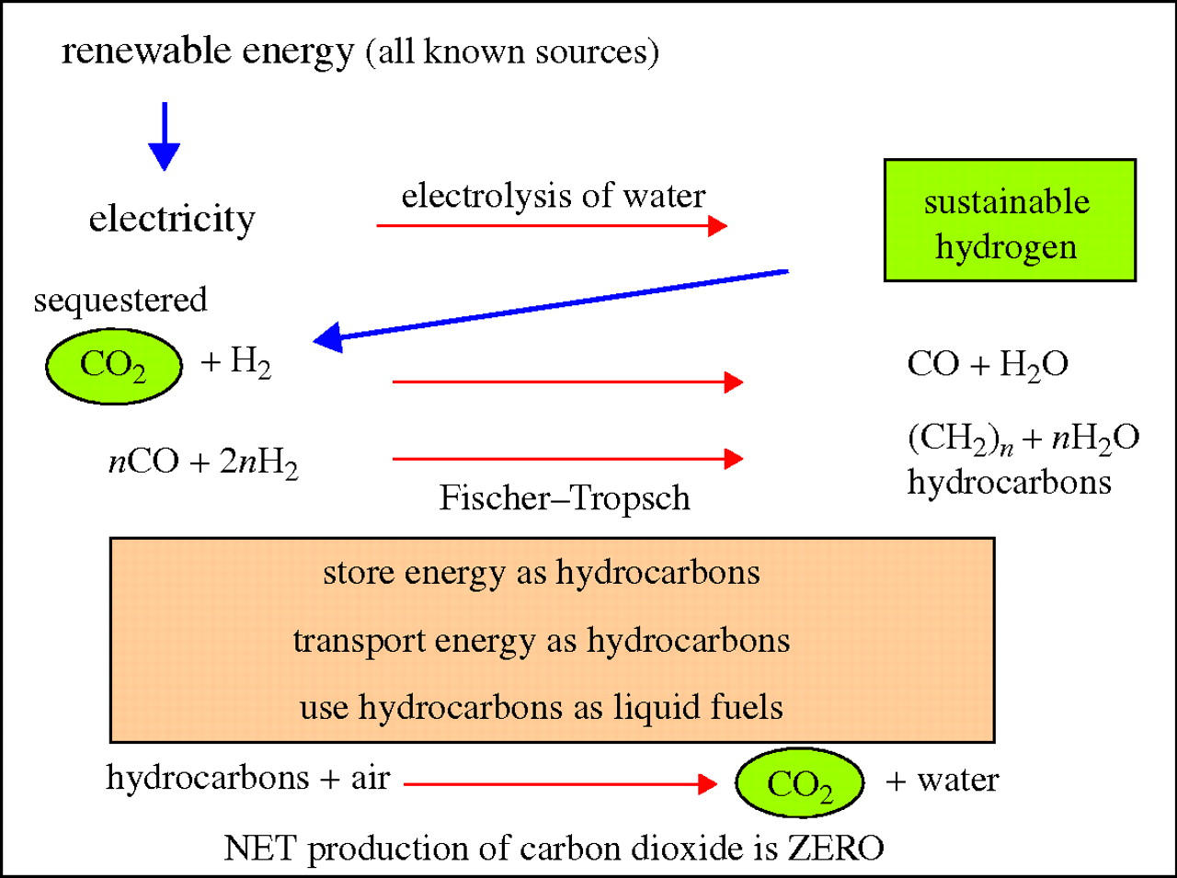
A generic energy cycle using captured or sequestered CO2 and sustainable or renewable hydrogen to yield carbon-neutral or renewable carbonaceous fuels (courtesy of M. L.
Jiang Z et al. Phil. Trans. R. Soc. A 2010;368:3343-3364
©2010 by The Royal Society
Notes:
A generic energy cycle using captured or sequestered CO2 and sustainable or renewable hydrogen to yield carbon-neutral or renewable carbonaceous fuels (courtesy of M. L. H. Green).

Slide 29
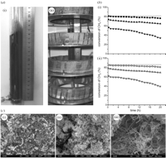
Some experimental observations
Aerogel Co/Al₂O₃ catalysts for CH₄–CO₂ reforming. (a) (i) Conventional and (ii) magnetic fluidized bed. (b) Conversions of (i) CH₄ and (ii) CO₂. (c) Microstructure of the catalysts after 20 h operation: (i) magnetic fluidized bed, (ii) fluidized bed and (iii) fixed bed. Note that in the fluidized-bed operation mode, (i), carbon deposition is mainly of particulates, while in the fixed-bed mode, (iii), we see extensive filamentous, graphitic carbon, causing deactivation of the catalyst. Symbols: (b) (i) filled squares, magnetic fluidized bed; filled triangles, fluidized bed; filled inverted triangles, fixed bed; dotted line, equilibrium conversion; (ii) open squares, magnetic fluidized bed; open triangles, fluidized bed; open inverted triangles, fixed bed; dotted line, equilibrium conversion.
.
reproduced fromZ.Jiang et al, Phil.Trans.Roy.Soc., A368,3343 (2010)

Slide 30
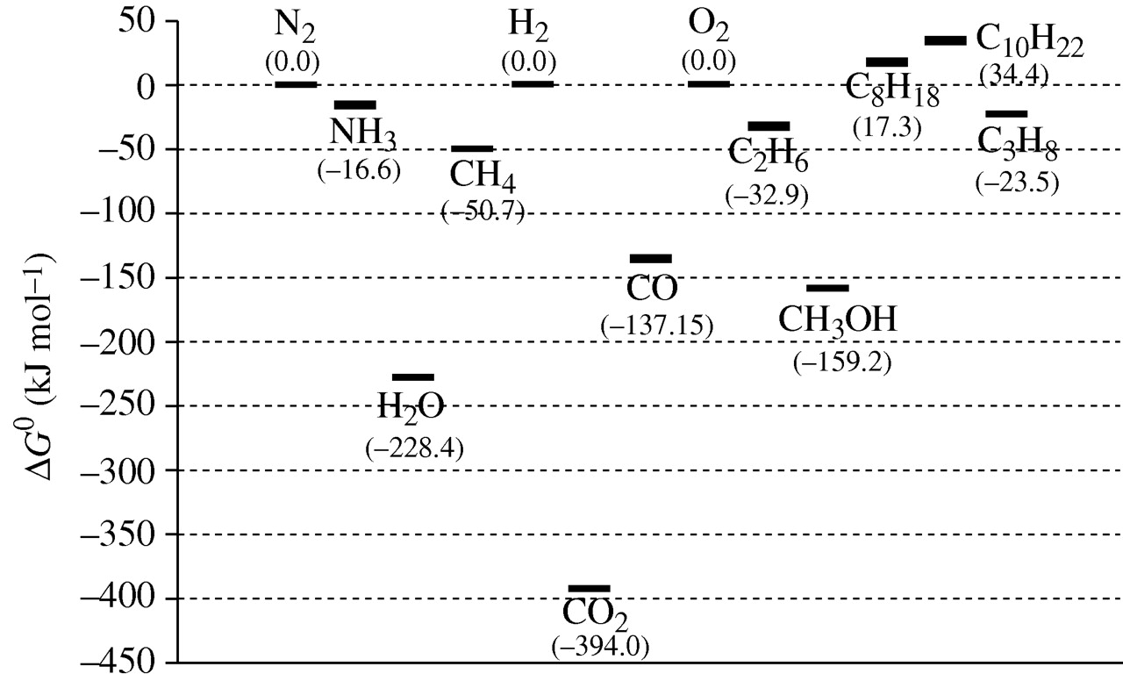
Gibbs free energy of formation for selected chemicals (data compiled and calculated from NIST database, http://webbook.nist.gov/chemistry/name-ser.html).
Jiang Z et al. Phil. Trans. R. Soc. A 2010;368:3343-3364
©2010 by The Royal Society
Notes:
Gibbs free energy of formation for selected chemicals (data compiled and calculated from NIST database, http://webbook.nist.gov/chemistry/name-ser.html). Here, ΔG0 for the constituent elements is taken as the reference point.

Slide 31
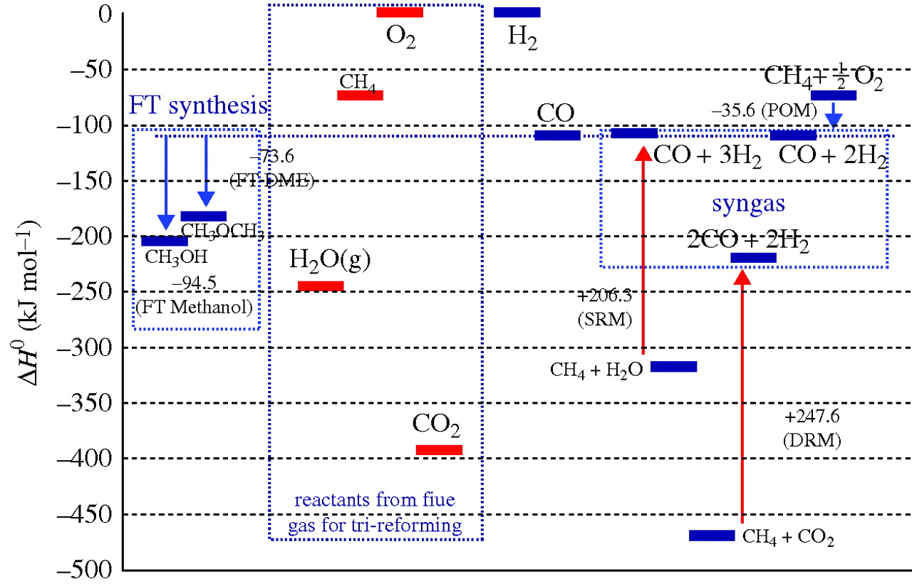
The enthalpy of reaction for syngas production and Fischer–Tropsch (FT) synthesis of methanol and dimethyl ether.
Jiang Z et al. Phil. Trans. R. Soc. A 2010;368:3343-3364
©2010 by The Royal Society
Notes:
The enthalpy of reaction for syngas production and Fischer–Tropsch (FT) synthesis of methanol and dimethyl ether. The various reactions labelled DRM, SRM and POM are listed in table 1 and discussed in §3c.

Slide 32
The interest for tri-reforming process is:
The attractive possibility of potential integration of this technology into gas-turbine-based electric power cycles, having very low overall CO₂ emissions.
Detailed experimental studies, computational analysis and engineering evaluations are being carried out on the tri-reforming process.
The CO₂ in power plant exhausts could be used directly in catalytic processes to generate a syngas suitable for ultimately delivering energy fuels (and a variety of chemical products).
Z.Jiang et al, Phil.Trans.Roy.Soc., A368,3343 (2010)

Slide 33
The development of catalysts
The majority of developments are directed on the CH₄–CO₂ reforming component of the tri-reforming process.
Both Ni and Co have frequently been employed as active metal components owing to their high intrinsic catalytic activities, wide availability and (relatively) low costs .
The drawback of these catalytic materials centres on serious carbon deposition in the industrial CO₂reforming of methane.
This leads to rapid catalyst deactivation and reaction inhibition
Carbon deposition was strongly influenced by the precise mode of operation of the chemical conversion process.
Fluidized-bed reforming leads to significant enhancement in the CH₄ conversion process and a considerably reduced carbon deposition when compared with the fixed-bed operation process Further optimization of the fluidized-bed configuration has taken the form of innovative approaches using a fluidized bed assisted by an external, axial magnetic field.
Ref: Z.Jiang et al, Phil.Trans.Roy.Soc., A368,3343 (2010)

Slide 34
Hao et al. (2008) have recently reported studies of CH₄–CO₂ reforming on aerogel Co/Al₂O₃ nanoparticulate catalysts in a magnetic fluidized bed. In their study, Co was introduced as the active catalyst component for the reforming process; here, they have taken advantage of the high Curie temperature of Co (ca 1120°C) that makes it ideally suited for the high operating temperatures of between 700 and 1000°C necessary for the reforming process. In addition, the influence of an external magnetic field on the catalytic activity and stability of these catalyst systems was investigated in detail and compared with data for a conventional fluidized bed and a static bed. These impressive studies are summarized in figure 9, which is a compilation of conversion efficiencies for both CH₄ and CO₂. Also shown are images of the operating catalysts that clearly demonstrate that carbon deposition is considerably reduced through improving the gas–solid efficiency by the use of the external magnetic field. For these ferromagnetic particulate catalysts, it is quite clear that magnetic-field enhancement of operating process properties may be a most important avenue for future, major studies.

Slide 35
Main reactions for syngas production by tri reforming of natural gas
Reaction | Stoichiometry | ∆H⁰₂₉₈ (kJ/mol) enthalpy
CO₂ reforming of methane (DRM) | CH₄ +CO₂↔2CO +2H₂ | +247.3 (endo)
Steam reforming of methane (SRM) | CH₄ + H₂O↔CO + 3H₂ | +206.3 (endo)
Partial oxidation of methane (POM) | CH₄ + 1/2O₂↔CO + 2H₂ | -35.6 (exo)
Catalytic combustion of methane(CCM) | CH₄+ 2O₂↔CO₂+2H₂O | -880 (exo)

