Slide 1
Application of theoretical chemistry as a tool for understanding catalysis
H. L. Janardhan
Materials science division
PPISR, Bangalore

Slide 2
Outline
Introduction
Fundamental principals
Approximation methods
Understanding zeolite catalysis
Acid strength of zeolites
Toluene methylation
Without steric factors
Over H-MOR
Selective hydrogenation of Butadiene

Slide 3
Catalysis-An interdisciplinary Science
Surface Science
Atoms
Interactions
Inorganic Chemistry
-Metals, non-metals
-Organometallics
Material Science
-Properties
-Phases
Physical Chemistry
-Kinetics
-Thermodynamics
- Spectroscopy
Organic Chemistry
-Organic Synthesis
-Reaction mechanisms
CATALYSIS
Chemical Engineering
-Heat & Mass transfer
-Reactor design
-Process technology
-Reactor design
Theoretical Chemistry
-Reaction Modeling
Biochemistry
-Enzyme catalysis

Slide 4
Introduction
Next RSC president predicts that in 15 years no chemist will do bench experiments without computer-modelling them first !
http://www.rsc.org/AboutUs/News/PressReleases/2013/Dominic-Tildesley-Royal-Society-of-Chemistry-President-Elect.asp (accessed on Jul 30 2013)

Slide 5
Introduction

Slide 6
Introduction
The term theoretical chemistry may be defined as the mathematical description of chemistry.
Quantum mechanics gives a mathematical description of the behavior of electrons and found to be correct always .
Hydrogen atoms are the only systems with analytical solution for Quantum Mechanical (QM) equations
For other systems approximations are made to solve QM equation with acceptable accuracy

Slide 7
Introduction
They are able to identify the unsuitability of 90% compounds for their intended use.
It can save months of lab work
Raw materials
Manpower
Money
Understanding mechanism of reactions more completely

Slide 8
Fundamental principles

Slide 9
Fundamental principals
Quantum mechanics represents the motion of electrons as wave motion and represents as wave function ψ.
Any operation on ψ yields an Eigen value of the function
This Eigen value is associated with an observable
Ĥψ = Eψ
Ĥ = Hamiltonian operator
ψ = Wave function
E = Eigen value = Energy

Slide 10
Fundamental principals
Hamiltonian is represented as
Ĥ $=−\sum_{i}^{particles}{\frac{∇2i}{2mi}}+\sum_{i<j}^{particles}{\sum{\frac{qiqj}{rij}}}$
$∇2=\frac{δ2}{δxi2}+\frac{δ2}{δyi2}+\frac{δ2}{δzi2}$ (Laplacian operator acting on particle i)
$qiqj$ = charge of particle i, j
$mi$= mass of particle i
$rij$= distance between particle i and j
kinetic energy
of particles
Energy due to columbic attraction or repulsion

Slide 11
Fundamental principals
First approximation to solve the QM equation is born-oppenheimer approximation by considering nucleus as stationary and separating equation into nuclear and electron motion
Ĥ $=−\sum_{i}^{electrons}{\frac{∇2i}{2}}−\sum_{i}^{nuclei}{\sum_{j}^{electrons}{\frac{Zi}{rij}+\sum_{i<j}^{electrons}{\sum{\frac{1}{rij}}}}}$
kinetic energy
of electrons
Attraction of electrons to nuclei
Repulsion of electrons

Slide 12
Approximation methods

Slide 13
Approximation methods
Ab initio methods it is completely based on QM principals, approximations are done only for mathematical forms.
Semi empirical methods these methods are similar to that of ab initio but the results are fitted to experimentally determined parameters (parameterization)
Density functional theory methods to determine energy of molecule it considers electron density rather than electron wave function this method requires lesser computational power than that of ab initio methods

Slide 14
Approximation methods
Molecular mechanics its energy expression consists of a simple algebraic equation for the energy of a compound. It does not use a wave function or total electron density. The constants in this equation are obtained either from spectroscopic data or ab initio calculations. A set of equations with their associated constants is called a force field.
Molecular dynamics is a simulation of the time-dependent behavior of a molecular system, such as vibrational motion or Brownian motion. MM energy expression is used to compute the forces on the atoms for any given geometry.

Slide 15
Approximation methods
Monte Carlo methods are built around some sort of a random sampling.
The location, orientation, and geometry of a molecule or collection of molecules are chosen according to a statistical distribution.
For example, many possible conformations of a molecule could be examined by choosing the conformation angles randomly. If enough iterations are done and the results are weighted by a Boltzmann distribution, this gives a statistically valid result.

Slide 16
Understanding zeolite catalysis

Slide 17
Understanding zeolite catalysis
Primary Building unit from Si, Al
Arrangement of various
Secondary building units
results in different zeolite
Structures.
2-methoxy naphthalene diffusing
in to the pores of Zeolite Beta (BEA)
ZSM-5 (MFI)
Faujasite (FAU)

Slide 18
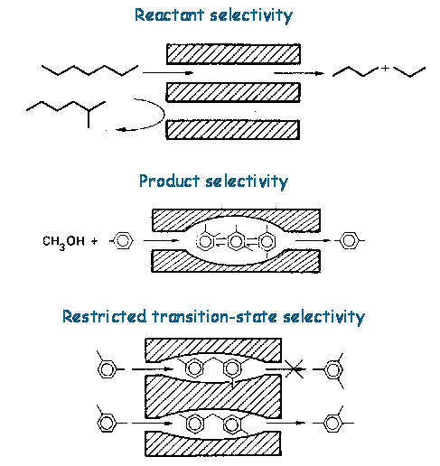
Shape selective catalysis in Zeolites

Slide 19
Models for Zeolite study
Small fragments can describe catalytic active sites termed cluster approach
Quantum mechanic - molecular mechanic methods (QM/MM) active site is treated quantum mechanically and framework is treated according to Molecular mechanics
Periodic approach an unit cell of about 300 atoms are treated QM

Slide 20
Acid strength of zeolites

Slide 21
Acid strength of zeolites
Expected acidity:
FAU ≤ LTL < OFF < MOR ≤ MEL < MFI based on electron charges on O*
doi:10.1016/S0167-2991(08)60997-0

Slide 22
Acid strength of zeolites
Observed Acidity:
FAU < LTL < OFF < MOR < MEL < MFI
doi:10.1016/S0167-2991(08)60997-0

Slide 23
Toluene methylation

Slide 24
Toluene methylation without steric hindrance
J. Am. Chem. Soc., Vol. 123, No. 12, 2001

Slide 25
Toluene methylation without steric hindrance
Theoretical prediction
ortho > para > meta
Experimental result ª
in homogeneous phase
without steric hindrance
ortho = 55-61,
para = 25-27,
meta = 14-16.
J. Am. Chem. Soc., Vol. 123, No. 12, 2001
ªJ. Chem. Soc., Faraday Trans. 1, 1983,79, 297-309

Slide 26
Toluene Methylation over H-MOR
meta
ortho
para
Reaction energy diagram of toluene methylation catalyzed by H-MOR, (Energies are in kJ/Mol)
Theoretical prediction
Activation energy for the formation of alkyl transission states in the order para < ortho < meta
Formation of desorbed product meta > para ≥ ortho
Experimental result ^{b}
meta = 7.2, para = 3.4, ortho = 3.2 (wt% at 400 °C)
J. Am. Chem. Soc., Vol. 123, No. 12, 2001
^{b}

Slide 27
Selective hydrogenation of butadiene

Slide 28
Hydrogenation of butadiene
Butadiene adsorbed
on surface
Chemo selectivity
to 1-butene
Nonselective hydrogenation
Pt and Pd both belong to
Group 10 in periodic table.
Why they differ so much in
activity and selectivity
Topics in Catalysis 13 (2000) 213–219

Slide 29
Arrangement of Atoms on the surface

Slide 30
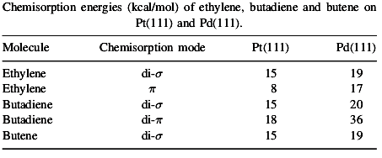
Adsorption modes of ethylene and butadiene
Ethylene di-σ mode is preferentially formed on Pt (111)
On Pd (111) surface di- σ and π both formed
Butadiene has similar probability for all modes on Pt (111)
On Pd (111) di- π mode is preferentially formed
Fig. Schematic representation of
adsorption modes
Topics in Catalysis 13 (2000) 213–219

Slide 31
Formation of stable structure
Pd has smaller radial distribution (size) of d orbitals where as Pt has larger distribution
di-σ mode of ethylene is favored due to lesser electron repulsion on Pt (111)
π mode is not formed over Pt (111) due to greater electron repulsion
di-σ and mode π both are equally probable on Pd (111) due to lesser electronic repulsion
Fig. Schematic representation of
energy levels of surface and alkene
Topics in Catalysis 13 (2000) 213–219

Slide 32
Butadiene adsorbed
on surface
Chemo selectivity
to 1-butene
Nonselective hydrogenation

Slide 33
Conclusions
Understanding of catalysis has increased exponentially in past few decades by using quantum mechanical principles.
Quantum mechanical methods have benefited catalyst studies significantly in understanding catalytic mechanism.
Theoretical chemistry can be used as tool to understand catalytic mechanism.
Usage of appropriate approximation method will be a choice of accuracy v/s time (money).
Theory helps to predict the possible out come
Validity of the result will depend on the model and approximation method used

Slide 34
References
Quantum mechanics –
Computational chemistry – David C young, John Wiley & Sons, Inc 2001
Progress in Theoretical Chemistry and Physics vol 8 Theoretical aspects of heterogeneous catalysis – Ed. Marco Antonio Chaer Nascimento Kluwer Academic Publishers 2002

