Slide 1
Alternates to Platinum for Electrode Applications
Presentation on the 7th Annual day of NCCR
28th July 2013

Slide 2
Why This Topic? With some personal bias Since Electrochemical devices will not only overcome the energy crisis but also product technology which will be totally green. Since the metallic electrodes have been examined for various process, it is necessary to look for alternatives

Slide 3
Why low temperature energy conversion devices?
High conversion efficiency
High power density
Low pollution
Quick start up
No electrolyte loss
Long life time

Slide 4
Options for Pt for use in low temperature fuel cells
Cathode
Anodes
Non Pt Electro-catalyst
Metal Nitrides
Metal carbides
Co-N-C & Fe-N-C
High activity
High selectivity
High stability
WC, Mo₂C
Metal Oxides
Pd alloy
ABO₃
Pd-M (Fe,Co,Ni,Mo)
Transition metal Macro-cylic compounds
Perovskite oxides
ABO₃ & A₂BO₄
A: Sr,Ba,La,Ce
B: Co,Fe,Ni,Cu,Ru
Active sites
Metal support interactions
Treatment conditions

Slide 5
ISSUES !
POSSIBLE ISSUES WITH EACH OF THEM
MATERIAL – WHICH ONE AND WHY?
COST CONSIDERATION AVAILABILITY STRINGENT CONDITIONS (T,P) TOO MANY REAGENTS OXIDES APPEALING FROM CERTAIN POINT OF VIEW BUT ELECTROCHEMICAL WINDOW AND MEDIUM ARE STILL ISSUES CARBIDES NITRIDES POSSIBLY WILL SATISFY BUT PREPARTION REPRODUCIBLY ARE DIFFICULT MACROCYCLES – COST, SYNTHETIC DIFFICULTY, RETAINING THEM IN THE MEDIUM QUESTIONABLE?
PREPARATION METHODS ARE STILL NOT YET SIMPLE RELATIVELY LOW CATALYTIC ACTIVITY,DISPERSING THE ACTIVE COMPONENT IN NANO SCALE IS STILL DIFFICULT AND EXPENSIVE CARBON MATERIALS UNIQUE PROPERTIES REQUIRED- MULTIDIMENSIONAL CARBON MATERIALS,OPTIMIZING SYNTHETIC CONDITIONS, PARTICLE SIZE, DISPERSION, MORPHOOLOGY,SURFACE CHARACTERISTICS, ACTIVE SITES

Slide 6
Why do we look for alternate to Pt?
1.Pt being a noble metal, the economics of using this material in electrochemical cells is not favourable for large scale adaptation.
2. Pt being noble metal, the available resources are limited and hence large scale usage may not be possible
3. Pt metal is susceptible for deactivation by impurities normally present (especially CO) in the feed of the fuel inlet or formed during oxidation of the fuel.
4. Since the source of Pt is limited, it is essential that the dispersion(low loading and maximum active site formation) has to be effective and such synthetic strategy is not highly reproducible.
5. Since the active metal has to be supported on a suitable conducting support (usually carbon) it is possible that potential induced aggregation may take place even if fine dispersion is obtained while synthesis of the electrode.
6. It has been estimated that if the all the vehicles on the road were to be powered by performing Hydrogen air fuel cells, then the requirement of Pt would still be about five times the total amount that has been mined to date {ref: Appleby}

Slide 7
Characteristics of a Material that can be Potential Electrode
1. They must be capable of being employed in both acid and alkaline media.
2. The potential window that is available must be suitable for most of the electron transfer process and the electrode itself should not undergo any reaction within this potential window.
3. The charge transfer between the electrode and electrolyte should be a reversible process. This may mean that the Fermi level (free energy of the electrons) of the electrode should be such that the charge transfer process becomes feasible.
4. The electrode material employed must not be too expensive.
5. The material employed should be as inert as possible and should promote only electro-chemical reactions and should not undergo reaction with the depolarizer used for electron transfer.

Slide 8
Some of the Prominent Low Temperature Electrochemical Process
1. Energy Conversion Processes
PEM fuel cell
DMFC
ORR
2. Electrochemical organic and inorganic Syntheses
3. Electrochemical Oxidation and Reduction reactions
and so on

Slide 9
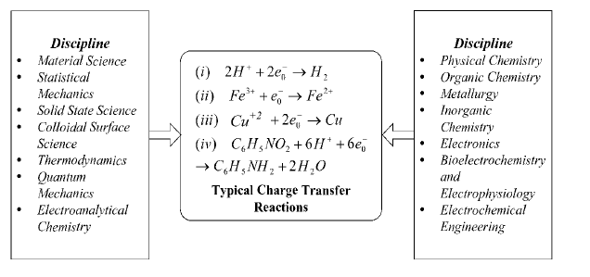

Slide 10
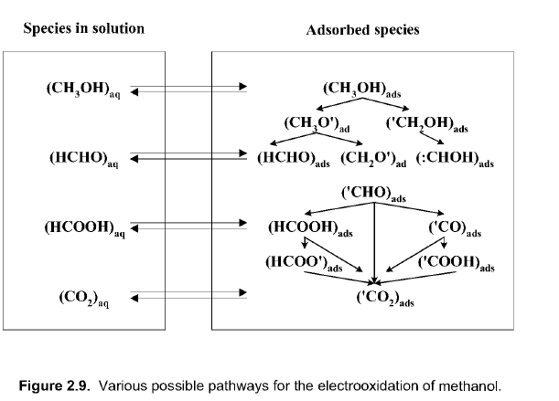

Slide 11
HCOOH_{bulk}
O_{2(bulk)}
2H₂O
2H₂O
H₂O
diff
O_{2 Surface}
K₄
K₁ (4e)
HCOOH_{adsorbed}
K₋₂ (2e)
K₃(+2e)
K-₂ (-2e)
HCOOH_{adsorbed}
Schematic presentation of ORR pathway suggested by Wroblowa

Slide 12
Possible configurations of dioxygen interaction with a metal
O
O
O
O
O
O
M
M
M
M
M
O
O
M

Slide 13
Mechanistic ORR pathways in acid and basic media
mode Acid medium
Alkaline medium
Bridge or Trans End on | O₂+ 2e +2H^{+ 2OH}_{ads} 2OH_{ads}+ 2H⁺ + 2e 2H₂O Eº =1.23 V vs NHE Over all direct reaction O₂ +n2H⁺ + 2e H₂O₂ E⁰ = 0.682 vs NHE With H₂O₂ + 2H⁺ +2e 2H₂O E⁰ = 1.77v vs NHE Overall indirect reaction | O ₂ + 2e +2H₂O 2OH_{ads} +2OH⁻ E⁰ = 0.401 vs NHE Over all direct reaction O₂ + H₂O + 2e HO₂⁻ + OH⁻ E⁰ = 0.076 v vs NHE HO₂⁻ + H₂O +2e 3OH⁻ E⁰ = 0.88 V vs NHE

Slide 14
Some Basis of Electrochemistry

Slide 15
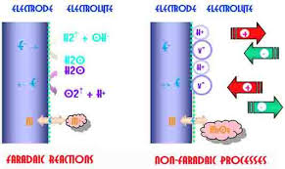

Slide 16
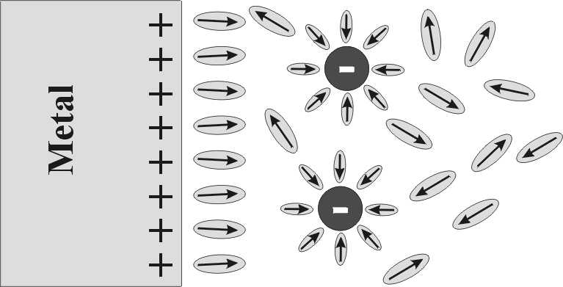

Slide 17
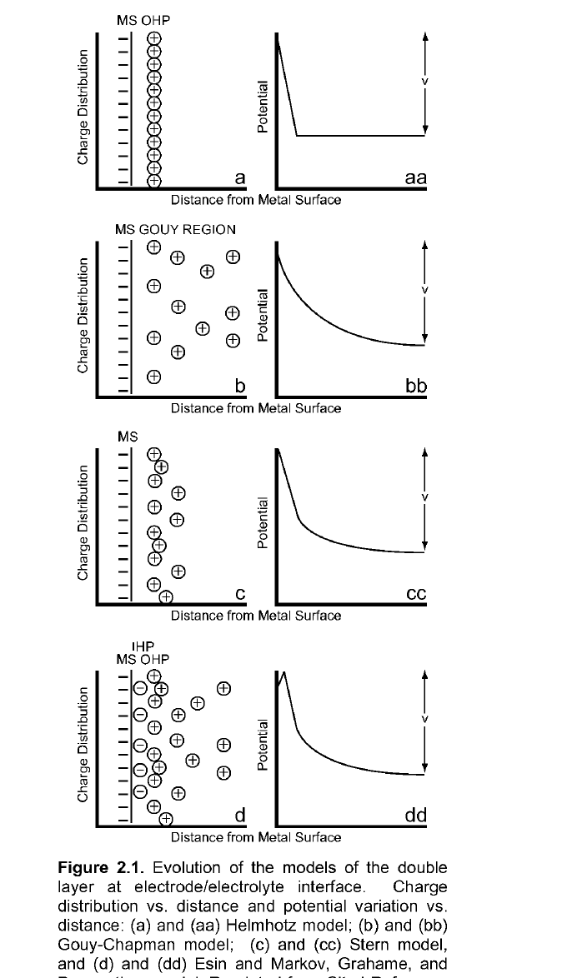

Slide 18
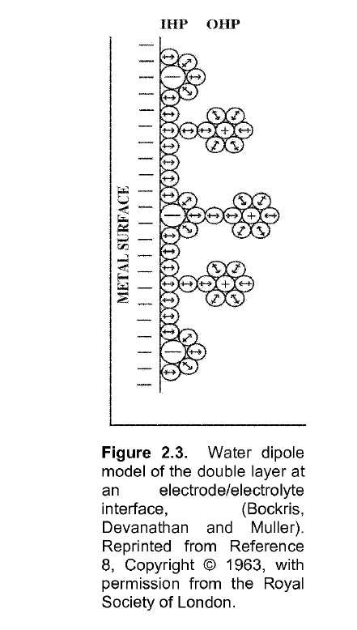

Slide 19
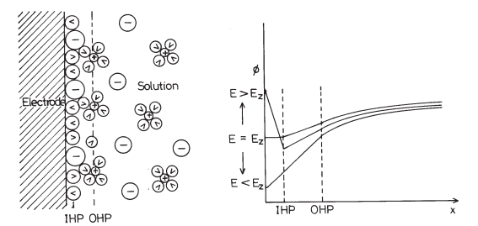

Slide 20
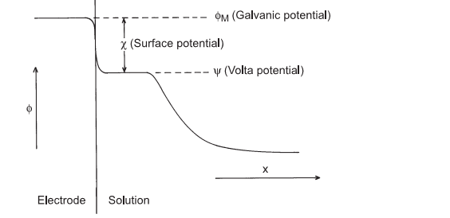

Slide 21
Options for replacing Pt

Slide 22
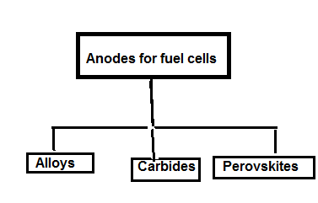

Slide 23
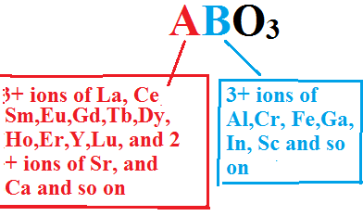
A and B combinations can be
3+ and 3+
2+ and 4+
1+ and 5+
AA’BB’O_{3 I} is also possible
K₂NiF₄ structure is also possible

Slide 24
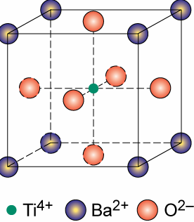
The crystal structure of perovskite

Slide 25
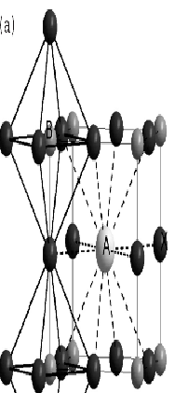
Another projection of the crystal structure of perovskite

Slide 26
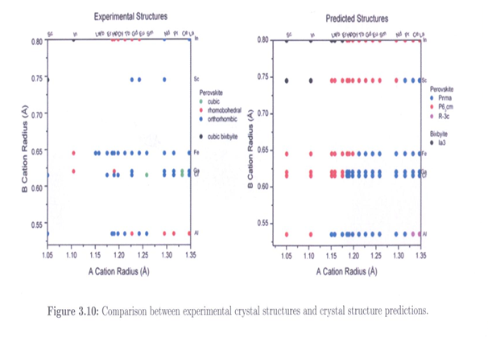

Slide 27
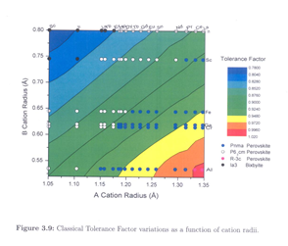

Slide 28
 Literature
Non-noble Metal electrodes adopted as anode for methanol oxidation
 Metallic glasses such as Fe, Co, Ni, Zr and Pd in alkaline medium
Pd+Zr glass - 50 mA/cm² (apparent) at 0.3 V vs RHE
Cu+Zr glass - 40 mA/cm² at +0.2 V vs RHE
Cu+Ti glass - 10 mA/cm² at +0.5 V vs RHE
- significant activity but stability problem
K. Machida and M. Enyo, Bull. Chem. Soc., Jpn. 58 (1985) 2043

Slide 29
Methanol oxidation on NiZr in acid solution
-reaction proceeds at surface O²⁻ ions neighboring a Ni³⁺ ion of a thicker passivating film; electron transfer from the surface to the electrode occurs diffusively by the nickel atoms of the film
J. B. Goodenough et al J. Power Sources ., J.Power sources 45 (1993) 291
 Tungsten carbide, Molybdenum carbide
K. Machida and M. Enyo, J. Electrochem. Soc., 137 (1990) 871
C SmCoO₃ and Pt containing perovskites in PEM mode
J. H. Whites and A. F. Samells, J. Electrochem., Soc. 140 (1993) 2167
NiO exhibit activity in alkaline medium at high potentials
A. El-Shafei, J. Electroanal. Chem., 447 (1998) 81 & , 471 (1999) 89.

Slide 30
NiO exhibit activity in alkaline medium at high potentials
El-Shafei, J. Electroanal. Chem., 447 (1998) 81 & , 471 (1999) 89.
oxides of Ni-Cu
- exhibits low overvoltages at 303 K for methanol oxidation.
- good corrosion resitance towards electrolyte medium
T. shobha et al J. Solid State Electrochem., 137 (2003) 871
 Ni–Pd alloy
T. shobha et al Material chemistry and physics., 80 (2003) 656

Slide 31
Points to consider
Methanol adsorption follows very closely to the desorption of H₂ on
Pt leaving bare metal sites
The maximum methanol adsorption will take place in the double layer region.
Gasteiger, J. Phys. Chem. 97 (1993) 12020
Most of the transition metals other than Pt & Rh, the desorption of H₂ is
concomitant with the adsorption of oxygen like surface species thus inhibiting
methanol adsorption.
 Alternate material Oxide electrodes - a possible choice
Semiconductor Electrochemical Concepts adopted

Slide 32
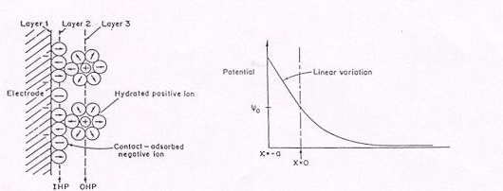
 Metal/Electrolyte Interface
1/C_{dl} = 1/C_{H} + 1/C_{GC}
 The density of states is 10²² cm⁻³V⁻¹
 The space charge of the metal is all squeezed onto the surface.
 Field gradient is absent in the bulk of metal.

Slide 33
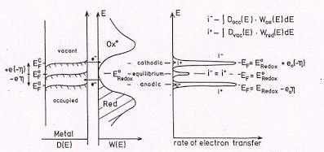
Electron transfer at Metal electrode/electrolyte interface
Gurney’s model : Electron passes from
Oxidation → Filled donor state of redox species to the Fermi level of the metal
Reduction → Fermi level of the metal to the empty acceptor states of an oxidant
Electron transfer rate at Metal/electrolyte interface
The electron transfer occurs in an energy range close to the Fermi level
not too far from equilibrium condition – does not to go to high overvoltages

Slide 34
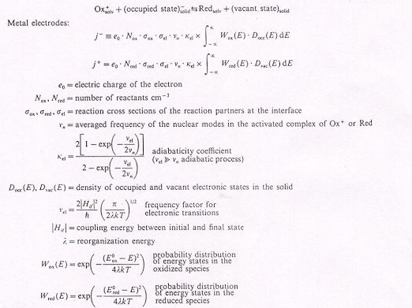
 Rate equation at Metal electrodes
The integrals represents the currents for metal electrodes
→ probability distribution of energy states in the Ox⁺ or Red species.
→ density of occupied or vacant electronic states in the solid

Slide 35
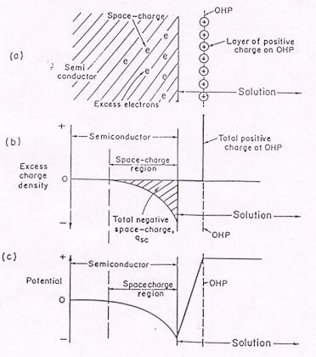
 Semiconductor/Electrolyte Interface
1/C_{dl} = 1/C_{SC} + 1/C_{H} + 1/C_{GC}
The potential due to atmosphere of holes and electrons is given by
= (8πηºe_{o}²/εkT)^{1/2}
χ⁻¹ → Thickness of the Garrett-Brattain space charge inside a semiconductor.

Slide 36
 Effect of potential on the Energy levels of the Semiconductor
 The energy bands near the surface of the Semiconductor are
disturbed by the existence of the field.
 The bending of the bands up or down depends on the sign of
the ionic charge populating the OHP.
 Field penetration exists inside the Semiconductor.
 Field gradient depends on
(i) Density of states
(ii) Surface states
(iii) Adsorption capacity

Slide 37
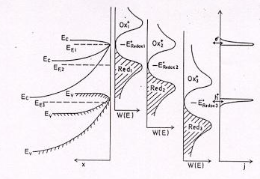
 Electron transfer at Semiconductor electrode/electrolyte interface
Redox system 1 → Eº_{redox} close to CB edge
Accumulation layer
High rate of e⁻ exchange can be expected
Redox system 2 → Depletion layer
Electron transition to Ox⁺ species nor from reduced species reach the conduction band energy.
Redox system 3 → The barrier height for electron is even higher
(close to E_{g} energy)
Eº_{redox} close to VB edge
e⁻ exchange is possible with VB edge.
Reference: H. Gerischer, Electrochimica Acta, 35 (1990) 1677.

Slide 38
 Electron transfer at the Semiconductor/electrolyte interface:
Current via the conduction band
j_{c} = k_{c}^{+ .} N_{c} . N_{red} – k_{c}⁻ . n_{s} . N_{ox}
n_{s} = n_{o} . exp(e_{o}Δϕ_{SC}/kT)
where n_{s} is surface concentration of electrons
Current via the valence band
j_{v} = k_{v}^{+ .} p_{s} . N_{ox} – k_{v}⁻ . N_{v} . N_{ox}
p_{s} = p_{o} . exp(e_{o}Δϕ_{SC}/kT)
where p_{s} is surface concentration of holes
 Equilibrium between the Semiconductor electrode and a redox system/depolarizer in solution can result in a situation where the Fermi level is located in the band gap of the semiconductor.
 Considerable electron transfer can occur only if the redox potential of the redox system is located close to the band edges of a semiconductor.
The rate of electron transfer across the semiconductor/depolarizer depends only the surface concentration of the charge carriers (density of states).
H. Gerischer, Electrochimica Acta, 35 (1990) 1677
A. M. Kuznetsov and J. Ulstrup, Electrochimica Acta, 45 (2000) 2339

Slide 39
 Fermi level and Density of states
The position of the Fermi level determines the chemisorption properties of the surface and controls the equilibrium population of the various species created by the adsorbed species.
By suitable doping of oxides with small amounts of foreign atoms alters the Fermi level which reflects the availability of carrier concentration (density of states) at the surface.
→ accelerated by the rise of F.L – availability of
electrons – n-class or acceptor reaction
→ accelerated by lowering of F.L – availability
of holes – p-class or donor reactions.
 States without intervention of foreign atoms – broken bonds on the surface.

Slide 40
 Selection criteria for Multicomponent system
1. Field gradient
Insulators (10⁵ V/cm)
Semiconductors
Metals (10⁷-10⁸ V/cm)
2. Adsorption capacity depends on the nature of
active site
depolarizer
3. Potential range of application
4. Identifying the possible candidates
 Perovskites, Pyrochlores and Spinels - satisfies the above condition to some extent

Slide 41
Why La_{2-x}M_{x}Cu_{1-y}M’_{1-y}CuO₄ ?
Oxide surface is coordinatively unsaturated hence covered with water molecules in aqueous solution
In order for the depolariser (methanol) to adsorb, the M-OH bond strength should be weak.
M-OH bond strength weak copper containing rare earth perovskite
J. O’M. Bockris and T. Otagawa, J. Electrochem. Soc., 131 (1984) 290.

Slide 42
Electrochemical studies on bulk Sr substituted Lanthanum cuprates
Anodic peak between +0.26 V - +0.5 V
⇒ Cu(2+) →Cu(3+)
Methanol oxidation starts at ~0.46 V vs Hg/HgO
Methanol oxidation to CO₂ was confirmed by charging measurements and carbonate estimation.
V.Raghuveer, K.R. Thampi, N. Xanthapolous, H.J. Mathieu and B. Viswanathan, Solid State Ionics 140 (2001) 263
Cyclic Voltammogram of bulk cuprate in (a) 3 M KOH and (b) 1 M CH₃OH at a scan rate of 25 mVs⁻¹

Slide 43
0 (vacuum level)
E_{(Cu(3+/2+)}
Correlation of Redox potential & Fermi level of the electrode with redox potential of methanol
-3.7
0.8
SrRu
Eº_{red} (CH₃OH)
-3.9
0.6
Ba
Ca
E_{F} = -(4.5eV + eE_{redox})
For effective charge transfer
process to occur – potential has to
be applied to bring the redox
potential of the electrode higher
than that of the redox potential of
the methanol.
Sr
-4.1
SrSb
0.4
-4.5
-0.0
-0.4
-0.4
SrSb
Sr
Ca
Overpotential required for methanol
oxidation onset follows the order
SrSb < Sr < Ca < Ba < SrRu
-0.6
-0.6
Ba
SrRu
-0.8
-0.8

Slide 44
Speculative Mechanism of Methanol Oxidation on the Oxide Surface
⁻OH
O²⁻⎯Cu²⁺ ⎯O²⁻ + OH⁻ → O²⁻⎯Cu²⁺ ⎯O²⁻ --------- (1)
OH- -OH
O²⁻⎯Cu²⁺ ⎯O²⁻ + → O²⁻⎯Cu³⁺ ⎯O²⁻ + e⁻ _-------- (2)
⁻OH ⁻OCH₃
O²⁻⎯Cu³⁺ ⎯O²⁻ + CH₃OH → O²⁻⎯Cu³⁺ ⎯O²⁻ + H₂O ------- (3)
⁻OCH₃ OC
O²⁻⎯Cu³⁺ ⎯O²⁻ + 3OH⁻ → O²⁻⎯Cu³⁺ ⎯O²⁻ + 3H₂O + 4e⁻ ------- (4)
OC
O²⁻⎯Cu³⁺ ⎯O²⁻ → O²⁻ ⎯Cu³⁺ ⎯ + CO₂ + 2e⁻ ------ (5)
O²⁻ ⎯Cu³⁺ ⎯ + 2OH⁻ → O²⁻ ⎯Cu³⁺ ⎯O²⁻ + H₂O -------- (6)
OH⁻
O²⁻ ⎯Cu³⁺ ⎯O²⁻ + OH⁻ → O²⁻ ⎯Cu³⁺ ⎯O²⁻ -------- (7)
OH⁻ OH⁻
O²⁻ ⎯Cu³⁺ ⎯O²⁻ + CH₃OH + 6OH ⁻ → O²⁻ ⎯Cu³⁺ ⎯O²⁻ + CO₂ + 5H₂O + 6e⁻

Slide 45
Sr Substituted Lanthanum Cuprates as Electrode For Methanol Oxidation and Its Comparison with Platinum
CCeramic method, Disk type electrode, Experimental Condition : 3M KOH and 1M CH₃OH
❍ at +0.08 V vs Hg/HgO

Slide 46
Electrophysical and Electrochemical characteristics of substituted lanthanum cuprates
Electrocatalystª
E_{fb}
( V vs Hg/HgO)
E_{F}
(eV)
N_{D}*
(cm⁻³)
N_{D}@
(cm⁻³)
Hole concentration (cm⁻³)
Activity^{c}
I
(mA/cm²)
La₂CuO₄
La_{1.9}Sr_{0.1}CuO₄
La_{1.8}Sr_{0.2}CuO₄
La_{1.7}Sr_{0.3}CuO₄
La_{1.6}Sr_{0.4}CuO₄
La_{1.9}Ca_{0.2}CuO₄
La_{1.9}Ba_{0.1}CuO₄
-0.055
-0.050
-0.050
-0.050
-0.115
-0.088
-4.40
-4.45
-4.45
-4.45
-
-4.46
-4.40
5.86 x 10²⁰
1.08 x 10²²
2.53 x 10²²
4.43 x 10²⁰
-
7.48 x 10¹⁹
1.32 x 10²²
5.86 x 10²⁰
5 x 10²¹
7.75 x 10²¹
1.01 x 10²¹
-
2.76 x 10²⁰
8.80 x 10²¹
-
1.99 X 10²⁰
3.69 X 10²⁰
1.89 X 10²⁰
6.75 X 10¹⁹
8.76 X 10¹⁹
2.40 X 10²⁰
4.0
8.0
14
0.6
0.5
3.3
1.8
ª prepared by conventional ceramic method; ^{b} determined Iodometrically [14];
^{c} at +0.6 V vs Hg/HgO; * w.r.t. ‘ε’ of La₂CuO₄ ; @ ‘ε’ was calculated for all compositions using the formula:

Slide 47
Electrophysical and Electrochemical characteristics of bulk and nanocrystalline strontium substituted lanthanum cuprate
Electrocatalyst
Methanol Oxidation Onset potential(v)
Vs Ag/Agcl
Activity I (mA/cm²) at +0.6 V
Internal resistance (Ωcm²)
Efb(V) Vs NHE
N_{D}
_{(cm}⁻³₎
Bulk
La_{1.8} Sr_{0.2} CuO₄
Nanocrystalline
La_{1.8} Sr_{0.2} CuO₄
0.480
0.400
1.9(1)
5.2(2.7)
0.9
3.2
0.09
(-4.590)*
0.065
(-4.610)*
6.9x10²¹
1.6x10²¹
* Values in the bracket represents E_{F}(eV)

Slide 48
Comparison of Nanocrystalline material with bulk for methanol oxidation
Electrocatalyst
Crystallite Size (nm)
Methanol Oxidation Onset Potential
( V vs Ag/AgCl)
Activity at 0.6 V (mA/cm²)
La_{1.8}Sr_{0.2}CuO₄
(Nanocrystalline)
1-14
0.400
5.2 (3)
Bulk La_{1.8}Sr_{0.2}CuO₄
(ceramic method)
200-800
0.480
1.9 (1)
Oxide/GC, Nafion Binder, catalyst amount – 200 μg
Experimental Condition : 1M KOH and 1M CH₃OH

Slide 49
Summary and Conclusions
Alternative electrode material oxide electrodes – a possible candidate
Semiconductor electrodes - The inherent possibility of altering the valence and the
conduction band positions can be utilized for effective redox processes.
Equilibrium between the semiconductor electrode and a redox system in solution depends
on the location of Fermi level in the band gap of the semiconductor
 The required characteristics for semiconductor/multicomponent system for electrode
application involves
1. Electronic conductivity
2. Considerable density of states so as to give requisite field penetration.
3. Amenable for alteration of the Fermi level by suitable substitutions at cationic lattice positions.
Mixed oxides like perovskites, spinels and pyrochlores to some extent satisfy the above
necessary conditions.

Slide 50
 The Fermi level and density of states can be altered by
(i) suitable substitution at A and/or B site
(ii) decreasing/controlling the particle size
(iii) electrode structure
Can La_{2-x}Sr_{x}CuO₄ be used as anodes for methanol fuel cells?
Lanthanum cuprates cannot be used as anode material at this stage because the methanol
oxidation takes place at higher potential (though reduced to some extent) compared to that of
noble metal.
The present study provides a possible selection criteria for arriving at alternative material as
electrode for fuel cell applications

Slide 51
Methanol oxidation activity comparison of Pt-W_{1-x} Ti_{x}O₃
Electrocatalyst
Amount of platinum
g)
Activity at
+0.6 V
I (mA/cm²)
Activity at +0.6 V
per mg of platinum (mA/cm²)
Pt/C
Pt-WO₃/C
Pt-W_{0.95}Ti_{0.05}O₃/C
Pt-W_{0.91}Ti_{0.09}O₃/C
Pt-W_{0.83}Ti_{0.17}O₃/C
40
60
60
45
21
43
106
33
24
41
1075
1766
550
533
1952

Slide 52
Rate of deactivation of Pt-W_{1-x} Ti_{X}O₃/C (where X=0.0, 0.05, 0.09 and 0.17) for methanol oxidation in acid medium during anodic polarization
Electrocatalyst
Rate of deactivation (mA/min)Polarized at +0.4V vs Ag/AgCl
Pt-WO₃/C
Pt-W_{0.95}Ti_{0.05}O₃/C
Pt-W_{0.91}Ti_{0.09}O₃/C
Pt-W_{0.83}Ti_{0.17}O₃/C
0.05
0.006
0.014
0.04

Slide 53
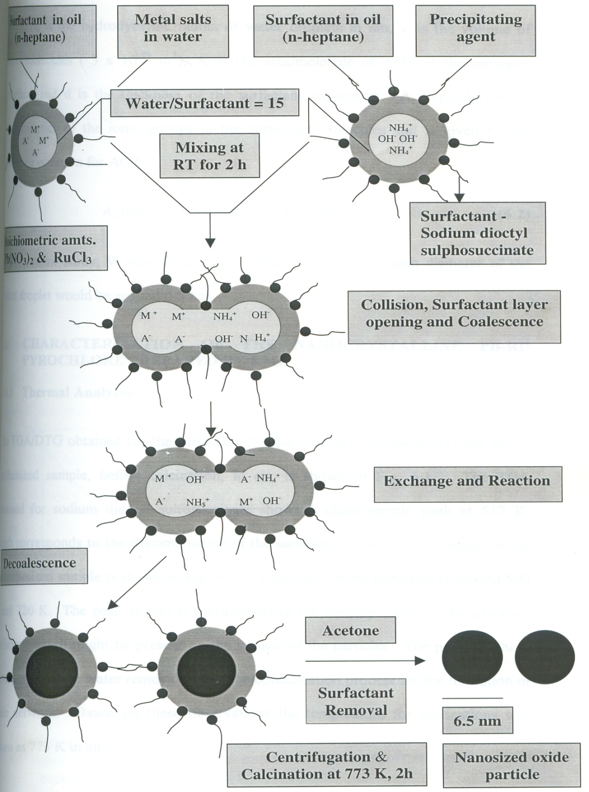
Schematic representation for the formation of nanosized particles in reverse
micellar technique for the composition Pb₂Ru _{1.95} Pb _{0.05} O₇

Slide 54
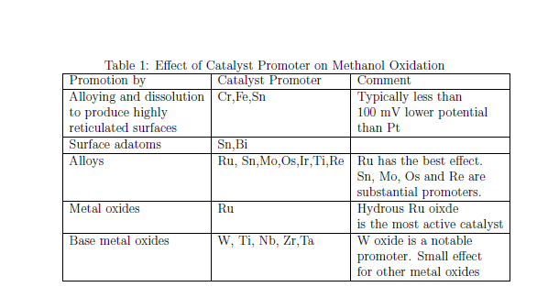

Slide 55
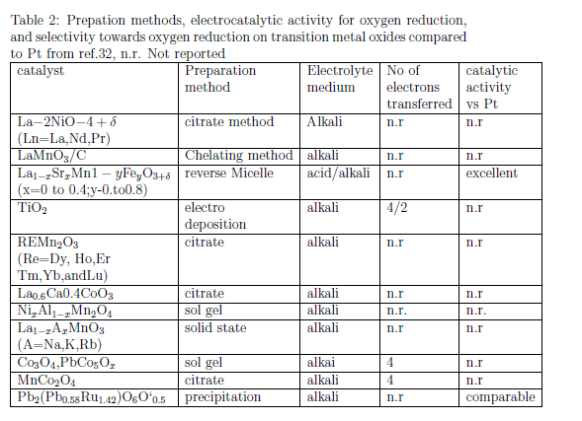

Slide 56
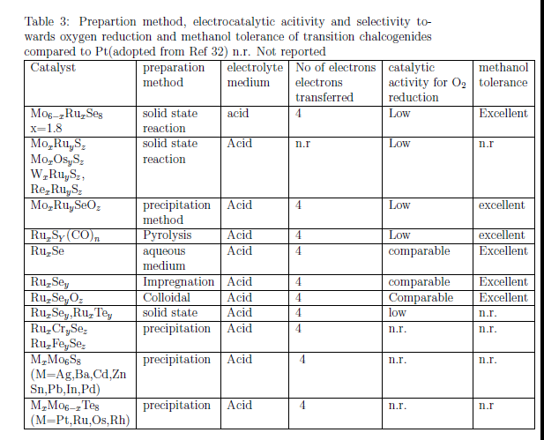

Slide 57
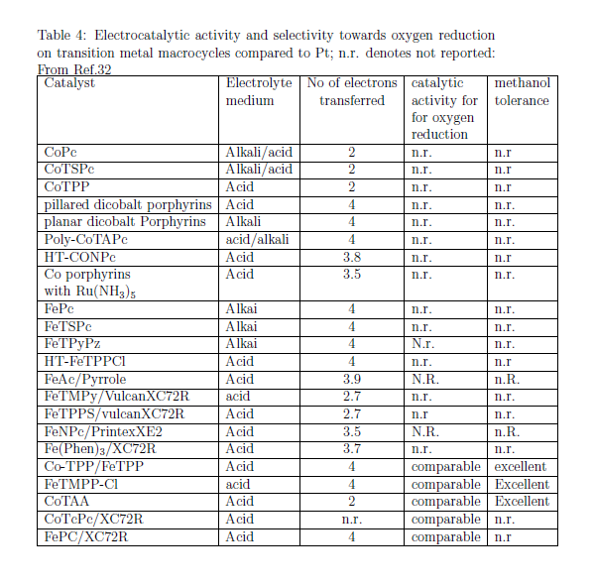

Slide 58
Electrophysical and Electrochemical characteristics of bulk and nanocrystalline strontium substituted lanthanum cuprate
Electrocatalyst
Methanol Oxidation Onset potential(v)
Vs Ag/Agcl
Activity I (mA/cm²) at +0.6 V
Internal resistance (Ωcm²)
Efb(V) Vs NHE
N_{D}
_{(cm}⁻³₎
Bulk
La_{1.8} Sr_{0.2} CuO₄
Nanocrystalline
La_{1.8} Sr_{0.2} CuO₄
0.480
0.400
1.9(1)
5.2(2.7)
0.9
3.2
0.09
(-4.590)*
0.065
(-4.610)*
6.9x10²¹
1.6x10²¹
* Values in the bracket represents E_{F}(eV)

Slide 59
Cathode
Anodes
Non Pt Electro-catalyst
Metal Nitrides
Metal carbides
Co-N-C & Fe-N-C
High activity
High selectivity
High stability
WC, Mo₂C
Metal Oxides
Pd alloy
ABO₃
Pd-M (Fe,Co,Ni,Mo)
Transition metal Macro-cylic compounds
Perovskite oxides
ABO₃ & A₂BO₄
A: Sr,Ba,La,Ce
B: Co,Fe,Ni,Cu,Ru
Active sites
Metal support interactions
Treatment conditions

Slide 60
ISSUES !
POSSIBLE ISSUES WITH EACH OF THEM
MATERIAL – WHICH ONE AND WHY?
COST CONSIDERATION AVAILABILITY STRINGENT CONDITIONS (T,P) TOO MANY REAGENTS OXIDES APPEALING FROM CERTAIN POINTS OF VIEW BUT ELECTROCHEMICAL WINDOW AND MEDIUM ARE STILL ISSUES CARBIDES NITRIDES POSSIBLY WILL SATISFY BUT PREPARTION REPRODUCIBLY IS DIFFICULT MACROCYCLES – COST, SYNTHETIC DIFFICULTY, RETAINING THEM IN THE MEDIUM IS QUESTIONABLE
PREPARATION METHODS ARE STILL NOT YET SIMPLE RELATIVELY LOW CATALYTIC ACTIVITY,DISPERSING THE ACTIVE COMPONENT IN NANO SCALE IS STILL DIFFICULT AND EXPENSIVE CARBON MATERIALS UNIQUE PROPERTIES REQUIRED- MULTIDIMENSIONAL CARBON MATERIALS,OPTIMIZING SYNTHETIC CONDITIONS, PARTICLE SIZE, DISPERSION, MORPHOOLOGY,SURFACE CHARACTERISTICS, ACTIVE SITES

Slide 61
Transition Metal Macro-cyclic Compounds
New synthetic methods like microwave
Increasing active sites like sulfidizing
New reaction media-ionic liquids
Electrochemical performance of non-Pt catalysts
catalyst | E_{1/2} | E_{1/2 methanol} | ΔE_{methanol} | E_{1/2 formic} | ΔE_{formic}
CoTMPP(none) | 0.44 | 0.36 | 0.08 | 0.26 | 0.18
CoTMPP(KOH) | 0.42 | 0.39 | 0.03 | 0.34 | 0.08
CoTMPP(HCl) | 0.41 | 036 | 0.05 | 0.39 | 0.02
CoTMPP (H₂SO₄) | 0.42 | 0.34 | 0.08 | 0.39 | 0.03
CoH₂TMP(none) | 0.45 | 0.41 | 0.04 | 0.40 | 0.05

Slide 62
Metal Carbides
Cost,
Environment-friendly,
energy low
to optimize
surface area,
catalytic structure ( read active sites) doping or surface modification, improved catalytic activity synergestically

Slide 63
WC and Mo₂C unstable catalytic behaviour multiple metal containing carbides nanocomposite metal carbides morphology and structure adsoprtion properties Rh/Ni/Au/WC catalytic activity for {o} of methanol Co tolerance new method of preparation low cost/energy consumption environment

Slide 64
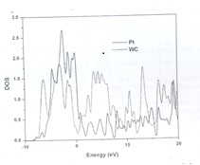
Density of states for Pt and WC above and below the Fermi level ( reproduced from ref 13}

Slide 65
Pd based Alloys
Current density must be increased
Electrochemical stability should be improved
Particle size control
Support on carbides
Morphology
C-C bond break in DAFCs

Slide 66
PERCEPTIONS MAIN CONCERN HAS BEEN ELECTRONIC PROPERTY BUT FIELD STRNGTH FACTOR NOT CONSIDERED WELL DEFINED ELECTRODES ARE NOT APPROPRIATE CHEMICAL IDENTITY NOT THE APPROPRITE PARAMETER ELECTRODE/ELECTROLYTE INTERFACE

