Slide 1


NCCR-The road ahead
7th Annual Day Meet
National Centre for Catalysis Research, IITM
27th July, 2013

Slide 2
NCCR-Progress in a Nutshell
M Tech & Ph D programmes
Orientation Course for research scholars
Special/Refresher/Capsule courses for Students, Faculty & Industry
Training: > 500 persons at different levels
Establishing facilities for research in Catalysis
Contributions: > 200 publications in Journals, 11 patents and 14 books
Analytical services: > 200, to institutions across the nation and many research scholars
Collaboration with Indian and foreign Universities
Many collaborative research projects with Industry
and Govt. & other Institutions in India and abroad

Slide 3
Progress in a Nutshell
NCCR has successfully completed the mandates
Developing Human resources through educational
programmes
Setting up advanced research facilities in Catalysis
Initiating research programmes in frontier areas
Establishing vibrant academia-industry partnership
Charting out a road map for future
Mission accomplished

Slide 4
NCCR-Focus areas
Educational programmes
Research areas relevant to the current & future perspectives
  Energy & Environment
  New materials
  Surface science
  Theoretical Science
Poised to take on new challenges

Slide 5
New vistas for research
Few selected topics-
Concepts and design of active centres
Relevance of nano structures and shapes
Nano materials in agriculture
Bio-routes for fuels & chemicals
The best is yet to come

Slide 6
Design of Catalysts
The approach ……..
Basic functionalities to be built in : Activity, Selectivity, Life, Regenerability, Thermal & Mechanical stability
Selection of catalytic components that generate the functionalities for a specific process- Empirical → Rational
Architectural approach in effective integration of the components.
Scientific basis for selection & integration-theoretical & experimental validation - Significant progress
Concept of active centre
The basis for catalyst design

Slide 7
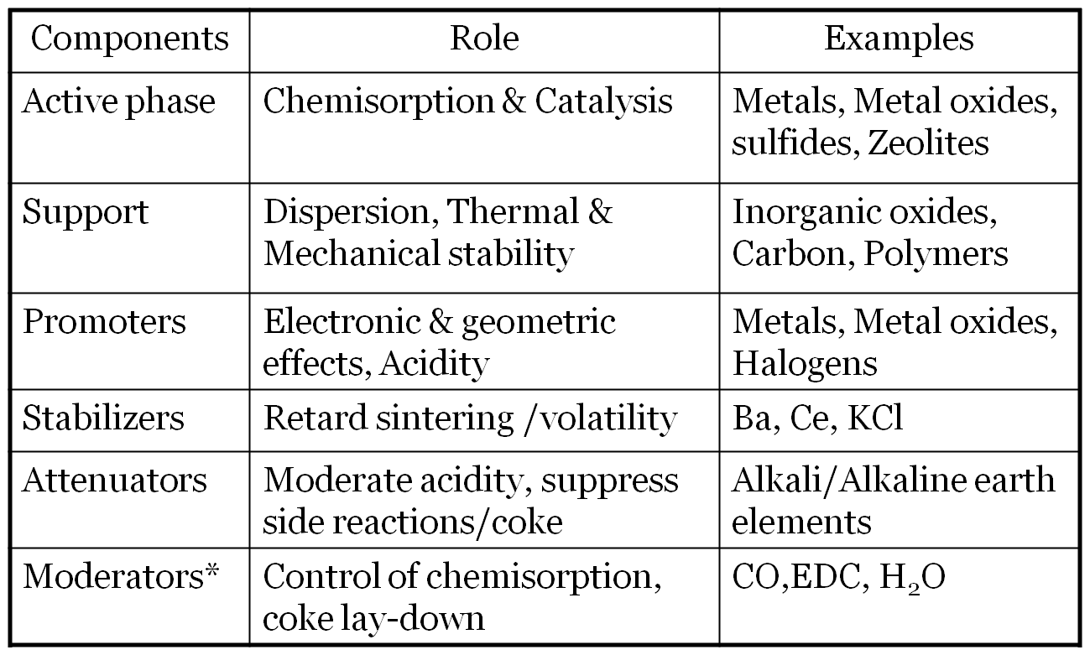
Catalysts-The components
Functional integration of the components- Catalyst architecture

Slide 8
Design of active centres
Process
Mechanistic pathways
Energetics of Reactant-surface
interactions
Theoretical studies
Surface structure
Preparation methods
Surface reactivity
Performance
Well defined morphology
Size & Shape control
Exposure of specific planes
Analytical techniques
Adsorption
Activation
Surface reactions
Desorption
Activity
Selectivity
Stability
Modern approaches

Slide 9
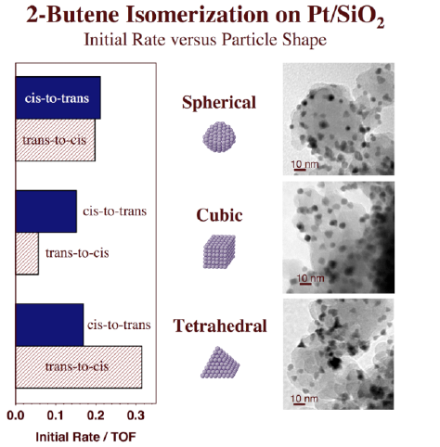
Role of catalyst architecture
Nano particle shape .Vs. Facets
Tetrahedral (111) planes
Cubic (100) planes
Different surface structures
Arrangement of Pt atoms
Interaction with olefins
Theoretical prediction of right surface structure
Thermodynamics favors -trans isomer
Specific surface structure yields -cis isomer
Tuning surface structures with nano science based
Preparation techniques

Slide 10

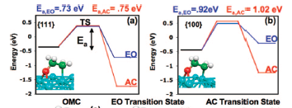

Selective oxidation of ethylene
Surface reaction pathways- Theoretical approach
Oxametallacycle- (OMC)
Potential energy surfaces for transformation of
OMC to AC & EO on a) Ag(111) & b) Ag (100)
Difference in activation barrier for formation of EO &
AC is higher by 0.1 ev on Ag(100) than on Ag(111)
Ag(100) more selective towards EO
JACS,125,4034,2003;130,11264,2008
Reactivity of oxametallacycle determines the EO selectivity

Slide 11
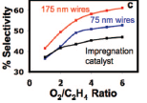
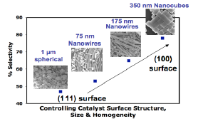
Selective oxidation of ethylene
Role of Nano Ag shape
Conventional Ag particles expose (111)
planes
Ag nanowire preferentially expose (100)
planes-higher surface to volume ratio
Nanowire & Nano cube shaped Ag
display higher selectivity w.r.t spherical
shaped Ag- 65 % Vs 47%
Results supported by transition state adsorption energy calculations for EO & AC on Ag(111) & Ag(100)
Theoretical predictions validated by
experimental results
JACS,125,4034,2003;130,11264,2008
  Surface Structure-Size-Shape .Vs. Activity & Selectivity

Slide 12
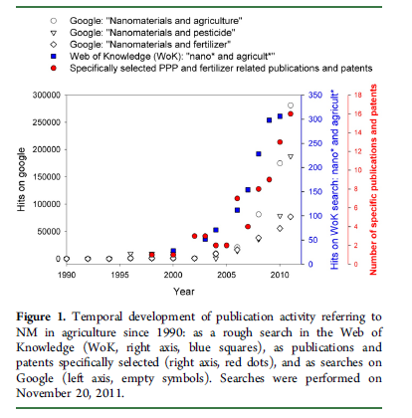
Nano materials in agriculture
J. Agric. Food Chem. 2012, 60, 9781−9792

Slide 13
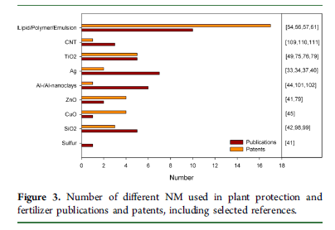
Nano materials in agriculture
J. Agric. Food Chem. 2012, 60, 9781−9792

Slide 14
Nano materials in agriculture
Slow /controlled release of N,P, Ca etc
Carrier for micronutrients, pesticides, inhibitors-delivery/removal
(Colloids and Surfaces B: Bio interfaces 62 (2008) 42–50)
Protection against microbial diseases
Photo catalytic- N₂ fixation, nitrate reduction,
Promote photo synthesis
Applications

Slide 15
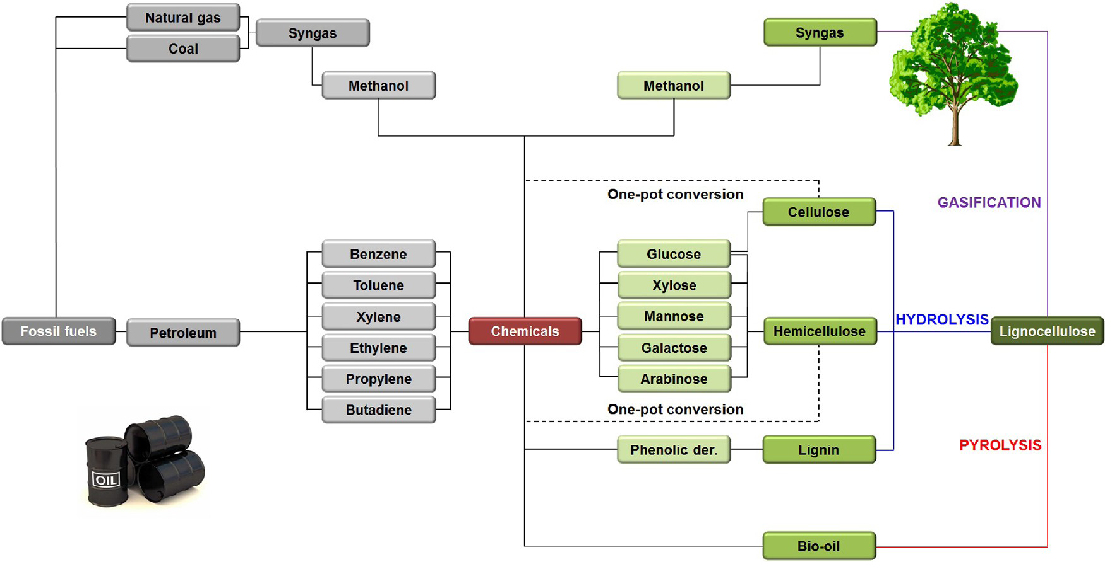
Bio-mass to Chemicals & Fuels
ACS Catal. 2012, 2, 1487−1499

Slide 16
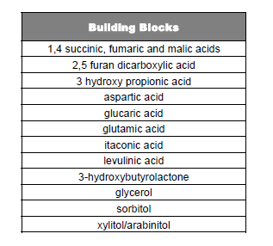
Bio-mass to platform chemicals

Slide 17
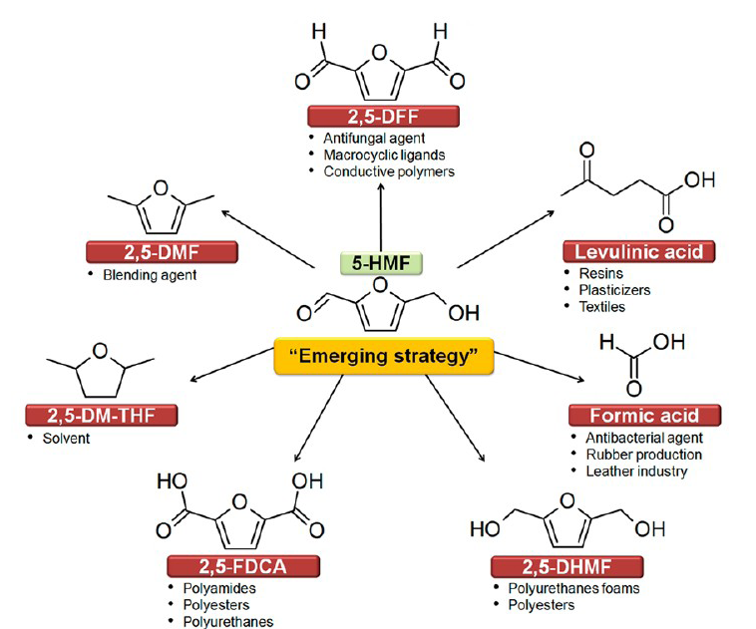
Furan platform- HMF
ACS Catal. 2012, 2, 1487−1499

Slide 18
Renewable p-X,PTA,PET
Bio
feedstock
Bio
P-X
Bio ethanol
Bio
Feedstock
Bio
MEG
Bio-PTA
Bio PET
resin
Plant
Bottle

Slide 19
p-Xylene from Biomass
Anellotech Inc.Process- “Biomass to Aromatics®”
Catalytic high temperature pyrolysis of bio-mass (wood waste, corn stover, sugarcane bagasse) in fluid bed, in the absence of oxygen, with zeolite catalyst. Process at demonstration stage
Gevo Inc. Process
First step consists of low temperature fermentation of sugar solution, enzymatic conversion to iso-butanol. In the second step, a series of dehydration, dimerization and cyclization leads to p-Xylene. Conversion to Iso-butanol proven commercially. Second step under development.
Virnet Energy Systems Inc. Process- Bioforming®
Aqueous phase reforming of C₅ / C₆ sugars to aromatics. Process proven at Pilot scale
Chemsystems,March,2012

Slide 20
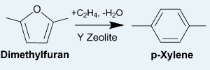
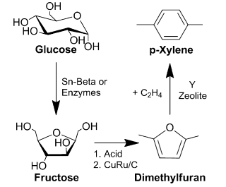
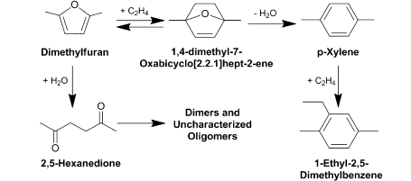
Cyclo addition of Biomass-Derived Furans for
Catalytic Production of Renewable p-Xylene
ACS Catal. 2012, 2, 935−939

Slide 21
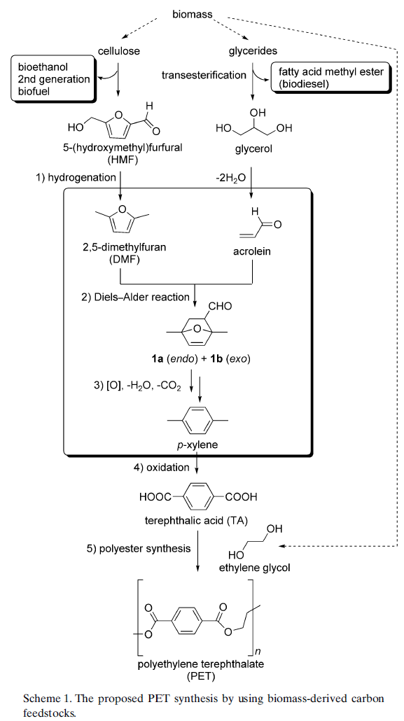
P-Xylene from DMF & Acrolein / Bio Glycerol

Slide 22
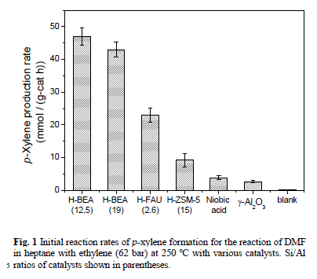
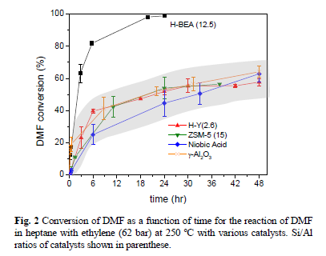
DMF to p-Xylene
Green Chemistry-DOI: 10.1039/c0xx00000x-2013
> 90 % yield of p-Xylene

Slide 23
Research facilities
in-situ- reaction studies by Spectroscopy
Investigations on reaction mechanism

Slide 24
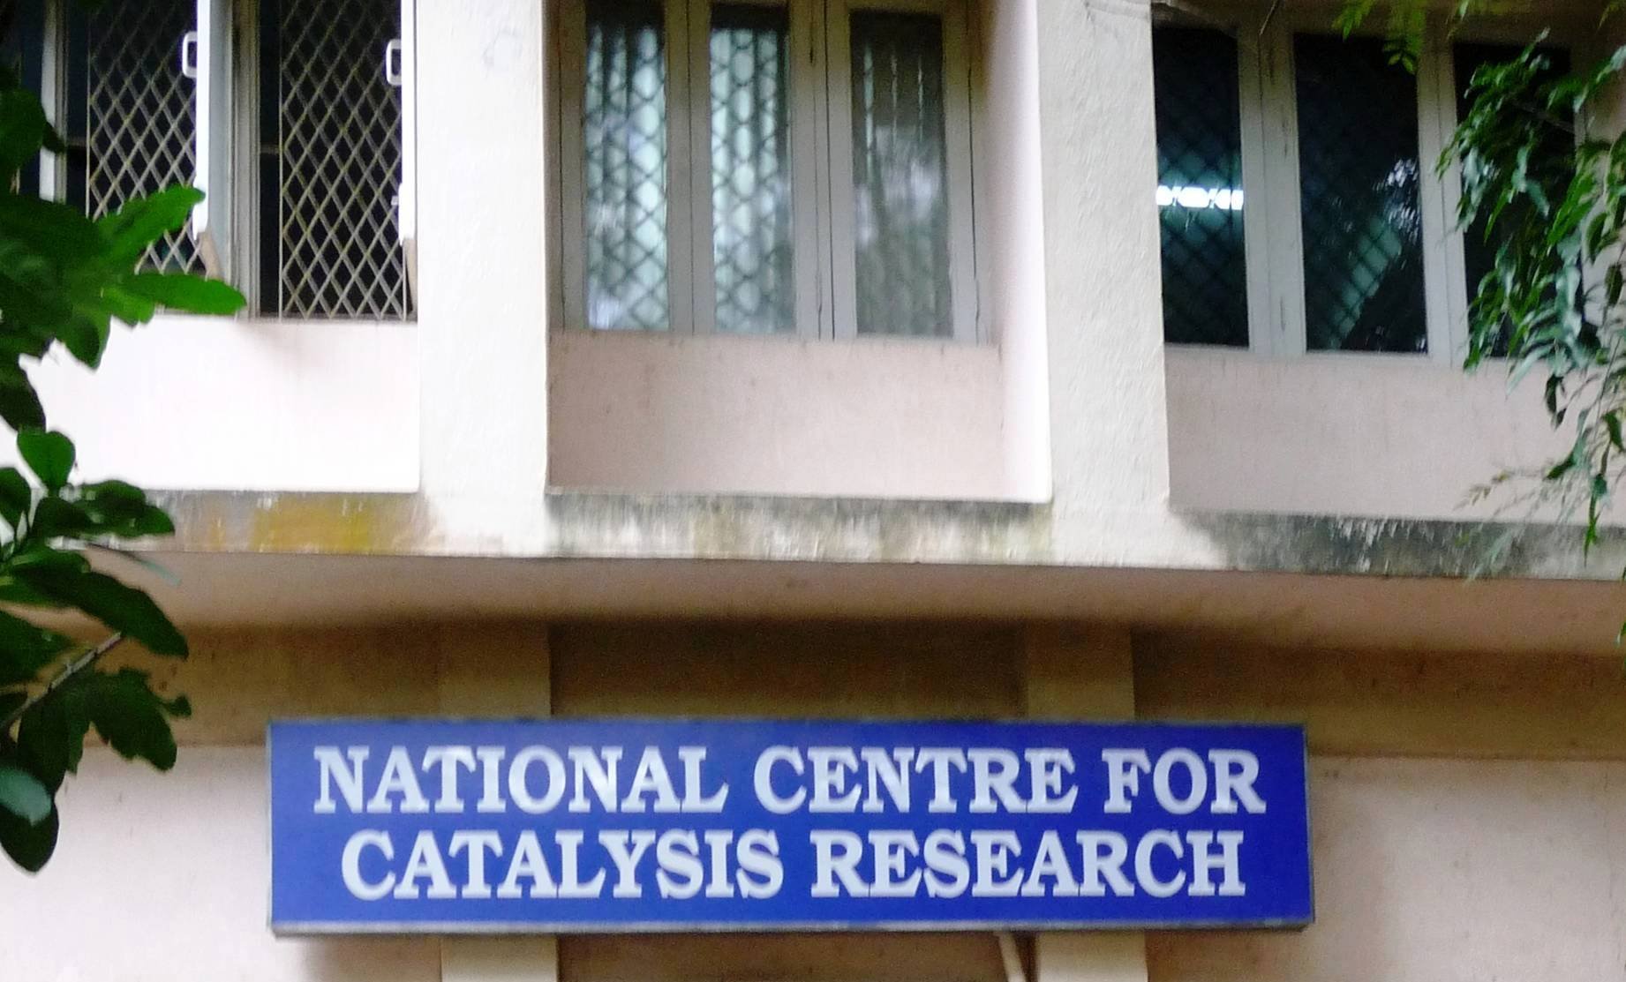
Thank you !

