Slide 1
Graphene and its derivatives for the development of solar cells, PEC and PC applications
De Chen, Hao Zhang, Yang Liu and Jinghong Li
Energy and Environment Sci.,6,1362 (2013)

Slide 2
Graphene –Rising star in material Science
Conductivity, electron mobility, chemical stability, S/V ratio
Single layer of carbon atoms in 2D honey comb network of six membered rings
High transparency, 2600m²/g ballistic transport (massless relativistic particle mobilities 15000 m²V⁻¹s⁻¹
Hall effect, Direac fermions
Surface properties energy storage, sensors, Drug delivery, catalysis

Slide 3
PEC
SC, TiO₂,ZnO,Fe₂O₃,WO₃,CdS,Bi₂WO₄,NaTaO₃
Proven materials but still there are issues economic feasibility, conversion efficiency,
Various modifications, metal loading doping, (anion &cation), sensitization, composite SCs.
Graphene conductive electrodes,PEC, PC.

Slide 4
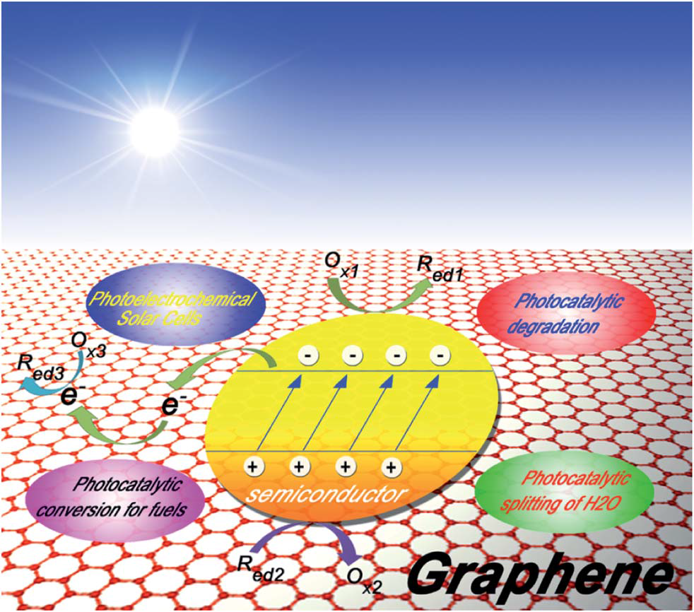
Schematic illustration of graphene-based materials for a wide range of applications in PEC, including photoelectrochemical solar cells, photocatalytic degradation of organic pollutants, photocatalytic splitting of H2O for H2 production, photocatalytic conversion of CO2 for fuels, and so on

Slide 5
Photo-electrochemical properties and processes of graphene-based materials
The first key process is the absorption of photons to create electron–hole pairs
The second key process is the separation and migration of the photo-generated electrons and holes to surface reaction sites, or recombination. The most widely used parameters to characterize this type of transport are the diffusion length of holes and electrons, and the recombination rate. It has been revealed by time resolved spectroscopy (of the order of 10 ⁻⁶ to
10 ⁻¹⁵ s),which can substantially lower the photo-electrochemical activity.
The final key process involves the surface chemical reactions, usually including at
least two reactions, i.e., oxidation by photo-generated holes and reduction by photo-generated electrons, in which several highly reactive species (such as OH radical, O ₂^{-.} , and H2O2 are usually involved.
minimization of electron–hole recombination; band gap tuning; provision of high quality highly adsorptive active sites; and photosensitization. In fact, all four factors were well established in other carbon-based photo-catalysts, and the previous literature has strongly shown that graphene-based semiconductor photo-catalysts are in essence the same as other carbon (carbon nanotubes, fullerenes, and activated carbon)- based semiconductor photo-catalysts in the enhancement of photo-catalytic activity.

Slide 6
Photo-electrochemical applications – Photo-electrochemical solar cells OPV
Graphene based materials as the transparent electrode (80% transparency) proper work fucntion 4.5 to 5.2 eV
ITO 90% transparency R_{s}10-30 ohm per square scare indium, acid reactive brittle nature of oxide
Graphene is used and the data are shown in Table 1

Slide 7
Table 1 Summary of graphene-based transparent electrodes and the PCEs of the corresponding OPVs
----------------------------------------------------------------------------------------------------------------------------
Graphene material Rs (kohm per square) T (%) Device structure PCE (%)
----------------------------------------------------------------------------------------------------------------------------
rGO 100–500 85–95 G/CuPc/C60/BCP/Ag 0.4
rGO 1.6 55 G/PEDOT:PSS/P3HT:PCBM/TiO2/Al 0.78
CVD 0.23–8.3 72–91 G/PEDOT:PSS/CuPc/C60/BCP/Al 1.18
CVD—multilayer 0.374 84.2 G/PEDOT:PSS/P3HT:PCBM/Ca:Al 1.17
CVD—AuCl3 doped 0.5–0.3 97.1, 91.2 G/PEDOT:PSS/CuPc/C60/BCP/Ag 1.63
CVD—acid doped 0.08 90 90 G/MoO3/PEDOT:PSS/P3HT:PCBM/LiF/Al 2.5
CVD—organic molecules doped 0.278 92.2 G/PEDOT:PSS/P3HT:PCBM/Ca:Al 2.58
rGO/CNTs 0.24 86 G/PEDOT:PSS/P3HT:PCBM/Ca:Al 0.85
a G represents graphene or its derivatives (including reduced graphene oxide (rGO), doped graphene, or multilayered graphene, etc.)-based transparent electrode

Slide 8
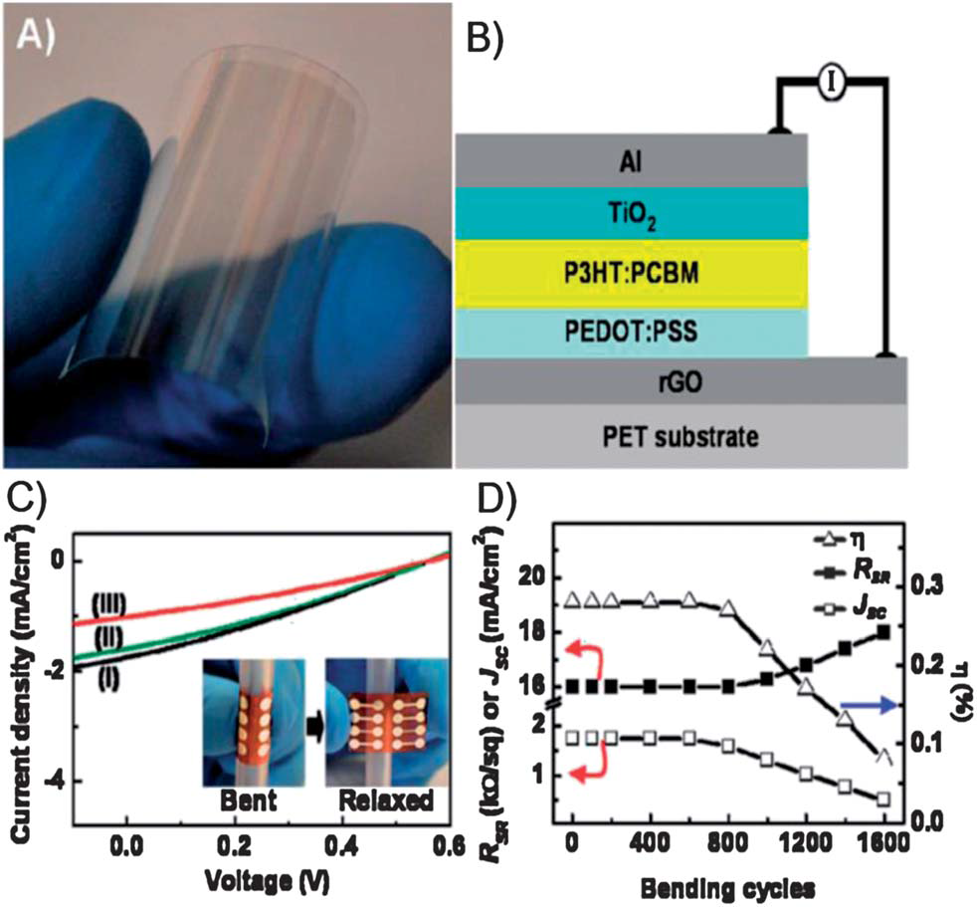
(A) Photograph of rGO/PET; (B) schematic representation of the layer structure of the device, i.e., rGO/PEDOT:PSS/P3HT:PCBM/TiO2/Al, with rGO as the transparent electrode; (C) current density–voltage (J–V) curves of the device after applying (I) 400, (II) 800, and (III) 1200 cycles of bending; (D) the short-circuit current density (Jsc), overall power conversion efficiency (h), and the sheet resistance (RSR) of the device as a function of bending cycles

Slide 9
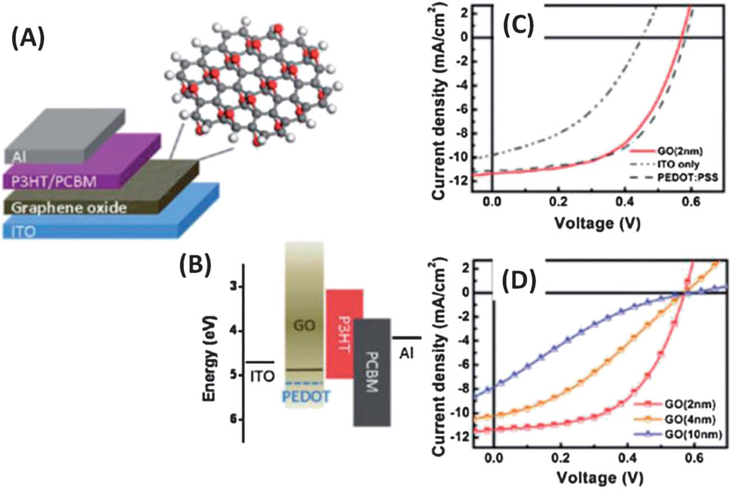
(A) Schematic of the photovoltaic device structure consisting of the following: ITO/GO/P3HT:PCBM/Al. (B) Energy level diagrams of the bottom electrode ITO, interlayer materials (PEDOT:PSS, GO), P3HT (donor), and PCBM (acceptor), and the top electrode Al. (C) J–V characteristics of photovoltaic devices with no hole transport layer (curve labeled as ITO), with a 30 nm PEDOT:PSS layer, and a 2 nm thick GO film. (D) J–V characteristics of ITO/GO/P3HT:PCBM/Al devices with different GO thickness. All of the measurements were under simulated A.M. 1.5 illumination at 100mW cm⁻².

Slide 10
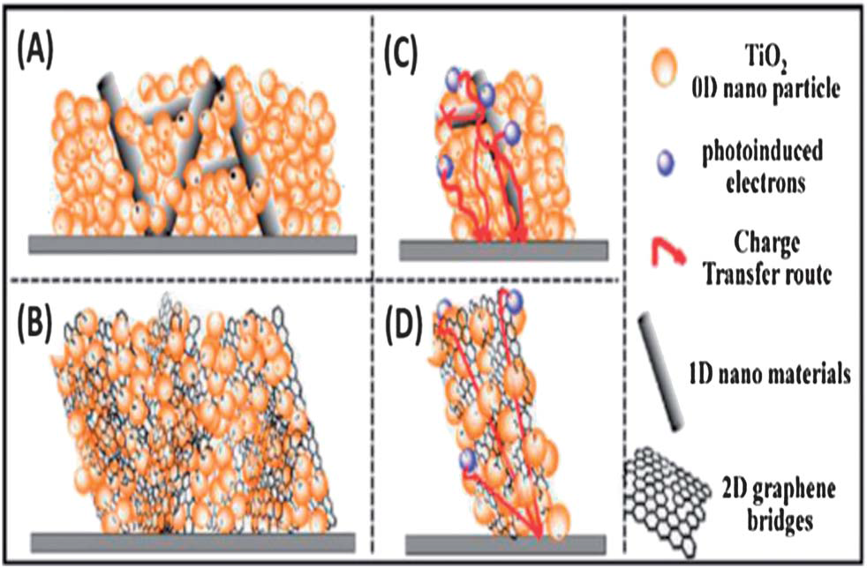
Differences between (A and C) 1D and (B and D) 2D nanomaterial composite electrodes. In 2D nanomaterial composite electrodes (graphene bridges), the TiO2 particles can anchor in the graphene better, and the photoinduced electrons can be captured and transferred by the graphene; however, with the 1D nanomaterial compositing, there are less intermolecular forces and connection between TiO2 and the 1D nanomaterial; therefore, the transfer barrier
is larger and it is much easier for the recombination to happen

Slide 11
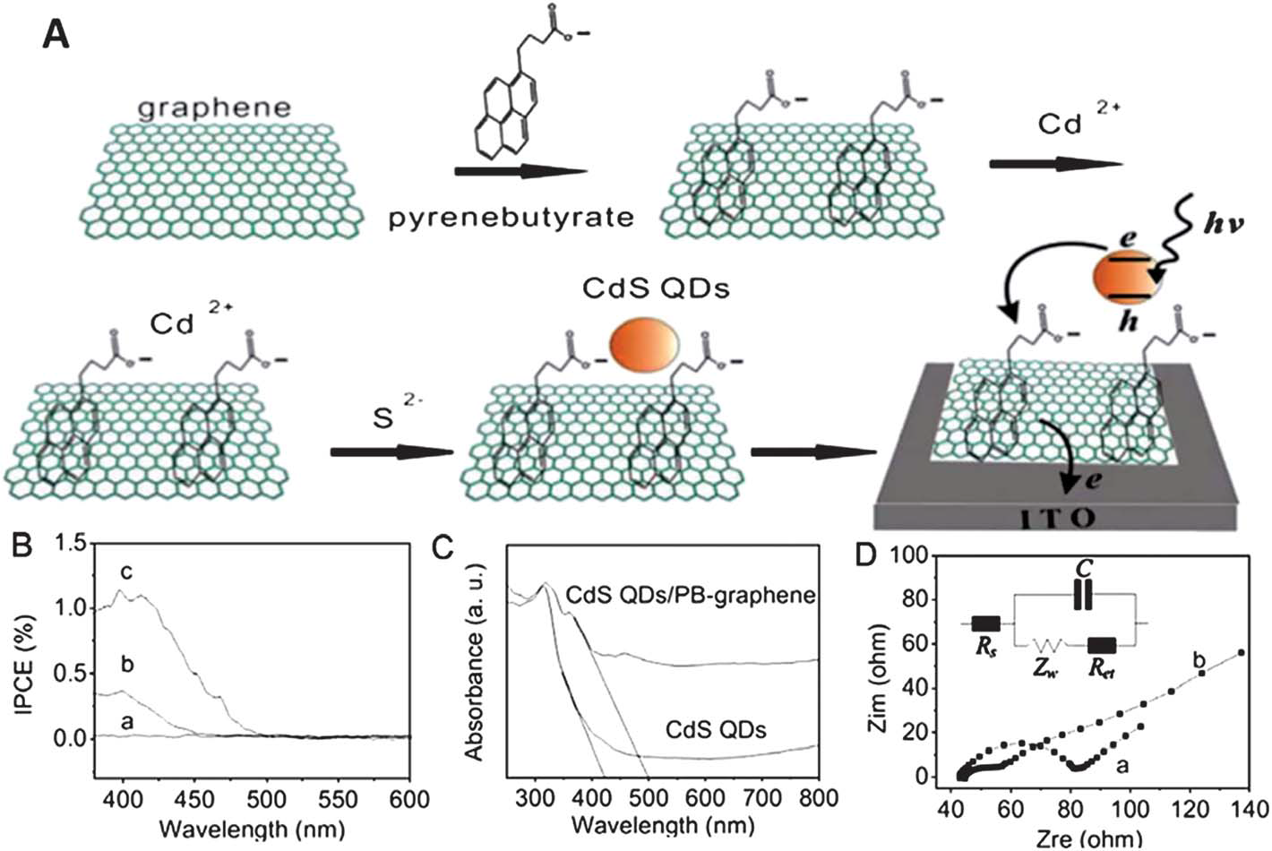
(A) Scheme of in situ growth of CdS QDs on graphene and QDs sensitized graphene photoelectrodes. (B) Monochromatic IPCE (380–600 nm) of PB–graphene
(a), CdS QDs (b) and CdS QDs sensitized graphene photoelectrodes (c). (C) Diffuse reflectance spectra of CdS QDs and CdS QDs/PB–graphene. (D) Nyquist plots of CdS QDs (a) and CdS QDs/PB–graphene (b) film on ITO. Electrolyte: 5mM[Fe(CN)6]3/4 aqueous solution with 100mMKCl. Frequency: from 0.1 Hz to 100 kHz, Amplitude: 10 mV. Inset: general equivalent circuit.

Slide 12
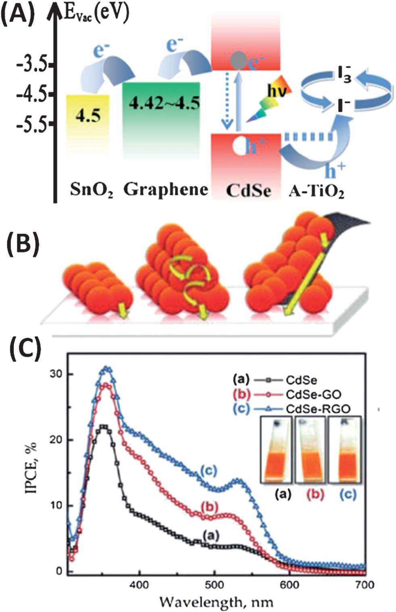
(A) Schematic diagrams for energy level matching in the graphene–CdSe based QDSSCs. (B) Electron transfer routes from photoexcited CdSe QDs to a current-collecting electrode. Electron hopping leads to poor film conductivity in thicker QD films (middle QD cluster). The addition of graphene to QD films should promote improved electron transport to the electrode (right
cluster). (C) IPCE of CdSe, CdSe–GO and CdSe–RGO films. (B and C)

Slide 13
This group reported the photo-degradation of organic compounds (methylene blue (MB)) using TiO2 (commercial P25, Degussa)–graphene (P25–GR) nanocomposites for the first time.
P25–graphene (P25–GR) nanocomposites were obtained via a facile, one-step hydrothermal method using P25 and GO as the starting materials. Compared to the bare P25 catalyst, the P25– GR composite exhibited three advantages. First, the pi–pi stacking between MB and the aromatic regions of graphene enhanced the adsorptivity of the dyes on the surface of the
catalysts (Fig. 7(A)), leading to a synergetic effect between adsorptivity and photoreactivity. Second, the introduction of graphene extended the light responding range of P25 by 30–
40 nm (Fig. 7(B)), facilitating a more efficient visible light driven photocatalysis. The red shi could be attributed to the formation of the Ti–O–C bonds during the preparation.202 Last but not least, P25–graphene showed a decrease in the solid state interface layer resistance and the charge transfer resistance on the surface compared to bare P25, according to the electrochemical impedance spectra (EIS) (Fig. 7(C)). Thus, P25–GR nanocomposites demonstrated significant advancement over bare P25 in the photodegradation of MB dye under both UV and visible light irradiation (Fig. 7(D) and (E)). In view of the high
efficiency achieved in the P25–graphene catalyst, many efforts have been devoted to the growth of TiO2 nanostructures on graphene through in situ or one-pot routes. In most studies,
TiO2 nanostructures were fabricated on graphene via: the hydrolysis of various Ti precursors including TiF4,203 titanium( IV) ammonium oxalate and TiCl4 on graphene; the solvothermal
process;206 or the two step method (hydrolysis of a Ti precursor, e.g. Ti(BuO)4, in the presence of GO, followed by the solvothermal reaction. Moreover, Kamat et al. and Ng
et al. developed the fabrication of TiO2–graphene composites by carrying out UV-assisted photocatalytic reduction of graphite oxide using TiO2 nanoparticles. In addition, other methods, such as the microwave-assisted synthesis211 and the redox reaction between Ti3+ and GO, can be also adopted to form the TiO2–graphene composites.

Slide 14
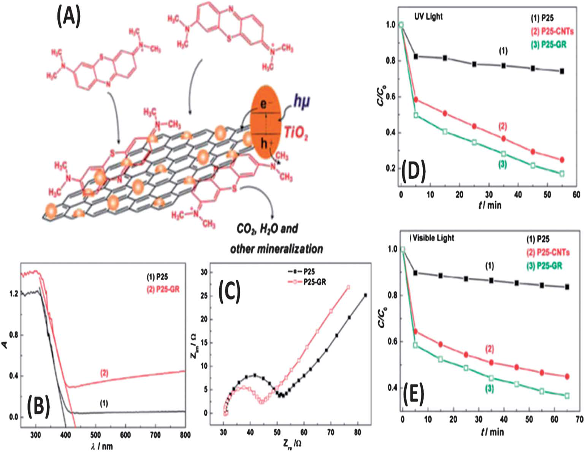
(A) Schematic structure of the P25–graphene composite and tentative processes of the photodegradation of MB, illustrating adsorption of MB on graphene sheets, and the role of graphene. (B) Diffuse reflectance absorption spectra and (C) electrochemical impedance of (1) P25 and (2) P25–GR, respectively. Comparison of photocatalytic activity in the degradation of MB under (D) UV light and (E) visible light over (1) P25, (2) P25–CNTs, and (3) P25–GR photocatalysts

Slide 15
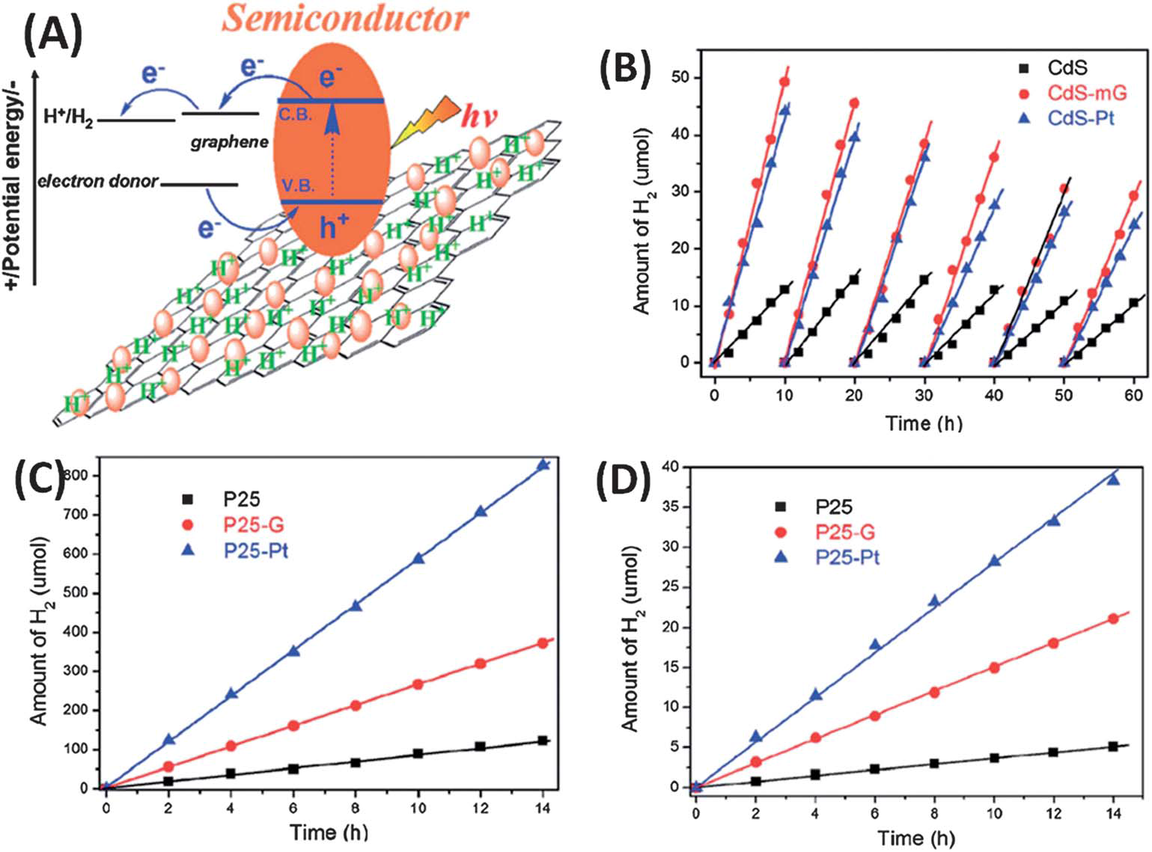
(A) Schematic illustration of the charge separation and transfer in the semiconductor nanoparticle (CdS or TiO2)–graphene system under irradiation; (B) hydrogen production based on CdS nanoparticles, CdS-mG and CdS–Pt composite photo-catalysts in 20 mL Na2S (0.05 M) and Na2SO3 (0.07 M) aqueous solution as a function of irradiation time under visible light irradiation (l > 380 nm); (C and D) hydrogen production based on P25 and its composite photo-catalysts in 30 mL water and methanol (v/v ¼ 2 : 1) solution upon irradiation with (C) UV-vis and (D) visible light irradiation (l > 380 nm), respectively

Slide 16
Photo-catalytic decomposition of organic pollutants: TiO2-graphene based photocatalysts. The photo-catalytic decomposition (also known as photodegradation) of the organic pollutants has been considered as an energy-effective pathway for environmental remediation. The photodegradation process is mainly achieved by the oxidation of organic pollutants by photogenerated radicals (e.g.OH radical anion, _superoxide ion radical) from semiconductor photo-catalysts. Among all the photo-catalysts used in photodegradation, TiO2 is considered as the dominant photocatalyst due to its high oxidation power, low cost and long term stability. However, a large band-gap
(3.2 eV) of anatase TiO2 restricts its use only to the narrow light responding range of ultra-violet (<5% of sunlight). In addition, the carrier recombination in TiO2 should also be suppressed for
a higher efficiency. Graphene nanosheets have been incorporated with TiO2 to form composite catalysts, which exhibit significantly enhanced activities in the photodegradation of the
organic pollutants.

Slide 17
Graphene based materials as electron acceptors- EA and electron donor Hole transporting layer tandem OPV Dye sensitized solar cells Transparent electrodes Quantum dot sensitized solar cells

Slide 18
Conclusion & Prospects Graphene 2004 -1/2D e,T,m,o properies, I,Sc, M [O]/[R] Chemical modification, couple graphene/Sc PEC,PC 1.Facile synthesis/processing 2.Surface microstructure 3.Structural optimizaton 4.Device fabrication

Slide 19
This group reported the photodegradation of organic compounds (methylene blue (MB)) using TiO2 (commercial P25, Degussa)–graphene (P25–GR) nanocomposites for the first time.
P25–graphene (P25–GR) nanocomposites were obtained via a facile, one-step hydrothermal method using P25 and GO as the starting materials. Compared to the bare P25 catalyst, the P25– GR composite exhibited three advantages. First, the pi–pi stacking between MB and the aromatic regions of graphene enhanced the adsorptivity of the dyes on the surface of the
Catalysts. leading to a synergetic effect between adsorptivity and photoreactivity. Second, the introduction of graphene extended the light responding range of P25 by 30–
40 nm , facilitating a more efficient visible light driven photocatalysis. The red shift could be attributed to the formation of the Ti–O–C bonds during the preparation.202 Last but not
least, P25–graphene showed a decrease in the solid state interface layer resistance and the charge transfer resistance on the surface compared to bare P25, according to the electrochemical impedance spectra (EIS). Thus, P25–GR nanocomposites demonstrated significant advancement over bare P25 in the photodegradation of MB dye under both UV and visible light irradiation. In view of the high efficiency achieved in the P25–graphene catalyst, many efforts have been devoted to the growth of TiO2 nanostructures on graphene through in situ or one-pot routes. In most studies, TiO2 nanostructures were fabricated on graphene via: the hydrolysis of various Ti precursors including TiF4,203 titanium(IV) ammonium oxalate204 and TiCl4 205 on graphene; the solvothermal process;206 or the two step method (hydrolysis of a Ti precursor, e.g. Ti(BuO)4, in the presence of GO, followed by the solvothermal reaction)..

Slide 20
Moreover, others have developed the fabrication of TiO2–graphene composites by carrying out UV-assisted photocatalytic reduction of graphite oxide using TiO2 nanoparticles. In addition, other methods, such as the microwave-assisted synthesis and the redox reaction between Ti3+ and GO, can be also adopted to form the TiO2–graphene composites

Slide 21
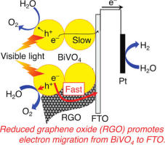

Slide 22
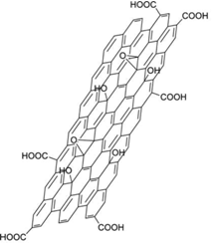

Slide 23
GO also has some other interesting properties. It is an amphiphile with hydrophilic edges that can act as surfactant , it is water permeable and ferromagnetic (which is believed to be produced by the defects on graphene structure). Monolayer GO has a lower Young Modulus value than pristine graphene with a value of approximately 207 GPa and a pre-stress oscillating between 39.7 and 76.8 MPa when an average thickness of 0.7 nm of the sample is tested . Moreover, it is an insulating material (the C–O bonds break the conjugation in the lattice, lateral resistivity values of 105 Ω·cm−1 but, by means of a controlled process of deoxidation, an optically and electrically active material can be produced, turning it into a transparent and conductive sample . The vertical resistivity of GO is an order of magnitude lower than the lateral resistivity . These low values of electrical conductivity are maintained in aqueous solutions, where it shows a value of 17 S/m, a very small value compared to reduced graphene oxide in the same conditions (1250 S/m). This proves a
restoration of the conjugated system .

Slide 24
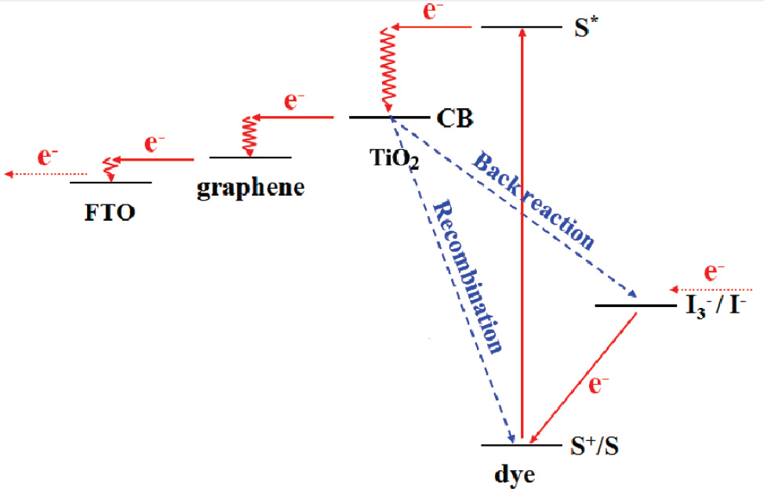
The introduced 2D rGO bridges perform as an electron acceptor and transfer the
electrons quickly. Hence, the recombination and back reaction are suppressed.

Slide 25
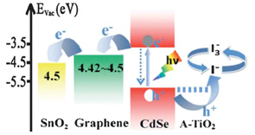
Schematic diagrams of the energy levels in the reduced graphene oxide-CdSe
based quantum dot sensitized solar cell

Slide 26
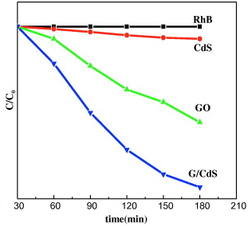
Degradation of Rh. B as a function of catalysis and irradiation time

Slide 27
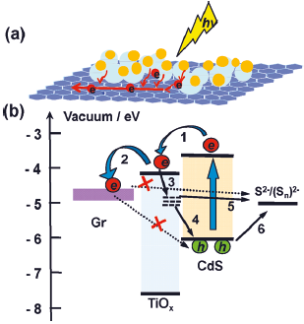
Schematic representation of photo-generated electron transfer processes in a
layered reduced graphene oxide/quantum dot (QD) structure with TiOx interlayer (a) and
the Energy Band Diagram (b) showing the main electronic processes at the interface in
QDs: (1) Electron injection; (2) electron transfer; (3) Trapping of the electron at surface
states; the two charge recombination pathways of trapped electron recombination with;
(4) the hole at the valence band of QDs and; (5) the oxidized redox couple; (6) hole extraction.
The recombination between the electron at Fermi level of rGO and the hole at the valence
band of QDs and the oxidized redox couple was inhibited by TiOx layer

Slide 28
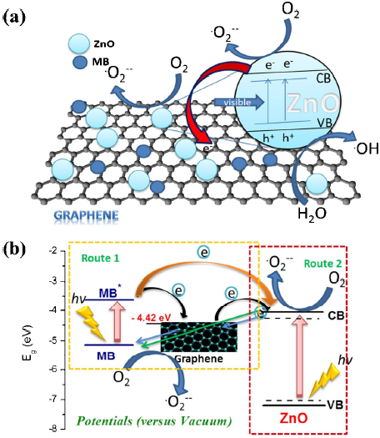
Two proposed mechanisms for the photodegradation of MB by rGO/ZnO
composite under visible light and energy diagram of excited MB, graphene and the
conduction band of ZnO. (a) The excitation of the semiconductor produced by light
irradiation generates an electron-hole pair. The reaction with the organic pollutant takes place
in the movement of those charges towards the particle surface. (b) The dye, which act as a light
sensitizer, is excited and transfers electrons. It becomes a cationic radical that self-degrades

Slide 29
Graphene and its derivatives combine a numerous range of supreme properties that can be useful in many applications. The purpose of this presentation is to analyse the photoelectrochemical properties of pristine graphene, graphene oxide (GO) and reduced
graphene oxide (rGO) and their impact on semiconductor catalysts/quantum dots. The mechanism that this group of materials follows to improve their performance will be cleared by explaining how those properties can be exploited in several applications such as
photo-catalysts (degradation of pollutants) and photo-voltaics (solar cells).

Slide 30
Graphene, a single layer or few layers of graphite with sp2 carbon atoms packed in a honeycomb
crystal lattice , has unique properties, since it was first isolated in 2004 . In order to exploit these properties, potential applications are being developed.
An example of that is photo-detectors and plasmonic devices, which are based on its electrical and optical properties. The material has different interesting properties such as large surface area (2630 m2 g−1) , gas impermeability, very high thermal conductivity (>3000 W mK−1), and
extremely high Young’s Modulus (1 TPa), amongst others .
Electrical and optical properties are two of the most novel convenient advances for photocatalysis. Since the electronic structure of a single layer of graphene (SLG) overlap between two conical points in the Brillouin zone, the charge carriers can be understood as mass-less electrons or Dirac fermions . Graphene monolayers have an electrical conductivity of (4.84–5.30) 103 W mK−1 and charge mobility of ≈200,000 cm2 V s−1. Besides, charge density can be controlled with a gate electrode and it has ballistic transport (negligible electrical resistivity). It is ambipolar (“charge carriers can be alternated between holes and electrons depending upon the nature of the gate voltage”) and, finally, has anomalous quantum hall effect . Regarding the optical properties of graphene, it almost has total transparency. A SLG can absorb a 2.3% fraction of light with a very wide spectral width. Besides, its high operating bandwidth allows to process data at high velocities . Moreover, the absorption range can be modified in double-layer graphene by tuning the electrical gating. Therefore, by means of an external gate field, the Fermi energy levels of graphene are changed

Slide 31
Functionalization graphene by functionalization . The reactivity of graphene is not fully understood yet but in order to generate covalent bonds from pristine graphene, it requires the breaking of a sp2 bond. In the adjacent regions to that break point, reactivity is enhanced, as well as the geometrically strained regions. However, it is remarkable that rGO and graphene oxide (GO) have oxygen groups that act as reactive regions.

