Slide 1
Selective hydrogenation of cinnamaldehyde to cinnamyl alcohol
Presented by
V Surya Kumar (CA11M005)
Under the guidance of
Dr. K.R.Krishnamurthy
&
Dr. Preeti Aghalayam
National Centre for Catalysis Research
Indian Institute of Technology, Madras

Slide 2
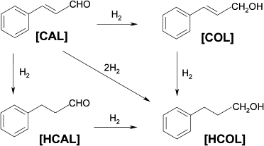
Reaction scheme
Olefinic group
Carbonyl group
G = 118 KJ/mol
Desired rex
G = 80.71KJ/mol
Desired product
undesired rex
undesired rex
G = 37.79 KJ/mol
G = 0.49KJ/mol
CAL=cinnamaldehyde, COL=cinnamyl alcohol, HCAL= hydrocinnamaldehyde,
HCOL=hydrocinnamyl alcohol
Notes:
Antibiotic chloromyctin, cinamates(ester) in flavor and fragrance, --- HCAL – cinnamic acid – protease inhibitor for treatment of AIDS

Slide 3
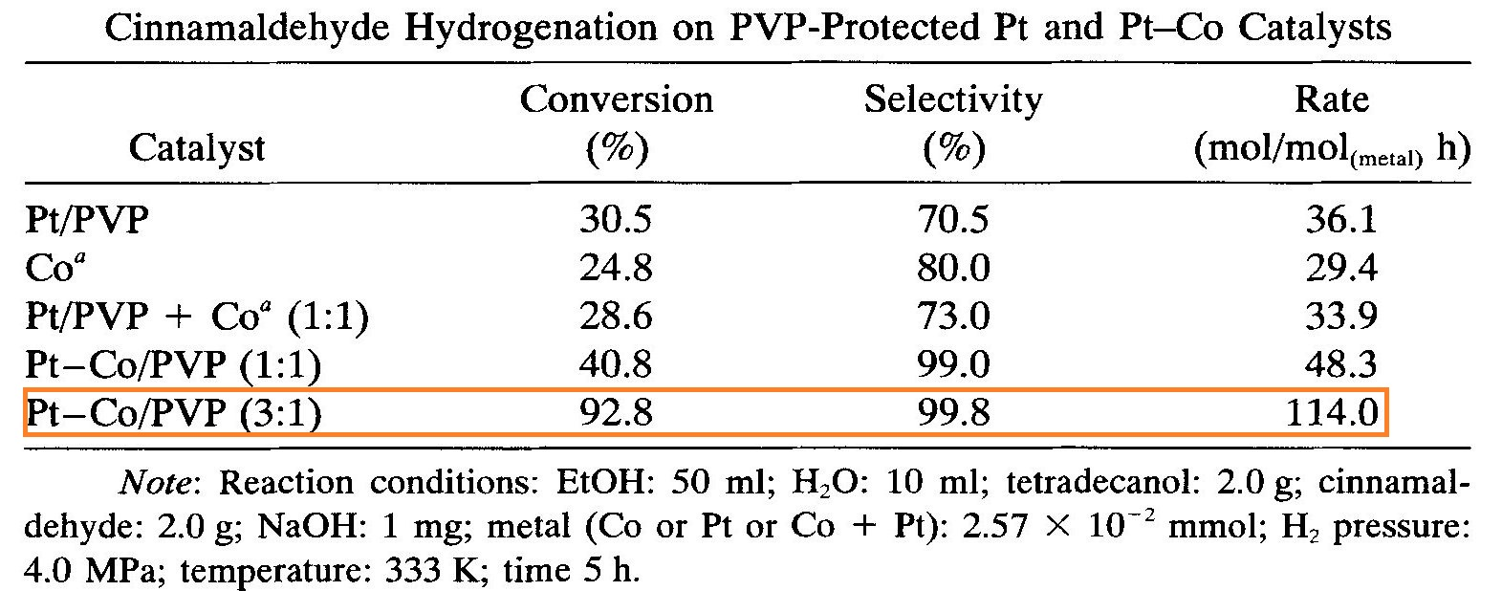
Reduction using Stoichiometric reagents
Sodium borohydride
MPV reduction (Meerweil-Ponndorf-Verley Reduction)
Heterogeneous catalyst : Best catalyst known from litrature
0.03 S⁻¹
Ref. W. Yu, Y. Wang, H. Liu, and W. Zheng, J. Molec. Catal. A, 112, 105 (1996).

Slide 4
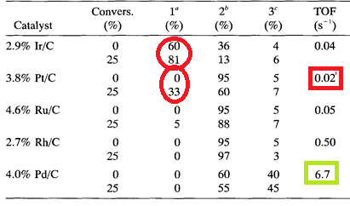
Problem for Research
a=Cinnamyl alcohol, b=hydrocinnamylaldehyde, c=hydrocinnamyl alcohol
T= 60ºC , P = 4 MPa, cinnamaldehyde=13.2g in 37.5 ml isopropanol and 10 ml H₂O, 400 mg of catalyst.)
Ref-A. Giroir-Fendler, D. Richard, and P. Gallezot, in Heterogeneous Catalysis and Fine Chemicals (M. Guisnet, J. Barrault, C. Bouchoule, D. Duprez, C. Montassier, and G. Perot, eds.), Studies in Surface Science and Catalysis Vol.41, Elsevier, Amsterdam, 1988, p. 171.

Slide 5
Aim and scope of the project
To design Pd based catalyst which will be selective for
Cinnamyl alcohol while retaining its high activity.
Experimental approach
To prepare, characterize and test performance of following catalysts
Shape controlled Pd/Hydrotalcite(HT) (3.6 and 1w%)
Tetrahedral Pd/HT
Octahedral Pd/HT
Spherical Pd/HT

Slide 6
2) Pd supported on different phases of titania
1%Pd/P25
1%Pd/Anatase
1%Pd/Rutile
3) Bimetallic systems
1%Pd-Ag/P25
1%Pd-Au/P25
To compare performance of above mentioned catalysts
following catalysts were prepared, studied
1%Ag/P25
1%Au/P25
1%Pd/Al₂O₃
1%Pd/SiO₂

Slide 7
Preparation of Tetrahedral Pd/HT
nPd/nMg/nAl molar ratio = 2/66/33
Step 1
Dissolve in 45mL water
0.750g(2.93 mmoles) of Mg(NO₃)₂ ·6H₂O
0.5485g(1.46 mmoles of Al(No₃)₃ .9H₂o
Step 2
Disolve in 5mL water
Solution B
0.01571g(0.0884 mmol) PdCl₂
Step 3 mix Sol A and Sol B
1.439g(10.2mmoles) of HMT
Solution A
0.01035g(0.17 mmol) of NaCl
Transfer sol A + Sol B into 100mL autoclave and keep at 150 ^{O}C oven for 6 h.
Step 4
allow Autoclave to cool, than wash the ppt till filtrate pH=7, than dry the ppt over night at 100 ^{O}C.
Notes:
Hydrotalcite is a LDH support, it is highly basic in nature because of presence of large no of hydroxyl groups, Shape controlled Pd- different shapes have different edges corners hence different dispersion and different plane facets giving rise to different activity.

Slide 8
Preparation of Octahedral Pd/HT
Same as tetrahedral Pd/HT, except for addition of CTAB1.3g(3.5mmol)
into the reaction mixture.
Preparation of Spherical Pd/HT
3.6%Pd/HT
Firstly hydrotalcite support is prepared separately followed by
impregnation of Na₂PdCl₄ and its reduction by formaldehyde.
1%Pd/HT
Firstly hydrotalcite support is prepared separately followed by
impregnation of H₂PdCl₄ and its reduction by polyol process.

Slide 9
Mechanism (precipitation – reduction method)
Mechanism of surfactant action in Octa-Pd/HT
Ref. J. Phys. D: Appl. Phys. 45 (2012) 385302 (6pp)
Notes:
Decomposition of HMT gives ammonia and formaldehyde – ammonia increases PH as a result Al⁺³ and mg⁺² getS ppt as hydroxides, formaldehyde reduces Pd⁺² ,
The shape of particle can be controlled either thermodynamically or kinetically based on the rate of reducing agent production in-situely, when decomposition of HMT is high formaldehyde production is high so reduction is high rate so kinetic control and anisotropic structures may form when rate of reduction is low than thermodynamically favotred tertahedral geometry are obtained. When CTAB is used the bromide ions adsorb to the palladium seeds and alter their surface free energy and lead to formation of octahedral morpholohy, in terahedral we see only 111 plane whereas in octahedral we see both 111 and 100 planes.
When CTAB is added the bromide ions present in CTAB adsorb on seed of Pd and alter the free energy and we get octahedral geometry.

Slide 10
XRD comparing a) Octahedral Pd/HT b) Tetrahedral Pd/HT c) Hydrotalcite
D) Incert view(38-42. 2 theta angle)
Notes:
We can see small sliver of pd 111 at angle 40, this sliver is less instance in octahedral because some pd are also present. For the selectivity 111 are important as the configuration of cinnamaldehyde is approaching end-on onto 111 which we shell see in simulation part, and it is observed in acetylene hydrogenation that from P111 is selective because ethylene gest desorbed quickly from 111 and presence of 100 is not good for selectivity because they enhance presence of subsurface hydrogen which are highly reactive and will further hydrogenate unsaturated alcohol to saturated alcohol.

Slide 11
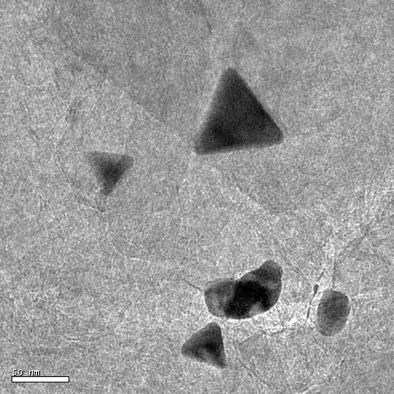
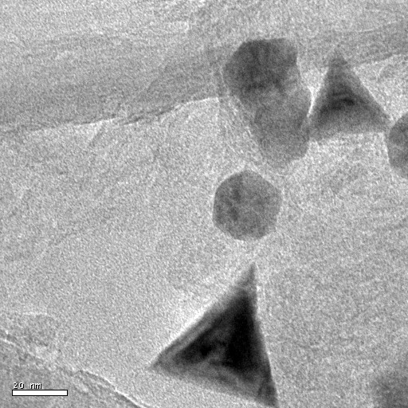
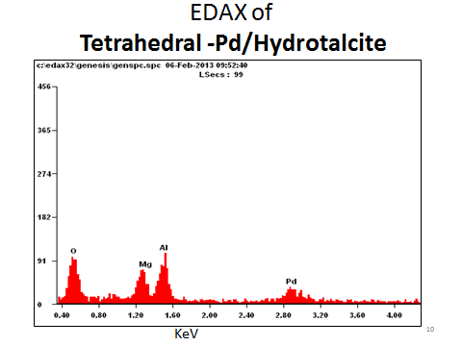
TEM images of Tetrahedral Pd/Hydrotalcite
EDAX FO tetrahedral Pd/HT
Crystallite size distribution of tetrahedral Pd/HT

Slide 12
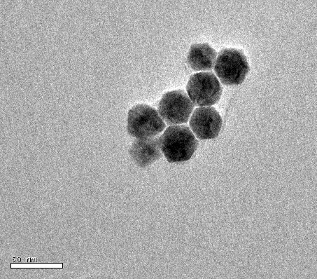
TEM image & crystallite size dist. of octahedral Pd/Hydrotalcite

Slide 13
TEM image &crystallite size dist. of Spherical Pd/Hydrotalcite

Slide 14
Consumes 6.69mmol/g of H₂
TPR of octahedral 3.6%Pd/Hydrotalcite

Slide 15
Preparation of 1.5%PVP Protected-Pd/TiO₂-P25
PVP/Pd molar ratio = 1:150
Add(250mmoles) 15 ml Ethylene glycol
Dissolve (1.25μmoles) 50 milligrams of PVP
Lastly add 0.31M NaOH (1.5mL) Stir the mix for ½ h at 60 ºC
followed by impregnation of Pd colloid on 1.98g of TiO₂-P25
Preparation of H₂Pdcl₄ (in RB flask) Conc.HCl(0.608mmoles)(50μl) + PdCl2(0.282mmoles)(50mgram)
Eº/V= -1.65eV
Pd⁺² Pd Eº/V= 0.951
Notes:
PVP – importance of PVP, it helps control the size of colloid depending on temp, PH, reduction time.., it protects colloid not to get agglomerated. Ethylene glycol – acts as a solvent and reducing agent.
NaoH importance – it helps accelerate the reduction by enhancing the decomposition of ethylene glycol and control the size depending on concentration.
Green process as no need to spend energy for hearing the rex as reductoin occurs at room temp, no need of further calcinatoin.
Ethanol <=> Acetaldehyde + 2H⁺ + 2e⁻ (E0' = +0.197 V) aldehyde to acetate is 0.6 pd+2 ------ pd is 0.95

Slide 16
1%Pd/P25, 1%Pd/Anatase, 1%Pd/Rutile, were prepared as 1.5%Pd/P25 were prepared using polyol method.
Bimetallic systems
1%Pd-Ag/P25
1%Pd-Au/P25
Bimetallic catalysts were also prepared using polyol method .
Pd/Ag Molar ratio = 4:1
Pd/Au Molar ratio = 4:1

Slide 17
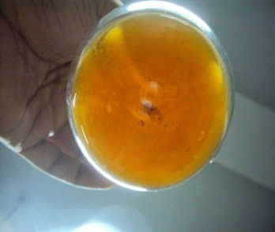
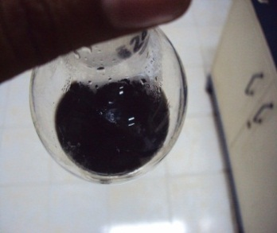
Characterization
UV–Vis spectral analysis
UV-VIS of Pd colloid a) before reduction b) after reduction
Notes:
Pd⁺² shows d-d inter band transitions (pd+2=4s2, 4p6, 4d7, 5s1) at 325 nm and 440nm. And disappearance means reduced Pd is present. While recording one must be careful about the concentration – it should be low in the range of milimoles.

Slide 18
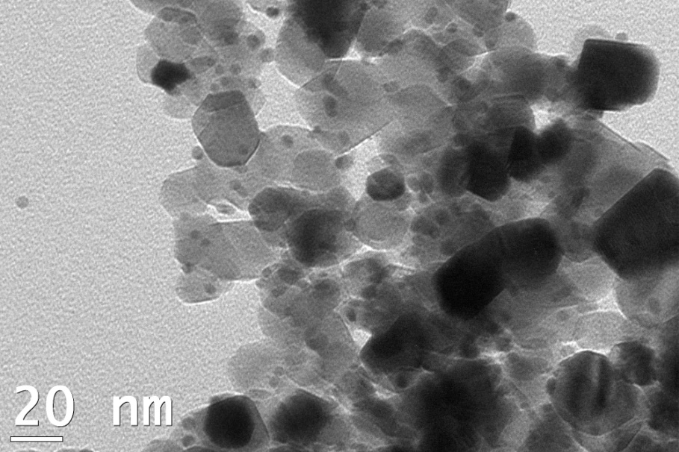
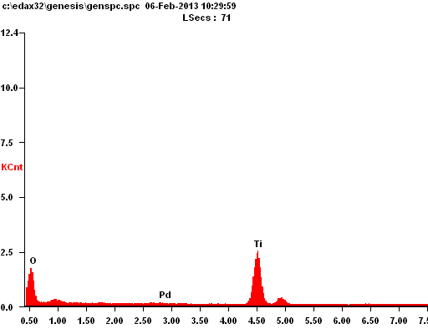
EDAX
TEM image and crystallite size dist. Of 1.5% Pd/ P25

Slide 19
TEM image and crystallite size dist. of 1% Pd/ P25

Slide 20
Reduction: at T=300^{O}C, Time=3h in H₂ atmosphere
TEM image and crystallite size dist. of Reduced 1%Pd/P25

Slide 21
TEM image and crystallite size dist. of 1%Pd-Ag/ P25

Slide 22
TEM image and crystallite size dist. of 1%Pd-Au/ P25

Slide 23
70ºC
0.12mmol/g H₂ consumption
TPR of 1% Pd/TiO₂ P-25

Slide 24
H₂ consumption
Pd-Ag = 1.061mmol/g
Pd-Au= 0.91mmol/g
290.20 ºC
286.14ºC
TRP of 1% Pd-Ag/TiO₂ P-25, 1% Pd-Au/TiO₂ P-25

Slide 25
H₂ consumption = 3.71mmol/g
TPR of 1% Pd/Anatase

Slide 26
XPS of 3d Pd of 1%Pd/Anatase, 1%Pd/TiO₂-P25, 1%Pd-Au/TiO₂-P25

Slide 27
Binding energy of 3d Pd in 1%Pd/TiO₂-P25, 1%Pd/Anatase, 1%Pd-Au/TiO₂-P25, 1%Pd/TiO₂-P25 used at 100ºC
Catalyst | BE of Pd 3d_{5/2}(eV) | BE of Pd 3d_{3/2}(eV)
Pd Standard | 335 ± 0.2 | 340± 0.2
1%Pd/P25 | 335.40 | 340.43
1%Pd/Anatase | 335.33 | 340.72
1%Pd-Au/P25 | 335.02 | 340.36
1%Pd/-P25 used at 100^{oC}C | 335.47 | 340.87

Slide 28
Deconvolution of Pd 3d peak 1%Pd/P25
Surface % ratios of Pdº and Pd⁺²
%Pd⁰ | %Pd⁺²
54 | 46

Slide 29
Deconvolution of Pd 3d peak 1%Pd/Anatase
%Pd⁰ | %Pd⁺²
50.5 | 49.5

Slide 30
Deconvolution of Pd 3d peak 1%Pd-Au/P25
%Pd⁰ | %Pd⁺²
66 | 34

Slide 31
UV-Vis DRS of 1%Pd/TiO₂-P25, 1%Pd-Ag/TiO₂-P25, 1%Ag/TiO₂-P25, 1%Pd-Au/TiO₂-P25 and 1%Au/TiO₂-P25.

Slide 32
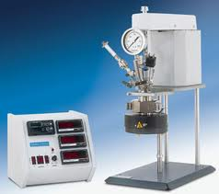
Testing of Catalysts
Prepared catalysts are being tested by carrying out hydrogenation of
cinnamaldehyde in a Parr Reactor
Obtained products are analyzed using Perkin Elmer GC with
RTX 5-ms column.

Slide 33
Calibration of GC
Mixture of reactant and products
HCOL
HCAL
Reactant
COL

Slide 34
Optimization of reaction conditions

Slide 35
Initial reaction conditions
Catalyst name | Conversion% | Selectivity% |  |  | TOF(s⁻¹)X 10⁻³
 |  | HCAL | HCOL | COL | From TEM
3.6%T Pd/HT | 100 | 78.9 | 20.8 | 0.3 | 9.9
3.6%O Pd/HT | 100 | 78.3 | 21.5 | 0.2 | 9.432
3.6%S Pd/HT | 100 | 71 | 22.7 | 6.3 | 2.346
1.5%Pd/TiO₂-P25 | 100 | 7.3 | 19.5 | 73.2 | 3.158
T=120 C, Catalyst wt. = 150g, P=10bar, time=1h, solvent(methanol)=13g
Reactant = 1.2g.

Slide 36
Effect of reactant weight
T=100 C, Catalyst wt. = 40g, P=10bar, time=1h, solvent(methanol)=13g
Reactant = 2.4g, as-synthsised catalyst
Catalyst | Conversion% | Selectivity%
 |  | HCAL | HCOL | COL | ACL
1%Pd/P25(1.2g) | 96.1 | 3.9 | 11.6 | 81.1 | 3.4
1%Pd/P25(2.4g) | 69.4 | 12.7 | 5 | 57.7 | 24.6
Acetal of cinnamaldehyde

Slide 37
Effect of Pre-reduction
Catalyst | Conversion% | Selectivity%
 |  | HCAL | HCOL | COL | ACL
1%Pd/P25 | 69.4 | 7 | 4.2 | 63.2 | 25.6
1%Pd/P25 reduced at 300ºC | 65.4 | 22.4 | 15.9 | 29.1 | 32.6
T=100 C, Catalyst wt. = 40g, P=10bar, time=1h, solvent(methanol)=13g
Reactant = 2.4g, Reduced catalyst .

Slide 38
Optimized reaction condition
T=100ºC, reactant(CAL)=2.4gm, solvent(methanol)=13gm,
H₂ pressure=10bar, reaction time=1h
With as-synthsized ccatalyst.

Slide 39
Selectivity and conversion

Slide 40
Pd supported on different phases of titania
Catalyst | Conversion% | Selectivity% |  |  |  | TOF(s⁻¹)
 |  | HCAL | HCOL | COL | ACL | ªH₂ Che
1%Pd/P25 | 69.4 | 7 | 4.2 | 63.2 | 25.6 | 0.4
1%Pd/Anatase | 100 | 10.8 | 13.9 | 75.3 | 0 | 0.77
1%Pd/Rutile | 95.1 | 21.6 | 9.5 | 65.3 | 3.5 | -
T=100ºC, P=10bar, catalyst=40mg, reactant(CAL)=2.4gm,solvant(methanol)=13gm, time=1h.

Slide 41
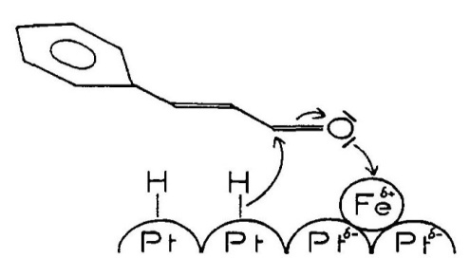
Concept of Lewis sites
C=O bond activation by electropositive Fe on Pt surface
Ref: Richard, J. Ockelford, A. Giroir-Fendler, and P. Gallezot, Catal.Lett., 3,53 (1989).

Slide 42
Pd bimetallic catalysts
Catalyst | Conversion | Selectivity |  |  |  | TOF(s⁻¹)
 |  | HCAL | HCOL | COL | ACL | ªH₂ Che
1%Pd/P25 | 69.4 | 7 | 4.2 | 63.2 | 25.6 | 0.4
1%Pd-Au/P25 | 70.3 | 11.6 | 3 | 47.5 | 37.9 | 0.25
1%Pd-Ag/P25 | 71.5 | 6.1 | 10.6 | 45 | 38.4 | 0.57
T=100ºC, P=10bar, catalyst=40mg, reactant(CAL)=2.4gm,solvant(methanol)=13gm, time=1h.

Slide 43
Pd supported on Hydrotalcite
Catalyst | Conversion% | Selectivity% |  |  |  | TOF(s⁻¹)
 |  | HCAL | HCOL | COL | ACL | From TEM
1%Td Pd/HT | 22.9 | 42.2 | 0 | 2.6 | 55.3 | 0.065
1%Sp Pd/HT | 95.2 | 69.9 | 18.9 | 10.9 | 0.3 | -
T=100 C, Catalyst wt. = 40g, P=10bar, time=1h, solvent(methanol)=13g
Reactant = 2.4g

Slide 44
Effect of supports
Catalyst | Conversion% | Selectivity%
 |  | HCAL | HCOL | COL | ACL
1%Pd/Anatase(TiO₂) | 100 | 10.8 | 13.9 | 75.3 | 0
1%Pd/γ-Al₂O₃ | 73.5 | 16.9 | 6.5 | 62 | 14.7
1%Pd/SiO₂ | 74 | 4.3 | 6.7 | 67.7 | 21.3
Sp 1%Pd/HT | 95.2 | 69.9 | 18.9 | 10.9 | 0.3
T=100 C, Catalyst wt. = 40g, P=10bar, time=1h, solvent(methanol)=13g
Reactant = 2.4g

Slide 45
Summary
Tetrahedral, octahedral Pd/Hydrotalcite catalyst show poor selectivity towards COL, whereas spherical Pd/Hydrotalcite show better conversion and selectivity towards COL, when compared to tetrahedral and octahedral Pd/HT. The low selectivity to COL is attributed to large particle size and high basic nature of hydrotalcite.
Among titania based catalyst systems, anatase based catalyst is most active with good selectivity, when compared to P25 and rutile phases. High activity is attributed to SMSI(strong metal support interactions) and high reducibility of Pd/Anatase.
Pd-Au/P25 & Pd-Ag/P25 bimetallic systems are showing similar activity and selectivity, but when compared to monometallic Pd/P25, bimetallic systems show 28% decrease in selectivity, which is attributed to formation of Pd-Ag and Pd-Au alloy.
Pd supported on γ-Al₂O₃ and SiO₂ show similar selectivity when compared to Pd/P25. More characterization of Pd supported on γ-Al₂O₃ and SiO₂ are needed.
Among all the catalyst prepared the best catalyst for selective hydrogenation of cinnamaldehyde to cinnamyl alcohol is 1%Pd/Anatase with TOF = 0.77s⁻¹.

