Slide 1
Nafion layer-enhanced photosynthetic conversion of CO₂ into
Hydrocarbons on TiO₂ nanoparticles
Wooyul Kim et al., Energy Environ. Sci., 5, 2012, 6066
V. Jeyalakshmi
27-04-2013

Slide 2
Introduction
Direct solar conversion of CO₂ into hydrocarbons is an ideal solution to reduce the
CO₂ concentration in the atmosphere with the simultaneous production of solar fuels.
The photosynthetic conversion of CO₂ is limited mainly by:
(i) The highly negative one-electron reduction potential of CO₂,
(ii) The strong oxidation power of photo-generated valence band holes (or OH
radicals) that can react with intermediates and products of CO₂ conversion
(e.g., formate, form-aldehyde, and methanol in reactions (3)–(7)),
(iii) The low solubility of CO₂ in water (33 mM@ 298 K and 1 atm),
(iv) The competition with H₂ formation (reaction (1))

Slide 3
In this study, a Nafion (perfluorinated polymer with sulfonate groups) overlayer on Pd-TiO₂ (Nf/Pd-TiO₂) was employed for the photo reduction of CO₂ in the absence of a sacrificial electron donor.
Nafion-coated TiO₂ catalyst was selected for the artificial photosynthesis on the basis of three reasons.
Being a superacid & an excellent proton conducting medium, the Nafion layer may enhance the local activity of protons near the TiO₂ surface region & the PCET reaction can be facilitated within the Nafion layer over TiO₂. The proton conducting property of Nafion should facilitate the diffusion of protons onto the CO₂ reduction sites.
The intermediates of CO₂ reduction might be stabilized within the Nafion layer, which should help the serial electron transfers from the intermediate to the final product (Nafion layer that should prohibit the direct contact between the products and the TiO₂ surface).
Being a per-fluorinated polymer, Nafion itself is stable against the photocatalytic oxidation and is inert toward the photoinduced redox reactions.

Slide 4
Preparation of Nf/Pd-TiO₂ catalyst
Photo-deposition method :
Aq. TiO₂ (0.5 g/L) in methanol (e⁻ donor, 1.25 M) + 1Wt% PdCl₂
UV irradiation for 30 min (with a 200-W Hg lamp)
filtered & washed with distilled water
1Wt% Pd –TiO₂ (A)
20 g of 5 wt% Nafion solution in a mixture of alcohol & water + 300 mL of DI water
Heated to 70–80°C until the volume reduced to 50ml
Repeated three times to remove aliphatic alcohols
Diluted to 100 mL by adding distilled water
Nafion Solution (B)

Slide 5
Preparation of Nf/Pd-TiO₂ catalyst
1Wt% Pd –TiO₂ (A)
+
Nafion Solution (B)
Vigorous stirring for 30 min.
Dried at 80°C for overnight
Nf/Pd-TiO₂

Slide 6
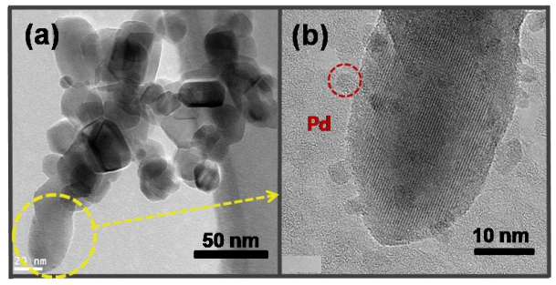
TEM images of Nf/Pd-TiO₂
(a) TEM image and (b) high-resolution TEM images of Nf/Pd-TiO₂.

Slide 7
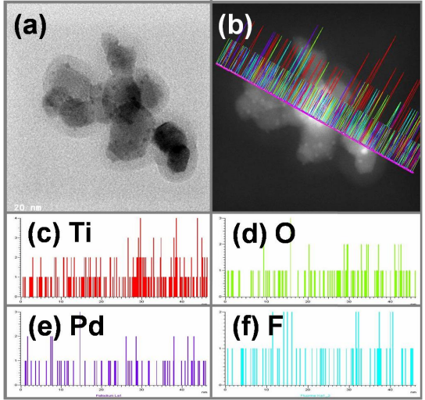
(a) TEM image and (b) Line Energy Dispersive X-ray microanalysis (EDX) image
(high-angle annular dark field image) and the elemental mapping of (c) Ti, (d) O, (e) Pd, and (f) F on Nf/Pd-TiO₂ sample.

Slide 8
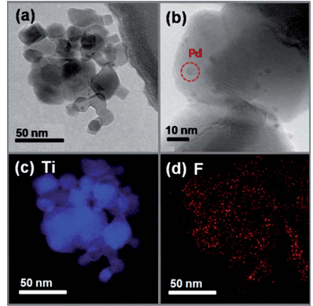
EFTEM Images
Nf/Pd–TiO₂ micrographs showing (a) TEM and (b) HRTEM images, as well as the energy-filtered TEM (EFTEM) maps of (c) Ti and (d) F (obtained from image (a)).

Slide 9
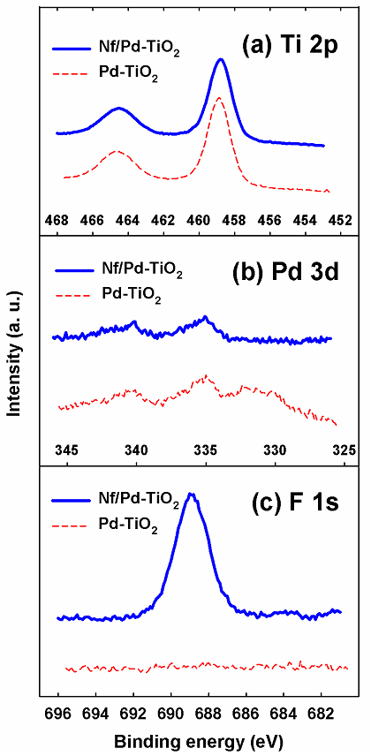
XPS Results
XPS spectra of Nf/Pd-TiO₂ (blue) and Pd-TiO₂
(red) powder, showing (a) Ti 2p, (b)
Pd 3d, and (b) F 1s band regions.

Slide 10
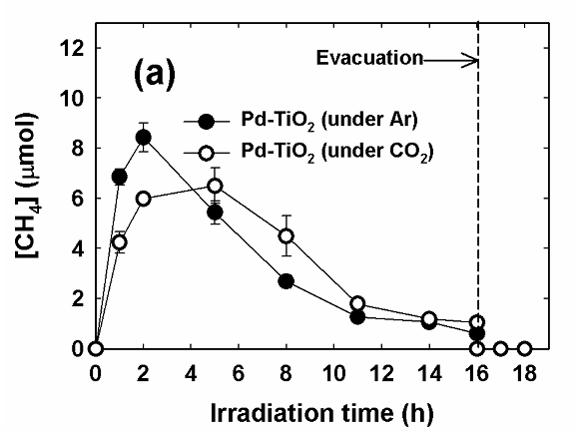
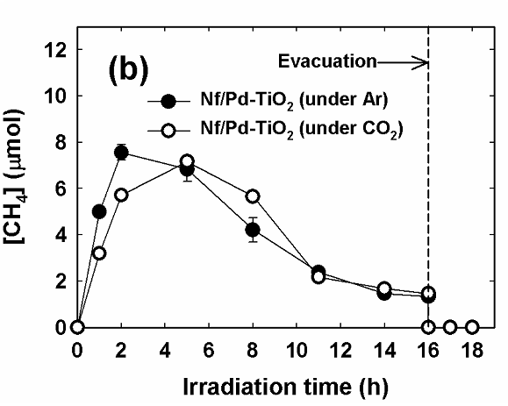
Surface Carbon Identification
Time profiles of methane production in the UV-irradiated suspension of (a) Pd-TiO₂
& (b) Nf/Pd-TiO₂ without pre-cleaning of the catalysts. The photo-irradiation experiments were compared between Ar - and CO₂ -purged conditions.
The experimental conditions were [catalyst] = 1.5 gL⁻¹ (with 1.0 wt% Pd), pHi = 5.3 (not adjusted), λ > 300 nm, and initially Ar or CO₂ -saturated.

Slide 11
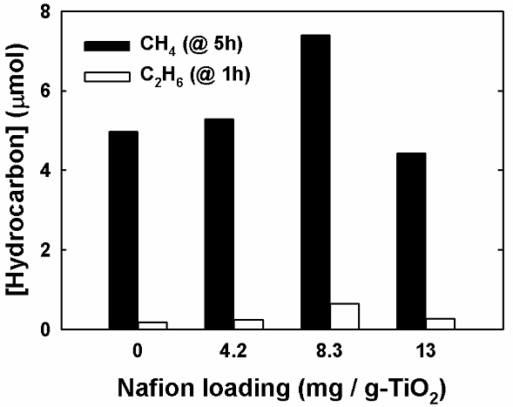
Effect of Nafion loading
The amounts of methane and ethane generated after 5 h and 1 h of continuous
illumination, respectively, as a function of Nafion loading.
The experimental conditions were [catalysts] = 1.5 gL⁻¹ (with 1.0 wt% Pd and 0.42 - 1.3 wt% Nafion), λ > 300 nm, and initially CO₂ -saturated with adding 0.2 M sodium carbonate & subsequent acidification to pH_{i}= 3.

Slide 12
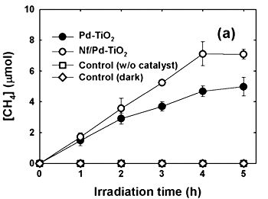
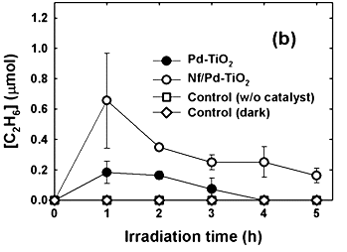
Photoconversion of CO₂
The experimental conditions: [catalyst]=1.5 gL⁻¹ (with 1.0 wt% Pd and 0.83 wt% Nafion), initially CO₂-saturated by adding 0.2 M sodium carbonate and subsequent acidification (pH 1 and 3).
Time profiles of (a) methane & (b) ethane production in the UV-irradiated (l> 300 nm) suspension of Pd–TiO₂ and Nf/Pd–TiO₂ after
the pre-cleaning process at pH 3.

Slide 13
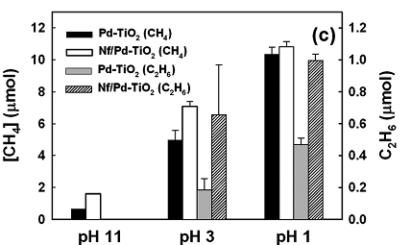
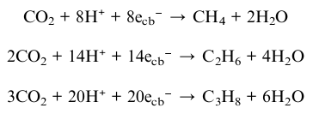
Effect of pH on Nf/Pd-TiO₂
The production of methane (@ 5 h) & ethane (@ 1 h) at pH 1, 3, and 11 on Pd–TiO₂ and Nf/Pd–TiO₂.
The experimental conditions were [catalyst]=1.5 g L⁻¹ (with 1.0 wt% Pd and 0.83 wt% Nafion), initially CO₂-saturated by adding 0.2 M sodium carbonate & subsequent acidification (pH 1 and 3).

Slide 14
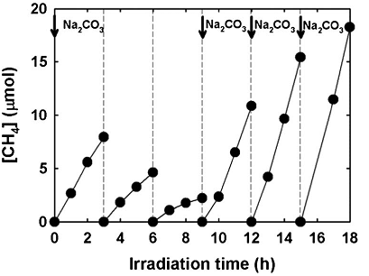
Stability of Nafion layer on Pd-TiO₂
Repeated cycles of methane production in the UV-irradiated (l> 300 nm) suspension of Nf/Pd–TiO₂ after the pre-cleaning process.
The experimental conditions: [catalyst]=1.5 gL⁻¹ (with 1.0 wt% Pd and 0.83 wt% Nafion). At the end of each cycle, the reactor was purged with CO₂ gas. At the point of each arrow, [Na₂CO₃] of 0.2 M was newly added and then acidified to pH 3 to obtain a fresh CO₂⁻saturated suspension.

Slide 15
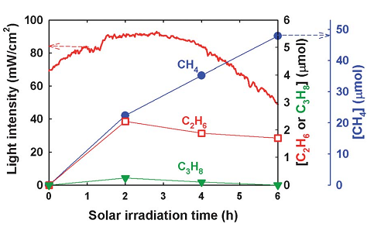
Outdoor solar tests for the photoconversion of CO₂
Outdoor solar tests for the photoconversion of CO₂ into hydrocarbons (CH₄,C₂H₆, and C₃H₈) in Nf/Pd–TiO₂ suspension at pH 3 (solid line: time profile of solar light intensity).

Slide 16
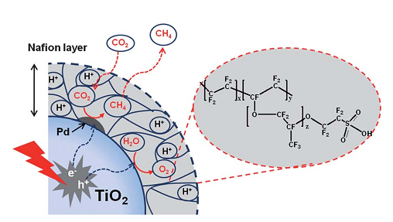
Photosynthetic conversion of CO₂ to hydro-carbons occurring on the Nf/Pd–TiO₂ nanoparticle.

Slide 17
Conclusions
Introducing a thin Nafion overlayer on Pd–TiO₂ significantly increased the photosynthetic activity for CO₂ reduction under UV & solar light.
The main role of the Nafion over layer seems to enhance the local proton activity within the layer to facilitate PCET reactions and to stabilize intermediates and to inhibit the re-oxidation of the CO₂ reduction products.
The production of hydrocarbons such as methane, ethane, & propane was clearly higher with Nf/Pd–TiO₂ than with Pd–TiO₂.
The photosynthetic activity of the Nf/Pd–TiO₂ catalyst was maintained through repeated cycles of photoreaction, which confirms the stability of the Nafion layer.

Slide 18
