Slide 1
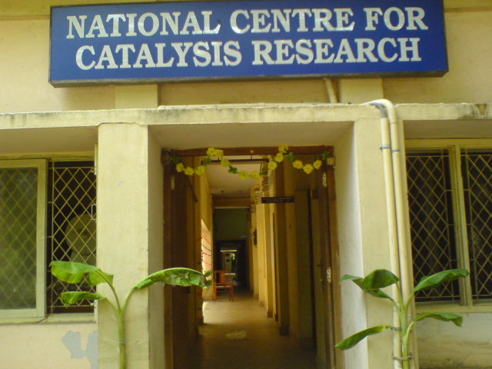
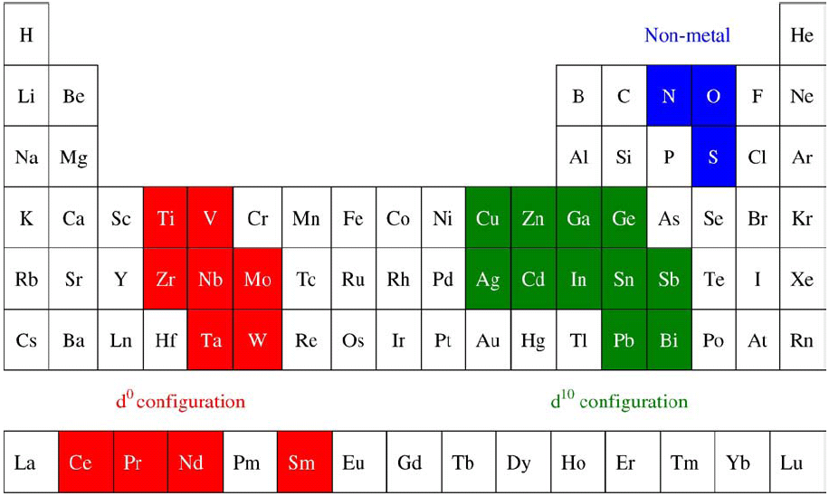
Photo-electrochemical decomposition of water and storage of hydrogen
One of the programs of NCCR – funded by Government agencies like DST, MNRE and private agencies like Tata Chemicals -Our grateful thanks to these agencies
B. Viswanathan
National Centre for Catalysis Research
Indian Institute of Technology Madras,
Chennai-600 036

Slide 2
Some Other Areas of Research
Electro-catalytic reduction of carbon dioxide (in cooperation with chemical Engineering Department)
Electrode materials for fuel cell especially for ORR ( in cooperation with laboratories in South Korea)
Solar Hydrogen ( with a consortium of laboratories like IITK, BARC, Dayalbagh, (Agra) CECRI and IIT, Rajesthan).
Encapsulation of active sites in Zeolites ( with University of Madras)
and so on……………….!

Slide 3
Situation and Questions
Production, storage and application - challenges of hydrogen
economy
Solid state storage – remarkable but not reproducible
6.5 wt% - desired level (DOE)
Demands consistent and innovative practice
(i) How to select appropriate materials for PEC of water!
Are the carbon materials appropriate for solid state hydrogen storage?
If this were to be true, what type of carbon materials or what type of treatments for the existing carbon materials are suitable to achieve desirable levels of solid state hydrogen storage?
What are the stumbling blocks in achieving the desirable solid state hydrogen storage?
Where does the lacuna lie? Is it in our theoretical foundation of the postulate or is it in our inability to experimentally realize the desired levels of storage?

Slide 4
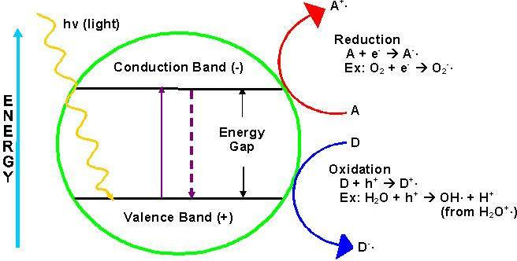
Desired properties of an ideal semiconductor photocatalyst
Small band gap – to absorb up to 600 nm
Ability to work without sacrificial agents
Low cost
High quantum yields
High efficiency without expensive co-catalysts such as Pt, Ru
Long term stability
Compounds with environmentally friendly elements
Direct band gap i.e. better light absorption

Slide 5
Percent contribution of various materials for water splitting
Distribution of scientific publications focusing on materials for photo-catalytic H₂ production
J. Zhu, M. Zach, Curr. Opin. Colloid. In., 14 (2009) 260

Slide 6
Choice of constituent metal ions present in materials as photocatalysts
Materials containing elements in d⁰ or d¹⁰ configuration
Elements with d⁰ and d¹⁰ metal ions- suitable as photo-catalysts
Partially filled d-orbitals - higher recombination
Materials with d¹⁰ ions - smaller band gaps
J. Zhu, M. Zach, Curr. Opin. Colloid. In., 14 (2009) 260

Slide 7
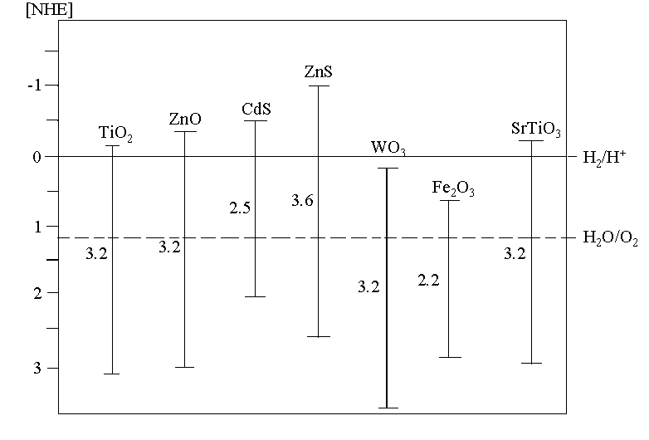
Binary oxide photo-catalysts
Bottom of CB - d and sp orbitals metal cations
Top of VB - O 2p orbitals
O 2p orbials normally located at ~+3 V (vs NHE) or higher
Catalyst | Pros | Cons
TiO₂ | Highly active and stable | Works only in UV light
ZnO | Considerably active | Suffers photo-corrosion ; works only in UV light
CeO₂ | Works in visible light | Considerably less active than TiO₂
WO₃ | None | Cannot evolve H₂ ; Less active than TiO₂; Inactive in UV light
SnO₂ | None | Less active than TiO₂ ; Inactive in UV light
Fe₂O₃ | Works in visible light | Cannot evolve H₂
Alonso et al., Energy Environ. Sci., 2 (2009) 1231

Slide 8
Binary sulfide photo-catalysts
VB - more negative potential due to S 3p orbitals
Most sulfide conduction bands lower in energy than H₂ evolution potential
Suffer from photo-corrosion
Sacrificial agents (S²⁻/SO₃²⁻) required to prevent photo-corrosion
Catalyst | Advantages | Disadvantages
CdS | Smaller band gap; can evolve H₂ | Photo-corrosion
ZnS | Can evolve H₂ | Large band gap ; Photo-corrosion
AgInS₂, CdInS₄, SnInS₄, AgIn₅S₈ | Small band gap; Can evolve H₂ | Photo-corrosion

Slide 9
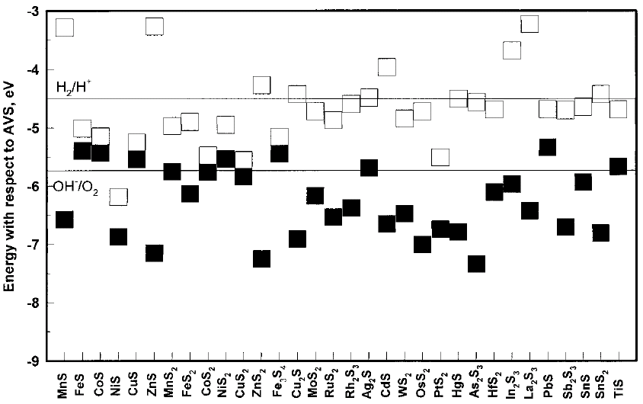
Comparison of band position of various sulfides and oxides
Sulfides have VB at higher energy due to S 3p
Most have smaller band gap
Most cant evolve H₂
Oxides have VB at lower energy
Most have large band gap
Hence can evolve H₂
Xu and Schoonen, Am. Mineral., 85 (2000) 543

Slide 10
Ternary and quarternary metal oxides with d⁰ metal ions
Oxides with d⁰ ions - larger band gaps
Only O 2p orbitals contributing to VB top - lower energy VB
CB positions suitable to evolve H₂
Most Ta, Nb and Ti oxides - larger band gaps due to d⁰ configuration
Catalyst | Advantages | Disadvantages | Example
Ta and Nb oxides | Evolve H₂ and O₂ | Large band gap | ATaO₃ (A – Li, Na, K), NaTaO₃, K₄Nb₆O₁₇
Ti oxides | Evolve H₂ and O₂ | Large band gap | Sr₃Ti₂O₇, SrTiO₃, La₂Ti₂O₇, K₂La₂Ti₃O₁₀
Vanadium oxides | Can absorb visible light | Cannot evolve H₂ | M₃V₂O₈ (M = Mg, Ni, Zn)

Slide 11
Ternary and quarternary metal oxides with d¹⁰ metal ions
d¹⁰ metal ions - smaller band gaps
d¹⁰ hybridize with O 2p to form top of VB
VB top at higher energy than d⁰
These oxides mostly contain Bi, Ag, In and Sb
Not all evolve H₂ - lower CB positions
Catalyst | H₂ evolution | Visible light activity | Example
Indium oxides | Yes | Yes | InVO₄
Bismuth oxides | No | Yes | BiVO₄, Bi₂WO₆, Bi₂MoO₆
Zn oxides | Yes | No | ZnFe₂O₄, ZnCr₂O₄
Silver oxides | Yes | Yes | AgInW₂O₈, Ag₂ZnGeO₄

Slide 12
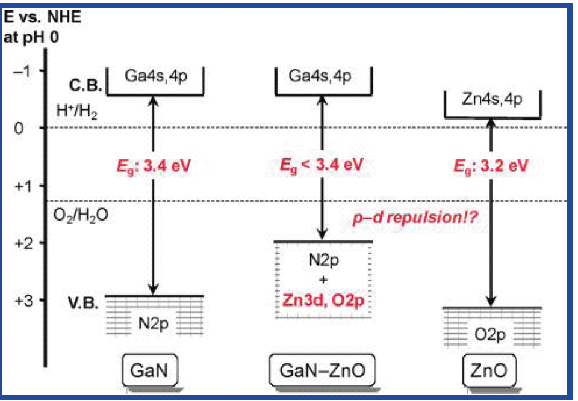
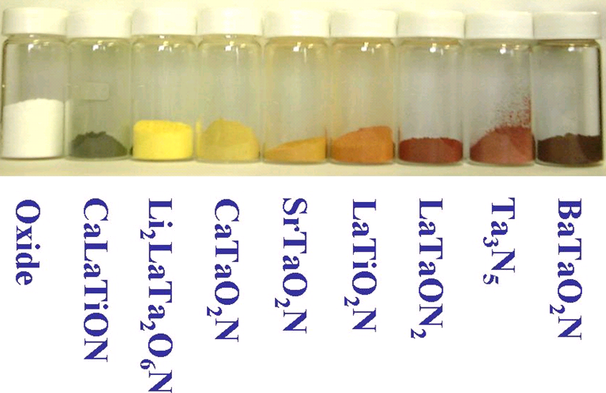
Metal oxysulfides, oxynitride and nitrides
VB top contains N 2p or hybridized N 2p/S 3p and O 2p
VB higher in energy than oxides
Oxysulfides, oxynitrides and nitrides of d⁰ and d¹⁰ metals have shorter band gaps
Ex. TaON, Ge₃N₄, (Ga_{1−X}Zn_{X})(N_{1−X}O_{X}), LaTiO₂N, SrTiO_{3-2x}N_{x}, NaTaO_{3x}N_{x}
Most are capable of evolving H₂ using visible light
K. Maeda, K. Domen, Chem. Mater., 22 (2010) 612

Slide 13
Electronic structure of materials
Generation of bands in solids from atomic orbitals of isolated atoms
Fermi level - Level where probability of an electron is ½
Instrinsic semiconductor - Fermi level lies at mid-point of band gap
n-type semiconductor - lies just below CB
p-type semiconductor - just above VB
Fermi level of semiconductor varies with applied potential

Slide 14
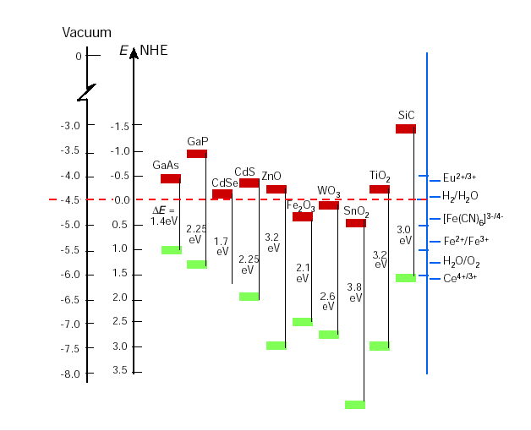
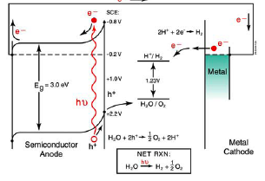
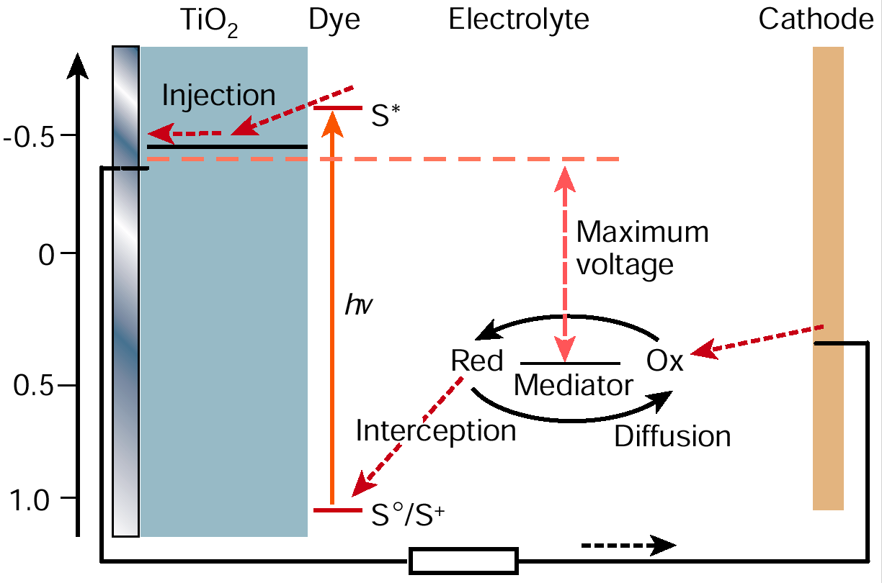
Photo-electrochemical hydrogen production at illuminated semiconductor electrodes
Photo-electrochemical energetics of semiconductors
Dye-sensitised photovoltaic cell

Slide 15

Photocatalysis
Conventional redox reaction
Oxidizing agent should have more positive potential
Photocatalysis - simultaneous oxidation and reduction
The redox couple capable of promoting both the reactions can act as photocatalyst
Metals, Semiconductors and Insulators
catalyst
WHY SEMICONDUCTOR ?
CB
reaction assisted by photons
H⁺/H₂
CB
CB
VB
E
H₂O/O₂
VB
SC
VB
Metals
Insulators
Metals : No band gap
Only reduction or oxidation
Depends on the band position
Insulators : High band gap
High energy requirement
15

Slide 16
Ionic character of M-O bond
The percentage ionic character of the M-O bond for some of the semiconductors
Ionic solids as the ionicity of the M-O bond increases, the top of the valence band (mainly contributed by the p- orbitals of oxide ions) becomes less and less positive (since the binding energy of the p orbitals will be decreased due to negative charge on the oxide ions) and the bottom of the conduction band will be stabilized to higher binding energy values due to the positive charge on the metal ions which is not favourable for the hydrogen reduction reaction.
More ionic the M-O bond of the semiconductor is, the less suitable the material is for the photo-catalytic splitting of water. The bond polarity can be estimated from the expression
Percentage ionic character (%) =
Semiconductor | M-O | % ionicity
TiO₂ SrTiO₃ Fe₂­O₃ ZnO WO₃ CdS CdSe LaRhO₃ LaRuO₃ PbO ZnTe ZnAs ZnSe ZnS GaP CuSe BaTiO₃ MoS₂ FeTiO_{3­} KTaO₃ MnTiO₃ SnO₂ Bi₂O₃ | Ti-O Ti-O-Sr Fe-O Zn-O W-O Cd-S Cd-S La-O-Rh La-O-Ru Pb-O Zn-Te Zn-As Zn-Se Zn-S Ga-P Cu-Se Ba-O-Ti Mo-S Fe-O-Ti K-O-Ti Mn-O-Ti Sn-O Bi-O | 59.5 68.5 47.3 55.5 57.5 17.6 16.5 53.0 53.5 26.5 5.0 6.8 18.4 19.5 3.5 10.0 70.8 4.3 53.5 72.7 59.0 42.2 39.6

Slide 17
TYPICAL PHOTOCATALYTIC PROCESS
Photodecomposition of water
Photocatalytic formation of fuel
Photocatalysis in pollution abatement
17

Slide 18
HYDROGEN PRODUCTION
There are various methods and technologies that have been developed and a few of them have already been practiced. These technologies can be broadly classified as:
Thermo-chemical routes for hydrogen production
Electrolytic generation of hydrogen
Photolytic means of hydrogen formation
Biochemical pathways for hydrogen evolution and
Chemical (steam ) reformation of naphtha
18

Slide 19
THE AVAILABLE OPPORTUNITIES
Identifying and designing new semiconductor materials with considerable conversion efficiency and stability
Constructing multilayer systems or using sensitizing dyes - increase absorption of solar radiation
Formulating multi-junction systems or coupled systems - optimize and utilize the possible regions of solar radiation
Developing nanosize systems - efficiently dissociate water
19

Slide 20
Limited success – Why?
The main reasons for this limited success in all these directions are due to:
The electronic structure of the semiconductor controls the reaction and engineering these electronic structures without deterioration of the stability of the resulting system appears to be a difficult proposition.
The most obvious thermodynamic barriers to the reaction and the thermodynamic balances that can be achieved in these processes give little scope for remarkable improvements in the efficiency of the systems as they have been conceived and operated. Totally new formulations which can still satisfy the existing thermodynamic barriers have to be devised.
The charge transfer processes at the interface, even though a well studied subject in electrochemistry has to be understood more explicitly, in terms of interfacial energetics as well as kinetics. Till such an explicit knowledge is available, designing systems will have to be based on trial and error rather than based on sound logical scientific reasoning.
20

Slide 21
Nanocrystalline (mainly oxides like TiO₂, ZnO, SnO and Nb₂O₅ or chalcogenides like CdSe) mesoscopic semiconductor materials with high internal surface area If a dye were to be adsorbed as a monolayer, enough can be retained on a given area of the electrode so as to absorb the entire incident light.
Since the particle sizes involved are small, there is no significant local electric field and hence the photo-response is mainly contributed by the charge transfer with the redox couple.
Two factors essentially contribute to the photo-voltage observed, namely, the contact between the nano crystalline oxide and the back contact of these materials as well as the Fermi level shift of the semiconductor as a result of electron injection from the semiconductor.
21

Slide 22
UV –VISIBLE SPECTRA OF CdS SAMPLES
Samples | Band Gap (eV)
CdS – Z CdS – Y CdS - β Bulk CdS | 2.38 2.27 2.21 2.13
M. Sathish, B. Viswanathan, R. P. Viswanath Int. J. Hydrogen Energy (In press)
22

Slide 23
PHOTOCATALYTIC PRODUCTION OF HYDROGEN
35ml of 0.24 M Na₂S and
0.35 M Na₂SO₃ in Quartz cell
N₂ gas purged before the reaction and constant stirring
0.1 g CdS
400 W Hg lamp
Hydrogen gas was collected over
water in the gas burette
23

Slide 24
AMOUNT OF HYDROGEN EVOLVED BY CdS PHOTOCATALYST
24

Slide 25
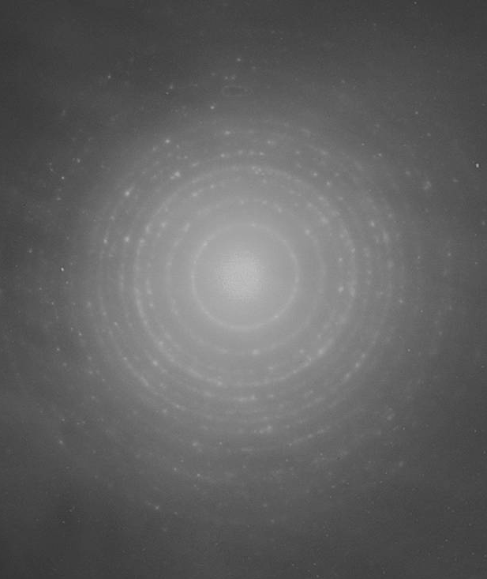
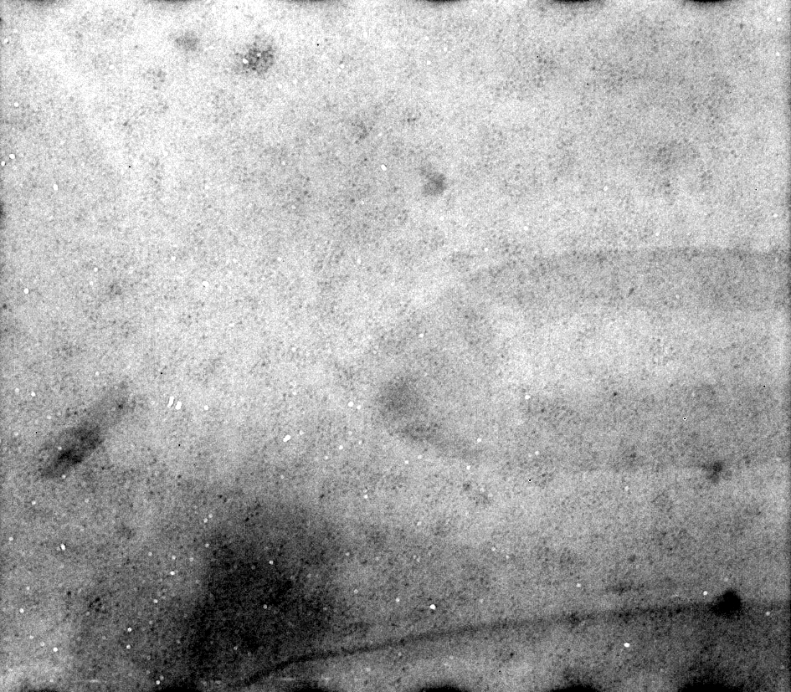
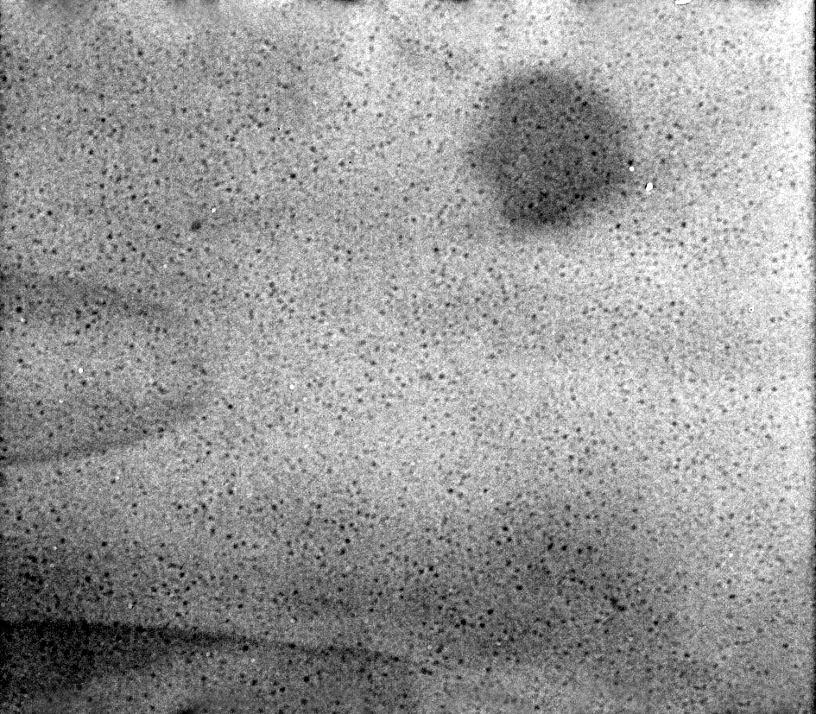
TEM IMAGE OF CdS NANOPARTICLES
Catalyst | Particle Size (nm) | Surface area (m²/g) | Rate of hydrogen production ( μ moles /h)
CdS - Y | 8.8 | 36 | 102
CdS - Z | 6 | 46 | 68
CdS - β | 11 | 26 | 67
CdS - Bulk | 23 | 14 | 45
CdS-Z
CdS-Z
CdS- β
100 nm
100 nm
25

Slide 26
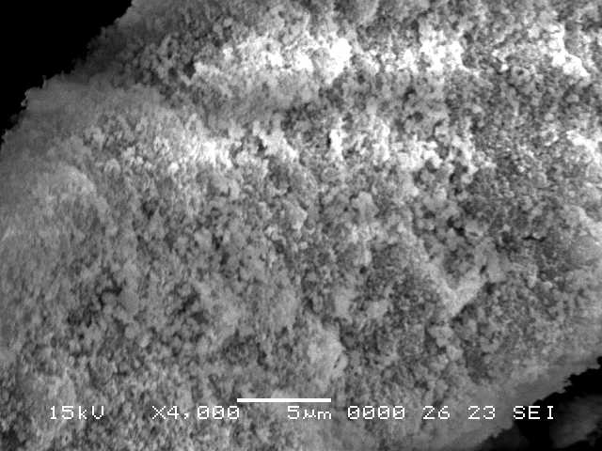
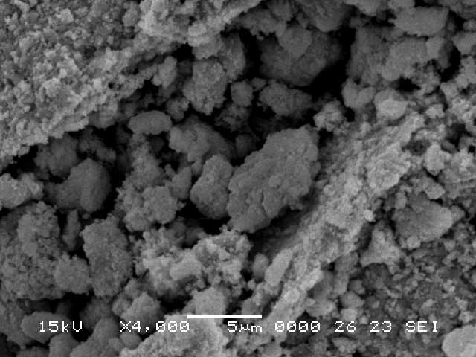
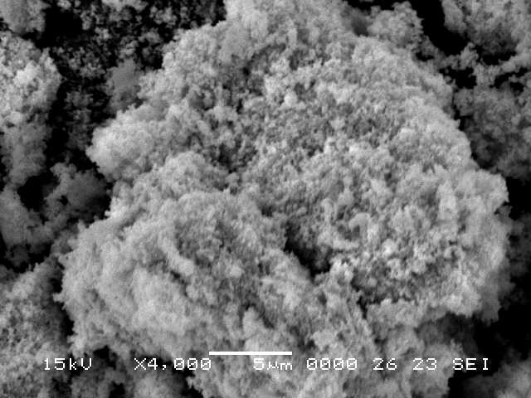
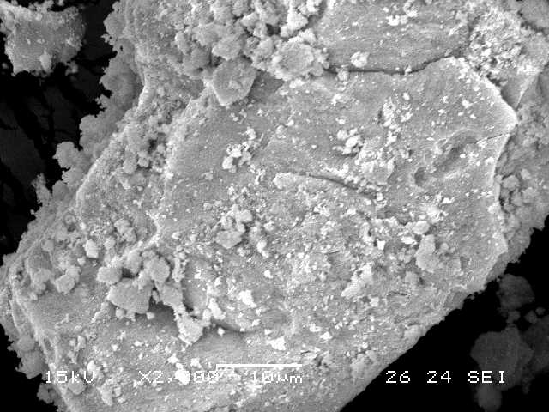
SCANNING ELECTRON MICROGRAPHS
CdS-Z
CdS-Y
CdS-β
CdS- bulk
26

Slide 27
PHOTOCATALYTIC HYDROGEN EVOLUTION OVER METAL LOADED CdS NANOPARTICLES
Activity of the catalyst is directly proportional to work function of the metal and M-H bond strength.
27

Slide 28
HYDROGEN PRODUCTION ACTIVITY OF METAL LOADED CdS PREPARED FROM H-ZSM-5
Metal | Redox potential (E⁰) | Metal- hydrogen bond energy (K cal mol⁻¹) | Work function (eV) | Hydrogen evolution rate* (µmol h⁻¹ 0.1g⁻¹)
Pt Pd Rh Ru | 1.188 0.951 0.758 0.455 | 62.8 64.5 65.1 66.6 | 5.65 5.12 4.98 4.71 | 600 144 114 54
*1 wt% metal loaded on CdS-Z sample. The reaction data is presented
after 6 h under reaction condition.
M. Sathish, B. Viswanathan, R. P. Viswanath Int. J. Hydrogen Energy (In press)
28

Slide 29
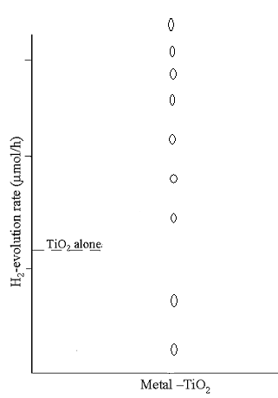
EFFECT OF METALS ON HYDROGEN EVOLUTION RATE
Pt
1000
Pd
Pt, Pd & Rh show higher
activity
High reduction potential.
Hydrogen over voltage
is less for Pt, Pd & Rh
Rh
Au
Cu
100
Ag
Ni
10
Fe
Ru
3 %
29

Slide 30
EFFECT OF SUPPORT ON THE CdS PHOTOCATLYTIC ACTIVITY
2, 5,10 and 20 wt % CdS on support - by dry impregnation method
Alumina & Magnesia supports enhance photocatalytic activity
MgO support has higher photocatalytic activity - favourable band position
30

Slide 31
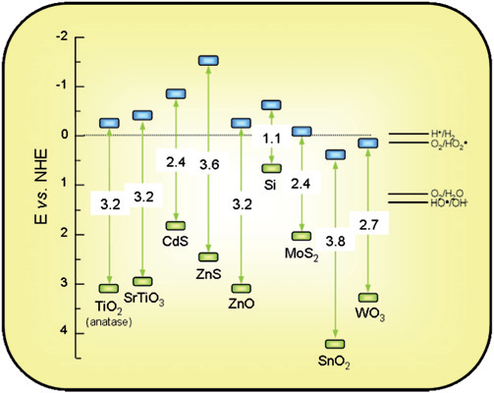
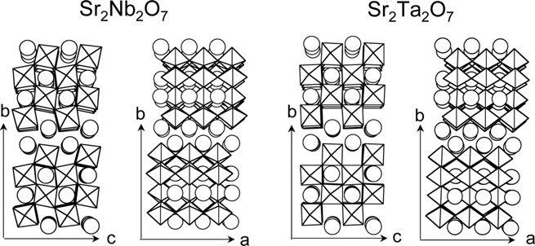
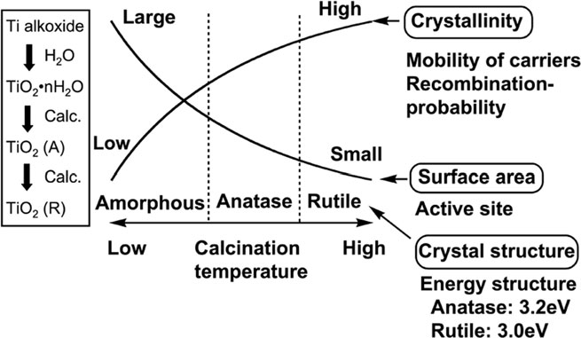
Properties of highly active photo-catalysts
Suitable band positions w.r.to the desired reactions
Compounds with layered structures. Layered structured with interconnected octahedra helps in better charge transfer e.g., perovskite structures
Absence of defect sites to prevent recombination
Compounds with high dipole moment (better charge separation)
High crystallinity and surface area
A.Kudo, Y.Miseki, Chem. Soc. Rev. 38 (2009) 253

Slide 32
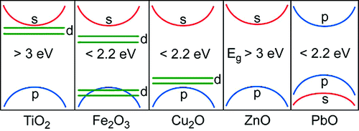
Factors deciding the bandgap of the materials
Electronic configuration of the constituent ions
Percentage ionic character of the metal –anion bond
Crystal structure of the material
The bandgap increases when the percentage ionic character increases
TiO₂ crystal structure | Bandgap (eV)
Anatase | 3.05
Rutile | 2.98
Brookite | 3.26
Changes in the coordination contributes to bandgap variation
Walsh et al., Chem Mater 21 (2009) 547
Di Paola et al., J. Phys. Chem. C, 113 (2009) 15166

Slide 33
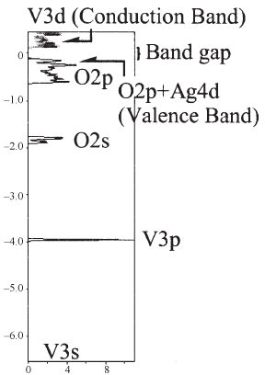
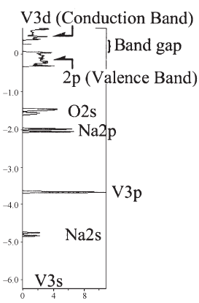
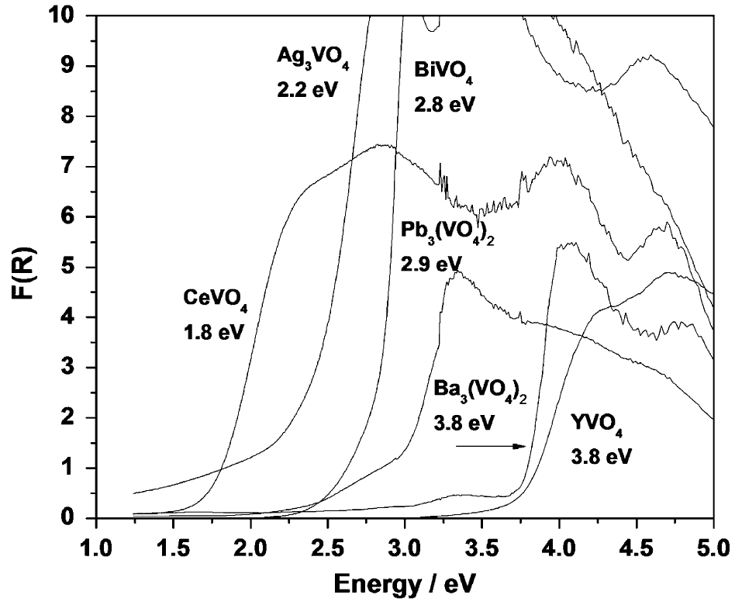
Influence of electronic configuration of elements on band gap
Top of VB composed of d- and O 2p-orbitals
Bottom of CB composed of d- (for d⁰ ions) and sp-orbitals
With O 2p-orbitals only in VB , bandgap higher than 3.0 eV
Band structure of AgVO₃
Band structure of NaVO₃
Sulfides and nitrides have VB made of S 3p- and N 2p- orbitals – small bandgap
Pb 6s in Pb²⁺, Bi 6s in Bi³⁺, and Sn 5s in Sn²⁺ also contribute to VB in some oxides
Materials containing elements with completely filled d-orbitals (d¹⁰) have VB edge at higher energy and hence small bandgap
Variation in bandgap with orbital contribution
Konta et al., Phys Chem Chem Phys 5 (2003) 3061
Dolgos et al., J. Solid State Chem., 182 (2009) 1964

Slide 34
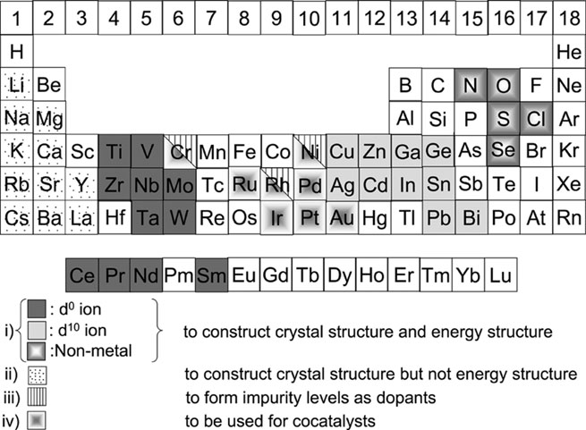
Role of various elements in the materials
Most mixed metal oxide photocatalysts with smaller bandgaps have d¹⁰ metal ions e.g., Ag₃VO₄ (2.0 eV), BiVO₄ (2.4 eV), SnNb₂O₆ (2.3 eV), BiCu₂VO₆ (2.1 eV)
A.Kudo, Y.Miseki, Chem. Soc. Rev. 38 (2009) 253

Slide 35
Influence of percentage ionic character of bonds on bandgap
Percentage ionic character of a bond =
When the percentage ionic character increases, the CB becomes more negative and VB becomes more positive
The more the percentage ionic character of the, the larger the band gap
Semiconductor | Bond | Percentage ionic character | Band gap (eV)
SrTiO₃ | Sr-O-Ti | 68.5 | 3.2
TiO₂ | Ti-O | 59.5 | 3.0
WO₃ | W-O | 57.5 | 2.8
Fe₂O₃ | Fe-O | 47.3 | 2.3
CdS | Cd-S | 17.6 | 2.4
CdSe | Cd-Se | 16.5 | 1.7
B.Viswanathan.. Bull. Catal. Soc. India, 2 (2003) 71

Slide 36
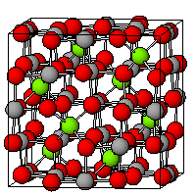
About cadmium stannates
CdSnO₃ and Cd₂SnO₄ are the two cadmium stannates
Both Cd²⁺ and Sn⁴⁺ have d¹⁰ orbitals
Cd₂SnO₄ exists in orthorhombic and cubic unit cells
CdSnO₃ exists in orthorhombic and rhombohedral unit cells
Orthorhombic Cd₂SnO₄
Cd₂SnO₄ is an indirect bandgap n-type semiconductor
Orthorhombic Cd₂SnO₄ has inverse spinel structure
O²⁻ forms ccp array
Cd²⁺ occupies octahedral sites ; Sn⁴⁺ occupies tetrahedral sites
Tin
Cadmium
Oxygen
Gulino, I. Fragala, J. Mater. Chem., 9 (1999) 2837

Slide 37
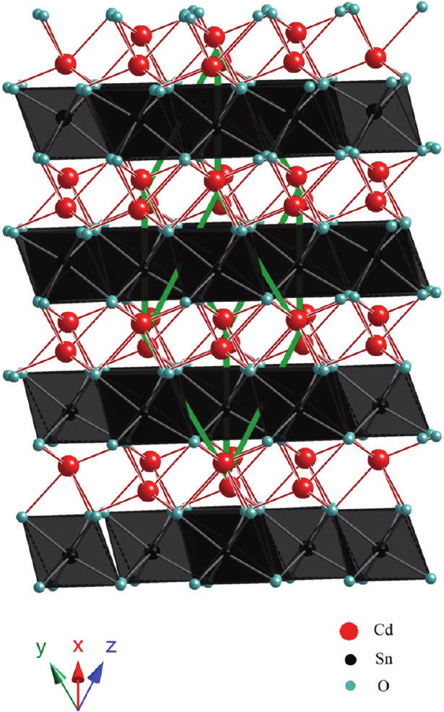
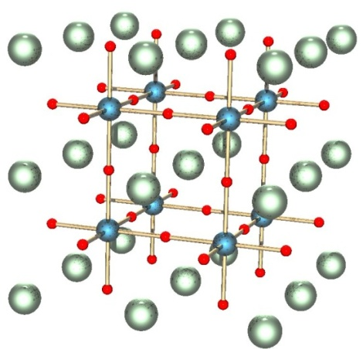
Rhombohedral CdSnO₃
CdSnO₃ has an indirect bandgap
Rhombohedral CdSnO₃ has Ilmenite type structure
Both Cd²⁺ and Sn⁴⁺ occupy the octahedral sites in an hcp array of oxygen atoms
Orthorhombic CdSnO₃
Has direct bandgap
Has the distorted orthorhombic distorted perovskite type structure
n-type semiconductor
Sn⁴⁺ occupies the octahedral sites
Cadmium
Tin
Oxygen
G. Natu, Y. Wu, J. Phys. Chem. C, 114 (2010) 6802

Slide 38
Properties and applications of Cd₂SnO₄
Electrical conductivity : 3.8 X 10⁻² S cm⁻¹
Cd₂SnO₄ shows high conductivity due to oxygen vacancies
Widely studied as transparent conducting oxides
shows upto 90% transmission in the visible region
Properties and applications of CdSnO₃
Electrical conductivity : 1.5 X 10⁻⁷ S cm⁻¹
CdSnO₃ is widely studied as a sensor for various compounds like ammonia, ethanol and chlorine
CdSnO₃ is also studied as host for Li ion batteries
As photoanodes for dye sensitized solar cells
Also studied as transparent conducting oxides

Slide 39
Preparation of CdSnO₃
Aqueous SnCl₄.5H₂O solution
Aq. 3CdSO₄. 8H₂O solution
Added simultaneously
Aq. NaOH solution
Stirred overnight
Stirred overnight
Washed, dried, calcined 850 ºC air 6 h
Washed, dried, calcined 1000 ºC air 6 h
Rhombohedral CdSnO₃
Orthorhombic CdSnO₃

Slide 40
Preparation of Cd₂SnO₄
Aq. SnCl₄.5H₂O solution
Aq. NaOH solution
Mixed together
Sn(OH)₄ precipitate
Washed till absence of Cl⁻
Dissolved in con. H₂SO₄
Mixed with aq. 3CdSO₄ . 8H₂O solution
Precipitated with NaOH
Precipitate washed till absence of SO₄²⁻
Dried calcined air 900 ºC
Orthorhombic Cd₂SnO₄

Slide 41
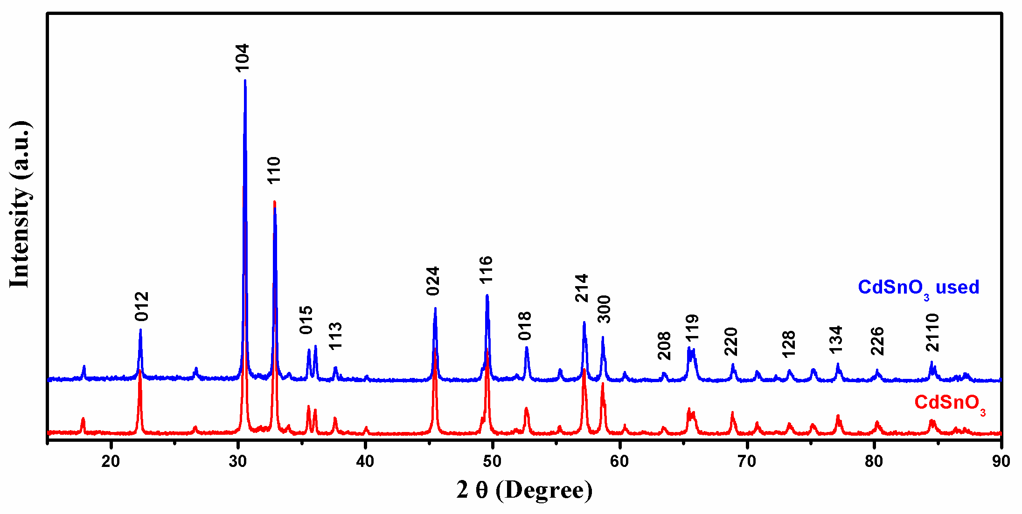
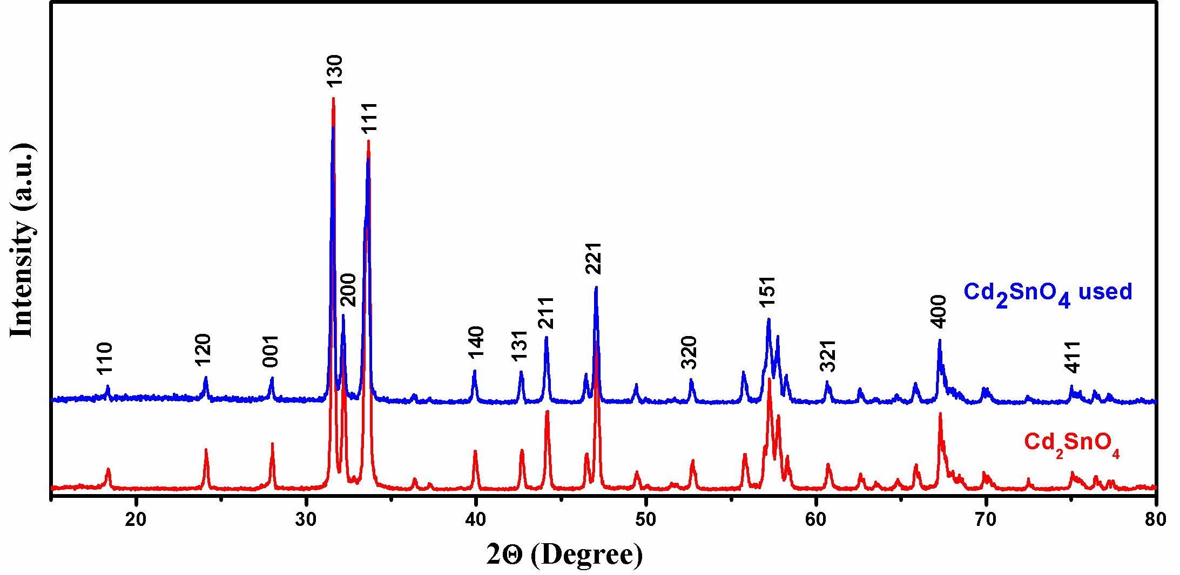
XRD pattern of CdSnO₃
Rhombohedral (JCPDS no. 880287)
Particle size from Debye-Scherrer equation – 45 nm
XRD pattern of Cd₂SnO₄
Orthorhombic (JCPDS no. 801467)
Particle size – 47 nm

Slide 42
Diffuse reflectance UV-visible spectrum of CdSnO₃
Absorbance starts 415 nm
Bandgap 3.0 eV
Diffuse reflectance UV-visible spectrum of Cd₂SnO₄
Absorbance starts at 532 nm
Bandgap : 2.3 eV

Slide 43
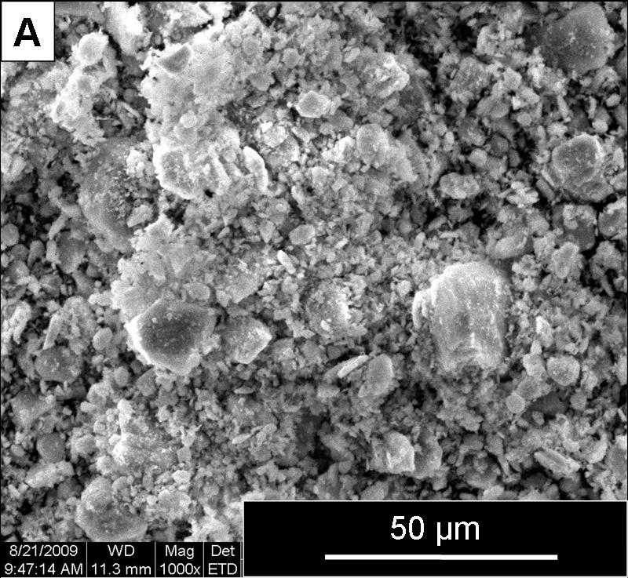
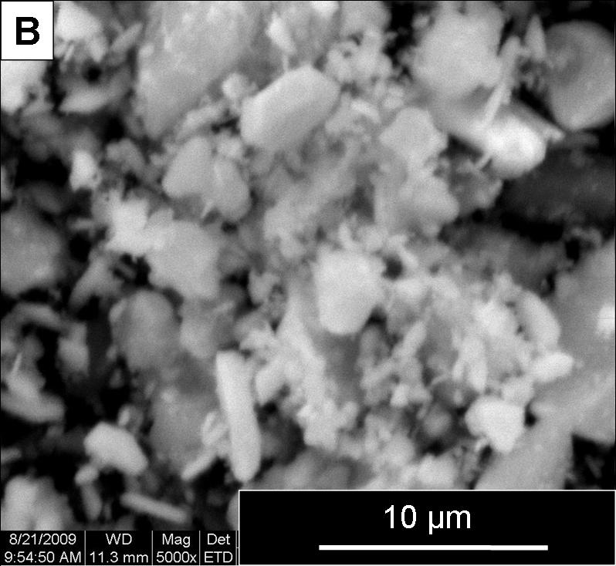
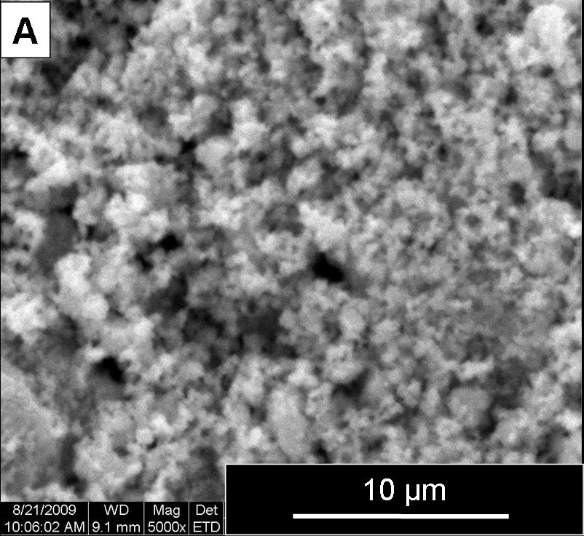
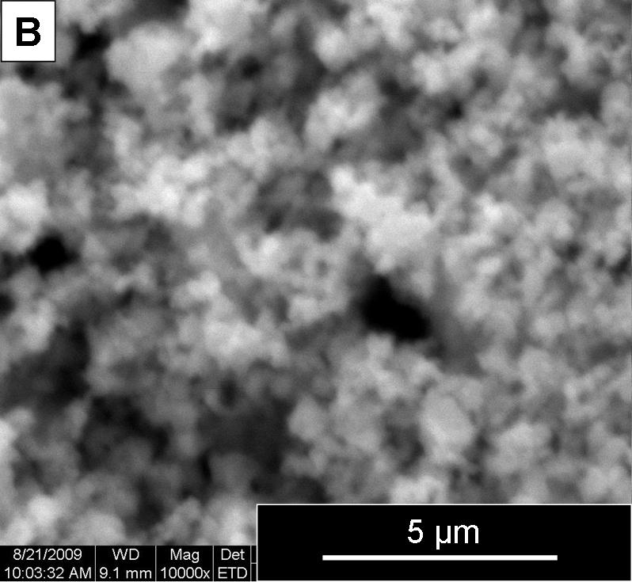
SEM images of CdSnO₃
Flake like particles in agglomerated state
SEM images of Cd₂SnO₄
Agglomerates of oval shaped particles

Slide 44
Photocatalytic degradation of p-chlorophenol – CdSnO₃
Catalyst : 50 mg
Light source : 480 W Hg lamp
Irradiation time : 90 min
Model pollutant : 50 ml 25 ppm p-chlorophenol
Visible light : λ > 420 nm (HOYA L-42 filter)
Catalyst | % Degradation
 | UV-visible | Visible
CdSnO₃ | 94.5 | 0.0

Slide 45
Photocatalytic degradation of p-chlorophenol – Cd₂SnO₄
Catalyst : 50 mg
Light source : 480 W Hg lamp
Irradiation time : 90 min
Model pollutant : 50 ml 25 ppm p-chlorophenol
Visible light : λ > 420 nm (HOYA L-42 filter)
Catalyst | % Degradation
 | UV-visible | Visible
Cd₂SnO₄ | 75.8 | 24.9

Slide 46
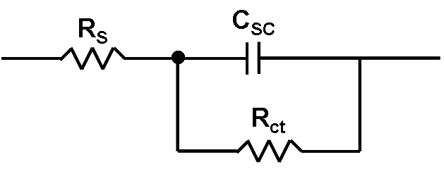
Determination of flatband potential by Mott-Schottky plot
Impedance measurements
Counter electrode : Pt
Amplitude : 0.005 V
Electrolyte : 0.5 M Na₂SO₄ (adjusted to pH 7)
Potential range : 0 V to 0.9 V
Coated on Ti plates using PVDF as binder
Frequency : 0.01 – 10000 Hz
Reference electrode : Ag/AgCl
MS plot of CdSnO₃
MS plot of Cd₂SnO₄
Flat band potential : 0.15 V vs Ag/AgCl 0.35 V vs NHE
Flat band potential : 0.23 V vs Ag/AgCl 0.43 V vs NHE

Slide 47
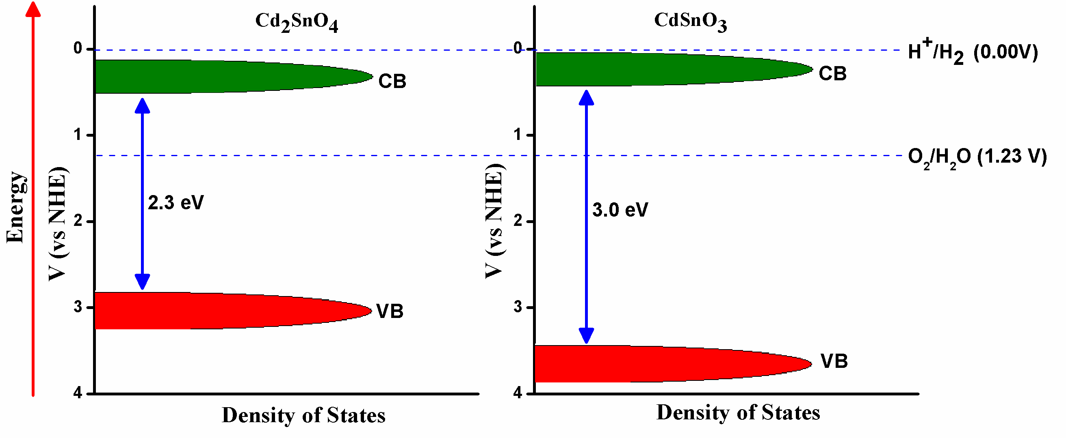
Band positions of the cadmium stannates
E_{cb} is approximated as equal to E_{fb} since doping density values are not available
Both cadmium stannates cannot evolve H₂

Slide 48
Photocatalytic water splitting studies
Hydrogen evolution reaction using CdSnO₃ and Cd₂SnO₄
Medium : 35 ml Water-methanol (5:1 ratio)
Catalyst : 50 mg
Light source : 480 W Hg lamp
No hydrogen evolution occurred in UV-visible and visible irradiation

Slide 49
Summary
Rhombhohedral CdSnO₃ and orthorhombic Cd₂SnO₄ were prepared by co-precipitation method
Diffuse reflectance measurements showed bandgaps of 3.0 and 2.3 eV for CdSnO₃ and Cd₂SnO₄ respectively
Photocatalytic p-chlorophenol degradation measurements showed both catalyst were effective in UV-Visible radiation
Only Cd₂SnO₄ was found to be photoactive in visible radiation (λ > 420 nm)
Mott-schottky plots showed flat band potentials of 0.35 and 0.43 V (vs. NHE) for CdSnO₃ and Cd₂SnO₄ respectively
Water splitting studies showed no H₂ evolution in accordance with measured flat band potentials

Slide 50
TiO₂ Core/Shell structure- A First principle study

Slide 51
Introduction
The extensive exploitation of Degussa P25 (TiO₂) for studies in photo-electrochemical splitting of water and photo-catalysis has to be rationalized even though, the objective of its use in reported studies is mainly for comparison purpose.
Its remarkable reproducibility has to be recognized. It is presumed that P25 is a model core-shell system with anatase and rutile (4:1 weight ratio) and possibly the relative thickness of the core and shell of this system is most appropriate for its behaviour as a photocatalyst.
It is necessary that one recognizes the relative values of surface energy of the polymorphs of TiO₂ in order to recognize the type of core shell configuration this system can adopt.

Slide 52
Core/shell model
The core shell structure possibly alters the relative electronic structure of the system so as to be facile for photo-catalytic reaction and for charge separation and transfer.
The thickness of the shell (Anatase) may be optimum so as to provide adequate amount of surface adsorption and activation sites.
There are two possible routes for the electron transfer either from anatase core conduction band to Rutile conduction band or Rutile conduction band to Anatase trap states. The correct electron transfer route has to be established..

Slide 53
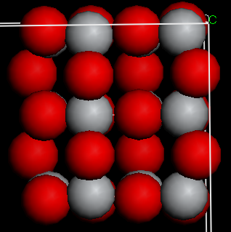
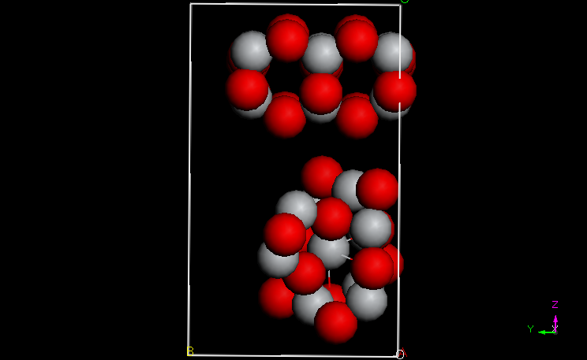
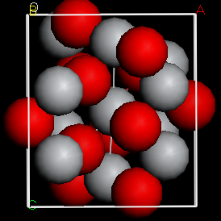
Construction of models
Rutile
Anatase
Anatase-Rutile

Slide 54
Computational details
The geometry optimisation been carried out in the CASTEP 5.5 implemented in materials studio package 5.5. The Density functional theory electronic structure calculations were performed in Generalised Gradient Approximation (GGA) method employing the exchange correlation function of PW91, with default spin. Cluster is treated with plane wave method with the energy cut-off value 300eV and the k points of 5 × 3 × 1. For single point energy and Density of States Calculations (DOS) the self-consistent field convergence window is set to be 2.0e⁻⁶eV/atom along with 48×48×48 FFT grid with the augmentation density scaling factor of 1. The psudopotentials were treated as Ultra soft in the real space system. The calculated DOS is plotted with smearing of 0.2 eV.

Slide 55
Results
Total density of states for Anatase, Rutile and Anatase-Rutile

Slide 56
Total density of states for Anatase, Rutile and Anatase-Rutile

Slide 57
Discussion & Conclusion
Pure anatase shows higher density of states at the valence band as compared to pure rutile . This will have implications for the observed photo-activity of anatase phase.
The Anatase-Rutile valance band shows the higher DOS as compare to Pure anatse.
The valence band width (~2.5 eV) appears to be greater for the rutile-anatase combination rather than the other two pure phases. This could be the reason why the combination system exhibits higher photo-activity.
This can result in higher photon absorption cross section and thus facilitate facile electron hole pair formation.

Slide 58
Table. 1. Data on Hydrogen Storage on a variety of Carbon Materials
Adsorbent | Temperature (K) | Pressure (MPa) | Weight % of Hydrogen | Ref
MWNT | 300 77 | 12 | 0.3 2.27 | 4,6
SWNT SWNT Acid treated ACF CNT | 77 77 303 303 | 0.1 3.1 11.5 | 0.8 1.8 0.26 <0.2 | 5 7
Wood based carbon | 303 |  | <0.3 | 8
CA800 CB850 Amorphous carbon | 77 77 299 | 2 2 1 | 3.9 5.5 0,05 | 9
Fishbone CNF Platelet CNF Ribbon CNF | 299 299 299 | 1 1 | 0.03 0.03 0.02 | 10
Nanofibres (Pd/C) |  | 0.1 to 10 | 0.04-0.33 | 11
AC CNF A-CNF | 77-303 303 303 | 2-10 10 3-10 | 0.85-5.5 0.35 0.33-1.03 | 12
ZIF templated carbon | 77 | 2 | 2.6-3.1 3.9-6.2 | 13
MWNT Multiwall nanotube; SWNT- Single wall nano tube; CNT- carbon nano tube; ACF activated carbon fibre [for more extensive compilation of data please see the earlier review articles [1, 14,15]]

Slide 59
Table 5 Hydrogen absorption activity of carbon nano-materials at 1 atm and at different temperatures
PDC prepared from polyvinylpyrolidone; MEC from poly acrylonitrile; NCNT1 using poly pyrrole; NCNT2
and NCNT using pyridine
Sample | Percentage nitrogen | SSA (m²/g) | Hydrogen absorption at 1 atm (cm²/g)
 |  |  | 77 K |  | 373 K
PDC | 7.6 | 93 | 20.4 | 0.90
MEC | 4.3 | 182 | 64.5 | 2.78
CNT1 | - | - | - | -
NCNT1 | 6.4 | 246 | 47.5 | 6.11
CNT2 | - | 633 | 28.0 | 3.42
NCNT2 | 2.5 | 646 | - | -
CNT3 | -1.8 | 49 | - | 3.0
NCNT3 |  | 66 | 7.45 | 2.4

Slide 60
Table. 4. Comparison of specific surface area (SSA) and hydrogen absorption activity of CDX and chemically modified CDX samples
T-CDX – acid treated A-CDX- amine treated TA-CDX both acid and amine treated
Sample | CDX-975 | T-CDX-975 | A-CDX-975 |  | TA-CDX-975
S S A in m²/g | 325 | 224 | 129 |  | 124
Hydrogen adsorption capacity (cm²/g) at 1 atm
77K | 28.1 | 27.3 | 8.2 | 10.4
298K | 0.53 | - | - |  | 0.7
373K | 2.83 | 3.17 | 3.03 |  | 2.97
423K | 4.18 | 4.25 | 4.30 |  | -

Slide 61
Table 3 Bond length and dissociation energy of hydrogen molecule upon interaction with fullerene –
calculated using B3LYP with 6-31g (p,d) basis set on the UFF optimized structure
System | Total energy (Hartrees) | H₁-H₂ (Å) | Dissociation energy (eV)
H₂ | -1.175 | 0.708 | 4.76
C₆₀ C₆₀+H₂ | -2286.042 -2287.211 | - 0.707 | - 4.61
NC₅₉ NC₅₉+H₂ | -2302.653 -2303.640 | - 0.831 | - 0.36
PC₅₉ PC₅₉+H₂ | -2589.253 -2590.276 | - 0.813 | - 0.64
SC₅₉ SC₅₉ + H₂ | -2646.036 -2647.013 | - 0.815 | - 0.62
BC₅₉ BC₅₉+ H₂ | -2272.764 --2273.908 | - 0.818 | - 3.92
2B C₅₈ (adjacent) 2BC₅₈ + H₂ (adjacent) | -2259.506 -2560.567 | - 1.126 | - 1,.662
2B C₅₈ (alternate) 2B C₅₈ + H₂ (alternate) | -2259.487 -2260.477 | - 1.016 | - 0.276

Slide 62
Table 2 Bond length and dissociation energy of hydrogen on CNT and heteroatom substituted
CNTs calculated using B3LYP with 6-31g(p,d) basis set on the UFF optimized structure
CNT and substituted hetero atom | Total energy (Hartrees) | Bond length H₁-H₂ (Å) | Dissociation energy (eV)
Hydrogen | -1.175 | 0.708 | 4.76
CNT CNT + H₂ | -3686.5502 -36687.7161 | - 0.776 | - 4.51
NCNT NCNT+H₂ | -3702.5908 -3703.5989 | - 0.835 | - 0.22
PCNT PCNT+H₂ | -3989.1694 -3990.2550 | - 0.815 | - 2.33
SCNT S CNT + H₂ | -4046.0020 -4047.0067 | - 0.817 | - 0.13
BCNT BCNT+ H₂ | -3671.7254 -3672.9440 | - 0.818 | - 5.95
2B CNT (adjacent) 2B CNT(adjacent) +H₂ | -3658.6666 -3659.8092 | - 0.913 | - 3.88
2B CNT (alternate) 2B CNT(alternate)+H₂ | -3659.3491 -3660.3594 | - 0.928 | - 0.28

Slide 63
Why carbon materials for solid state hydrogen storage?
Coordination number is variable/expandable
Promote new morphologies
Covalent character retention
Variable hybridization possible
Geometrical possibilities/size considerations
Meta-stable state
Similar to biological architectures “Haeckelites”
Boron and nitrogen doped graphitic
arrangements promise important applications.

Slide 64
Objectives
Necessity of active sites
Heteroatom containing carbon materials - appropriate candidates?
Gradation of the carbon materials containing various heteroatoms
Geometrical positions of the heteroatoms

Slide 65
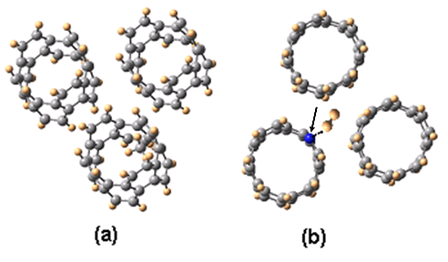
Model & Methodology
Three Single Walled Carbon nanotubes (SWNTs) of armchair type (4, 4)
Each tube having 32 carbon atoms
Tube diameter - 5.56 Å
Interface with three nanotubes – intertubular distance - 3.64 Å
Energy minimization – UFF 1.02 (Cerius2 Software)
Single point energy and bond population analysis – DFT
( B3LYP/6-31G*)

Slide 66
Bond length and dissociation energy of H₂ on NCNT
Substitution | Total Energy (Hartrees) | H₁-H₂ (Å) | Dissociation Energy (eV)
H₂ | -1.175 | 0.708 | 4.76
CNT CNT + H₂ | -3686.5502 -3687.7161 | - 0.776 | - 4.51
NCNT NCNT + H₂ | -3702.5908 -3703.5989 | - 0.835 | - 0.22
Character of HOMO
HOMO (Hartrees) | % orbital contribution
 | C |  | N |  | H
 | s | p | s | p | s_{b} | s_{t}
CNT (-0.1612) | 0 | 100 | - | - | - | -
CNT + H₂ (–0.1613) | 0 | 100 | - | - | 0 | 0
NCNT (– 0.1617) | 1 | 98.30 | 0 | 0.18 | - | 0.56
NCNT + H₂ ( – 0.1371) | 0.52 | 37.39 | 1.37 | 31.91 | 26.66 | 2.15
* b- bonded hydrogen to nitrogen and t- terminal hydrogen in the cluster

Slide 67
Bond length and dissociation energy of H₂ on PCNT
Substitution | Total Energy (Hartrees) | H₁-H₂ (Å) | Dissociation Energy (eV)
H₂ | -1.175 | 0.708 | 4.76
CNT CNT + H₂ | -3686.5502 -3687.7161 | - 0.776 | - 4.51
PCNT PCNT + H₂ | -3989.1694 -3990.2550 | - 0.815 | - 2.33
Character of HOMO
HOMO level (Hartrees) | % of orbital contribution
 | C |  | P |  | H
Contribution | s | p | s | p | s_{b} | s_{t}
CNT (-0.1612) | 0 | 100 | - | - | - | -
CNT + H₂ (–0.1613) | 0 | 100 | - | - | 0 | 0
PCNT (– 0.1611) | 1 | 96.85 | 0 | 1.71 | - | 0.53
PCNT+ H₂ ( – 0.1516) | 1 | 85.62 | 0.04 | 8.06 | 4.83 | 0.49
* b- bonded hydrogen to phosphorus and t- terminal hydrogen in the cluster

Slide 68
Bond length and dissociation energy of H₂ on SCNT
Substitution | Total Energy (Hartrees) | H₁-H₂ (Å) | Dissociation Energy (eV)
H₂ | -1.175 | 0.708 | 4.76
CNT CNT + H₂ | -3686.5502 -3687.7161 | - 0.776 | - 4.51
SCNT SCNT + H₂ | -4046.0020 -4047.0067 | - 0.817 | - 0.13
Character of HOMO
HOMO level (Hartrees) | % of orbital contribution
 | C |  | S |  | H
 | s | p | s | p | s_{b} | s_{t}
CNT (-0.1612) | 0 | 100 | - | - | - | -
CNT + H₂ (–0.1613) | 0 | 100 | - | - | 0 | 0
SCNT (– 0.1375) | 1 | 76.87 | 0 | 21.17 | - | 1.16
SCNT + H₂ ( – 0.1207) | 0.45 | 41.80 | 0.35 | 41.65 | 14.87 | 0.88
* b- bonded hydrogen to sulphur and t- terminal hydrogen in the cluster

Slide 69
Energy profile for hydrogen interaction with heteroatom substituted CNT clusters
Reaction coordinate
Substitution | E_{a} I (eV) | E_{a} II (eV) | H₁-H₂ (Å) | X-H (Å) | C-H₁* (Å) | C-H₂* (Å)
CNT | 10.02 | - | 0.71 | - | - | -
N CNT | 3.84 | 4.58 | 1.45 | 1.11 | 1.70 | 1.94
P CNT | 3.81 | 3.99 | 1.51 | 1.61 | 1.27 | 2.33
S CNT | 3.65 | 4.85 | 1.50 | 1.75 | 1.24 | 2.40
E_{a} = E (transition state) – E (reactant) * Shortest C-H bond distance

Slide 70
Bond length and dissociation energy of H₂ on BCNT
Substitution | Total energy (Hartrees) | H₁-H₂ (Å) | Dissociation energy (eV)
H₂ | -1.175 | 0.708 | 4.76
CNT CNT + H₂ | -3686.5502 -3687.7161 | - 0.776 | - 4.51
B CNT B CNT + H₂ | -3671.7254 -3672.9440 | - 0.818 | - 5.95
Character of HOMO
HOMO level (Hartrees) | % of orbital contribution
 | C |  | B |  | H
Contribution | s | p | s | p | s_{b} | s_{t}
CNT (-0.1612) | 0 | 100 | - | - | - | -
CNT + H₂ (–0.1613) | 0 | 100 | - | - | 0 | 0
BCNT (–0.1576) | 1 | 94.87 | 0 | 3.59 | - | 0.5
BCNT + H₂ (– 0.1534) | 1 | 96.26 | 0.10 | 1.12 | 1 | 0.54
* b- bonded hydrogen to boron and t- terminal hydrogen in the cluster

Slide 71
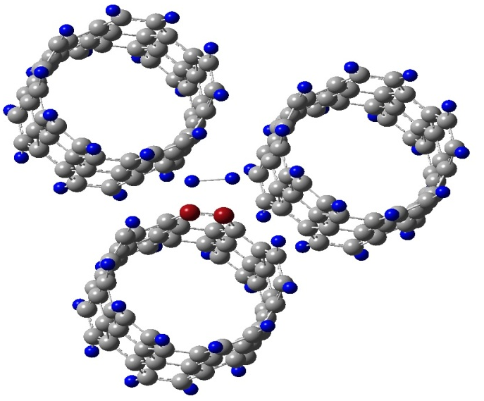
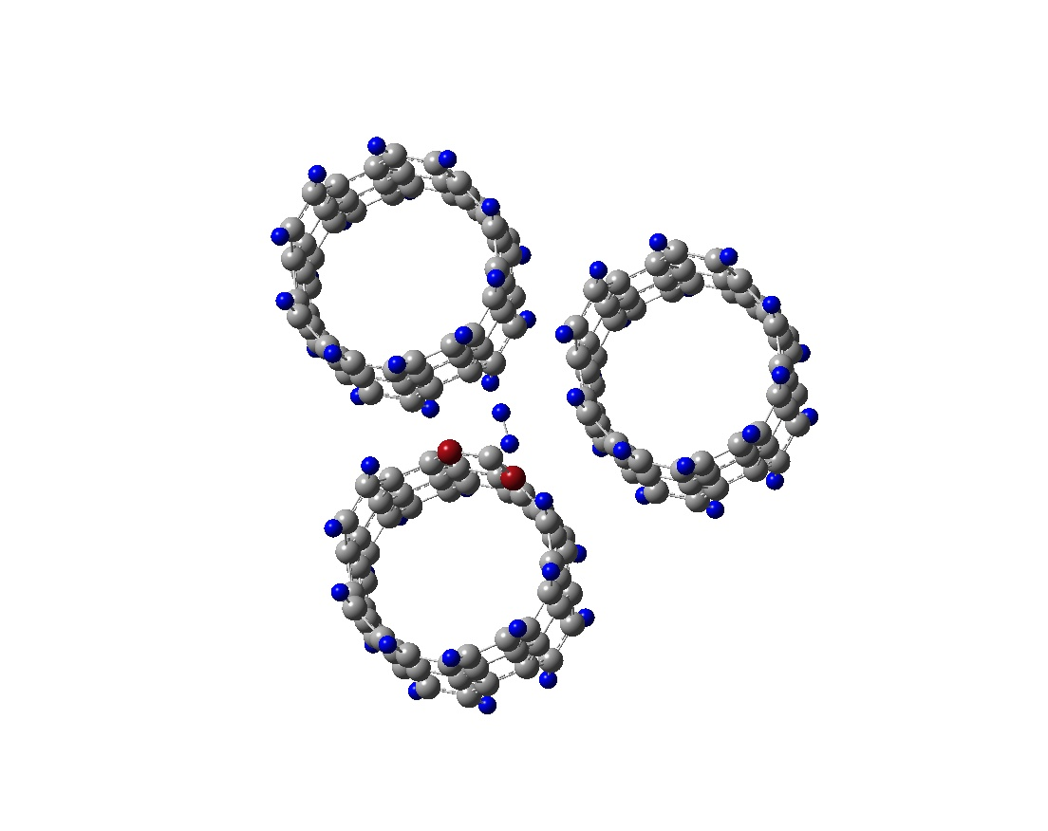
Bond length and dissociation energy of H₂ on BCNTs
Substitution | Total energy (Hartrees) | H₁-H₂ (Å) | Dissociation energy (eV)
H₂ | -1.175 | 0.708 | 4.76
CNT CNT + H₂ | -3686.5502 -3687.7161 | - 0.776 | - 4.51
2B CNT (adjacent) 2B CNT (adjacent) + H₂ | -3658.6666 -3659.8092 | - 0.913 | - 3.88
2B CNT (alternate) 2B CNT (alternate) + H₂ | -3659.3491 -3660.3594 | - 0.928 | - 0.28
Adjacent position
Alternative position

Slide 72
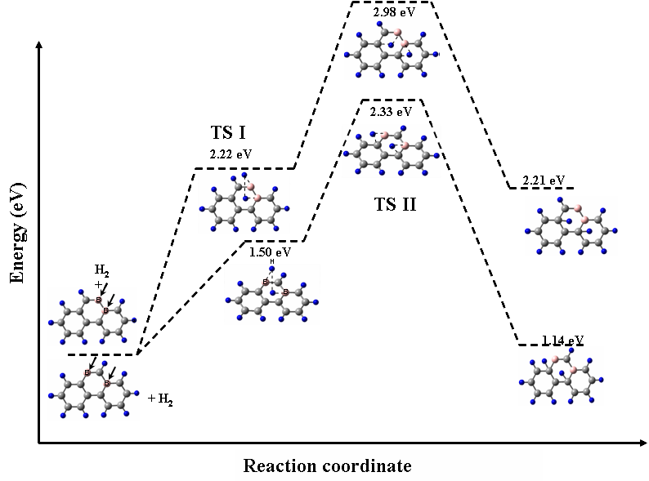
Energy profile of boron substituted CNT clusters
Substitution | E_{a} I (eV) | E_{a} II (eV) | H₁-H₂ (Å) | X-H (Å) | C-H₁∗ (Å) | C-H₂* (Å)
CNT | 10.02 | - | 0.71 | - | - | -
2B CNT (adjacent) | 2.22 | 2.98 | 1.95 | 1.31 | 2.59 | 2.72
2B CNT (alternate) | 1.5 | 2.33 | 2.95 | 1.47 | 1.47 | 2.34
E_{a} = E (transition state) – E (reactant) * Shortest C-H bond distance

Slide 73
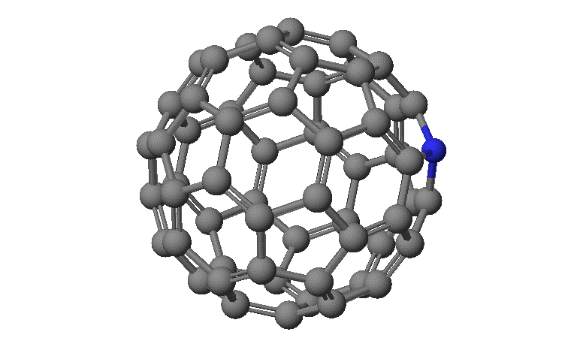
Hydrogen activation in heteroatom substituted fullerene
METHODOLOGY
Energy minimization – UFF 1.02 (Cerius2 Software)
Single point energy – DFT ( B3LYP/6-31G*)
Bond length and dissociation energy of H₂
 | Total Energy (Hartrees) | (H₁-H₂) Å | H₂ Dissociation energy (eV)
H₂ | -1.175 | 0.708 | 4.74
C₆₀ C₆₀+H₂ | -2286.042 -2287.211 | - 0.707 | - 4.61
NC₅₉ NC₅₉ +H₂ | -2302.653 -2303.640 | - 0.831 | - 0.36
PC₅₉ PC₅₉ +H₂ | -2589.253 -2590.276 | - 0.813 | - 0.64
SC₅₉ SC₅₉ +H₂ | -2646.036 -2647.013 | - 0.815 | - 0.62

Slide 74
Transition state path ways for hydrogen interaction
X
X
X= N, P & S
X
X
X
Unsubstituted fullerenes
Substituted fullerenes
Substitution | *E_{a} I (eV) | E_{a} II (eV) | E_{a} III (eV) | H₁-H₂ Å | X-H₁ Å | C₁-X Å | C₂-X Å | C₃-X Å
Carbon | 18.49 | - | - | 0.70 | - | - | - | -
Nitrogen | 3.24 | 3.15 | 3.08 | 1.85 | 1.04 | 1.44 | 1.50 | 1.50
Phosphorus | 1.73 | 1.52 | 1.52 | 1.85 | 1.26 | 1.48 | 1.62 | 1.62
Sulphur | 2.56 | 6.48 | 1.86 | 1.13 | 1.60 | 1.70 | 1.70 | 1.70
* = E (each transition state) – E (reactant)

Slide 75
Boron substituted fullerene
Substitution | Total energy (Hartrees) | (H-H) Å | H₂ dissociation energy (eV)
H₂ | -1.175 | 0.708 | 4.74
C₆₀ | -2286.042 | - | -
C₆₀ + H₂ | -2287.211 | 0.707 | 4.61
BC₅₉ | -2272.764 | - | -
BC₅₉ +H₂ | -2273.908 | 0.818 | 3.92
2BC₅₈ (Adj) | -2259.506 | - | -
2BC₅₈ (Adj) +H₂ | -2560.567 | 1.126 | 1.66
2BC₅₈ (Alt) | -2259.487 | - | -
2BC₅₈ (Alt) +H₂ | -2260.477 | 1.016 | 0.28

Slide 76
Transition state optimized parameters and the E_{a} for the proposed pathway
Substitution | E_{a}I (eV) | H₁-H₂ (Å) | B₁-H₁ (Å) | B₂-H₂ (Å) | C-H₁* (Å) | C-H₂* (Å)
Adjacent (X, 2) | 2.26 | 1.98 | 1.19 | 1.29 | 2.52 (C₂) | 1.43 (C₄)
Alternate (X, 3) | 0.50 | 2.95 | 1.27 | 1.23 | 1.25 (C₂) | 1.97 (C₅)
E_{a} = E (each transition state) – E (reactant) * = Shortest C-H bond distance
Outcome
Substituted heteroatom acts as an active centre for hydrogen activation
For the effective hydrogenation and hydrogen storage, the heteroatoms should be incorporated geometrically and chemically into the carbon network

Slide 77
High Pressure adsorption apparatus
Vacuum system
RC
33.8 mL (V₁)
TC
NV
Vent
V₂ (18.64 mL)
NV- Needle valve
RC- Reference Cell
PT- Pressure transducer
SC- Sample cell
TC- Thermocouple
SC
PT
V₃ (20.72 mL).
Gas inlet
Furnace
Digital Pressure Indicator
Calculation:
P_{i}V_{i} = P_{f} (V₁+V₂+V₃+ V_{ads})
V_{ads} Z = V_{correct}
Where Z = Compressibility factor

Slide 78
Chapter 4. Hydrogen storage capacity in activated carbon
Activated Carbon and their modifications
Activated carbon
(CALGON & CDX-975)
Metal supported on CALGON
  Nickel metal - (2, 5 & 20 wt %) - physical mixture of acetate metal precursor - reduction in hydrogen atmosphere at 450 °C
Chemical treatment on CDX-975
  Chemical treatment with 1M HNO₃ for acid treatment and for amine treatment tri ethylene tetra amine.

Slide 79
Hydrogen absorption capacity at 1 atm pressure
 | Calgon | Nickel/Carbon (Calgon) |  |  | CDX- 975 | T-CDX | A-CDX | TA-CDX
 |  | 20 wt% | 5 wt% | 2 wt%
Surface area (m²/g) | 931 | 616 | 750 | 1066 | 325 | 224 | 129 | 124
Hydrogen absorption at 1 atm (cm³/g)
77K | 137.7 | 54.4 | 44.5 | 120.8 | 28.1 | 27.3 | 8.2 |  | 10.4
298K | 0.70 | 0.5 | - | - | 0.53 | - | - |  | 0.7
373K | 0.43 | 3.14 | 1.4 | 1.53 | 2.83 | 3.17 | 3.03 |  | 2.97
423K |  | 1.95 | 1.7 | 2.05 | 4.18 | 4.25 | 4.30
473K |  |  |  |  | 5.0 | 4.60
523K |  |  |  |  | 4.80 | 6.36

Slide 80
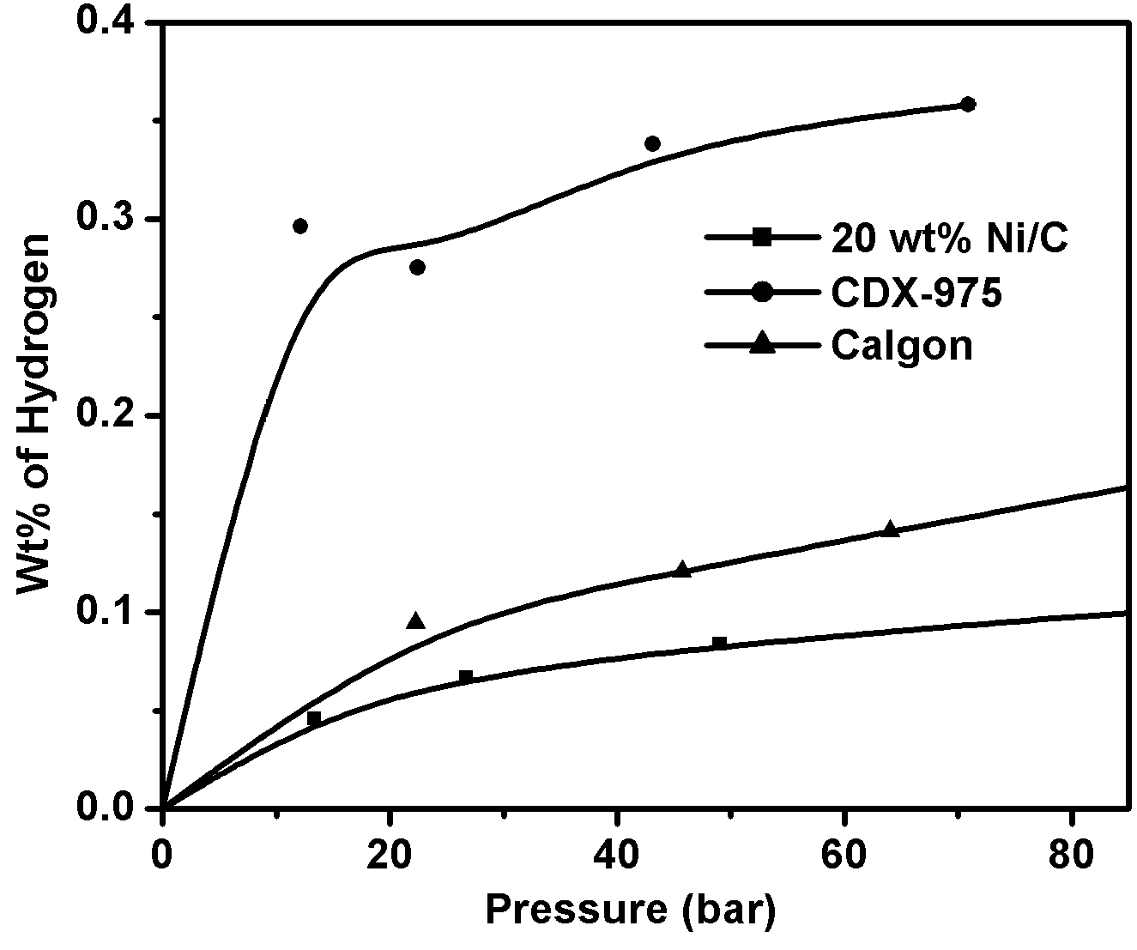
High pressure hydrogen absorption activity of activated carbon

Slide 81
Carbon materials | Template | Carbon Source | Technique | Morphology
PDC | Silica | PVP | Precipitation | Rod shape
MEC | Silica | PAN | Insitu precipitation | Coiled and fibers
CNT1 & NCNT 1 (6.4 %) | Alumina membrane | PPA PPY | In-situ polymerization | Tubular
CNT2 & NCNT2 (2.5%) | Zeolite | Acetylene Acetylene + Pyridine | Chemical vapor deposition | Tubes and fibers
CNT3 & NCNT3 (1.8%) | Clay (pillared) | Acetylene Acetylene + pyridine | Chemical vapor deposition | Tubes and fibers

Slide 82
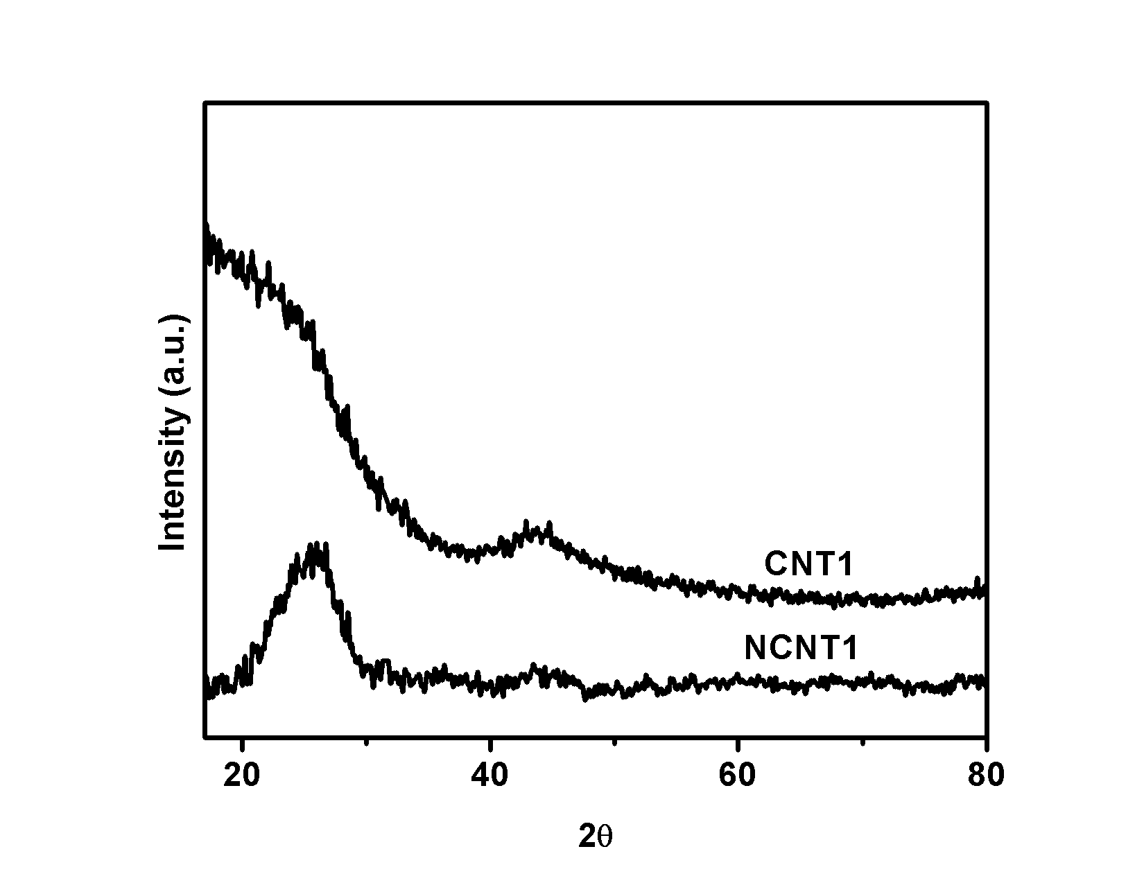
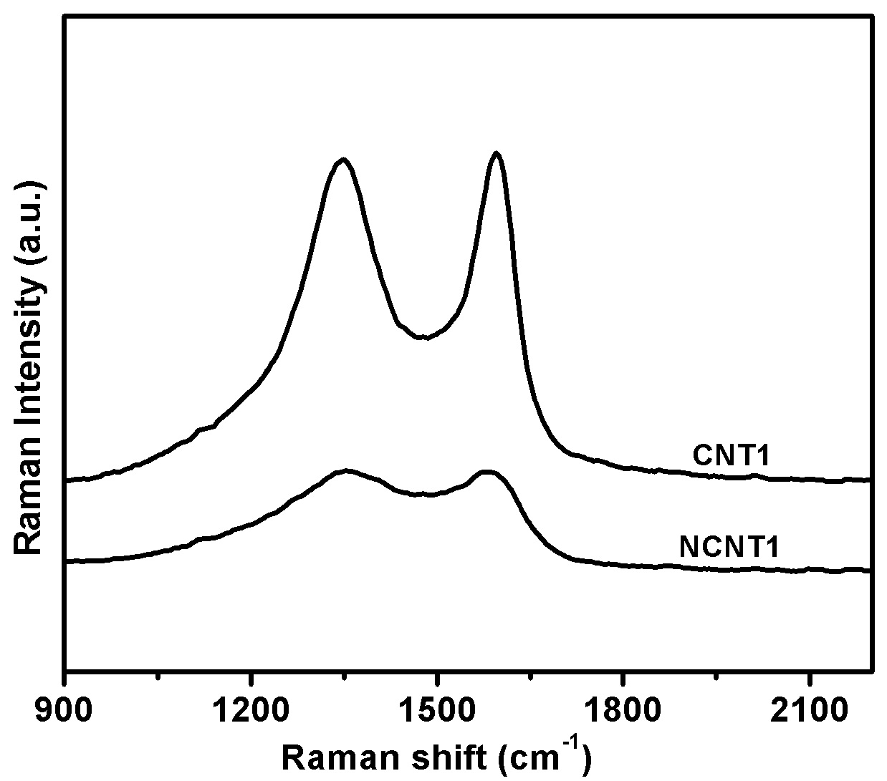
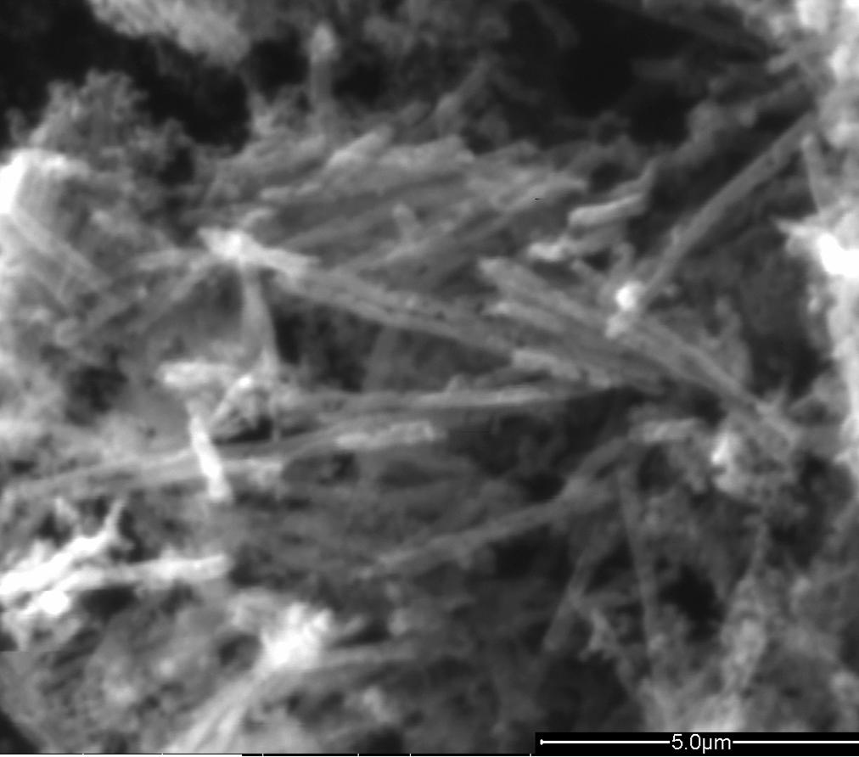
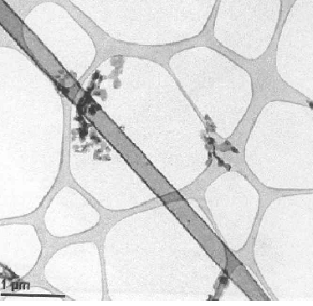
Characterization of Carbon Nanotubes

Slide 83
Specific surface area and amount of hydrogen absorbed at 1 atm & different temperatures
Sample | SSA (m²/g) | Hydrogen absorption at 1 atm (cm³/g) at various temperatures (K)
 |  | 77 | 298 | 373
PDC | 93.0 | 20.2 | 0.34 | 0.90
MEC | 182 | 64.4 | - | 2.78
NCNT1 | 246 | 47.5 | - | 6.11
CNT2 | 633 | 28.0 | - | 3.42
NCNT2 | 646.5 | - | - | -
CNT3 | 48.8 | - | - | 3.0
NCNT3 | 66.4 | 7.45 | - | 2.4

Slide 84


Hydrogen storage capacity at various pressures

Slide 85
Template | Carbon Source | Technique | Morphology
Alumina membrane (BCNT1) | Polymer (hydroborane) | In-situ polymerization | Tubular
Zeolite (BCNT2) | Hydrocarbon (Acetylene + borane gas) | Chemical vapor deposition | Tubes and Fibers
Clay (pillared) (BCNT3) | Hydrocarbon (Acetylene + borane gas) | Chemical vapor deposition | Tubes and Fibers

Slide 86
Boron containing carbon nanotubes prepared using alumina membrane
Alumina membrane
(0.2μm pore size) in THF
Borane (BH₃.THF)
Divinyl benzene
Stirred 273 K
Polymerization at RT 3h
Polymer /Alumina
Carbonization 1173K Ar,4h
Carbon / Alumina
48% HF 24h
Carbon nanotubes (BCNT1)
0°C
THF solvent
N₂ atm
+ BH₃:THF
using hydroborane polymers

Slide 87
Preparation of boron containing carbon nanomaterials using zeolite and pillared clay
Tubular furnace
H-Y Zeolite or pillared clay in quartz boat
Mass flow meter
After carbonization treated wit 48% HF to remove the template
Conc. H₂SO₄
Acetylene gas
Ar gas
Ice bath
BCNT 2 (Zeolite)
BCNT 3 (Clay)
Magnetic stirrer
NaBH₄ + THF
Chemical vapor deposition of borane gas + acetylene mixture over template

Slide 88



Characterization of Carbon Nanotubes

Slide 89


¹³C & ¹¹B CP MAS NMR of boron containing carbon nanotubes prepared by different methods
¹³C CP MAS NMR of BCNT1
¹¹B CP MAS NMR of BCNT1 & BCNT2

Slide 90


XPS of BCNT1
(a). The servey X-ray photoelectron spectrum of boron substituted carbon nanotube. (b). The deconvoluted XPS spectrum of B1s.
Confirms the presence of two different chemical environment of boron

Slide 91
Hydrogen absorption activity of boron containing carbon nanomaterials at 1 atm
Carbon nanomaterial | Surface area (m²/g) | Amount of hydrogen absorbed (cm³/g) at 1 atm & at various temperatures (°C)
 |  | -196 | 25 | 100 | 150
BC | 11.9 | 3.63 | 0.6 | 3.63 | 4.68
PBC | 429.9 | 73 | - | 2.90 | 3.02
BCNT1 | 523 | 127 | - | 16.5 | 14.8
BCNT2 | 62.3 | 3.22 | - | 2.38 | 4.73
BCNT3 | 32.7 | 1.09 | - | 1.7 | -

Slide 92

Hydrogen storage capacity of boron containing carbon nanotubes
Boron containing carbon nanotubes prepared with polymer precursor, show different boron chemical environments and structural morphology. This configuration has a bearing on hydrogen sorption characteristics.

Slide 93
THANK YOU ALL

