Slide 1
Structural Properties of Nanomaterials
Prepared by:
Harisankar N S
CA12M003

Slide 2
Nanotechnology- “ Next Big Thing”

Slide 3
“Structure at Nanoscale Matters”

Slide 4
Nanomaterials: Solids characterized by at least one dimension in nanometer range.
Source:Nanomaterials-2b--Preparation-and-Properties.pdf -Nanotecnologia Università di Bologna.
Notes:
Source:Nanomaterials-2b--Preparation-and-Properties.pdf -Nanotecnologia Università di Bologna

Slide 5
Importance of Surface
Surface consists of atoms/molecules that experience considerable coordinative unsaturation.
Everything has a surface.
Surface is important regardless of how small /large the material is.
Few phenomena that depend on surface: Catalytic Activity, Electrical Resistivity, Adhesion, Gas Storage etc.
Surface performs many vital functions.

Slide 6
Surface From Natural Perspective
Nature-Ultimate Nanotechnologist.
Most of the biochemistry occurs at nanoscales.
Enzymes-Nanoscale catalytic proteins.
Enzymes have considerably increased their surface area so that greater number of substrates can participate in reaction.
In context of evolution, surface to volume ratio played an important role in limiting the size that a cell can achieve?

Slide 7
Surface From Inorganic Perspective
Surface is important to inorganic materials, whether they are the size of stars and planets or as minute as nanosized catalysts.
Catalyst reduce the activation energy of reaction without being consumed. How does this energy reduction accomplished?-It is through the energy of the surface.
Bulk gold is noble in the sense that it is relatively inert to oxidation and other reactions.
On the other hand nanosized gold particles on oxide support shows significant catalytic activity towards oxidation of CO even at low temperatures.

Slide 8
Surface From Nano Perspective
Properties of nanomaterials depend on the following.
Molecular makeup
Amount of material
Size
Shape
Orientation
Examples.
Optical properties - Orientation
Mechanical Properties-Orientation of particles within matrix.

Slide 9
Particle Shape & Surface
Surface of a material depends on it’s size and geometric shape.
Three factors that relate to the surface are as follows.
The effect of subdivision of a parent material on the overall surface area.
The effect of a particular shape on the surface area.
The accompanying increase in surface to volume ratio as individual particles assume smaller dimensions.

Slide 10
Exterior and Interior Surfaces
Nanomaterials have significant proportion of surface atoms, of which there are two general types- Exterior surfaces & Interior Surfaces.
Exterior Surfaces: Atoms existing on outside surface and edges; Includes cavities wider than they are deep.
Examples: metals, semiconductor clusters.
Interior Surfaces: Cavities deeper than they are wide; Pore channels & surfaces between grain boundaries of a crystalline solid.
Examples: inorganic porous oxides like Al₂O₃, natural and synthetic zeolites.

Slide 11
Surface to Volume Ratio & Collective Surface Area
Surface to Volume Ratio (S/V)
Ratio of surface area to volume of same particle.
Intensive property as it is relevant to single entity.
Although it has dimensions, it is usually listed as a dimensionless quantity.
How does (S/V) changes as a material acquires smaller dimensions?
Collective Surface Area
Sum total of surface areas of individual materials.
Extensive/Additive property.

Slide 12
How does Collective Surface Area Changes with Reduction in Size?
If a cube is divided into ‘8’ equivalent cubes with each step, Collective Surface Area doubles after each step.
Consider a cube of length 1 meter.
Initial surface area = 6 square meters.
Surface area after first step = 12 square meters.
Number of steps required to create cubes of length
1 nanometer = 30.
Surface area after 30 steps= 6400 square kilometers.

Slide 13
Cube Cutting Sequence
Source: Introduction to Nanoscience by Gabor L. Hornyak, Joydeep Dutta, Harry F. Tibbals & Anil K. Rao

Slide 14
Plot between Proportion of Surface Atoms and Dimensions of Cube
Source: Introduction to Nanoscience by Gabor L. Hornyak, Joydeep Dutta, Harry F. Tibbals & Anil K. Rao

Slide 15
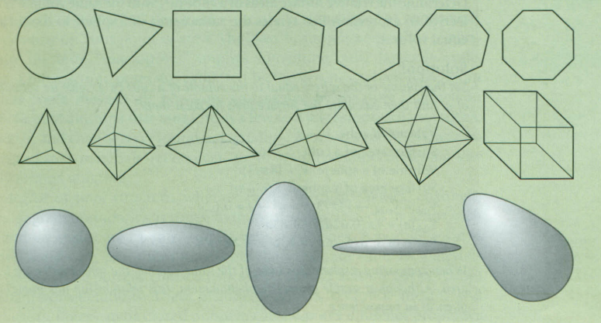
Common Shapes of Nanomaterials
Cubes, rectangular solids, spheres, spheroids, cylinders, pyramids, discs etc.
Tetrahedrons, icosahedrons, dodecahedrons, cube octahedrons, tubes, hollow spherical structures.
Source: Introduction to Nanoscience by Gabor L. Hornyak, Joydeep Dutta, Harry F. Tibbals & Anil K. Rao

Slide 16
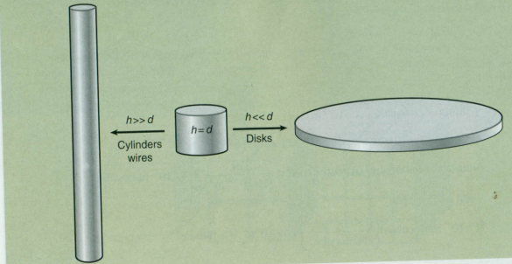
The relation between ‘h’ and ‘d’ determines whether a material is more like a disk or a more like a wire.
Many nanomaterials are found in both morphologies.
Nanomaterials are also found in all of the seven basic crystal systems and in all the Bravais Lattices.
Source: Introduction to Nanoscience by Gabor L. Hornyak, Joydeep Dutta, Harry F. Tibbals & Anil K. Rao

Slide 17
Interior Nanoscale Surface Area
Some extent of pore structure is inherent in most solids.
Porous Solids: Solid with pores that are deeper than they are wide.
IUPAC classification of pores:
Micropores (less than 2 nm)
Mesopores (2 nm to 50 nm)
Macropores (greater than 50 nm)
Pores-Open Pores and Closed Pores
Closed Pores-Influence density, electrical conductivity, thermal conductivity etc
Open Pore-Influence transport properties-Important in Catalysis

Slide 18
Surface Atoms
They form interface with exterior environment.
They are ‘first responders’ in a chemical reaction.
Hence surface atoms are responsible for chemical properties of a material.
Ratio of number of atoms on surface (Surface Atoms) to number of atoms that exist in the volume (Volume Atoms) is of considerable significance.

Slide 19
Surface-Volume Parameters for Hypothetical Gold of Diminishing Volume
Source: Introduction to Nanoscience by Gabor L. Hornyak, Joydeep Dutta, Harry F. Tibbals & Anil K. Rao

Slide 20
Crystal Systems & the Unit Cell
Seven geometric crystal systems and 14 unique Bravais lattices describe the position, direction, and structural planes of most crystalline materials.
Crystal structure is based on regularly repeating elements that form a pattern in three dimensions.
The unit cell is determined by a set of lattice parameters:
Unit Cell Edge Lengths (a, b, c)
Crystallographic Axis Angles ( α, β, γ )

Slide 21
Source: Introduction to Nanoscience by Gabor L. Hornyak, Joydeep Dutta, Harry F. Tibbals & Anil K. Rao

Slide 22
Bravais Lattices in Cubic System
There are three Bravais Lattices in Cubic System-primitive (cubic-P), body-centred cubic (bcc), face-centred cubic (fcc).
Coordination number of primitive (cubic-P) is 6.
Coordination number of body-centred cubic (bcc) is 8.
Coordination number of face-centred cubic (fcc) is 12.

Slide 23
Bravais Lattices in Cubic System
Source: Introduction to Nanoscience by Gabor L. Hornyak, Joydeep Dutta, Harry F. Tibbals & Anil K. Rao

Slide 24
Cubic Close Packing & Hexagonal Close Packing
Source: Introduction to Nanoscience by Gabor L. Hornyak, Joydeep Dutta, Harry F. Tibbals & Anil K. Rao

Slide 25
Structural Magic Numbers
Clusters consist of a few to several thousand atoms. Some clusters exhibit remarkable stability. These stable forms are said to consist of Magic Number of atoms. They have achieved completeness with regard to physical and electronic structures.
Cluster with Magic Number of atoms can be organised into a closed shell configuration corresponding to lowest energy.

Slide 26
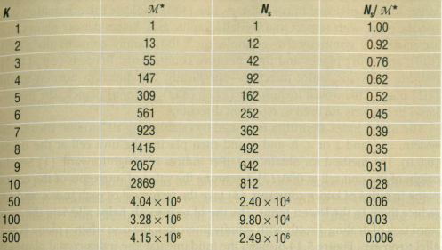
Formula for Magic Nimber of atoms with ‘k’ closed shells:
Source: Introduction to Nanoscience by Gabor L. Hornyak, Joydeep Dutta, Harry F. Tibbals & Anil K. Rao

Slide 27
Surface Energy
Structure surface is certainly due to energy consideration.
Atoms/Molecules at surface are different from those present in the bulk. This is manifested in altered structure, enhanced reactivity, and a greater tendency to agglomerate.
At surface periodicity and chemical bonding of a crystal are disrupted.
Driving force exist in molecules to reduce Surface Area &Surface Energy.
Surface Energy is an extrinsic property.

Slide 28
Surface Energy of one side of cube = S
Surface Energy of one cube = 6 S
Surface Energy of 2 cubes separately = 12 S
2 surfaces are lost during coalescence
Energy after coalescence= 12 S – 2 S = 10 S
During coalescence energy equivalent to 2 S is transformed into energy of cohesion.
Source: Introduction to Nanoscience by Gabor L. Hornyak, Joydeep Dutta, Harry F. Tibbals & Anil K. Rao

Slide 29
Nanomaterials are characterized by high proportion of surface atoms. Hence they have very high surface energies.
“A system of high energy will strive to attain a low energy state by whatever means possible”

Slide 30
Consider FCC
Coordination number of a surface atom in (111) plane is 9.
Coordination number of a surface atom in (100) plane is 8.
Coordination number of a surface atom in (110) plane is 7.
Hence Surface Energy will be according to the following order.
(111)<(100) <(110)

Slide 31
Structural Stabilization in Soilids
Lattice parameters of metallic nanoparticles contract with decrease in particle size.
This can be accomplished in two ways
Contraction of surface layer into bulk.
Lateral shift to increase the number of nearest neighbors.
In both cases lattice parameter ‘a’ is reduced

Slide 32
Restructuring of a Simple Cubic Surface
Source: Introduction to Nanoscience by Gabor L. Hornyak, Joydeep Dutta, Harry F. Tibbals & Anil K. Rao

Slide 33
However, in case of atoms with higher coordination number, manifestation of surface restructuring is interesting.
Consider Silicon which exist in fcc lattice.
It is shown earlier that (100) face is having a higher energy than (111) face.
But restructured (100) face has low energy when compared with natural (111) plane.
Reconstruction of outer layer can also occur by other mechanism that involve loss of periodicity.

Slide 34
Surface layer can stabilize by “outward relaxation” rather than by contraction.
The surface layer moves outward and rearrange to preserve the configuration of bulk atom packing symmetry .This layer is parallel to bulk layers but not normal. For instance, layer can shift by certain distance.
In another case, surface layer moves outwards and arrange into structure that has symmetry different when compared with bulk. This can lead to changes in surface properties- electrical properties, chemical behavior, optical properties, etc

Slide 35
Wulff’s Plot
It predicts the equilibrium shape of nanocrystalline materials.
It gives the relationship between surface energy of a plane and it’s normal distance from a central point of reference.
According to this law, equilibrium distance of a surface facet plane is proportional to surface energy of that plane.

Slide 36
Wulff’s Rule in case of Cuboctahedron
Source: Introduction to Nanoscience by Gabor L. Hornyak, Joydeep Dutta, Harry F. Tibbals & Anil K. Rao

Slide 37
Structural Change During Oxidation of Cubic NiO
Cube
( All {100} faces )
Truncated Cuboctahedron
(Contains {100} faces at vertices)
Cuboctahedron
(Contains {100} faces & {111} faces; 75% oxidation)
Octahedron
(All {111} faces; complete oxidation)

Slide 38
Source: Introduction to Nanoscience by Gabor L. Hornyak, Joydeep Dutta, Harry F. Tibbals & Anil K. Rao

Slide 39
THANK YOU

