Slide 2
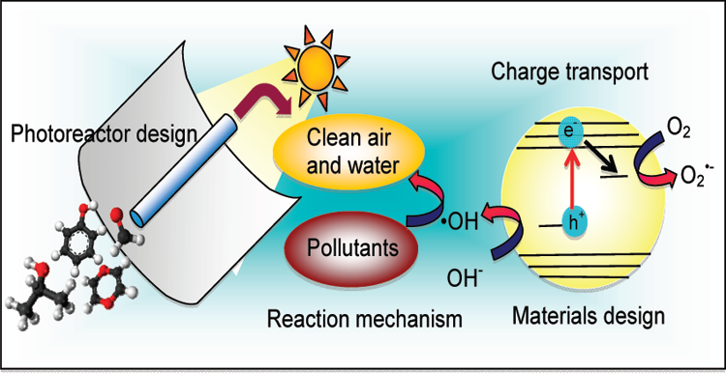
Progress in Heterogeneous Photocatalysis: From Classical Radical
Chemistry to Engineering Nanomaterials and Solar Reactors
W.Y.Teoh, J.A.Scott and R.Amal J.Physical Chemistry Letters, 3, 629-639 (2012)

Slide 3
Overview of Time Evolution of Photocatalysis
The term functional designates photomediated redox reactions such as photocatalytic water splitting, environmental pollutant abatement, and organic
synthesis. Ultimately, these applications were fuelled by the
expectation of efficiently harnessing and utilizing freely available solar energy.

Slide 4
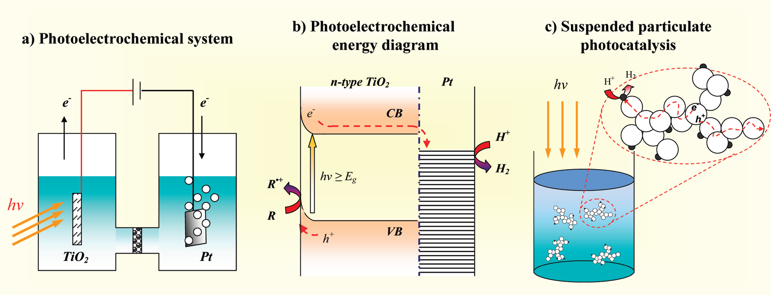
Schematic diagram of (a) the photoelectrochemical system using a TiO2 single crystal as the photoanode; (b) the corresponding energy diagram of the system (which is similarly applicable to); and (c) the “miniaturizsed” photoelectrochemical system in the form of suspended platinized TiO2 particulates. R denotes general organic electron-donor molecule

Slide 5
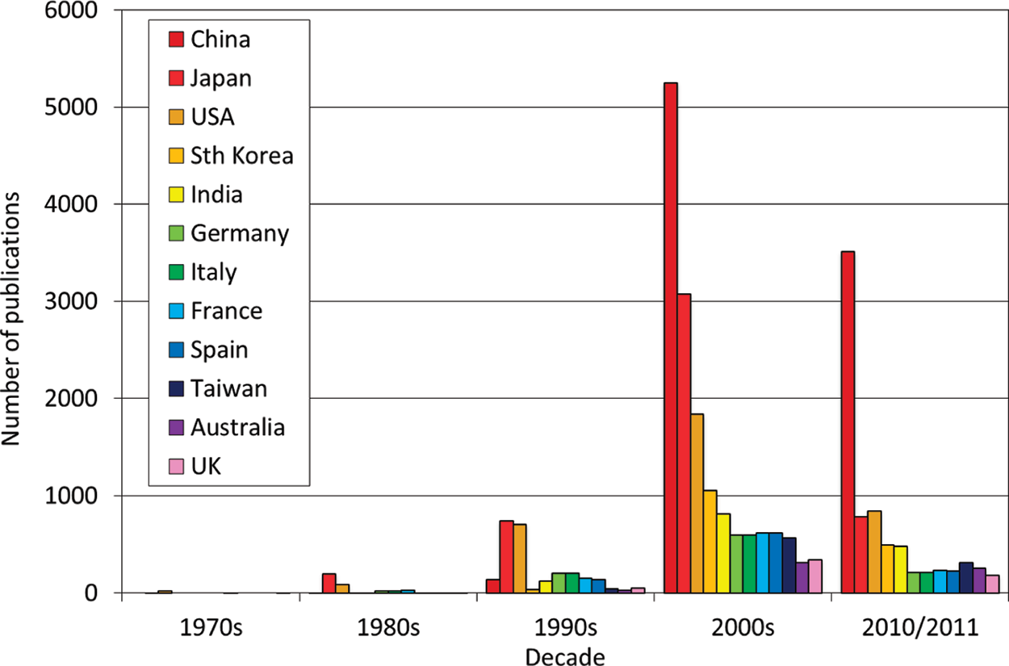
Number of publications pertaining to photocatalysis on a decadal basis originating from the top 12 (overall) publishing nations (topic: photocatalysis/photocatalytic/photocatalyst, ISI Web of Science, 12/01/2012). Besides the traditional photocatalysis powerhouses of Japan and the United States, the research output from China has dominated over the past decade, whereas South Korea and India have also experienced substantial growth in this field

Slide 6
Although it was substrate-specific, organic degradation was predominantly centered on direct (hole-mediated) and indirect oxidation reactions (mediated by hydroxyl and superoxide radicals) This was complemented by identifying the key function of molecular oxygen as an efficient electron scavenger, prompting system aeration or oxygenation when assessing photocatalytic oxidation reactions. Further interfacing with engineering saw effective photon delivery to the photocatalyst surface through light harvesting and photoreactor design.
In this instance, photovoltaic (PV) conversion by excitonic (dyes, quantum dots, plasmonic) solar cells is a vanguard photocatalysis-related solution

Slide 7
understanding charge transport
, identifying the reaction mechanism,
designing an innovative photo-catalyst,
and (4) engineering photon delivery

Slide 8
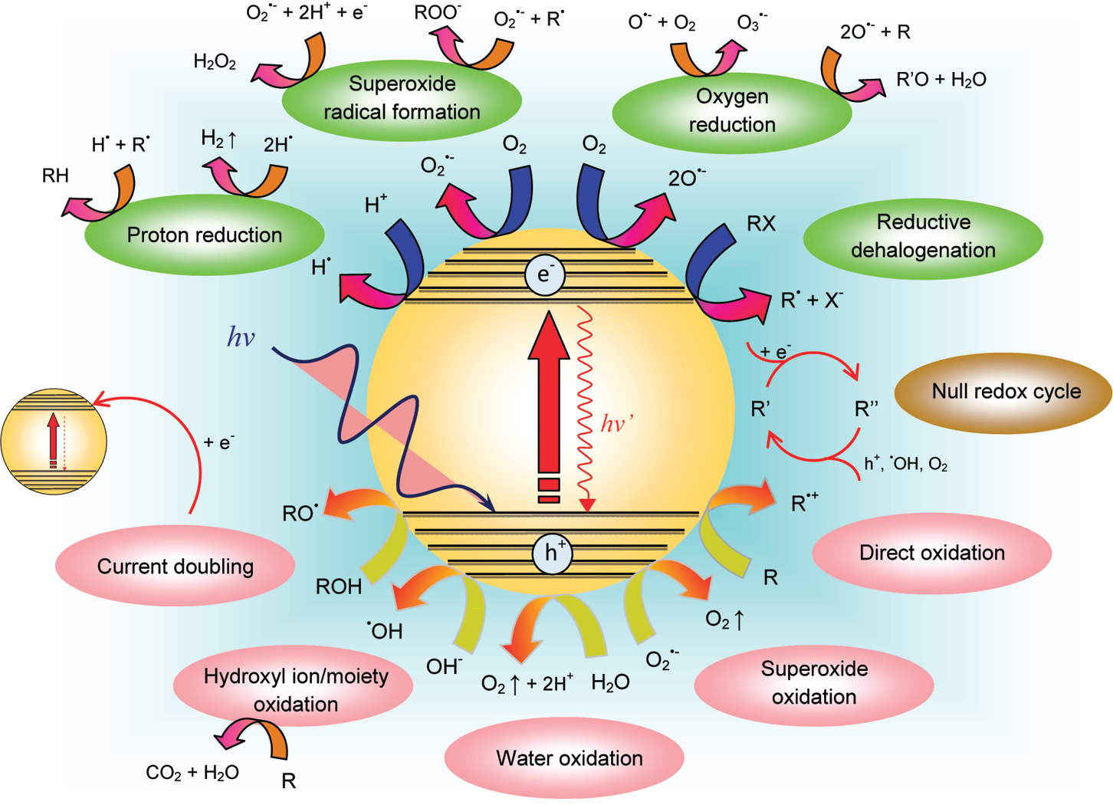
Possible reaction pathways arising from the excitation of photocatalysts. Included are primary redox reactions and selected ensuing secondary radical reactions. R denotes the general organic electron donor molecule

Slide 9
(•OH(ads), E⁰_{ox} > +1.6 VNHE (•OHfree, E⁰_{ox} = +2.72 VNHE (O2 + e− → O2 •− -0.33 V). Singlet oxygen O_{2/}OH₂* = -005V O₂/H₂O₂ - 0.33 V Multielectron reduction O₂ + 2H⁺ + 2e +0.695 V O₂ + 4H⁺ + 4e +1.23 V *CH₂OH/CH₂O -.95 V

Slide 11
chemisorbed oxygen can: (i) be reduced upon UV illumination, where it remains either in an undissociated state or dissociates to produce atomic oxygen species, or (ii) undergo hole-mediated desorption as molecular O2.
Photo catalytic mechanism is intricate plus the
Photo catalyst material and its history

Slide 12
Photo-catalytic materials and substrate specificity ZnO Hematite <10ps 2-4nmdiffusionlength Cr, MO or Si WO₃ 2.7 eV E_{CB} below TiO₂ P25 surface hydroxyl group density, crystallinity, size, specific surface area *OH generation

Slide 13
One of the most fundamentally intriguing issues in TiO2 photo-catalysis is the proposed synergistic effect between anatase and rutile, the two most dominant polymorphs – heterojunction- (13-79%)

Slide 14
Noble metals like Pt,Ag,Au, Pd Rh Schottky barrier vs Fermi level work function and E_{CB –} dark catalytic effect of the metal deposited

Slide 15
RGO good electron transport scaffold large adsorption region for the pollutant. Z scheme

Slide 16
Organic dye sensitize and other functions have to be considered and hence making them as model systems need careful examination

Slide 17
Modification by doping and new photo-catalytic materials - introduction of foreign elements in the host matrix without new crystallographic phase net separation – extend solar spectrum metal ions intrinsic energy levels electron or hole acceptors recombination (Fe).

Slide 18
Stability of the dopant Non metal N,C,S Oh radical or oxygen radical composite systems GaN:ZnO 2.4to 2.8 eVis lower than expected 3 from Zn 3d and Nitrogen 2p lead bismuth niobate, calcium bismuth zinc gallium systems.

Slide 19
Anisotropic photo-catalysts and other structures!D, Nanorods, wires, ribbons vectorial charge transport – non electrochemical the effect may not be clear

Slide 20
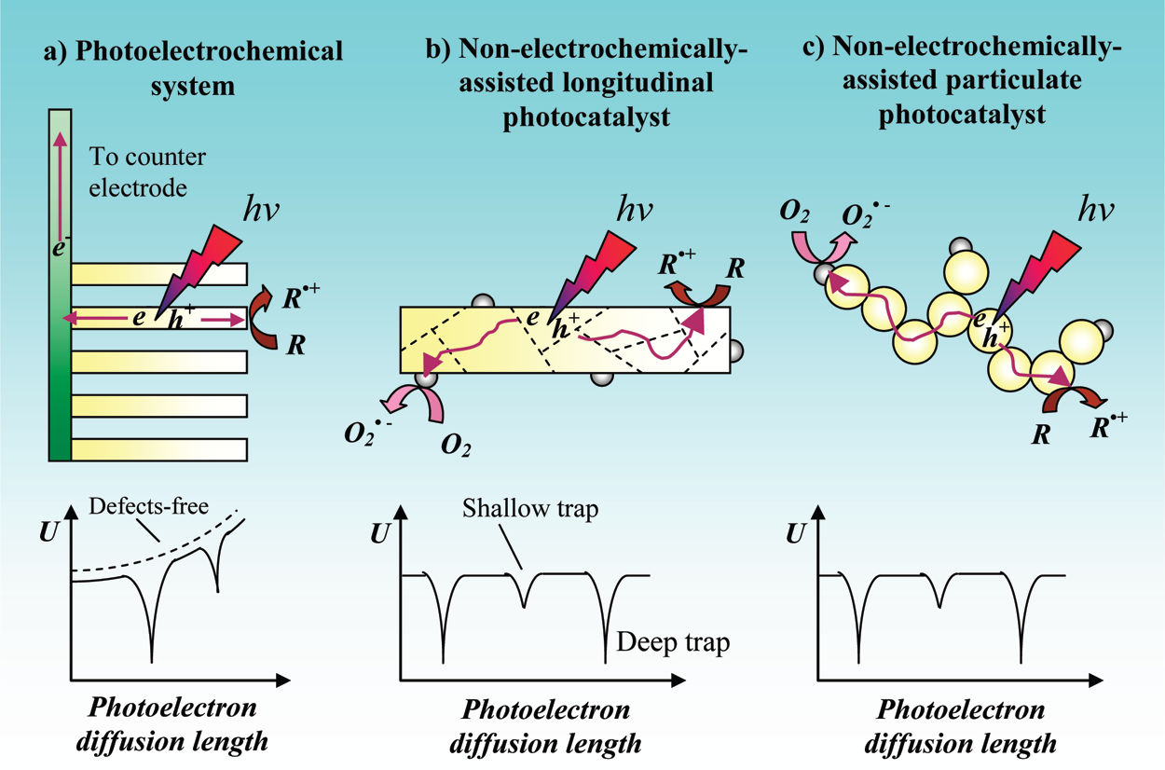
Schematic diagram of the mobility path of photoelectrons upon bandgap excitation in: (a) a photoelectrochemical system comprising an aligned longitudinal photocatalyst array where an externally applied potential bias exists; (b) the corresponding suspended longitudinal
photocatalysts; and (c) an aggregate of particulate photocatalysts. In the latter two systems, photoelectrons diffuse almost “naturally” to the reactive or charge trapping sites. Deep and shallow traps exist in all three systems, arising from various crystal defects and grain boundaries. U denotes the electrochemical potential of the photoelectrons driving their transport along the photocatalysts. .

Slide 21
Synthesis of photo-catalysts possessing alternate morphologies such as cube, pyramid, spinel, and fractals has also been extensively reported in recent years. Compared with the anisotropic design, these 3D structures are bound by their facets, each of which is energetically unique. In principle, the photo-catalytic redox sites as well as sites for preferential adsorption of reactants are dictated by the facets. Association of facet control with catalytic selectivity is a topic that has been thoroughly investigated in thermal (nonphoto) catalytic reactions

Slide 22
TiO₂ {001} facet {00a}0.9Jm⁻² {010 = 0.53;{101}0.44 (1) preferential adsorption of targeted reactants, (2) migration of charge carriers, (3) interfacial oxygen exchange/ mobility, and (4) product desorption.

Slide 23
They identified rutile {110} and anatase {011} as the reductive sites, whereas rutile {011} and anatase {001} acted as the oxidative sites. The reductive anatase {011} was further confirmed visually by single particle fluorescence spectroscopy

Slide 24
Photon Delivery. No matter how active a photo-catalyst, if photons are not effectively transmitted to its surface then its full potential will not be reached and system efficiency will be lowered. Consequently, this aspect deserves to be mentioned as it represents a key component of any successful photo-catalytic
array. The challenge lies in ensuring that the photo-catalytic rate is not limited by a poor illumination strategy. However, effective photon delivery has to be balanced with mass transfer effects, with the two mainly governed by photo-reactor style

Slide 25
Schematic diagram of: (a) Channelled optical fiber reactor (COFR) system for the gas-phase photocatalytic degradation of VOCs − inset shows a cross sectional view of the COFR and its dimensions and (b) light reflection and refraction from/across a quartz photoreactor wall coated
with (i) mesoporous SiO2 only and (ii) a mesoporous SiO2 optical barrier between the wall and a TiO2 coating − Pi = incident light, Pr = reflected light, θ = incidental angle.

Slide 26
Mukherjee and Ray defined four photoreactor groups − slurry, immersion, distributive, and external illumination − with each class providing superior performance in terms of photon delivery or mass transfer, but rarely both For instance, slurry photoreactors facilitate mass transfer; however, in the context of uniformly supplying photons to the surface they are limited by poor light penetration into the suspension. An alternative to slurry photo-reactors is thin film systems where the photo-catalyst is present as a thin film on the reactor walls. This reactor variety promotes illumination but at the detriment of mass transfer. The coated area may be increased by packing with a material (e.g., beads, fiberglass mesh) coated with the photocatalyst, although again this is at the expense of light penetration. Distributive systems, such as those employing optical fibres as waveguides, allow for the two criteria to be satisfied however, complications with uncontrolled light refraction across the coated interface hamper this technology. Recent efforts by ourselves and others have focused on overcoming this issue by modifying optical fiber design (Figure 6a) or by using an
intermediate coating (Figure 6b) with some success

Slide 27
Outlook and Concluding Remarks.
The growth of heterogeneous photocatalysis has been and will continue to be application-driven, supported by strong process fundamentals. Solar water splitting and environmental remediation, which are the mainstay applications, will continue to serve as important platforms for showcasing photocatalytic technologies as well as motivation for establishing relevant fundamental knowledge. In addition, the photocatalytic conversion of carbon dioxide to fuels and other useful chemicals is expected to be a dominant
area and contribute new knowledge, be it the reaction mechanisms, materials design, or reactor design. Whereas successes in pursuing the different areas of photocatalytic applications are
highly rewarding, it is critical to remember that establishing fundamental depth in photocatalysis is the shared responsibility of scientists and engineers alike. At the same time, continuous bridging of interdisciplinary knowledge has been identified, at least within this Perspective, as one of the most important elements to warrant sustainable growth of the field for many years to come.

