Slide 1
Carbon-titania composites for solar hydrogen production
Ranjit T. Koodali

Slide 2
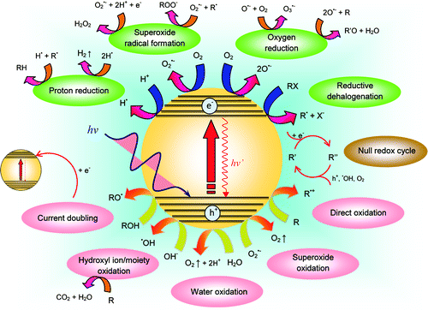
Various light induced reactions involved in semiconductor photocatalysis
Teoh et al. J. Phys. Chem. Lett., 2012, 3, 629−639.

Slide 3
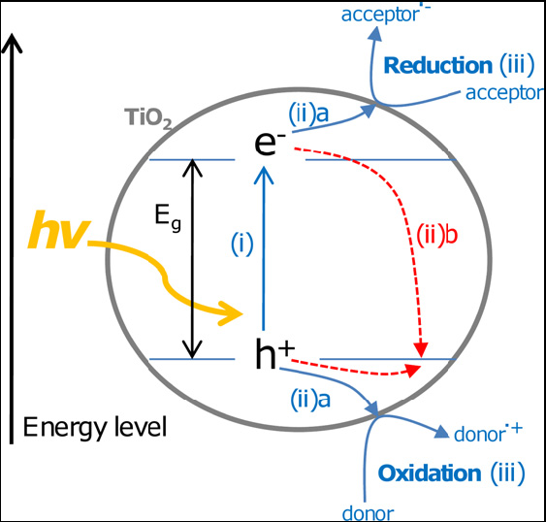
Various processes involved in semiconductor photocatalysis. (i) Photon absorption and electron–hole pair generation. (ii) Charge separation and migration; (ii)a to surface reaction sites or (ii)b to recombination sites. (iii) Surface chemical reaction at active sites.
Leary et al. Carbon, 2011, 49, 741-772.

Slide 4
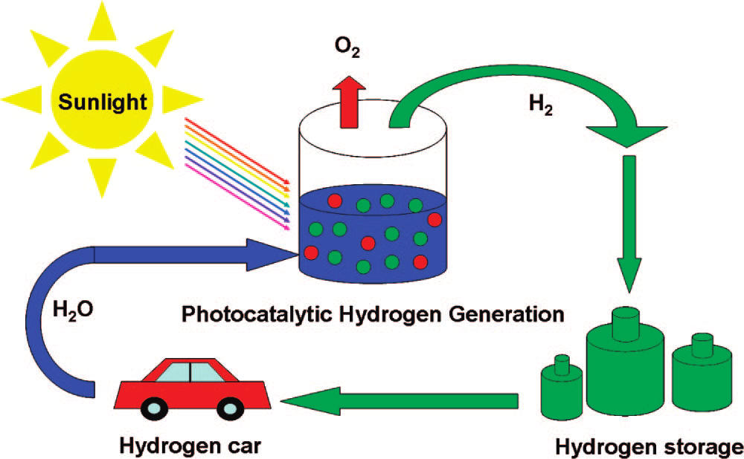
Schematic diagram of photocatalytic hydrogen generation from water in the presence of semiconductor materials
Chen et al. Chemical Reviews, 2010, 110, 6505-6570.

Slide 5
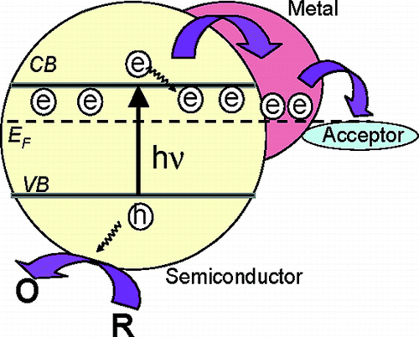
Various Methods for Improving the Efficiency of TiO₂ Photocatalyst
Metal (Au, Pt, etc.) deposition:
- formation of a Schottky barrier between metal and semiconductor
- shifting of the Fermi level to more negative values
Subramanian et al., J. Am. Chem. Soc. 2004, 126, 4943-4950.

Slide 6
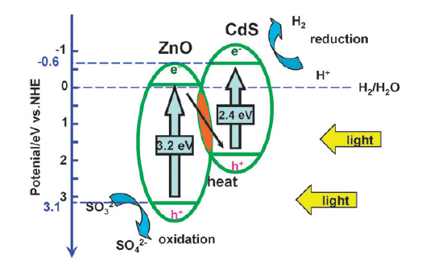
2. Coupling of two semiconductors:
Interfacial electron transfer between two semiconductors with different conduction band edges minimizes electron-hole recombination.
Wang et al. Chem. Commun., 2009, 3452–3454.

Slide 7
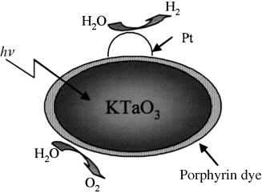
3. Dye sensitization:
The splitting of pure water was achieved with dye-coated photocatalyst which is attributed to good electronic contact between dye and photocatalyst.
Hagiwara et al. Angew. Chem. Int. Ed., 2006, 45, 1420–1422.

Slide 8
4. Doping with metal ions (Fe³⁺, V⁵⁺ etc.) and non-metals (N, C, S etc.)
The doping process helps to introduces additional states in the TiO₂ there-by reducing the band gap and improving the visible light absorbing properties.
Drawbacks:
The new energy states introduced into the composite material can also act as recombination center for excitonic species especially when dopant concentration is high.
Thermal instability of the dopant.

Slide 9
Why Carbon?
Limitations of TiO₂
Absorbs only UV irradiation - Less <5% solar radiation.
Electron-hole recombination high - retards efficiencies.
Carbon support
Enhances the visible light absorbing ability of TiO₂ thereby improving the efficiency of photocatalytic process.
Provides large-surface area to volume ratio of TiO₂ crystallites which improves the exposure of electrons and holes for reactions with substrates.
Enhance the synergetic effect between various TiO₂ phases.
May suppress the complete phase transformation of anatase to rutile in TiO₂.

Slide 10
Why is carbon a promising material in photocatalysis?
Carbon exist in various forms such as carbon black, amorphous carbon, graphite, carbon nanotubes, fullerene, graphene etc.
It acts as an excellent material for transferring photocarriers by electronic interactions with semiconductor materials like TiO₂ (minimizing e⁻ - h⁺ recombination).
Presence of carbon may lower the band gap of wide band-gap semiconductors (photosensitization).
It can enhance surface area (provide appropriate adsorptive sites).

Slide 11
Carbon can act as building block for various nanoarchitectures
Lee et al. Adv. Funct. Mater. 2011, 21, 1338–1354.

Slide 12
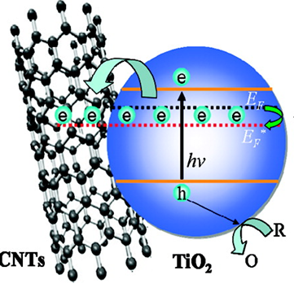
TiO₂-SWCNT - DSSC Applications
Carbon nanotube act as an electron accepter thereby reducing the electron- hole recombination
Zhang et al. J. Phys. Chem. C, 2011, 115, 22025–22034.

Slide 13
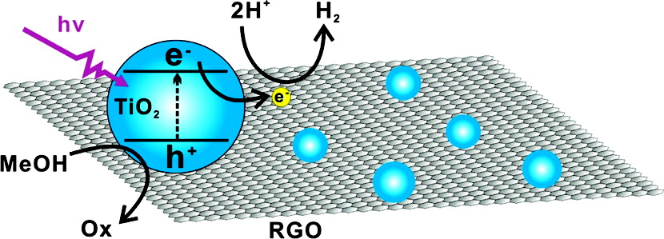
Graphene–TiO₂ Photocatalytic system
Graphene layer can promote electron flow and reduce the electron- hole recombination.
Fan et al. J. Phys. Chem. C, 2011, 115,10694–10701.

Slide 14
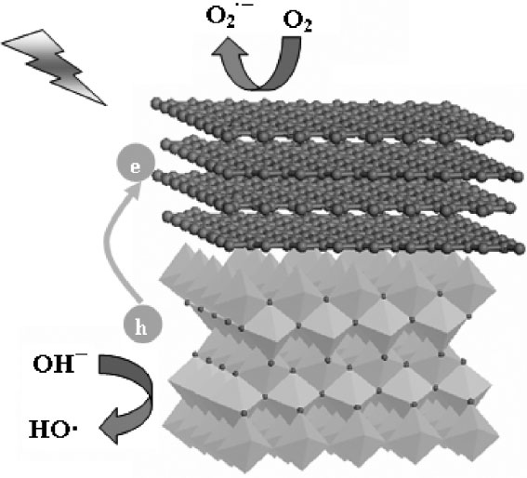
Graphite like C-TiO₂ composites (degradation)
Zhang et al. Adv. Funct. Mater, 2008, 18, 2180–2189.

Slide 15
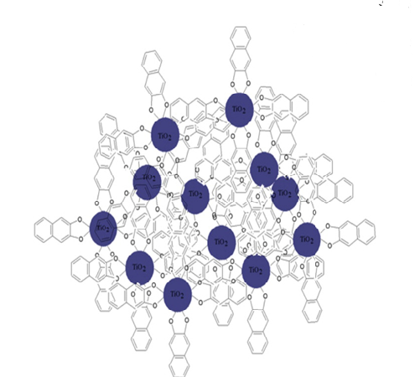
C-TiO₂ material formed from 2,3 Dihydroxynaphthalene during pyrolysis at 800°C
Carbon may reduce the electron-hole recombination thereby enhancing the photocatalytic activity of TiO_{2.}
Parayil et al. Catal. Today, 2012, doi:10.1016/j.cattod.2012.02.010.
Notes:
However these procedures entail the use of a combination of strong, potentially hazardous acids such as H2SO4, NaNO3, and H3PO4 etc.. The Hummers method is also vulnerable to production of excess permanganate ions that may require treatment by H2O2, washing and thorough dialysis in order to minimize contamination
of the resultant composite. An additional step to convert graphitic oxide to graphene is necessary and often requires strong reducing agents, such as hydrazine, a highly toxic reagent that imposes health and environmental risks.

Slide 16
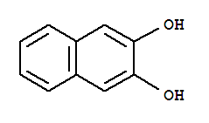
Synthesis of Carbon modified TiO₂ from 2,3-dihydroxynaphthalene
2,3-dihydroxy naphthalene
(DN)
TiO₂
LMCT Charge Transfer Complex of TiO₂-DN
RT, stir 1h
Drying at 80°C
800°C, 4h
Carbon-TiO₂
Orange Colored Powder
N₂ Flow

Slide 17
Powder XRD
Bare TiO₂ obtained from hydrothermal synthesis.
The XRD data indicates presence of anatase phase only.

Slide 18
Powder XRD
XRD patterns of the pyrolysis product of TiO₂-DN, where 120 and 240 indicate the amount (in milligram) of DN used for reacting with TiO₂ prior to pyrolysis.
TiO₂-0 is obtained from the calcination of hydrothermally synthesized TiO₂ in the absence of DN under identical conditions.
TiO₂–C hybrids exhibits diffraction peaks due to rutile (>90%) mainly.

Slide 19
Raman spectra
Raman spectra of TiO₂–C hybrid material obtained from DN.
A and R refers to anatase and rutile phase of TiO₂ and D and G refers to the A_{1g} and E_{2g} vibrational mode of graphite like carbon.
Notes:
The bare TiO2-0 displays strong bands at 140, due to anatase and at 235, 450, and 610 due to rutile. The incorporation of C results in the display of two broad bands with intensity maxima close to 1350 (D band), related to imperfections in the sp2 carbon structure and associated with A1g symmetry. The band at approximately 1585 (G band) is associated with the E2g vibrational mode of sp2 bonded carbon atoms.

Slide 20
Nitrogen isotherms and pore size distribution of TiO₂–C
The isotherms indicate H3 type hysteresis loop with type V isotherms of mesoporous materials.
The pore geometries in TiO₂-0 display a bimodal distribution at 27 and 38 Å.
TiO₂–C materials shows unimodal distribution of pores.
Notes:
Type H3 loops that do not level off at relative pressures close to the saturation vapor pressure were reported for materials comprised of aggregates (loose assemblages) of platelike particles forming slitlike pores.

Slide 21
Textural properties of C-modified TiO₂
Material | S_{BET}ª (m² g⁻¹) | Pore volume (cm³ g⁻¹) | Ave. Pore Diameter (Å) | BJH Pore Diameter ^{b} (Å)
TiO₂-0 | 6.5 | 0.020 | 133.6 | 24.2
TiO₂–C-120 | 10.5 | 0.027 | 101.3 | 27.0
TiO₂–C-240 | 12.5 | 0.031 | 100.3 | 37.7
ª Surface area determined by applying Brunauer–Emmett–Teller (BET) equation to a relative pressure (P/P₀) range of 0.05–0.35 of the adsorption isotherm.
^{b} Calculated from the Barrett–Joyner–Halenda (BJH) equation using the desorption isotherm.

Slide 22
X-ray Photoelectron Spectroscopy (XPS)
C1s spectra, shows the binding energy of C-C in both samples to be 284.4 eV.
C-O and C=O peaks occurs at 286.1, and 288.3 eV respectively, indicate the presence of carbonated species and could indicate presence of Ti-O-C bonds.
O1s spectra, shows binding energy for O–Ti occurs at 529.7 and for O-H at 531.9 eV in TiO₂-0.
Ti 2p spectra, shows binding energies at 458.4 eV and 464.1 eV that are due to Ti 2p_{3/2} and 2p_{1/2} spin orbit pairs.
Notes:
The content of surface hydroxyl groups is much lower in TiO₂–C-240 than TiO₂-0 attributed to the complex formation of TiO₂ with C.

Slide 23
Diffuse Reflectance Spectroscopy (DRS)
TiO₂-0 exhibited a large optical absorption band below 380 nm corresponding to the band-gap energy of TiO₂.
The effective band gap of TiO₂ is maintained near 2.9 eV even after the incorporation of carbon.
Notes:
The loss of intensity of absorption in TiO₂-C could be attributed to the carbon structures that hinder the penetration of the UV light from sensitizing the embedded semiconductor particles.

Slide 24
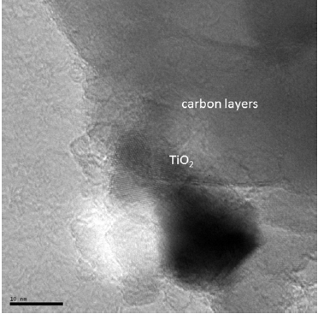
Transmission Electron Microscopy
The average diameter of the TiO₂ particle lie between 15 - 20 nm within the carbon layers that are stacked together.

Slide 25
Photocatalytic Hydrogen Evolution
H₂ evolution
PL spectra
The generated electrons are transported through the C layers that minimize electron–hole recombination. This results in the availability of more electrons to participate in the reduction of H⁺ to H₂.
Fluorescence quenching of TiO₂ occurred in the presence carbon species probably due to photoinduced electron transfer from TiO₂ to carbon.
Notes:
Emission spectra were collected for the materials excited at 280 nm and monitored in the range of 400–600 nm. They exhibited an emission band at 467 nm, attributed to the charge-transfer transition from Ti3+ to oxygen anion in a TiO6 8− complex associated with oxygen vacancies at the surface.
The PL quenching may have originated from contributions of higher rutile content or the presence of C as an electron acceptor. The addition of more C to TiO2 led to further quenching of the this luminescence band probably due to increased electron shuttling from the TiO2 to the C, thus confirming electron transfer from the semiconductor to the carbon network through the Ti–O–C complexation.

Slide 26
Summary
1. Carbon-TiO₂ composite materials were successfully synthesized by the pyrolysis of 2,3-dihydroxynaphthalene in the presence of TiO₂.
2.The C-TiO₂ materials exhibited modest photocatalytic activity for evolution of hydrogen under simulated solar irradiation.
3. The presence of C allows faster electron propagation and facilitates electron transfer from the titania conduction band and minimizes the electron–hole recombination thus enhancing hydrogen evolution.
4.This work creates opportunities for the preparation of novel catalytic materials from C using simple molecular precursors.

Slide 27
Hydrothermal Synthesis of Carbon-TiO₂ composite material from sucrose
EtOH + H₂O + Conc. HNO₃
RT, 300rpm
Slow addition of Ti(^{i}OPr)₄
Carbon-TiO₂
RT, 300rpm
Sucrose solution
Sucrose-TiO₂ condensation product
Autoclave treatment, 120°C, 14 h
N₂ Flow
800°C, 4 h
Filtration
Sucrose-TiO₂
Sucrose-TiO₂ mixture
Drying at 80°C

Slide 28
Powder XRD
The amount of anatase content was determined to be 5, ~0, 3, 4, 8, and 1% in the TiO₂-0, TiO₂-0-N, TiO₂-C-79, TiO₂-C-120, TiO₂-C-362, and TiO₂-C-402 samples respectively by indexing the peak positions.
TiO₂-0,TiO₂-0-N indicate calcination and pyrolysis product obtained without sucrose loading on TiO₂ at 800°C and the values 79, 120, 362, and 402 indicate 0.79, 1.2, 3.62, and 4.02 percentage carbon obtained from the pyrolysis product of sucrose-TiO₂.

Slide 29
Raman spectra
Besides the rutile peaks, the materials show band due to imperfections in the carbon structure (D band) associated with A_{1g} symmetry.
The G band is attributed to the E_{2g} vibrational mode of sp² bonded carbon atoms.
The additional bands at 2720 and 2950 cm⁻¹ (very weak) assigned to the first overtone of D band (D') and a combination of D and G respectively due to the presence of various forms of carbon may also be discerned.

Slide 30
Nitrogen isotherms and pore size distributions of TiO₂–C obtained after pyrolysis
The figure indicate mostly H3 type hysteresis loop with type IV isotherms of mesoporous materials (slit-like pores)
The pore size distribution becomes broad as more carbon is introduced in the TiO₂ matrix.

Slide 31
Textural properties of C-modified TiO₂ composite materials obtained from sucrose
Material | S_{BET}ª (m² g⁻¹) | Pore volume (cm³ g⁻¹) | Ave. Pore diameter (Å) | BJH Pore ^{b} Diameter (Å)
TiO₂-0 | 6.5 | 0.02 | 133.6 | 24.2
TiO₂-C-79 | 47.0 | 0.05 | 122.4 | 24.5
TiO₂-C-120 | 47.9 | 0.04 | 95.9 | 42.5
TiO₂-C-362 | 72.1 | 0.12 | 63.9 | 38
TiO₂-C-402 | 65.3 | 0.11 | 64.3 | 38
ª Surface area determined by applying Brunauer–Emmett–Teller (BET) equation to a relative pressure (P/P₀) range of 0.05–0.35 of the adsorption isotherm.
^{B} Calculated from the Barrett–Joyner–Halenda (BJH) equation using the desorption isotherm.

Slide 32
X-ray Photoelectron Spectroscopy (XPS)
C-C and C-O binding energy for TiO₂-C-362 and TiO₂-0 are the same and appears at 284.6 eV and at 286.1 eV respectively.
C=O binding energy for TiO₂-C-362 is 287.6 eV and for TiO₂-0 the value is 288.4 eV.
All the carbon peaks in TiO₂-0 are less intense than TiO₂-C-362.
TiO₂-C-362 show two additional peaks at 289.1 and ~291.4 eV corresponding to the O–C=O binding energy and π-π* shake up satellite peak reported for graphite like species.

Slide 33
Diffuse Reflectance Spectra
TiO₂-0 shows large optical absorbance in the UV region while the C-modified TiO₂ materials shows low absorbance in the UV region.
In C-modified TiO₂ materials, there is a modest increase in the visible region.

Slide 34
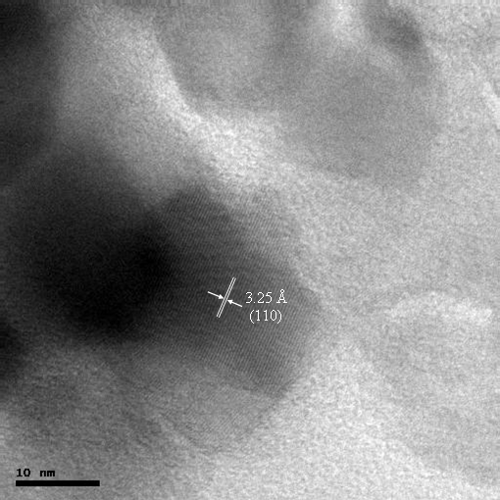
TEM
The TEM image shows lattice fringes due to TiO₂. The rutile phase with d spacing of 3.25 Å due to d₁₁₀ could be observed in the TEM image.
Amorphous carbon layers that were randomly deposited are also observed.

Slide 35
Photocatalytic Hydrogen Evolution
H₂ evolution
PL spectra
The high activity of TiO₂-C-362 may be attributed to higher surface area, larger pore volume, and effective trapping of the electrons in the shallow traps associated with oxygen vacancies minimizing electron-hole recombination.
At higher carbon contents, more oxygen vacancies populate impurity states and suppress photocatalytic activity and thus an optimal C is beneficial.
Parayil et al. International Journal of Hydrogen Energy, 2012 , doi:10.1016/j.ijhydene.2012.02.067
Notes:
Our results suggest that no hydrogen is evolved for the sample, TiO2-0. This sample had 5% anatase; although a mixed phase of anatase and rutile may minimize charge carrier recombination and generate hydrogen, our results indicate the important role that carbon plays in minimizing electron-hole recombination and in producing hydrogen.
Upon illumination of TiO2, the photogenerated holes are capable of oxidizing methanol in two ways. The first method involves direct oxidation, while the second method involves the formation of hydroxyl radicals via the reaction of water molecules and holes. The hydroxyl radicals may then react with methanol and form hydroxymethyl radicals. In the absence of dissolved oxygen the hydroxymethyl radical may inject additional electrons into the TiO2 conduction band. Our experiments were performed under solar simulated conditions and the UV component of the solar light would have provided sufficient energy for electrons to be promoted to the conduction band edge of anatase which lie at more negative values compared to the H+/H2 redox potential. The electrons can then migrate to the conduction band edge of rutile. Additional electrons may be injected into the conduction band of rutile via the mechanism discussed previously. Besides mixed phases, the presence of carbon may facilitate the electron transfer and reduce the electron-hole recombination and increase the production of hydrogen. The differences in energy of the trap levels identified in these spectra at 504 nm and 586 nm are attributed to Ti4+ ions adjacent to oxygen vacancies (intra gap surface states). The surface emissions at 440, 451, and 467 nm are attributed to indirect transition X1a to G1b and linked to exciton recombination in shallow trapped surface states. Other surface emissions observed at 482 and 492 nm are attributed to defect levels of coordinately unsaturated ions such as Ti3+ incorporated OH.

Slide 36
Conclusions
C–modified TiO₂ composite materials were prepared from pyrolysis of hydrothermally synthesized sucrose–TiO₂ or DN-anchored titanium dioxide
The C-modified materials exhibited higher photocatalytic activities for the evolution of hydrogen under solar simulated irradiation conditions in comparison to the bare TiO₂.
An optimal loading of carbon allows efficient electron trapping in shallow states thereby enabling effective separation of the charge carriers and promoting improved photocatalytic activities.
The work provides guidance for the environmental friendly synthesis of carbon based nanocomposites and utilization of such materials for alternative fuel generation.

Slide 37
Acknowledgements
Department of Chemistry, University of South Dakota (USD).
University of South Dakota (USD).
State of South Dakota (SD).
National Science Foundation (NSF).
Department of Energy (DOE).

