Slide 2
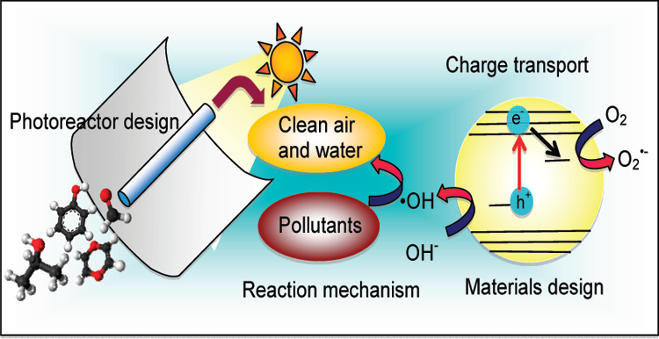
Plasmon Catalysis
Photo-electrochemistry and photo-catalysis
Principles and Applications
Fuel
H⁺
1/2H₂
B. Viswanathan & M.Aulice Scibioh
Photosynthesis
Photo-electrochemical decomposition of water

Slide 3
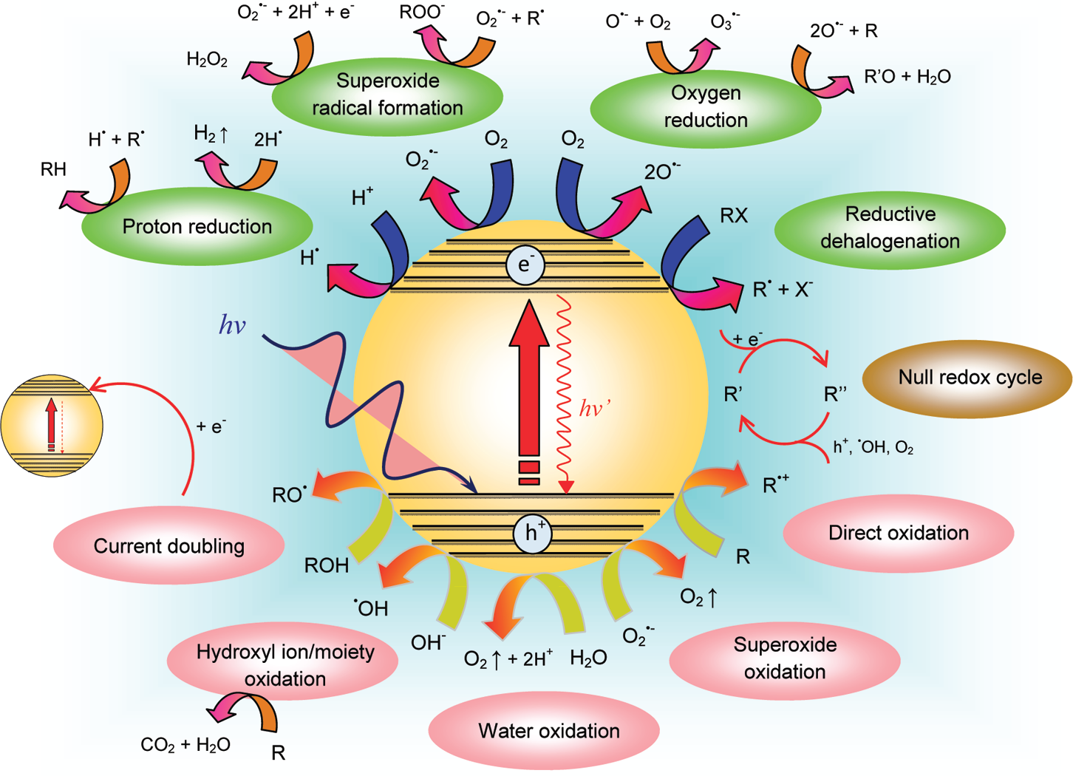
Light induced reactions on a semiconductor photo-catalysis
Teoh et al., J.Phys.Chem.Lett., 3,629(2012)
Reproduced from Teoh et al., J.Phys.Chem.Lett.,3, 629(2012)

