Slide 1
1D compounds of Mo/W for electrochemcial applications

Slide 2
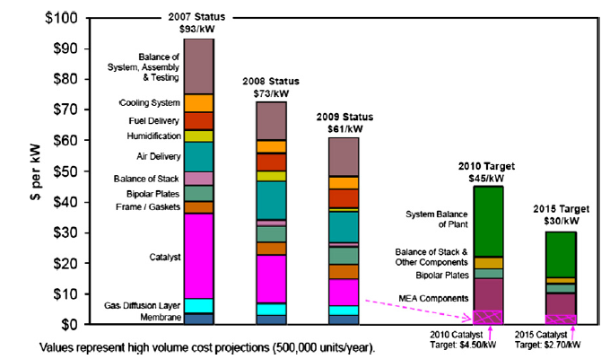
Fuel Cell Cost Breakdown
2015 DOE target for Pt loading, ~ 0.2 mg/cm2 , with a performance of 650W/L
High cost and durability – barriers for commercialization
Y. Wang et al., Applied Energy 88 (2011) 981-1007

Slide 3
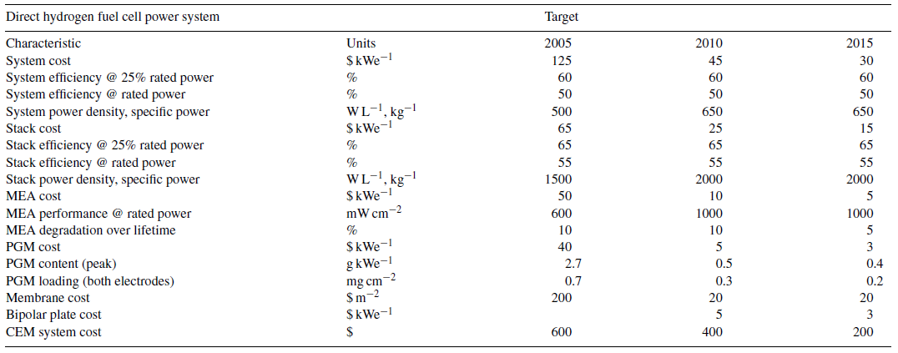
Fuel Cell Cost Breakdown
Rajesh K. Ahluwalia and X. Wang, J. Power Sources 177 (2008) 167-176

Slide 4
Objectives and Approaches
Objective: Development of low cost, high performance
electrode materials for methanol oxidation, oxygen reduction
reaction, hydrogen evolution reaction and
electrochemical capacitors
Approach: Low cost nanomaterials are synthesized from
simple synthetic procedures
Objective: It is preliminary requisite to understand the
fundamental properties of the catalysts before employing
them in a realistic environments such as fuel cell and
capacitor devices
Approach: To achieve this, half cell reactions are performed.
Conduct fundamental studies of the developed nanomaterials
Catalyst activities for methanol oxidation, ORR, etc..

Slide 5
Work at National Centre for Catalysis Research, India
Diagnostics
TEM
SEM
XRD
Electrochemical Studies
Fuel Cell - Methanol oxidation and
Oxygen reduction reaction
WO₃ nanorod as supports for PGM electrocatalyst
Reduce the loading of PGM
Prevent carbon corrosion in fuel cell conditions
Syntheses of Nanomaterials
Nanorods of WO₃, MoO₂ and Mo_{x}V_{y}O_{z}
MoS₂ nanotube and WS2 nanomaterial
Energy Storage –
Electrochemical capacitors
Chronopotentiometry and CV
WO₃ nanorods and MoO₂ nanorods
Hydrogen Evolution Reaction
WO₃ nanorods
MoS₂ nanotubes

Slide 6
Approach: Nanorod Synthesis
Method: Thermal decomposition of tetrabutylammonium
salts of metal oxides
Precursor method: Preparation methods from literature
Precursors: ((C₄H₉)₄)N)₄W₁₀O_{32,} ((C₄H₉)₄)N)₂Mo₆O_{19,}
((C₄H₉)₄)N)₄PMo₁₀V₂O₄₀
Metal oxide nanorods: WO₃, MoO₂ and Mo_{x}V_{y}O_{z}
Metal Sulfide nanotube and nanomaterial: WS₂ and MoS₂
A. Chemseddine, C. Sanchez, J. Livage, P. Launay, M. Fournier, Inorg. Chem. 23 (1984) 2609.
M. Che, M. Fournier, J.P. Launay, J. Chem. Phys. 71 (1979) 1954.

Slide 7
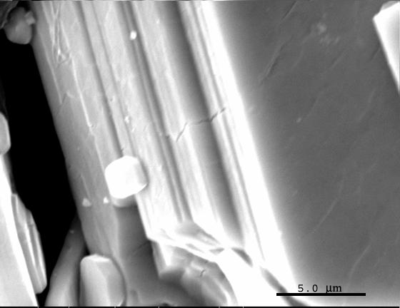
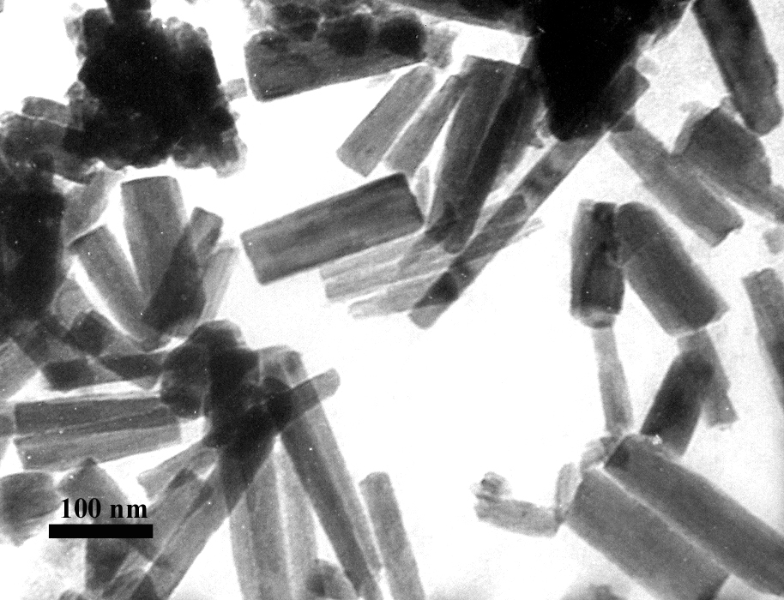
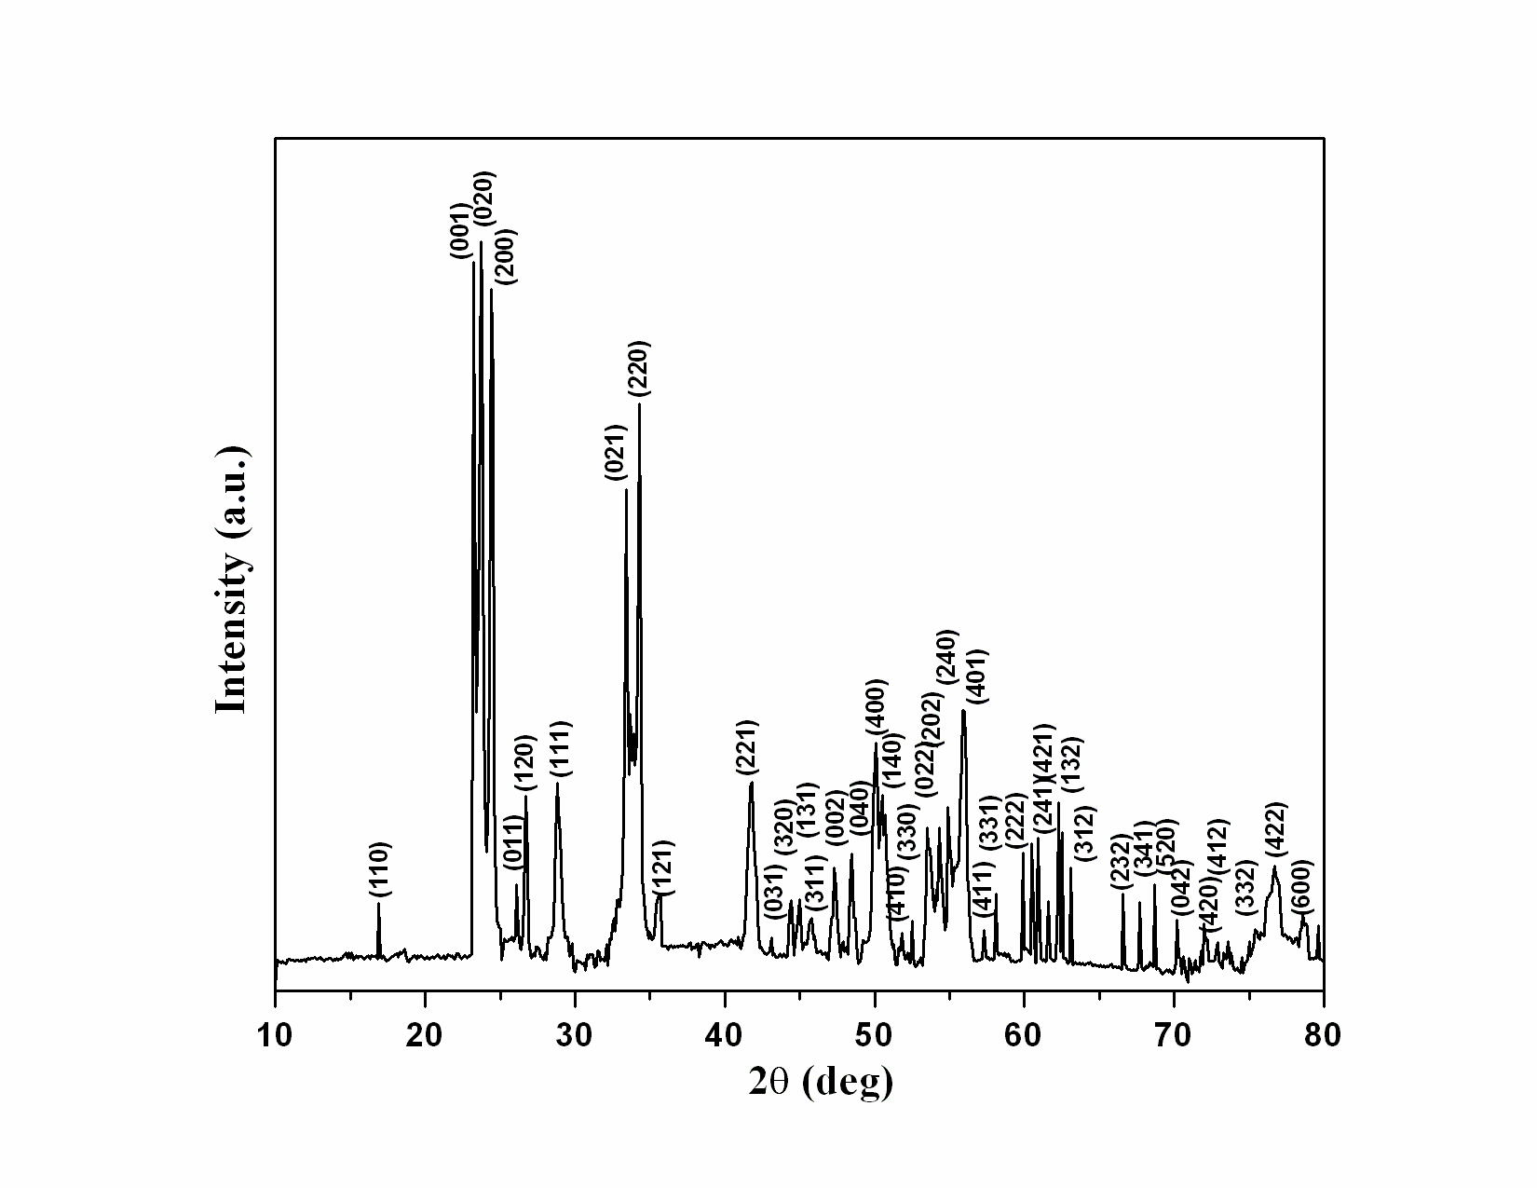
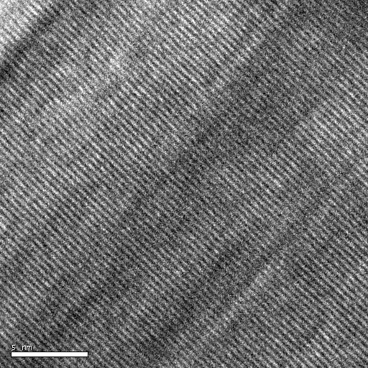
Approach: WO₃Nanorod Synthesis
Precursor, ((C₄H₉)₄)N)₄W₁₀O₃₂
Tungsten oxide nanorods
5 nm
XRD of Tungsten oxide nanorods

Slide 8
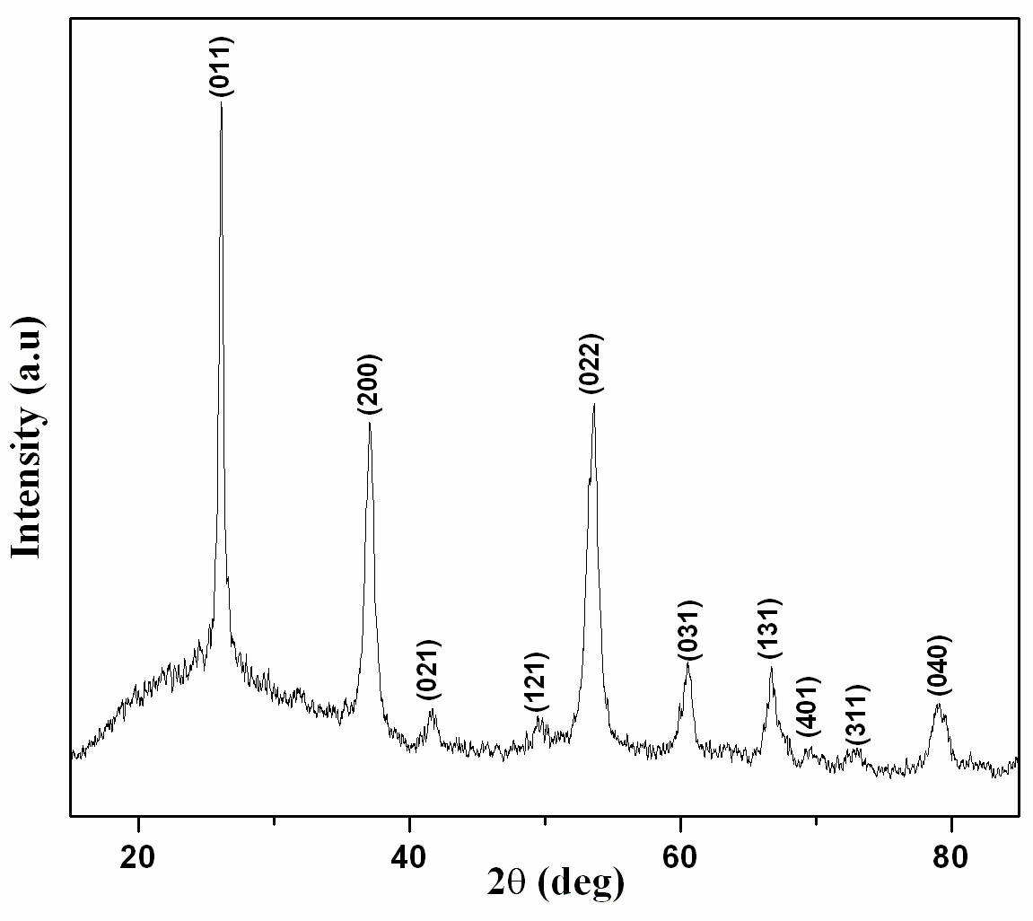
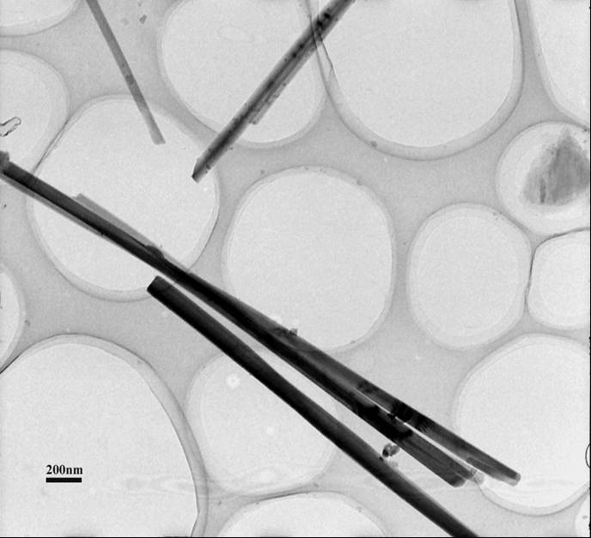
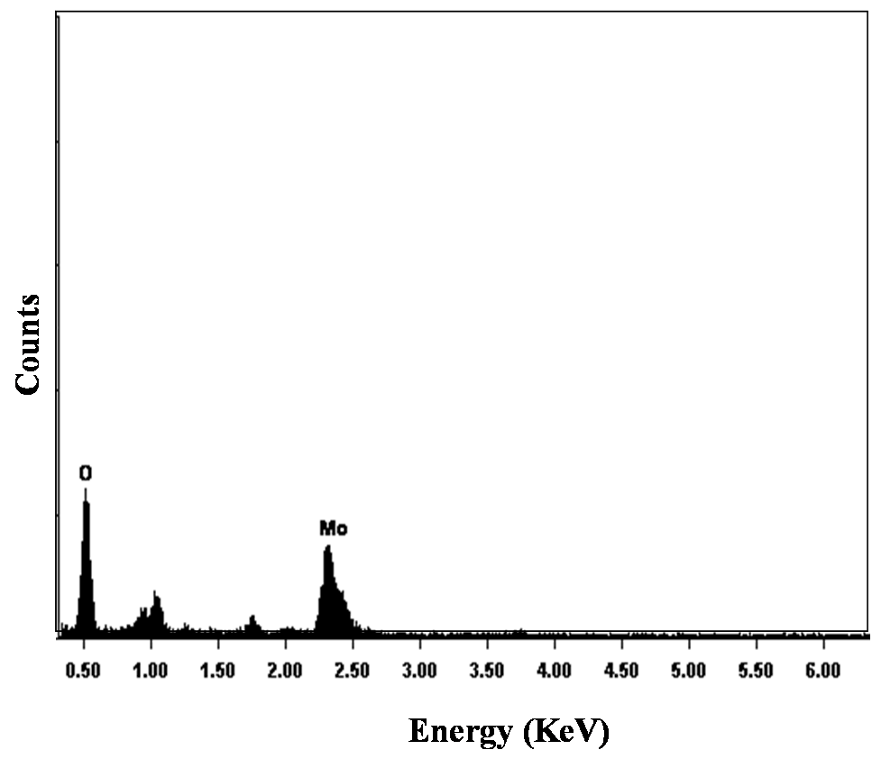
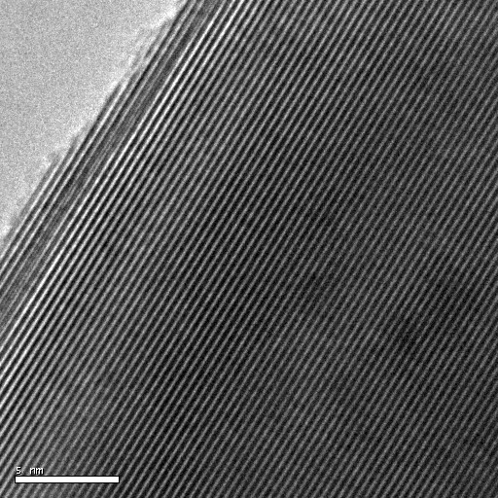
Approach: MoO₂ Nanorod Synthesis
5 nm
Width : 20- 50 nm; Length : 5-10 μm
Interplanar spacing :0.17 nm corresponds to (022) plane of monoclinic MoO₂

Slide 9
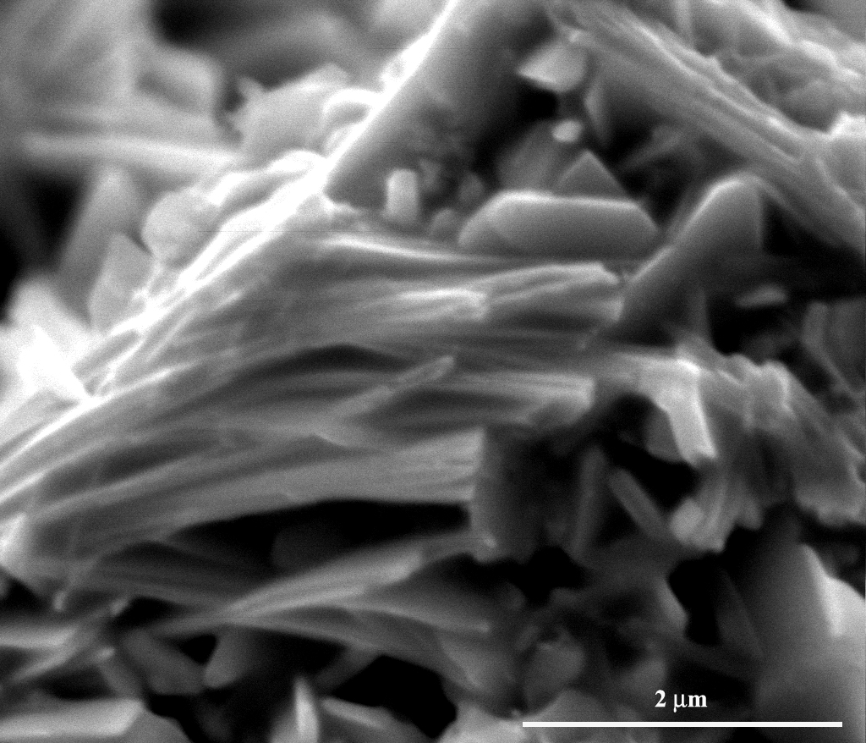
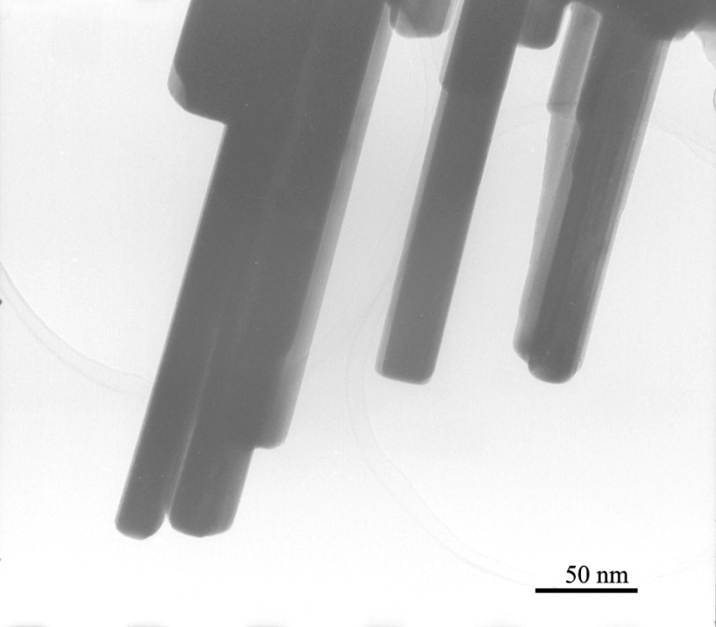
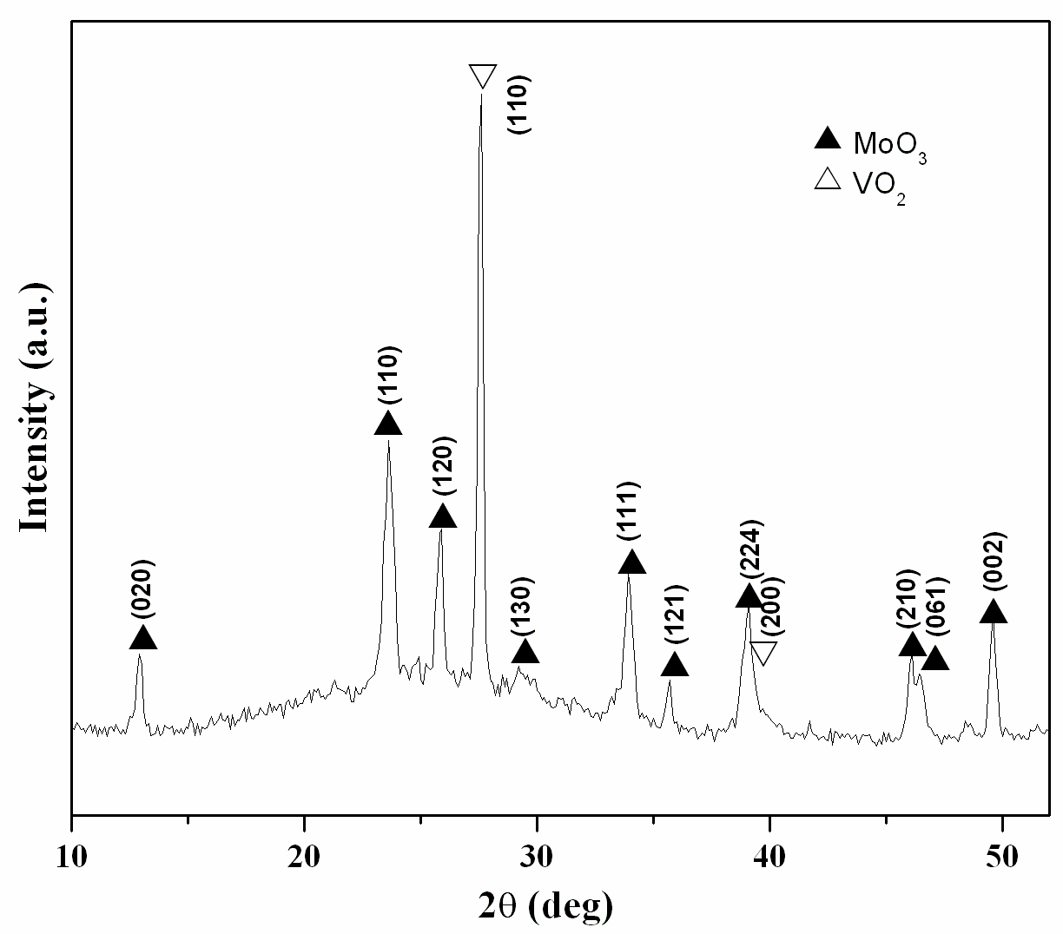
Approach: Mo_{x}V_{y}O_{z} Nanorod Synthesis
Precursor: ((C₄H₉)₄)N)₄PMo₁₀V₂O₄₀
Orthorhombic MoO₃ (JCPDS: 89-5108)
Tetragonal VO₂ (JCPDS: 76-0678)

Slide 10
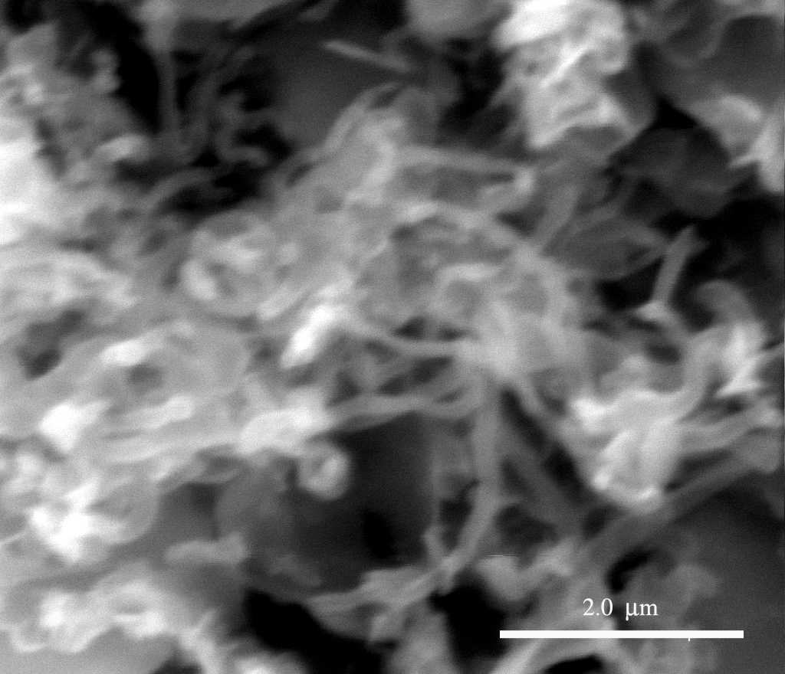
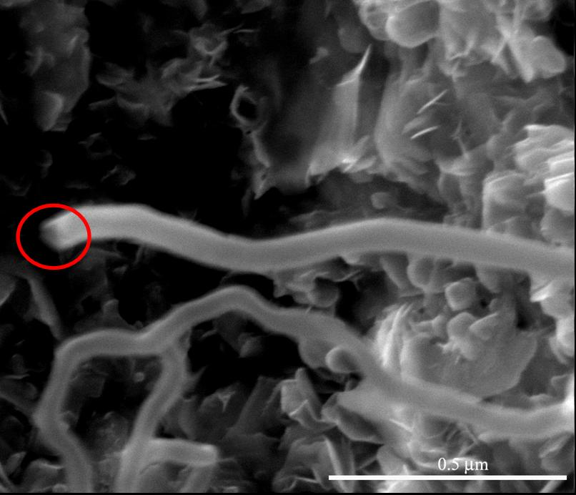
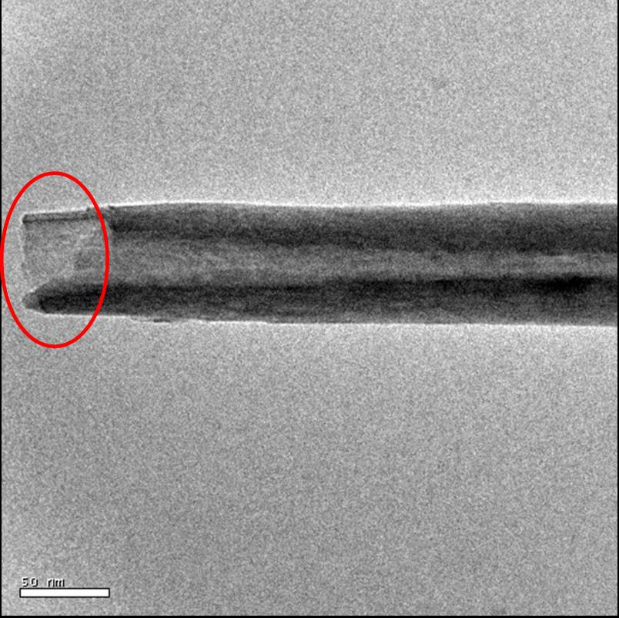
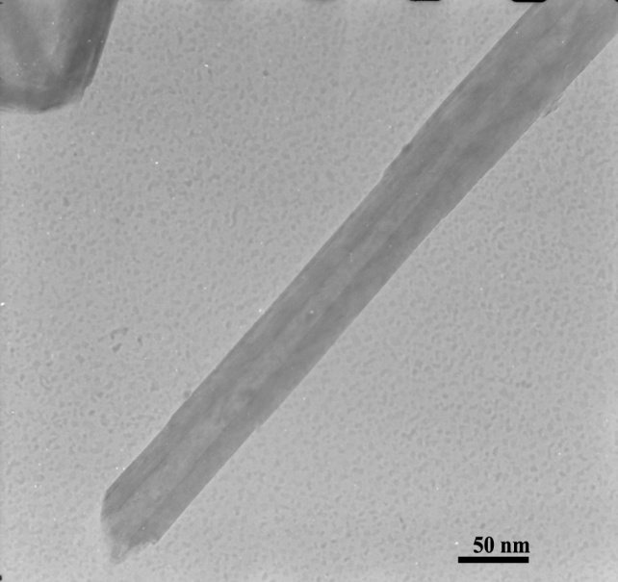
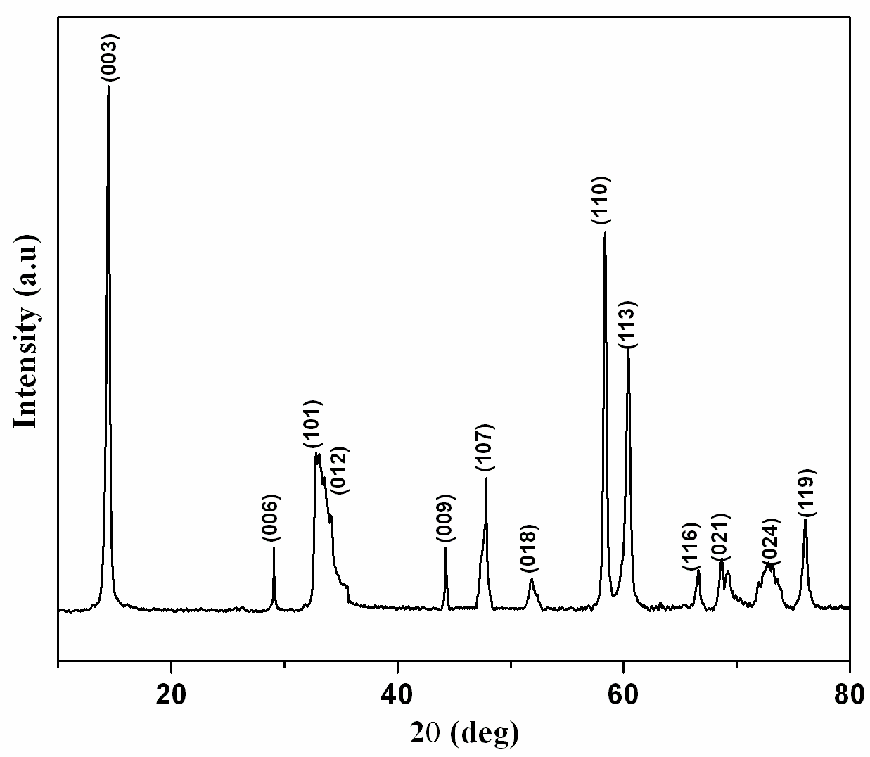
Approach: MoS₂ Nanotube Synthesis
Diameter of the nanotube: ~ 60 nm, Inner diameter: 15 nm; Length: ~ 550 nm to 1 μm
Treatment of MoO₂ nanorods with H₂S

Slide 11
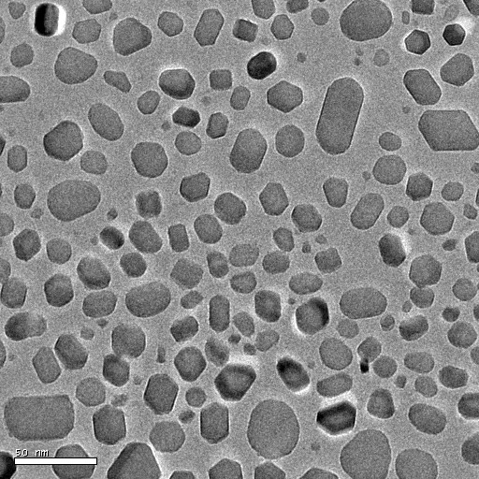
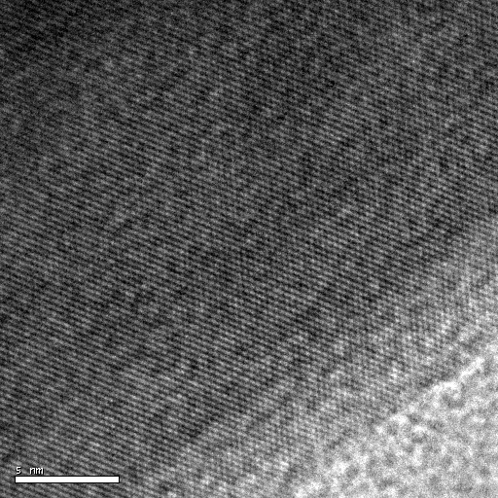
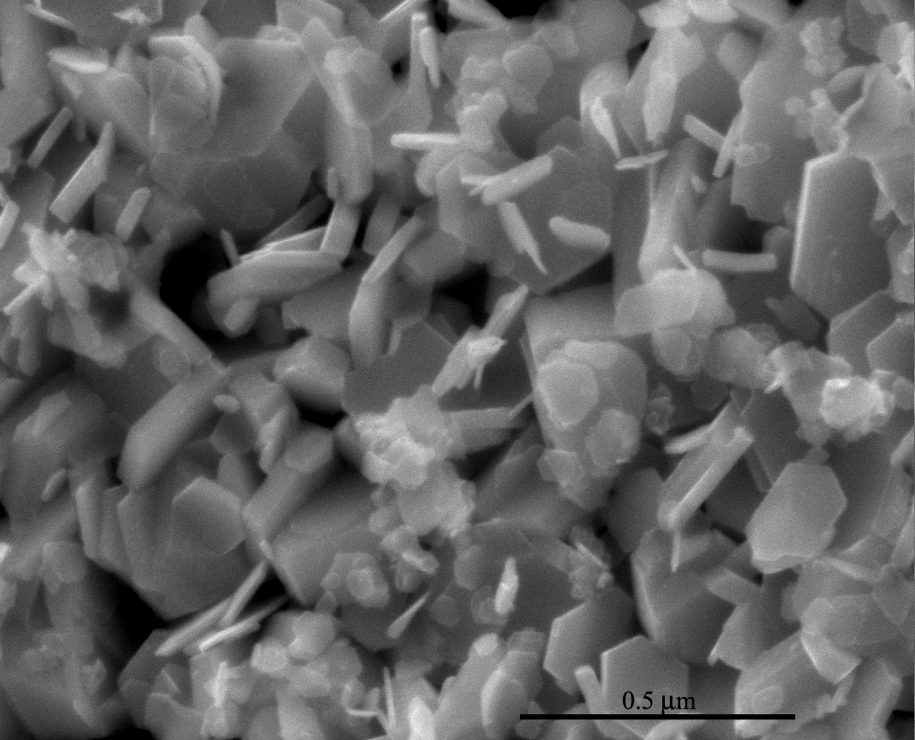
Approach: WS₂ Nanotube Synthesis
Short nanorods: 20-40 nm length and
8-20 nm width
Irregular shaped nanoparticles
Interplanar spacing: 0.61 nm - (003) plane
of WS₂

Slide 12
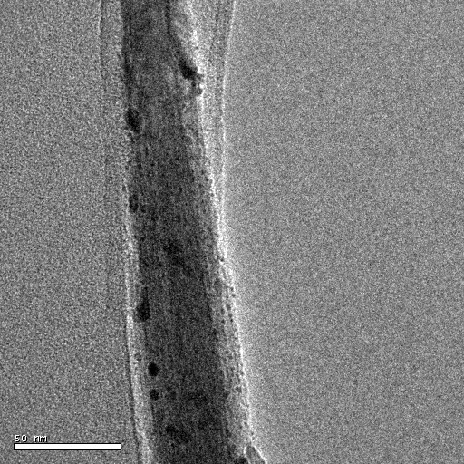
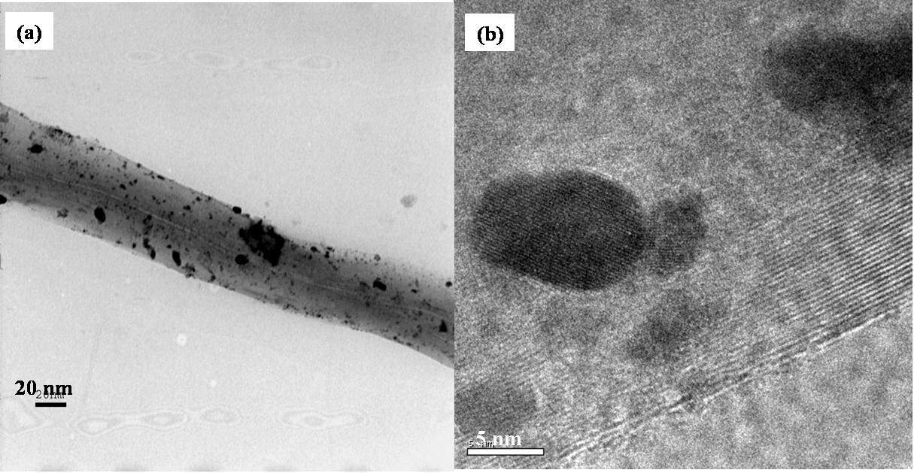
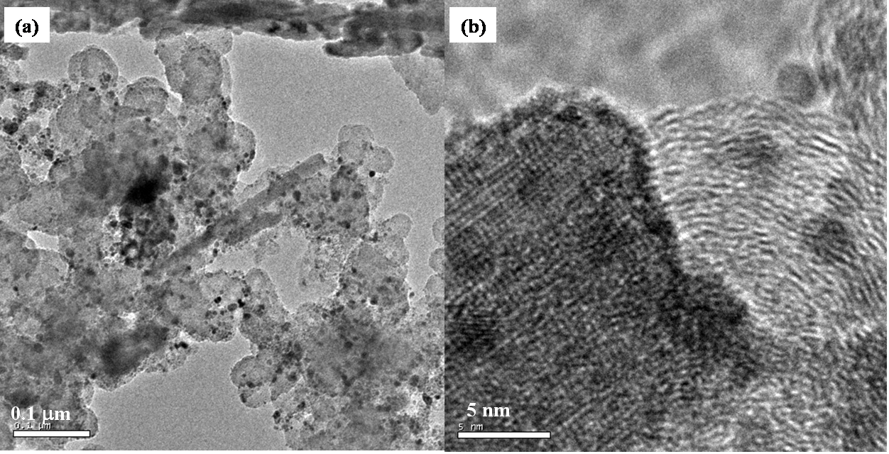
Approach: Methanol Oxidation Electrocatalysts
Catalyst: Platinum (H₂PtCl₆ precursor)
Catalyst supports: WO₃ nanorods (represented as WO₃NR), WO₃NR-CNT,
WO₃NR-C (vulcan XC) and WO₃B (commercial WO₃)
Method for metal reduction: Hydrogen reduction at 450 °C
Pt/WO₃(NR)-CNT
Pt/WO₃(NR)
50 nm
Pt/WO₃(NR)-C

Slide 13
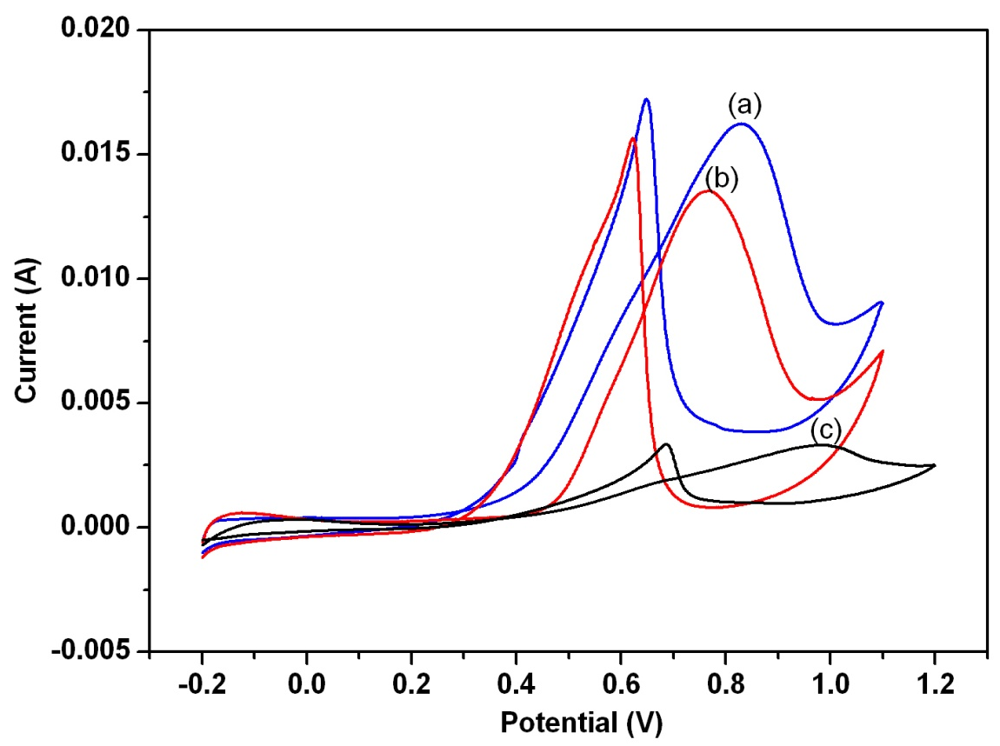
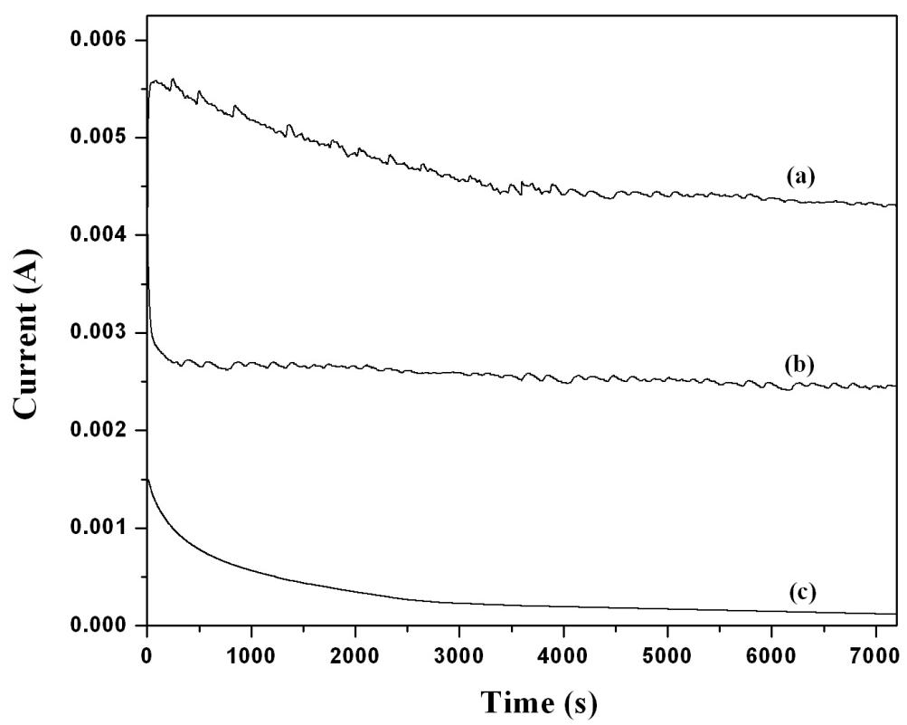
Technical Accomplishment: Electrochemical Methanol Oxidation
Improved activity for WO₃ NR supported catalyst
<
<
<
<
<
<
1M CH₃OH – 1M H₂SO₄ at a scan rate of 25mVs⁻¹
1M CH₃OH – 1M H₂SO₄ at 0.7 V
Electrocatalyst | Current density (mA cm⁻²) | Mass activity (mA mg⁻¹)
(a) 20%Pt/WO₃(NR) | 211 | 295
(b) 20% Pt-Ru/C (J. M) | 192 | 268
(c) 20%Pt/WO₃ | 35 | 49
J. Rajeswari, B. Viswanathan, T.K. Varadarajan, Mater. Chem. Phys.106 (2007) 168

Slide 14
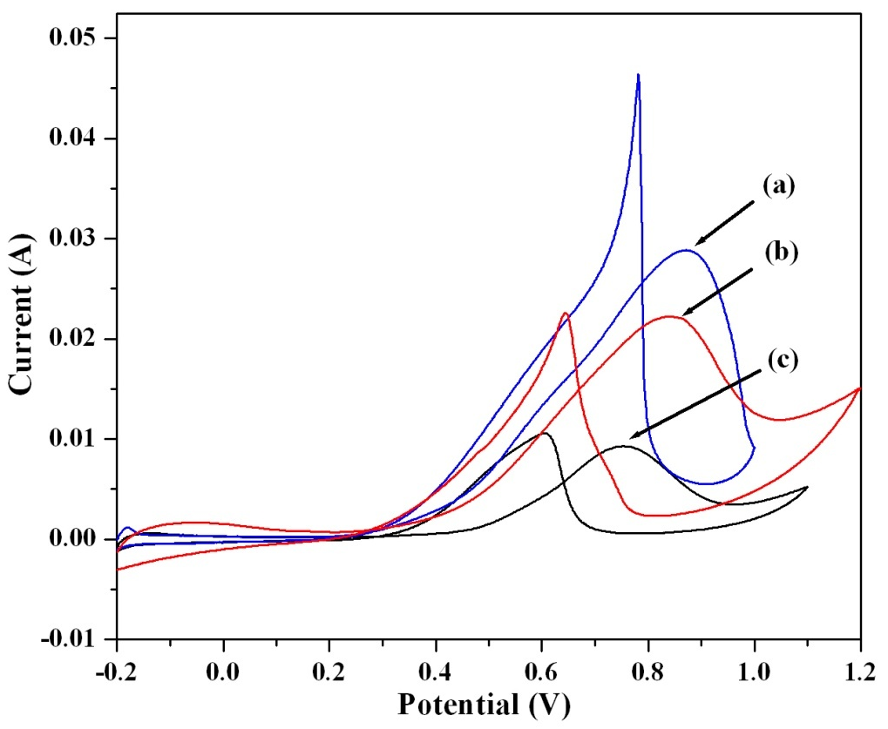
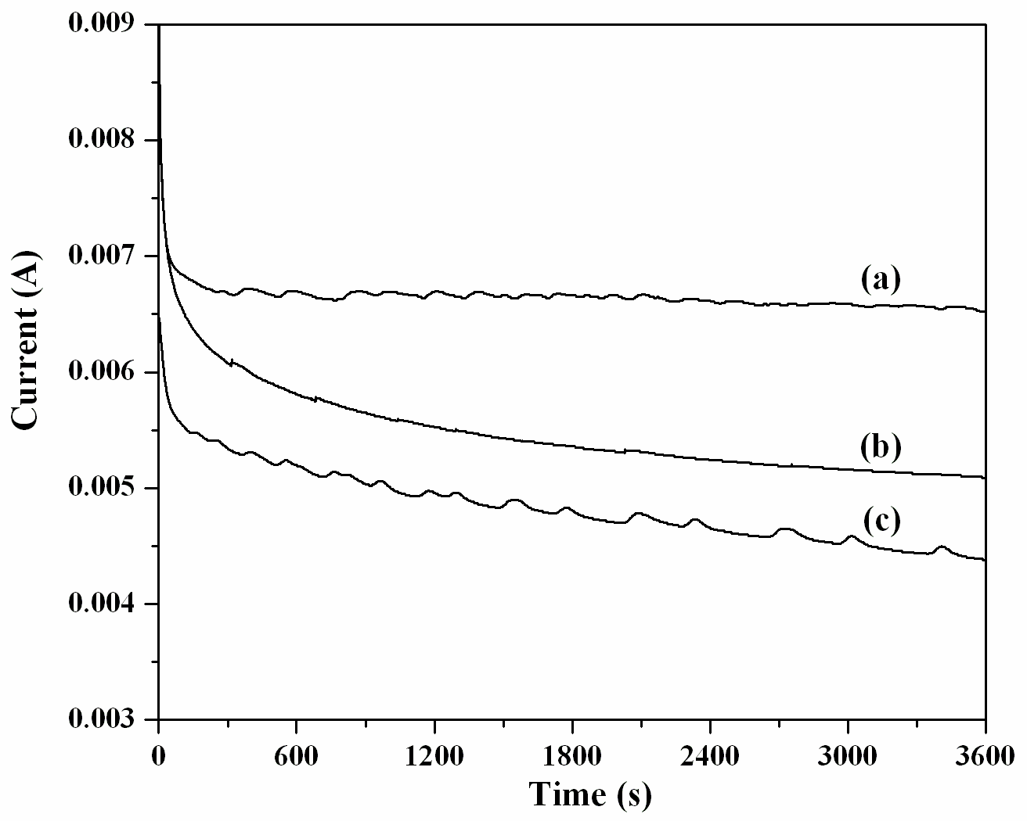
Technical Accomplishment: Electrochemical Methanol Oxidation
Improved activity for WO₃ NR supported catalyst
<
<
<
<
<
<
1M CH₃OH – 1M H₂SO₄ at a scan rate of 25mVs⁻¹
1M CH₃OH – 1M H₂SO₄ at 0.7 V
Electrocatalyst | Current density (mA cm⁻²) | Mass activity (mA mg⁻¹)
20% Pt/WO₃(NR)-CNT | 322 | 452
20% Pt/WO₃(NR)-C | 272 | 382
20% Pt/C | 130 | 180

Slide 15
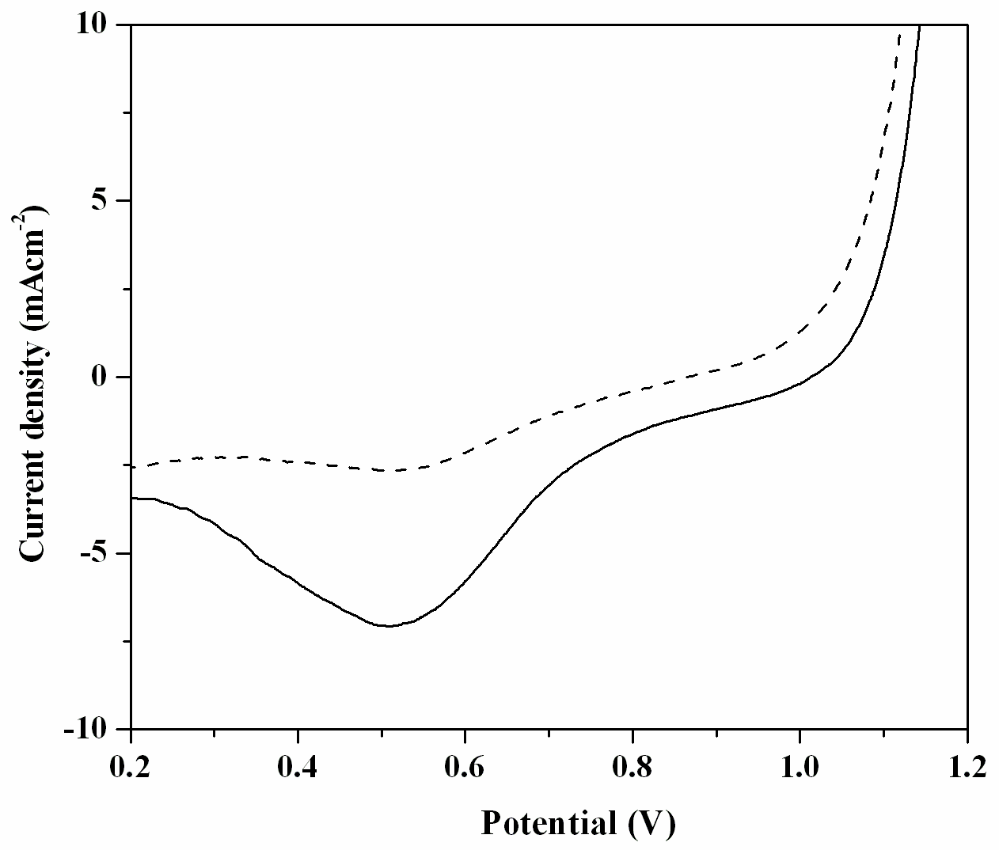
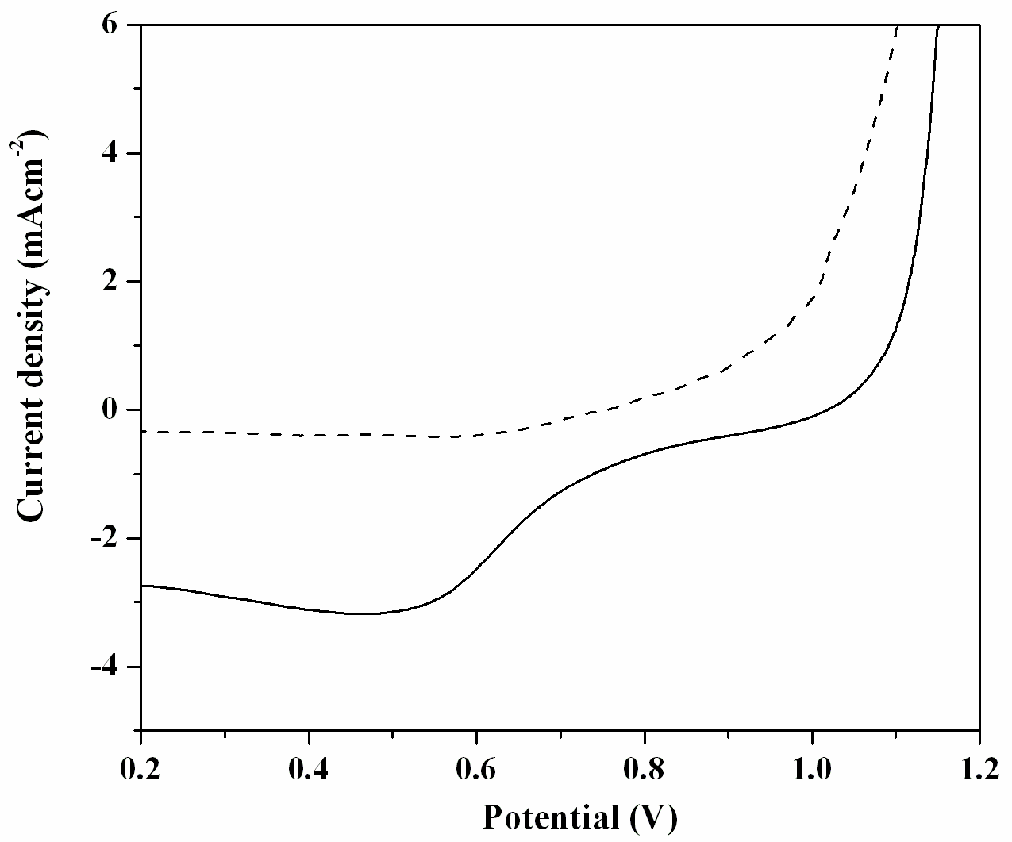
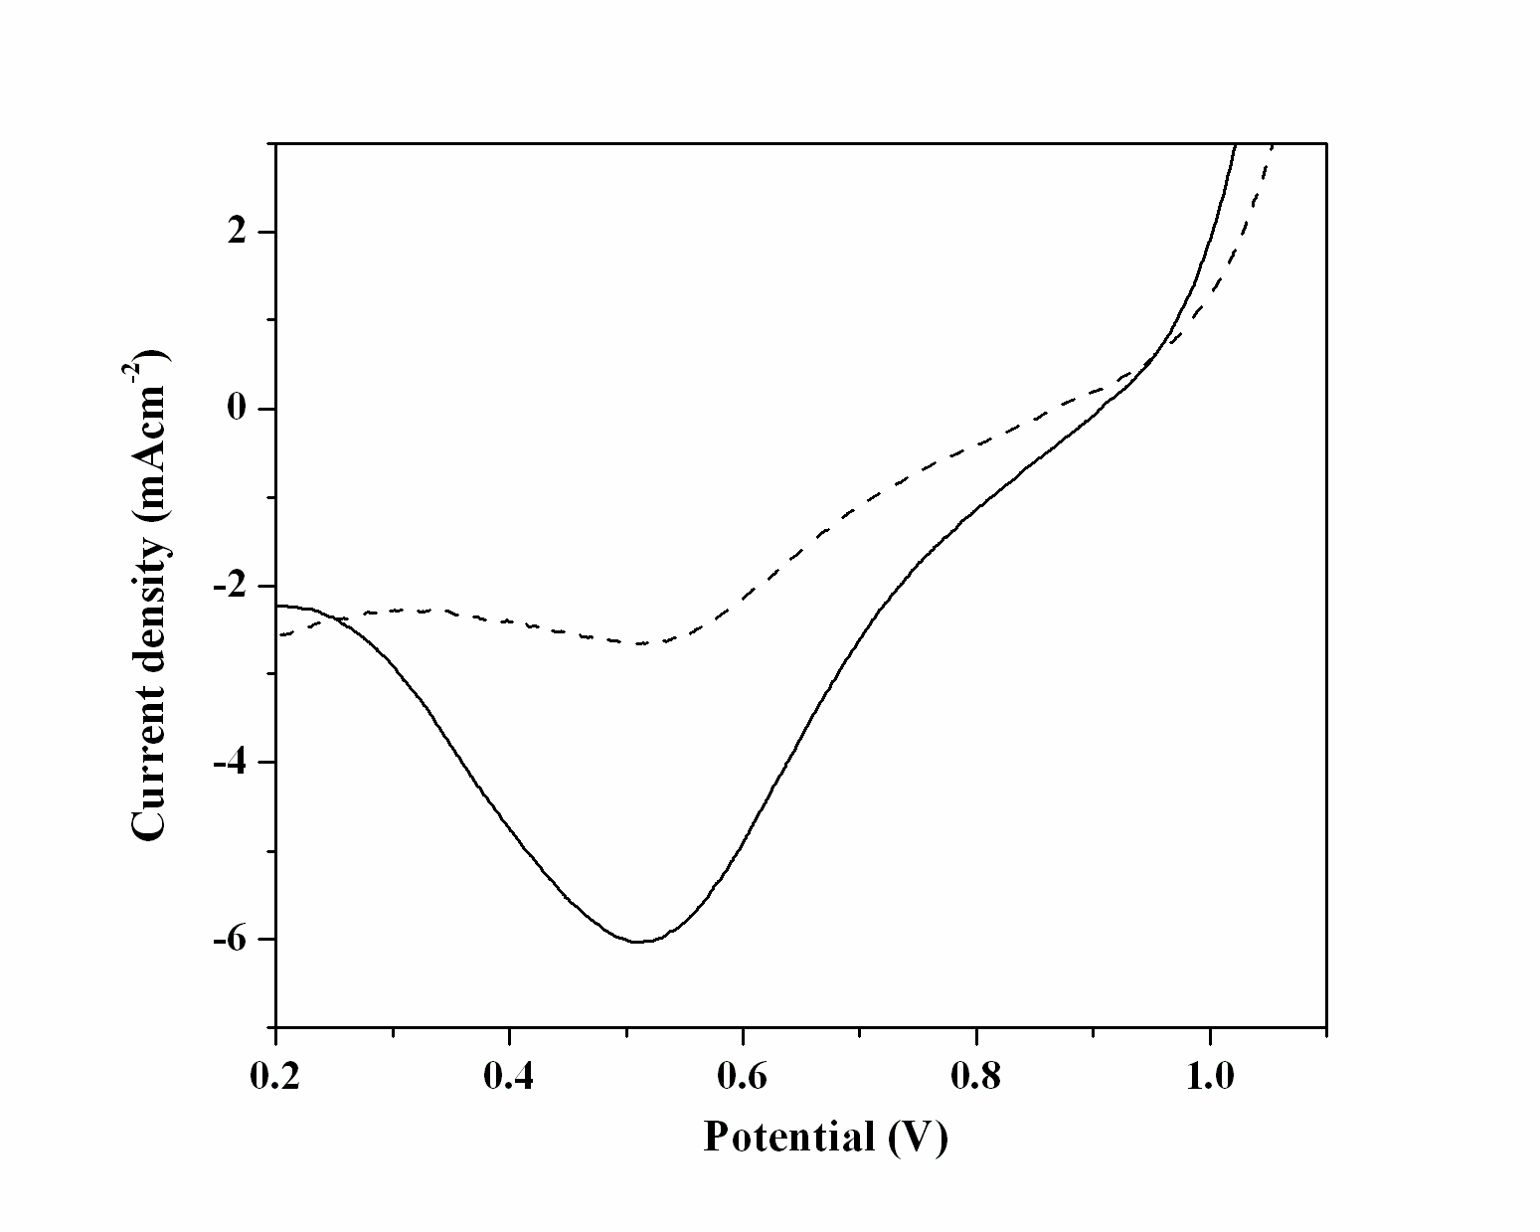
Technical Accomplishment: Oxygen Reduction Reaction
Improved activity for WO₃ NR supported catalyst
Pt/WO₃(NR)-C
Pt/C
Pt/WO₃-C
0.5 M H₂SO₄, Scan Rate: 5 mVs⁻¹ (solid line: O₂- saturated and dashed line: Ar- saturated)
Electrocatalyst | Mass activity (mAmg⁻¹) | Specific activity (mAcm⁻²)
Pt/WO₃(NR)-C | 3.83 | 5.45
Pt/WO₃-C | 2.42 | 3.44
Pt/C | 1.91 | 2.72

Slide 16
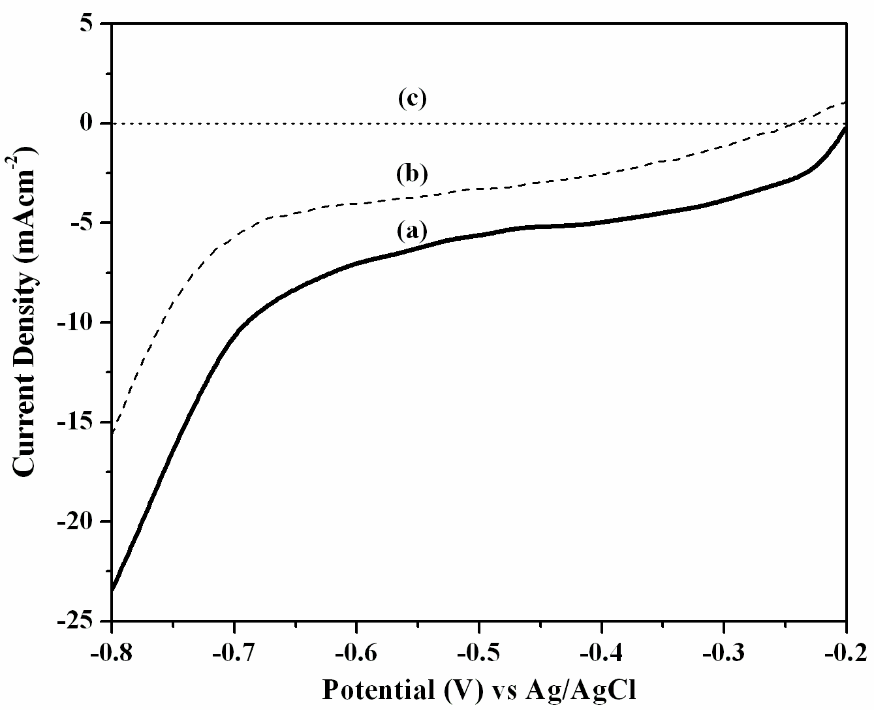
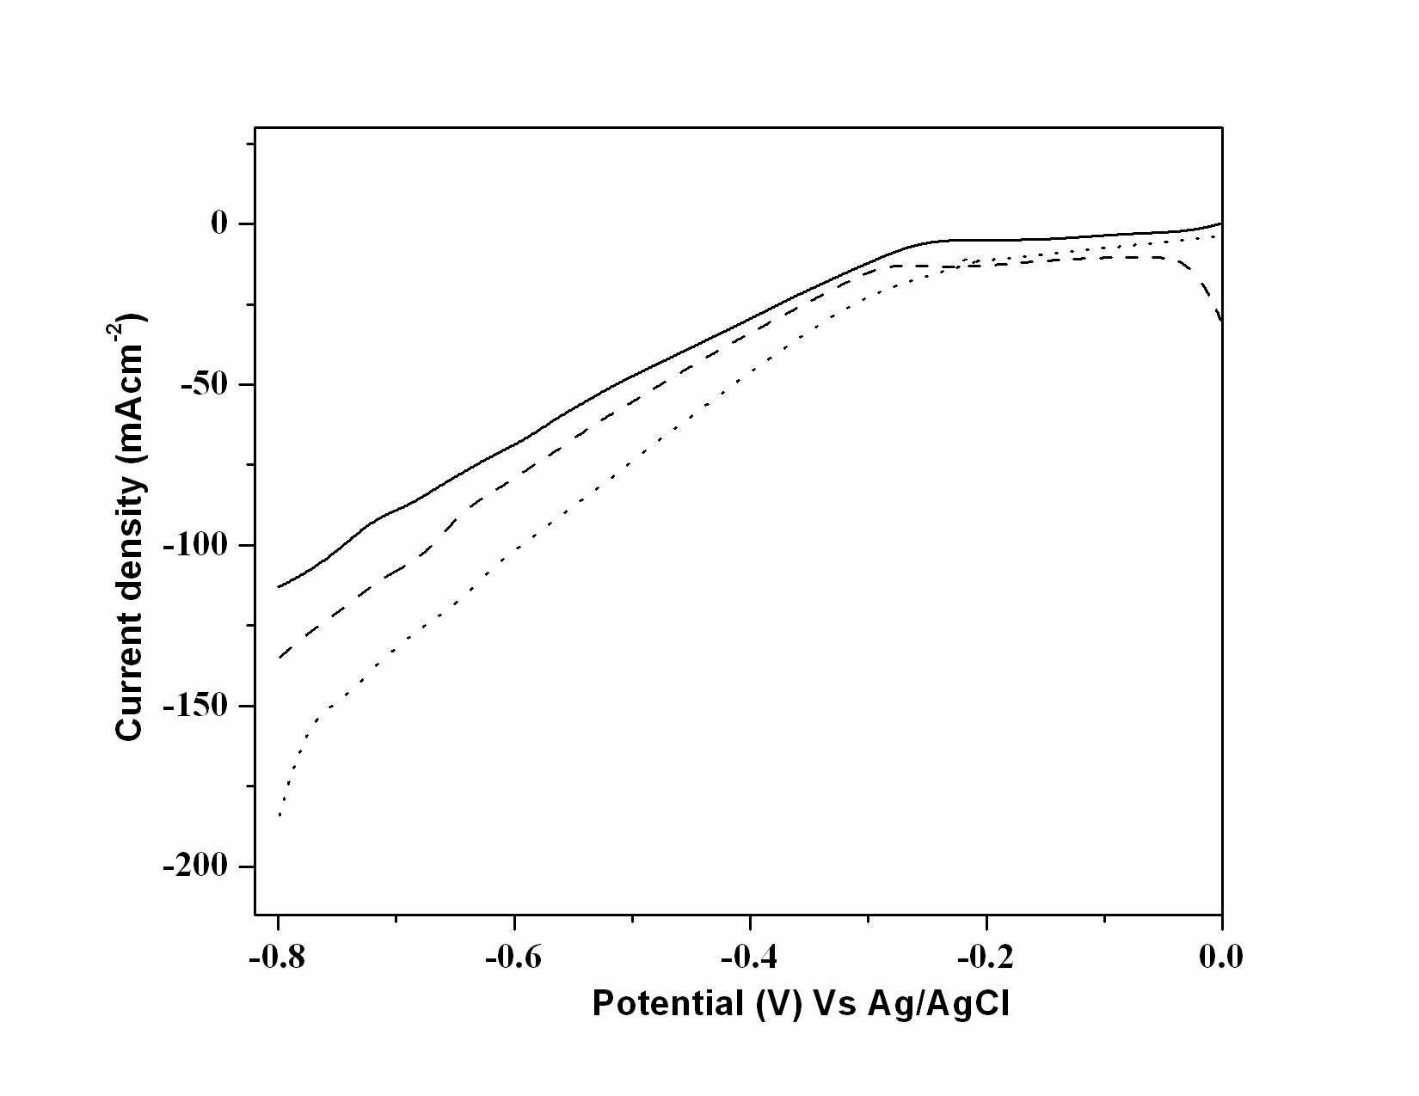
Technical Accomplishment: Hydrogen Evolution Reaction
Low cost, non noble catalyst materials
(a)
(b)
(c)
1 M H₂SO₄ at 5 mVs⁻¹
Current density at -0.8 V,
WO₃(NR): 23 mAcm⁻²
commercial WO₃: 15 mAcm⁻²
(c) bare glassy carbon electrode
Electrocatalyst | HER activity (mAcm⁻²)
(a) 20% Pt/WO₃(NR)-C | 185
(b) 20% Pt/WO₃-C | 135
(c) 20% Pt/C | 110

Slide 17
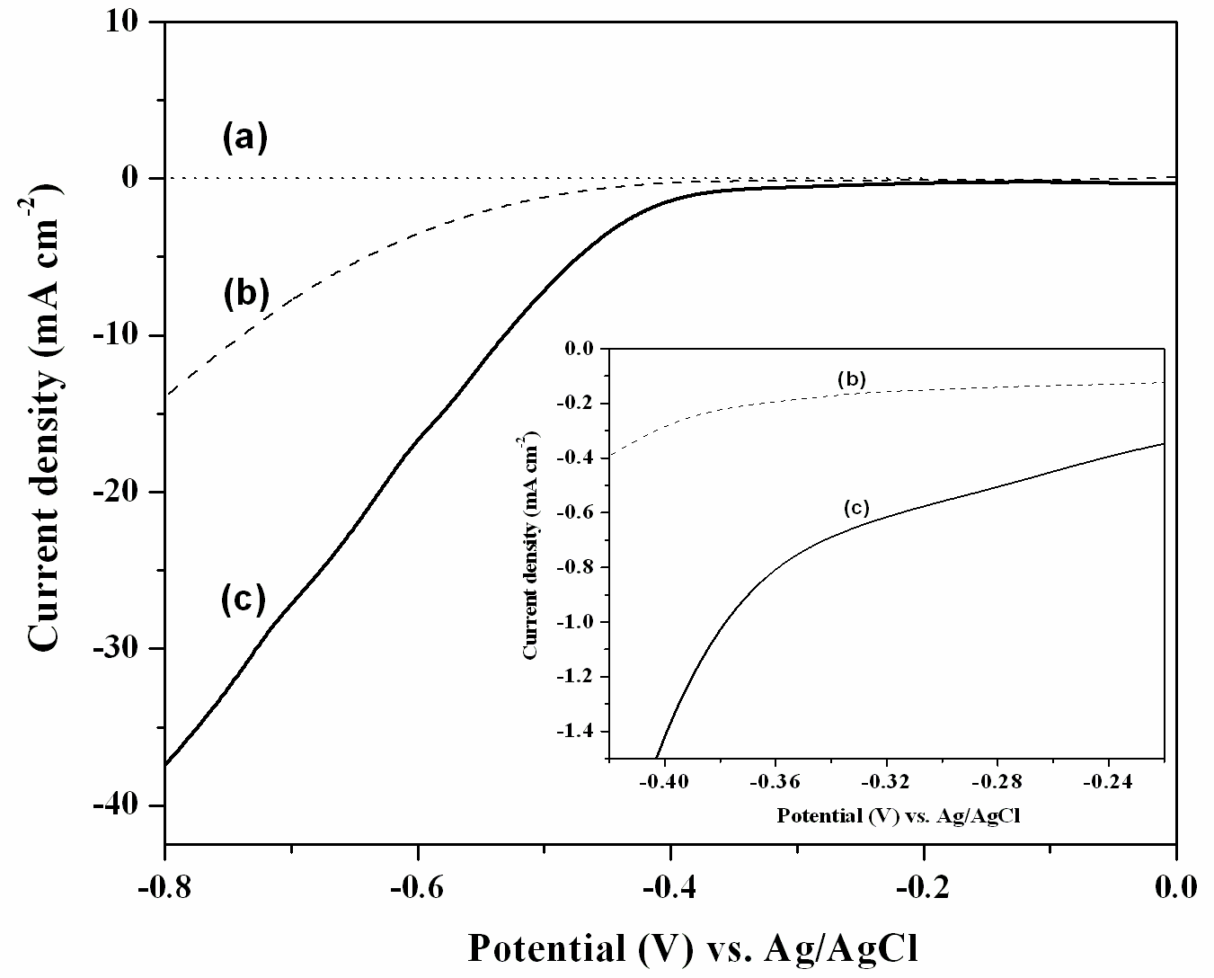
Technical Accomplishment: Hydrogen Evolution Reaction
Low cost non noble catalyst materials
Material | Activity (mAcm⁻²) | Onset Potential (V)
MoS₂ nanotubes | 37.4 | -0.22
Bulk MoS₂ | 13.7 | -0.32

Slide 18
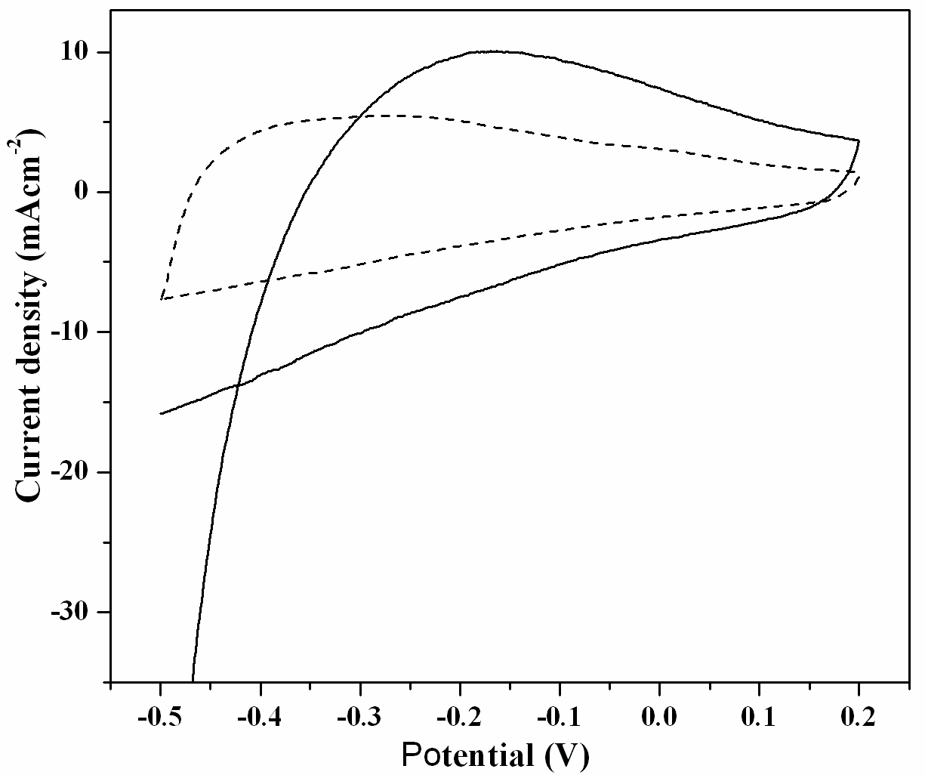
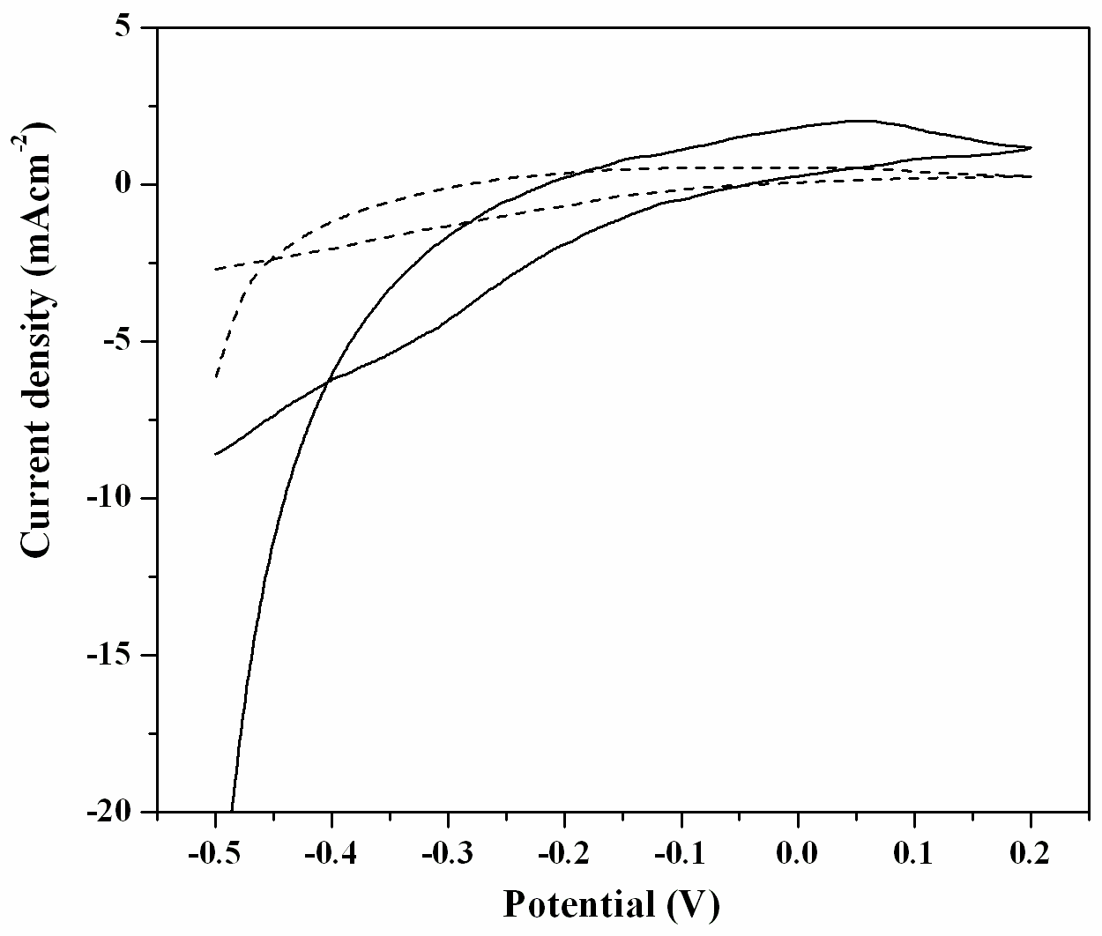
Electrochemical Capacitors-
Specific capacitance from cyclic voltammetry
WO₃NR
WO₃B
Specific capacitance, C = i /(ν x m), where i is the current density, ν is the scan rate
and m is the weight of the active material
Specific capacitance for WO₃NR:
2 mVs⁻¹: 266 Fg⁻¹
5 mVs⁻¹ : 198 Fg⁻¹
Specific capacitance for commercial WO₃:
2 mVs⁻¹: 36 Fg⁻¹
5 mVs⁻¹: 28 Fg⁻¹

Slide 19
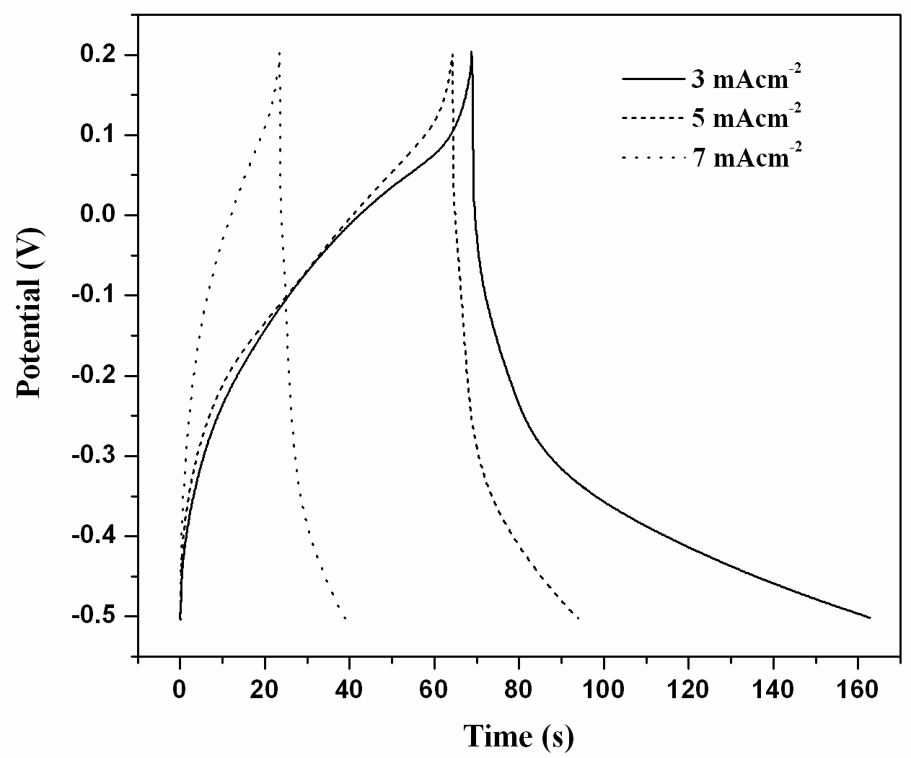
Electrochemical Capacitors- WO₃ nanorods
Specific capacitance from galvanostatic charge-discharge studies
Potential range (V) | Specific capacitance of WO₃ (Fg⁻¹) | Specific capacitance of WO₃(NR) (Fg⁻¹)
-0.5 to + 0.2 | 56 | 435
-0.4 to + 0.3 | 35 | 292
-0.3 to + 0.4 | 14 | 190
-0.2 to + 0.5 | 10 | 98
Current density (mAcm⁻²) | Specific capacitance (Fg⁻¹)
3 | 56
5 | 29
7 | 20
J. Rajeswari, B. Viswanathan, T. K. Varadarajan, Indian Pat. Appl. (2007) 1488 CHE

Slide 20
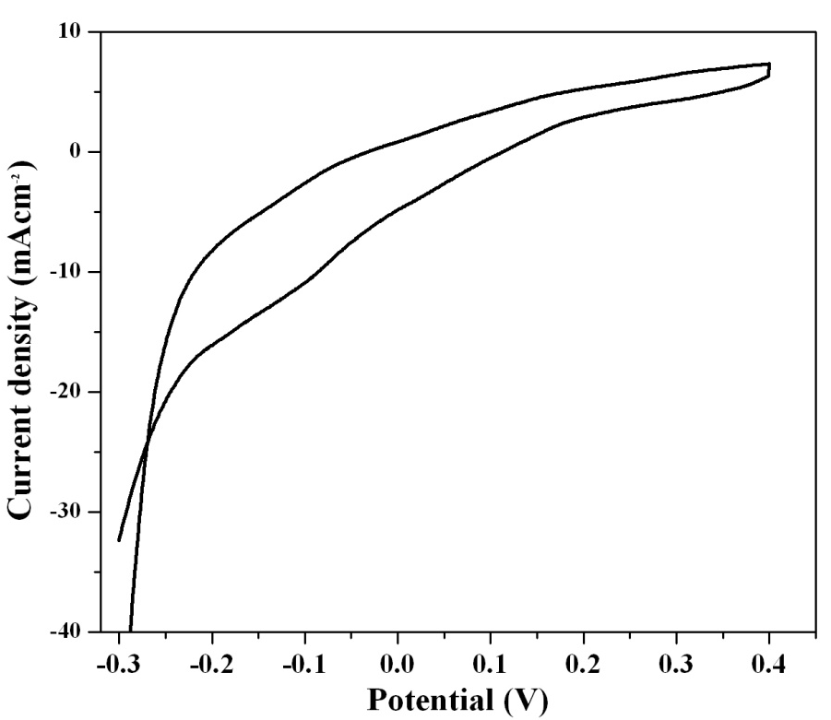
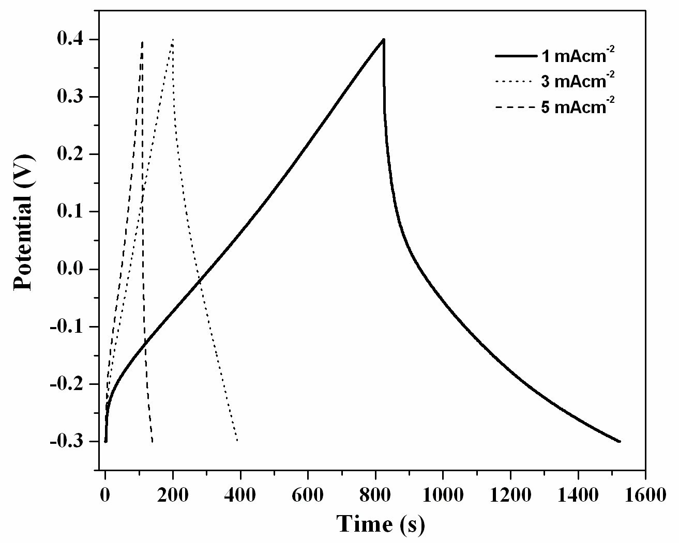
Electrochemical Capacitors- MoO₂ nanorods
Electrolyte: 1M H₂SO₄; scan rate: 5 mVs⁻¹
Mo⁴⁺ → Mo⁶⁺ ~ 0.2 V vs. Ag/AgCl
Electrolyte: 1M H₂SO₄
Current density (mAcm⁻²) | Specific capacitance (Fg⁻¹)
1 | 140
3 | 115
5 | 30
H. Zhang, Y. Wang, E.R. Fachini, C.R. Cabrera, Electrochem. Solid-state Lett. 2 (1999) 437

Slide 21
Summary and Overview
Relevance: Focussed on overcoming the most significant barrier for
commercialization – high cost of PGM catalysts and electrodes for
fuel cells and electrochemical capacitors
Approach: Development of simple method to synthesize low cost metal
oxides and metal sulfides nanomaterials such as nanorods, nanotubes, etc..
Conducted fundamental electrochemical studies in a half cell reaction mode
to understand the catalyst properties for above mentioned applications
Accomplishments: Electrochemical activity, in terms of mass, showed the
potential to reduce Pt loading for methanol oxidation and ORR and
Possibility to use non PGM electrode materials for HER and
electrochemical supercapacitors
Future work: Catalysts have to be tested in a single cell fuel cell

