Slide 1
Guard Catalyst Systems for demetallation in Hydroprocessing
Aditya V. Ajgaonkar
M.Tech Catalysis Technology
Roll No :- CA10M001
NCCR, IIT-Madras

Slide 2
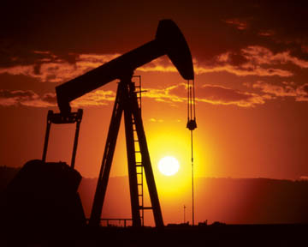
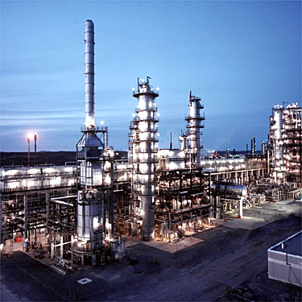
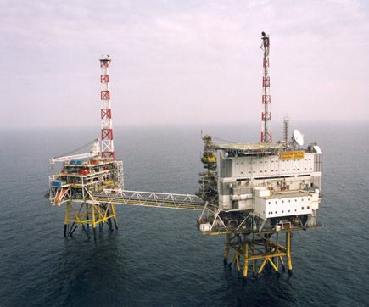
Introduction
Upstream Operations :
Oil & Gas exploration, production, transportation
Midstream Operations :
Refining and processing
Downstream Operations :
Petroleum product distribution and retail sale

Slide 3
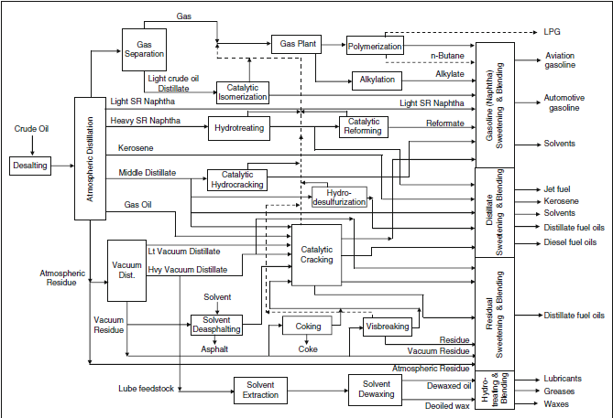
Refinery Flow Diagram
Catalytic Processes
Reforming
Hydrotreating
Hydrocracking
Alkylation
Isomerization
Thermal
Physical Separation
Chemical Conversion

Slide 4
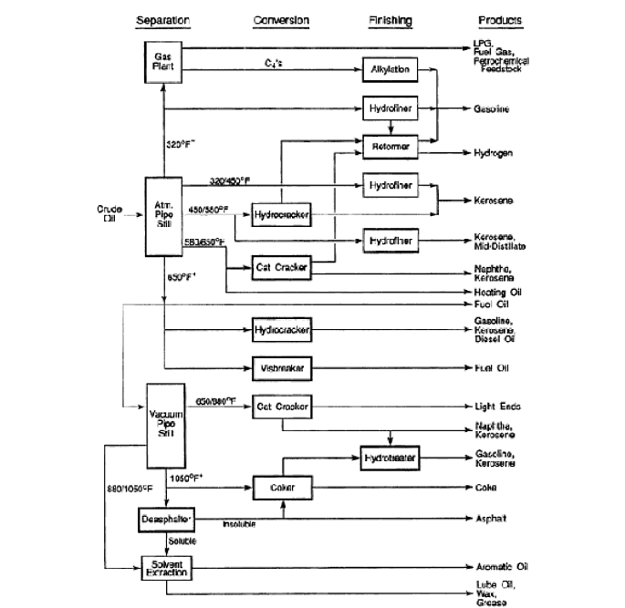
Placement of Hydrotreating Units
Hydroprocessing is a refining technology in which a feedstock is thermally treated with hydrogen under pressure.
Hydrotreating (HDT) is carried out for feed treatment and for product quality improvement.
It is therefore an important and most practiced process in industry.
Based on the amount of catalyst sold hydrotreating catalysts constitute third largest business.
HDT
HDT
HDT
HDT
HDT
HDT
HDT

Slide 5
Why Hydroprocessing ?
The purposes of refinery hydroprocessing are :
To improve the existing petroleum products
To enable petroleum products meet the specifications
To develop new products or new uses of the existing products
To convert inferior or low grade materials into valuable products
To transform near solid residua into liquid fuels

Slide 6
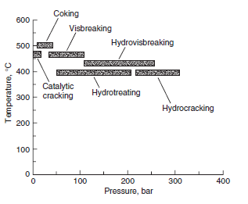
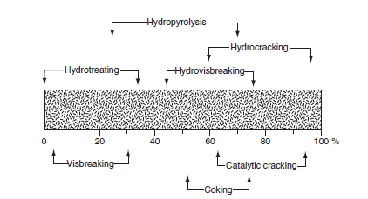
Hydrotreating – T, P, Conversion
Temperature – 300- 450 deg. C
Pressure – 0.7-15 MPa
Low Conversions of feedstock

Slide 7
Hydrotreating Reactions
Hydrodesulphurization (HDS)
Hydrodemetallation (HDM)
H₂
M- porphyrin
M_{x}S_{y} + H- porphyrin
(H₂S)
Hydrodeoxygenation (HDO)
Hydrodenitrogenation (HDN)
Hydrogenation of olefins
Hydrogenation of aromatics
Hydrodechlorination (HDCl)

Slide 8
Why Hydrotreating ?
The purposes of refinery hydrotreating are :
Reduction, or elimination, of corrosion during refining, handling, or use of the various products
To produce clean products for transportation fuels and petrochemicals
Increasing performance (stability) of gasoline
Decreasing smoke formation in kerosene
Reduction of heteroatom content in fuel oil to a level that improves burning characteristics and is environmentally acceptable

Slide 9
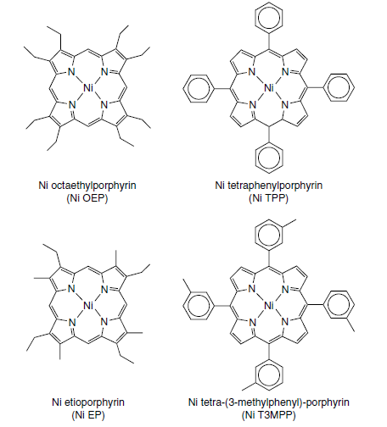
Metal compounds in Petroleum
Both Ni and V in petroleum exist as soluble organometallic complexes that fall in two categories :
Metal porphyrins
Non-porphyrin metal complexes
These compounds are distributed over a wide boiling range (350 – 650 deg C).

Slide 10
Metal compounds in Petroleum
Metal Compounds
Porphyrins
Non-porphyrins
Asphaltenes
Biological , Non-biological origin.
Diameter is of the order of 0.8-1 nm which may get expanded due to substitution.
At least one double bond on methine bridge or pyrrole ring is hydrogenated.
Hydroporphyrins
Aryl porphyrins
Significant amount is associated with asphaltenes.

Slide 11
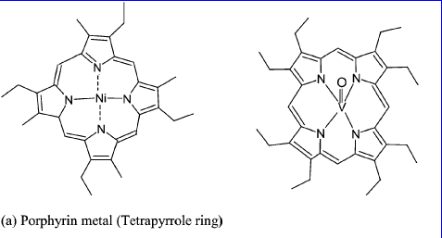
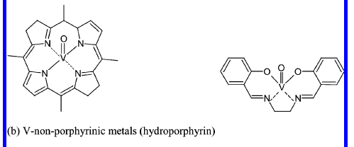
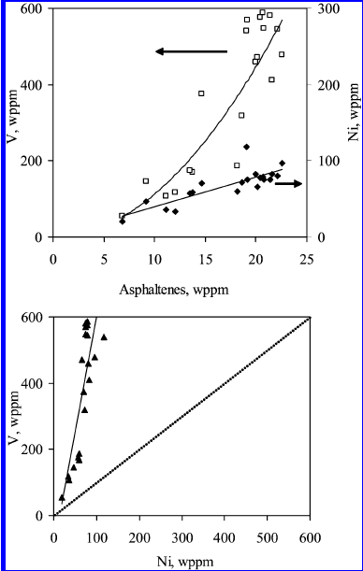
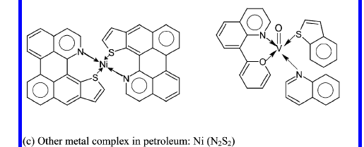
Metal compounds in Petroleum

Slide 12
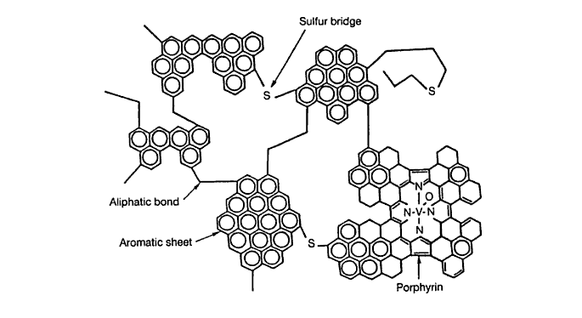
Metal compounds in Petroleum
Porphyrins account for only half of the V and Ni present in the petroleum crude.
The remaining part of the metals was supposed to comprise less-defined forms which may involve some bonding with heteroatoms in resins and asphaltenes.
Asphaltenes contain porphyrins and non porphyrins depending upon the origin of the crude oil.

Slide 13
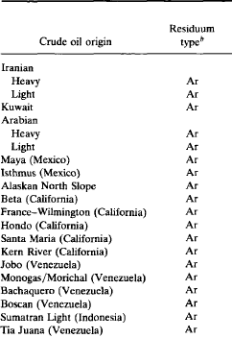
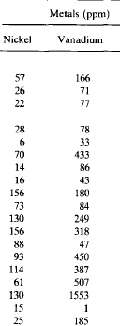
Metal content
Metal content varies depending upon the type of crude.
Generally varies between few ppm to 1000 ppm.
Vanadium content is more than Nickel except few exceptions.

Slide 14
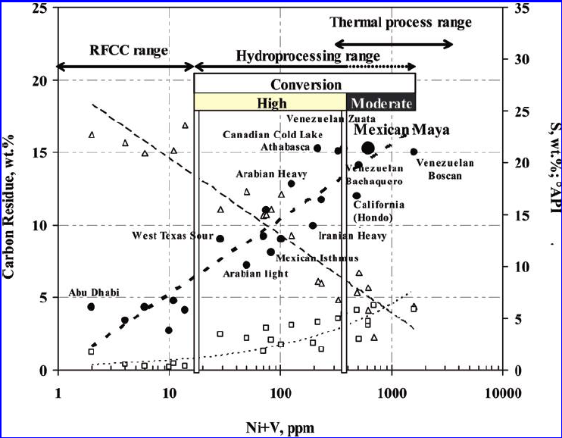
Metal content

Slide 15
Metal content
The trace metals Ni and V are generally orders of magnitude higher than other metals in petroleum.
Part of the metallic constituents of crude oils exist as inorganic water-soluble salts, mainly as chlorides and sulphates of Na, K, Mg, Ca. These may due to contact with brine salts.
They are removed by desalting.
Arsenic is also present but it has received little attention till now.

Slide 16
Why Hydrodemetallation ?
Metals affect many upgrading processes.
V and Ni deposit as sulfides at the pore mouth and block the pores in hydrotreating catalysts (HDS, HDN catalysts)
Ni deposits on the catalyst, acts as dehydrogenation catalyst, enhances production of undesirable products such as hydrogen and coke.
Ni initially deposits on the exterior
As the catalyst ages Ni migrates to the interior.

Slide 17
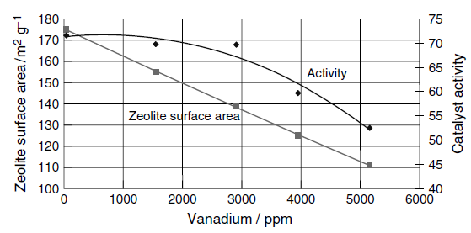
Why Hydrodemetallation ?
V like Ni also catalyzes dehydrogenation reactions to form hydrogen & coke, however activity is ¼ to ½ of Ni.
V is more notorious because it causes destruction of zeolite structure.
Dissolution of zeolite crystals
Vanadic acid is not consumed but acts as catalyst getting regenerated after every cycle.

Slide 18
Why Hydrodemetallation ?
In high-temperature power generators, such as oil fired gas turbines, the presence of metallic constituents may lead to ash deposits on the turbine rotors, thus reducing clearances and disturbing their balance.
The ash resulting from the combustion of fuels vanadium reacts with refractory furnace linings to lower their fusion points and so cause their deterioration.

Slide 19
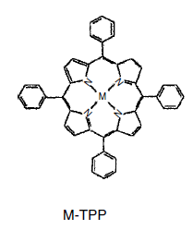
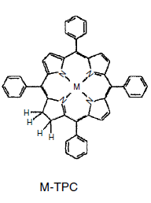
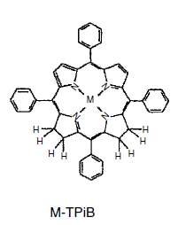
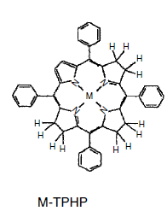
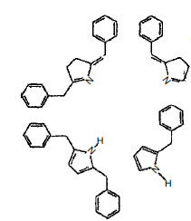
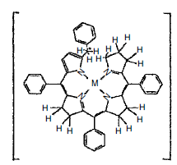
Hydrodemetallation Mechanism
H₂
H₂
H₂
Ring Fragmentation
H⁺/H₂
Ring opening & acid attack
+
Metal Sulfides
Jansen et al. Appl. Catal. 179 (1999) 229

Slide 20
Hydroprocessing Catalysts
Catalyst Components
Important Parameters
I ) Appropriate Composition (Selectivity / Stability)
Acidity (Cracking)
Basicity (Selectivity/stability)
RE-zeolite scavenger
II ) Meso / Macropores
Diffusion of large molecules
Stability
III ) Catalytic Active Components
Metal Loading
High dispersion of active sites
IV) Catalytic Activities
Primary / secondary reactions
Hydrotreating
Hydrogenation / Dehydrogenation
Cracking
Isomerization (alkylation)
Cyclization (Polymerization)
Aromatization
Support
Modified Zeolites (by exchanging)
Mixed Oxide
Macroporous Amorphous filler matrix
Porosity
Active Metals
Ni-Mo / Ni-W / Co-Mo
Pt/Pd/Ru/Rh
Leyva et al., Ind. Eng. Chem. Res. 2007, 46, 7449

Slide 21
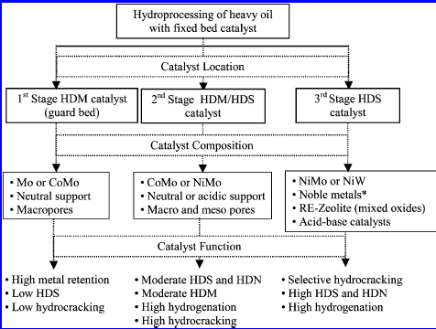
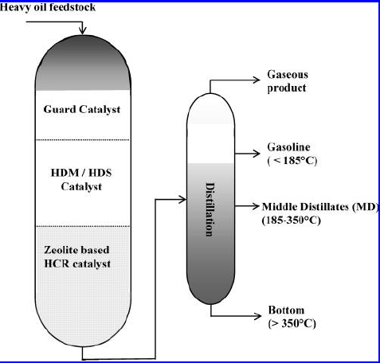
Guard Catalyst
Guard Catalysts : High HDM

Slide 22
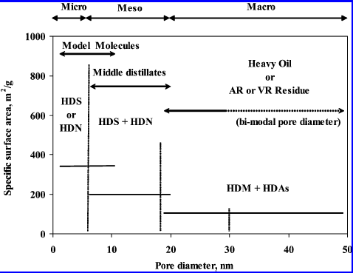
Hydrodemetallation Catalysts
Anchetya et al., Catal. Today 2005, 109, 3-15

Slide 23
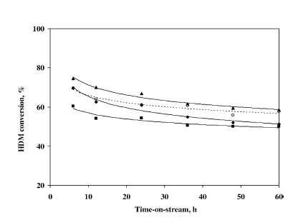
Rana et al. : Studied the effect of alumina preparation on HDM
Parameters Studied :
Catalyst : γ – Alumina (support) prepared by urea (u), ammonium carbonate (acs) and ammonium hydroxide (am) as hydrolyzer.
Co- Mo (Active metals)
Temperature : 380 deg. C
Pressure : 5.4 MPa

Slide 24
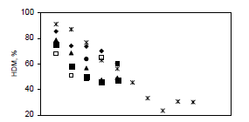
Maity et al. : Studied the effect of active metals on HDM
Parameters Studied :
Catalyst : γ – Alumina (support)
Co- Mo, Ni-Mo, Co-W, Ni-W(Active metals)
Temperature : 380 deg. C
Pressure : 5.4 MPa
Catalysts | MoO₃ | WO₃ | CoO | NiO | P₂O₅
A | 15 |  | 4
B | 15 |  |  | 4
C |  | 20 | 4
D |  | 20 |  | 4
E | 10 |  | 3 |  | 0.8
Co-Mo > Co-W
Ni-Mo > Ni-W
Co-Mo > Ni-Mo

Slide 25
Problem Statement
The project aims to carry out demetallation (HDM) reactions by synthesizing guard catalyst systems.
Proposed Catalysts :
Metal Sites (Active Component): Co, Ni, Mo
Support : Mesoporous Alumina, Silica

Slide 26
Thank You!

