Slide 1
Hierarchically structured mesoporous silica films

Slide 2
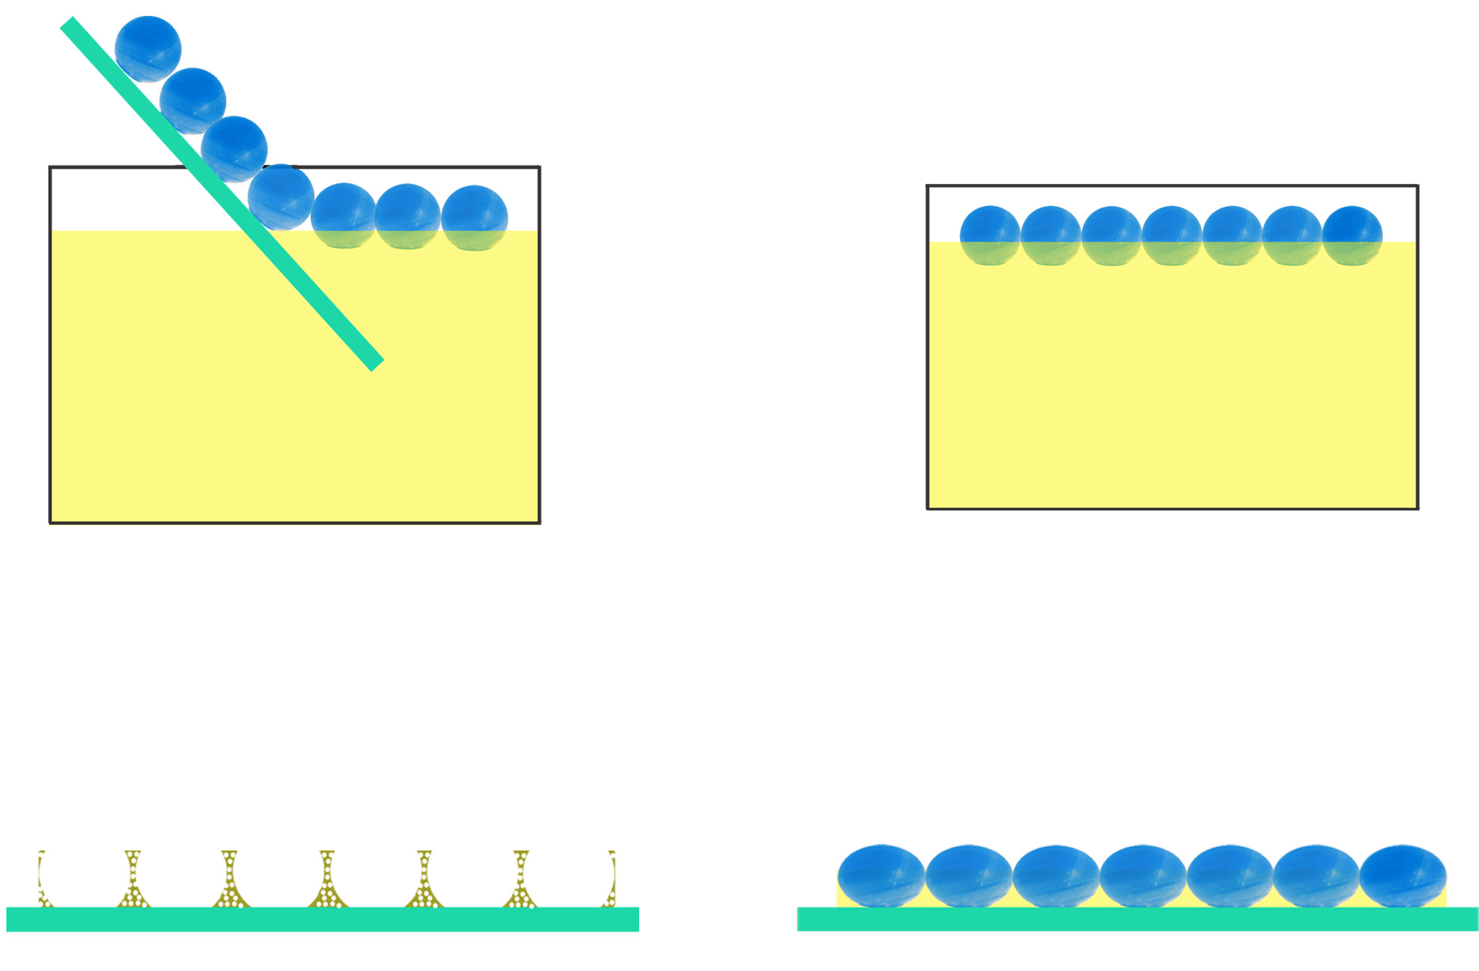
Hierarchically Structured Mesoporous Silica films
PS template
P₁₂₃ +TEOS + HCl
drying
calcination

Slide 3
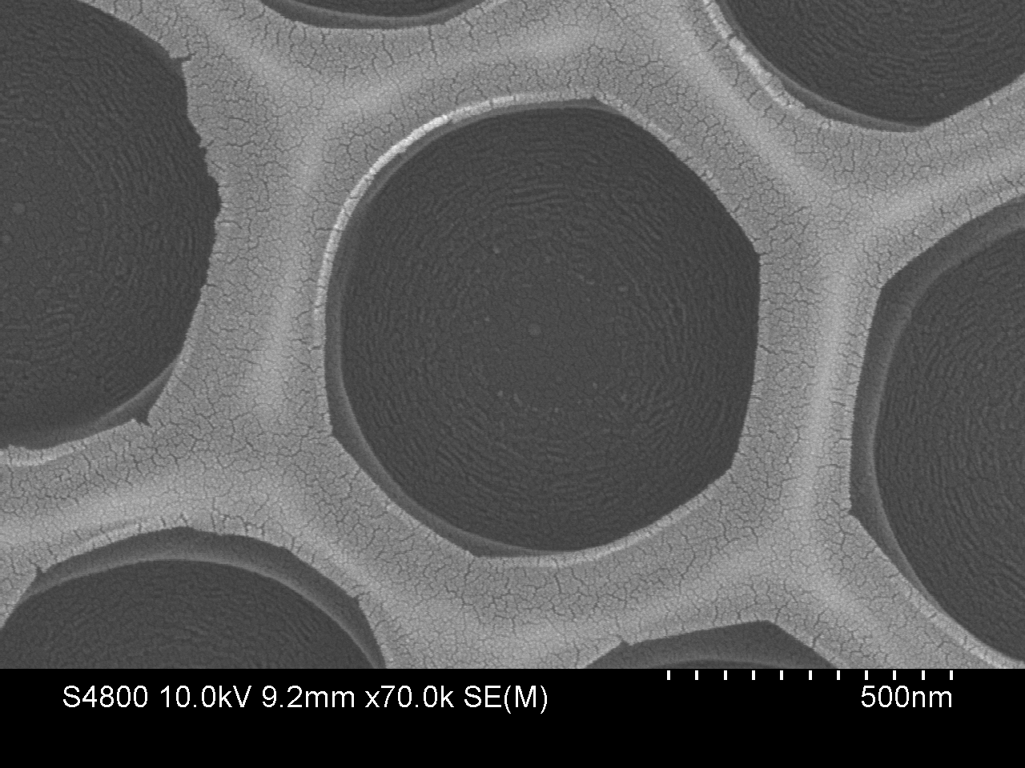
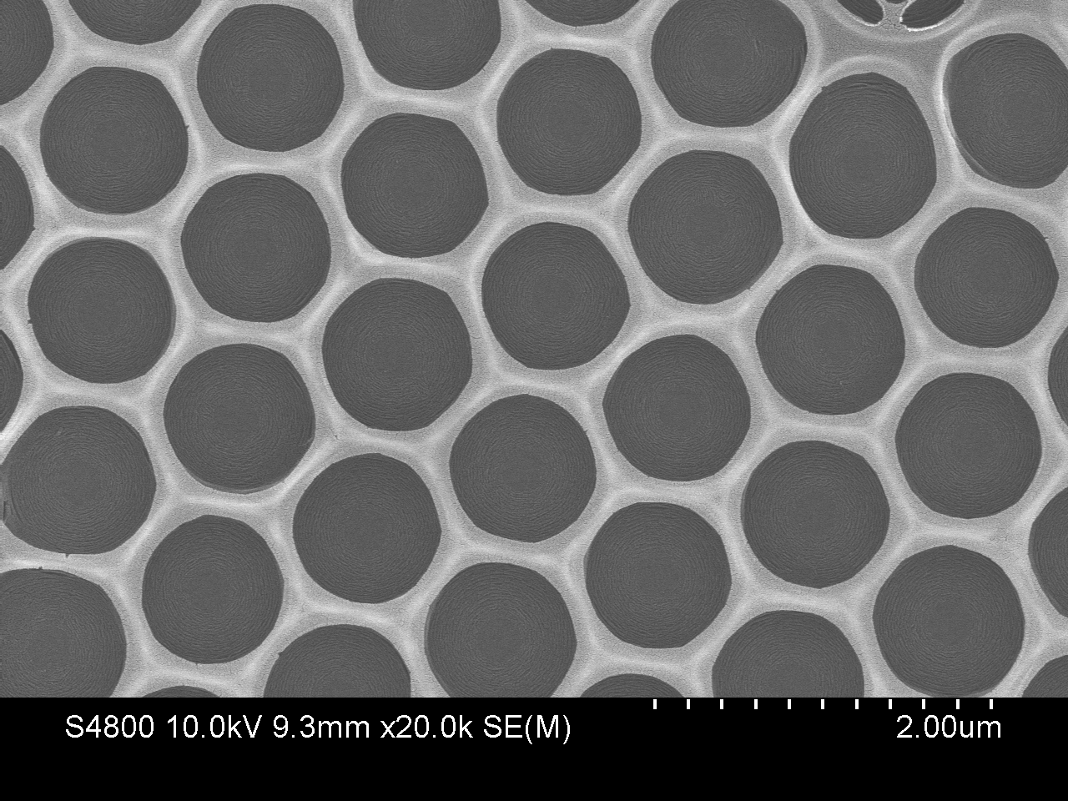
HRSEM images of Hierarchichally Structured
Mesoporous Silica films (PS 1000 nm size)

Slide 4
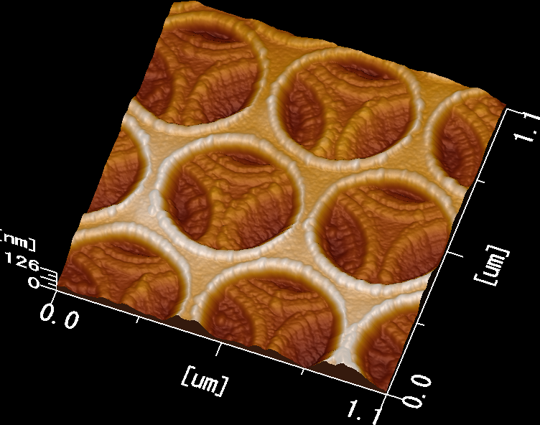
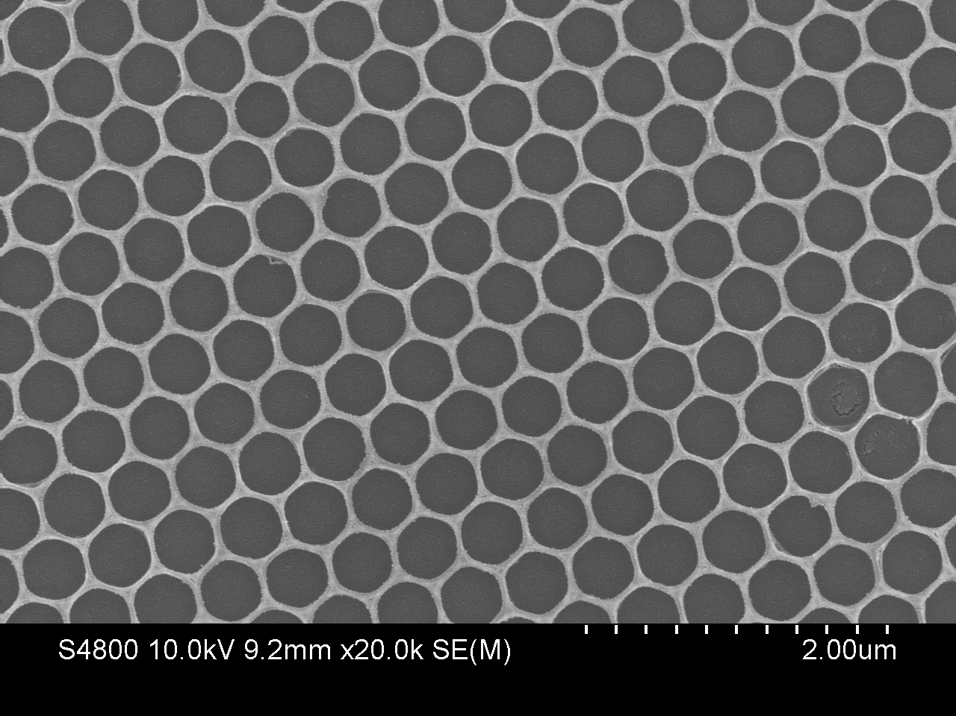
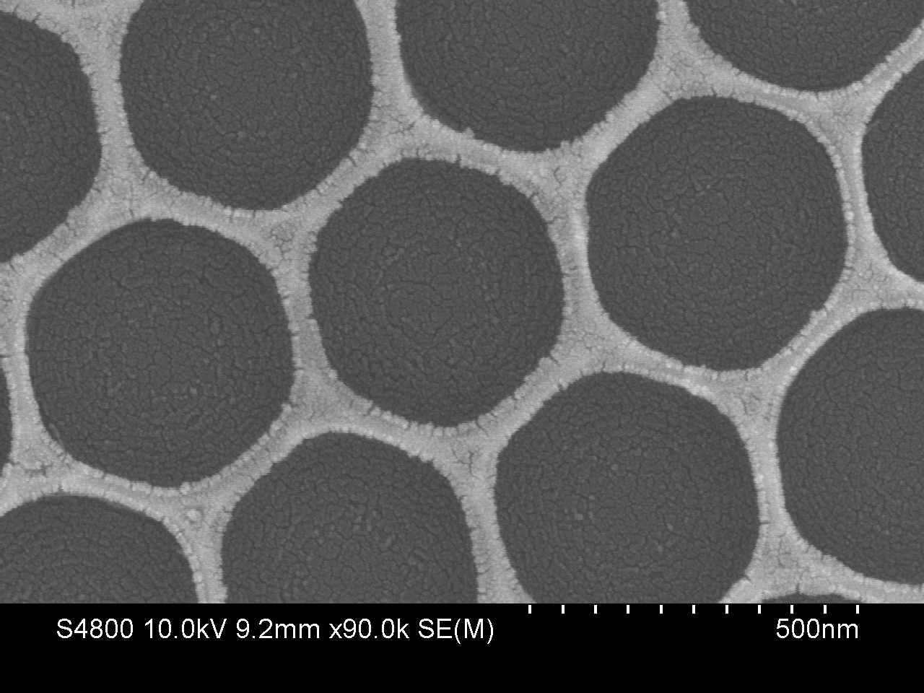
Mesoporous Silica films using PS 500 nm size
Pores are highly ordered; Nanopores are present within the spheres
Bright and dark color: Difference in the thickness

Slide 5
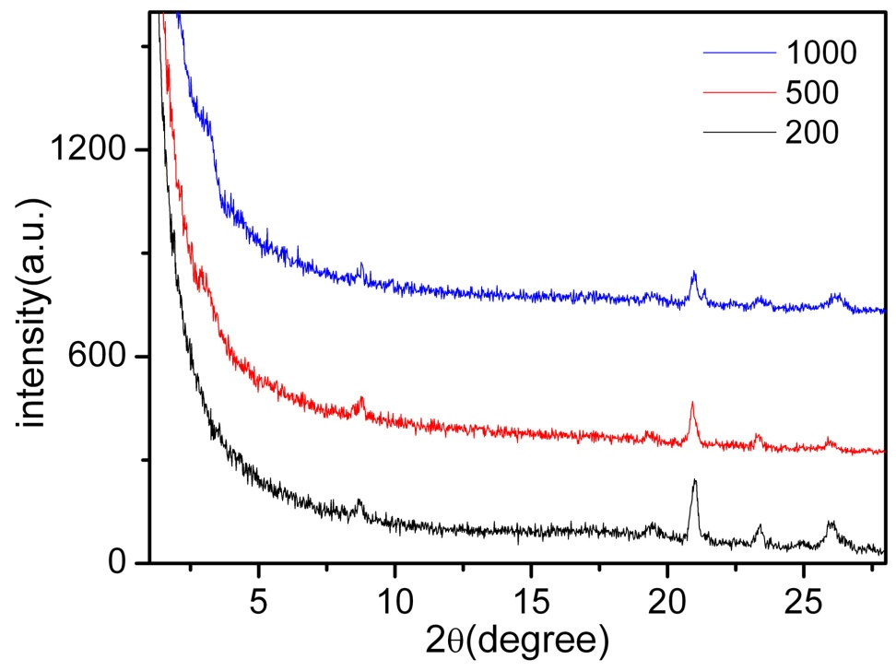
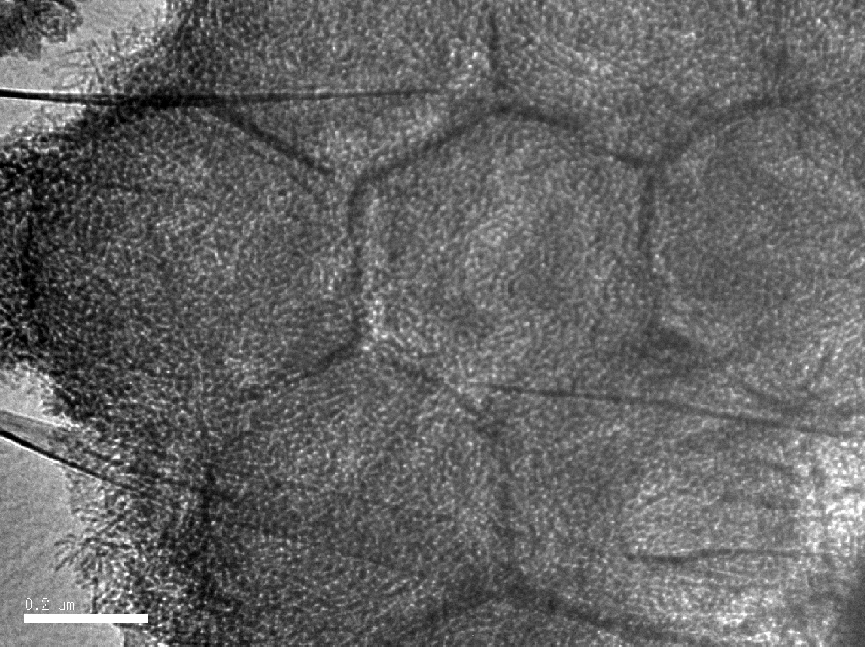
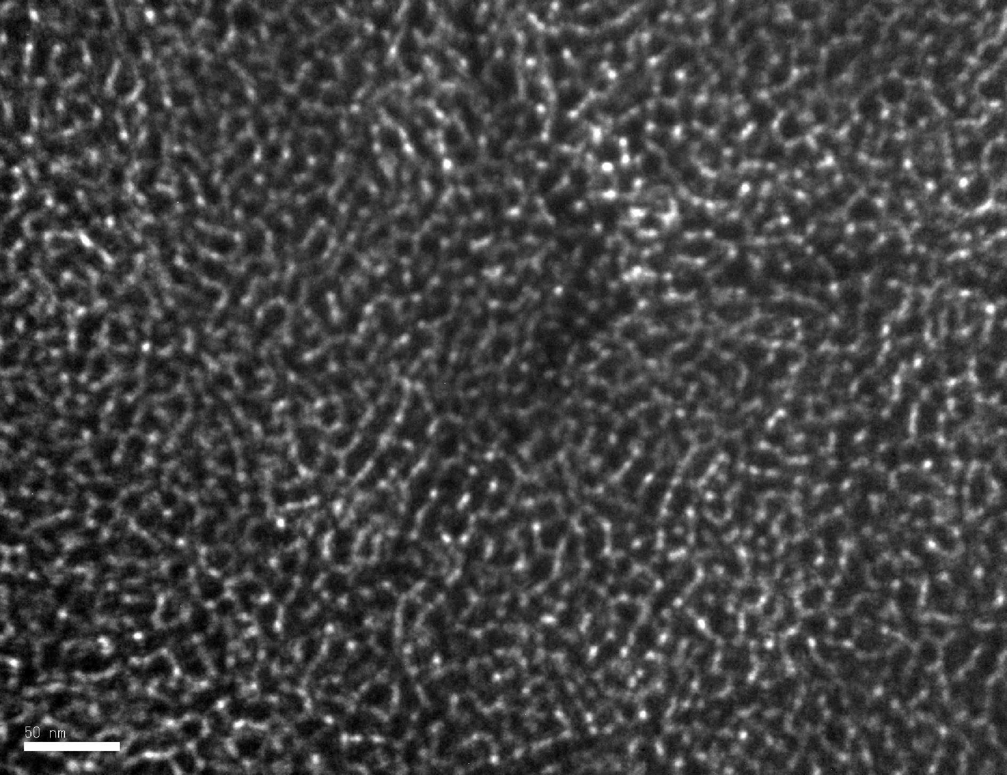
Characterization by HRTEM and XRD
Structural order for 1000 and 500 nm is really good

Slide 6
Hierarchically structured nano/macroporous carbon
films and their application in sensing

Slide 7
Hierarchically Structured Mesoporous Carbon films
PS template
drying
P₁₂₃ +Glucose and H₂SO₄
calcination

Slide 8
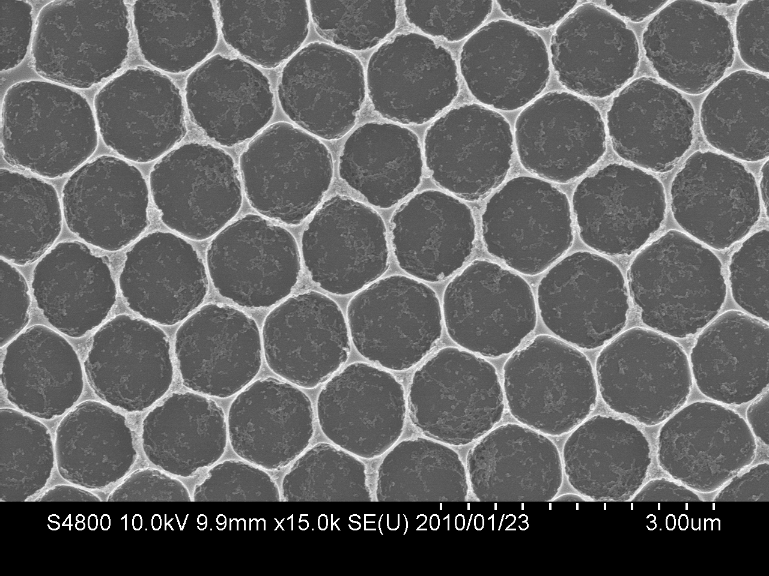
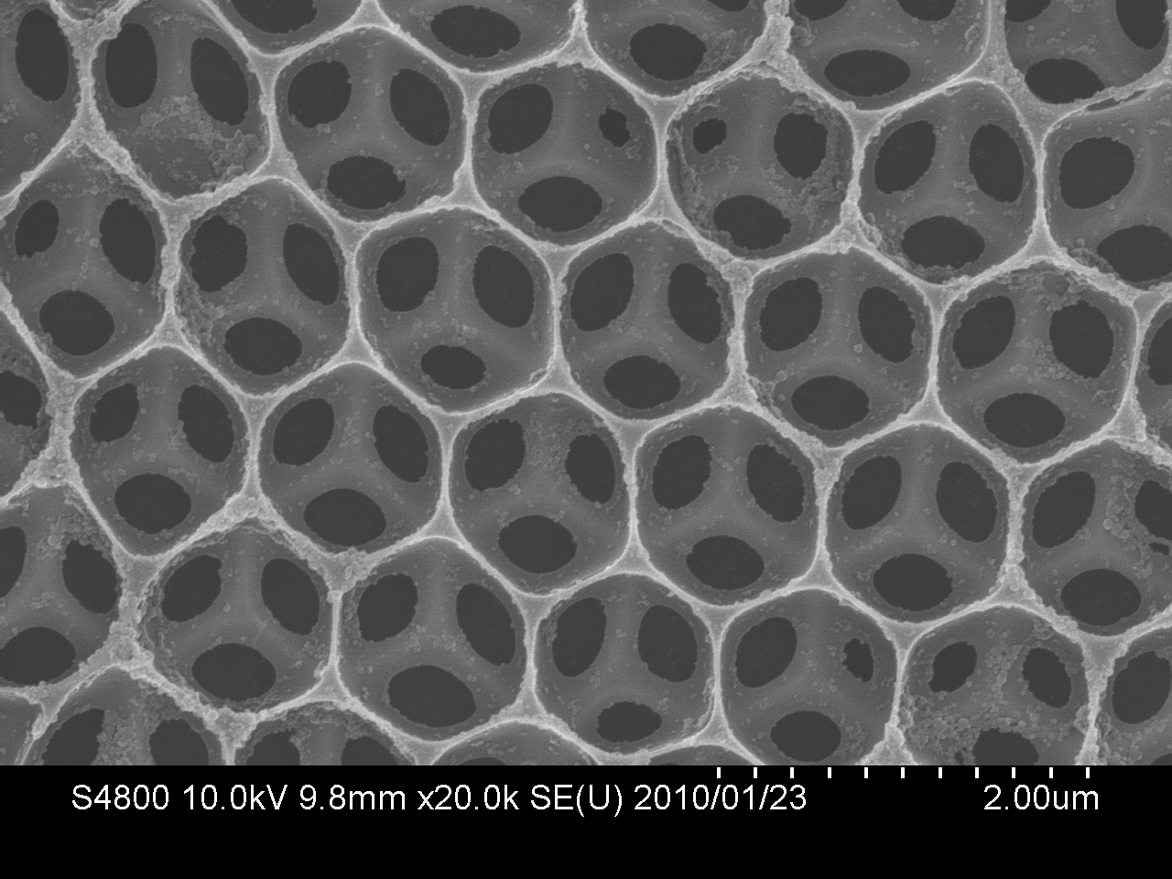
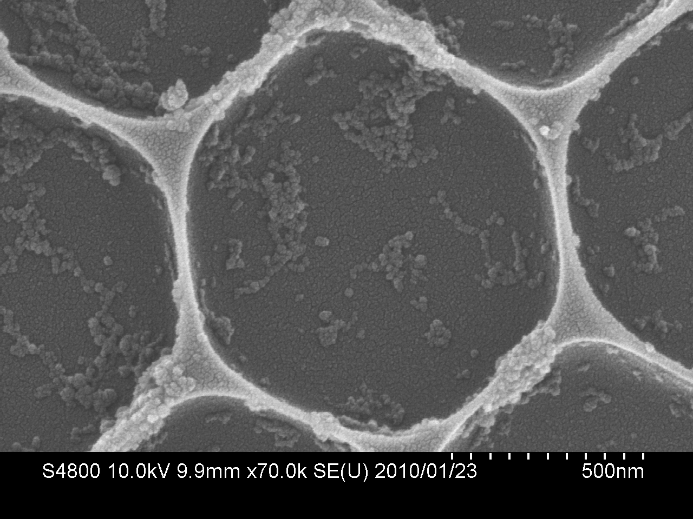
HRSEM images of Hierarchichally Structured
Mesoporous Carbon films (PS 1000 nm size)
One layer
Two layers

Slide 9
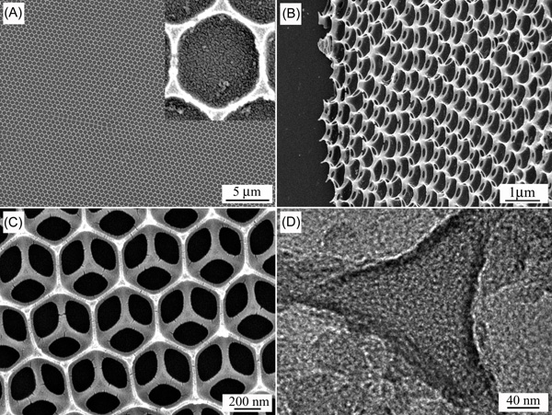
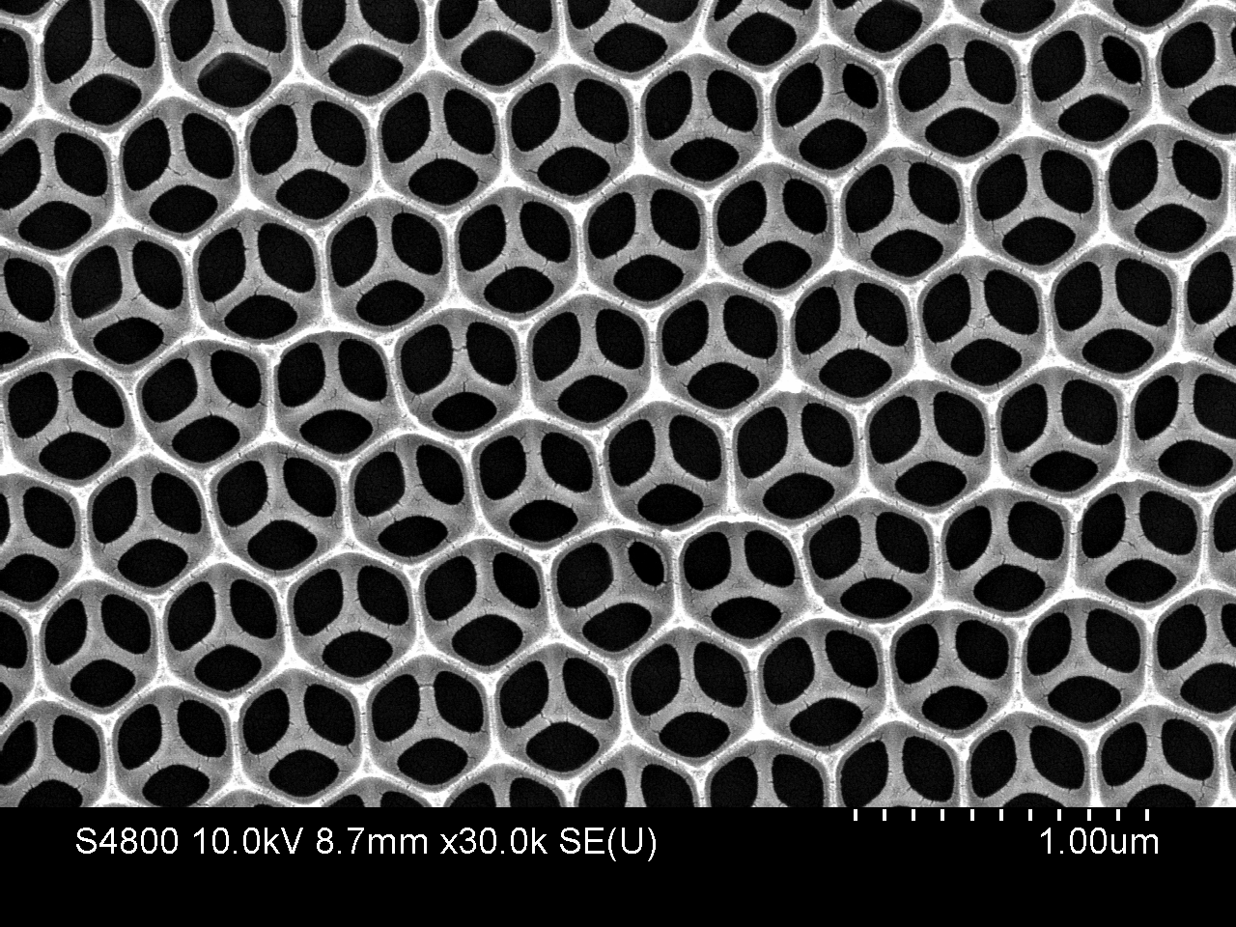
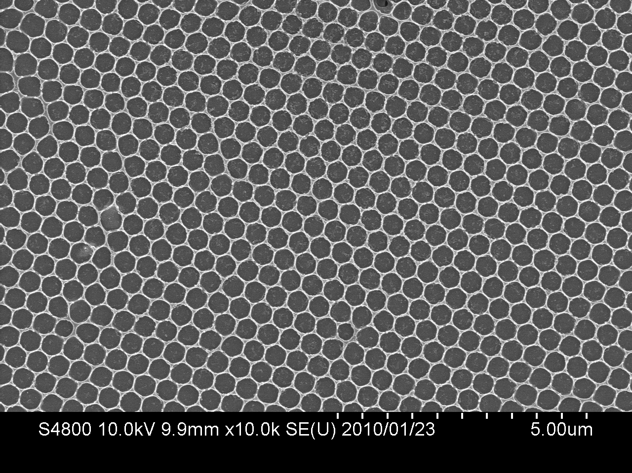
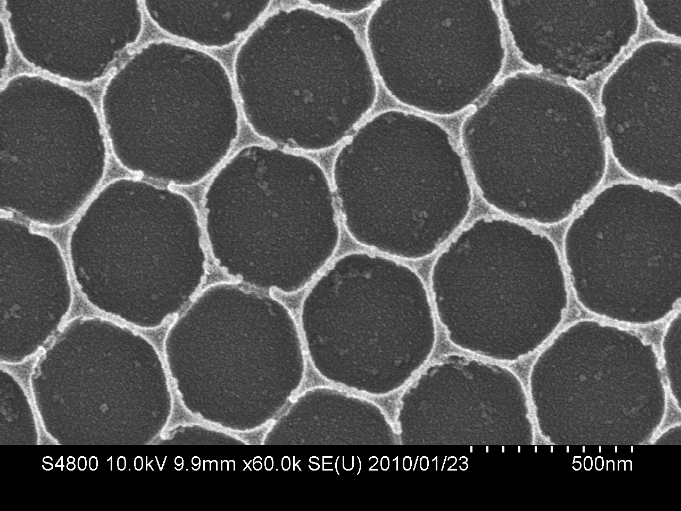
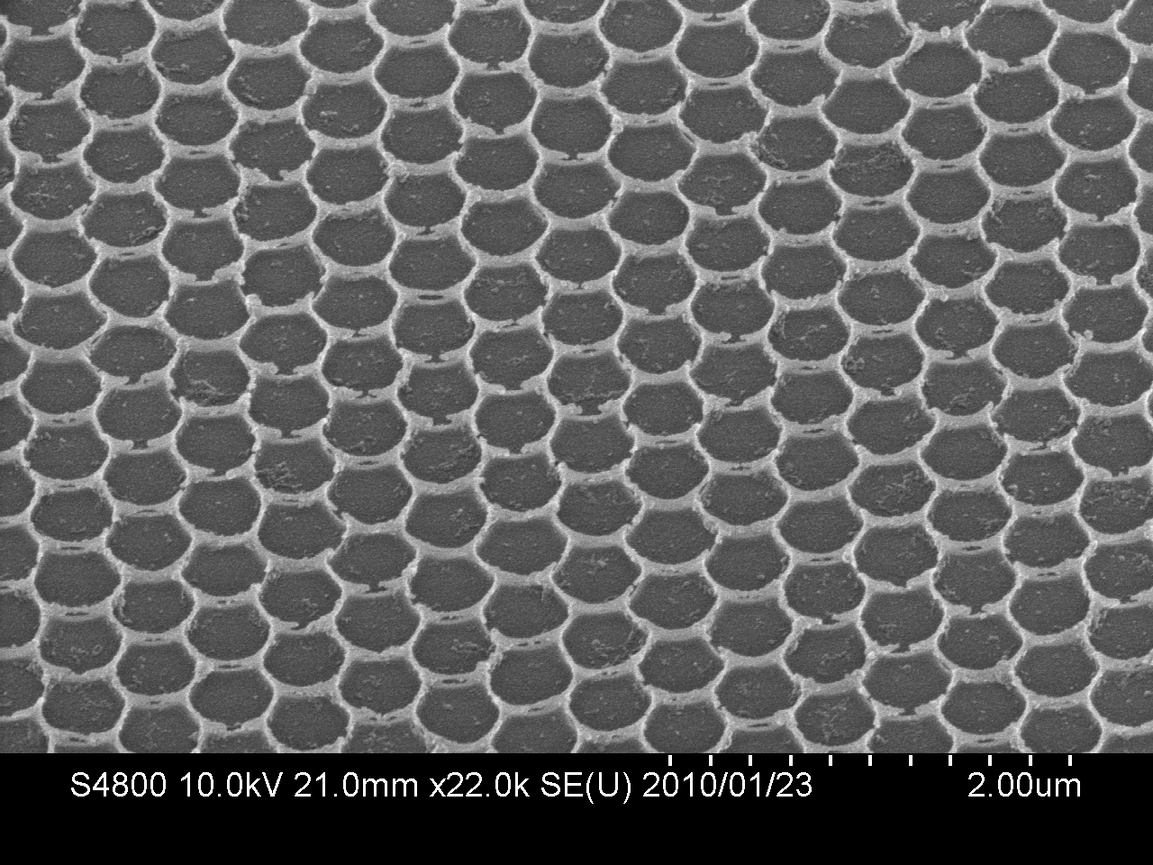
HRSEM images of Hierarchically Structured
Mesoporous Carbon films (PS 500 nm size)
One layer
Close view

Slide 10
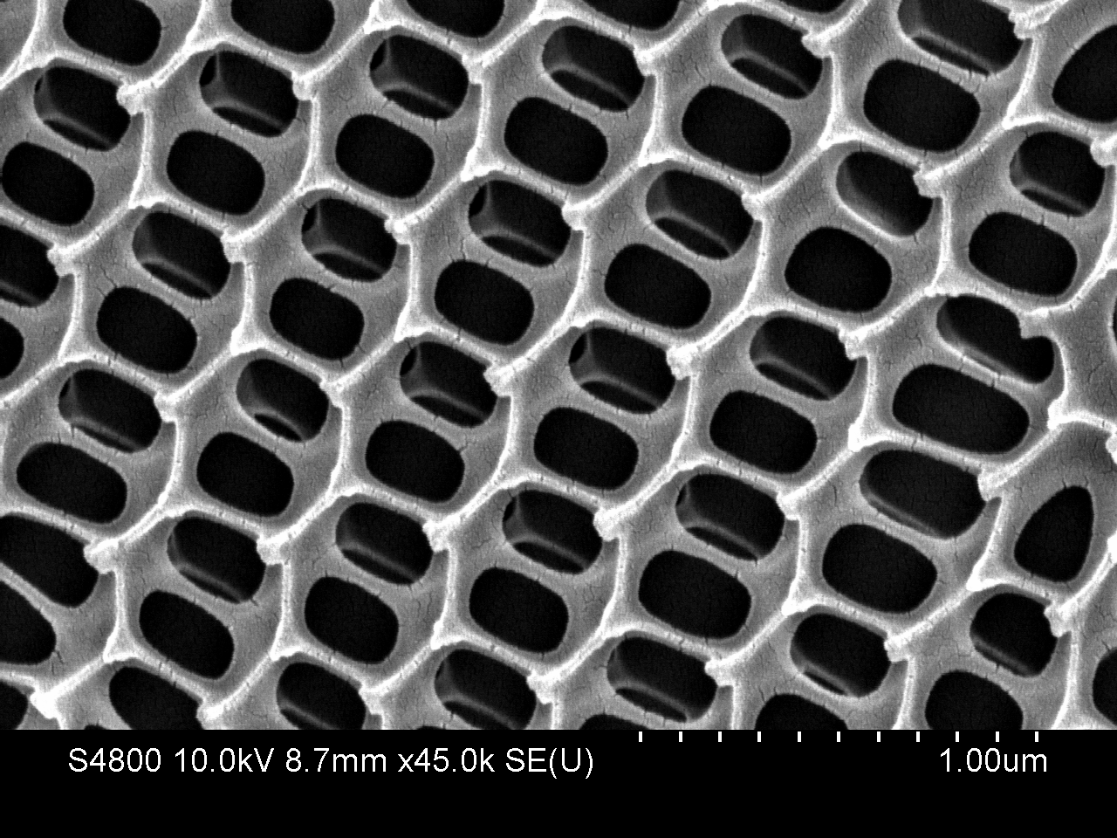
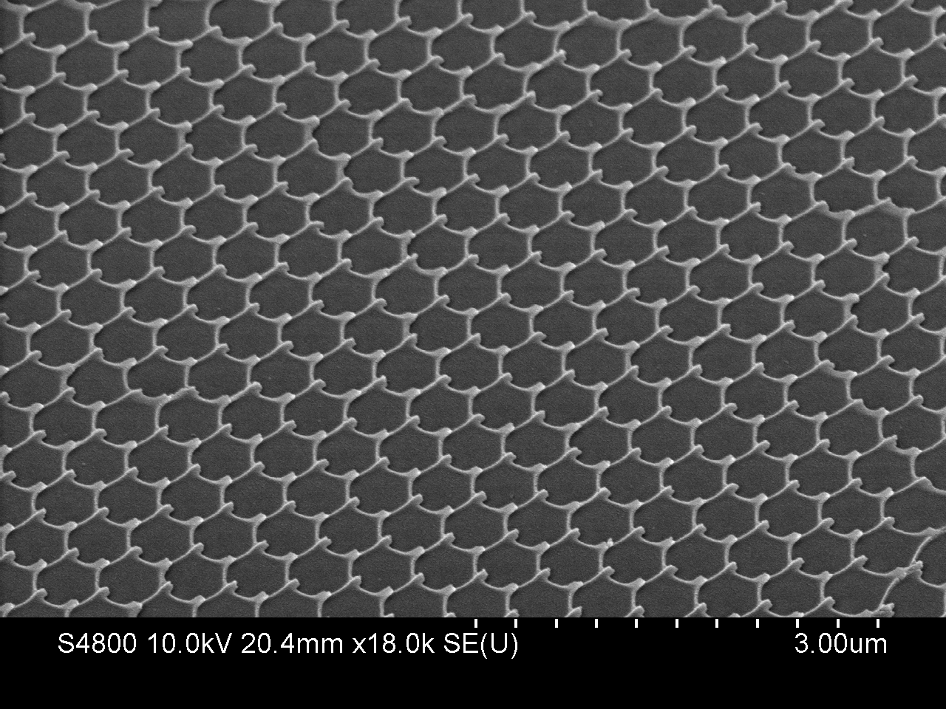
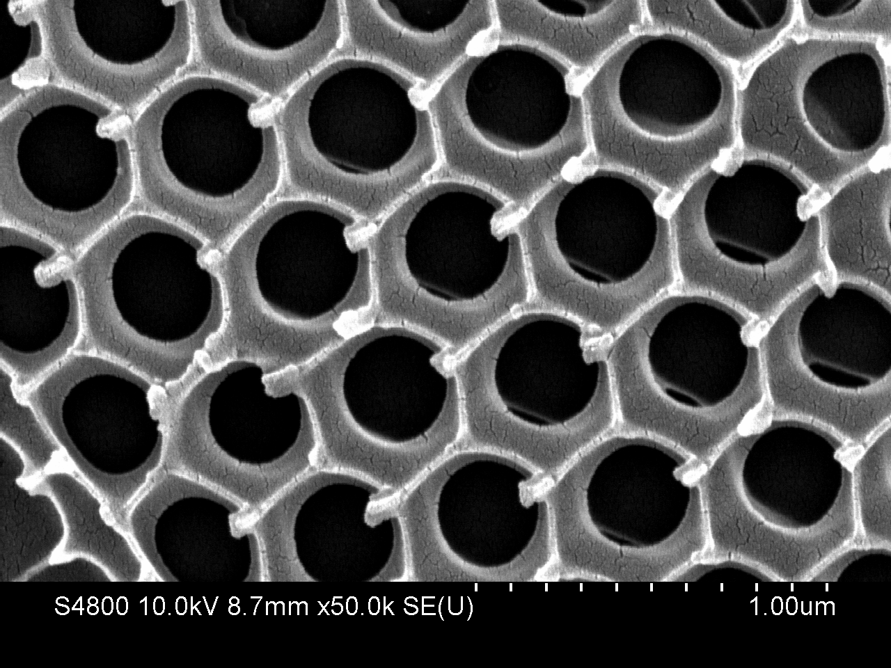
Different Morphology – cooking temperature
Mesoporous carbon films with needle like edges: Expected to have good field emission properties

Slide 11
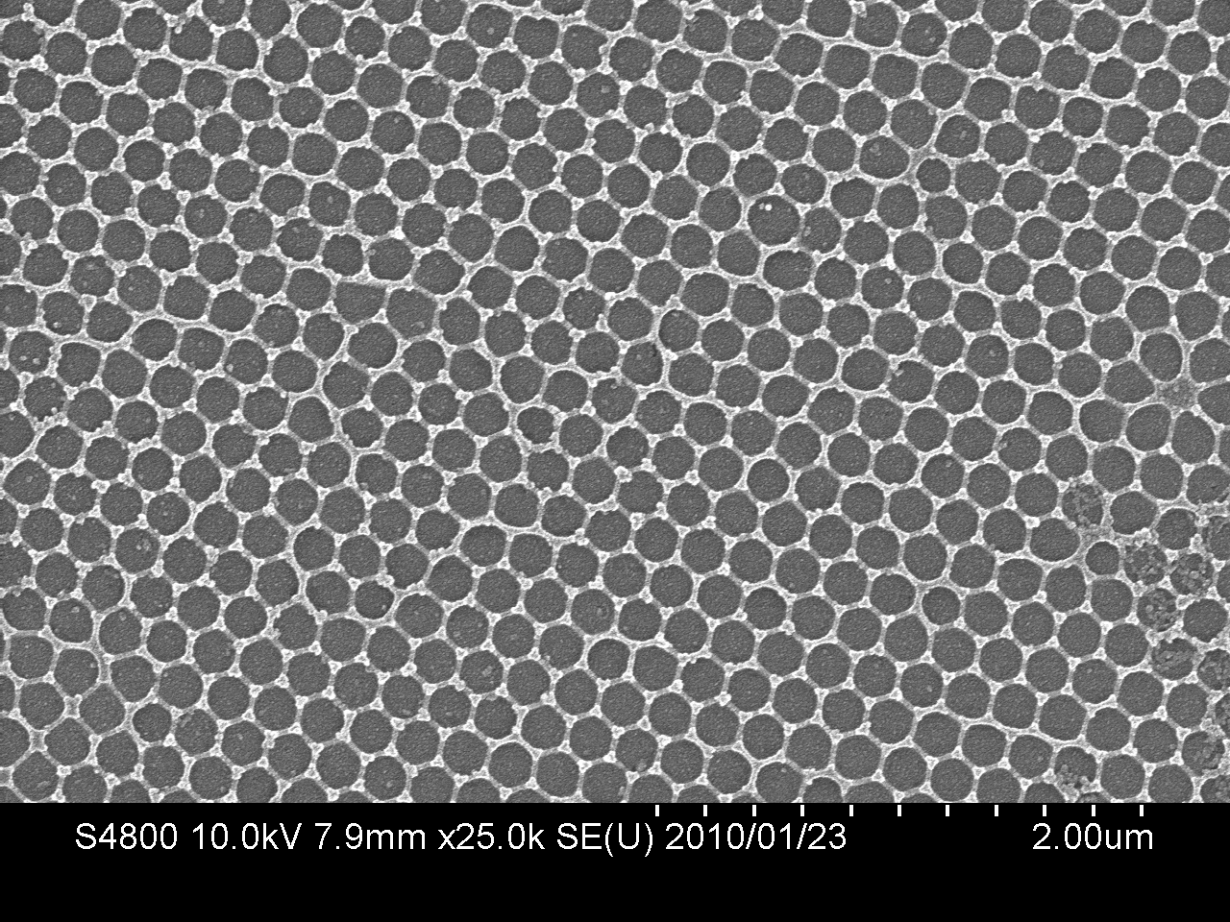
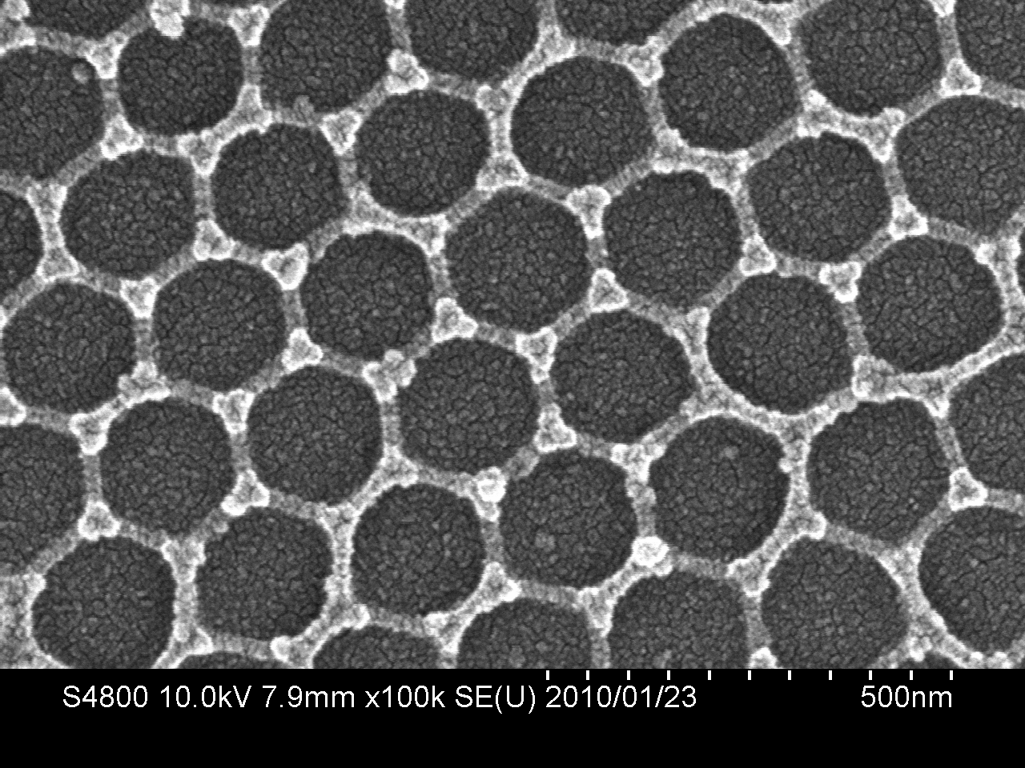
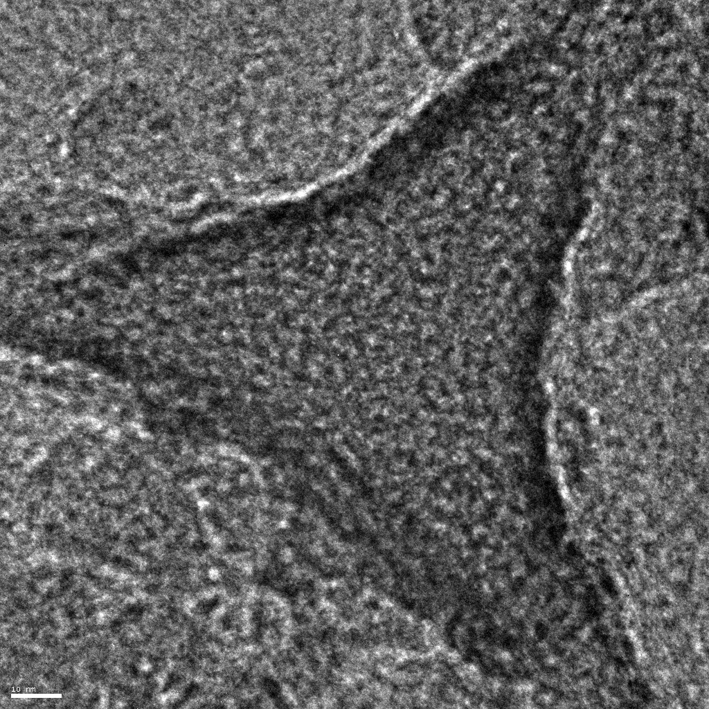
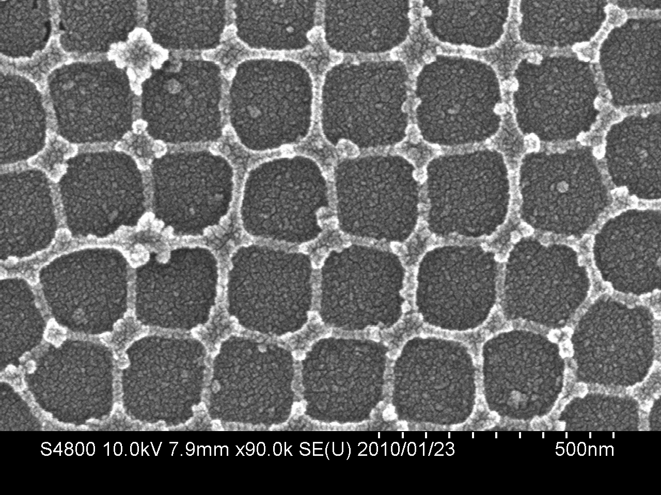
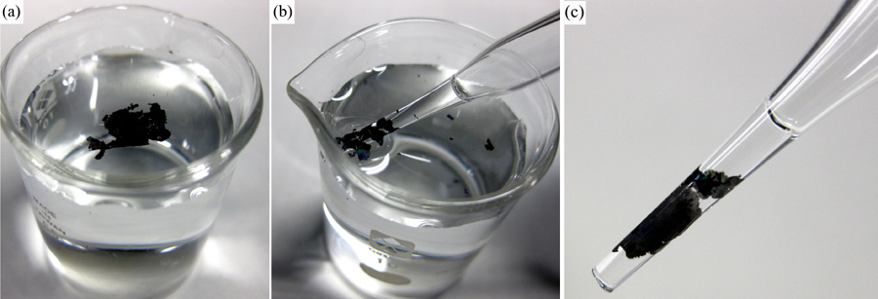
Mesoporous Carbon Films Prepared from PS 200 nm
Low concentration

Slide 12
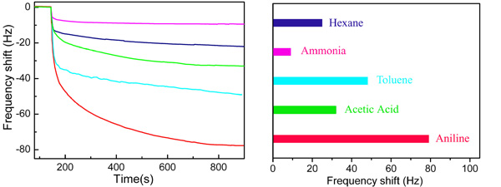
Selectivity of Adsorption of the films - QCM
Selectivity of adsorption can be controlled by the surface modification of the carbon films

Slide 13
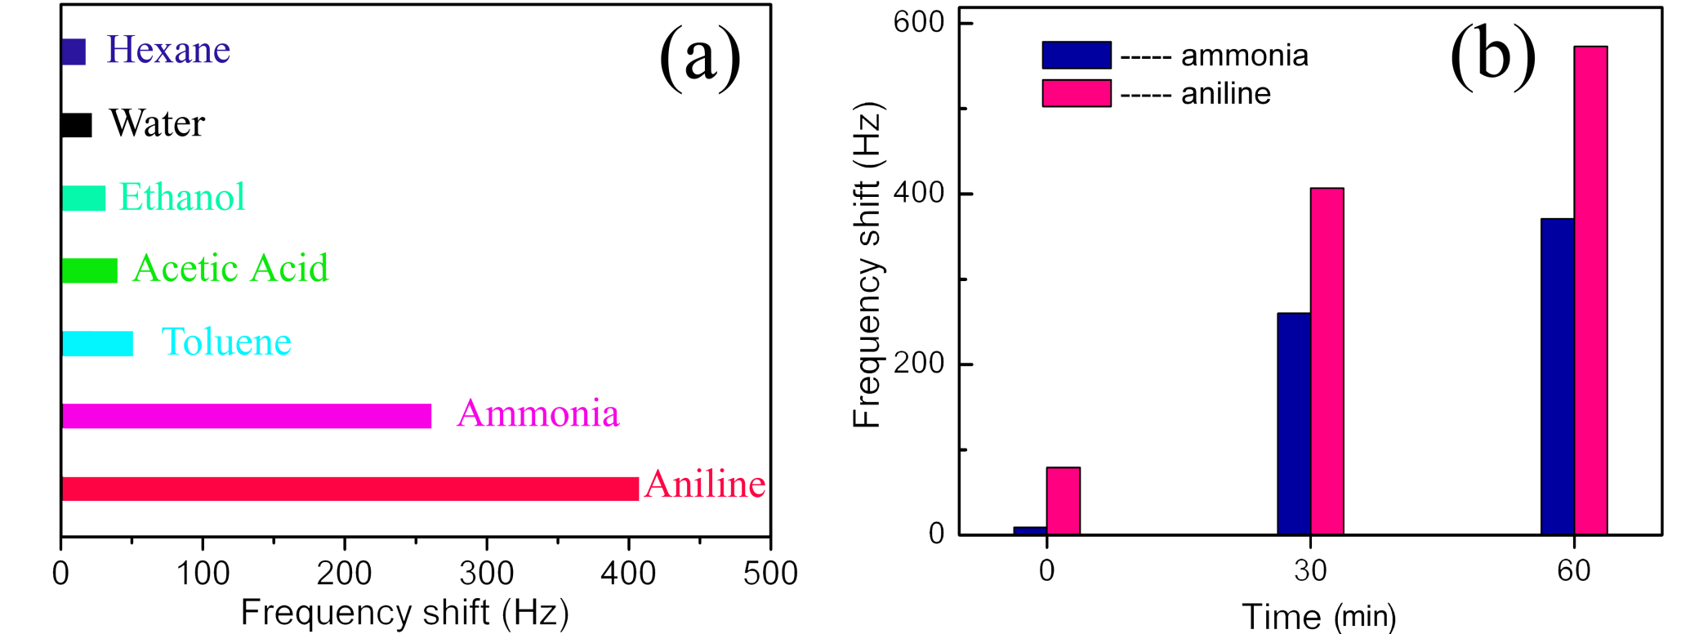
Photofunctionalization of mesoporous carbon films
- QCM – improved sensing of basic molecules
(a) QCM frequency shift upon absorption of vapor phase for ozonization treated porous carbon film, the irradiation time of UV is 30 min.(b) the QCM frequency shift of ammonia and aniline versus irradiation time of UV.

Slide 14
Fabrication of hierarchically structured
porous carbon nitride based on
monolayer colloidal crystal

Slide 15
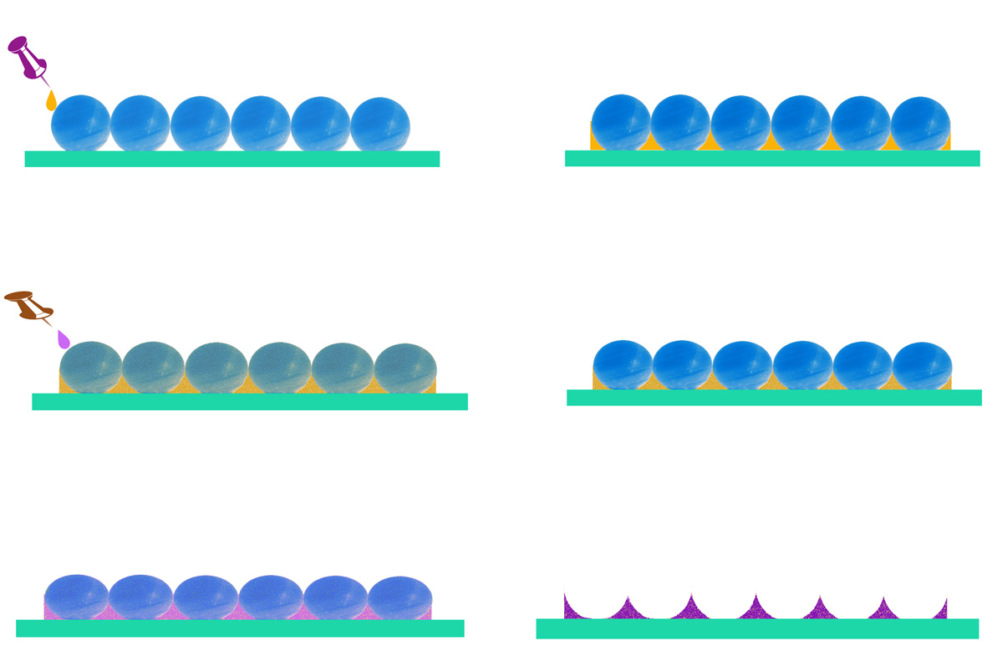
Fabrication process: Mesoporous CN films
P₁₂₃ and TEOS
PS sphere
polyethylenimine precursors
Drying at 100º
Carbonized and etching

Slide 16
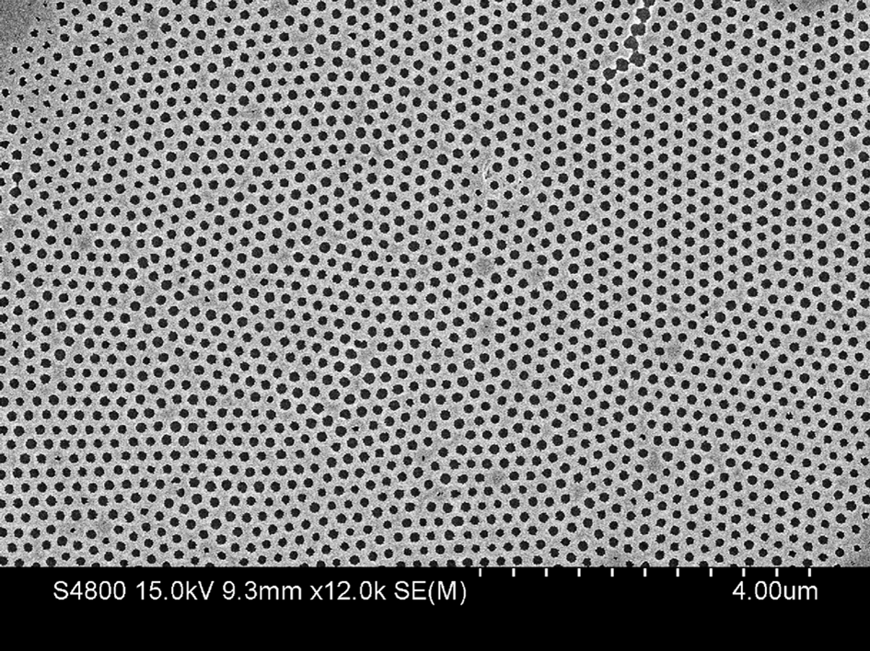
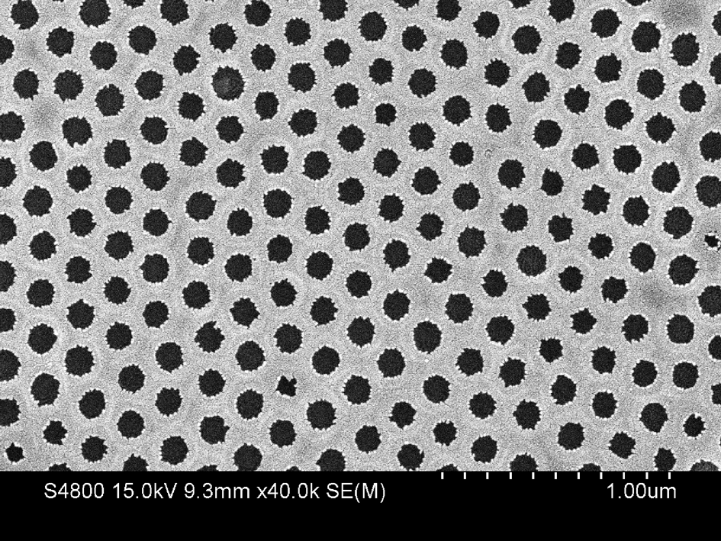
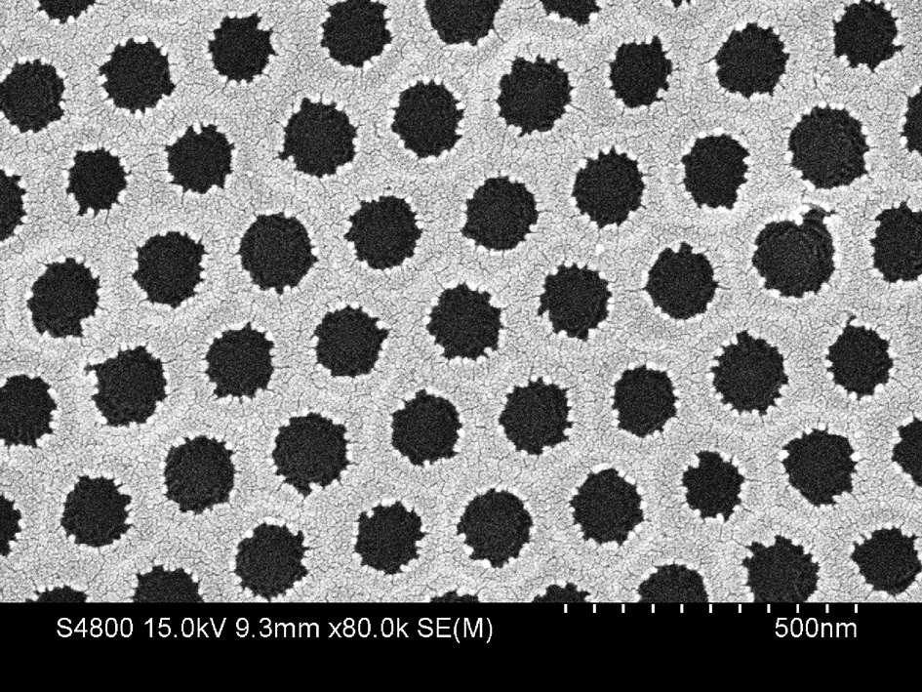
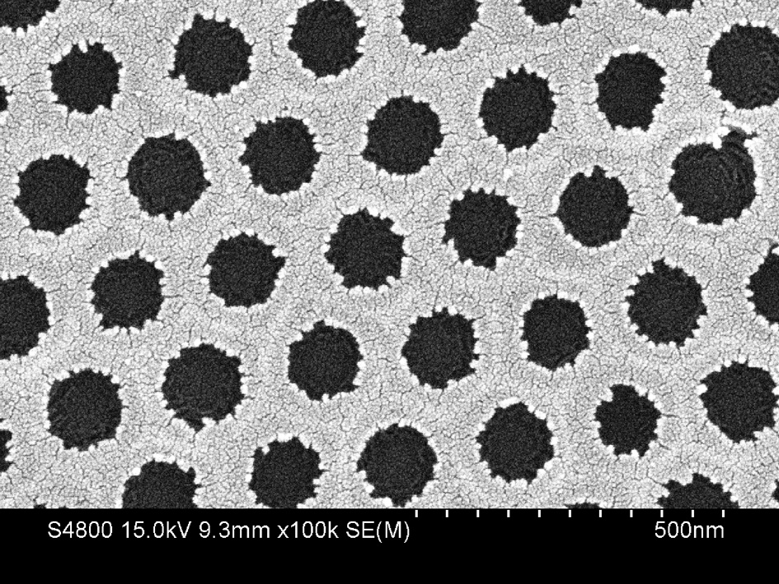
HRSEM images of mesoporous CN films (200 nm PS)
200 nm pore size

Slide 17
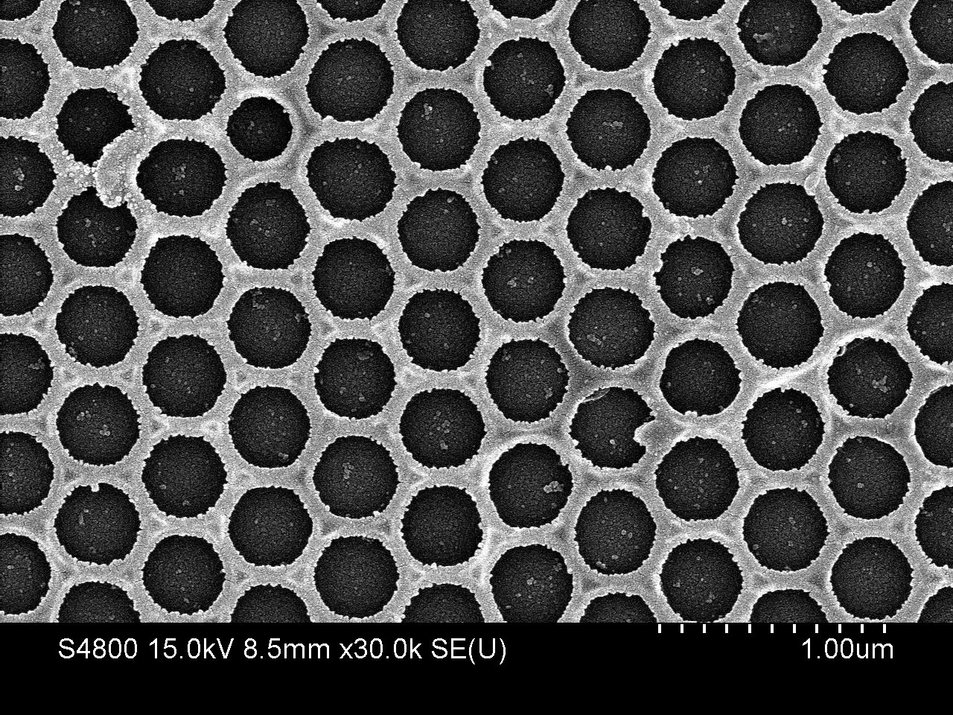
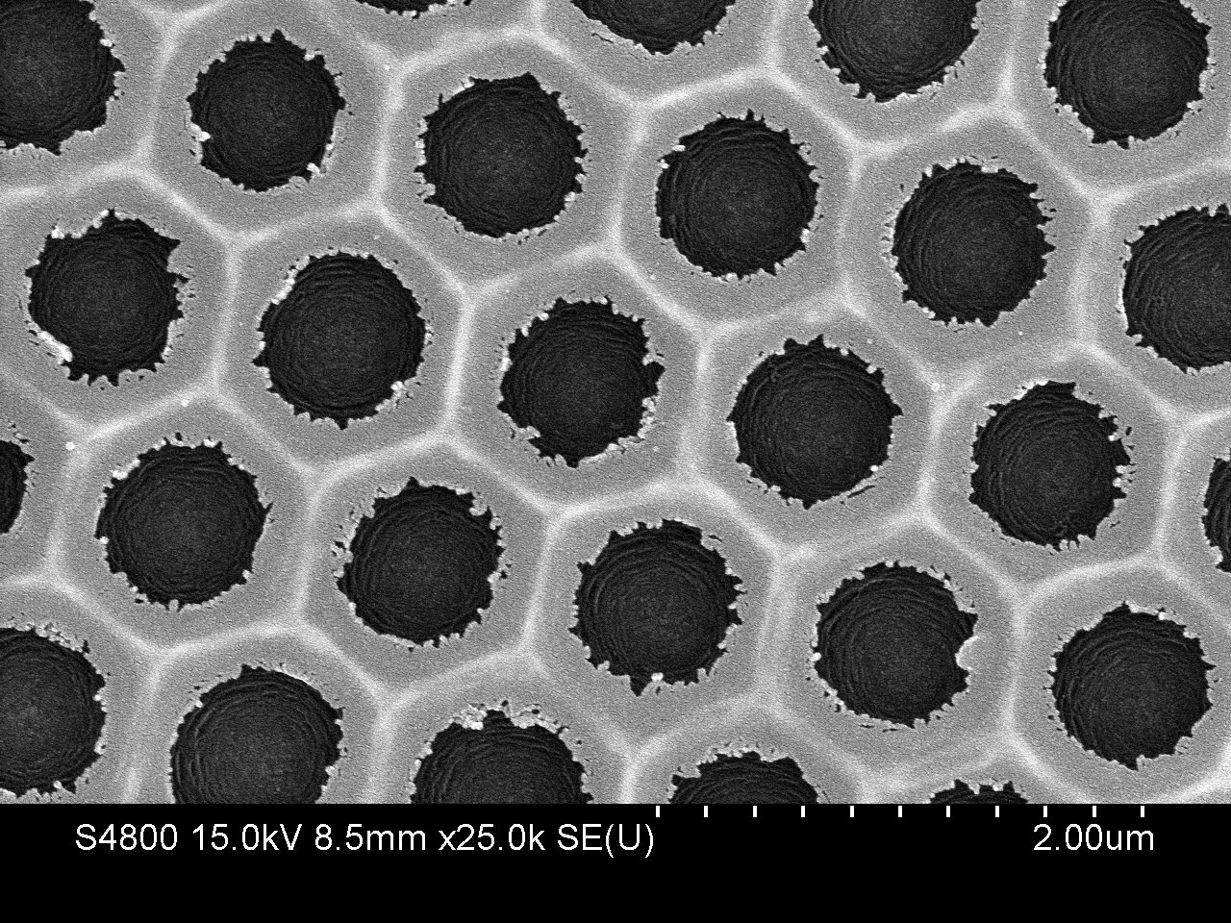
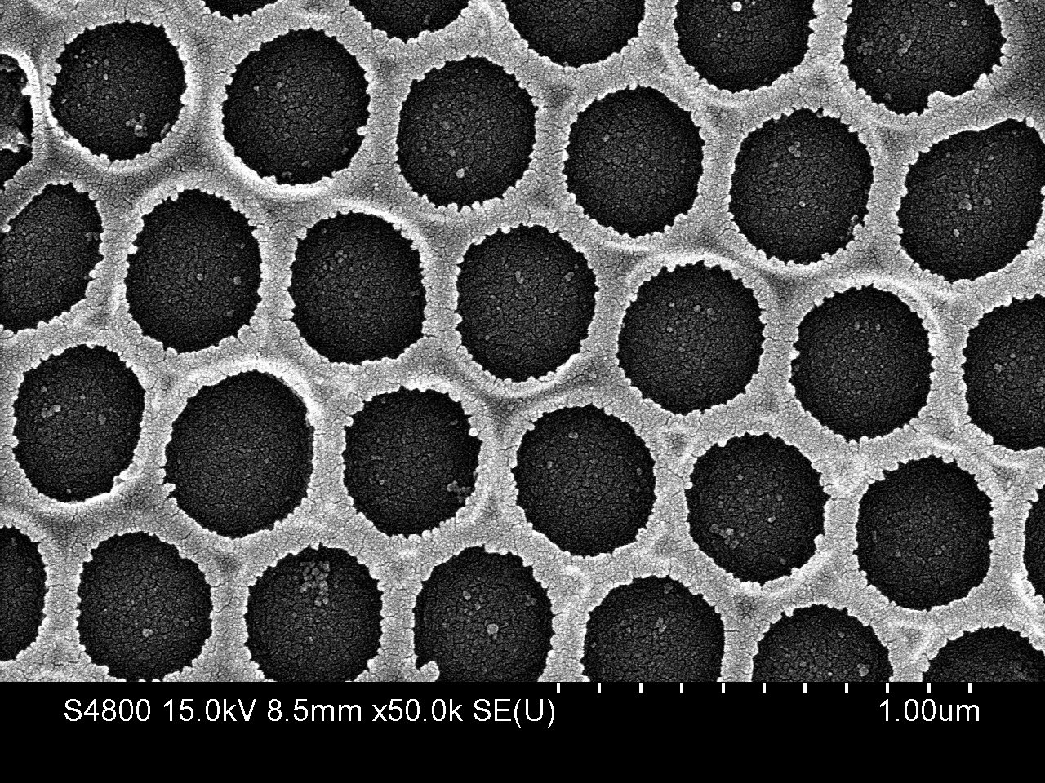
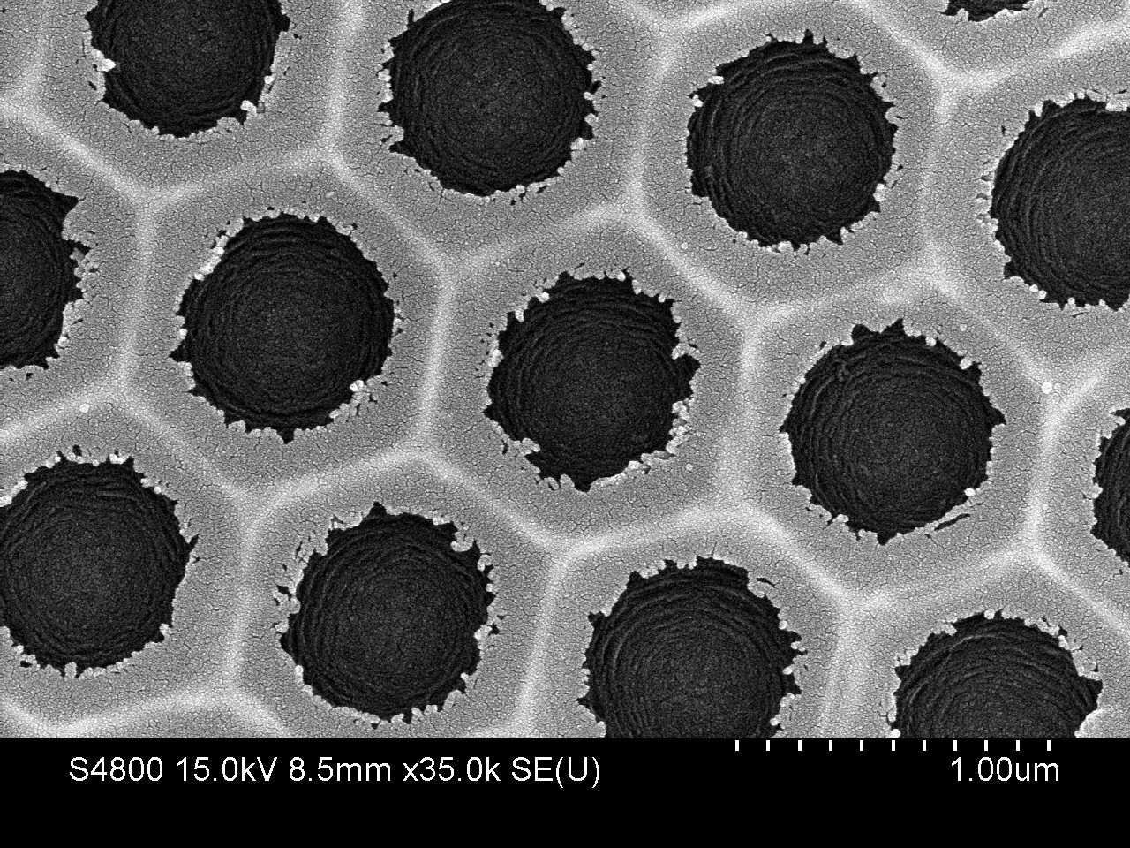
Nano/macroporous CN films (500 and 1000 nm)

Slide 18
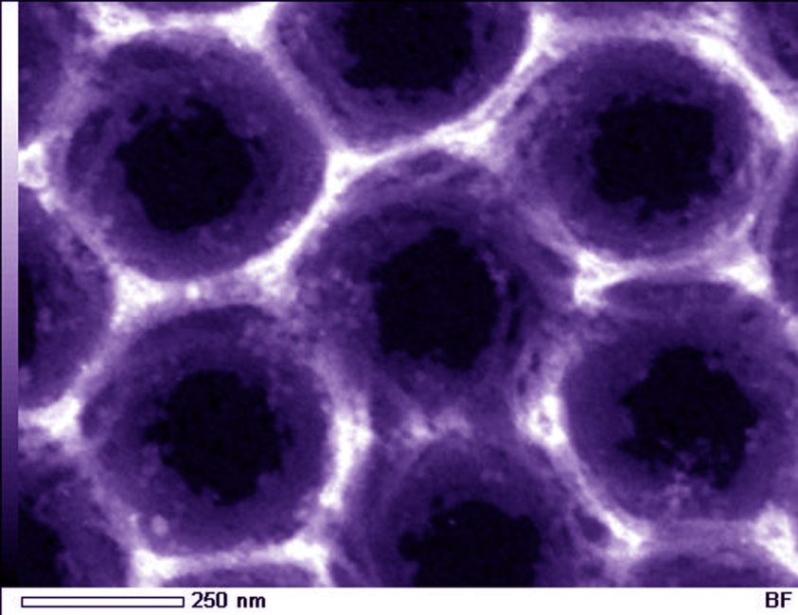
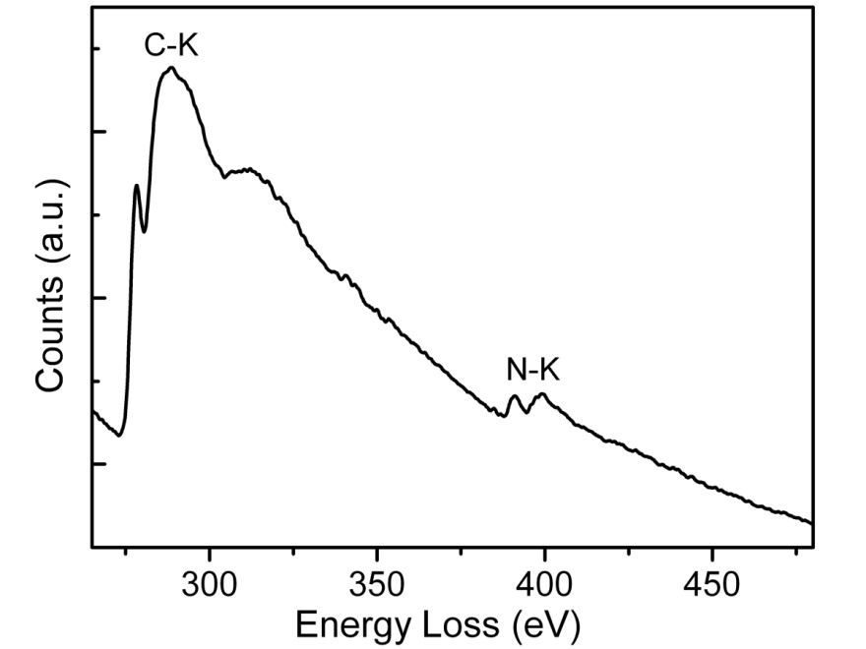
Elemental mapping and EELS of MCN films
carbon-to-nitrogen atomic ratio is 3.5

Slide 19
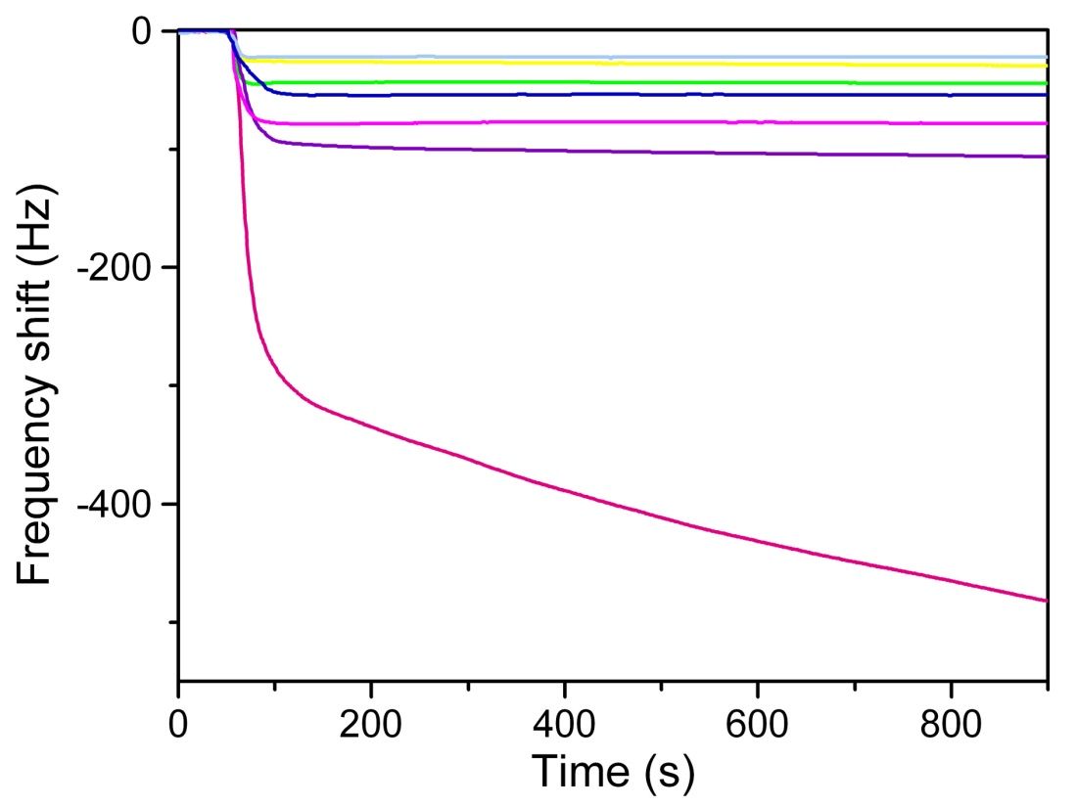
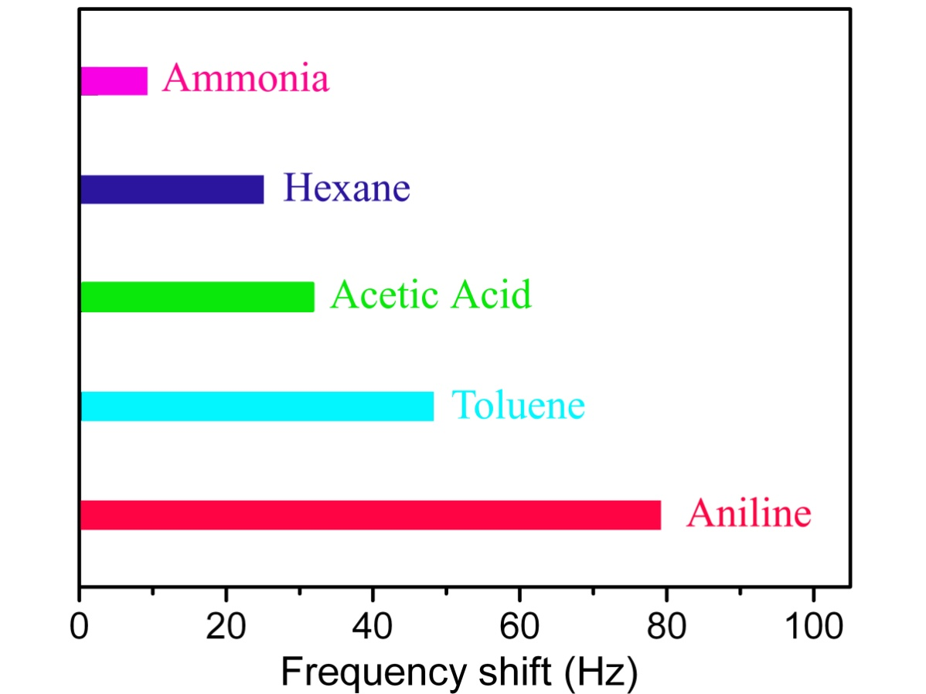
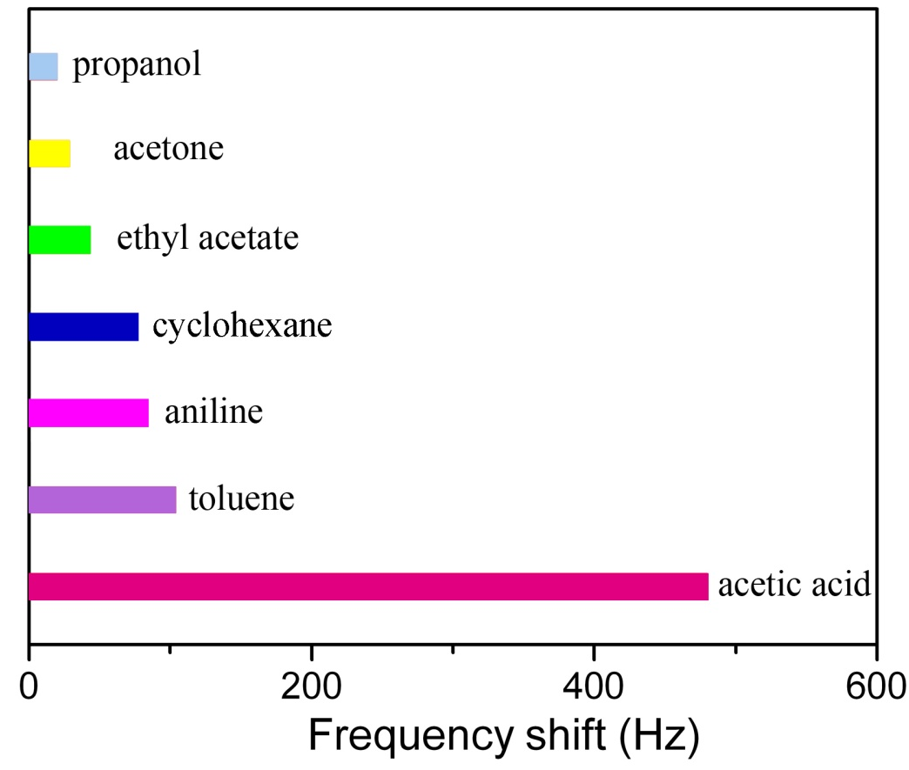
Sensing of organic molecules using
nano/macroporous CN films – QCM measurements
Adsorption properties
Carbon
Carbon nitride
High selectivity to acetic acid was observed for MCN films

Slide 20
Conclusions
Adsorption properties
Mesoporous carbon with different structure, pore diameter and morphology and their applications in adsorption, separation and fuel cells have been demonstrated.
Addition of nitrogen functionalities in the mesoporous carbon matrix significantly changes the properties of the materials especially in the field of sensors and catalysis.
Preparation of hierarchically ordered nano/macroporous carbons and carbon nitride films has been presented.
It has been found that the above materials showed excellent performance in the biosensing and sensing the selective organic molecules.

